Slide 1
CSC 221
Computer Organization and Assembly Language

Slide 2
About Me
Dr. Safdar Hussain Bouk
Assistant Professor
Department of Electrical Engineering
COMSATS Institute of Information Technology
Islamabad.
bouk@comsats.edu.pk

Slide 3
Course Outline
Computer Organization
Data Representation
  Integer Arithmetic
  Binary Representation
  Floating Point Representation
Machine Instruction Characteristics
  Instruction Cycles, types of Operands
  Pentium and Power PC Data Types
Microporessor Bus Structure
  Address, Data, Control Buses and Registers
Memory Organization and Structure
Addressing Modes

Slide 4
Course Outline (Continued...)
Assembly Language
Objectives and Perspectives
Introduction to Assembler and Debugger
Introduction to Registers and Flags
Data Movement
Arithmetic and Logic operations
Program Control
Subroutines
Stack and its Operations
Interrupts and Interrupt Handling
Interfacing with High-level Languages

Slide 5
Course is About:
What Computers consist of?
How Computers work?
How to represent information?
How they are organized internally?
How design affects programming and applications?
Programming the machine: Assembly Language

Slide 6
Course Objectives
After successfully completing the course, you will be able to:
Describe the basic components of a Computer System, its instruction set architecture and its basic fetch-execute cycle operation.
Describe how data is represented and recognized in a Computer.
Understand the basics of Assembly Language programming including addressing modes, subroutines, interrupts, stacks, etc.
Analyze, design, implement, and test assembly language programs.

Slide 7
Computing Machines
Ubiquitous ( = everywhere)
  General purpose: servers, desktops, laptops, PDAs, etc.
  Special purpose: cash registers, ATMs, games, Mobile Phones, etc.
  Embedded: cars, door locks, printers, digital players, industrial machinery, medical equipment, etc.
Distinguishing Characteristics
  Speed
  Cost
  Ease of use, software support & interface
  Scalability

Slide 8

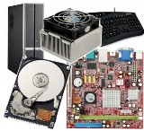

Computer
Hardware
Electronics circuit boards
that provide
functionality of the system
Software
Program consists
of sets of instructions
that control the system

Slide 9
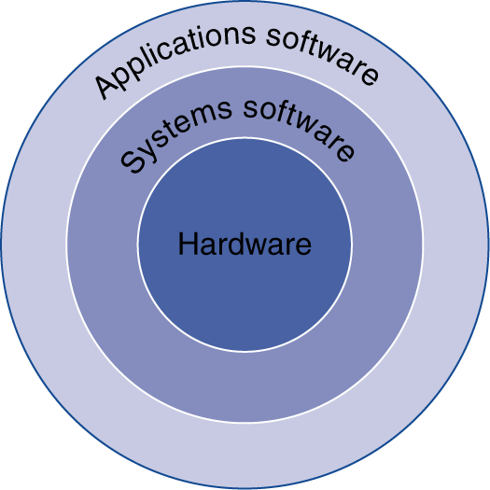
Inside the Computer
Application software
  Written in high-level language
System software
  Compiler: translates HLL code to machine code
  Operating System: service code
    Handling input/output
    Managing memory and storage
    Scheduling tasks & sharing resources
Hardware
  Processor, memory, I/O controllers

Slide 10
Functions of a Computer
Functions of all Computers are:
  Data processing
  Data storage
  Data movement
  Control

Slide 11
A Programmer’s View of a Computer
Application Programs
Machine-independent
Machine-Specifi
High-Level Languages
High-Level Languages
Low-Level Language
Assembly Language
Machine Language
Microprogram Control
Hardware

Slide 12
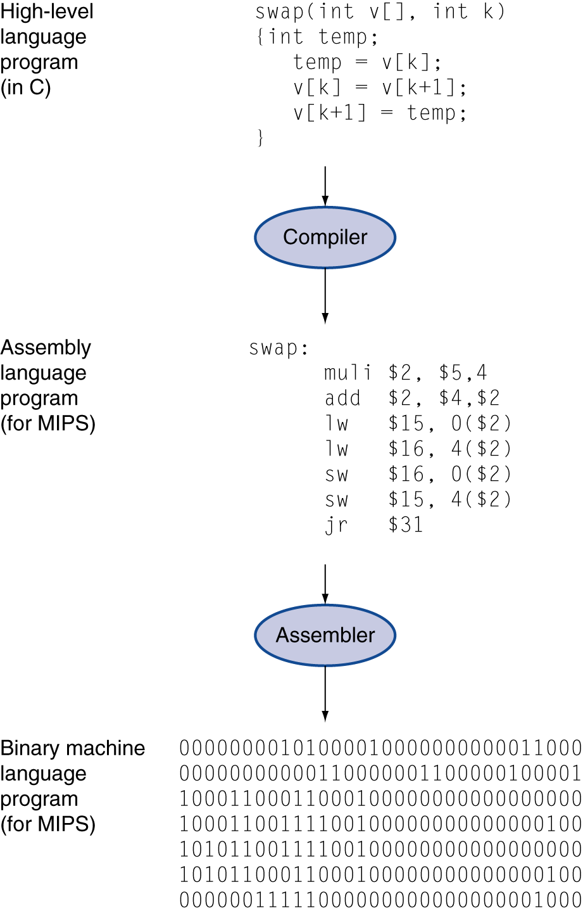
Levels of Program Code
High-level language
  Level of abstraction closer to problem domain
  Provides productivity and portability
Assembly language
  Textual representation of instructions
Hardware representation
  Binary digits (bits)
  Encoded instructions and data

Slide 13
Computer Organization and Architecture
COMPUTER ORGANIZATION
How components fit together to create working computer system
Includes physical aspects of computer systems
Concerned with how computer hardware works
COMPUTER ARCHITECTURE
Structure and behavior of computer system
Logical aspects of system implementation as seen by programmer
Concerned with how computer is designed
Combination of hardware components with Instruction Set Architecture (ISA): ISA is interface between software that runs on machine & hardware that executes it

Slide 14
Moore’s Law
In 1965, Intel founder Gordon Moore stated:
  “The density of transistors in an integrated circuit
  will double every year”
Current version of Moore’s Law predicts doubling of density of silicon chips every 18 months
Moore originally thought this postulate would hold for 10 years; advances in chip manufacturing processes have allowed the law to hold for 40 years, and it is expected to last for perhaps another 10

Slide 15
Principle of Equivalence of Hardware and Software
Anything that can be done with software can also be done with hardware, and anything that can be done with hardware can also be done with software
Modern computers are implementations of algorithms that execute other algorithms
Semantic Gap
Open space between the physical components of a computer system and the high-level instructions of an application
Semantic gap is bridged at each level of abstraction

Slide 16
Abstraction
Complete definition of abstraction includes the following:
  Suppression of detail
  Outline structure
  Division of responsibility
  Subdivision of system into smaller subsystems

Slide 17
Abstraction and Computer Systems
Can look at a computer as being a machine composed of a hierarchy of levels
  Each level has specific function
  Each level exists as a distinct hypothetical machine (or virtual machine)
Each level’s virtual machine executes its own particular set of instructions, calling upon machines at lower levels to carry out tasks as necessary

Slide 18

Abstraction and Computer Systems
“I really don’t think that you can write a book for serious computer programmers unless you are able to discuss low-level details.”
Donald E. Knuth
The Art of Computer Programming
http://en.wikipedia.org/wiki/Donald_Knuth

Slide 19
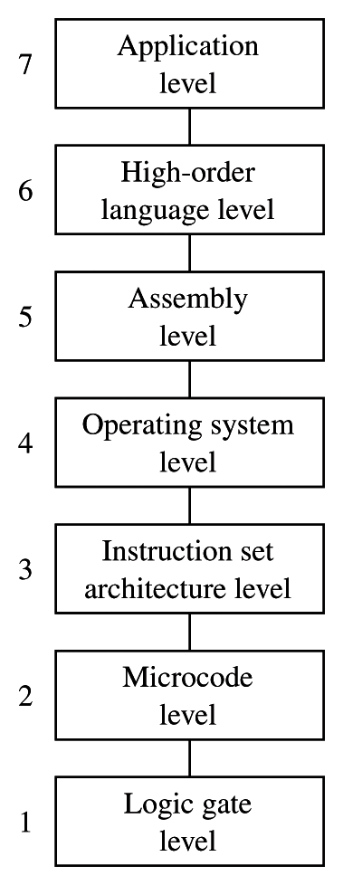
Abstraction and Computer Systems
Text uses the following labels to describe levels of abstraction in a computer system:
    App7
    HOL6
    Asmb5
    OS4
    ISA3
    Mc2
    LG1
Each level has its own language to describe tasks performed by Computer
Machine-independent
Machine-specific

Slide 20
Abstraction and Computer Systems
Level : APP7
The application level is composed of those programs designed to do specific kinds of tasks for end users
An application may have some sort of programming language associated with it (macros or shortcuts, e.g.)
Ideally, end users need not be concerned with the actions and language(s) associated with lower levels in the abstraction hierarchy
Machine-independent
Machine-specific

Slide 21
Abstraction and Computer Systems
Level : HOL6
The high order language layer is the layer of abstraction at which most programmers operate
Applications are typically written in high order languages
High order languages are characterized by:
  Portability across platforms
  Relative ease of use
  Relatively high level of abstraction, requiring translation of program code prior to execution
Machine-independent
Machine-specific

Slide 22
Abstraction and Computer Systems
Level : ASMB5
The assembly language level is an intermediate step between high order language and the machine language of a particular processor
Programs at the HOL6 level are usually compiled to level Asmb5, then translated (assembled) to machine language
Source code can also be written in assembly language
Machine-independent
Machine-specific

Slide 23
Abstraction and Computer Systems
Level : OS4
The operating system is responsible tasks related to multiprogramming, including:
  Memory protection
  Process synchronization
  Device management
Operating systems were originally developed for multiuser systems, but even most single user systems utilize an operating system
Compilers and assemblers are also considered systems software
Machine-independent
Machine-specific

Slide 24
Abstraction and Computer Systems
Level : ISA3
The instruction set architecture, or machine language level, consists of the set of instructions recognized by the particular hardware platform
Instructions at this level are directly executable without any translation
Machine-independent
Machine-specific

Slide 25
Abstraction and Computer Systems
Level : MC2
The microinstruction or control level is the level at which the computer decodes and executes instructions and moves data in and out of the processor
The processor’s control unit interprets machine language instructions, causing required actions to take place
Machine-independent
Machine-specific

Slide 26
Abstraction and Computer Systems
Level : LG1
The digital logic level consists of the physical components of the computer system, the actual electronic gates and wires
Boolean algebra and truth tables can be used to describe the operations at this level
Machine-independent
Machine-specific

Slide 27
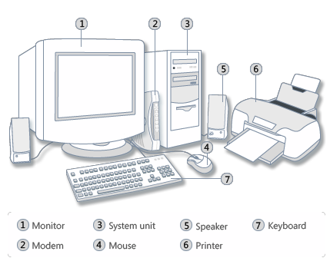
Anatomy of a Computer

Slide 28
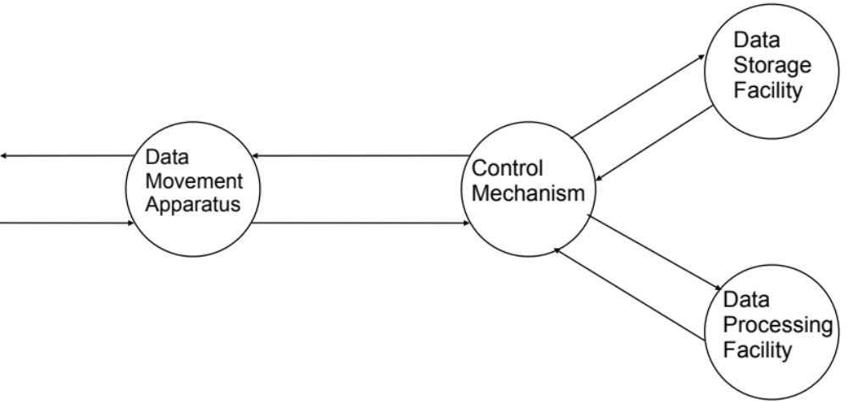
Computer: Functional View

Slide 29
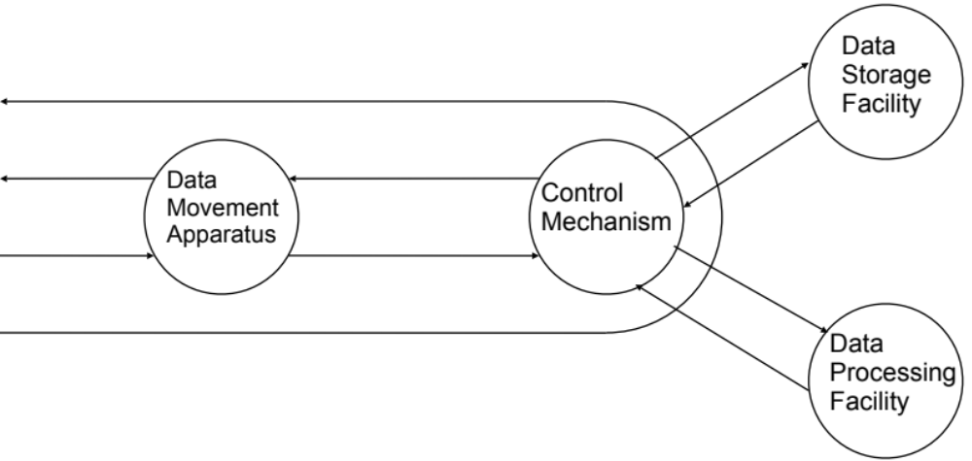
Computer: Operation
Data Movement
e.g. Keyboard to Screen

Slide 30
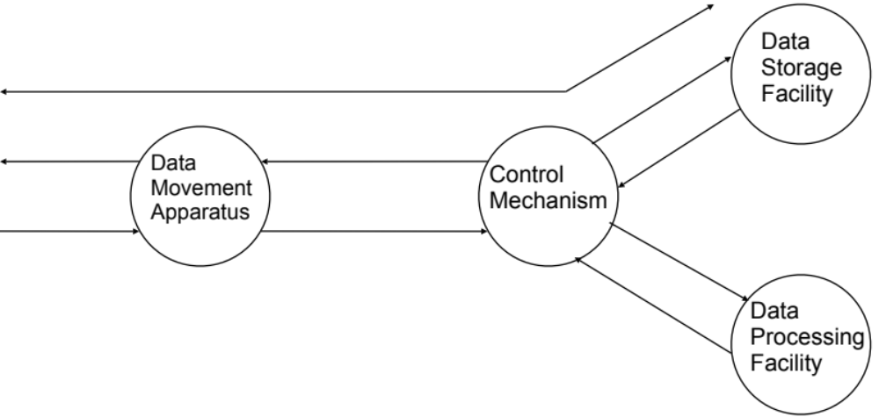
Computer: Operation..
Storage
e.g. Internet Download to Hard Disk

Slide 31
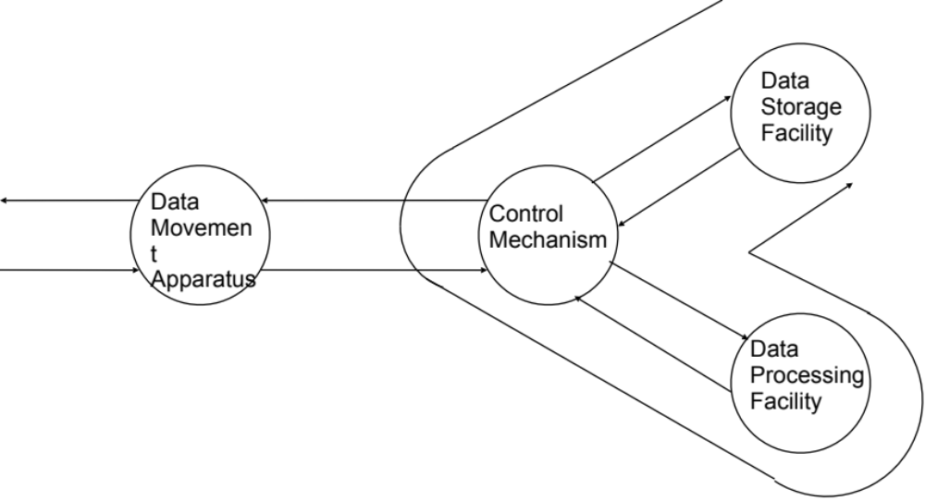
Computer: Operation….
Processing from/to storage
e.g. Updating Word/Excel File

Slide 32
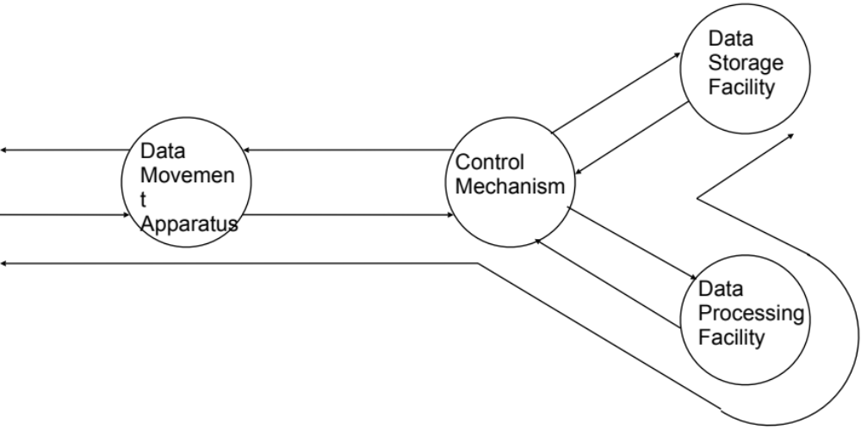
Computer: Operation…...
Processing from storage to I/O
e.g. Printing a Word/Excel file.

Slide 33
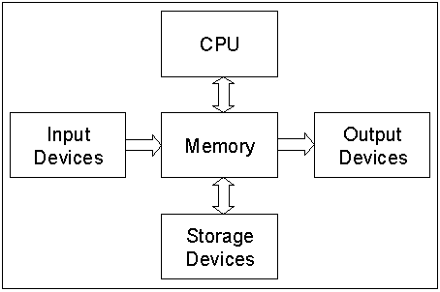
Anatomy of a Computer: Block Diagram

Slide 34
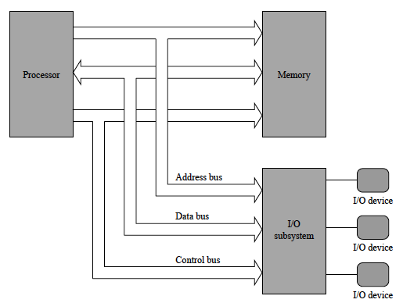
Anatomy of a Computer: Detailed Block Diagram

Slide 35
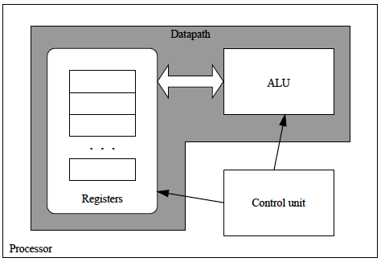
Anatomy of a Computer: Detailed Block Diagram ..

Slide 36
Detailed Anatomy of a Computer
Processor (CPU)
Control Unit
Common Bus (address, data & control)
Datapath
Arithmetic Logic Unit (ALU)
Registers
Memory
Program Storage
Data Storage
Output Units
Input Units

Slide 37
Anatomy of a Computer: CPU
The brain of a Computer System
Processor (CPU)
Decodes and monitors the execution of instructions.
Controls flow of information in CPU, memory, I/O devices:
  System clock (Intel® Core™ I7-720QM Processor (1.6GHz, turbo up to 2.8GHz, 6MB L3 Cache))
  Maintains a register called program counter(PC)
Control Unit
Datapath
Arithmetic Logic Unit (ALU)
Registers
ALU: performs all arithmetic computations & logic evaluations.
Registers: storage location in CPU, used to hold data or a memory address during the execution of an instruction..

Slide 38
Anatomy of a Computer: Common Bus
A group of conducting wires that allow signals to travel from one point to another:
  Address bus: the location of data in memory or I/O devices
  Data bus: carry data in & out from CPU
  Control bus: control the operation of the CPU
Common Bus (address, data & control)

Slide 39
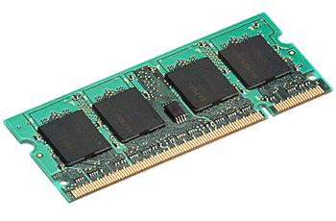
Anatomy of a Computer: Memory
Memory
Program Storage
Data Storage
RAM
Volatile: cannot retain data without power.
Allows the processor to read from & write into any location on memory chip.
ROM
Nonvolatile: when power is removed, the reapplied, the original data will still be there
Can only be read, cannot be written to by the processor

Slide 40
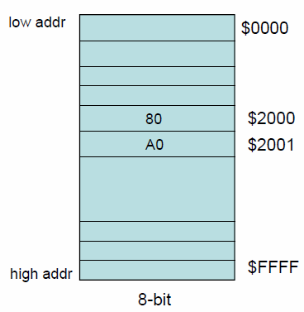
Anatomy of a Computer: Memory
Components of memory
A memory in Microprocessor stores data in binary format. To retrieve an information, the Microprocessor assigns addresses to the location. Each location stores 1 byte of data.
If a value of hex A0 is stored in the location of $2001, show the content of the memory on $2001.
data
address

Slide 41



Anatomy of a Computer: I/O Devices
Input devices
  Allow computer user to enter data & programs into the computer

Slide 42

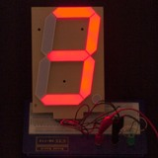


Anatomy of a Computer: I/O Devices
Output device
  Displaying the results of computation

Slide 43
Assembly Language
Some Important Questions to ask
  What is Assembly Language?
  Why Learn Assembly Language?
  What is Machine Language?
  How is Assembly related to Machine Language?
  What is an Assembler?
  How is Assembly related to High-Level Language?
  Is Assembly Language portable?

Slide 44
A Hierarchy of Languages
Application Programs
Machine-independent
Machine-Specifi
High-Level Languages
High-Level Languages
Low-Level Language
Assembly Language
Machine Language
Microprogram Control
Hardware

Slide 45
Assembly and Machine Language
Machine language
  Native to a processor: executed directly by hardware
  Instructions consist of binary code: 1s and 0s
Assembly language
  A programming language that uses symbolic names to represent operations, registers and memory locations.
  Slightly higher-level language
  Readability of instructions is better than machine language
  One-to-one correspondence with machine language instructions
Assemblers translate assembly to machine code
Compilers translate high-level programs to machine code
  Either directly, or
  Indirectly via an assembler

Slide 46
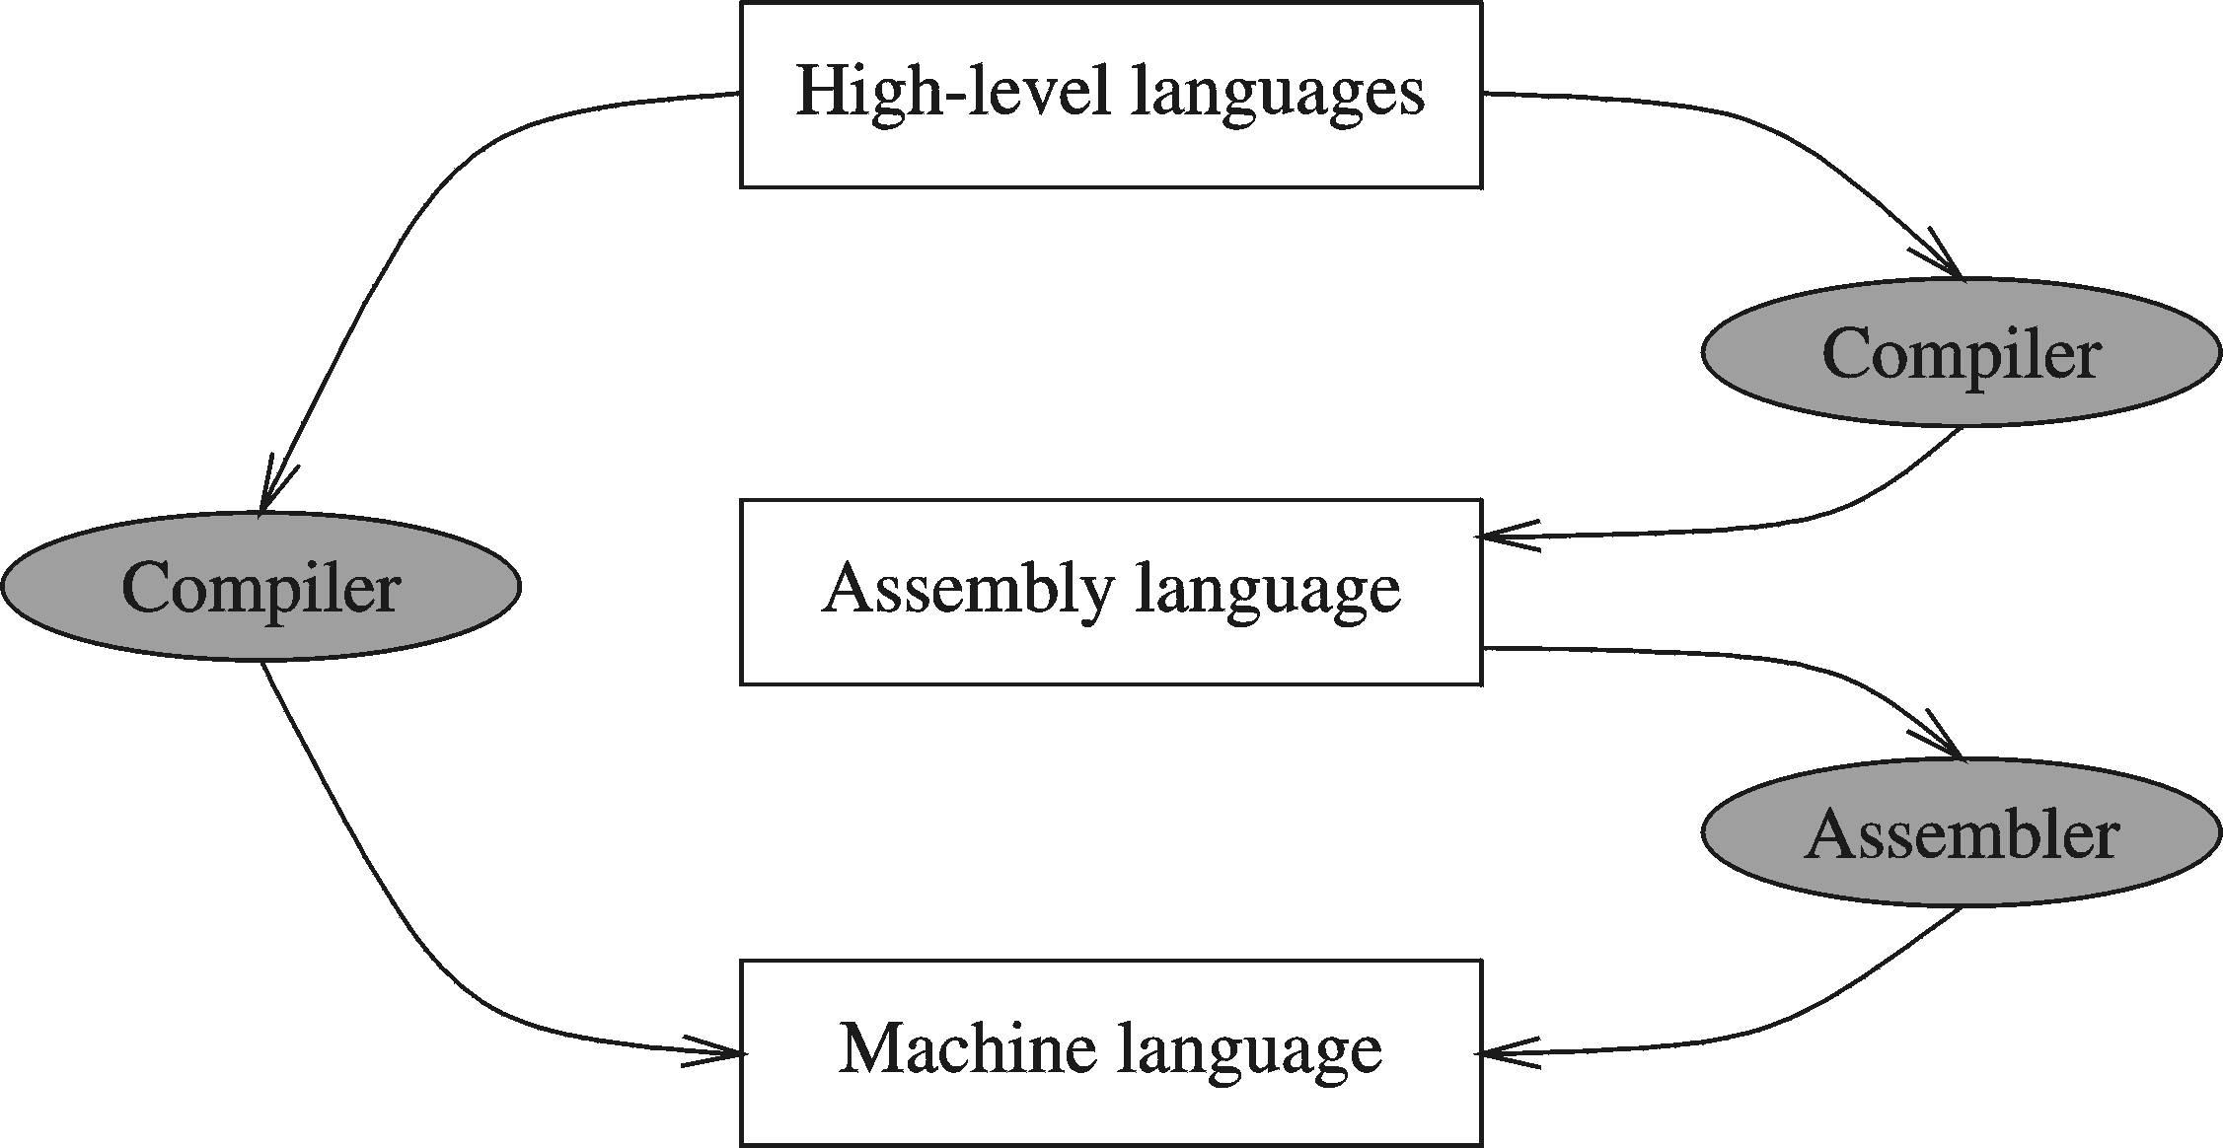
Compiler and Assembler

Slide 47
Instructions and Machine Language
Each command of a program is called an instruction (it instructs the computer what to do).
Computers only deal with binary data, hence the instructions must be in binary format (0s and 1s) .
The set of all instructions (in binary form) makes up the computer's machine language. This is also referred to as the instruction set.

Slide 48
Instruction Fields
Machine language instructions usually are made up of several fields. Each field specifies different information for the computer. The major two fields are:
Opcode field which stands for operation code and it specifies the particular operation that is to be performed.
  Each operation has its unique opcode.
Operands fields which specify where to get the source and destination operands for the operation specified by the opcode.
  The source/destination of operands can be a constant, the memory or one of the general-purpose registers.

Slide 49
Translating Languages
English: D is assigned the sum of A times B plus 10.
High-Level Language: D = A * B + 10
A statement in a high-level language is translated typically into several machine-level instructions
Intel Assembly Language:
mov eax, A
mul B
add eax, 10
mov D, eax
Intel Machine Language:
A1 00404000
F7 25 00404004
83 C0 0A
A3 00404008

Slide 50
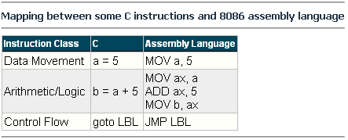
Mapping Between Assembly Language and HLL
Translating HLL programs to machine language programs is not a one-to-one mapping
A HLL instruction (usually called a statement) will be translated to one or more machine language instructions

Slide 51
Advantages of High-Level Languages
Program development is faster
  High-level statements: fewer instructions to code
Program maintenance is easier
  For the same above reasons
Programs are portable
  Contain few machine-dependent details
    Can be used with little or no modifications on different machines
  Compiler translates to the target machine language
  However, Assembly language programs are not portable

Slide 52
Why Learn Assembly Language?
Accessibility to system hardware
  Assembly Language is useful for implementing system software
  Also useful for small embedded system applications
Space and Time efficiency
  Understanding sources of program inefficiency
  Tuning program performance
  Writing compact code
Writing assembly programs gives the computer designer the needed deep understanding of the instruction set and how to design one
To be able to write compilers for HLLs, we need to be expert with the machine language. Assembly programming provides this experience

Slide 53
Assembly vs. High-Level Languages
HLL programs are machine independent. They are easy to learn and easy to use.
Assembly language programs are machine specific. It is the language that the processor directly understands.

Slide 54
Tools for Assembly Language: Assembler
Software tools are needed for editing, assembling, linking, and debugging assembly language programs
An assembler is a program that converts source-code programs written in assembly language into object files in machine language
Popular assemblers have emerged over the years for the Intel family of processors. These include …
  TASM (Turbo Assembler from Borland)
  NASM (Netwide Assembler for both Windows and Linux), and
  GNU assembler distributed by the free software foundation
  MASM (Macro Assembler from Microsoft)

Slide 55
Tools for Assembly Language: Linker & Libraries
You need a linker program to produce executable files
It combines your program's object file created by the assembler with other object files and link libraries, and produces a single executable program

Slide 56
Assemble and Link Process
A project may consist of multiple source files
Assembler translates each source file separately into an object file
Linker links all object files together with link libraries
Source
File
Assembler
Object
File
Source
File
Assembler
Object
File
Linker
Executable
File
Source
File
Assembler
Object
File
Link
Libraries

Slide 57
Summary
Complete anatomy and functional view of a Computer.
How different components fit together to create working computer system.
A computer system can be viewed as consisting of layers. Programs at one layer are translated or interpreted by the next lower-level layer.
Assembly language helps you learn how software is constructed at the lowest levels.
Assembly language has a one-to-one relationship with machine language.
An assembler is a program that converts assembly language programs into machine language.
A linker combines individual files created by an assembler into a single executable file.

