Slide 1
CSC 211
Data Structures
Lecture 7
Dr. Iftikhar Azim Niaz
ianiaz@comsats.edu.pk
1

Slide 2
Last Lecture Summary I
Dynamic Memory Management with Pointers
  malloc() calloc() free() realloc()
  new and delete operators
  Memory Leaks
Dynamic Arrays
Structures
  Declaration and fields access
Unions
Strings
Multidimensional Arrays
2

Slide 3
Objectives Overview
Ned for data structures
Selecting a data structure
Data structure philosophy
Arrays and Lists
Operations on Lists

Slide 4
Need for Data Structures
Data structures organize data ⇒ more efficient programs.
More powerful computers ⇒ more complex applications.
More complex applications demand more calculations

Slide 5
Data Management Objectives
To make the data resource resilient, flexible, and adaptable to supporting an organization's decision-making processes.
Four useful guidelines are:-
  1. Data must be represented and stored so that they can be accessed later.
  2. Data must be organized so that they can be selectively and efficiently accessed.
  3. Data must be processed and presented so that they support the user environment effectively.
  4. Data must be protected and managed so that they retain their value.

Slide 6
Organizing Data
Any organization for a collection of records that can be searched, processed in any order, or modified.
Nicklaus Wirth Definition
Program = Algorithms + Data Structures
The choice of data structure and algorithm can make the difference between a program running in a few seconds or many days

Slide 7
Data Structure
Is the organized collection of data
programs have to follow certain rules to access and process the structured data
Data structure = Organized data + Allowable operations
this is an extension of the concept of data type. We defined a data type as:
Data Type = Permitted Data Values + Operations
Simple data type can be used to built new scalar data types, for example enumerated type in C
Similarly there are standard data structures which are often used in their own right and can form the basis for complex data structures,
  like Arrays, are basic building block for more complex data structures

Slide 8
Efficiency
A solution is said to be efficient if it solves the problem within its resource constraints.
  Space
  Time
The cost of a solution is the amount of resources that the solution consumes.

Slide 9
Selecting a Data Structure
Designing and using data structures is an important programming skill
Select a data structure as follows:
  Analyze the problem to determine the resource constraints a solution must meet.
  Determine the basic operations that must be supported. Quantify the resource constraints for each operation.
  Select the data structure that best meets these requirements.

Slide 10
Some Question to Ask
Are all data inserted into the data structure at the beginning, or are insertions interspersed (here and there) with other operations?
Can data be deleted?
Are all data processed in some well-defined order, or is random access allowed?

Slide 11
Data Structure Philosophy
Each data structure has costs and benefits
Rarely is one data structure better than another in all situations.
A data structure requires:
  space for each data item it stores,
  time to perform each basic operation,
  programming effort.
  debugging effort,
  maintenance effort.

Slide 12
Data Structure Philosophy (Cont…)
Each problem has constraints on available space and time.
Only after a careful analysis of problem characteristics can we know the best data structure for the task.
Bank example:
  Start account: a few minutes
  Transactions: a few seconds
  Close account: overnight

Slide 13
Data Structure Classification
We may classify as linear and non-linear data structures
  This is not the only way to classify
linear data structure the data items are arranged in a linear sequence
  like in an array.
In a non-linear, the data items are not in sequence.
  An example of is a tree
May also be classified as homogenous and non- homogenous data structures.
  An Array is a homogenous structure in which all elements are of same type.
  In non-homogenous structures the elements may or may not be of the same type. Records are common example.

Slide 14
Data Structure Classification
Another way of classifying data structures is as static or dynamic data structures.
Static structures are ones whose sizes and structures associated memory location are fixed at compile time
  Arrays, Records, Union
Dynamic structures are ones, which expand or shrink as required during the program execution and their associated memory locations change
  Linked List, Stacks, Queues, Trees

Slide 15
Logical Data Structures
Data structures are very important in computer systems.
In a program, every variable is of some explicitly or implicitly defined data structure
  which determines the set of operations that are legal upon that variable.
The data structures that we discuss here are termed logical data structures
There may be several different physical representations on storage possible for each logical data structure
  For each data structure that we consider, several possible mappings to storage will be introduced

Slide 16
Primitive and Simple Structures
Some are primitive: that is, they are not composed of other data structures
  Examples are: integers, booleans, and characters
Other data structures can be constructed from one or more primitives.
The simple data structures built from primitives
  examples are strings, arrays, and records
  Many programming languages support these data structures.

Slide 17
Linear and Non Linear
Simple data structures can be combined in various ways to form more complex structures
The two fundamental kinds of more complex data structures are linear and nonlinear
  depending on the complexity of the logical relationships they represent
The linear data structures that we will discuss include stacks, queues, and linear linked lists
The nonlinear data structures include trees and graphs
  We will find that there are many types of tree structures that are useful in information systems

Slide 18
File Organizations
The data structuring techniques applied to collections of data that are managed as "black boxes" by operating systems are commonly called file organizations
A file carries a name, contents, a location where it is kept, and some administrative information
  for example, who owns it and how big it is
Four basic kinds of file organization are
  sequential, relative, indexed sequential, and multikey
  These organizations determine how the contents of these are structured
  They are built on the data structuring techniques

Slide 19
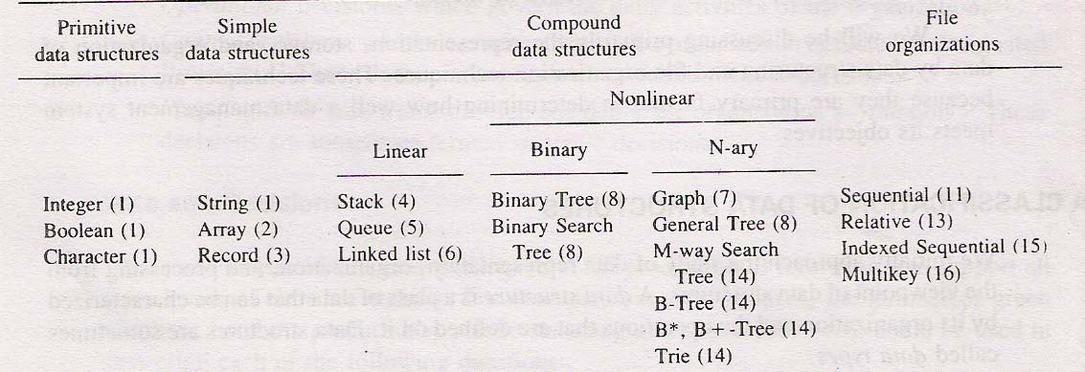
Various Data Structures

Slide 20
Why Data Structures are Required?
Data may be organized in many different ways
Logical or mathematical model of a particular organization of data is called a data structure
The choice of a particular data model depends on two considerations.
  First, it must be rich enough in structure to mirror the actual relationships of the data in the real world.
  Secondly, the structure should be simple enough that one can effectively process the data when necessary

Slide 21
Data Structure Operations
data appearing in our data structures are processed by means of certain operations
In fact, the particular data structure that one chooses for a given situation depends largely on the frequency with which specific operations are performed

Slide 22
Data Structure Operations (Cont…)
Following are the major operations:
Traversing: Accessing each record exactly once so that certain items in the record may be processed. (This accessing and processing is sometimes called "visiting" the record.)
Searching: Finding the location of the record with a given key value, or finding the locations of all records that satisfy one or more conditions
Inserting: Adding a new record to the structure
Deleting: Removing a record from the structure

Slide 23
Data Structure Operations (Cont…)
Sometimes two or more of the operations may be used in a given situation;
  e.g., we may want to delete the record with a given key, which may mean we first need to search for the location of the record.
Following two operations, which are used in special situations, are also be considered:
Sorting: Arranging the records in some logical order
  (e.g., alphabetically according to some NAME key, or in numerical order according to some NUMBER key, such as social security number or account number)
Merging: Combining the records in two different sorted files into a single sorted file
Other operations, e.g., copying and concatenation, are also used

Slide 24
Data Structure Operations Example
An organization contains a membership file in which each record contains the following data for a given member:
  Name, Address, Telephone Number, Age, Sex
(a) Suppose the organization wants to announce a meeting through a mailing. Then one would traverse the file to obtain Name and Address for each member.
(b) Suppose one wants to find the names of all members living in a certain area. Again one would traverse the file to obtain the data.
(c) Suppose one wants to obtain Address for a given Name. Then one would search the file for the record containing Name

Slide 25
Data Structure Operations Example
(d) Suppose a new person joins the organization. Then one would insert his or her record into the file.
(e) Suppose a member dies. Then one would delete his or her record from the file.
(f) Suppose a member has moved and has a new address and telephone number. Given the name of the member, one would first need to search for the record in the file. Then one would perform the "update"- i.e., change items in the record with the new data.
(g) Suppose one wants to find the number of members 65 or older. Again one would traverse the file, counting such members

Slide 26
Data Structure – Linear Array
a list of a finite number n of homogeneous data elements (i.e., data elements of the same type) such that:
  (a) The elements are referenced respectively by an index set consisting of n consecutive numbers.
  (b) The elements are stored respectively in successive memory locations.
  (c) The number n of elements is called the length or size of the array. In general, the length or the number of data elements of the array can be obtained from the index set by the formula
  Length = UB - LB + 1
  Where UB is the largest index, called the upper bound, and LB is the smallest index, called the lower bound, of the array
  Number K in A[K] is called a subscript or an index and A[K] is called a subscripted variable. Note that subscripts allow any element of A to be referenced by its relative position in A

Slide 27
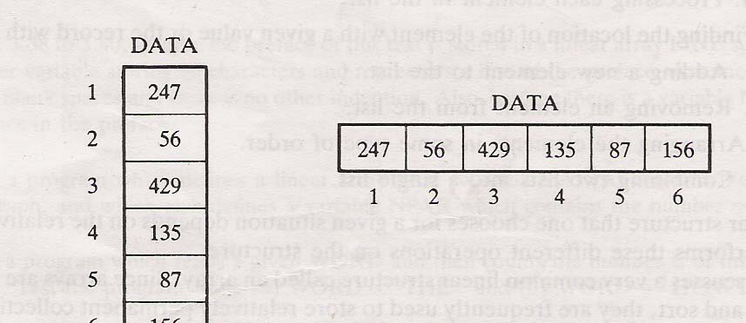

Array Example
Let DATA be a 6-element linear array of integers such that
DATA[1] =247 DATA[2] = 56 DA T A[3] = 429 DATA[4] = 135 DATA[5] = 87 DATA[6] = 156
DATA: 247, 56, 429, 135, 87, 156

Slide 28
Arrays in C
Elementary data structure that exists as built-in in most programming languages
Lower Bound (LB) is fixed at 0
Upper Bound (UB) to be defined by user as an integer
  main( int argc, char** argv ) {
  int x[6];
  int j;
  for(j=0; j < 6; j++)
  x[j] = 2*j;
  }

Slide 29
Arrays in C
Array declaration: int x[6];
An array is collection of cells of the same type.
The collection has the name ‘x’.
The cells are numbered with consecutive integers.
To access a cell, use the array name and an index:
x[0], x[1], x[2], x[3], x[4], x[5]

Slide 30
Array Layout
x[0]
Array cells are contiguous in computer memory
The memory can be thought of as an array
x[1]
x[2]
x[3]
x[4]
x[5]

Slide 31
What is Array Name?
‘x’ is an array name but there is no variable x. ‘x’ is not an lvalue
For example, if we have the code
int a, b;
then we can write
b = 2;
a = b;
a = 5;
But we cannot write
2 = a;

Slide 32
Array Name
‘x’ is not an lvalue
int x[6];
int n;
x[0] = 5;
x[1] = 2;
x = 3; // not allowed
x = a + b; // not allowed
x = &n; // not allowed

Slide 33
Dynamic Arrays
You would like to use an array data structure but you do not know the size of the array at compile time
You find out when the program executes that you need an integer array of size n=20
Allocate an array using the new operator:
int* y = new int[20]; // or int* y = new int[n]
y[0] = 10;
y[1] = 15; // use is the same

Slide 34
Dynamic Arrays
‘y’ is a lvalue; it is a pointer that holds the address of 20 consecutive cells in memory
It can be assigned a value. The new operator returns as address that is stored in y
We can write:
y = &x[0];
y = x; // x can appear on the right
// y gets the address of the
// first cell of the x array

Slide 35
Dynamic Arrays
We must free the memory we got using the new operator once we are done with the y array.
delete[ ] y;
We would not do this to the x array because we did not use new to create it.

Slide 36
The LIST Data Structure
The List is among the most generic of data structures.
Real life:
  shopping list,
  groceries list,
  list of people to invite to dinner
  List of presents to get
A list is collection of items that are all of the same type (grocery items, integers, names)
The items, or elements of the list, are stored in some particular order

Slide 37
Lists
It is possible to insert new elements into various positions in the list and remove any element of the list
List is a set of elements in a linear order.
For example, data values a₁, a₂, a₃, a₄ can be arranged in a list:
(a₃, a₁, a₂, a₄)
In this list, a₃, is the first element, a₁ is the second element, and so on
The order is important here; this is not just a random collection of elements, it is an ordered collection

Slide 38
List Operations
Useful operations
createList(): create a new list (presumably empty)
copy(): set one list to be a copy of another
clear(); clear a list (remove all elements)
insert(X, ?): Insert element X at a particular position in the list
delete(?): Remove element at some position in
the list
get(?): Get element at a given position
update(X, ?): replace the element at a given position with X
find(X): determine if the element X is in the list
length(): return the length of the list.

Slide 39
List Operations
We need to decide what is meant by “particular position”; we have used “?” for this.
There are two possibilities:
  Use the actual index of element: insert after element 3, get element number 6. This approach is taken by arrays
  Use a “current” marker or pointer to refer to a particular position in the list

Slide 40
List Operations
If we use the “current” marker, the following four methods would be useful:
  start(): moves to “current” pointer to the very first element.
  tail(): moves to “current” pointer to the very last element.
  next(): move the current position forward one element
  back(): move the current position backward one element

Slide 41
Implementing Lists Using Arrays
We have designed the interface for the List; we now must consider how to implement that interface.
Implementing Lists using an array: for example, the list of integers (2, 6, 8, 7, 1) could be represented as:
A
current
size
2
6
8
7
1
3
5
1
2
3
4
5

Slide 42
Traversing List (linear Arrays)
Let A be a collection of data elements stored in the memory of the computer.
  Suppose we want to print the contents of each element of A or
  Suppose we want to count the number of elements of A with a given property.
This can be accomplished by traversing A, that is, by accessing and processing (frequently called visiting) each element of A exactly once.
The following algorithm traverses a linear array LA. The simplicity of the algorithm comes from the fact that LA is a linear structure.
  Other linear structures, such as linked lists, can also be easily traversed.
  On the other hand, the traversal of nonlinear structures, such as trees and graphs, is considerably more complicated.

Slide 43
Traversing List Arrays - Algorithm
Here LA is a linear array with lower bound LB and upper bound UB. This algorithm traverses LA applying an operation PROCESS to each element of LA.
  1. [Initialize counter.] Set K:= LB.
  2. Repeat Steps 3 and 4 while K≤UB.
  3. [Visit element.] Apply PROCESS to LA[K].
  4. [Increase counter.] Set K: = K + 1.
  [End of Step 2 loop.]
  5. Exit.

Slide 44
Traversing Implementation in C
void traverse(int A[], int size) {
int i, count =0;
for (i=0; i<size; i++) {
if (A[i] > 0) {
printf(“%d”, A[i]);
count++;
}
printf(“\n\t Total number of elements greater than 0 = %d“, count);
}

Slide 45
List Implementation
add(9); current position is 3. The new list would thus be: (2, 6, 8, 9, 7, 1)
We will need to shift everything to the right of 8 one place to the right to make place for the new element ‘9’.
A
current
size
step 1:
2
6
8
7
1
3
5
1
2
3
4
5
6
step 2:
A
2
6
8
9
7
1
current
size
4
6
1
2
3
4
5
6
notice: current points
to new element

Slide 46
Implementing Lists
next():
There are special cases for positioning the current pointer:
  past the last array cell
  before the first cell
We will have to worry about these when we write the actual code.
A
current
size
2
6
8
9
7
1
4
6
1
2
3
4
5
6
5

Slide 47
Implementing Lists
remove(): removes the element at the current
index
Step 1:
A
current
size
2
6
8
9
1
5
6
1
2
3
4
5
6
5
A
current
size
Step 2:
2
6
8
9
1
5
5
1
2
3
4
5
We fill the blank spot left by the removal of 7 by
shifting the values to the right of position 5 over to the left one space.

Slide 48
Implementing Lists
find(X): traverse the array until X is located.
int find(int X)
{
int j;
for(j=1; j < size+1; j++ )
if( A[j] == X ) { // found X
current = j; // current points to where X found
return 1; // 1 for true
}
return 0; // 0 (false) indicates not found
}

Slide 49
Implementing Lists
Other operations:
get() → return A[current];
update(X) → A[current] = X;
length() → return size;
back() → current--;
start() → current = 1;
end() → current = size;

Slide 50
Analysis of Array Lists
add
  we have to move every element to the right of current to make space for the new element.
  Worst-case is when we insert at the beginning; we have to move every element right one place.
  Average-case: on average we may have to move half of the elements

Slide 51
Analysis of Arrays Lists
remove
  Worst-case: remove at the beginning, must shift all remaining elements to the left.
  Average-case: expect to move half of the elements.
find
  Worst-case: may have to search the entire array
  Average-case: search at most half the array.
Other operations are one-step

Slide 52
Summary
Need for Data Structures
Selecting a data structure
Data structure philosophy
Data structure classification
Data structure operations
Arrays and Lists
Some Operations on Lists

