Slide 1
CSC 211
Data Structures
Lecture 31
Dr. Iftikhar Azim Niaz
ianiaz@comsats.edu.pk
1

Slide 2
Last Lecture Summary
Dictionaries
  Concept and Implementation
Table
  Concept, Operations and Implementation
  Array based, Linked List, AVL, Hash table
Hash Table
  Concept
  Hashing and Hash Function
  Hash Table Implementation
  Chaining, Open Addressing, Overflow Area
Application of Hash Tables
2

Slide 3
Objectives Overview
Hash Function
Properties of a Good Hash Function
Hash Function Methods
File
  Text and Binary Files
  Operations on Files
File Access Methods
  Sequential Files
  Indexed Files
  Hashed Files

Slide 4
What is a Hash Function
A hash function is a mapping between a set of input values (Keys) and a set of integers, known as hash values.
Hash
function
Keys
Hash values

Slide 5
Nature of keys
Most hash functions assume that universe of keys is the set N = {0, 1, 2,…} of natural numbers
If keys are not N, ways to be found to interpret them as N
A character key can be interpreted as an integer expressed in ASCII code
  Example: The identifier pt might be interpreted as a pair of decimal integers (112, 116) as p = 112 and t = 116 in ASCII notation

Slide 6
Properties of a Good Hash Function
Rule1: The hash value is fully determined by the data being hashed.
Rule2: The hash function uses all the input data.
Rule3: The hash function uniformly distributes the data across the entire set of possible hash values.
Rule4: The hash function generates very different hash values for similar strings

Slide 7
Example – Hash Function
int hash(char *str, int table_size)
{
int sum=0;
//sum up all the characters in the string
for( ; *str; str++)
sum+=*str
//return sum mod table_size
return sum%table_size;
}

Slide 8
Analysis of Example
Rule1: Satisfies, the hash value is fully determined by the data being hashed, the hash value is just the sum of all input characters.
Rule2: Satisfies, Every character is summed.
Rule3: Breaks, from looking at it, it is not obvious that it doesn’t uniformly distribute the strings, but if you were to analyze this function for larger input string, you will see certain statistical properties which are bad for a hash function.
Rule4: Breaks, hash the string “CAT”, now hash the string “ACT”, they are the same, a slight variation in the string should result in different hash values, but with this function often they don’t

Slide 9
Good Hash Function - Properties
  (1) Easy to compute
  (2) Approximates a random function
  i.e., for every input, every output is equally likely.
  (3) Minimizes the chance that similar keys hash to the same slot (minimize collision)
  i.e., strings such as pt and pts should hash to different slot.
  Keeps chains short
  maintain O(1) average
Choosing hash function
  Key criterion is minimum number of collisions

Slide 10
Uniform Hashing
Ideal hash function
  P(k) = probability that a key, k, occurs
  If there are m slots in our hash table,
  a uniform hashing function, h(k), would ensure:
  Read as sum over all k such that h(k) = 0
  In plain English
  The number of keys that map to each slot is equal
Σ P(k) =
Σ P(k) = ....
Σ P(k) =
1
m
k | h(k) = 0
k | h(k) = 1
k | h(k) = m-1

Slide 11
Uniform Hash function
If the keys are integers
randomly distributed in [ 0 , r ),
then
is a uniform hash function
Most hashing functions can be made to map the keys to [ 0 , r ] for some r
  eg adding the ASCII codes for characters mod 256
  will give values in [ 0, 255 ]
  Replace + by xor
    same range without the mod operation
Read as 0 ≤ k < r
mk
h(k) =
r

Slide 12
Hash Functions
We’ve mapped the keys to a range of integers
0 ≤ k < r
Now we must reduce this range to [ 0, m )
where m is a reasonable size for the hash table
Methods
  Division - use a mod function
  Multiplication
  Mid-square method
  Folding Method
  Universal Hashing

Slide 13
The Division Method
Idea:
  Map a key k into one of the m slots by taking the remainder of k divided by m
  h(k) = k mod m
Advantage:
  fast, requires only one operation
Disadvantage:
  Certain values of m are bad (i.e., collisions), e.g.,
    power of 2
    non-prime numbers

Slide 14
Division Method - Example
If m = 2^{p}, then h(k) = k mod 2^{p} just the least significant p bits of k
  p = 1 ⇒ m = 2
  ⇒ h(k) = {0, 1) , select least significant 1 bit of k
  p = 2 ⇒ m = 4
  h(k) = {0,1,2,3}, select least significant 2 bits of k
  All combinations are not generally equally likely
  Prime numbers not close to 2^{n} seem to be good choices
  eg want ~4000 entry table, choose m = 4093 (2¹² = 4096)
k mod 2⁸ selects these bits
0110010111000011010

Slide 15
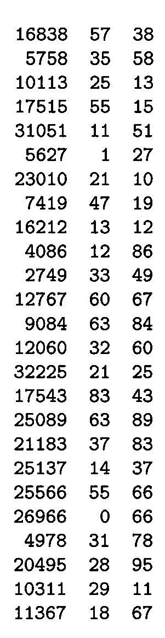
Division Method - Example
m97
m
100
Power of 10 should be avoided, if application deals with decimal numbers as keys.
Choose m to be a prime,
  Column 2: k mod 97 (Prime)
  Column 3: k mod 100 (non- prime)
Good values of m are primes not close to the exact powers of 2 (or 10).

Slide 16

The Multiplication Method
Idea:
(1) Multiply key k by a constant A, where 0 < A < 1
(2) Extract the fractional part of kA
(3) Multiply the fractional part by m (hash table size)
(4) Truncate the result to get result in the range 0 ..m-1
h(k) = = ⎣m (k A mod 1)⎦
Disadvantage: Slower than division method
Advantage: Value of m is not critical
fractional part of kA = kA - ⎣kA⎦

Slide 17
Multiplication Method - Example
Suppose k=6 , A=0.3, m=32
(1) k x A = 1.8
(2) fractional part:
(3) m x 0.8 = 32 x 0.8 = 25.6
(4)
h(6)=25

Slide 18
Mid-Square Method
The key is squared and the address selected from the middle of the squared number
The hash function H is defined by:
h(k) = k² = l
Where l is obtained by digits from both the end of k² starting from left
The most obvious limitation of this method is the size of the key
Given a key of 6 digits, the product will be 12 digits, which may be beyond the maximum integer size of many computers
Same number of digits must be used for all of the keys

Slide 19


Mid-Square Method - Example
Consider following keys in the table and its hash index :

Slide 20
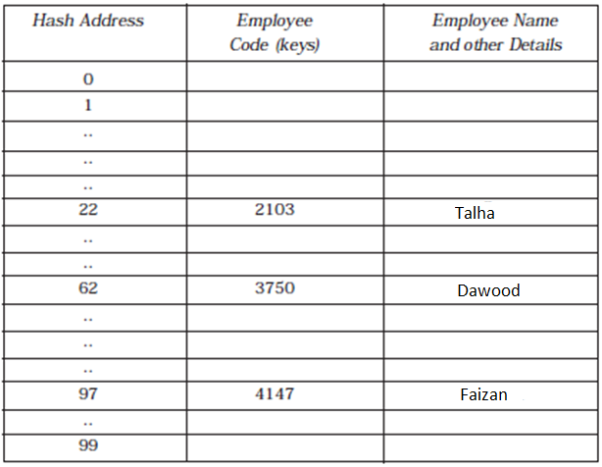
Mid-Square Method - Example
Hash Table with Mid-Square Division

Slide 21
Folding Method
In this method, the key K is partitioned into number of parts, k1, k2,...... kr
The parts have same number of digits as the required hash address, except possibly for the last part
Then the parts are added together, ignoring the last carry
h(k) = k₁ + k₂ + ...... + kr

Slide 22

Folding Method
Here we are dealing with a hash table with index from 00 to 99, i.e., two-digit hash table
So we divide the K numbers of two digits
8

Slide 23
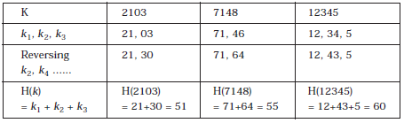
Folding Method
Sometimes, for extra "milling;" the even-numbered parts, k₂, k₄, . . . , are each reversed before the addition
H(7148) = 71 + 84 = 155, here we will eliminate the leading carry (i.e., 1). So H(7148) = 71 + 64 = 55
8

Slide 24
Universal Hashing
A determined “adversary” can always find a set of data that will defeat any hash function
  Hash all keys to same slot ç O(n) search
Selecting a hash function at random (at run time) from a family of hash functions
This guarantees a low number of collisions in expectation, even if the data is chosen by an adversary
Reduce the probability of poor performance

Slide 25
Universal Hashing
Assume we want to map keys from some universe U into m bins (labelled [)
  [m] = {0, ……., m – 1}
The algorithm will have to handle some data set S ⊆ U of |S| = n keys, which is not known in advance
Usually, the goal of hashing is to obtain a low number of collisions (keys from S that land in the same bin)
A deterministic hash function cannot offer any guarantee in an adversarial setting if the size of U is greater than m²
  since the adversary may choose S to be precisely the preimage of a bin.
  This means that all data keys land in the same bin, making hashing useless.
Furthermore, a deterministic hash function does not allow for rehashing: sometimes the input data turns out to be bad for the hash function
  e.g. there are too many collisions, so one would like to change the hash function.

Slide 26

Universal Hashing
Solution is to pick a function randomly from a family of hash functions.
A family of functions H = {h : U → [m] } is called a universal family if
In other words, any two keys of the universe collide with probability at most 1/m when the hash function h is drawn randomly from H
This is exactly the probability of collision we would expect if the hash function assigned truly random hash codes to every key

Slide 27
Universal Hashing
Can we design a set of universal hash functions?
Quite easily
Key, x = x₀, x₁, x₂, ...., x_{r}
Choose a = <a₀, a₁, a₂, ...., a_{r}>
a is a sequence of elements
chosen randomly from { 0, m-1 }
h_{a}(x) = Σ a_{i}x_{i} mod m
There are m^{r+1} sequences a,
so there are m^{r+1} functions, h_{a}(x)
x₀ x₁ x₂ .... x_{r}
n-bit “bytes” of x

Slide 28
Files
Data hierarchy
Storage in Data files
File Access Methods
  Sequential file
  Indexed File
  Hashed File
Text file and Binary File

Slide 29
Data Hierarchy
Bit – smallest data item Value of 0 or 1
Byte – 8 bits Used to store a character
    Decimal digits, letters, and special symbols
Field – group of characters conveying meaning
  Example: your name
Record – group of related fields
  Represented by a struct or a class
  Example: In a payroll system, a record for a particular employee that contained his/her identification number, name, address, etc.

Slide 30
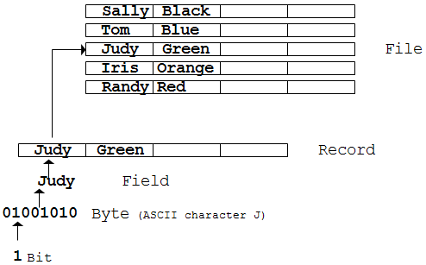
Data Hierarchy
File – group of related records
  Example: payroll file
Database – group of related files
  A database is a collection of related, logically coherent data used by the application programs in an organization

Slide 31
File
A file is an external collection of related data treated as a unit.
Files are stored in auxiliary/secondary storage devices.
  Disk
  Tapes
A file is a collection of data records with each record consisting of one or more fields.

Slide 32
Text and Binary Files
Text files
  Unformatted Text file (plain text)
  Formatted Text files (styled text or rich text)
Binary File
  Data file

Slide 33
Text Files Types
Unformatted Text files (Plain Text)
  contents of an ordinary sequential file readable as textual material without much processing
  the encoding has traditionally been either ASCII, or sometimes EBCDIC. Unicode-based encodings such as UTF-8 and UTF-16
  Files that contain markup or other meta-data are generally considered plain-text, as long as the entirety remains in directly human-readable form (as in HTML, XML, and so on
Formatted Text files (Styled Text, Rich Text)
  has styling information beyond the minimum of semantic elements:
  colours, styles (boldface, italic), sizes and special features (such as hyperlinks)
  is not necessarily binary, it may be text-only, such as HTML, RTF or enriched text files,
  PDF is another formatted text file format that is usually binary

Slide 34
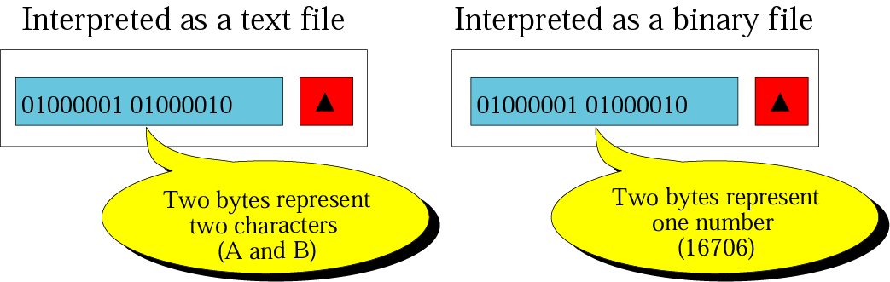
Text and Binary file Interpretations
A file stored on a storage device
is a sequence of bits that can be interpreted by an application program as a text file or a binary file.

Slide 35
Text Files
A text file is a file of characters
It cannot contain integers, floating-point numbers, or any other data structures in their internal memory format
  To store these data types, they must be converted to their character equivalent formats
Structured as a sequence of lines of electronic text
The end of a text file is often denoted by placing one or more special characters, known as an end-of-file(EOF) marker, after the last line in a text file

Slide 36
Text Files
commonly used for storage of information
Some files can only use character data types
Most notable are file streams (input/output objects in some object-oriented language like C++) for keyboards, monitors and printers
This is why we need special functions to format data that is input from or output to these devices
when data corruption occurs in a text file
  it is often easier to recover and continue processing the remaining contents

Slide 37
Binary Files
A binary file is a collection of data stored in the internal format of the computer
In this definition, data can be an integer
  including other data types represented as unsigned integers, such as image, audio, or video
  a floating-point number or any other structured data (except a file).
Unlike text files, binary files contain data that is meaningful only if it is properly interpreted by a program
If the data is textual, one byte is used to represent one character (in ASCII encoding)
But if the data is numeric, two or more bytes are considered a data item

Slide 38
Binary Files
a computer file that is not a text file
it may contain any type of data, encoded in binary form for computer storage and processing purposes
typically contain bytes that are intended to be interpreted as something other than text characters
A hex editor or viewer may be used to view file data as a sequence of hexadecimal (or decimal, binary or ASCII character) values for corresponding bytes of a binary file.

Slide 39
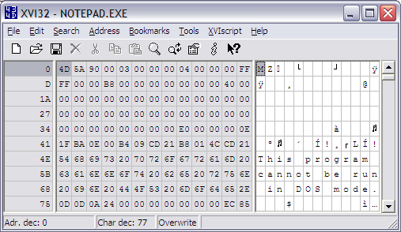
Hex Editor

Slide 40
Common Operations on Files
Creating a file with a given name
Setting attributes that control operations on the file
Opening a file to use its contents
Reading or updating the contents
Committing updated contents to durable storage
Closing the file, thereby losing access until it is opened again

Slide 41
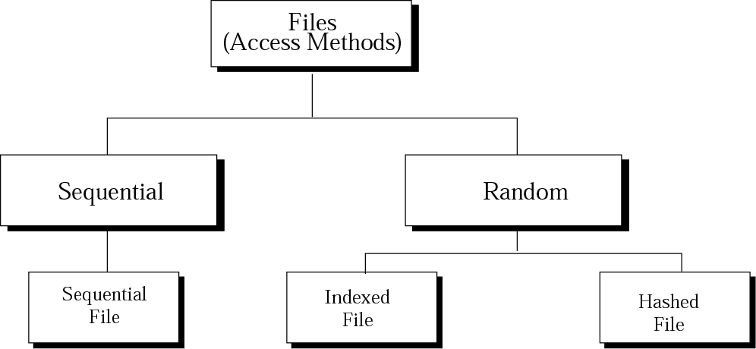
File Access Methods
The access method determines how records can be retrieved: sequentially or randomly.
One record after another,
from beginning to end
Access one specific record without having to retrieve all records before it

Slide 42
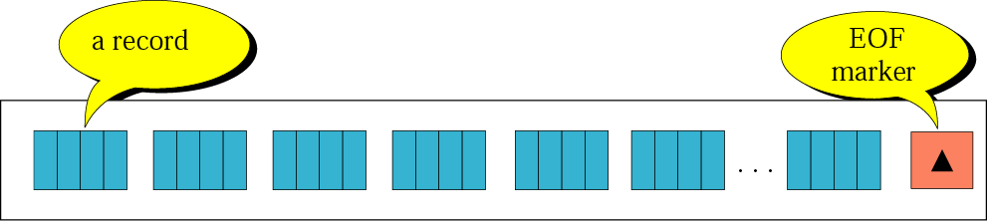
Sequential File
records can only be accessed sequentially, one after another, from beginning to end
Processing records in a sequential file
While Not EOF {
Read the next record
Process the record
}

Slide 43
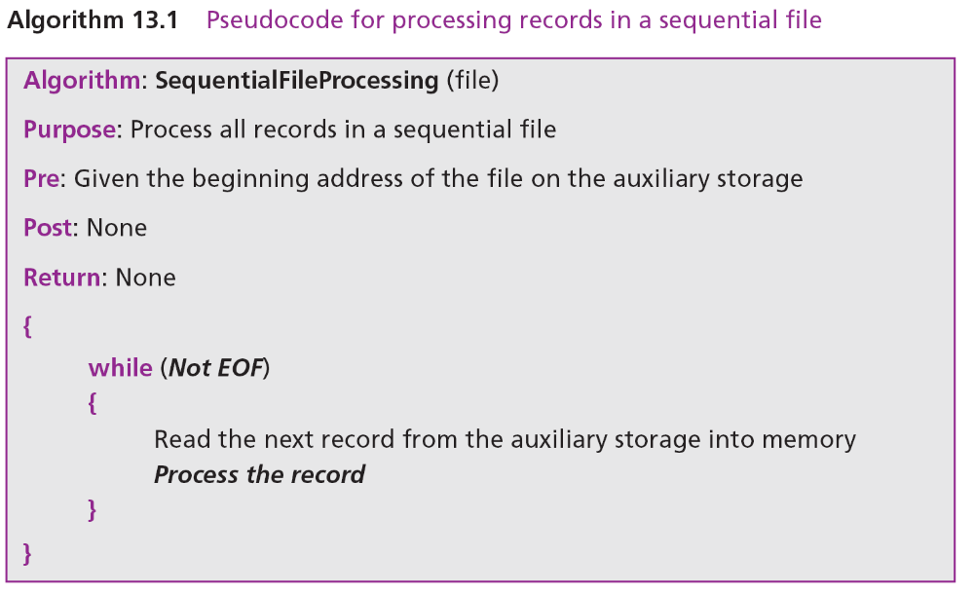
Sequential File Processing - Algorithm

Slide 44
Applications
that need to access all records from beginning to end
  Personal Information
Because you have to process each record, sequential access is more efficient and easier than random access.
Sequential File is not efficient for random access

Slide 45
Updating Sequential files
sequential files must be updated periodically to reflect changes in information.
The updating process –
all of the records need to be checked and updated
(if necessary) sequentially.
  New Master File
  Old Master File
  Transaction File –
  contains changes to be applied to the master file.
    Add transaction
    Delete transaction
    Change transaction
    A key is one or more fields that uniquely identify the data in the file.
  Error Report File

Slide 46
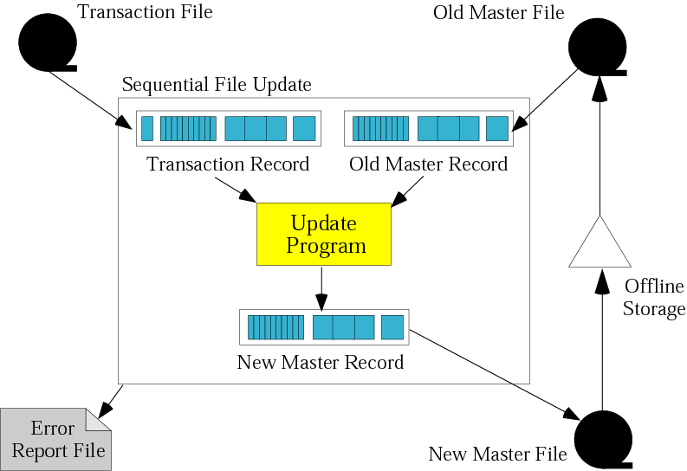
Updating a Sequential File

Slide 47
Updating Sequential Files
To make updating process efficient, all files are sorted on the same key.
The update process requires that you compare :
[transaction file key] vs. [old master file key]
  < : add transaction to new master
  = :
    Change content of master file data (transaction code = R(revise) )
    Remove data from master file (transaction code = D(delete) )
  > : write old master file record to new master file
  (transaction code = A(add) )

Slide 48
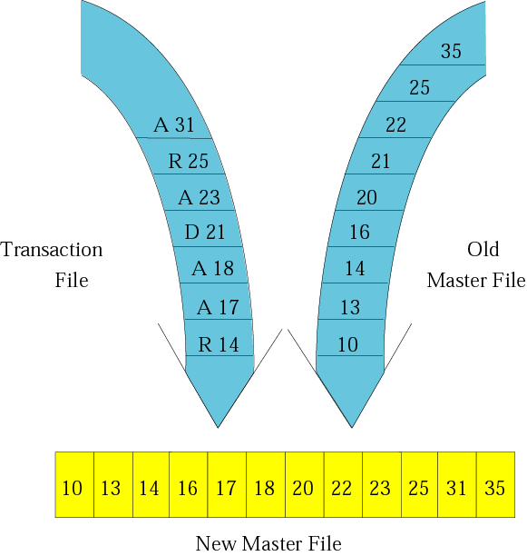
Updating Process

Slide 49
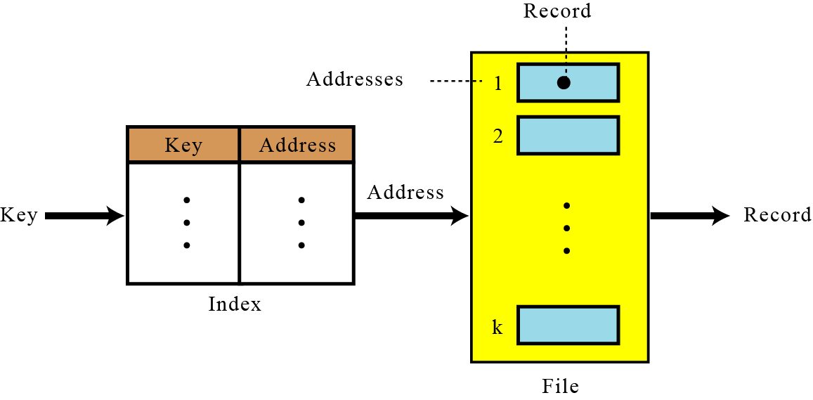
Indexed Files
Mapping in an indexed file
To access a record in a file randomly,
you need to know the address of the record.
An index file can relate the key to the record address.

Slide 50
Indexed Files
An index file is made of a data file, which is a sequential file, and an index.
Index – a small file with only two fields:
  The key of the sequential file
  The address of the corresponding record on the disk.
To access a record in the file :
  Load the entire index file into main memory.
  Search the index file to find the desired key.
  Retrieve the address the record.
  Retrieve the data record. (using the address)
Inverted file –
you can have more than one index, each with a different key

Slide 51
Inverted File
One of the advantages of indexed files is that we can have more than one index, each with a different key.
For example, an employee file can be retrieved based on
  either social security number or
  last name.
This type of indexed file is usually called an inverted file.

Slide 52
Inverted File
A file that reorganizes the structure of an existing data file to enable a rapid search to be made for all records having one field falling within set limits.
For example, a file used by an estate agent might store records on each house for sale, using a reference number as the key field for sorting.
One field in each record would be the asking price of the house.
To speed up the process of drawing up lists of houses falling within certain price ranges, an inverted file might be created in which the records are rearranged according to price.
Each record would consist of an asking price, followed by the reference numbers of all the houses offered for sale at this approximate price

Slide 53
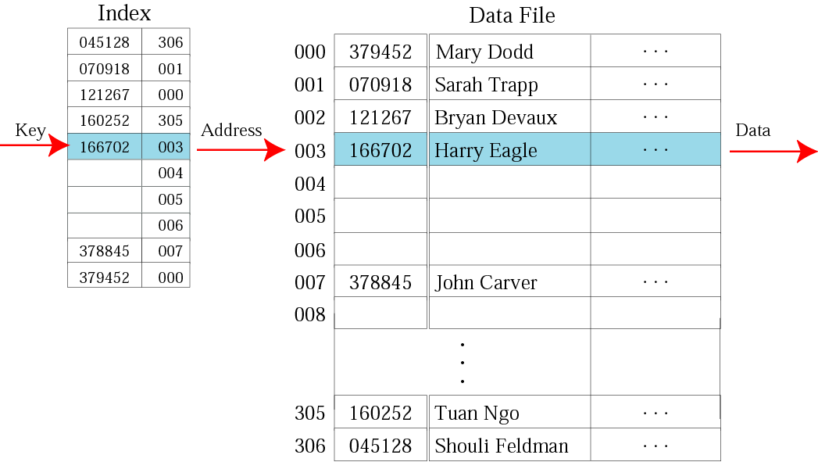
Logical View of an Indexed File

Slide 54
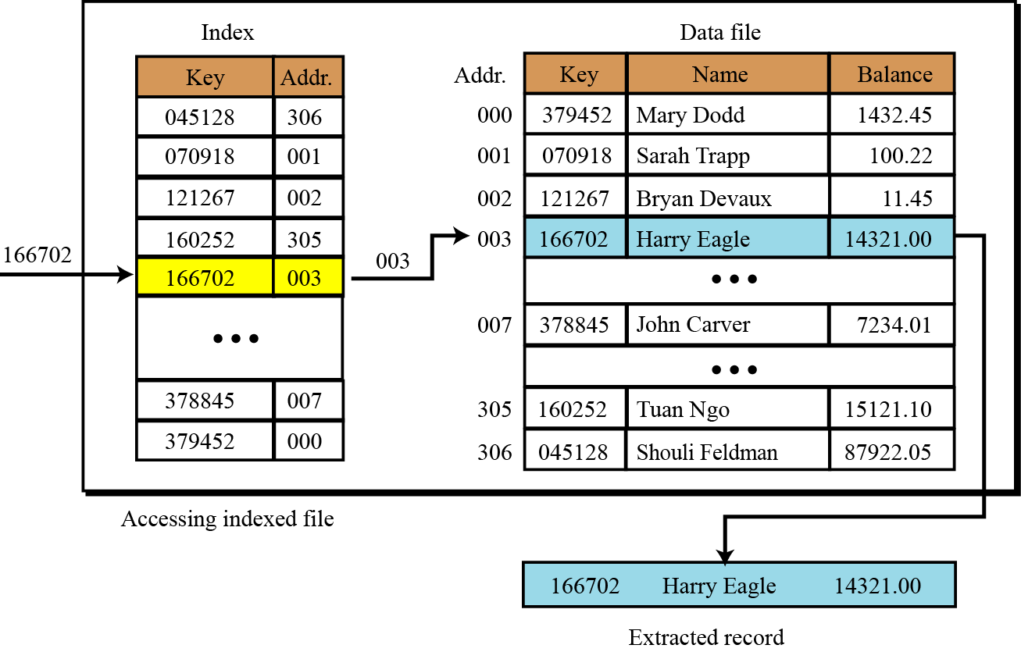
Logical View of an Indexed File

Slide 55
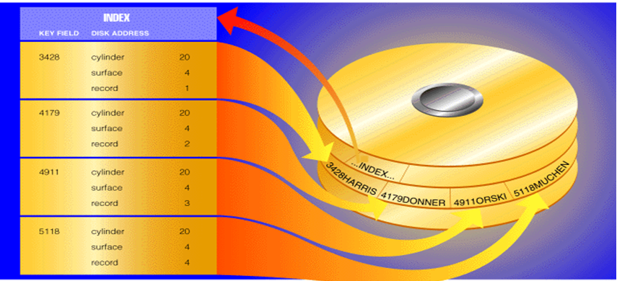
Physical View of Indexed File

Slide 56
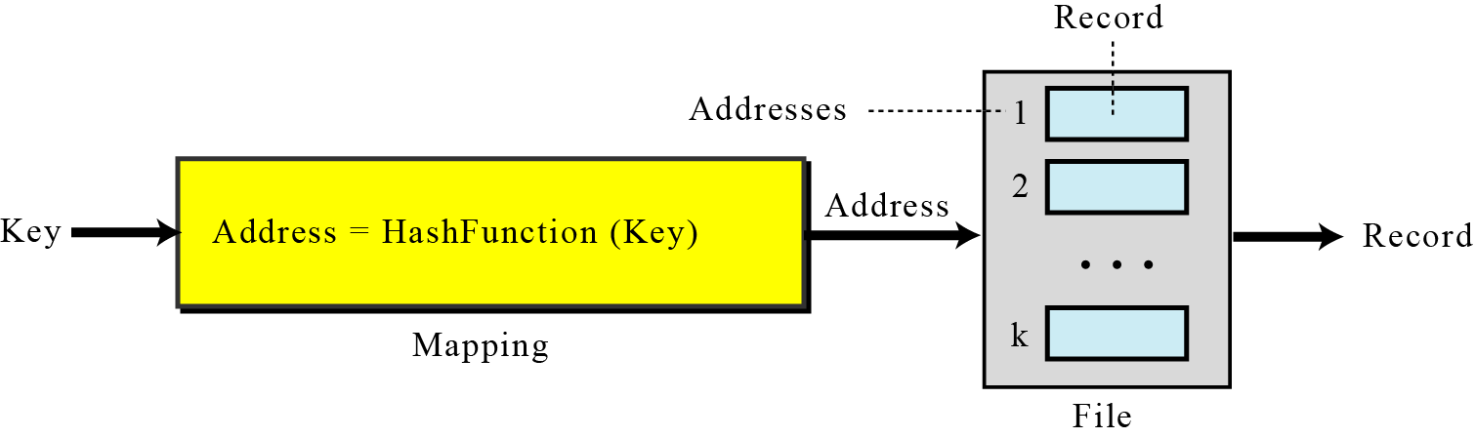
Hashed Files
Mapping in a hashed file
A hashed file uses a hash function to map the key to the address.
Eliminates the need for an extra file (index).
There is no need for an index and all of the overhead associated with it

Slide 57
Hashing Methods
Direct Hashing –
the key is the address without any algorithmic manipulation.
Modulo Division Hashing – (Division remainder hashing)
divides the key by the file size and
use the remainder plus 1 for the address.
Digit Extraction Hashing –
selected digits are extracted from the key and used as the address.

Slide 58
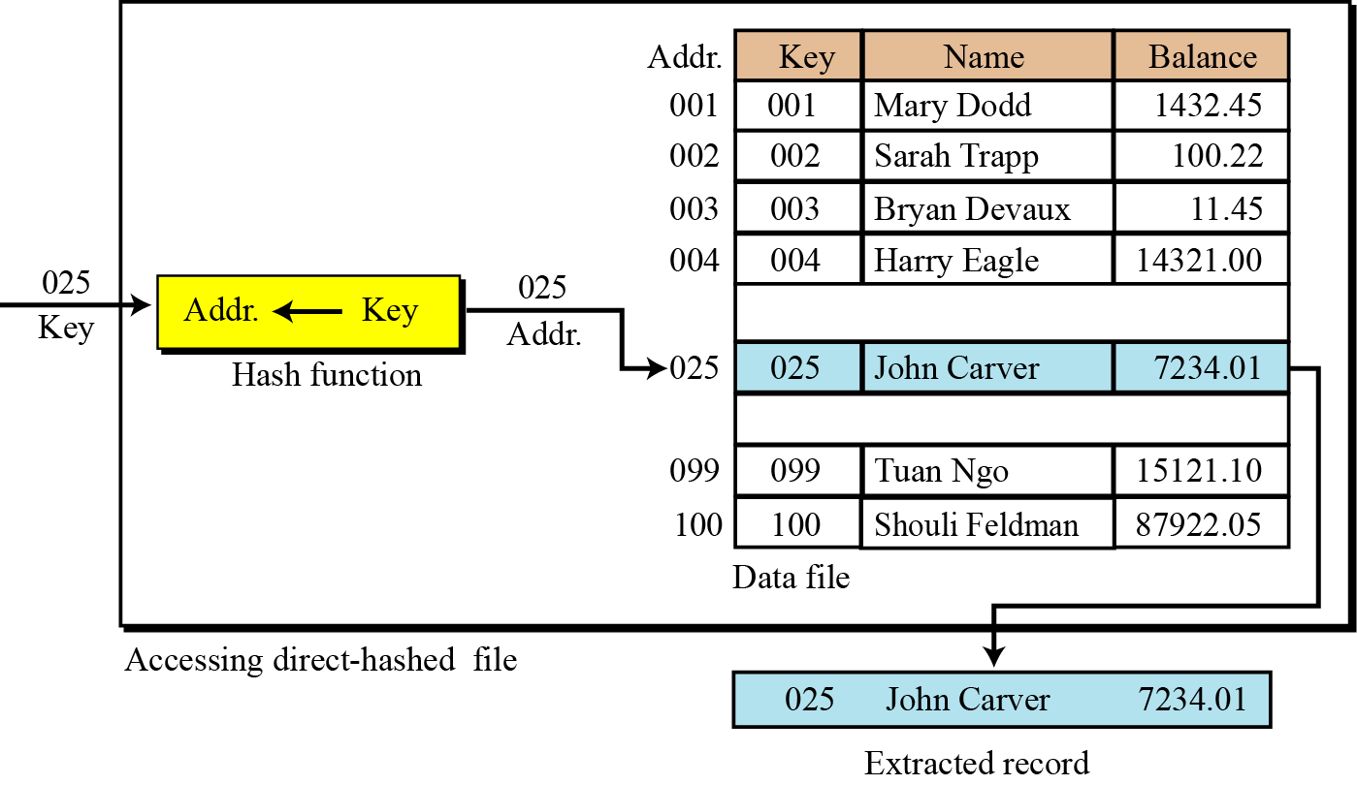
Direct Hashing
Key is the address without any algorithmic manipulation

Slide 59
Direct Hashing
the file must contain a record for every possible key.
Advantage
  No collision.
Disadvantage
  Space is wasted.
Hashing techniques –
  map a large population of possible keys into a small address space.

Slide 60
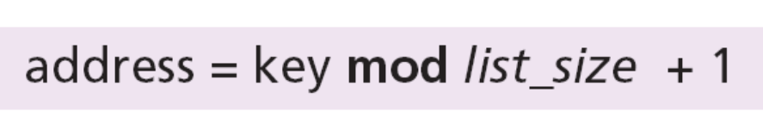
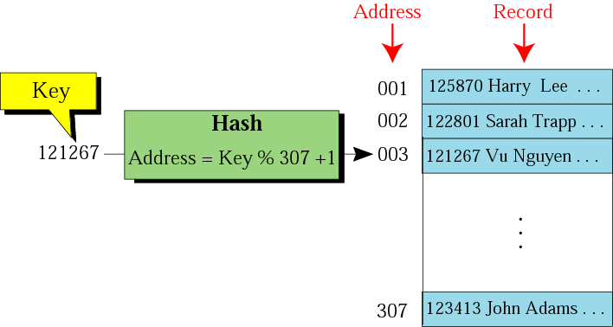
Modulo Division
address = key % list_size + 1
list_size : a prime number produces fewer collisions
A new employee numbering system
that will handle 1 million employees.

Slide 61
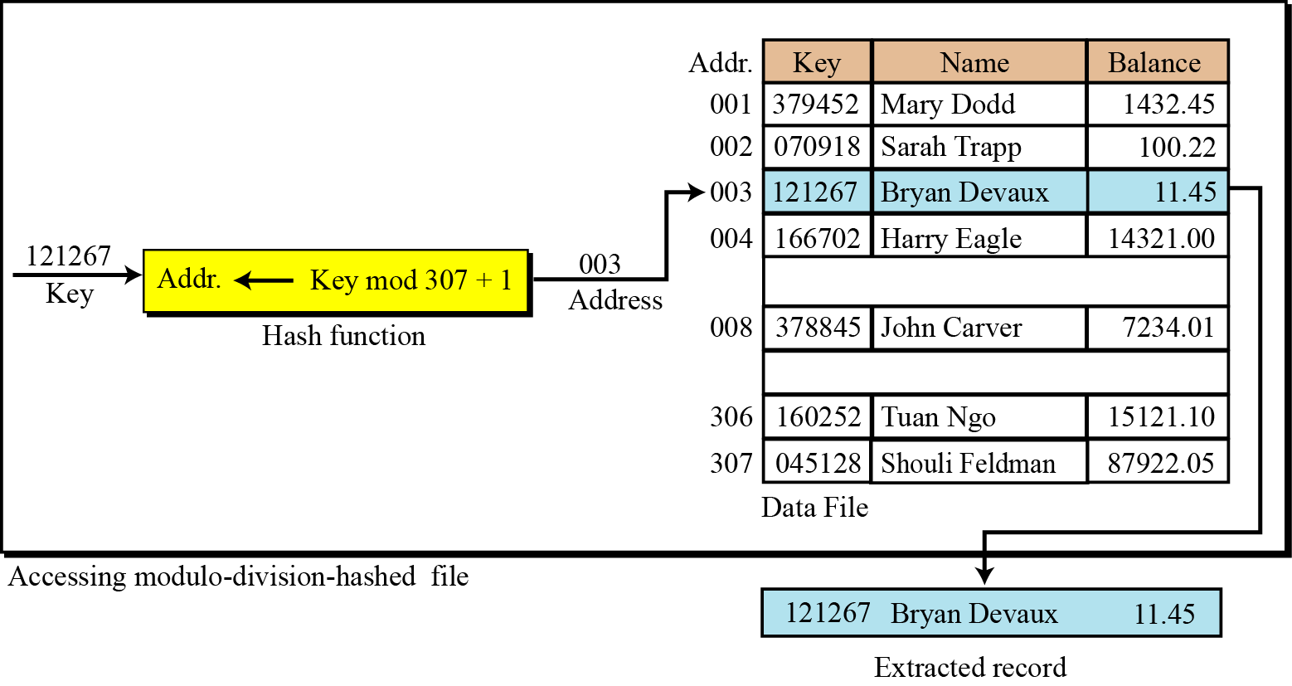
Modulo Division

Slide 62
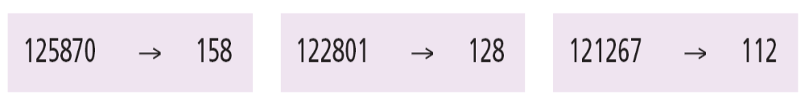
Digit Extraction Hashing
selected digits are extracted from the key
and used as the address.
For example : 1,3,4
6-digit employee number → → → 3-digit address
  125870 → 158
  122801 → 128
  121267 → 112
  …
  123413 → 134

Slide 63
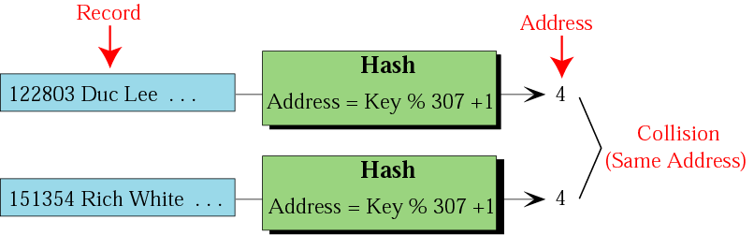
Collision
Because there are many keys for each address in the file, there is a possibility that more than one key will hash to the same address in the file.
Synonyms – the set of keys that hash to the same address.
Collision – a hashing algorithm produces an address for an insertion key, and that address is already occupied.
Prime area – the part of the file that contains all of the home addresses

Slide 64
Collision Resolution
With the exception of the directed hashing,
none of the methods we discussed creates one-to-one mapping.
Several collision resolution methods :
  Open addressing resolution
  Linked list resolution
  Bucket hashing resolution

Slide 65
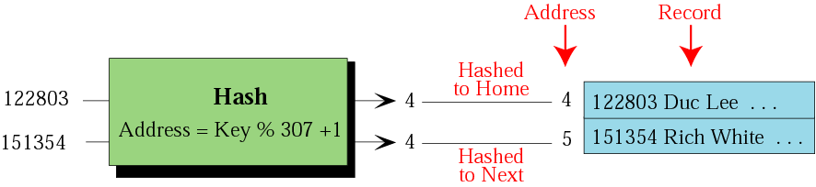
Open Addressing Resolution
Resolve collisions in the prime area.
The prime area addresses are searched for an open or unoccupied record where the new data can be placed.
One simplest strategy – the next address (home address + 1)
Disadvantage. – each collision resolution increases the possibility of future collisions.

Slide 66
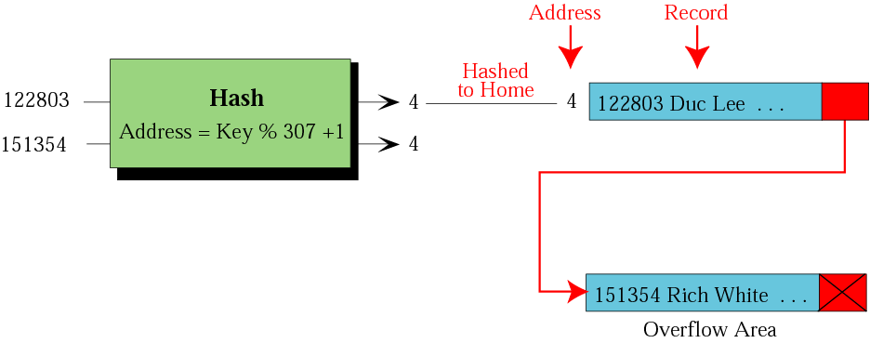
Linked List Resolution
The first record is stored in the home address (prime area), but it contains a pointer to the second record. (overflow area)

Slide 67
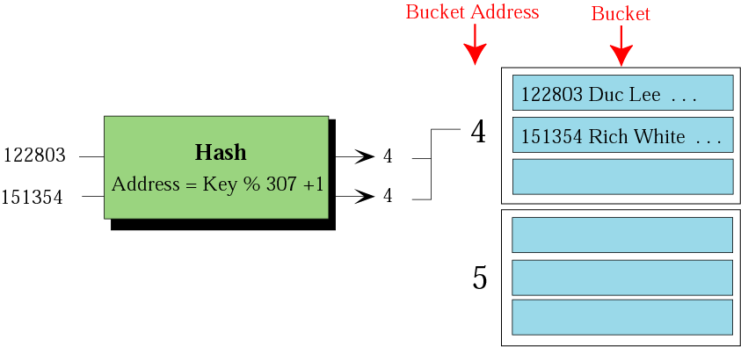
Bucket Hash Resolution
Bucket – a node that can accommodate more than one record.

Slide 68
Summary
Hash Function
Properties of a Good Hash Function
Hash Function Methods
File
  Text and Binary Files
  Operations on Files
File Access Methods
  Sequential Files
  Indexed Files
  Hashed Files

