Slide 1
CSC 211
Data Structures
Lecture 30
Dr. Iftikhar Azim Niaz
ianiaz@comsats.edu.pk
1

Slide 2
Last Lecture Summary
Shortest Path Problem
  Dijkastra’s Algorithm
  Bellman Ford Algorithm
  All Pairs Shortest Path
Spanning Tree
Minimum Spanning Tree
  Kruskal’s Algorithm
  Prim’s Algorithm
2

Slide 3
Objectives Overview
Dictionaries
  Concept and Implementation
Table
  Concept, Operations and Implementation
  Array based, Linked List, AVL, Hash table
Hash Table
  Concept
  Hashing and Hash Function
  Hash Table Implementation
  Chaining, Open addressing, Overflow Area
Application of Hash Tables

Slide 4
Dictionaries
Collection of pairs.
  (key, element)
  Pairs have different keys.
Operations.
  get(Key)
  put(Key, Element)
  remove(Key)

Slide 5
Dictionaries - Application
Collection of student records in this class.
  (key, element) = (student name, linear list of assignment and exam scores)
  All keys are distinct.
Get the element whose key is Ahmed Hassan
Update the element whose key is Rahim Khan
  put() implemented as update when there is already a pair with the given key.
  remove() followed by put().

Slide 6
Dictionary With Duplicates
Keys are not required to be distinct.
Word dictionary.
  Pairs are of the form (word, meaning).
  May have two or more entries for the same word.
    (bolt, a threaded pin)
    (bolt, a crash of thunder)
    (bolt, to shoot forth suddenly)
    (bolt, a gulp)
    (bolt, a standard roll of cloth)
    etc.

Slide 7
Dictionary – Represent as a Linear List
L = (e₀, e₁, e₂, e₃, …, e_{n-1})
Each e_{i} is a pair (key, element).
5-pair dictionary D = (a, b, c, d, e).
  a = (aKey, aElement), b = (bKey, bElement), etc.
Array or linked representation.

Slide 8
Dictionary – Array Representation
a
b
c
d
e
Unsorted array
Get(Key)
  O(size) time
Put(Key, Element)
  O(size) time to verify duplicate, O(1) to add at end
Remove(Key)
  O(size) time

Slide 9
Dictionary – Array Representation
A
B
C
D
E
Sorted array
  Elements are in ascending order of Key
Get(Key)
  O(log size) time
Put(Key, Element)
  O(log size) time to verify duplicate, O(size) to add at end
Remove(Key)
  O(size) time

Slide 10
Dictionary – List Representation
firstNode
null
a
b
c
d
e
Unsorted Chain
Get(Key)
  O(size) time
Put(Key, Element)
  O(size) time to verify duplicate, O(1) to add at end
Remove(Key)
  O(size) time

Slide 11
Dictionary – List Representation
firstNode
null
A
B
C
D
E
Sorted Chain
  Elements are in ascending order of Key
Get(Key)
  O(size) time
Put(Key, Element)
  O(size) time to verify duplicate, O(1) to add at end
Remove(Key)
  O(size) time

Slide 12
Dictionary - Applications
Many applications require a dynamic set that supports dictionary operations
Example: a compiler maintaining a symbol table where keys correspond to identifiers

Slide 13
Table
Table is an abstract storage device that contains dictionary entries
Each table entry contains a unique key k.
Each table entry may also contain some information, I, associated with its key.
A table entry is an ordered pair (K, I)
Operations:
  insert: given a key and an entry, inserts the entry into the table
  find: given a key, finds the entry associated with the key
  remove: given a key, finds the entry associated with the key, and removes it

Slide 14
How Should We Implement a Table?
Our choice of representation for the Table ADT depends on the answers to the following
How often are entries inserted and removed?
How many of the possible key values are likely to be used?
What is the likely pattern of searching for keys? e.g. Will most of the accesses be to just one or two key values?
Is the table small enough to fit into memory?
How long will the table exist?

Slide 15
Implementation 1: Unsorted Sequential Array
An array in which TableNodes are stored consecutively in any order
insert: add to back of array; O(1)
find: search through the keys one at a time, potentially all of the keys; O(n)
remove: find + replace removed node with last node; O(n)
key
entry
and so on

Slide 16
Implementation 2: Sorted Sequential Array
An array in which TableNodes are stored consecutively, sorted by key
insert: add in sorted order; O(n)
find: binary search; O(log n)
remove: find, remove node and shuffle down; O(n)
key
entry
and so on
We can use binary search because the
array elements are sorted

Slide 17
Implementation 3: Linked List
TableNodes are again stored consecutively (unsorted or sorted)
insert: add to front;
  O(1) or O(n) for a sorted list
find: search through potentially all the keys, one at a time;
  O(n) for unsorted or for a sorted list
remove: find, remove using pointer alterations; O(n)
key
entry
and so on

Slide 18
Implementation 4: AVL Tree
An AVL tree, ordered by key
insert: a standard insert; O(log n)
find: a standard find (without removing, of course); O(log n)
remove: a standard remove; O(log n)
key
entry
key
entry
key
entry
key
entry
and so on

Slide 19
Implementation 5: Direct Addressing
Suppose the range of keys is 0..m-1 and keys are distinct
Idea is to set up an array T[0..m-1] in which
  T[i] = x if x∈ T and key[x] = i
  T[i] = NULL otherwise
  This is called a direct-address table
  Operations take O(1) time! ,the most efficient way to access the data
Works well when the Universe U of keys is reasonable small
When Universe U is very large
Storing a table T of size U may be impractical, given the memory available on a typical computer.
The set K of the keys actually stored may be so small relative to U that most of the space allocated for T would be wasted

Slide 20
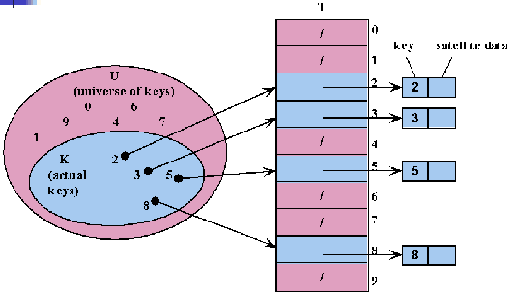
Direct Addressing

Slide 21
An Example
A table for 50 students in a class
Key is 9 digit SSN number to identify each student
Number of different 9 digit number=10⁹
The fraction of actual keys needed. 50/10⁹, 0.000005%
Percent of the memory allocated for table wasted, 99.999995%
An ideal table needed
  Table should be of small fixed size
  Any key in the universe should be able to be mapped in the slot into table, using some mapping function

Slide 22
Implementation 6: Hashing
An array in which TableNodes are not stored consecutively
Their place of storage is calculated using the key and
a hash function
Keys and entries are scattered throughout the array
key
entry
4
10
hash function
array index
Key
123

Slide 23
Hashing
Idea:
  Use a function h to compute the slot for each key
  Store the element in slot h(k)
A hash function h transforms a key into an index in a hash table T[0…m-1]:
h : U → {0, 1, . . . , m - 1}
We say that k hashes to slot h(k)

Slide 24
Hash Table
All search structures so far
  Relied on a comparison operation
  Performance O(n) or O( log n)
Assume we have a function
  f ( key ) → integer
  i.e. one that maps a key to an integer
What performance might we expect now?
24

Slide 25
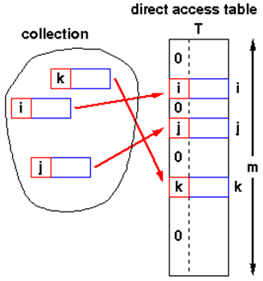
Hash Table - Structure
Simplest Case
  Assume items have integer keys in the range 1 .. m
  Use the value of the key itself
  to select a slot in a
  direct access table
  in which to store the item
  To search for an item with key, k,
  just look in slot k
    If there’s an item there,
    you’ve found it
    If the tag is 0, it’s missing.
  Constant time, O(1)

Slide 26
Hash Table - Constraints
Keys must be unique
Keys must lie in a small range
For storage efficiency,
keys must be dense in the range
If they’re sparse (lots of gaps between values),
a lot of space is used to obtain speed
  Space for speed trade-off

Slide 27
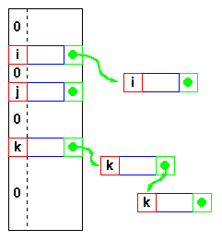
Hash Tables –Relaxing the Constraints
Keys must be unique
  Construct a linked list of duplicates
  “attached” to each slot
  If a search can be satisfied
  by any item with key, k,
  performance is still O(1)
  but
  If the item has some
  other distinguishing feature
  which must be matched,
  we get O(n^{max}), where n^{max} is the largest number
  of duplicates - or length of the longest chain

Slide 28
Hash Tables –Relaxing the Constraints
Keys are integers
  Need a hash function
  h( key ) → integer
  ie one that maps a key to
  an integer
  Applying this function to the
  key produces an address
  If h maps each key to a unique
  integer in the range 0 .. m-1
  then search is O(1)

Slide 29
Hash Tables –Hash Functions
Form of the hash function
  Example - using an n-character key
  int hash( char *s, int n ) {
  int sum = 0;
  while( n-- ) sum = sum + *s++;
  return sum % 256;
  }
  returns a value in 0 .. 255
  xor function is also commonly used
  sum = sum ^ *s++;
  But any function that generates integers in 0..m-1 for some suitable (not too large) m will do
  As long as the hash function itself is O(1) !

Slide 30
Hash Tables - Collisions
Hash function
  With this hash function
  int hash( char *s, int n ) {
  int sum = 0;
  while( n-- ) sum = sum + *s++;
  return sum % 256;
  }
  hash( “AB”, 2 ) and hash( “BA”, 2 )
  return the same value!
  This is called a collision
  A variety of techniques are used for resolving collisions

Slide 31
Hash Tables - Collisions
h : U → {0, 1, . . . , m - 1}
Hash table Size : m
Collisions occur when h(k_{i})=h(k_{j}), i≠j
0
U
(universe of keys)
h(k₁)
h(k₄)
k₁
K
(actual
keys)
k₄
k₂
h(k₂) = h(k₅)
k₅
k₃
h(k₃)
m - 1

Slide 32
Hash Tables – Collision Handling
Collision occur when the hash function maps
two different keys to the same address
The table must be able to recognize and resolve this
Recognize
  Store the actual key with the item in the hash table
  Compute the address k = h( key )
  Check for a hit
    if ( table[k].key == key ) then hit else try next entry
Resolution
  Variety of techniques
We’ll look at various
“try next entry” schemes

Slide 33
Hash Tables – Implementation
Chaining
Open addressing (Closed Hashing)
Overflow Area
Bucket

Slide 34
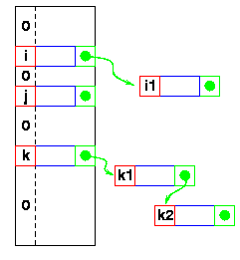
Hash Tables – Chaining
Collisions - Resolution
Linked list attached
to each primary table slot
  h(i) == h(i1)
  h(k) == h(k1) == h(k2)
Searching for i1
  Calculate h(i1)
  Item in table, i,
  doesn’t match
    Follow linked list to i1
  If NULL found, key isn’t in table

Slide 35
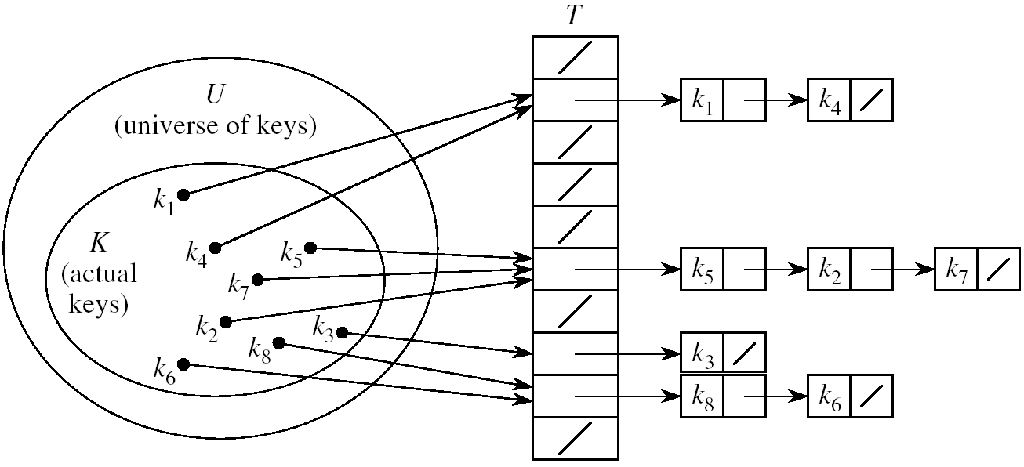
Chaining
Idea: Put all elements that hash to the same slot into a linked list
  Slot j contains a pointer to the head of the list of all elements that hash to j

Slide 36
Chaining
How to choose the size of the hash table m?
  Small enough to avoid wasting space.
  Large enough to avoid many collisions and keep linked-lists short.
  Typically 1/5 or 1/10 of the total number of elements.
Should we use sorted or unsorted linked lists?
  Unsorted
  Insert is fast
  Can easily remove the most recently inserted elements

Slide 37
Hash Table Operations - Chaining
CHAINED-HASH-SEARCH(T, k)
  search for an element with key k in list T[h(k)]
  Running time depends on the length of the list of elements in slot h(k)
CHAINED-HASH-INSERT(T, x)
  insert x at the head of list T[h(key[x])]
  T[h(key[x])] takes O(1) time; insert will take O(1) time overall since lists are unsorted.
CHAINED-HASH-DELETE(T, x)
  delete x from the list T[h(key[x])]
  T[h(key[x])] takes O(1) time
  Finding the item depends on the length of the list of elements in slot h(key[x])

Slide 38
Analysis of Chaining – Worst Case
How long does it take to search for an element with a given key?
Worst case:
  All n keys hash to the same slot
then O(n) + time to compute the hash function
T
0
chain
m - 1

Slide 39
Analysis of Chaining – Average Case
It depends on how well the hash function distributes the n keys among the m slots
Under the following assumptions:
  (1) n = O(m)
  (2) any given element is equally likely to hash into any of the m slots (i.e., simple uniform hashing property)
then → O(1) time + time to compute the hash function
T
n₀ = 0
n₂
n₃
n_{j}
n_{k}
n_{m – 1} = 0

Slide 40
Open Addressing – (Closed Hashing)
So far we have studied hashing with chaining, using a linked-list to store keys that hash to the same location.
Maintaining linked lists involves using pointers
  which is complex and inefficient in both storage and time requirements.
Another option is to store all the keys directly in the table. This is known as open addressing
  where collisions are resolved by systematically examining other table indexes, i ₀ , i ₁ , i ₂ , … until an empty slot is located

Slide 41
Open Addressing
Another approach for collision resolution.
All elements are stored in the hash table itself
  so no pointers involved as in chaining
To insert: if slot is full, try another slot, and another, until an open slot is found (probing)
To search, follow same sequence of probes as would be used when inserting the element

Slide 42
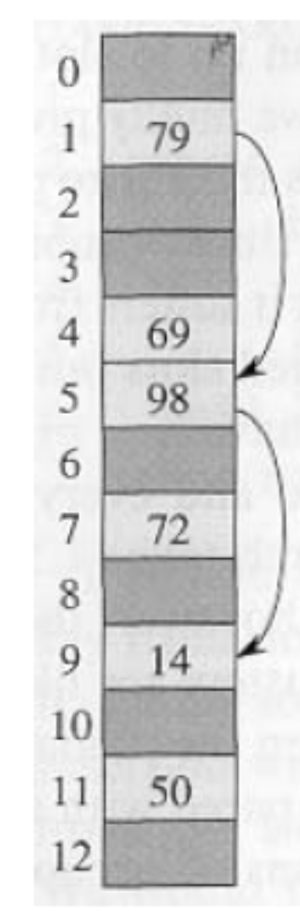
Open Addressing
Idea: store the keys in the table itself
No need to use linked lists anymore
Basic idea:
  Insertion: if a slot is full, try another one,
  until you find an empty one.
  Search: follow the same probe sequence.
  Deletion: need to be careful!
Search time depends on the length of
probe sequences!
e.g., insert 14
probe sequence:
<1, 5, 9>

Slide 43
Open Addressing – Hash Function
A hash function contains two arguments now:
  (i) key value, and (ii) probe number
  h(k,p), p=0,1,...,m-1
Probe sequence:
<h(k,0), h(k,1), h(k,2), …. >
Probe sequence must be a permutation
  of <0,1,...,m-1>
There are m! possible permutations
Example:
e.g., insert 14
Probe sequence:
<h(14,0), h(14,1), h(14,2)>=<1, 5, 9>

Slide 44
Common Open Addressing Methods
Linear Probing
Quadratic probing
Double hashing
None of these methods can generate more than m² different probe sequences!

Slide 45
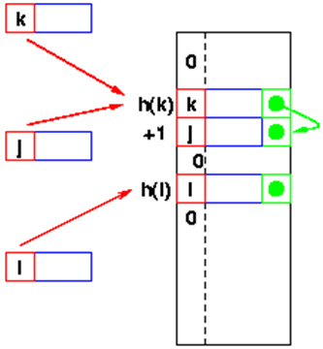
Linear Probing
The re-hash function
    Many variations
Linear probing
  h’(x) is +1
  Go to the next slot
  until you find one empty
  Can lead to bad clustering
  Re-hash keys fill in gaps
  between other keys and exacerbate
  the collision problem

Slide 46
Linear Probing
The key is first mapped to a slot:
If there is a collision subsequent probes are performed:
If the offset constant, c and m are not relatively prime, we will not examine all the cells. Ex.:
  Consider m=4 and c=2, then only every other slot is checked.
  When c=1 the collision resolution is done as a linear search.

Slide 47
Insertion in Hash Table
HASH_INSERT(T,k)
i ← 0
repeat j ← h(k,i)
if T[j] = NIL
then T[j] = k
return j
else i ← i +1
until i = m
error “ hash table overflow”
Worst case for
inserting a key is O(n)

Slide 48
Search from Hash Table
HASH_SEARCH(T,k)
1 i ← 0
2 repeat j ← h(k,i)
3 if T[j] = k
4 then return j
5 i ← i +1
6 until T[j] = NIL or i = m
7 return NIL
Worst case for
Searching a key is O(n)
Running time depends
on the length of probe
sequences
Need to keep probe
sequences short to
ensure fast search

Slide 49
Delete from Hash Table
First, find the slot containing the key
to be deleted.
Can we just mark the slot as empty?
  It would be impossible to retrieve keys inserted after that slot was occupied!
Solution
  “Mark” the slot with a sentinel value DELETED (introduced a new class of entries, full, empty and removed)
The deleted slot can later be used for insertion.
e.g., delete 98

Slide 50
Open addressing - Disadvantages
The position of the initial mapping i₀ of key k is called the home position of k.
When several insertions map to the same home position, they end up placed contiguously in the table. This collection of keys with the same home position is called a cluster.
As clusters grow, the probability that a key will map to the middle of a cluster increases, increasing the rate of the cluster’s growth. This tendency of linear probing to place items together is known as primary clustering.
As these clusters grow, they merge with other clusters forming even bigger clusters which grow even faster

Slide 51
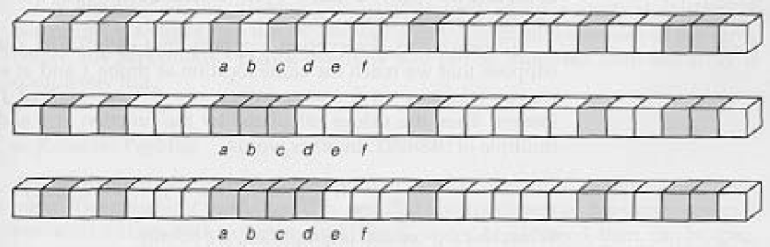
Primary Clustering Problem
Long chunks of occupied slots are created.
As a result, some slots become more likely than others.
Probe sequences increase in length. ⇒ search time increases!!
initially, all slots have probability 1/m
Slot b:
2/m
Slot d:
4/m
Slot e:
5/m

Slide 52
Hash Tables – Quadratic Probing
The re-hash function
  Many variations
Quadratic probing
  h’(x) is c i² on the i^{th} probe
  Avoids primary clustering
  Secondary clustering occurs
    All keys which collide on h(x) follow the same sequence
    First
      a = h(j) = h(k)
    Then a + c, a + 4c, a + 9c, ....
    Secondary clustering generally less of a problem

Slide 53
Quadratic Probing
h(k,i) = (h’(k) + c₁i + c₂i ²) mod m for i = 0,1,…,m − 1.
Leads to a secondary clustering (milder form of clustering)
The clustering effect can be improved by increasing the order to the probing function (cubic)
  However the hash function becomes more expensive to compute
But again for two keys k1 and k2, if h(k1,0)= h(k2,0) implies that h(k1,i)= h(k2,i)

Slide 54
Double Hashing
Recall that in open addressing the sequence of probes follows
We can solve the problem of primary clustering in linear probing by having the keys which map to the same home position use differing probe sequences
  In other words, the different values for c should be used for different keys.
Double hashing refers to the scheme of using another hash function for c

Slide 55
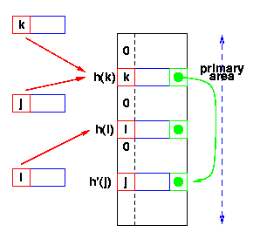
Double Hashing
Use a second hash function
  Many variations
  General term: re-hashing
  h(k) == h(j)
  k stored first
  Adding j
    Calculate h(j)
    Find k
    Repeat until we find an empty slot
      Calculate h’(j)
    Put j in it
  Searching - Use h(x), then h’(x)
h’(x) -
second hash function

Slide 56
Double Hashing
Advantage
  Handles clustering better
Disadvantage
  More time consuming
How many probes sequences can double hashing generate? m²

Slide 57
Double Hashing Example
h₁(k) = k mod 13
h₂(k) = 1+ (k mod 11)
h(k,i) = (h₁(k) + i h₂(k) ) mod 13
Insert key 14:
i=0: h(14,0) = h₁(14) = 14 mod 13 = 1
i=1: h(14,1) = (h₁(14) + h₂(14)) mod 13
= (1 + 4) mod 13 = 5
i=2: h(14,2) = (h₁(14) + 2 h₂(14)) mod 13
= (1 + 8) mod 13 = 9
0
79
69
98
72
50
1
2
3
4
5
6
7
8
9
14
10
11
12

Slide 58
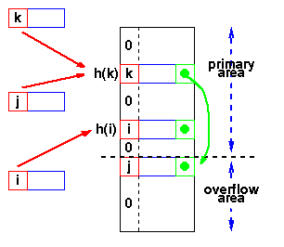
Overflow Area
Overflow area
  Linked list constructed
  in special area of table
  called overflow area
  h(k) == h(j)
  k stored first
  Adding j
    Calculate h(j)
    Find k
    Get first slot in overflow area
    Put j in it
    k’s pointer points to this slot
  Searching - same as linked list

Slide 59
Overflow Area
Separate the table into two sections:
  the primary area to which keys are hashed
  an area for collisions, the overflow area
K₁
Overflow area
When a collision occurs, a
slot in the overflow area is
used for the new element
and a link from the primary
slot established
Primary Area
K₂
K₁
K₃
K₃
K₂
Overflow Area

Slide 60
Hash Table – Collision Resolution
Chaining
  Unlimited number of elements
  Unlimited number of collisions
  Overhead of multiple linked lists
Re-hashing
  Fast re-hashing
  Fast access through use of main table space
  Maximum number of elements must be known
  Multiple collisions become probable
Overflow area
  Fast access
  Collisions don't use primary table space
  Two parameters which govern performance need to be estimated

Slide 61
Hash Table – Representation
Organization | Advantages | Disadvantages
Chaining | Unlimited number of elements Unlimited number of collisions | Overhead of multiple linked lists
Open Addressing | Fast re-hashing Fast access through use of main table space | Maximum number of elements must be known Multiple collisions may become probable
Overflow area | Fast access Collisions don't use primary table space | Two parameters which govern performance need to be estimated

Slide 62
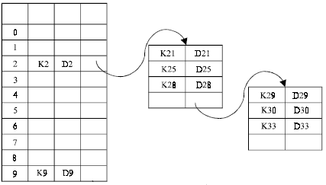
Bucket Addressing
Another solution to the hash collision problem is to store colliding elements in the same position in table by introducing a bucket with each hash address
A bucket is a block of memory space, which is large enough to store multiple items

Slide 63
Applications of Hash Tables
Compilers use hash tables to keep track of declared variables (symbol table).
A hash table can be used for on-line spelling checkers — if misspelling detection (rather than correction) is important, an entire dictionary can be hashed and words checked in constant time.
Game playing programs use hash tables to store seen positions, thereby saving computation time if the position is encountered again.
Hash functions can be used to quickly check for inequality — if two elements hash to different values they must be different.

Slide 64
When is Hashing Suitable?
Hash tables are very good if there is a need for many searches in a reasonably stable table.
Hash tables are not so good if there are many insertions and deletions, or if table traversals are needed — in this case, AVL trees are better.
Also, hashing is very slow for any operations which require the entries to be sorted
  e.g. Find the minimum key

Slide 65
Summary
Dictionaries
  Concept and Implementation
Table
  Concept, Operations and Implementation
  Array based, Linked List, AVL, Hash table
Hash Table
  Concept
  Hashing and Hash Function
  Hash Table Implementation
  Chaining, Open addressing, Overflow Area
Application of Hash Tables

