Slide 1
CSC 211
Data Structures
Lecture 3
Dr. Iftikhar Azim Niaz
ianiaz@comsats.edu.pk
1

Slide 2
Last Lecture Summary I
System Development Life Cycle Phases
Ongoing Activities
  Project Management, Feasibility, Documentation
Planning
  Review, approve and prioritize project requests
Analysis
  Preliminary Investigation, Detailed analysis
Design
  Acquire Hardware and software, Develop details
Implementation
  Develop programs, install and test new system
Operation, Support and Security
  Maintenance Activities, System performance and security
2

Slide 3
Last Lecture Summary II
Program Development Life Cycle
Analyze requirements
  Review requirements, develop IPO charts
Design solution
  Design solution algorithm, Structured and OOP
  Flowchart and Pseudo code
Validate design
  Inspection and Desk check
Implement design
  Program development tool, writing code
Test solution
  Testing and Debugging
Document solution
  Review Program code and documentation

Slide 4
What is a Programming Language?
A programming language:
  is a language
  has strict grammar rules, symbols, and special words
  is used to construct a computer program.

Slide 5
Programming Languages
First-Generation Languages: Machine Languages (1s and 0s)
Second-Generation Languages: Assembly Languages – are a little easier for humans to program in
Third-Generation Languages: Programming Comes of Age
Fourth-Generation Languages: Getting Away from Procedure
Object-Oriented Programming: A Revolution in the Making?

Slide 6
First Generation Computer Programming Languages
Machine languages
  1’s and 0’s represent instructions and procedures (the Instruction Set)
  Machine-dependent code (machine code)
  Programmers have to know the structure of the machine (architecture), addresses of memory registers, etc.
    Different for each hardware manufacturer (e.g., Intel differs from Motorola)

Slide 7
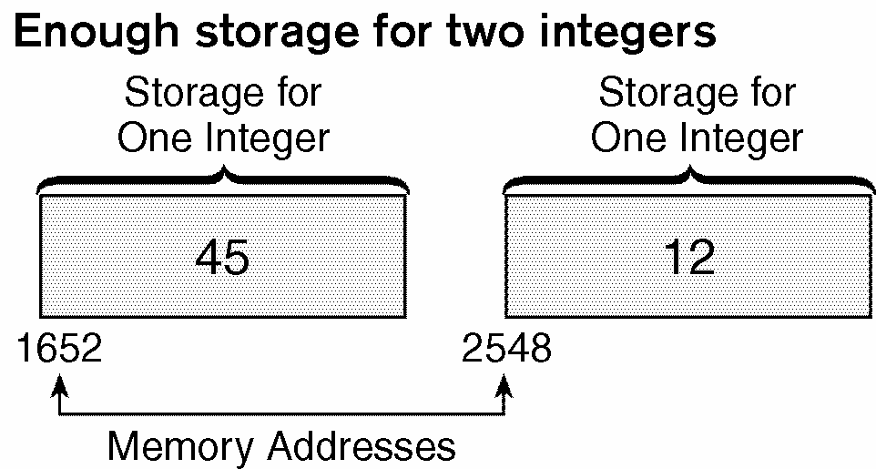
Early Programming Languages…
Memory locations were referenced by their address
This made the process of giving a computer instructions to do things very cumbersome
  E.g., storing the values 45 and 12 in memory locations 1652 and 2548 required instructions such as:
    Get storage for two integers
    Put 45 in location 1652
    Put 12 in location 2548
Adding two numbers was even more cumbersome!
  Add the contents of location 1652 to the contents of location 2548 and store the result into location 3000

Slide 8
Programming Language Evolution
Early computers were programmed in machine language
Machine language is also called binary code
To calculate wages = rate * hours in machine language, the following sequence of instructions might be needed:
address | content | meaning
000001 | 100100 | load
000010 | 010001 | address
000011 | 100110 | multiply to
000100 | 010010 | address
000101 | 100010 | store to
000110 | 010011 | address
address | content | meaning
010001 | 000010 | 2
010010 | 000110 | 6
010011 | 001100 | 12

Slide 9
Second Generation
Assembly language
  Still “low-level” (i.e., machine architecture dependent)
  But uses mnemonic command names
    ADD(3,2), COMPARE(A,B), etc.
  An “assembler” translates program source code into the appropriate machine language (binary code) → adds overhead

Slide 10
First Generation vs. Second Generation
Machine language Assembly
  01001100 mov bx, offset value
  11101001 mov ax, [bx]
  10101010 add ax, 5
  10001100 sub ax, 2
  00001100 inc ax

Slide 11
Assembly Language
An instruction in assembly language is an easy-to-remember form called a mnemonic
An assembler is a program that translates a program in assembly language into machine language
E.g., compare instructions in Assembly and Machine languages:

Slide 12
Assembly Program Example
Using assembly language instructions, the equation
wages = rate * hours
can be written as follows:
LOAD rate
MULT hours
STOR wages

Slide 13
Third Generation
Largely Procedural languages (Imperative)
  Not CPU dependent
High level
  Command names are not about the machine any more
    A=5
    B=A+6
    PRINT B
Command vocabulary and syntax rules
Compilers translate program source code into object code (machine language binary code)
Interpreters execute one line at a time → more overhead

Slide 14
Cf. 2nd & 3rd Generation
Assembly High level
  mov bx, offset value x=2;
  mov ax, [bx] if (x <= y)
  add ax, 5 x = x + 1;
  sub ax, 2 else
  inc ax x = x – 1;

Slide 15

Third-Generation Languages (3GL): Programming Comes of Age
Still procedural but high level languages
Compilers and Interpreters
Spaghetti Code and the Great Software Crisis led to Software Engineering
Structured Programming Languages (late 1960s)
Modular Programming Languages (1970s)

Slide 16
Higher Level Languages…
In high-level languages, symbolic names replace actual memory addresses
  I.e., we give mnemonic names to memory addresses in addition to instructions!
The symbolic names for the memory locations where values are stored are called variables
A variable is a name given by the programmer to refer to a computer memory storage location
The word variable (just like variables in mathematics) is used because the value stored in the variable (or memory location) can change or vary
For each variable name that the programmer uses, the computer keeps track of the actual memory address corresponding to that variable
  If memory addresses are analogous to the street addresses of houses, then naming a variable is equivalent to naming a house
    e.g., referring to 1600 Pennsylvania Avenue as The White House

Slide 17
High-Level Languages
High-level languages are portable across different machine types (architectures)
The user writes high-level language programs in a language similar to natural languages (like English, e.g.)
  The equation
  wages = rate * hours
  can be written in C as
  wages = rate * hours
Most high-level languages are standardized by ISO/ANSI to provide an official description of the language
High-level languages include BASIC, FORTRAN, COBOL, Pascal, C++, C , JAVA, C#
A compiler is a program that translates a program written in a high-level language into machine language (binary code) for that particular machine architecture

Slide 18
Programming Languages
Structural Programming Languages
  Java, C, C++, Visual Basic, Pascal, Turbo Pascal, Modula-2
Non-Structural Languages
  Fortran
Scripting Languages
  Bourne Shell, C Shell, Perl
Functional Programming Languages
  Prolog, LISP, Hope
Query Languages
  MSQL Lite, SQL, DBQ/AG

Slide 19
Fourth-Generation Languages (4GL):
Getting Away with Procedures
Terminology
  Report Generators
  Query Languages
    Structured Query Language (SQL)
  Natural Languages
nonprocedural

Slide 20
Three Fundamental C Program Stages
myprog.c
myprog.obj
myprog.exe
SOURCE
OBJECT
EXECUTABLE
written in
C
written in
machine
language
written in
machine
language
via compiler
via linker
other code from
libraries, etc.
(also in machine
language)

Slide 21
Processing a program
To execute a program written in a high-level language such C
  Use an editor to create a source program (code) in C
  A source program (code) is a program written in a high-level language
  Use the compiler to check that the program obeys the rules and translates the program in to an equivalent machine language object program
    An object program is the machine language (binary code) version of the high-level language program that the CPU can understand and execute

Slide 22
Processing a program (graphic)
CPU schedules (and executes) programs in main memory
source program
object program
executable code
other object programs
Loads executable program into main memory

Slide 23
Problem Solving Process (Programming Life Cycle)
Step 1 - Analyze the problem
  Outline the problem and its solution requirements
    Design steps (algorithm) to solve the problem
Step 2 - Implement the algorithm
  Implement the algorithm in a programming language
    Verify that the algorithm works
Step 3 - Maintenance
  Maintenance requires using and modifying the program if the problem domain changes
~75 % of costs!

Slide 24
Analyze the Problem
In order to minimize maintenance costs, you have to thoroughly understand what the problem is about
Understand the problem requirements
  Does the program require interaction with the user?
  Does the program manipulate data?
  Is there any output of the program?
If the problem is complex, divide the problem into sub-problems.
  Analyze each sub-problem as above

Slide 25
Problem Analysis: Coding-Execution Cycle

Slide 26
Software Development Activities
Editing
Compiling
Linking with precompiled files
  Object files & Library modules
Loading and executing
Viewing the behavior of the program

Slide 27
Software Development Cycle

Slide 28
Coding-Execution Cycle
Remove compilation and semantic (logic) errors (debugging)
Link object code with system resources (predefined subroutines like finding A⁻¹)
Compiler only guarantees that the program follows the rules of the language, but it does not guarantee that it will run correctly !
So, test the results with sample data to see if the program is calculating what you intend to calculate before testing it on real data
If results are inconsistent, go back to debugging

Slide 29
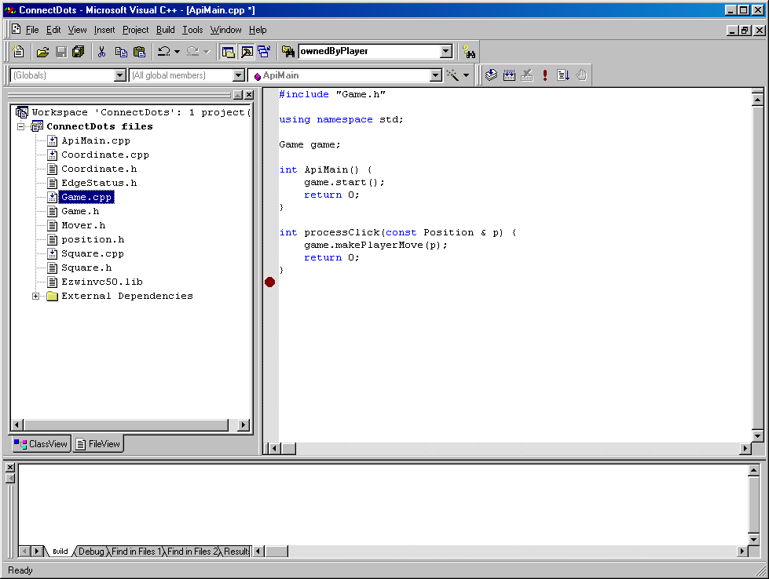
IDEs
Integrated Development Environments or IDEs
  Supports the entire software development cycle
    E.g., MS Visual C++, Dev-C++, Code Warrior
Provides all the capabilities for developing software
  Editor
  Compiler
  Linker
  Loader
  Debugger
  Viewer

Slide 30
Maintenance Phase
Maintenance includes
  Ongoing correction of newly discovered bugs
  Revisions to meet changing user needs
  Addition of new features
Maintenance is usually the longest phase, and may be the primary source of revenue
Good documentation is vital for effective maintenance
Also ~75 % of costs!

Slide 31
Maintenance Phase
USE and MODIFY the program to meet changing requirements
Correct errors that show up in using it
Maintenance begins when your program is put into use and accounts for the majority of effort on most programs
  Accounts for more than 50% of computer budgets and programmer costs

Slide 32
Implementation methods
Compilation
  Source language is translated into machine-executable instructions prior to execution
Interpretation
  Source language is translated on-the-fly (line by line!) by interpreter, or “virtual machine,” and executed directly
  Benefit: Easy to implement source-level debugging, on-the-fly program changes
  Disadvantage: Orders of magnitude slower than separate compilation and execution
Hybrid
  Source language is translated into an intermediate language
  Intermediate language executed by interpreter
  Java was initially implemented this way, but now a Just-In-Time Compiler is used to augment performance.

Slide 33
Compiled
Editor
Program is created in
the editor and stored
on disk (source code).
Phase 1
Disk
Disk
Compiler creates
machine language and stores
it on disk as executable.
Phase 2
Compile
Primary
Memory
Phase 3
Loader
Loader puts
executable in memory.
Disk
.
.
.
.
.
.
Interpreted
Primary
Memory
Phase 1
Load code
Load the source
.
.
.
.
.
.
Primary
Memory
Interpreter reads
source code line by line and
translates it into machine language on the fly
Phase 2
Interpreter
.
.
.
.
.
.

Slide 34
Procedural Programming…
Structured design – dividing a problem into smaller subproblems
The process of implementing a structured design is called structured programming
Structured programming:
  Each sub-problem is addressed by using three main control structures: sequence, selection, repetition
  Leads to organized, well-structured computer programs (code)
  Also allows for modular programming
The problem is divided into smaller problems in modular programming
  Each subproblem is then analyzed independently
  A solution is obtained to solve the subproblem
  The solutions of all subproblems are then combined to solve the overall problem
Procedural programming is combining structured programming with modular programming

Slide 35
Modular, Structured Programming
For example, solving Ax= b
1st step: entering A, b
2nd step: finding B=A⁻¹
3rd step: multiple Bb
Each of the steps can be programmed as a subroutine
  The finding of the inverse in Step 2 may have already been written and provided in the library

Slide 36
Sample Problem
A programmer needs an algorithm to determine an employee’s weekly wages. How would the calculations be done by hand???
In one week, an employee works 52 hours at the hourly pay rate of $24.75. Assume a 40.0 hour normal work week and an overtime pay rate factor of 1.5. What are the employee’s wages?
Please come up with a formulaic AND a procedural expression for your algorithm

Slide 37
One Employee’s Wages
In one week, an employee works 52 hours at the hourly pay rate of $24.75. Assume a 40.0 hour normal work week and an overtime pay rate factor of 1.5
What are the employee’s wages?
40 x $ 24.75 = $ 990.00
12 x 1.5 x $ 24.75 = $ 445.50
___________
$ 1435.50

Slide 38
Weekly Wages, in General
If hours are more than 40.0, then
wages = (40.0 * payRate) + (hours - 40.0) * 1.5 *payRate
otherwise,
wages = hours * payRate
RECALL EXAMPLE
( 40 x $ 24.75 ) + ( 12 x 1.5 x $ 24.75 ) = $1435.50

Slide 39
Algorithm to Determine an Employee’s Weekly Wages
1. Get the employee’s hourly payRate
2. Get the hours worked this week
3. Calculate this week’s regular wages
4. Calculate this week’s overtime wages (if any)
5. Add the regular wages to overtime wages (if any) to determine total wages for the week

Slide 40
Implementation Phase: Program
Translating your algorithm into a programming language is called CODING
Different languages use different tools & methodologies to do the translation
With C++, you use:
  Documentation -- your written comments
  Compiler -- translates your program into machine language
  Main Procedure -- may be called sub-algorithms

Slide 41
Implementation Phase: Test
TESTING your program means running (executing) your program on the computer, to see if it produces correct results
If it does not, then you must find out what is wrong with your program or algorithm and fix it
This is called debugging

Slide 42
What Can a Program Do?
A program can only instruct a computer to:
  Read Input
  Calculate
  Store data
  Write Output
  Work in a sequential progression (Sequence)
  Compare and branch (Selection)
  Iterate or Loop (Repetition)

Slide 43
Programming in C
A C program is a collection of one or more functions (or procedures)
Functions (in Computer Science) are very much like functions in mathematics
A function is like a black box
There must be a function called main( ) in every executable C program
Execution always begins with the first statement in the function main( )
  Any other functions in your program are sub-programs and are not executed until they are called (either from main() or from functions called by main())

Slide 44
Every C function has 2 parts
Header
int main ( ) {
return 0;
}
Body

Slide 45
Block (Compound Statement)
a block is a sequence of zero or more statements enclosed by a pair of curly braces { }
SYNTAX
{
Statement (optional)
.
.
.
}

Slide 46
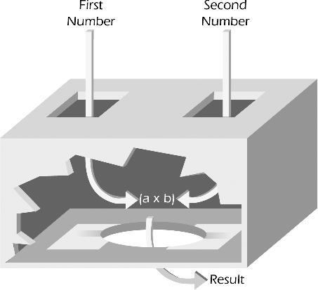
A Multiplying Function

Slide 47
Function Concept in Math
Function definition
f ( x ) = 5 x - 3
When x = 1, y = f(x)= 2 is the returned value.
When x = 4, y = f(x)= 17 is the returned value.
Returned value is determined by the function definition and by the values of any parameters.
Parameter of function
Name of function

Slide 48
The Function Header
In mathematics, the function header for our function, f(x) = 5x – 3 is:
y = f(x);
  // Semi-colon added for C++ style
If you’re given JUST the function header, how can you find out what the function does?
Start plugging in values for the argument/parameter x and see what values for y result:
  Make a table →
Black Box Testing is when you don’t have access to the function definition!
x | y = f(x)
1
2
3
4
5

Slide 49
What is a header? Function Signature
type of returned value
says no parameters
name of function
int main ( );

Slide 50
The Function Definition
The mathematical definition of the function y = f(x) is f(x) = 5x – 3
The C programmatic definition would be:
int f(x)
{
int y = 5*x – 3;
return y;
}
Function definition include function declaration and function body

Slide 51
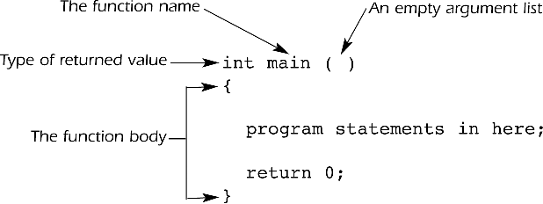
The Structure of a main() function
Structure of main()

Slide 52
The main() Function
Overall structure of a C program contains one function named main()
Often called the driver function
All other functions are invoked from main()
Function header line: the first line of a function, which contains
  The type of data returned by the function (if any)
  The name of the function
  The type of data that must be passed into the function when it is invoked (if any)
Arguments: the data passed into a function
Function body: the statements inside a function (enclosed in braces)

Slide 53
Back to main()
Each statement inside the function must be terminated with a semicolon
return: a keyword causing the appropriate value to be returned from the function
return 0 in the main() function causes the program to end

Slide 54
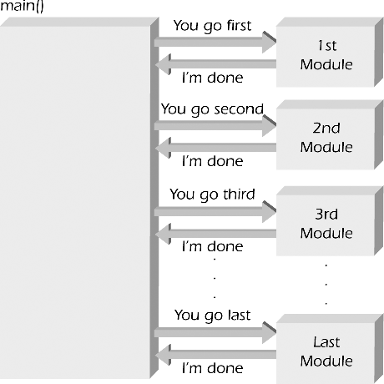
The main() function directs all other functions

Slide 55
OUTLINE of a Program with Several Functions:
When you are assigned a research paper, what’s the first thing you do?
You brainstorm and come up with an outline of the paper
Exactly the same way, this is an outline of a C program
  The modular approach, utilizing subroutines or functions, allows you to outline your program in advance, before you sit there and code all the detailed implementation
main() function
square() function
cube() function

Slide 56
A Program with Three Functions
#include <iostream>
int Square( int ); // declares these two
int Cube( int ); // value-returning functions
using namespace std ;
int main( )
{
cout << “The square of 3 is “
<< Square(3) << endl; // function call
cout << “The cube of 3 is “
<< Cube(3) << endl; // function call
return 0;
}

Slide 57
The Rest of the Program
int Square( int n ) {
return n * n;
}
int Cube( int n ) {
return n * n * n;
}
The square of 3 is 9
The cube of 3 is 27
Output of Program

Slide 58
What is a Good Solution?
A solution is good if:
  The total cost it incurs over all phases of its life cycle is minimal
The cost of a solution includes:
  Computer resources that the program consumes
  Difficulties encountered by users
  Consequences of a program that does not behave correctly
Programs must be well structured and documented
Efficiency is one aspect of a solution’s cost

Slide 59
Achieving a Modular Design
Abstraction
  Separates the purpose of a module from its implementation
  Specifications for each module are written before implementation
  Functional abstraction
    Separates the purpose of a function from its implementation
Data abstraction
  Focuses of the operations of data, not on the implementation of the operations
Abstract data type (ADT)
  A collection of data and operations on the data
  An ADT’s operations can be used without knowing how the operations are implemented, if the operations’ specifications are known
Data structure
  A construct that can be defined within a programming language to store a collection of data

Slide 60
Data
Variable
  the name given to a collection of memory cells, designed to store a particular data item
  the value stored in that variable may change or vary as the program executes
Constant
  a data item with a name and a value that remain the same during the execution of the program (e.g. 8, 10)
Literal
  a constant whose name is the written representation of its value (e.g. “8”, “10”)

Slide 61
Data type
Integers
  whole numbers
Real
  Numbers with a decimal point
  Two choices in VB: single and double
Character
Boolean
  True or False

Slide 62
Data Structures (also called data aggregates)
Record
  One set of related data
    A time card; an invoice
File
  A set of related records
Array
  A collection of data that have same data type
String
  An array of characters
    Hello Daniel Chen

Slide 63
Problems
Problem: a task to be performed.
  Best thought of as inputs and matching outputs.
  Problem definition should include constraints on the resources that may be consumed by any acceptable solution.
  But NO constraints on HOW the problem is solved

Slide 64
Resource (Space)
INPUTS
OUTPUT
Data Structure
ALGORITHM
Resource (Time)

Slide 65
Examples – Factors to Consider
Airline Reservations Trans-Fryslan Airlines
    Attempt 1:
    Declare as many variables as are the available seat and assign a value to each variable.
    → Horrible algorithms for the basic operations!
    Attempt 2:
    Declare an array of length equal to the Maximum seats available and then specify whether the seat is occupied or unoccupied.
  → Nice algorithms for the basic operations!
Tradeoff: simplicity of data organization ↔ simplicity/elegance of algorithms
Simple (unsophisticated data structure)
may require much work for processing data.
More complex data organization
may yield nicer algorithms for the basic operations

Slide 66
Examples - cont.

Slide 67
The Need for Data Structures
Goal: to organize data
Criteria: to facilitate efficient
  storage of data
  retrieval of data
  manipulation of data
Complex computing tasks are unlike our everyday experience
More complex applications demand more calculations, searching and sorting
More powerful computers?
⇒ more complex applications
Data structures organize data
⇒ more efficient programs.

Slide 68
Organizing Data
The choice of data structure and algorithm can make the difference between a program running in a few seconds or many days.
The selection of the correct data structure is the difference between success and failure.
Any organization and collection of records should be
  Searchable
  Processable, and
  modifiable in any order
If you are willing to pay enough in time delay
  Example: Simple unordered array of records.

Slide 69
Efficiency
The cost of a solution is the amount of resources that the solution consumes.
A solution is said to be efficient if it solves the problem within its resource constraints.
The resources are:
  Space
  Time
Alternate definition: Better than known alternatives (“relatively efficient”).
Space and time are typical constraints for programs.
This does not mean always strive for the most efficient program. If the program operates well within resource constraints, there is no benefit to making it faster or smaller
Notes:
This does not mean always strive for the most efficient program. If the program operates well within resource constraints, there is no benefit to making it faster or smaller.

Slide 70
Selecting a Data Structure
Select a data structure as follows:
Analyze the problem to determine the resource constraints a solution must meet.
Determine the basic operations that must be supported. Quantify the resource constraints for each operation.
Select the data structure that best meets these requirements.
Notes:
Typically want the “simplest” data structure that will meet the requirements.

Slide 71
Some Questions to Ask
Are all data inserted into the data structure at the beginning, or are insertions interspersed with other operations?
Can data be deleted?
  If data can be deleted, a more complex representation is typically required
Are all data processed in some well-defined order, or is random access allowed/required?
These questions often help to narrow the possibilities

Slide 72
Data Structure Philosophy
Each data structure has costs and benefits.
Rarely is one data structure better than another in all situations.
A data structure requires:
  space for each data item it stores,
  time to perform each basic operation,
  programming effort,
  debugging effort,
  maintenance effort.
Notes:
The space required includes data and overhead.
Some data structures/algorithms are more complicated than others.

Slide 73
Data Structure Philosophy (cont)
Each problem has constraints on available space and time.
Only after a careful analysis of problem characteristics can we know the best data structure for the task.
Bank example:
  Start account: a few minutes
  Transactions: a few seconds
  Close account: overnight

Slide 74
Abstract Data Types
Abstract Data Type (ADT): a definition for a data type solely in terms of a set of values and a set of operations on that data type.
Each ADT operation is defined by its inputs and outputs.
Encapsulation: Hide implementation details.

Slide 75
Abstract Data Types (Cont.)
Def.
a collection of related data items
together with
an associated set of operations
    e.g. whole numbers (integers) and arithmetic operators for addition, subtraction, multiplication and division.
    e.g. Flight reservation
    Basic operations: find empty seat, reserve a seat,
    cancel a seat assignment
    Why "abstract?"
    Data, operations, and relations are studied
    independent of implementation.
What not how is the focus.

Slide 76
Abstract Data Types (Cont.)
Def.
Consists of
    storage structures (aka data structures)
    to store the data items
    and
    algorithms for the basic operations.
The storage structures/data structures used in implementations are provided in a language (primitive or built-in) or are built from the language constructs (user-defined).
In either case, successful software design uses data abstraction:
Separating the definition of a data type from its implementation.

Slide 77
Data Structure
A data structure is the physical implementation of an ADT.
  Each operation associated with the ADT is implemented by one or more subroutines in the implementation.
Data structure usually refers to an organization of data in main memory.
File structure is an organization for data on peripheral storage, such as a disk drive.

Slide 78
ADT and Data Structure
Data Type
ADT:
  Type
  Operations
Data Items:
Logical Form
Data Structure:
  Storage Space
  Subroutines
Data Items:
Physical Form

Slide 79
Simple Data Types
    Memory:
    2-state devices ↔ bits 0 and 1
    Organized into bytes (8 bits) and
    words (machine dependent — e.g., 4 bytes).
    Each byte (or word) has an address making it possible to store and retrieve contents of any given memory location.
    Therefore:
    the most basic form of data: sequences of bits
    simple data types (values are atomic — can't be subdivided) are ADTs.
    Implementations have:
    » Storage structures: memory locations
    » Algorithms: system hardware/software to do basic operations.

Slide 80
Boolean data
Data values: {false, true}
In C/C++: false = 0, true = 1 (or nonzero)
Operations: and &&
or ||
not !
&& | 0 | 1
0 | 0 | 0
1 | 0 | 1
| | | 0 | 1
0 | 0 | 1
1 | 1 | 1
x !x
0 1
1 0

Slide 81




Character Data
Store numeric codes (ASCII, EBCDIC, Unicode)
1 byte for ASCII and EBCDIC,
2 bytes for Unicode
ASCII/EBCDIC
Unicode
,
Basic operation: comparison to determine if
Equal, Less than
Greater
than
, etc. use their numeric codes (i.e. use ordinal value)

Slide 82
Integer Data
Nonegative (unsigned) integer:
Store its base-two representation in a fixed number w of bits
    (e.g., w = 16 or w = 32)
88 =
0000000001011000₂
    Signed integer:
    Store in a fixed number w of bits using one of the following representations:

Slide 83
Sign-magnitude representation
Save one bit (usually most significant) for sign
(0 = +, 1 = – )
Use base-two representation in the other bits.
88 → _000000001011000
0
sign bit
↓
1
–88 → _000000001011000
Cumbersome for arithmetic computations

Slide 84
Two's complement representation
Same as
sign mag.
For nonnegative n:
Use ordinary base-two representation with leading (sign) bit 0
For negative n (–n):
(1) Find w-bit base-2 representation of n
(2) Complement each bit.
(3) Add 1
Example: –88
1. 88 as a 16-bit base-two number
(Flip all bits from rightmost 0 to the end)
0000000001011000
2. Complement this bit string
1111111110100111
3. Add 1
1111111110101000

Slide 85
Summary
Generation of Programming Languages
  Machine Language
  Assembly Language
  High Level Languages
Processing a Computer Program
  Stages of compilation, Interpreter
Procedural and modular programming
Structure of a C Program
Data and Data structure
Abstract Data Type (ADT)

