Slide 1
CSC 211
Data Structures
Lecture 28
Dr. Iftikhar Azim Niaz
ianiaz@comsats.edu.pk
1

Slide 2
Last Lecture Summary
Properties of Binary Trees
Types of Binary trees
  Expression Tree
  Threaded Binary Tree
  AVL Tree
  Red-Black
  Splay
Insertion and Deletion Operations
Time Complexity
B – trees
2

Slide 3
Objectives Overview
Graphs
Definition and Terminology
Representation of Graphs
  Array based
  Linked List
Common Operations on Graphs
Graph Traversals
  Breadth First Search (BSF)
  Depth First Search (DFS)

Slide 4
Graph
Abstract data type that is meant to implement the graph concept from mathematics
A graph data structure consists of a finite (and possibly mutable) set of ordered pairs, called edges or arcs, of certain entities called nodes or vertices
An edge (x, y) is said to point or go from x to y
The nodes may be part of the graph structure, or may be external entities represented by integer indices or references.
A graph data structure may also associate to each edge some edge value,
  such as a symbolic label or a numeric attribute (cost, capacity, length, etc.)

Slide 5
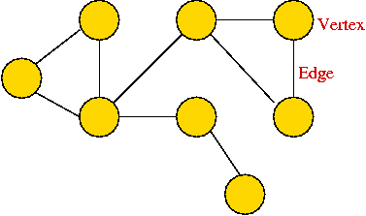
Graph - Terminology
Node or Vertex or Terminal or Endpoint
Edge or Arc or Link

Slide 6
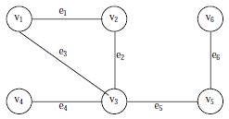
Graph - Example
Consider the following graph, G
Then the vertex V and edge E can be represented as:
V = {v1, v2, v3, v4, v5, v6} and E = {e1, e2, e3, e4, e5, e6}
E = {(v1, v2) (v2, v3) (v1, v3) (v3, v4),(v3, v5) (v5, v6)}
There are six edges and vertex in the graph

Slide 7
Graph Definition
A graph G consists of two sets
  a finite, nonempty set of vertices V(G)
  a finite, possible empty set of edges E(G)
  G(V, E) represents a graph
An undirected graph is one in which the pair of vertices in a edge is unordered, (v0, v1) = (v1,v0)
A directed graph is one in which each edge is a directed pair of vertices, <v0, v1> != <v1,v0>
tail
head
7

Slide 8
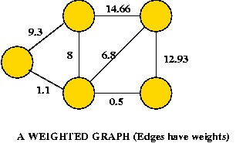
Graph Terminology
Graph is an ordered pair G = (V, E)
  V = set of vertices
  E = set of edges (2-element subset) ⊆ (V×V)
Types of graphs
  Undirected: edge (u, v) = (v, u); for all v, (v, v) ∉ E (No self loops.)
  Directed: (u, v) is edge from u to v, denoted as u → v. Self loops are allowed.
  Weighted: each edge has an associated weight, given by a weight function w : E → R.
  Dense: |E| ≈ |V|².
  Sparse: |E| << |V|².
|E| = O(|V|²)

Slide 9
Graph Terminology
Graph is an ordered pair G = (V, E)
  V = set of vertices
  E = set of edges (2-element subset) ⊆ (V×V)
The vertices belonging to an edge are called the ends, endpoints, or end vertices of the edge
A vertex may exist in a graph and not belong to an edge
V and E are usually taken to be finite
The order of a graph is |V| (the number of vertices)
A graph's size is |E|, the number of edges
The degree of a vertex is the number of edges that connect to it, where an edge that connects to the vertex at both ends (a loop) is counted twice

Slide 10
Graphs
If (u, v) ∈ E, then vertex v is adjacent to vertex u.
The edges E of an undirected graph G induce a symmetric binary relation ~ on V that is called the adjacency relation of G
  Specifically, for each edge {u, v} the vertices u and v are said to be adjacent to one another, which is denoted u ~ v
Adjacency relationship (~)is:
  Symmetric if G is undirected.
  Not necessarily so if G is directed.
If G is connected:
  There is a path between every pair of vertices.
  |E| ≥ |V| – 1.
  Furthermore, if |E| = |V| – 1, then G is a tree

Slide 11
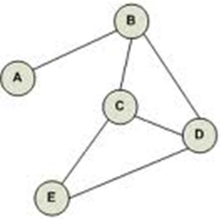
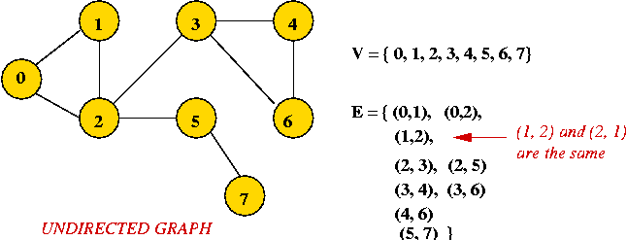
Undirected Graph
An undirected graph is one in which edges have no orientation
The edge (A, B) is identical to the edge (B, A)
i.e., they are not ordered pairs, but sets {u, v} (or 2-multisets) of vertices
(v0, v1) = (v1,v0)

Slide 12
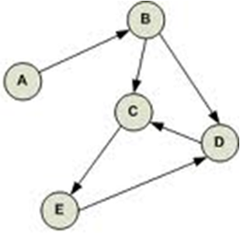
Directed Graph
A directed graph or digraph is an ordered pair D = (V, A) with
V, a set whose elements are called vertices or nodes, and
A, a set of ordered pairs of vertices, called arcs, directed edges, or arrows.
An arc a = (x, y) is considered to be directed from x to y
y is called the head and x is called the tail of the arc
y is said to be a direct successor of x, and x is said to be a direct predecessor of y
If a path leads from x to y, then
  y is said to be a successor of x and reachable from x, and
  x is said to be a predecessor of y.

Slide 13
Directed Graph - 2
The arc (y, x) is called the arc (x, y) inverted
A directed graph D is called symmetric if, for every arc in D, the corresponding inverted arc also belongs to D
A symmetric loopless directed graph D = (V, A) is equivalent to a simple undirected graph G = (V, E),
  where the pairs of inverse arcs in A correspond 1-to-1 with the edges in E;
  thus the edges in G number |E| = |A|/2, or half the number of arcs in D.

Slide 14
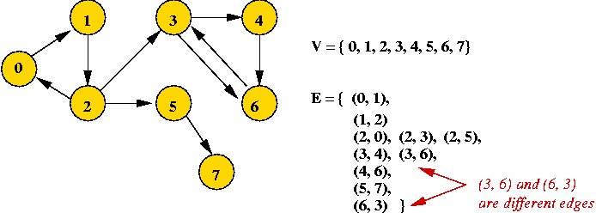
Directed Graph

Slide 15
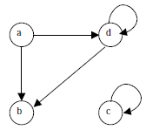
Directed Graph - Example
For example, following figure shows a directed graph, where G ={a, b, c, d }, E={(a, b), (a, d), (d, b), (d, d), (c, c)}
An edge (a, b), is said to be the incident with the vertices it joints, i.e., a, b
We can also say that the edge (a, b) is incident from a to b
The vertex a is called the initial vertex and the vertex b is called the terminal vertex of the edge (a, b)

Slide 16
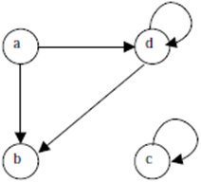
Directed Graph - Example
If an edge that is incident from and into the same vertex, say (d, d) or (c, c) in figure, is called a loop
Two vertices are said to be adjacent if they are joined by an edge
Consider edge (a, b), the vertex a is said to be adjacent to the vertex b, and the vertex b is said to be adjacent to vertex a
A vertex is said to be an isolated vertex if there is no edge incident with it
In this figure vertex C is an isolated vertex

Slide 17
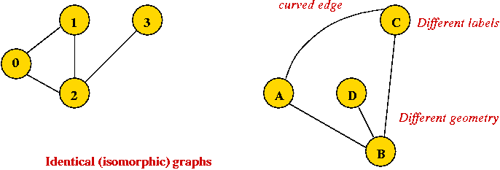
Identical Graph
Edges can be drawn "straight" or "curved”
Geometry of drawing has no particular meaning
Both figures represents the same identical graph

Slide 18


Sub-Graph
Let G = (V, E) be a graph
A graph G1 = (V1, E1) is said to be a sub-graph of G if E1 is a subset of E and V1 is a subset of V such that the edges in E1 are incident only with the vertices in V1
For example, Fig.(b) is a sub-graph of Fig. (a)
Fig (a)
Fig (b)

Slide 19

Spanning Sub-Graph
A sub-graph of G is said to be a spanning sub-graph if it contains all the vertices of G
For example Fig.(c) shows a spanning sub-graph of Fig.(a).
Fig (a)
Fig (c)

Slide 20
Degree of a Vertex
The number of edges incident on a vertex is its degree
The degree of vertex a, is written as degree (a)
If the degree of vertex a is zero, then vertex a is called isolated vertex
For example the degree of the vertex a in following figure is 3

Slide 21
Weighted Graph
A graph G is said to be weighted graph if every edge and/or vertices in the graph is assigned with some weight or value
A weighted graph can be defined as G = (V, E, We, Wv) where V is the set of vertices, E is the set of edges and We is a weight of the edges whose domain is E and Wv is a weight of the vertices whose domain is V

Slide 22
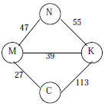
Weighted-Graph Example
Consider the following figure
Here V = {N, K, M, C,}
E = {(N, K), (N,M,), (M,K), (M,C), (K,C)}
We = {55,47, 39, 27, 113} and Wv = {N, K, M, C}
The weight of the vertices is not necessary as the set Wv and V are same

Slide 23
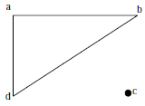
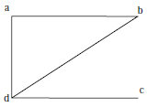
Connected and Disconnected Graph
An undirected graph is said to be connected if there exist a path from any vertex to any other vertex
Otherwise it is said to be disconnected
Fig. A shows the disconnected graph, where the vertex c is not connected to the graph
Fig. B shows the connected graph, where all the vertexes are connected

Slide 24
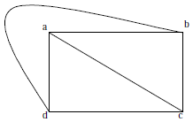
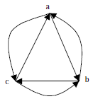
Complete Graph
A graph G is said to complete (or fully connected or strongly connected) if there is a path from every vertex to every other vertex
Let a and b are two vertices in the directed graph, then it is a complete graph if there is a path from a to b as well as a path from b to a
Fig X illustrates the complete undirected graph
Fig Y shows the complete directed graph
Fig X
Fig Y

Slide 25
Path and Cycle
A path in a graph is a sequence of vertices such that from each of its vertices there is an edge to the next vertex in the sequence
A path may be infinite
But a finite path always has
  a first vertex, called its start vertex, and
  a last vertex, called its end vertex
  Both of them are called terminal vertices of the path
  The other vertices in the path are internal vertices.
A cycle is a path such that the start vertex and end vertex are the same
  The choice of the start vertex in a cycle is arbitrary

Slide 26
Path and Cycle - 2
Same concepts apply both to undirected graphs and directed graphs
In directed graphs, the edges are being directed from each vertex to the following one
  Often the terms directed path and directed cycle are used in the directed case
A path with no repeated vertices is called a simple path, and
A cycle with no repeated vertices or edges aside from the necessary repetition of the start and end vertex is a simple cycle
The weight of a path in a weighted graph is the sum of the weights of the traversed edges
  Sometimes the words cost or length are used instead of weight

Slide 27
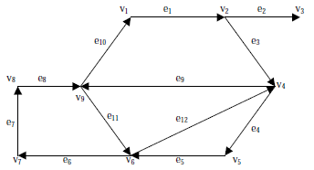
Elementary or Simple Path
In a directed graph, a path is a sequence of edges (e1, e2, e3, ...... en) such that the edges are connected with each other
A path is said to be elementary if it does not meet the same vertex twice
A path is said to be simple if it does not meet the same edges twice

Slide 28
Elementary or Simple Path - 2
Where (e1, e2, d3, e4, e5) is a path;
(e1, e3, e4, e5, e12, e9, e11, e6, e7, e8, e11) is a path but not a simple one;
(e1, e3, e4, e5, e6, e7, e8, e11, e12) is a simple path but not elementary one;
(e1, e3, e4, e5, e6, e7, e8) is an elementary path

Slide 29
Elementary or Simple Path - 3
A circuit is a path (e1, e2, .... en) in which terminal vertex of en coincides with initial vertex of e1
A circuit is said to be simple if it does not include (or visit) the same edge twice
A circuit is said to be elementary if it does not visit the same vertex twice
In above figure (e1, e3, e4, e5, e12, e9, e10) is a simple circuit but not a elementary one
(e1, e3, e4, e5, e6, e7, e8, e10) is an elementary circuit

Slide 30
Graph - Some Definitions
Degrees:
  Undirected graph: the degree of a vertex is the number of edges incident to it.
  Directed graph: the out-degree is the number of (directed) edges leading out, and the in-degree is the number of (directed) edges terminating at the vertex.
Neighbors:
  Two vertices are neighbors (or are adjacent) if there's an edge between them.
  Two edges are neighbors (or are adjacent) if they share a vertex as an endpoint.
Connectivity:
  Undirected graph : Two vertices are connected if there is a path that includes them.
  Directed graph: Two vertices are strongly-connected if there is a (directed) path from one to the other

Slide 31
Graph - Some Definitions
Components:
  A subgraph is a subset of vertices together with the edges from the original graph that connects vertices in the subset.
  Undirected graph : A connected component is a subgraph in which every pair of vertices is connected.
  Directed graph: A strongly-connected component is a subgraph in which every pair of vertices is strongly-connected.
  A maximal component is a connected component that is not a proper subset of another connected component

Slide 32
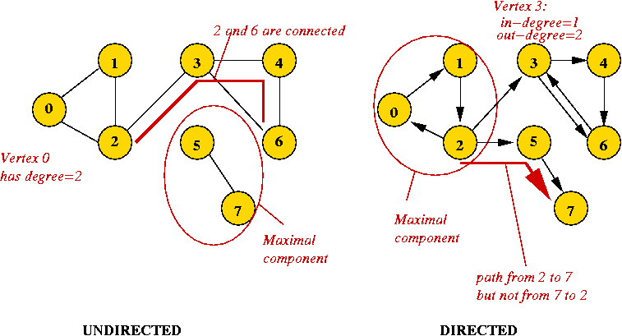
Graph - Some Definitions

Slide 33
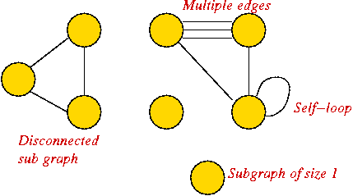
Graph Conventions
Self-loops (occasionally used).
Multiple edges between a pair of vertices (rare)
Disconnected pieces or sub graph (frequent in some applications)

Slide 34
Representation of Graphs
Two standard ways.
  Adjacency Lists.
  Adjacency Matrix.
a
b
a
b
d
c
b
a
c
c
d
c
d
a
b
d
a
c
1
2
1 2 3 4
1 0 1 1 1
2 1 0 1 0
3 1 1 0 1
4 1 0 1 0
a
b
c
d
3
4

Slide 35
Adjacency Lists
Consists of an array Adj of |V| lists.
One list per vertex.
For u ∈ V, Adj[u] consists of all vertices adjacent to u.
a
b
a
b
d
c
b
c
c
d
If weighted, store weights also in adjacency lists.
c
d
d
a
b
a
b
d
c
b
a
c
c
d
c
d
a
b
d
a
c

Slide 36
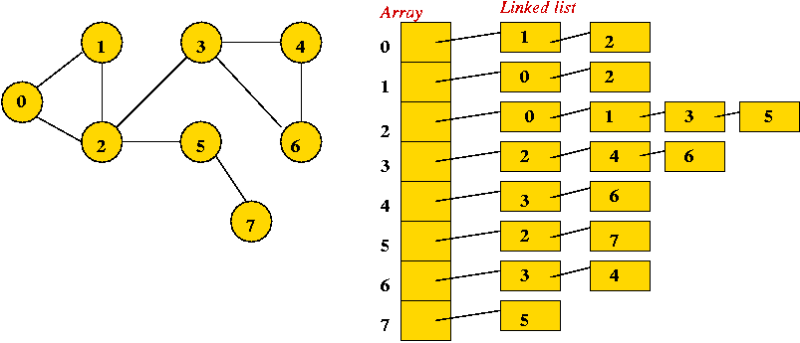
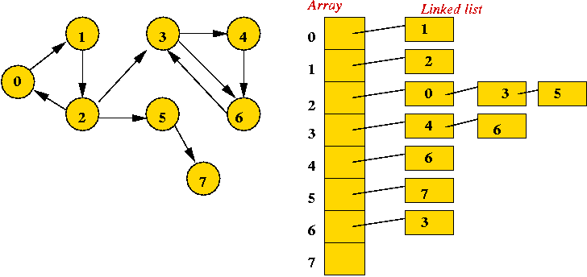
Adjacency List

Slide 37
Storage Requirement
For directed graphs:
  Sum of lengths of all adj. lists is
∑out-degree(v) = |E|
^{v∈V}
  Total storage: Θ(V+E)
For undirected graphs:
  Sum of lengths of all adj. lists is
∑degree(v) = 2|E|
^{v∈V}
  Total storage: Θ(V+E)
No. of edges leaving v
No. of edges incident on v. Edge (u,v) is incident on vertices u and v.

Slide 38
Pros and Cons: Adjacency List
Pros
  Space-efficient, when a graph is sparse (few edges).
  Easy to store additional information in the data structure.
  (e.g., vertex degree, edge weight)
  Can be modified to support many graph variants.
Cons
  Determining if an edge (u,v) ∈G is not efficient.
    Have to search in u’s adjacency list. Θ(degree(u)) time.
    Θ(V) in the worst case.

Slide 39
Adjacency Matrix
|V| × |V| matrix A.
Number vertices from 1 to |V| in some arbitrary manner.
A is then given by:
1
2
1 2 3 4
1 0 1 1 1
2 0 0 1 0
3 0 0 0 1
4 0 0 0 0
a
b
c
d
4
3
1
2
1 2 3 4
1 0 1 1 1
2 1 0 1 0
3 1 1 0 1
4 1 0 1 0
a
b
A = A^{T} (transpose)
for undirected graphs.
c
d
3
4

Slide 40
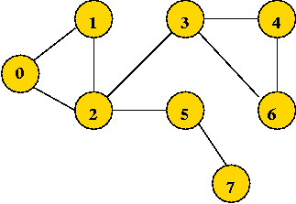
Adjacency Matrix - Undirected
use a 2D matrix
Row i has "neighbor" information about vertex i.
adjMatrix[i][j] = 1
  if and only if there's an edge between vertices i and j
adjMatrix[i][j] = 0 otherwise
adjMatrix[i][j] == adjMatrix[j][i] A = A^{T}
0 1 2 3 4 5 6 7
0 0 1 1 0 0 0 0 0
1 1 0 1 0 0 0 0 0
1 1 0 1 0 1 0 0
0 0 1 0 1 0 1 0
4 0 0 0 1 0 0 1 0
0 0 1 0 0 0 0 1
0 0 0 1 1 0 0 0
7 0 0 0 0 0 1 0 0

Slide 41
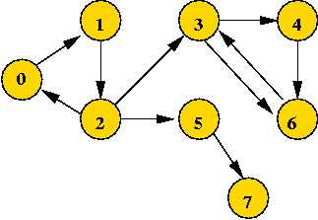
Adjacency Matrix - Directed
use a 2D matrix
Row i has "neighbor" information about vertex i.
adjMatrix[i][j] = 1
  if and only if there's an edge from vertices i to j
adjMatrix[i][j] = 0 otherwise
0 1 2 3 4 5 6 7
0 0 1 0 0 0 0 0 0
1 0 0 1 0 0 0 0 0
1 0 0 1 0 1 0 0
0 0 0 0 1 0 1 0
4 0 0 0 0 0 0 1 0
0 0 0 0 0 0 0 1
0 0 0 1 0 0 0 0
7 0 0 0 0 0 0 0 0

Slide 42
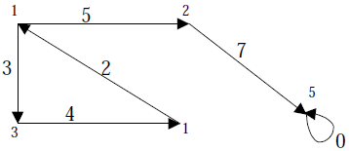
Adjacency Matrix – Weighted Graph
The weight of the edge (i, j) is simply stored as the entry in i th row and j th column of the adjacency matrix
There are some cases where zero can also be the possible weight of the edge,
Then we have to store some sentinel value for non-existent edge, which can be a negative value
Since weight of the edge is always a positive number

Slide 43
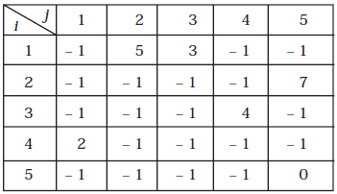
Adjacency Matrix – Weighted Graph
The adjacency matrix A for a directed weighted graph G = (V, E, We ) can be represented as:
Aij = Wij { if there is an edge from Vi to Vj then represent its weight Wij}
Aij = – 1 { if there is no edge from Vi to Vj}

Slide 44
Space and Time for Adjacency Matrix
Space: Θ(V²).
  Not memory efficient for large graphs.
Time: to list all vertices adjacent to u: Θ(V).
Time: to determine if (u, v) ∈ E: Θ(1).
Can store weights instead of bits for weighted graph
Advantages
  It is preferred if the graph is dense, that is the number of edges |E| is close to the number of vertices squared, |V|², or
  if one must be able to quickly look up if there is an edge connecting two vertices
  Simple to program

Slide 45
Representation of Graphs - List
Adjacency list
  Vertices are stored as records or objects, and every vertex stores a list of adjacent vertices
  Allows the storage of additional data on the vertices.
Incidence list
  Vertices and edges are stored as records or objects
  Each vertex stores its incident edges, and each edge stores its incident vertices
  Allows the storage of additional data on vertices and edges

Slide 46
Representation of Graphs - Array
Adjacency matrix
  A two-dimensional matrix, in which the rows represent source vertices and columns represent destination vertices
  Data on edges and vertices must be stored externally
  Only the cost for one edge can be stored between each pair of vertices.
Incidence matrix
  A two-dimensional Boolean matrix, in which the rows represent the vertices and columns represent the edges
  The entries indicate whether the vertex at a row is incident to the edge at a column.

Slide 47
Time Complexity of Graph Operations
 | Adjacency list | Incidence list | Adjacency matrix | Incidence matrix
Storage | O(|V| + |E|) | O(|V| + |E|) | O(|V|²) | O(|V| . |E|)
Add vertex | O(1) | O(1) | O(|V|²) | O(|V| . |E|)
Add edge | O(1) | O(1) | O(1) | O(|V| . |E|)
Remove vertex | O(|E|) | O(|E|) | O(|V|²) | O(|V| . |E|)
Remove edge | O(|E|) | O(|E|) | O(1) | O(|V| . |E|)
Query: are vertices u, v adjacent? | O(|V|) | O(|E|) | O(1) | O(|E|)
(Assuming that the storage positions for u, v are known)

Slide 48
Common Operations on Graphs
adjacent(G, x, y): tests whether there is an edge from node x to node y
neighbors(G, x): lists all nodes y such that there is an edge from x to y
add(G, x, y): adds to G the edge from x to y, if it is not there
delete(G, x, y): removes the edge from x to y, if it is there
get_node_value(G, x): returns the value associated with the node x
set_node_value(G, x, a): sets the value associated with the node x to a
Structures that associate values to the edges usually also provide:
get_edge_value(G, x, y): returns the value associated to the edge (x,y)
set_edge_value(G, x, y, v): sets the value associated to the edge (x,y) to v

Slide 49
Initialize Graph – Adjacency Matrix
int[ ][ ] adjMatrix; // pointer based adjMatrix
void initialize (int numVertices) {
adjMatrix = new int [numVertices][ ];
for (int i=0; i < numVertices; i++) {
adjMatrix[i] = new double [numVertices];
for (int j=0; j < numVertices; j++)
adjMatrix[i][j] = 0;
}
numEdges = 0
}
void add (int startVertex, int endVertex) {
adjMatrix[startVertex] [endVertex] = 1;
adjMatrix[endVertex] [startVertex] = 1; // Remove this for directed graphs
numEdges++;
}

Slide 50
Graph Search or Traversal
"Searching" here means "exploring" a particular graph.
Searching will help reveal properties of the graph
  e.g., is the graph connected?
Usually, the input is: vertex set and edges (in no particular order).
Two Techniques
Breadth First Search (BSF)
Depth First Search (DSF)

Slide 51
Breadth First Search - Undirected
Mark all vertices as "unvisited“
Initialize a queue (to empty)
Find an unvisited vertex and apply breadth-first search to it
In breadth-first search, add the vertex's neighbors to the queue
Repeat: extract a vertex from the queue, and add its "unvisited" neighbors to the queue

Slide 52
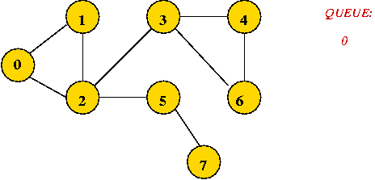

Breadth First Search – Trace (1)
Initially, place vertex 0 in the queue
Dequeue 0
=> mark it as visited, and add its unvisited neighbors to queue:

Slide 53
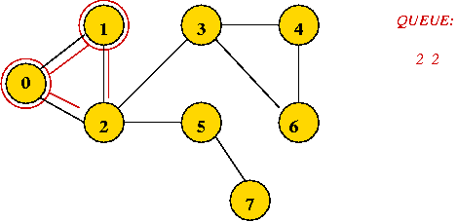
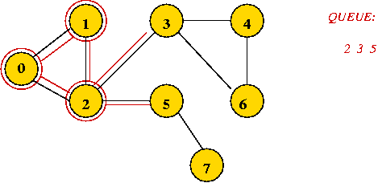
Breadth First Search – Trace (2)
Dequeue 1
=> mark it as visited, and add its unvisited neighbors to queue:
Dequeue 2
=> mark it as visited, and add its unvisited neighbors to queue:

Slide 54
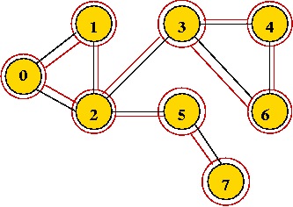
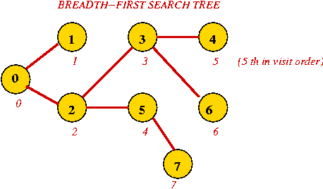
Breadth First Search – Trace (3)
Dequeue 2
=> it's already visited, so ignore.
Continuing ...

Slide 55
Breadth First Search - Algorithm
Algorithm: breadthFirstMatrix (adjMatrix, n)
Input: A graph's adjacency matrix, number of vertices n
// Visit order will start with "0", so initialize to -1
1. for i=0 to n-1
2. visitOrder[i] = -1
3. endfor
// A counter for the order:
4. visitCount = -1
// Standard queue data structure.
5. Create queue;
// Look for an unvisited vertex and explore its tree.
// We need this because the graph may have multiple components.
6. for i=0 to n-1
7. if visitOrder[i] < 0
// We call this "iterative" because other searches are recursive
8. breadthFirstMatrixIterative (i)
9. endif
10. endfor

Slide 56
Breadth First Search - Algorithm
Algorithm: breadthFirstMatrixIterative (u)
Input: vertex u, adjMatrix is assumed to be global
1. Clear queue; // Queue needs to be reset for each tree
2. queue.addToRear (u); // Place root of tree on the queue.
3. while queue not empty // Continue processing vertices until no more can be added
4. v = remove item at front of queue; // Remove a vertex
5. if visitOrder[v] < 0 // If it hasn't been visited ...
6. visitCount = visitCount + 1 // Visit the vertex.
7. visitOrder[v] = visitCount
8. for i=0 to n-1 // Look for neighbors to visit.
9. if adjMatrix[v][i] = 1 and i != v // Check self-loop: i != v
10. queue.addToRear (i)
11. endif
12. endfor
13. endif
14. endwhile

Slide 57
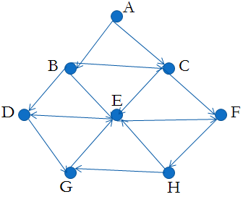
Breadth First Search (BFS)
Given an input graph G = (V, E) and a source vertex S from where the searching starts
The breadth first search systematically traverse the edges of G to explore every vertex that is reachable from S
Then examine all the vertices neighbor to source vertex S
Then traverse all the neighbors of the neighbors of source vertex S and so on
A queue is used to keep track of the progress of traversing the neighbor nodes
Suppose the source vertex is A

Slide 58
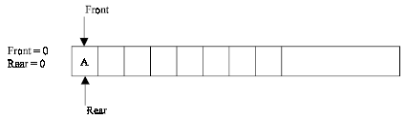
Breadth First Search (BFS)
Step 1: Initially push A (the source vertex) to the queue
Step 2: Dequeue (or remove) the front element A from the queue (by incrementing front =front +1) and display it
Then Enqueue (or add) the neighboring vertices of A to the queue, (by incrementing Rear = Rear +1) if it is not in queue

Slide 59
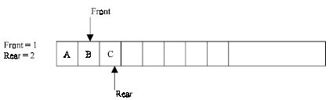
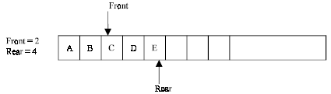
Breadth First Search (BFS)
Step 3: Dequeue the front element B from the queue and display it. Then add the neighboring vertices of B to the queue, if it is not in queue
One of the neighboring element C of B is preset in the queue, So C is not added to queue

Slide 60
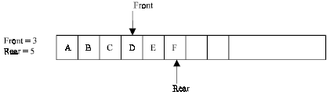
Breadth First Search (BFS)
Step 4: Remove the front element C and display it. Add the neighboring vertices of C, if it is not present in queue
One of the neighboring elements E of C is present in the queue, so E is not added

Slide 61
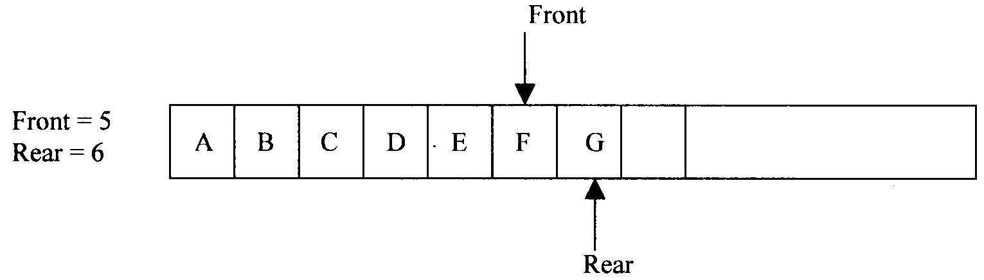
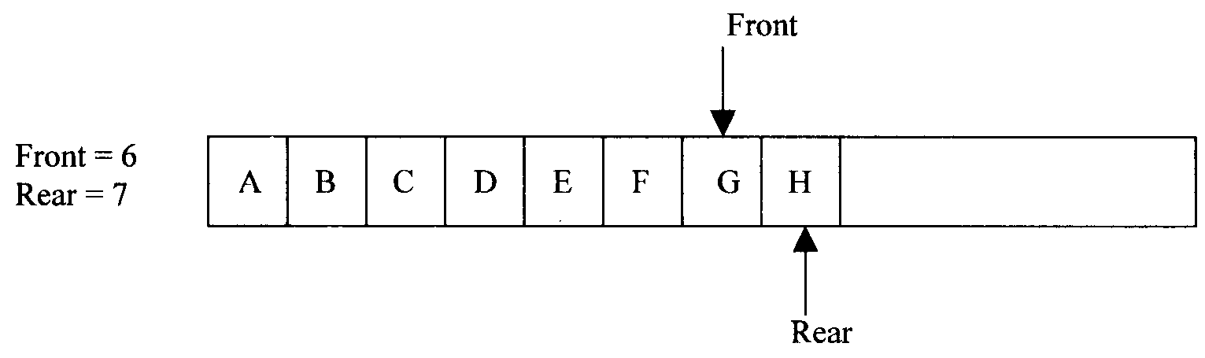
Breadth First Search (BFS)
Step 5: Remove the front element D, and add the neighboring vertex if it is not present in queue
Step 6: Again the process is repeated (until front>rear). Remove the front element E of the queue and add the neighboring vertex if it is not present in queue

Slide 62
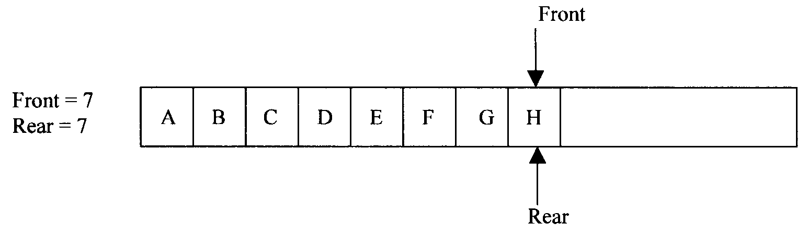
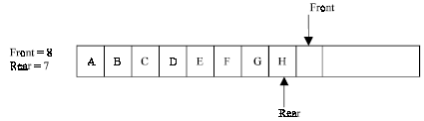
Breadth First Search (BFS)

Slide 63
Breadth First Search (BFS) - Algorithm
1. Input the vertices of the graph and its edges G = (V, E)
2. Input the source vertex and assign it to the variable S.
3. Enqueue or add the source vertex to the queue.
4. Repeat the steps 5 and 6 until the queue is empty (i.e., front > rear)
5. Dequeue the front element of the queue and display it as visited.
6. Enqueue the vertices, which is neighbor to just, popped element, if it is not in the queue and displayed (i.e., not visited).
7. Exit

Slide 64
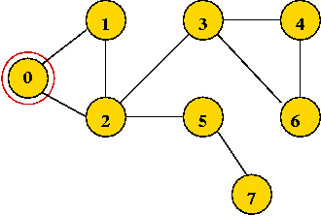
Depth First Search - Undirected Graph
Mark all vertices as "unvisited“
Visit first vertex
Recursively visit its "unvisited" neighbors.
Example: Start with vertex 0 and mark it visited.

Slide 65
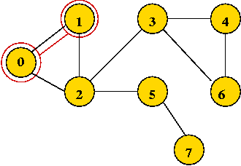
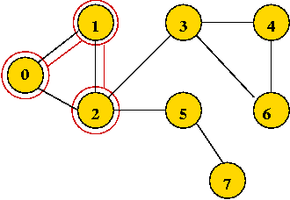
Depth First Search – Trace (1)
Visit the first neighbor 1, mark it visited.
Explore 1's first neighbor, 2.

Slide 66
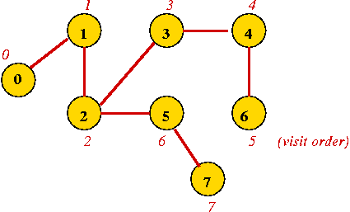
Depth First Search – Trace (2)
Continuing until all vertices are visited ...
Vertices are marked in order of visit.
An edge to an unvisited neighbor that gets visited next is in the depth-first search tree

Slide 67
Depth First Search - Algorithm
Algorithm: depthFirstMatrix (adjMatrix, n)
Input: A graph's adjacency matrix, number of vertices n
// Visit order will start with "0", so initialize to -1
1. for i=0 to n-1
2. visitOrder[i] = -1
3. endfor
// A counter for the order:
4. visitCount = -1
// Look for an unvisited vertex and explore its tree.
// We need this because the graph may have multiple components.
5. for i=0 to n-1
6. if visitOrder[i] < 0
7. depthFirstMatrixRecursive (i)
8. endif
9. endfor

Slide 68
Depth First Search - Algorithm
Algorithm: depthFirstMatrixRecursive (v)
Input: vertex v, adjMatrix is assumed to be global
// Mark vertex v as visited
1. visitCount = visitCount + 1Clear queue;
2. visitOrder[v] = visitCount;
// Look for first unvisited neighbour
3. for i=0 to n-1
4. if adjMatrix[v][i] > 1 and i != v
5. If visitOrder[i] < 0
// If unvisited visit recursively
6. depthFirstMatrixRecursive(i)
7. endif
8. endif
9. endfor

Slide 69
Depth First Search
The Depth First Search (DFS), as its name suggest, is to search deeper in the graph, when ever possible
Given an input graph G = (V, E) and a source vertex S, from where the searching starts
First we visit the starting node
Then we travel through each node along a path, which begins at S
That is we visit a neighbor vertex of S and again a neighbor of a neighbor of S, and so on
The implementation of DFS is almost same except a stack is used instead of the queue

Slide 70
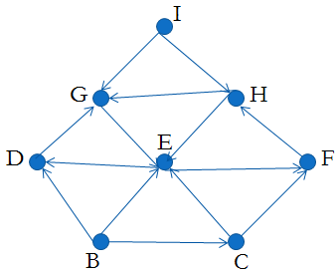
Depth First Search - Example
Suppose the source vertex is I

Slide 71
Depth First Search - Example
Step 1: Initially push I on to the stack.
  STACK: I
  DISPLAY:
Step 2: Pop and display the top element, and then push all the neighbors of popped element (i.e., I) onto the stack
  STACK: G, H
  DISPLAY: I
Step 3: Pop and display the top element and then push all the neighbors of popped the element (i.e., H) onto top of the stack, if it is not visited

Slide 72
Depth First Search - Example
  STACK: G, E
  DISPLAY: I, H
The popped element H has two neighbors E and G. G is already visited, means G is either in the stack or displayed
Here G is in the stack, so only E is pushed onto the top of the stack
Step 4: Pop and display the top element of the stack.
Push all the neighbors of the popped element on to the stack, if it is not visited
  STACK: G, D, F
  DISPLAY: I, H, E

Slide 73
Depth First Search - Example
Step 5: Pop and display the top element of the stack
Push all the neighbors of the popped element onto the stack, if it is not visited.
  STACK: G, D
  DISPLAY: I, H, E, F
The popped element (or vertex) F has neighbor(s) H, which is already visited
Then H is displayed, and will not be pushed again on to the stack

Slide 74
Depth First Search - Example
Step 6: The process is repeated as follows.
  STACK: G
  DISPLAY: I, H, E, F, D
  STACK: //now the stack is empty
  DISPLAY: I, H, E, F, D, G
So I, H, E, F, D, G is the DFS traversal of graph from the source vertex I

Slide 75



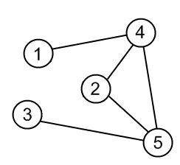
Depth First Search – Example Trace
In DFS, each vertex has three possible colors representing its state:
white: vertex is unvisited;
gray: vertex is in progress
black: DFS has finished processing the vertex.
Consider this source Graph

Slide 76
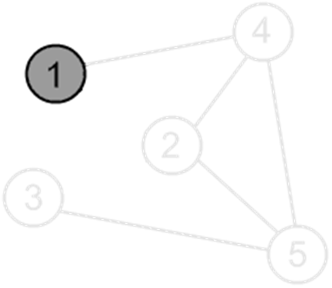
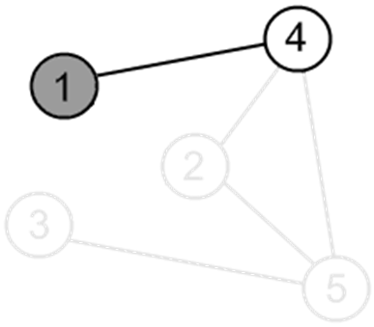
Depth First Search – Example Trace
Mark a vertex 1 as visited.
Print the vertex.
There is an edge (1, 4) and a vertex 4 is unvisited. Go there.

Slide 77
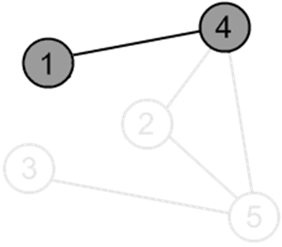
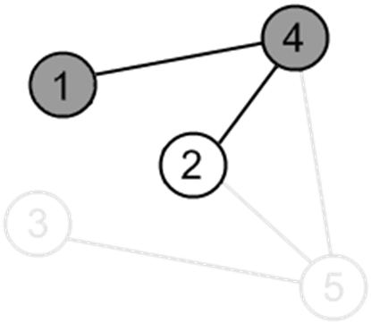
Depth First Search – Example Trace
Mark a vertex 4 as visited.
Print the vertex.
There is an edge (4, 2) and a vertex 2 is unvisited. Go there.

Slide 78
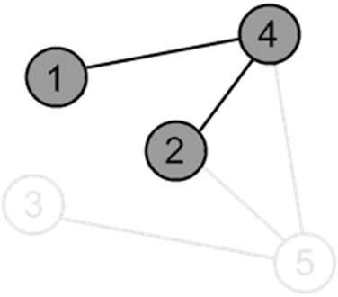
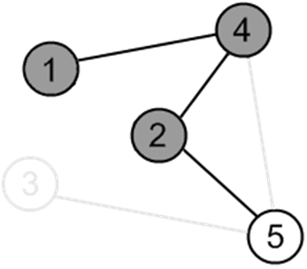
Depth First Search – Example Trace
Mark a vertex 2 as visited.
Print the vertex.
There is an edge (2, 5) and a vertex 5 is unvisited. Go there.

Slide 79


Depth First Search – Example Trace
Mark a vertex 5 as visited.
Print the vertex.
There is an edge (5, 3) and a vertex 3 is unvisited. Go there.

Slide 80


Depth First Search – Example Trace
Mark a vertex 3 as visited.
Print the vertex.
There are no ways to go from the vertex 3.
So, backtrack to the vertex 5 to check other adjacent vertices of the vertex 5

Slide 81


Depth First Search – Example Trace
There is an edge (5, 4), but the vertex 4 is already visited.
So do not go to the vertex 4. Continue with other adjacent vertices of vertex 5.
There are no ways to go from the vertex 5.
So, backtrack to the vertex 2 to check other adjacent vertices of the vertex 2.

Slide 82


Depth First Search – Example Trace
There are no more edges, adjacent to vertex 2. So, backtrack to the vertex 4 to check other adjacent vertices of the vertex 4
There is an edge (4, 5), but the vertex 5 is already visited. So do not go to the vertex 5. Continue with other adjacent vertices of vertex 4.

Slide 83


Depth First Search – Example Trace
There are no more edges, adjacent to the vertex 4. So, backtrack to the vertex 1 to check other adjacent vertices of the vertex 1
There are no more edges, adjacent to the vertex 1.
DFS is over.

Slide 84
Depth First Traversal
A depth first traversal method tends to traverse very long, narrow trees;
whereas breadth first traversal method tends to traverse very wide, short trees.

Slide 85
Summary
Graphs
Definition and Terminology
Representation of Graphs
  Array based
  Linked List
Common Operations on Graphs
Graph Traversals
  Breadth First Search (BSF)
  Depth First Search (DFS)

