Slide 1
CSC 211
Data Structures
Lecture 26
Dr. Iftikhar Azim Niaz
ianiaz@comsats.edu.pk
1

Slide 2
Last Lecture Summary
Operations on Binary Tree
Binary Tree Traversal
  InOrder, PreOrder and PostOrder
Binary Search Tree (BST)
  Concept and Example
BST Operations
  Minimum and Maximum
  Successor and Predecessor
  BST Traversing
    InOrder, PreOrder and PostOrder
  Insertion and Deletion
2

Slide 3
Objectives Overview
Complete Binary Tree
Heaps
  Min-Heap and Max-Heap
Heap Operations
  Insertion and Deletion
Applications of Heaps
Priority Queue
Heap Sort
  Concept , Algorithm and Example Trace
  Complexity of Heap Sort
  Comparison with Quick and Merge Sort

Slide 4
Complete Binary Tree
A complete binary tree is a tree that is completely filled, with the possible exception of the bottom level.
The bottom level is filled from left to right.
A
B
C
D
E
F
G
H
I
J
4

Slide 5
Complete Binary Tree
Recall that such a tree of height h has between 2^{h} to 2^{h+1} –1 nodes.
The height of such a tree is thus log₂N where N is the number of nodes in the tree.
Because the tree is so regular, it can be stored in an array; no pointers are necessary.
For any array element at position i,
  the left child is at 2i,
  the right child is at (2i +1) and
  the parent is at i / 2
A
B
C
D
E
F
G
H
I
J
0
1
2
3
4
5
6
7
8
9
10
11
12
13
14

Slide 6
Complete Binary Tree
Recall that such a tree of height h has between 2^{h} to 2^{h+1} –1 nodes.
The height of such a tree is thus log₂N where N is the number of nodes in the tree.
Because the tree is so regular, it can be stored in an array; no pointers are necessary.
For any array element at position i,
  the left child is at 2i,
  the right child is at (2i +1) and
  the parent is at i / 2
A
B
C
D
E
F
G
H
I
J
0
1
2
3
4
5
6
7
8
9
10
11
12
13
14

Slide 7
Complete Binary Tree
1
A
2
3
B
C
4
5
6
7
D
E
F
G
8
9
10
H
I
J
A
B
C
D
E
F
G
H
I
J
0
1
2
3
4
5
6
7
8
9
10
11
12
13
14
Level-order numbers = array index

Slide 8
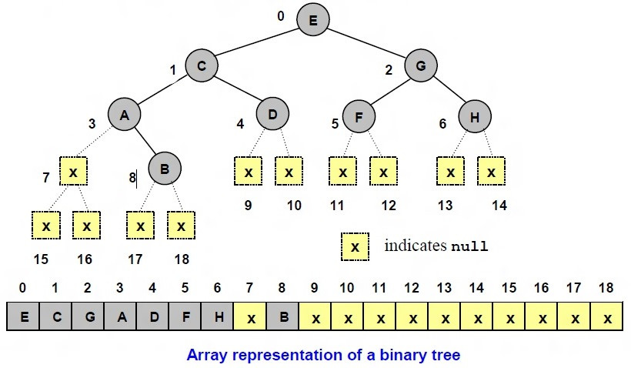
Array Representation – Binary Tree
If start of tree from index 0 then for node i
Left child 2i + 1 and Right child = 2i + 2
Parent of node i is at (i – 1) /2

Slide 9
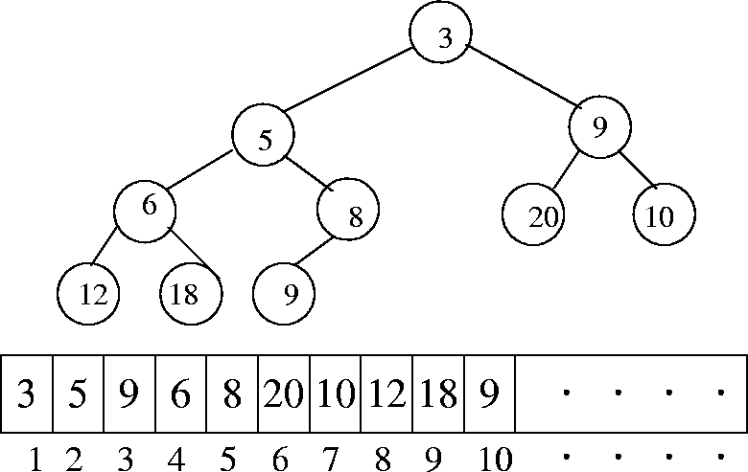
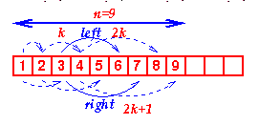
Array Representation of Binary Tree
For any array element at position i,
  the left child is at 2i,
  the right child is at (2i +1) and
  the parent is at i / 2

Slide 10
Heaps
Application of Almost complete binary tree
  All levels are full, except the last one, which is left-filled
A heap is a specialized tree-based data structure that satisfies the heap property:
If A is a parent node of B then key(A) is ordered with respect to key(B) with the same ordering applying across the heap
  Either the keys of parent nodes are always greater than or equal to those of the children and the highest key is in the root node (this kind of heap is called max heap) or
  The keys of parent nodes are less than or equal to those of the children (min heap).

Slide 11
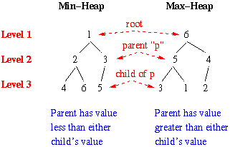
Heaps
A Min-heap is an almost complete binary tree where
  Every node holds a data value (or key)
  The key of every node is ≤ the keys of the children
A Max-heap has the same definition except that the
  The key of every node is ≥ the keys of the children

Slide 12
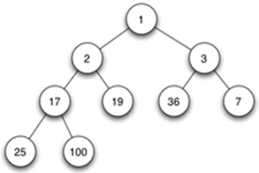
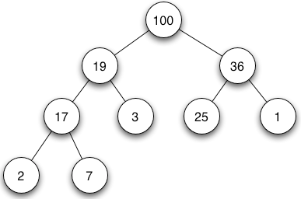
Heaps–Example
There is no implied ordering between siblings or cousins and
No implied sequence for an in-order traversal (as there would be in, e.g., a binary search tree).
The heap relation mentioned above applies only between nodes and their immediate parents.
Min-heap
Max-heap

Slide 13
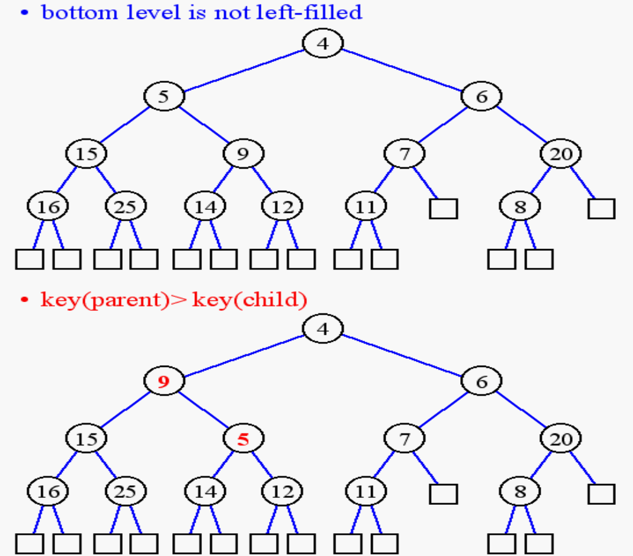
Heap or Not a Heap?

Slide 14
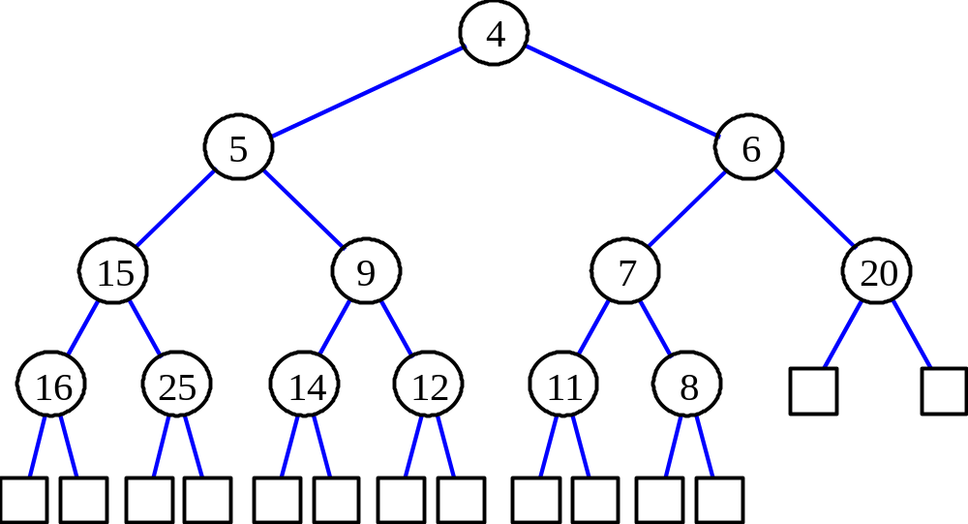
Heap Properties
A heap T storing n keys has height h = ⎣log(n + 1)⎦, which is O(log n)

Slide 15
Applications of Heaps Operation
A priority queue (with min-heaps),
  that orders entities not a on first-come first-serve basis, but on a priority basis: the item of highest priority is at the head, and the item of the lowest priority is at the tail
Heap Sort, which will be seen later
  One of the best sorting methods being in-place and with no quadratic worst-case scenarios
Selection algorithms:
  Finding the min, max, both the min and max, median, or even the k-th largest element can be done in linear time (often constant time) using heaps
Graph algorithms:
  By using heaps as internal traversal data structures, run time will be reduced by polynomial order.

Slide 16
Common Operations on Heaps
create-heap: create an empty heap
(a variant) create-heap: create a heap out of given array of elements
find-max or find-min: find the maximum item of a max-heap or a minimum item of a min-heap, respectively
delete-max or delete-min: removing the root node of a max- or min-heap, respectively
increase-key or decrease-key: updating a key within a max- or min-heap, respectively
insert: adding a new key to the heap
merge: joining two heaps to form a valid new heap containing all the elements of both

Slide 17
Heaps Operation in MinHeap
Insert a new data value
Delete the minimum value and return it. This operation is called deleteMin

Slide 18
Inserting into a Min-Heap
Suppose you want to insert a new value x into the heap
Create a new node at the “end” of the heap (or put x at the end of the array)
If x is >= its parent, done
Otherwise, we have to restore the heap:
  Repeatedly swap x with its parent until either x reaches the root of x becomes >= its parent

Slide 19
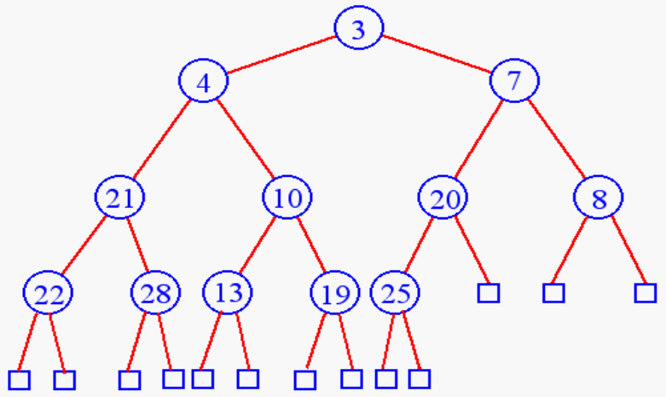
Heap Insertion
Insert 6

Slide 20
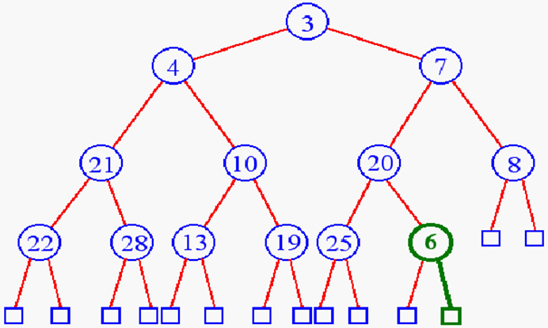
Heap Insertion
Add key (6) in next available position in the heap i.e. new leaf

Slide 21
Restore Heap
If key >= parent done else restore the heap
To bring the structure back to its “heapness”, we restore the heap
Swap the new root key with the smaller child
Now the potential bug is at the one level down If it is not already ≤ the keys of its children, swap it with its smaller child
Keep repeating the last step until the “bug” key becomes ≤ its children, or the it becomes a leaf

Slide 22
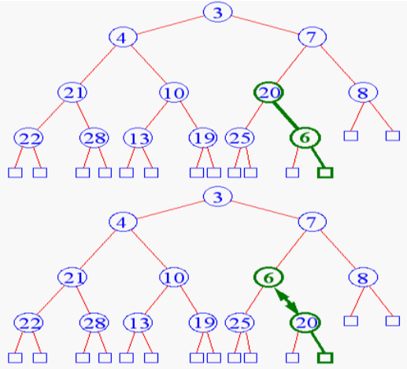
Heap Insertion
Restore the heap

Slide 23
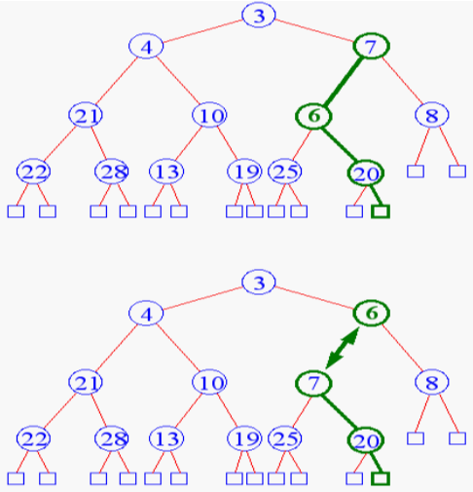
Heap Insertion
Restore the heap

Slide 24
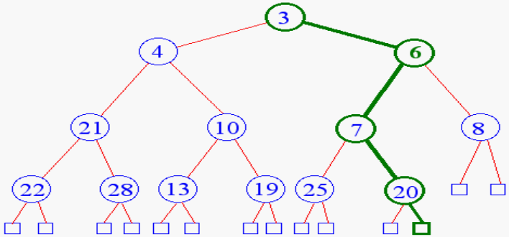
Heap Insertion
Terminate restore heap when
  Reach root node or
  Key child is greater than key parent

Slide 25
DeleteMin in Min-heaps
The minimum value in a min-heap is at the root!
To delete the min, you can’t just remove the data value of the root, because every node must hold a key
Instead, take the last node from the heap, move its key to the root, and delete that last node
But now, the tree is no longer a heap (still almost complete, but the root key value may no longer be ≤ the keys of its children

Slide 26
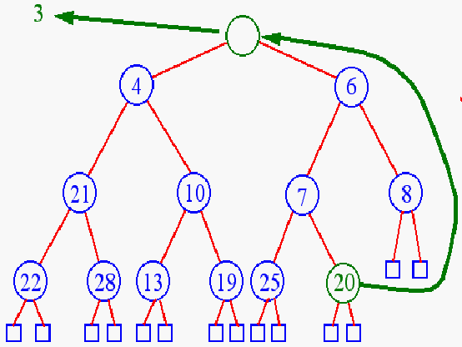
Heap Removal – deleteMin
Take the last node from the heap, move its key to the root, and delete that last node

Slide 27
Restore Heap
To bring the structure back to its “heapness”, we restore the heap
Swap the new root key with the smaller child
Now the potential bug is at the one level down. If it is not already ≤ the keys of its children, swap it with its smaller child
Keep repeating the last step until the “bug” key becomes ≤ its children, or the it becomes a leaf

Slide 28
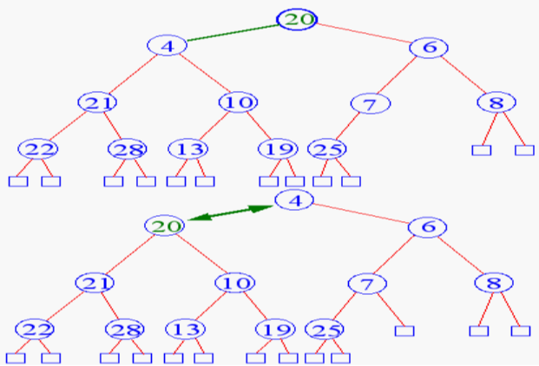
Heap Removal - deleteMin
Restore the heap – begin downheap

Slide 29
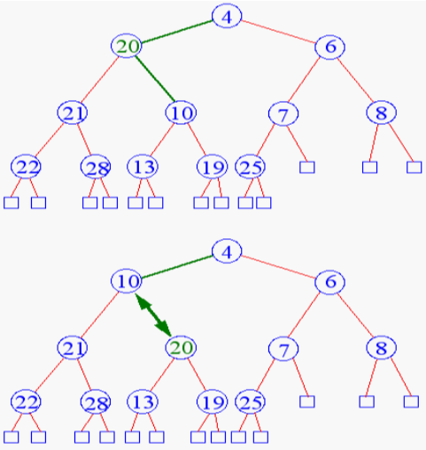
Heap Removal - deleteMin
Restore the heap

Slide 30
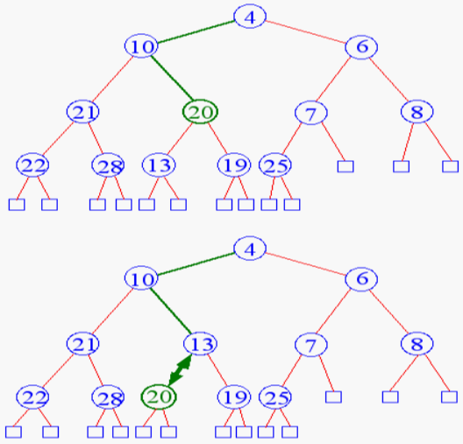
Heap Removal - deleteMin
Restore the heap

Slide 31
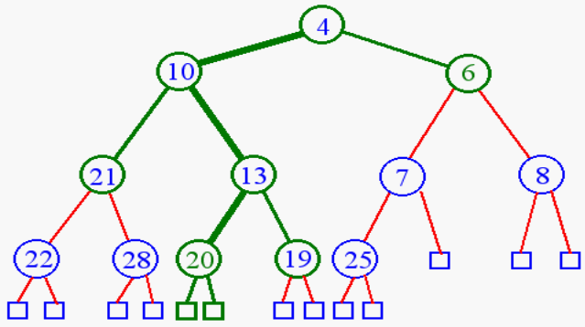
Heap Removal - deleteMin
Terminate downheap when
  reach leaf level
  key parent is greater than key child

Slide 32
Time complexity of Insert and deleteMin
Both operations takes time proportional to the height of the tree
  When restoring the heap, the bug moves from level to level until, in the worst case, it becomes a leaf (in deletemin) or the root (in insert)
  Each move to a new level takes constant time
  Therefore, the time is proportional to the number of levels, which is the height of the tree.
But the height is O(log n)
Therefore, both insert and deleteMin take O(log n) time, which is very fast

Slide 33
Implementing Code – MinHeap (1)
#include<stdio.h> #include<limits.h>
/*Declaring heap globally so that we do not need to pass it as an argument every time. Heap implemented here is Min Heap */
int heap[1000], heapSize;
void Init() { /*Initialize Heap*/
heapSize = 0;
heap[0] = -INT_MAX;
}
void Insert(int element) { /*Insert an element into the heap */
heapSize++;
heap[heapSize] = element; /*Insert in the last place*/
/*Adjust its position*/
int now = heapSize;
while(heap[now/2] > element) {
heap[now] = heap[now/2];
now /= 2; }
heap[now] = element;
}
2^{k}-1=n ==> k=⎡log₂(n+1)⎤
O(log₂n)

Slide 34
Implementing Code – MinHeap (2)
int DeleteMin() {
/* heap[1] is the minimum element. So we remove heap[1].
Size of the heap is decreased. Now heap[1] has to be filled.
We put the last element in its place and see if it fits.
If it does not fit, take minimum element among both its children and replaces parent with it.
Again See if the last element fits in that place. */
int minElement, lastElement, child, now; /*declaring local variables */
minElement = heap[1];
lastElement = heap[heapSize--];
/* now refers to the index at which we are now */
for(now = 1; now*2 <= heapSize ;now = child) {
/* child is the index of the element which is minimum among both the children . indexes of children are i*2 and i*2 + 1*/
child = now*2;

Slide 35
Implementing Code – MinHeap (3)
/*child != heapSize because heap[heapSize+1] does not exist, which means it has only one child */
if(child != heapSize && heap[child+1] < heap[child] ) {
child++;
}
/* To check if the last element fits or not it suffices to check if the last element is less than the minimum element among both the children*/
if(lastElement > heap[child]) {
heap[now] = heap[child];
}
else { /* It fits there */
break;
}
} /* end of For loop */
heap[now] = lastElement;
return minElement;
} /* end of function DeleteMin() */

Slide 36
Implementing Code – MinHeap (4)
int main() /* Main Program */
{
int number_of_elements;
scanf("%d",&number_of_elements);
int iter, element;
Init();
for(iter = 0;iter < number_of_elements;iter++)
{
scanf("%d",&element);
Insert(element);
}
for(iter = 0;iter < number_of_elements;iter++)
{
printf("%d ",DeleteMin());
}
printf("\n");
return 0;
}

Slide 37
Time Complexities for Min-Heap
Operation | Time Complexity
FindMin | O(1)
DeleteMin | O(log n)
Insert | O(log n)
decreaseKey | O(log n)
Merge | O(n)

Slide 38
Priority Queue
is an ADT which is like a regular queue or stack data structure, but where additionally each element has a "priority" associated with it
In a priority queue
  an element with high priority is served before an element with low priority
  If two elements have the same priority, they are served according to their order in the queue
It is a common misconception that a priority queue is a heap
A priority queue is an abstract concept like "a list" or "a map";
  just as a list can be implemented with a linked list or an array
  Priority queue can be implemented with a heap or a variety of other methods

Slide 39
Priority Queue - Operations
must at least support the following operations
insert_with_priority: add an element to the queue with an associated priority
pull_highest_priority_element: remove the element from the queue that has the highest priority, and return it (also known as "pop_element(Off)“
  "get_maximum_element” or get_front(most)_element”
  some conventions consider lower priorities to be higher, so this may also be known as "get_minimum_element", and is often referred to as "get-min" in the literature

Slide 40
Priority Queue – Operations 2
literature also sometimes implement separate "peek_at_highest_priority_element" and "delete_element" functions, which can be combined to produce "pull_highest_priority_element“
More advanced implementations may support more complicated operations, such as pull_lowest_priority_element, inspecting the first few highest- or lowest-priority elements
peeking at the highest priority element can be made O(1) time in nearly all implementations
Clearing the queue, Clearing subsets of the queue, performing a batch insert, merging two or more queues into one, incrementing priority of any element, etc

Slide 41
Priority Queue – Similarities to Queues
One can imagine a priority queue as a modified queue
  but when one would get the next element off the queue, the highest-priority element is retrieved first.
Stacks and queues may be modeled as particular kinds of priority queues
In a stack (LIFO), the priority of each inserted element is monotonically increasing;
  thus, the last element inserted is always the first retrieved
In a queue (FIFO), the priority of each inserted element is monotonically decreasing;
  thus, the first element inserted is always the first retrieved

Slide 42
Priority Queue –Implemented as Heap
To improve performance, priority queues typically use a heap as their backbone
  giving O(log n) performance for inserts and removals, and O(n) to build initially
Binary heap uses O(log n) time for both operations, but also allow queries of the element of highest priority without removing it in constant time O(1)
The semantics of priority queues naturally suggest a sorting method:
  insert all the elements to be sorted into a priority queue, and sequentially remove them; they will come out in sorted order
  Heap sort if the priority queue is implemented with a heap
  Selection sort if the priority queue is implemented with an unordered array
  Insertion sort if the priority queue is implemented with an ordered array

Slide 43
Heap Sort
Heap sort is a comparison-based sorting algorithm to create a sorted array (or list)
It is part of the selection sort family.
It is an in-place algorithm, but is not a stable sort
Although somewhat slower in practice on most machines than a well-implemented quicksort,
it has the advantage of a more favorable worst-case O(n log n) runtime

Slide 44
Heap Sort – Two Step Process
Step 1: Build a heap out of data
Step 2:
  Begins with removing the largest element from the heap
  We insert the removed element into the sorted array
  For the first element, this would be position 0 of the array
  Next we reconstruct the heap and remove the next largest item, and insert it into the array
  After we have removed all the objects from the heap, we have a sorted array
  We can vary the direction of the sorted elements by choosing a min-heap or max-heap in step one

Slide 45
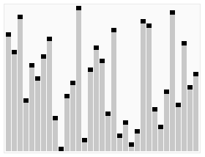
Heap Sort - Animation
A run of the heapsort algorithm sorting an array of randomly permuted values
In the first stage of the algorithm the array elements are reordered to satisfy the heap property
Before the actual sorting takes place, the heap tree structure is shown briefly for illustration

Slide 46
Heap Sort
Heap sort can be performed in place
The array can be split into two parts
  sorted array and
  heap.
The storage of heaps as arrays is diagrammed earlier (starting from subscript 0)
  Left child 2i +1 and Right child at 2i + 2
  Parent node at 2i - 1
The heap's invariant is preserved after each extraction, so the only cost is that of extraction

Slide 47
Heap Sort - Algorithm (1)
Arrays are zero-based i.e. index starts at 0
Swap is used to exchange two elements of the array
Movement 'down' means from the root towards the leaves, or from lower indices to higher
During the sort the largest element is at the root of the heap at a[0]
while at the end of the sort, the largest element is in a[end]

Slide 48
Heap Sort - Algorithm (2)
function heapSort(a, count) is
input: an unordered array a of length count
(first place a in max-heap order)
heapify(a, count)
end := count-1 //in languages with zero-based arrays the children are 2*i+1 and 2*i+2
while end > 0 do
(swap the root(maximum value) of the heap with the last element of the heap)
swap(a[end], a[0])
(decrease the size of the heap by one so that the previous max value will stay in its proper placement)
end := end - 1
(put the heap back in max-heap order)
siftDown(a, 0, end)
end-while

Slide 49
Heap Sort - Algorithm (3)
function heapify(a, count) is
(start is assigned the index in a of the last parent node)
start := (count - 2) / 2
while start ≥ 0 do
(sift down the node at index start to the proper place such that all nodes below the start index are in heap order)
siftDown(a, start, count-1)
start := start - 1
(after sifting down the root all nodes/elements are in heap order)
end-while
The heapify function can be thought of as building a heap from the bottom up, successively shifting downward to establish the heap property

Slide 50
Heap Sort - Algorithm (4)
function siftDown(a, start, end) is
input: end represents the limit of how far down the heap to sift.
root := start
while root * 2 + 1 ≤ end do (While the root has at least one child)
child := root * 2 + 1 (root*2 + 1 points to the left child)
swap := root (keeps track of child to swap with)
if a[swap] < a[child] (check if root is smaller than left child)
swap := child
(check if right child exists, and if it's bigger what we're currently swapping with )
if child+1 ≤ end and a[swap] < a[child+1]
swap := child + 1
if swap != root (check if we need to swap at all)
swap(a[root], a[swap])
root := swap (repeat to continue sifting down the child now)
else
return
end-while

Slide 51
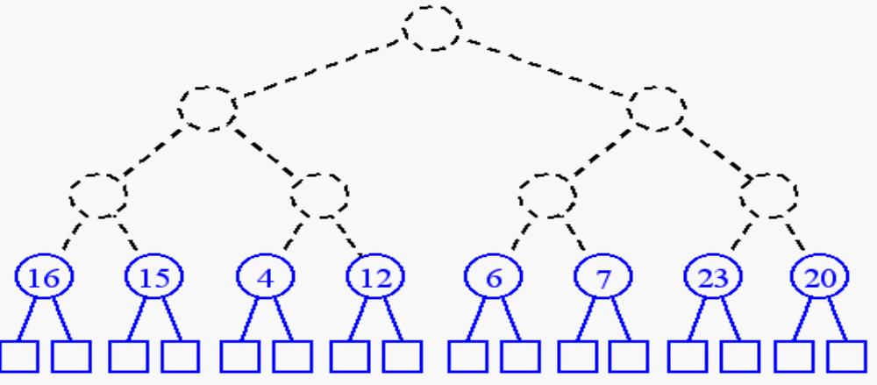
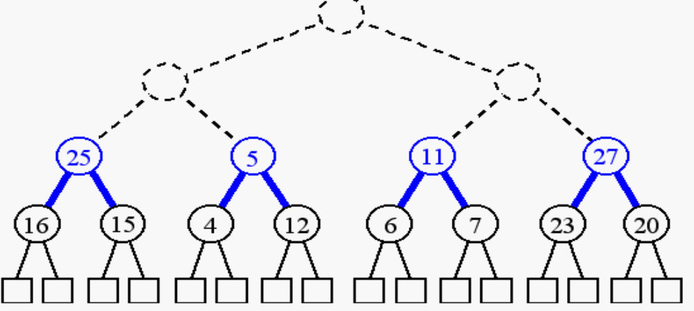
Heapify - Building a Heap (1)
build (n + 1)/2 trivial one-element heaps
build three-element heaps on top of them

Slide 52
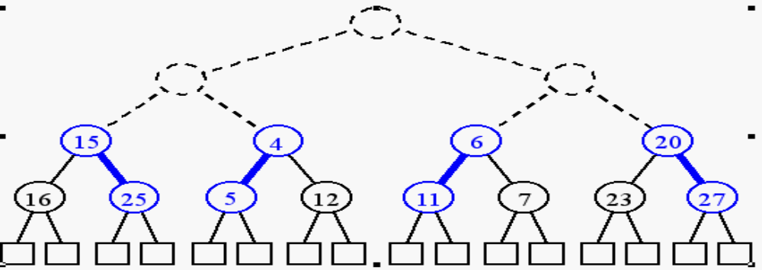
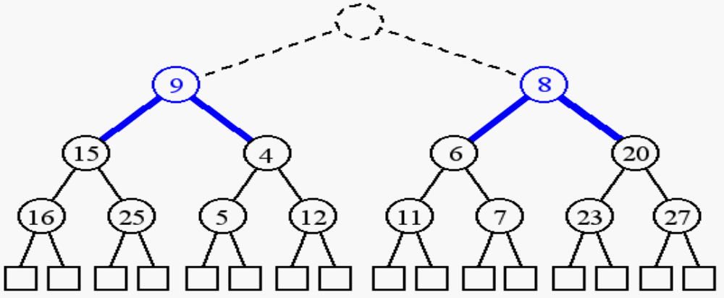
Heapify - Building a Heap (2)
Downheap to preserve the order property
Now form seven-element heap

Slide 53
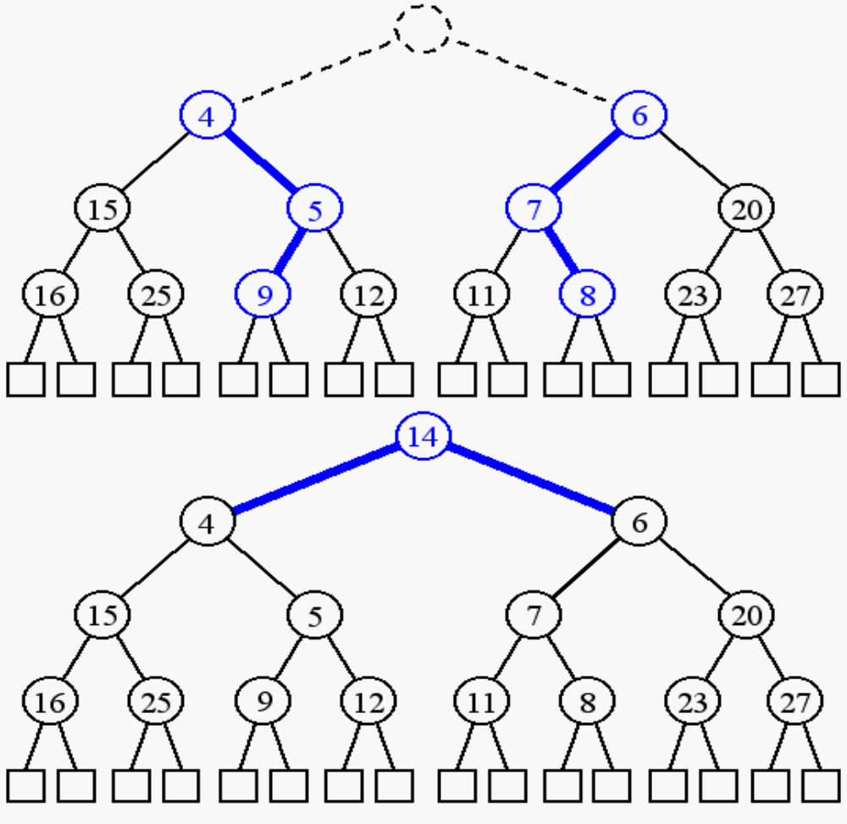
Heapify - Building a Heap (3)
Downheap to preserve the order property
Insert the root node

Slide 54
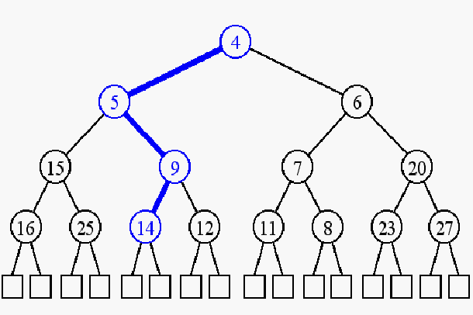
Heapify - Building a Heap (4)
Downheap to preserve the order property

Slide 55
Heapify (Alternate Version - 1)
It builds the heap top-down and sifts upwards
This "siftUp" (“percolateUp”)version can be visualized as starting with an empty heap and successively inserting elements
  whereas the "siftDown" version given above treats the entire input array as a full, "broken" heap and "repairs" it starting from the last non-trivial sub-heap (that is, the last parent node)
"siftDown" (“percolateDown”)version of heapify has O(n) time complexity,
while the "siftUp" version has O(n log n) time complexity due to its equivalence with inserting each element, one at a time, into an empty heap
heapsort algorithm itself has O(n log n) time complexity using either version of heapify

Slide 56
Heapify - Alternate Version (2)
function heapify(a, count) is
(end is assigned the index of the first (left) child of the root)
end := 1
while end < count do
(sift up the node at index end to the proper place such that all nodes above the end index are in heap order)
siftUp(a, 0, end)
end := end + 1
(after sifting up the last node all nodes are in heap order)
end-while

Slide 57
Heapify - Alternate Version (3)
function siftUp(a, start, end) is
input: start represents the limit of how far up the heap to sift.
end is the node to sift up.
child := end
while child > start do
parent := floor((child - 1) / 2) (map to the largest previous
integer)
if a[parent] < a[child] then (out of max-heap order)
swap(a[parent], a[child])
child := parent (repeat to continue sifting up the parent now)
else
return
end-while

Slide 58
Implementation of Heap Sort
The implementation is left to the students as an exercise

Slide 59
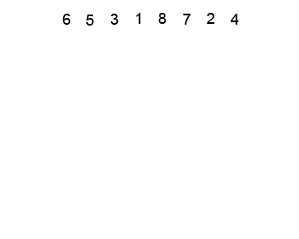
Heap Sort - SiftUp - Trace

Slide 60
Complexity of Heap Sort
Best case performance O(n log₂ n)
Average case performance O(n log₂ n)
Worst case performance O(n log₂ n)
Worst case space complexity O(n) O(1) total auxiliary
Where n is the number of elements to be sorted

Slide 61
Comparison Heap Sort and Quick Sort
Heap sort primarily competes with quick sort
  another very efficient general purpose nearly-in-place comparison-based sort algorithm
Quick sort is typically somewhat faster due to better cache behavior and other factors
But the worst-case running time for quick sort is O(n²),
  which is unacceptable for large data sets and can be deliberately triggered given enough knowledge of the implementation, creating a security risk
Heap sort is often used in Embedded systems with real-time constraints or systems concerned with security
  because of the O(n log n) upper bound on heapsort's running time and constant O(1) upper bound on its auxiliary storage

Slide 62
Comparison Heap Sort and Merge Sort
Heap sort also competes with Merge sort
  Both have the same O(n log n) upper bound on running time
  Merge sort requires O(n) auxiliary space, but heap sort requires only a constant O(1) upper bound on its auxiliary storage
Heap sort typically runs faster in practice on machines with small or slow data caches

Slide 63
Comparison Heap Sort and Merge Sort
Merge sort have several advantages over heap sort
  Heap sort is not a stable sort; merge sort is stable
  Like quick sort, merge sort on arrays has considerably better data cache performance, often outperforming heap sort on modern desktop computers
    because merge sort frequently accesses contiguous memory locations (good locality of reference);
    heapsort references are spread throughout the heap
  Merge sort is used in external sorting; heap sort is not. Locality of reference is the issue
  Merge sort parallelizes well and can achieve close to linear speedup with a trivial implementation; heap sort is not an obvious candidate for a parallel algorithm
  Merge sort can be adapted to operate on linked lists with O(1) extra space. Heap sort can be adapted to operate on doubly linked lists with only O(1) extra space overhead

Slide 64
Efficiency Summary
Sort | Worst Case | Average Case
Insertion | O(n²) | O(n²)
Selection | O(n²) | O(n²)
Bubble | O(n²) | O(n²)
Shell | O(n^{1.5}) | O(n^{1.25})
Bucket Sort | O(n²) | O(n + k)
Quick | O(n²) | O(nlog₂n)
Heap | O(nlog₂n) | O(nlog₂n)
Merge | O(nlog₂n) | O(nlog₂n)

Slide 65
Efficiency of Sorting Algorithms

Slide 66
Efficiency of Sorting Algorithms

Slide 67
Summary
Complete Binary Tree
Heaps
  Min-Heap and Max-Heap
Heap Operations
  Insertion and Deletion
Applications of Heaps
Priority Queue
Heap Sort
  Concept , Algorithm and Example Trace
  Complexity of Heap Sort
  Comparison with Quick and Merge Sort

