Slide 1
CSC 211
Data Structures
Lecture 25
Dr. Iftikhar Azim Niaz
ianiaz@comsats.edu.pk
1

Slide 2
Last Lecture Summary
Trees
Concept
Examples and Applications
Definition
Terminology
Types of Trees
General Trees
  Representation and Traversal
Binary Tree
  Types and Representations
2

Slide 3
Objectives Overview
Operations on Binary Tree
Binary Tree Traversal
  InOrder, PreOrder and PostOrder
Binary Search Tree (BST)
  Concept and Example
BST Operations
  Minimum and Maximum
  Successor and Predecessor
  BST Traversing
    InOrder, PreOrder and PostOrder
  Insertion and Deletion

Slide 4
Tree Common Operations
Enumerating all the items
Enumerating a section of a tree
Searching for an item
Adding a new item at a certain position on the tree
Deleting an item
Pruning: Removing a whole section of a tree
Grafting: Adding a whole section to a tree
Finding the root for any node
4

Slide 5
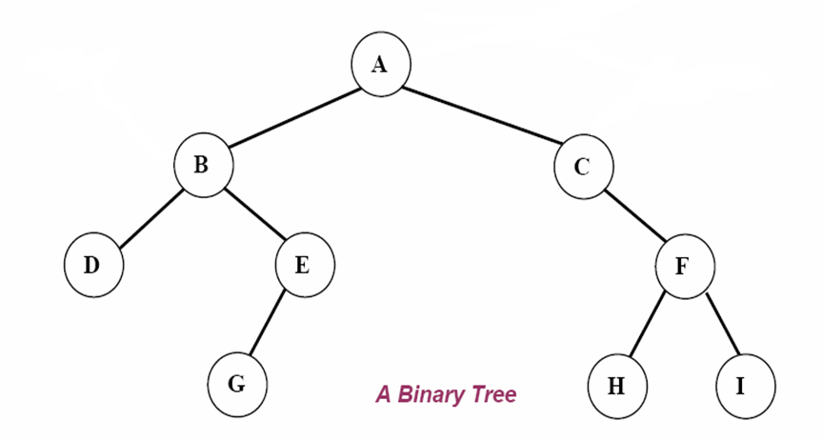
Binary Tree - Basics
root
left subtree
right subtree

Slide 6
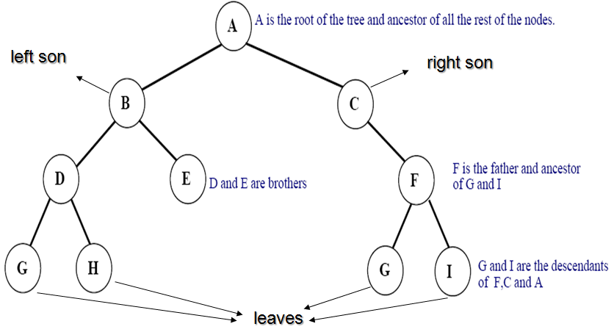
Binary Tree Basics

Slide 7
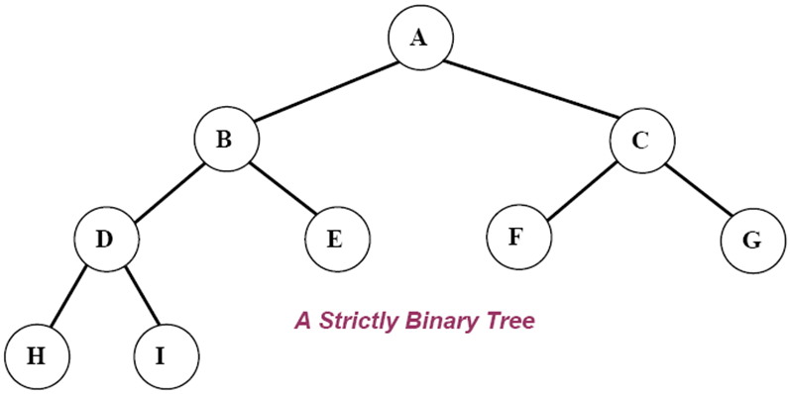
Strictly Binary Tree
If every non-leaf node in a binary tree has nonempty left and right subtrees, the tree is called a strictly binary tree.

Slide 8
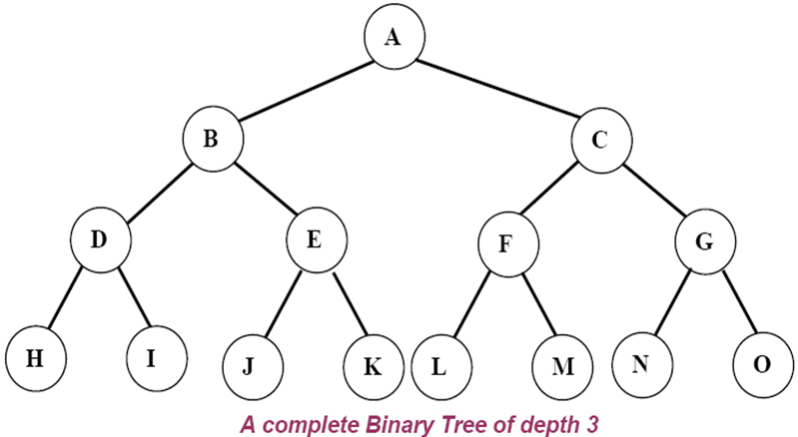
Complete Binary Tree
A complete binary tree of depth d is the strictly binary all of whose leaves are at level d
A complete binary tree with depth d has 2^{d} leaves and 2^{d}-1 non-leaf nodes

Slide 9
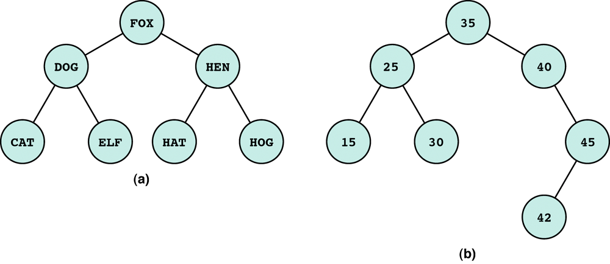
Binary Tree
We can extend the concept of linked list to binary trees which contains two pointer fields.
  Leaf node: a node with no successors
  Root node: the first node in a binary tree.
  Left/right subtree: the subtree pointed by the left/right pointer.

Slide 10
Binary Tree - Linked Representation
typedef struct tnode *ptnode;
typedef struct tnode {
int data;
ptnode left, right;
ptnode parent; // optional
};
data
left
data
right
left
right

Slide 11
Binary Tree - Operations
makeTree(int x) – Create a binary tree
setLeft(ptnode p, int x) – sets the left child
setRight(ptnode p, int x) – sets the right child
Binary Tree Traversal
  PreOrder preOrder(ptnode tree)
  Post Order postOrder(ptnode tree)
  InOrder inOrder(ptnode tree)

Slide 12
Make Tree - Function
The makeTree function allocates a node and sets it as the root of a single node binary tree.
ptnode makeTree(int x) {
ptnode p;
p = new ptnode;
p->data = x;
p->left = NULL;
p->right = NULL;
return p;
}

Slide 13
Setting the Left and Right Children
The setleft and setright functions sets a node with content x as the left child (son) and right child (son) of the node p respectively.
void setLeft(ptnode p, int x) { if (p == NULL) printf(“void insertion\n”); else if (p->left != NULL) printf(“invalid insertion\n”); else p->left = maketree(x); } | void setRight(ptnode p, int x) { if (p == NULL) printf(“void insertion\n”); else if (p->right != NULL) printf(“invalid insertion\n”); else p->right = maketree(x); }

Slide 14
PreOrder Traversal (Depth-first order)
1. Visit the root.
2. Traverse the left subtree in preorder.
3. Traverse the right subtree in preorder.
void preOrder(ptnode tree) {
if(tree != NULL) {
  printf(“%d\n”, tree->data); // Visit the root
  preOrder(tree->left); //Recursive preOrder traverse
  preOrder(tree->right); //Recursive preOrder traverse
}
}

Slide 15
InOrder Traversal (Symmetric order)
1. Traverse the left subtree in inOrder.
2. Visit the root
3. Traverse the right subtree in inOrder.
void inOrder(ptnode tree) {
if(tree != NULL) {
  inOrder(tree->left); //Recursive inOrder traverse
  printf(“%d\n”, tree->data); // Visit the root
  inOrder(tree->right); //Recursive inOrder traverse
}
}

Slide 16
PostOrder Traversal
1. Traverse the left subtree in postOrder.
2. Traverse the right subtree in postOrder.
3. Visit the root.
void postOrder(ptnode tree) {
if(tree != NULL) {
  postOrder(tree->left); //Recursive postOrder traverse
  postOrder(tree->right); //Recursive postOrder traverse
  printf(“%d\n”, tree->data); // Visit the root
}
}

Slide 17
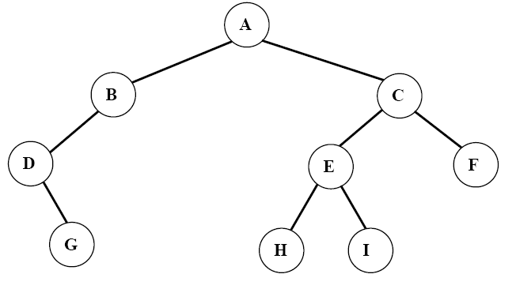
PreOrder Traversal - Trace
Preorder: ABDGCEHIF

Slide 18
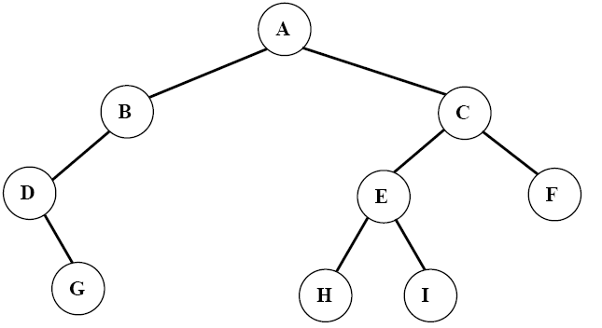
InOrder Traversal - Trace
Inorder: DGBAHEICF

Slide 19
PostOrder Traversal - Trace
Postorder: GDBHIEFCA

Slide 20
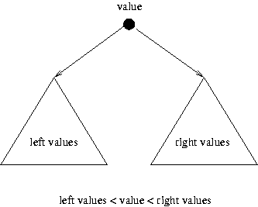
Binary Search Tree - Application
An application of Binary Trees
Binary Search Tree (BST) or Ordered Binary Tree has the property that
  All elements in the left subtree of a node N are less than the contents of N and
  All elements in the right subtree of a node N are greater than nor equal to the contents of N

Slide 21
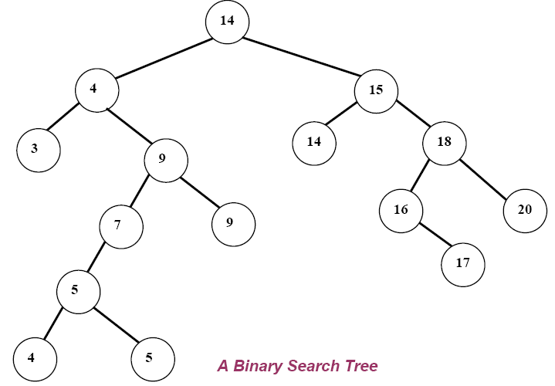
Binary Search Tree
Given the following sequence of numbers,
14, 15, 4, 9, 7, 18, 3, 5, 16, 4, 20, 17, 9, 14, 5
The following binary search tree can be constructed.

Slide 22
Binary Search Tree
The inorder (left-root-right) traversal of the above Binary Search Tree and printing the info part of the nodes gives the sorted sequence in ascending order
Therefore, the Binary search tree approach can easily be used to sort a given array of numbers

Slide 23
Binary Search Tree
The inorder traversal on the Binary Search Tree is:
3, 4, 4, 5, 5, 7, 9, 9, 14, 14, 15, 16, 17, 18, 20

Slide 24
Searching Through Binary Search Tree
The recursive function
BinSearch(ptnode P, int key)
can be used to search for a given key element in a given array of integers
The array elements are stored in a binary search tree
Note that the function returns
  TRUE (1) if the searched key is a member of the array and
  FALSE (0) if the searched key is not a member of the array

Slide 25
BinSearch() Function
int BinSearch( ptnode p, int key ) {
if ( p == NULL )
  return FALSE;
else {
if ( key == p->data )
  return TRUE;
else {
if ( key < p->info )
  return BinSearch(p->left, key);
else
  return BinSearch(p->right, key);
}
}
} // end of function

Slide 26
BinInsert() Function
ptnode BinInsert (ptnode p, int x) {
if ( p == NULL ) {
  p = new ptnode;
  p->data = x;
  p->left = NULL;
  p->right = NULL;
  return p;
  }
else {
if ( x < p->data)
  p->left = insert(p->left, x);
else
  p->right = insert(p->right, x);
}
} // end of function

Slide 27
Application of Binary Search Tree - 1
Suppose that we wanted to find all duplicates in a list of numbers
One way of doing this to compare each number with all those that precede it
However this involves a large number of comparison
The number of comparison can be reduced by using a binary tree

Slide 28
Application of Binary Search Tree
The first number in the list is placed in a node that is the root of the binary tree with empty left and right sub-trees
The other numbers in the list is than compared to the number in the root
  If it is matches, we have duplicate
  If it is smaller, we examine the left sub-tree
  if it is larger we examine the right sub-tree
  If the sub-tree is empty, the number is not a duplicate and is placed into a new node at that position in the tree
  If the sub-tree is nonempty, we compare the number to the contents of the root of the sub-tree and the entire process is repeated with the sub-tree
A program for doing this follows

Slide 29
BST – Application Program
#include <stdio.h>
#include <stdlib.h>
struct node {
int data ;
struct node *left ;
struct node *right;
};
typedef struct node *ptNode;
ptNode makeTree(int); // Function Declarations
void inTraversal(ptNode);
void main() {
int number;
ptNode root , p , q;

Slide 30
BST – Application Program
printf("%s\n","Enter First number"); scanf("%d",&number);
root=makeTree(number); // insert first root item
printf("%s\n","Enter the other numbers");
while(scanf("%d",&number) !=EOF) {
p=q=root;
// find insertion point
while((number != p->data) && q != NULL) {
p = q;
if (number < p->data)
q = p->left;
else
q = p->right;
}

Slide 31
BST – Application Program
q = makeTree(number);
if (number == p->info) //*insertion
printf("%d is a duplicate \n“,number);
else if (number < p->idata)
p->left = q;
else
p->right = q;
} // end of outer while
printf("Tree Created \n ");
inTraversal(root); / / inorder Traversing
} // end of Main Program

Slide 32
BST – Application Program
// Function Definitions
ptNode makeTree(int x) {
ptNode p;
p = new ptNode;
p->info = x;
p->left = NULL;
p->right = NULL;
return p;
}
void inTraversal(ptNode tree) {
if ( tree != NULL ) {
intrav(tree->left); printf(“%d\n”, tree->data);
intrav(tree->right);
} } // end of inTraversal

Slide 33
Binary Search Tree
A binary search tree is either empty or has the property that the item in its root has
  a larger key than each item in the left subtree, and
  a smaller key than each item in its right subtree.

Slide 34
Binary Search Tree (BST) - Example
10
root
7
14
5
9
16
leaf
2
6
8
leaf
leaf
leaf

Slide 35
Operations on BST
10
Search
Minimum
Maximum
Predecessor
Successor
Insert
Delete
7
14
5
9
16
2
6
8

Slide 36
Binary Search Tree Property
10
x
7
14
5
9
z
16
y
For any node x
let y be a node in the left subtree of x, then key[y] < key[x].
If y is a node in the right subtree of x, then key[x]≤key[y].
2
6
8

Slide 37
Binary Search Tree Traversals
10
Inorder
Preorder
Postorder
7
14
5
9
16
2
6
8

Slide 38
BST – InOrder Traversal
Inorder(node x)
If x ≠ NIL
Inorder(x→left)
print(x)
Inorder(x→right)
10
7
14
5
9
16
2
6
8
2, 5, 6, 7, 8, 9, 10, 14, 16
(that’s exactly the sorted ordering!)

Slide 39
BST – PreOrder Traversal
Preorder(node x)
If x ≠ NIL
print(x)
Preorder(x→left)
Preorder(x→right)
10
7
14
5
9
16
2
6
8
10, 7, 5, 2, 6, 9, 8, 14, 16

Slide 40
BST – PostOrder Traversal
Postorder(node x)
If x ≠ NIL
Postorder(x→left)
Postorder(x→right)
print(x)
10
7
14
5
9
16
2
6
8
2, 6, 5, 8, 9, 7, 16, 14, 10

Slide 41
Binary Search Tree Traversals
10
7
14
5
9
16
2
6
8
What is the running time?
Traversal requires O(n) time, since it must visit every node.

Slide 42
Minimum and Maximum
Minimum(node x)
while x → left ≠ NIL
do x ← x→left
return x
Maximum(node x)
while x → right ≠ NIL
do x ← x→right
return x
10
7
14
5
9
16
2
6
8

Slide 43
BST - Search
Recursive
Search(node x, k)
if x = NIL or k =key[x]
then return x
if x < key[x]
then return Search(x→left,k)
else return Search(x→right,k)
Iterative
Search(node x,k)
while x≠NIL and k≠key[x]
if k < key[x]
then x ← x→left
else x ← x→right
return x
x
10
7
14
5
9
16
k=11?
2
6
8
k=6

Slide 44
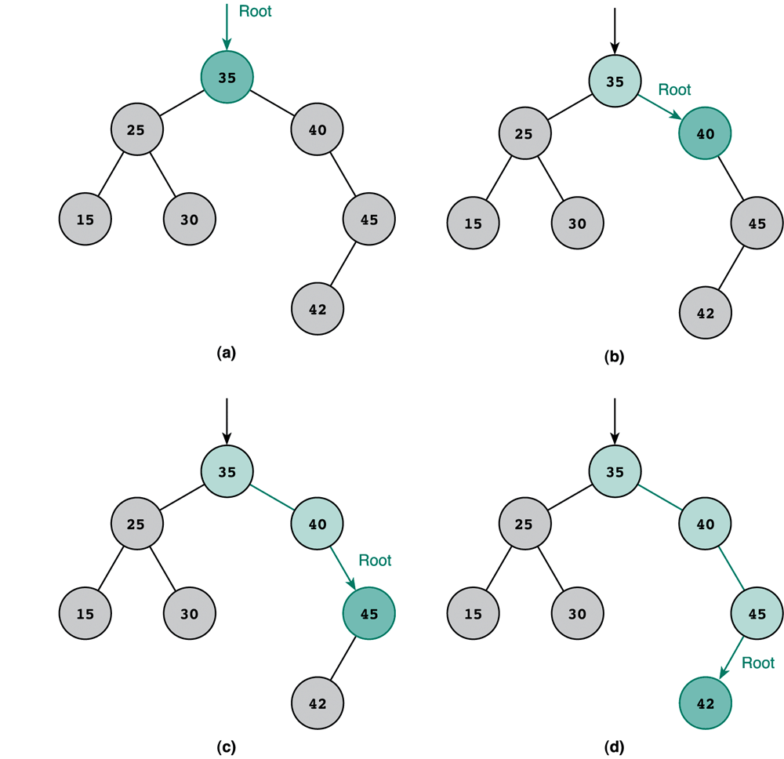
BST- Search Trace
Key is 42
Recursive
Search(node x, k)
if x = NIL or k =key[x]
then return x
if x < key[x]
then return Search(x→left,k)
else return Search(x→right,k)
Iterative
Search(node x,k)
while x≠NIL and k≠key[x]
if k < key[x]
then x ← x→left
else x ← x→right
return x

Slide 45
Successor
10
x
7
14
5
9
16
2
6
8
The successor of x is the node with the smallest key greater than key[x].

Slide 46
Successor
10
7
14
5
9
x
16
Successor(node x)
if x→right ≠ NIL
then return Minimum(x→right)
y ← x→p
while y ≠ NIL and x == y→right
x ← y
y ← y→p
return y
2
6
8

Slide 47
BST - Running Time
10
7
14
5
9
16
2
6
8
Search, Minimum, Maximum, Successor
All run in O(h) time, where h is the height of the
corresponding Binary Search Tree

Slide 48
Building a Binary Search Tree
If the tree is empty
  Insert the new key in the root node
else if the new key is smaller than root’s key
  Insert the new key in the left subtree
else
  Insert the new key in the right subtree (also inserts the equal key)
The parent field will also be stored along with the left and right child

Slide 49
BST - Insertion
10
7
14
5
9
16
2
6
8
9.5
z
Insert a new node z with key[z]=v into a tree T

Slide 50
BST - Insertion
x
Insert(T,z)
y ← NIL
x ← root(T)
While x ≠ NIL
y ← x
if key[z] < key[x]
then x ← x→left
else x ← x→right
z→p ← y
10
7
14
5
9
16
2
6
8
9.5
z

Slide 51
BST - Insertion
y
Insert(T,z)
y ← NIL
x ← root(T)
While x ≠ NIL
y ← x
if key[z] < key[x]
then x ← x→left
else x ← x→right
z→p ← y
10
x
7
14
5
9
16
2
6
8
9.5
z

Slide 52
BST - Insertion
y
Insert(T,z)
y ← NIL
x ← root(T)
While x ≠ NIL
y ← x
if key[z] < key[x]
then x ← x→left
else x ← x→right
z→p ← y
10
7
x
14
5
9
16
2
6
8
9.5
z

Slide 53
BST - Insertion
Insert(T,z)
y ← NIL
x ← root(T)
While x ≠ NIL
y ← x
if key[z] < key[x]
then x ← x→left
else x ← x→right
z→p ← y
10
y
7
x
14
5
9
16
2
6
8
9.5
z

Slide 54
BST - Insertion
Insert(T,z)
y ← NIL
x ← root(T)
While x ≠ NIL
y ← x
if key[z] < key[x]
then x ← x→left
else x ← x→right
z→p ← y
10
y
7
14
5
9
x
16
2
6
8
9.5
z

Slide 55
BST - Insertion
Insert(T,z)
y ← NIL
x ← root(T)
While x ≠ NIL
y ← x
if key[z] < key[x]
then x ← x→left
else x ← x→right
z→p ← y
10
7
14
y
5
9
16
x ← NIL
2
6
8
9.5
z

Slide 56
BST - Insertion
Insert(T,z)
y ← NIL
x ← root(T)
While x ≠ NIL
y ← x
if key[z] < key[x]
then x ← x→left
else x ← x→right
z→p ← y
10
7
14
y
5
9
16
2
6
8
9.5
z
Parent of z is assigned the value of y

Slide 57
BST - Insertion
Insert(T,z)
y ← NIL
x ← root(T)
While x ≠ NIL
y ← x
if key[z] < key[x]
then x ← x→left
else x ← x→right
z→p ← y
If y = NIL then root[T]←z
else if key[z] < key [y]
then y→left ← z
else y→right ← z
10
7
14
y
5
9
16
2
6
8
9.5
z

Slide 58
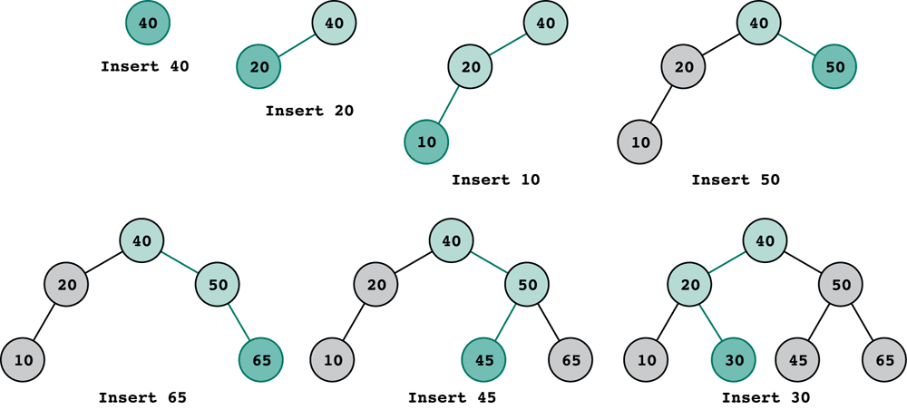
Building a Binary Search Tree
Assume 40, 20, 10, 50, 65, 45, 30 are inserted in order.

Slide 59
Deletion – 3 Cases
10
z
z
7
14
5
9
16
Deleting a leaf node (6)
Deleting a root node of a subtree (14) having one child
Deleting a root node of a subtree (7) having two children
2
6
8
z

Slide 60
Deletion of a Leaf Node
10
7
14
5
9
16
X
2
6
8
z

Slide 61
Delete a Root Node Having One Child
10
X
z
7
14
X
5
9
16
2
6
8

Slide 62
Delete a Root Node having 2 Children
10
z
7
14
5
9
16
2
6
8
Find the successor y of z
Replace z with y
Delete y (careful, as y might have a right child)

Slide 63
Delete a Root Node having 2 Children
10
z
8
14
5
9
16
X
X
2
6
8
Find the successor y of z
Replace z with y
Delete y (careful, as y might have a right child)

Slide 64
Deletion – Algorithm
1. if z→left=NIL or z→right=NIL
then y ← z
else y ← Successor(z)
4. if y→left≠NIL
then x ← y→left
else x ← y→right
7. if x ≠ NIL
then x→p ← y→p
9. if y→p = NIL
10. then root[T] ← x
else if y = (y→p)→left
then (y→p)→left ← x
else (y→p)→right ← x
14.if y≠z
then key[z] ← key[y]
copy y’s data into z
17.return y
10
z
z
7
14
5
9
16
2
6
8
z
8.5

Slide 65
Deletion – Algorithm
1. if z→left=NIL or z→right=NIL
then y ← z
else y ← Successor(z)
4. if y→left≠NIL
then x ← y→left
else x ← y→right
7. if x ≠ NIL
then x→p ← y→p
9. if y→p = NIL
10. then root[T] ← x
else if y = (y→p)→left
then (y→p)→left ← x
else (y→p)→right ← x
14.if y≠z
then key[z] ← key[y]
copy y’s data into z
17.return y
10
z
z
7
14
y
5
9
16
2
6
8
y
z
8.5
y

Slide 66
Deletion – Algorithm
1. if z→left=NIL or z→right=NIL
then y ← z
else y ← Successor(z)
4. if y→left≠NIL
then x ← y→left
else x ← y→right
7. if x ≠ NIL
then x→p ← y→p
9. if y→p = NIL
10. then root[T] ← x
else if y = (y→p)→left
then (y→p)→left ← x
else (y→p)→right ← x
14.if y≠z
then key[z] ← key[y]
copy y’s data into z
17.return y
10
z
z
7
14
y
5
9
16
x
2
6
8
y
z
8.5
x
y
x = NIL

Slide 67
Deletion – Algorithm
1. if z→left=NIL or z→right=NIL
then y ← z
else y ← Successor(z)
4. if y→left≠NIL
then x ← y→left
else x ← y→right
7. if x ≠ NIL
then x→p ← y→p
9. if y→p = NIL
10. then root[T] ← x
else if y = (y→p)→left
then (y→p)→left ← x
else (y→p)→right ← x
14.if y≠z
then key[z] ← key[y]
copy y’s data into z
17.return y
10
z
z
7
y
14
5
9
16
x
2
6
8
y
z
8.5
x
y
x = NIL

Slide 68
Deletion – Algorithm
1. if z→left=NIL or z→right=NIL
then y ← z
else y ← Successor(z)
4. if y→left≠NIL
then x ← y→left
else x ← y→right
7. if x ≠ NIL
then x→p ← y→p
9. if y→p = NIL
10. then root[T] ← x
else if y = (y→p)→left
then (y→p)→left ← x
else (y→p)→right ← x
14.if y≠z
then key[z] ← key[y]
copy y’s data into z
17.return y
10
X
z
z
7
y
14
X
5
9
16
x
X
2
6
8
y
8.5
x

Slide 69
Deletion – Algorithm
1. if z→left=NIL or z→right=NIL
then y ← z
else y ← Successor(z)
4. if y→left≠NIL
then x ← y→left
else x ← y→right
7. if x ≠ NIL
then x→p ← y→p
9. if y→p = NIL
10. then root[T] ← x
else if y = (y→p)→left
then (y→p)→left ← x
else (y→p)→right ← x
14.if y≠z
then key[z] ← key[y]
copy y’s data into z
17.return y
10
z
z
7
y
14
5
9
16
x
2
6
8
y
8.5
x

Slide 70
Deletion – Algorithm
1. if z→left=NIL or z→right=NIL
then y ← z
else y ← Successor(z)
4. if y→left≠NIL
then x ← y→left
else x ← y→right
7. if x ≠ NIL
then x→p ← y→p
9. if y→p = NIL
10. then root[T] ← x
else if y = (y→p)→left
then (y→p)→left ← x
else (y→p)→right ← x
14.if y≠z
then key[z] ← key[y]
copy y’s data into z
17.return y
10
z
z
7
y
14
5
9
16
x
2
6
8
y
8.5
x

Slide 71
Deletion – Algorithm
1. if z→left=NIL or z→right=NIL
then y ← z
else y ← Successor(z)
4. if y→left≠NIL
then x ← y→left
else x ← y→right
7. if x ≠ NIL
then x→p ← y→p
9. if y→p = NIL
10. then root[T] ← x
else if y = (y→p)→left
then (y→p)→left ← x
else (y→p)→right ← x
14.if y≠z
then key[z] ← key[y]
copy y’s data into z
17.return y
10
z
z
7
y
5
9
16
x
2
6
y
8.5
x

Slide 72
Tree Rotation
Tree rotation is an operation on a binary tree that changes the structure without interfering with the order of the elements
A tree rotation moves one node up in the tree and one node down
It is used to change the shape of the tree, and in particular to decrease its height by moving smaller subtrees down and larger subtrees up
Thus resulting in improved performance of many tree operations

Slide 73
Tree Rotation
Single right rotation
3
2
2
1
3
1

Slide 74
Tree Rotation Example
Left side single rotation
5
5
3
6
2
6
2
1
3
Grand father have only one child, so rotate it
Grand father is now at his right child’s place
1

Slide 75
Tree Rotation Example
Right Side Single rotation
5
5
3
8
3
6
6
9
1
1
8
Grand father have only one child, so rotate it
9

Slide 76
Summary
Operations on Binary Tree
Binary Tree Traversal
  InOrder, PreOrder and PostOrder
Binary Search Tree (BST)
  Concept and Example
BST Operations
  Minimum and Maximum
  Successor and Predecessor
  BST Traversing
    InOrder, PreOrder and PostOrder
  Insertion and Deletion

