Slide 1
CSC 211
Data Structures
Lecture 24
Dr. Iftikhar Azim Niaz
ianiaz@comsats.edu.pk
1

Slide 2
Last Lecture Summary
Stacks
Concept
Stack Operations
  Push and Pop
Stack Implementation
  Static Array Based
  Dynamic Linked List
Stack Applications
  Balanced Symbol Checking
  Prefix, Infix and Postfix
2

Slide 3
Objectives Overview
Trees
Concept
Examples and Applications
Definition
Terminology
Types of Trees
General Trees
  Representation and Traversal
Binary Tree
  Types and Representations

Slide 4
Tree - Introduction
Trees are very flexible, versatile and powerful non-linear data structure
It can be used to represent data items possessing hierarchical relationship
A tree can be theoretically defined as a finite set of one or more data items (or nodes) such that
  There is a special node called the root of the tree
  Remaining nodes (or data item) are partitioned into number of subsets each of which is itself a tree, are called subtree
A tree is a set of related interconnected nodes in a hierarchical structure

Slide 5
Tree - Introduction
Some data is not linear (it has more structure!)
  Family trees
  Organizational charts
Linked lists etc don’t store this structure information.
Linear implementations are sometimes inefficient or otherwise sub-optimal for our purposes
Trees offer an alternative
  Representation
  Implementation strategy
  Set of algorithms

Slide 6
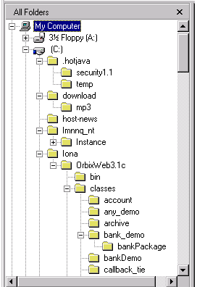
Tree Examples
Where have you seen a tree structure before?
Examples of trees:
  Directory tree
  Family tree
  Company organization chart
  Table of contents etc.

Slide 7
Tree Example – Tic Tac Toe
X
X
X
X
X
O
X
O
X
X
X
X
O
O
O

Slide 8
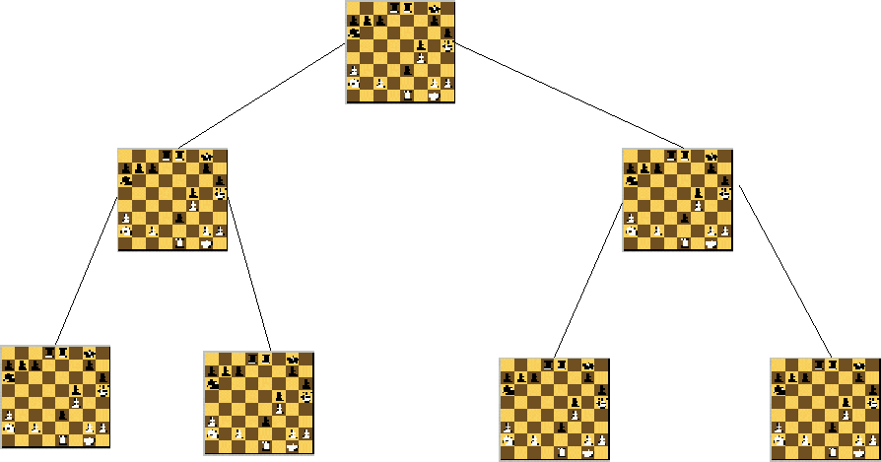
Tree Example - Chess

Slide 9
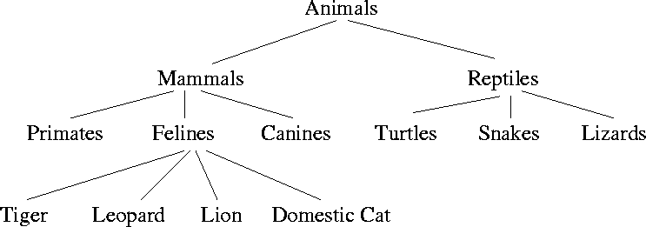
Tree Example – Taxonomy Tree

Slide 10
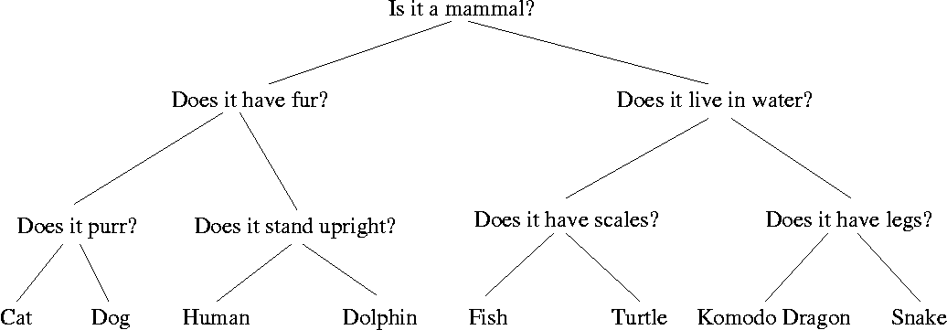
Tree Example – Decision Tree
tool that uses a tree-like graph or model of decisions and their possible consequences
  including chance event outcomes, resource costs, and utility
It is one way to display an algorithm.

Slide 11
What is a Tree Useful for?
Artificial Intelligence – planning, navigating, games
Representing things:
  Simple file systems
  Class inheritance and composition
  Classification, e.g. taxonomy (the is-a relationship again!)
  HTML pages
  Parse trees for language
  3D graphics

Slide 12
Tree - Definition
A tree is a finite set of one or more nodes
such that:
  There is a specially designated node called the root.
The remaining nodes are partitioned into n>=0 disjoint sets T1, ..., Tn, where each of these sets is a tree.
  We call T1, ..., Tn the subtrees of the root r
  Each of whose roots are connected by a directed edge from r
A tree is a collection of N nodes, one of which is the root and N-1 edges

Slide 13
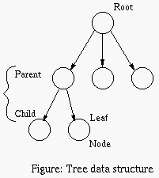
Tree – Basic Terminology
Each data item within a tree is called a 'node’
The highest data item in the tree is called the 'root' or root node
  First node in hierarchical arrangement of data
Below the root lie a number of other 'nodes'. The root is the 'parent' of the nodes immediately linked to it and these are the 'children' of the parent node
Leaf node has no children

Slide 14
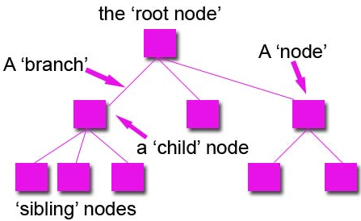
Tree – Basic Terminology
If nodes share a common parent, then they are 'sibling' nodes, just like a family.
The link joining one node to another is called the 'branch'.
This tree structure is a general tree
Leaves: nodes with no children (also known as external nodes)
Internal Nodes: nodes with children
The ancestors of a node are all the nodes along the path from the root to the node

Slide 15
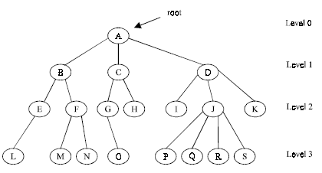
Tree – Basic Terminology
‘A’ is root node
Each data item in a tree is known as node
It specifies the data information and links to other data items
Degree of a node is the number of sub-trees of a node in a given tree
In the example
  Degree of node A is 3
  Degree of node B is 2
  Degree of node C is 2
  Degree of node D is 3
  Degree of node J is 4

Slide 16
Tree – Basic Terminology
Degree of a tree is the maximum degree of node in a given tree
Degree of node J is 4
All other nodes have less or equal degree
So degree of the tree is 4
A node with degree zero (0) is called terminal node or a leaf
Nodes M,N,I,O etc are leaf nodes
Any node whose degree is not zero is called a non-terminal node

Slide 17
Tree – Basic Terminology
Levels of a Tree
The tree is structured in different levels
The entire tree is leveled in such a way that the root node is always of level 0
Its immediate children are at level 1 and their immediate children are at level 2 and so on up to the terminal nodes
If a node is at level n then its children will be at level n+1

Slide 18
Tree – Basic Terminology
Depth of a Tree is the maximum level of any node in a given tree
The number of levels from root to the leaves is called depth of a tree. Depth of tree is 4
The term height is also used to denote the depth of a tree
Height (of node): length of the longest path from a node to a leaf.
All leaves have a height of 0
The height of root is equal to the depth of the tree

Slide 19
Tree – Basic Terminology
A vertex (or node) is a simple object that can have a name and can carry other associated information
An edge is a connection between two vertices
A path in a tree is a list of distinct vertices in which successive vertices are connected by edges in the tree
The defining property of a tree is that there is precisely one path connecting any two nodes

Slide 20
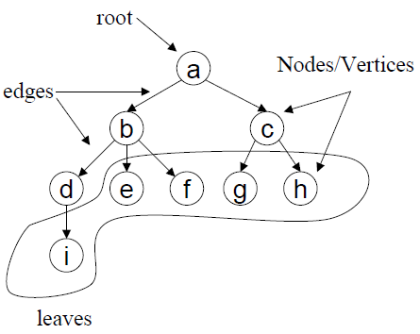
Tree – Basic Terminology
  Example: {a, b, d, i } is path
Path

Slide 21
Path in a Tree
A path from node n₁ to n_{k} is defined as a sequence of nodes n₁, n₂, …, n_{k} such that n_{i} is the parent of n_{i+1} for 1<= i <= k.
The length of this path is the number of edges on the path namely k-1.
The length of the path from a node to itself is 0.
There is exactly one path from from the root to each node.

Slide 22
What is a Tree?
Models the parent/child relationship between different elements
  Each child only has one parent
From mathematics:
  “a directed acyclic graph”
  At most one path from any one node to any other node
Different kinds of trees exist.
Trees can be used for different purposes.
In what order to we visit elements in a tree?

Slide 23
How Many Types of Trees are there?
Far too many:
  General tree
  Binary Tree
  Red-Black Tree
  AVL Tree
  Partially Ordered Tree
  B+ Trees
  … and so on
Different types are used for different things
  To improve speed
  To improve the use of available memory
  To suit particular problems

Slide 24
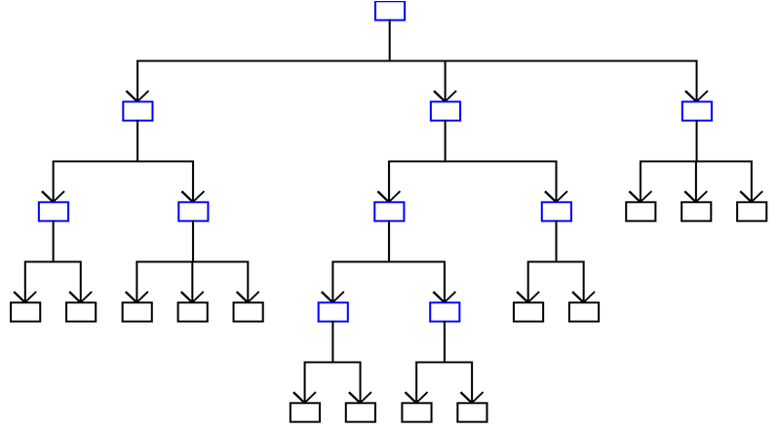
General tree

Slide 25
Representation of Trees
List Representation
  ( A ( B ( E ( K, L ), F ), C ( G ), D ( H ( M ), I, J ) ) )
  The root comes first, followed by a list of sub-trees
data
link 1
link 2
...
link n
How many link fields are
needed in such a representation?

Slide 26
A Tree Node
Every tree node:
  object – useful information
  children – pointers to its children nodes
O
O
O
O
O

Slide 27
Left Child – Right Sibling
data
A
left child
right sibling
B
C
D
E
F
G
H
I
J
K
L
M

Slide 28
Tree ADT
Objects: any type of objects can be stored in a tree
Methods:
accessor methods
  root() – return the root of the tree
  parent(p) – return the parent of a node
  children(p) – returns the children of a node
query methods
  size() – returns the number of nodes in the tree
  isEmpty() - returns true if the tree is empty
  elements() – returns all elements
  isRoot(p), isInternal(p), isExternal(p)

Slide 29
Tree Implementation
typedef struct tnode {
int key;
struct tnode* lchild;
struct tnode* sibling;
} *ptnode;
  Create a tree with three nodes (one root & two children)
  Insert a new node (in tree with root R, as a new child at level L)
  Delete a node (in tree with root R, the first child at level L)

Slide 30
Tree Traversal
Two main methods:
  Preorder
  Postorder
Recursive definition
PREorder:
  visit the root
  traverse in preorder the children (subtrees)
POSTorder
  traverse in postorder the children (subtrees)
  visit the root

Slide 31
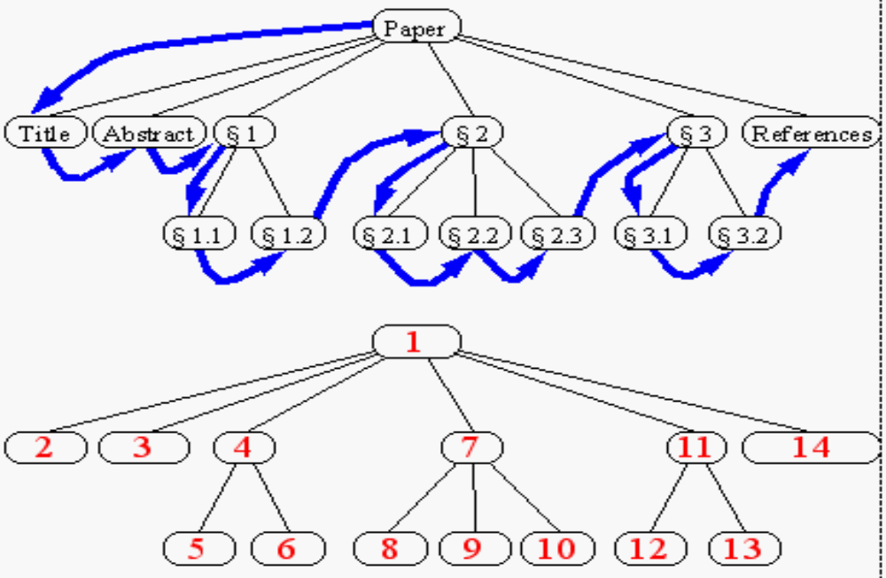
Tree - Preorder Traversal
preorder traversal
  Algorithm preOrder(v)
  “visit” node v
  for each child w of v do
  recursively perform preOrder(w)

Slide 32
Prerder Implementation
public void preorder(ptnode t) {
ptnode ptr;
display(t->key);
for(ptr = t->lchild; NULL != ptr; ptr = ptr->sibling) {
preorder(ptr);
}
}

Slide 33
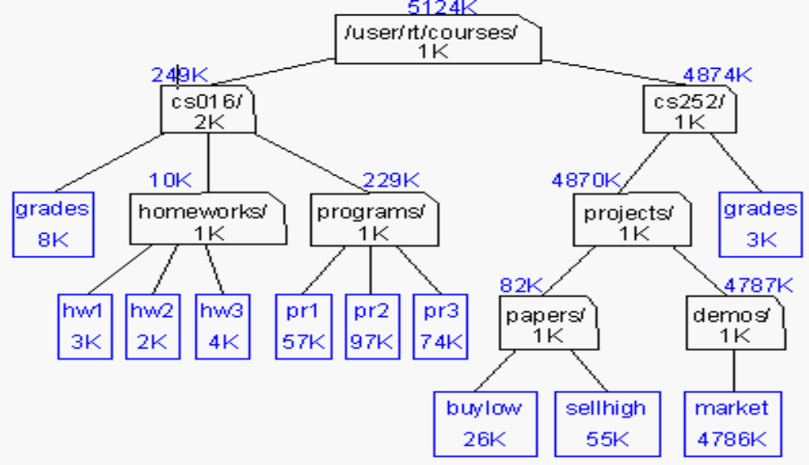
Tree - Postorder Traversal
postorder traversal
  Algorithm postOrder(v)
  for each child w of v do
  recursively perform postOrder(w)
  “visit” node v
du (disk usage) command in Unix

Slide 34
Postorder Implementation
public void postorder(ptnode t) {
ptnode ptr;
for(ptr = t->lchild; NULL != ptr; ptr = ptr->sibling) {
postorder(ptr);
}
display(t->key);
}

Slide 35
Binary Tree
A special class of trees:
  max degree for each node is 2
Recursive definition:
A binary tree is a finite set of nodes that is either empty or consists of a root and two disjoint binary trees called the left subtree and the right subtree.
Any tree can be transformed into binary tree.
by left child-right sibling representation

Slide 36
Binary Tree - Example
A
B
C
E
G
D
K
F
H
L
M
I
J

Slide 37
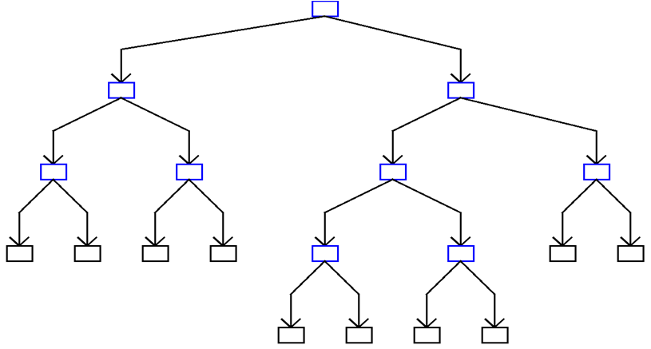
Binary Tree
Tree size is limited by the depth of the tree
For binary tree, nodes at level k = n
For N-ary tree, nodes at level k = n ^{k - 1}
Size for Binary is: 1 + 2 + … + n = 2^{n} – 1 and
Size for N-ary is (n^{k-1})/(n-1) where k is number of full levels.

Slide 38
Binary Tree
A binary tree is a tree in which no node can have more than 2 children
These children are described as “left child” and “right child” of the parent node
A binary tree T is defined as a finite set of elements called nodes such that
  T is empty if T has no nodes called the null or empty tree
  T contains a special node R, called root node of T
  remaining nodes of T form an ordered pair of disjoined binary trees T1 and T2. They are called left and right sub tree of R

Slide 39
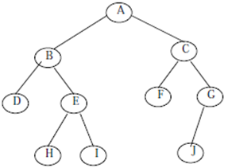
Binary Tree
‘A’ is the root node of the tree
‘B’ is left child of ‘A’ and ‘C’ is right child of ‘A’
‘A’ is the father of ‘B’ and ‘C’
The nodes ‘B’ and ‘C’ are called brothers

Slide 40
Sample of Binary Trees
A
A
Complete Binary Tree
1
A
B
B
Skewed Binary Tree
2
B
C
C
D
3
D
E
F
G
E
5
4
H
I

Slide 41
Maximum Nodes in Binary Tress
The maximum number of nodes on level i of a binary tree is 2^{i-1}, I >= 1.
The maximum number of nodes in a binary tree
of depth k is 2^{k}-1, k >= 1.
Prove by Induction

Slide 42
Relation between Number of Leaf Nodes and Nodes of Degree 2
For any nonempty binary tree, T, if n0 is the number of leaf nodes and n2 the number of nodes of degree 2, then n0=n2+1
proof:
Let n and B denote the total number of nodes & branches in T.
Let n0, n1, n2 represent the nodes with no children, single child, and two children respectively.
n= n0+n1+n2, B+1=n, B=n1+2n2 ==> n1+2n2+1= n,
n1+2n2+1= n0+n1+n2 ==> n0=n2+1

Slide 43
Full Binary Tree and Complete BT
A full binary tree of depth k is a binary tree of
depth k having 2^{k} -1 nodes, k >=0.
A binary tree with n nodes and depth k is
complete iff its nodes correspond to the nodes numbered from 1 to n in the full binary tree of depth k
A
A
B
C
B
C
D
E
F
G
D
E
F
G
H
I
J
K
L
M
N
O
H
I
Complete binary tree
Full binary tree of depth 4

Slide 44
Binary Tree Representation
If a complete binary tree with n nodes (depth =
log n + 1) is represented sequentially, then for
any node with index i, 1<=i<=n, we have:
  parent(i) is at i/2 if i!=1. If i=1, i is at the root and
  has no parent.
  leftChild(i) is at 2i if 2i<=n. If 2i>n, then i has no
  left child.
  rightChild(i) is at 2i+1 if 2i +1 <=n. If 2i +1 >n,
  then i has no right child.

Slide 45
Sequential Representation
[1]
[2]
[3]
[4]
[5]
[6]
[7]
[8]
[9]
A
B
C
D
E
F
G
H
I
(1) waste space
(2) insertion/deletion
problem
A
[1]
[2]
[3]
[4]
[5]
[6]
[7]
[8]
[9]
.
[16]
A
B
--
C
--
--
--
D
--
.
E
B
A
C
B
C
D
D
E
F
G
E
H
I

Slide 46
Linked Representation
typedef struct tnode *ptnode;
typedef struct tnode {
int data;
ptnode left, right;
};
data
left
data
right
left
right

Slide 47
Summary
Trees
Concept
Examples and Applications
Definition
Terminology
Types of Trees
General Trees
  Representation and Traversal
Binary Tree
  Types and Representations

