Slide 1
CSC 211
Data Structures
Lecture 23
Dr. Iftikhar Azim Niaz
ianiaz@comsats.edu.pk
1

Slide 2
Last Lecture Summary
Queues
Concept
Operations on Queues
  Enqueue
  Dequeue
Queue Implementation
  Static Array based
  Dynamic Linked List
Circular Queue and Deque
  Insertion and Deletion
2

Slide 3
Objectives Overview
Stacks
Concept
Stack Operations
  Push and Pop
Stack Implementation
  Static Array Based
  Dynamic Linked List
Stack Applications
  Balanced Symbol Checking
  Prefix, Infix and Postfix

Slide 4

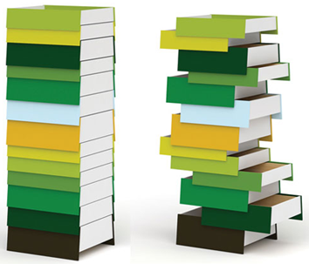
Stacks
Real Life Examples
Shipment in a Cargo
Plates on a tray
Stack of Coins
Stack of Drawers
Shunting of Trains in Railway Yard
Follows the Last-In First-Out (LIFO) strategy
4

Slide 5
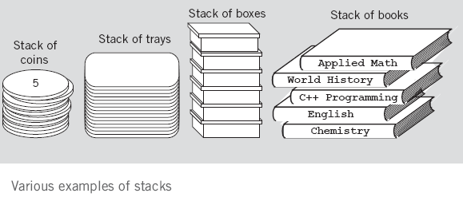
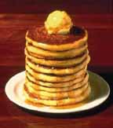
Stack Examples

Slide 6
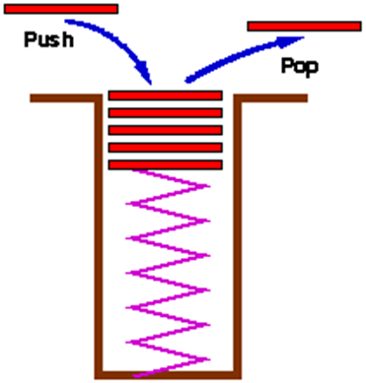
Stack
An ordered collection of homogeneous data elements where the insertions and deletions take place at on end only called Top
New elements are added or pushed onto the top of the stack
The first element to be removed or popped is taken from the top - the last one in

Slide 7
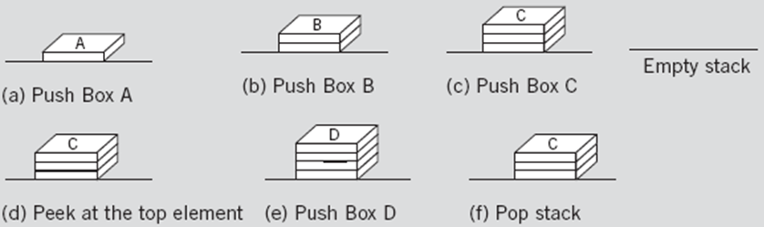
Stack Operations
Insertion
Deletion
Bottom Top

Slide 8
Stack Operations
A stack is generally implemented with only two principle operations
  Push adds an item to a stack
  Pop extracts the most recently pushed item from the stack
Other methods such as
  Top returns the item at the top without removing it
  Isempty determines whether the stack has anything in it

Slide 9
Common Stack Operations
MAKENULL(S): Make Stack S be an empty stack.
TOP(S): Return the element at the top of stack S.
POP(S): Remove the top element of the stack.
PUSH(S): Insert the element x at the top of the stack.
ISEMPTY(S): Return true if S is an empty stack; return false otherwise.

Slide 10
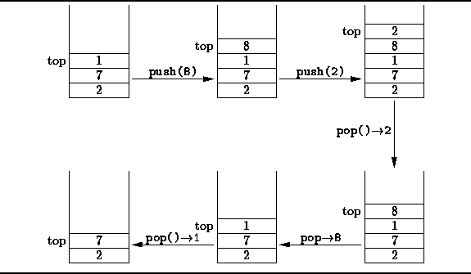
Stack Operations

Slide 11
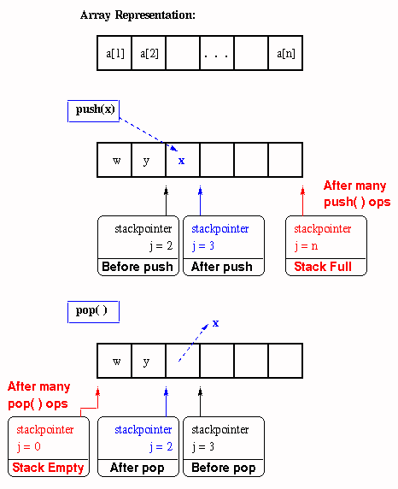
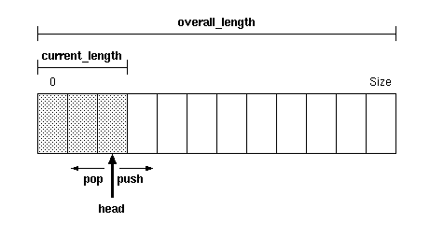
Push and Pop Trace

Slide 12
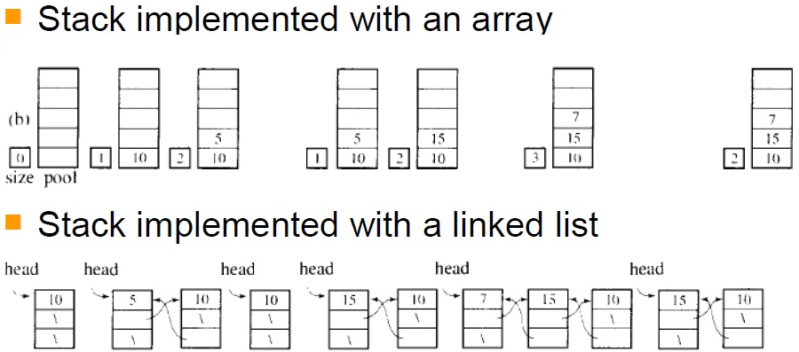
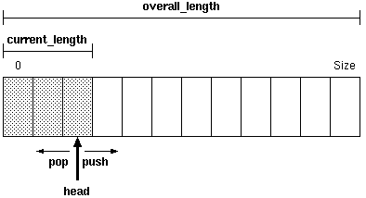
Stack Implementation

Slide 13
Stack – Array Implementation
First Implementation
  Elements are stored in contiguous cells of an array.
  New elements can be inserted to the top of the list
top
First Element
Second Element
List
Last Element
Empty
maxlength

Slide 14
Push– Array Implementation
4
3
2
1
0
4
4
4
4
top
4
5
3
3
3
top
3
4
3
4
2
2
top
2
9
2
9
2
9
Push 8
Push 9
Push 7
Push 4
Push 5
1
1
8
1
8
1
8
1
8
top
top
0
7
0
7
0
7
0
7
0
7
Empty stack
StackSize = 5
top = -1
top = StackSize – 1,
Stack is full,
We can’t push more elements

Slide 15
Push – Array Implementation
push(Stack[],element)
{
if (top == StackSize – 1)
cout<<“stack is full”;
else
Stack[++top] = element;
}

Slide 16
Pop – Array Implementation
top
4
3
2
1
0
4
5
4
4
4
4
3
4
top
3
4
3
3
3
2
9
2
9
top
2
9
2
2
Pop
Pop
Pop
Pop
Pop
1
8
1
8
1
8
1
8
1
top
0
7
0
7
0
7
0
7
top
0
7
Empty stack top = -1
We can’t pop more
elements
top = StackSize – 1,
Stack is full,
We can’t push more elements.

Slide 17
Pop – Array Implementation
pop( Stack[])
{
if (top == –1)
cout<<“stack is empty”;
else
return Stack[top--];
}

Slide 18
Other Stack Operations
//returns the top element of stack without removing it
int top (Stack[]) {
if (top == –1)
cout<<“stack is empty”;
else
return Stack[top]; }
int isEmpty() { //checks stack is empty or not
if (top == –1)
return 1;
else
return 0; }

Slide 19
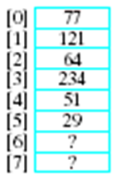
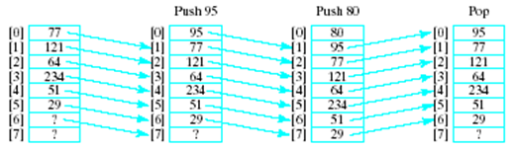
Select position 0 as top of the stack
Model with an array
  Let position 0 be top of stack
Problem consider pushing and popping
  Requires much shifting

Slide 20
Stack – Array Implementation
Since, in a stack the insertion and deletion take place only at the top, so…
A better Implementation:
Anchor the bottom of the stack at the bottom of the array
Let the stack grow towards the top of the array
Top indicates the current position of the first stack element

Slide 21
Stack – Array Implementation
A better Implementation:
top
1
2
First Element
.
.
maxlength
Last Element

Slide 22
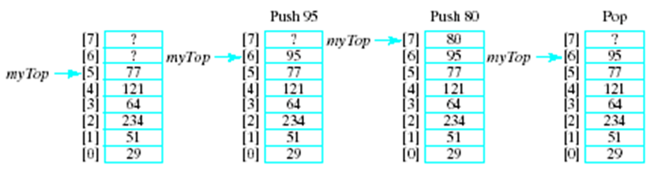
Select position 0 as bottom of the Stack
A better approach is to let position 0 be the bottom of the stack
Thus our design will include
  An array to hold the stack elements
  An integer to indicate the top of the stack

Slide 23
Stack – Linked Representation
PUSH and POP operate only on the header cell and the first cell on the list
struct Node{
int data;
Node* next;
} *top;
top = NULL;
Top
7
8
9

Slide 24
Push operation - Algorithm
void push (int item) {
Node *newNode;
// Insert at Front of the list
newNode->data = item;
newNode->next = top;
top = newNode;
}

Slide 25
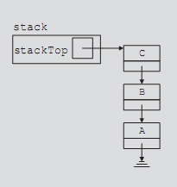
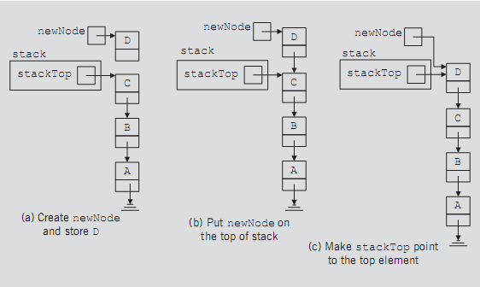
Push Operation - Trace

Slide 26
Pop Operation - Algorithm
int pop () {
Node *temp; int val;
if (top == NULL)
return -1;
else { // delete the first node of the list
temp = top;
top = top->next;
val = temp->data;
delete temp;
return val;
}
}

Slide 27
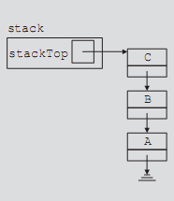
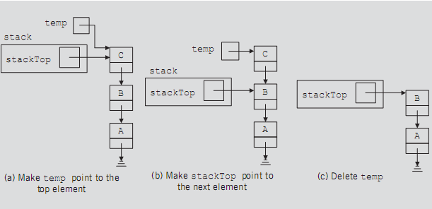
Pop Operation - Trace

Slide 28
1 /* Fig. 12.8: fig12_08.c
2 dynamic stack program */
3 #include <stdio.h>
4 #include <stdlib.h>
1. Define struct
1.1 Function definitions
1.2 Initialize variables
2. Input choice
5
6 struct stackNode { /* self-referential structure */
7 int data;
8 struct stackNode *nextPtr;
9 };
10
11 typedef struct stackNode StackNode;
12 typedef StackNode *StackNodePtr;
13
14 void push( StackNodePtr *, int );
15 int pop( StackNodePtr * );
16 int isEmpty( StackNodePtr );
17 void printStack( StackNodePtr );
18 void instructions( void );
19
20 int main()
21 {
22 StackNodePtr stackPtr = NULL; /* points to stack top */
23 int choice, value;
24
25 instructions();
26 printf( "? " );
27 scanf( "%d", &choice );
28

Slide 29
29 while ( choice != 3 ) {
30
31 switch ( choice ) {
32 case 1: /* push value onto stack */
2.1 switch statement
33 printf( "Enter an integer: " );
34 scanf( "%d", &value );
35 push( &stackPtr, value );
36 printStack( stackPtr );
37 break;
38 case 2: /* pop value off stack */
39 if ( !isEmpty( stackPtr ) )
40 printf( "The popped value is %d.\n",
41 pop( &stackPtr ) );
42
43 printStack( stackPtr );
44 break;
45 default:
46 printf( "Invalid choice.\n\n" );
47 instructions();
48 break;
49 }
50
51 printf( "? " );
52 scanf( "%d", &choice );
53 }
54
55 printf( "End of run.\n" );
56 return 0;
57 }
58

Slide 30
59 /* Print the instructions */
60 void instructions( void )
61 {
62 printf( "Enter choice:\n"
3. Function definitions
63 "1 to push a value on the stack\n"
64 "2 to pop a value off the stack\n"
65 "3 to end program\n" );
66 }
67
68 /* Insert a node at the stack top */
69 void push( StackNodePtr *topPtr, int info )
70 {
71 StackNodePtr newPtr;
72
73 newPtr = malloc( sizeof( StackNode ) );
74 if ( newPtr != NULL ) {
75 newPtr->data = info;
76 newPtr->nextPtr = *topPtr;
77 *topPtr = newPtr;
78 }
79 else
80 printf( "%d not inserted. No memory available.\n",
81 info );
82 }
83

Slide 31
84 /* Remove a node from the stack top */
85 int pop( StackNodePtr *topPtr )
86 {
87 StackNodePtr tempPtr;
3. Function definitions
88 int popValue;
89
90 tempPtr = *topPtr;
91 popValue = ( *topPtr )->data;
92 *topPtr = ( *topPtr )->nextPtr;
93 free( tempPtr );
94 return popValue;
95 }
96
97 /* Print the stack */
98 void printStack( StackNodePtr currentPtr )
99 {
100 if ( currentPtr == NULL )
101 printf( "The stack is empty.\n\n" );
102 else {
103 printf( "The stack is:\n" );
104
105 while ( currentPtr != NULL ) {
106 printf( "%d --> ", currentPtr->data );
107 currentPtr = currentPtr->nextPtr;
108 }
109
110 printf( "NULL\n\n" );
111 }
112 }
113

Slide 32
114 /* Is the stack empty? */
115 int isEmpty( StackNodePtr topPtr )
116 {
117 return topPtr == NULL;
3. Function definitions
Program Output
118 }
Enter choice:
1 to push a value on the stack
2 to pop a value off the stack
3 to end program
? 1
Enter an integer: 5
The stack is:
5 --> NULL
? 1
Enter an integer: 6
The stack is:
6 --> 5 --> NULL
? 1
Enter an integer: 4
The stack is:
4 --> 6 --> 5 --> NULL
? 2
The popped value is 4.
The stack is:
6 --> 5 --> NULL

Slide 33
Balanced Symbol Checking - Stack Application
In processing programs and working with computer languages there are many instances when symbols must be balanced { } , [ ] , ( )
A stack is useful for checking symbol balance
  When a closing symbol is found it must match the most recent opening symbol of the same type
Make an empty stack
Read symbols until end of file
  if the symbol is an opening symbol push it onto the stack
  if it is a closing symbol do the following
    if the stack is empty report an error
    otherwise pop the stack. If the symbol popped does not match the closing symbol report an error
At the end of the file if the stack is not empty report an error

Slide 34
Algorithm in Practice
list[i] = 3 * ( 44 - method( foo( list[ 2 * (i + 1) + foo( list[i - 1] ) ) / 2 *) - list[ method(list[0])];
Processing a file
Tokenization: the process of scanning an input stream. Each independent chunk is a token.
Tokens may be made up of 1 or more characters

Slide 35
Mathematical Calculations
What is 3 + 2 * 4? 2 * 4 + 3? 3 * 2 + 4?
The precedence of operators affects the order of operations
A mathematical expression cannot simply be evaluated left to right.
A challenge when evaluating a program.
Lexical analysis is the process of interpreting a program. Involves Tokenization
What about 1 - 2 - 4 ^ 5 * 3 * 6 / 7 ^ 2 ^ 2

Slide 36
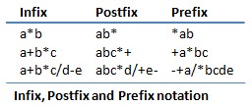
Mathematical Expression Notation
The way we are used to writing expressions is known as infix notation
Postfix expression does not require any precedence rules
3 2 * 1 + is postfix of 3 * 2 + 1

Slide 37
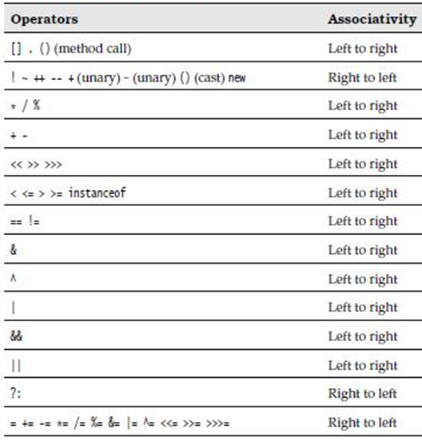
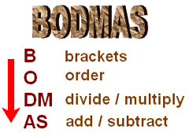
Operator Precedence and Associativity
Order includes Power, square roots
Operator Precedence in Java

Slide 38
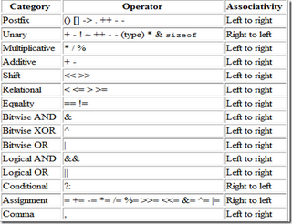
Operator Precedence in C++

Slide 39
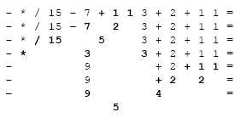
Evaluating Prefix (Polish Notation)

Slide 40
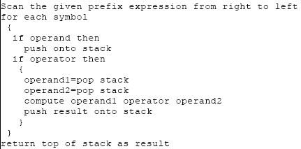
Evaluating Prefix Notation
Algorithm

Slide 41
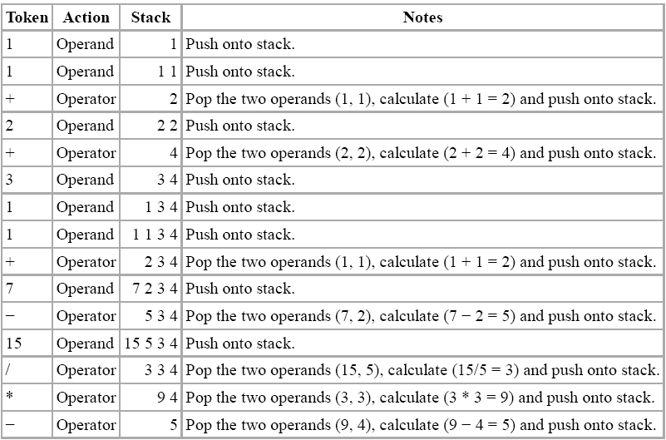
Prefix Notation Stack Example

Slide 42
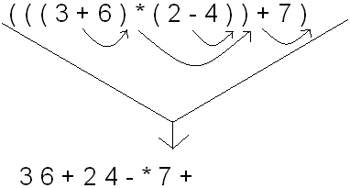
Converting Infix to Postfix Notation
The first thing you need to do is fully parenthesize the expression.
So, the expression (3 + 6) * (2 - 4) + 7
Becomes (((3 + 6) * (2 - 4)) + 7).
Now, move each of the operators immediately to the right of their respective right parentheses. If you do this, you will see that
(((3 + 6) * (2 - 4)) + 7) becomes 3 6 + 2 4 - * 7 +

Slide 43
Implementing Postfix Through Stack
Read in one symbol at a time from the postfix expression.
Any time you see an operand, push it onto the stack
Any time you see a binary operator (+, -, *, /) or unary (square root, negative sign) operator
  If the operator is binary, pop two elements off of the stack.
  If the operator is unary, pop one element off the stack.
Evaluate those operands with that operator
Push the result back onto the stack.
When you're done with the entire expression, the only thing left on the stack should be the final result
  If there are zero or more than 1 operands left on the stack, either your program is flawed, or the expression was invalid
The first element you pop off of the stack in an operation should be evaluated on the right-hand side of the operator
  For multiplication and addition, order doesn't matter, but for subtraction and division, the answer will be incorrect if the operands are switched around.
43

Slide 44
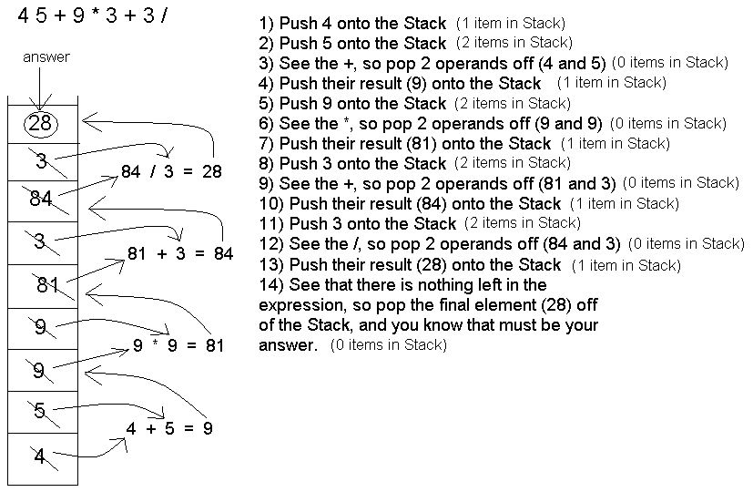
Implementing Postfix Through Stack
44

Slide 45
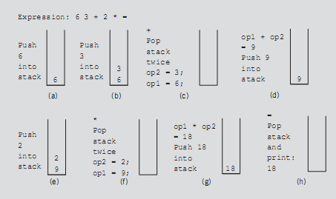
Implementing Postfix Through Stack
45

Slide 46
Implementing Infix Through Stacks
Implementing infix notation with stacks is substantially more difficult
3 stacks are needed :
  one for the parentheses
  one for the operands, and
  one for the operators.
Fully parenthesize the infix expression before attempting to evaluate it

Slide 47
Implementing Infix Through Stack
To evaluate an expression in infix notation:
Keep pushing elements onto their respective stacks until a closed parenthesis is reached
When a closed parenthesis is encountered
  Pop an operator off the operator stack
  Pop the appropriate number of operands off the operand stack to perform the operation
Once again, push the result back onto the operand stack

Slide 48
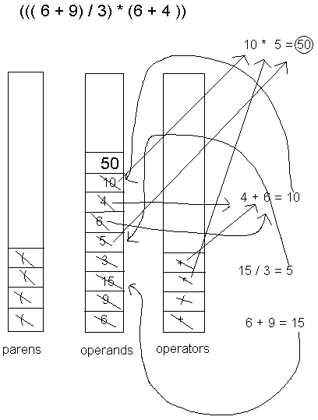
Implementing Infix Through Stack
Keep pushing elements onto their respective stacks until a closed parenthesis is reached
When a closed parenthesis is encountered
  Pop an operator off the operator stack
  Pop the appropriate number of operands off the operand stack to perform the operation
Once again, push the result back onto the operand stack

Slide 49
Application of Stacks
Direct applications
  Page-visited history in a Web browser
  Undo sequence in a text editor
  Chain of method calls in the Java Virtual Machine
  Validate XML
Indirect applications
  Auxiliary data structure for algorithms
  Component of other data structures

Slide 50
Summary
Stacks
Concept
Stack Operations
  Push and Pop
Stack Implementation
  Static Array Based
  Dynamic Linked List
Stack Applications
  Balanced Symbol Checking
  Prefix, Infix and Postfix

