Slide 1
CSC 211
Data Structures
Lecture 22
Dr. Iftikhar Azim Niaz
ianiaz@comsats.edu.pk
1

Slide 2
Last Lecture Summary
Doubly Linked List
Concept
Operations on Doubly Linked List
  Insertion
  Deletion
  Traversing
  Search
Implementation Code
Doubly Linked List with Two Pointers
  Insertion and Deletion
2

Slide 3
Objectives Overview
Queues
Concept
Operations on Queues
  Insertion
  Deletion
  Traversing
  Search
Implementation Code
Circular Queue and Deque
  Insertion and Deletion

Slide 4
Problem to be Solved
It is so often necessary to wait one’s turn before having access to something.
We may want to simulate a real life situation of a waiting line, like
  A line of people waiting to purchase tickets, where the first person in line is the first person served.
With in a computer system there may be lines of tasks
  Waiting for the printer
  Waiting for access to disk storage
  Or in a time sharing system for use of the CPU.
The data structures used to solve this type of problems is called Queue

Slide 5
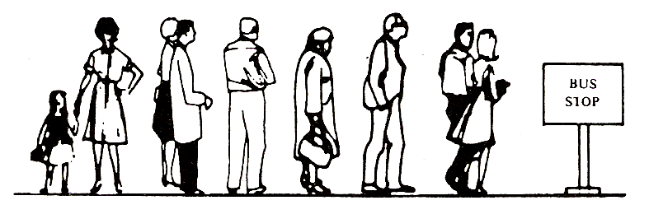
Queue
A linear list in which items may be added only at one end and items may be removed-only at the other end
The name "queue" likely comes from the everyday use of the term e.g. queue at Bus Stop
Another example of a queue is a batch of jobs waiting to be processed, assuming no job has higher priority than the others

Slide 6
Queue
We define a queue to be a list in which
  All additions to the list are made at one end, and
  All deletions from the list are made at the other end
Queues are also called First-In, First-Out lists, or FIFO for short.
The entry in a queue ready to be served, will be
  the first entry that will be removed from the queue,
  We call this the front of the queue.
The last entry in the queue is the one most recently added, we call this the rear of the queue

Slide 7
Queue
Deletion (Dequeue) can take place only at one end, called the front
Insertion (Enqueue) can take place only at the other end, called the rear
The general Queue model is
Queue Q
Dequeue( ) Enqueue (x)
7

Slide 8
Graphic Model of Queue
Rear:
All new items
are added on
this end
Head:
All items are
deleted from
this end

Slide 9
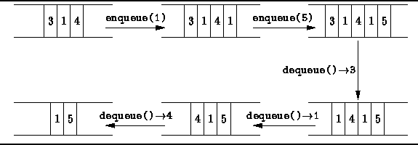

Slide 10
Common Operations on Queue
Create an empty queue
Destroy a queue
Determine whether a queue is empty
Add a new item to the queue
Remove the item that was added earliest

Slide 11
Common Operations on Queue
MAKENULL(Q): Makes Queue Q be an empty list.
FRONT(Q): Returns the first element on Queue Q.
ENQUEUE(x,Q): Inserts element x at the end of Queue Q.
DEQUEUE(Q): Deletes the first element of Q.
EMPTY(Q): Returns true if and only if Q is an empty queue.

Slide 12
Representation of Queue
Static
  Queue is implemented by an array and
  the size of the queue remains fix
Dynamic
  A queue can be implemented as a linked list and
  expand or shrink with each enqueue or dequeue operation
12

Slide 13
Queue – Array representation
Maintained by a linear array QUEUE and
Two variables:
  FRONT containing the location of the front element of the queue; and
  REAR, containing the location of the rear element of the queue
Condition FRONT = -1 will indicate that the queue is empty
whenever an element is deleted from the queue, FRONT = FRONT + 1
whenever an element is added to the queue, REAR = REAR +1

Slide 14
Queue – Array representation
After N insertions, the rear element of the queue will occupy QUEUE [N] or,
  eventually the queue will occupy the last part of the array
  This occurs even through the queue itself may not contain many elements
Suppose we want to insert an element ITEM into a queue at the time the queue does occupy the last part of the array, i.e., when REAR = N
One way to do this is to simply move the entire queue to the beginning of the array, changing FRONT and REAR accordingly, and then inserting ITEM as above
This procedure may be very expensive.
It takes Ω(N) times if the queue has length N

Slide 15
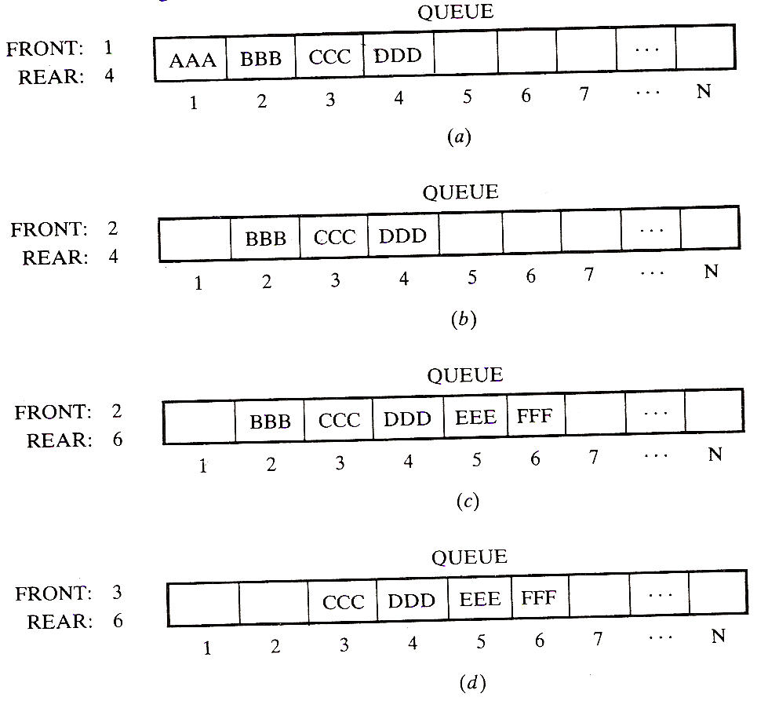
Queue – Array representation

Slide 16
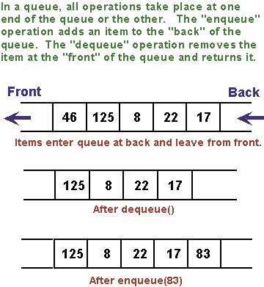
Enqueue and Dequeue Operations

Slide 17
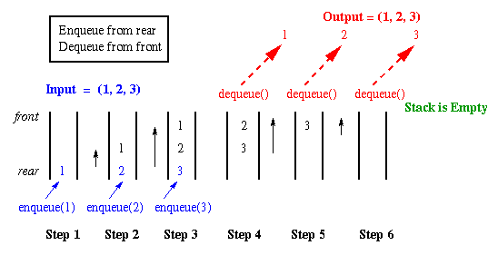

Slide 18
Array Representation
When queue is empty both front and rear are set to -1
While enqueueing increment rear by 1, and while dequeueing increment front by 1
When there is only one value in the Queue, both rear and front have same index
Can we implement Queue by using only one index variable Front or Rear??
YES, by moving elements of array to neighboring locations but this is in-efficient
Why it is inefficient?
Front
First Element
Second Element
Rear
Last Element
maxlength

Slide 19
Array Implementation
5
4
6
7
8
7
6
0 1 2 3 4 5 6 7 8
Front=0
Rear=6
8
7
6
0 1 2 3 4 5 6 7 8
Front=4
Rear=6
7
6
12
67
0 1 2 3 4 5 6 7 8
Front=5
Rear=8
How can we insert more elements? Rear index can not move beyond the last element….

Slide 20
Solution: Using circular queue
Allow rear to wrap around the array.
if(rear == queueSize-1)
rear = 0;
else
rear++;
Or use module arithmetic
rear = (rear + 1) % queueSize;

Slide 21
Circular Queue
7
6
12
67
0 1 2 3 4 5 6 7 8
Front=5
Rear=8
Enqueue 39 Rear=(Rear+1) mod Queue Size = (8+1) mod 9 = 0
39
7
6
12
67
0 1 2 3 4 5 6 7 8
Front=5
Rear=0

Slide 22

Circular Queue - Array
The First position follows the last
The queue is found somewhere around the circle in consecutive positions
QUEUE [l] comes after QUEUE [N] in the array
Suppose that our queue contains only one element, i.e.,
If element is deleted. Then we assign
  FRONT:= NULL and
  REAR: = NULL to indicate that the queue is empty

Slide 23
Circular Queue - Array
1
maxlength
2
.
.
.
.
.
Rear
Front
queue

Slide 24
Circular Queue - Array
If Queue is Full and there are spaces available in the beginning REAR = N and FRONT != 1
Insert ITEM into the queue by assigning ITEM to QUEUE [l].
  Specifically, instead of increasing REAR to N + 1, we reset REAR = 1 and then assign
  QUEUE [REAR]: = ITEM
Similarly, if FRONT = N and an element of QUEUE is deleted
  Reset FRONT = 1 instead of increasing FRONT to N + 1

Slide 25
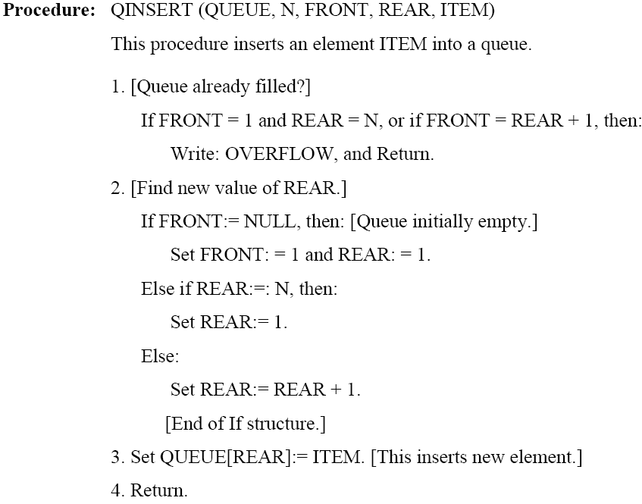
Circular Queue – Insertion in Array Insertion

Slide 26
Circular Queue – Array Insertion
Insert : Move the REAR pointer one position clockwise
1
maxlength
.
2
.
.
X
.
REAR
FRONT

Slide 27
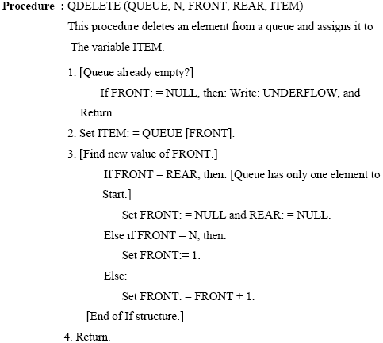
Circular Queue – Array Deletion

Slide 28
Circular Queue – Deletion in Array
Delete: Move FRONT pointer one position clockwise
1
maxlength
.
2
.
.
.
X
REAR
FRONT

Slide 29
Circular Queue –Array -Problem
Problem with above implementation:
No way to distinguish an Empty Queue from a Completely Filled Queue.

Slide 30
Circular Queue –Array -Problem
Rear
Front
Rear
Front
i
i
h
a
g
b
f
c
e
d
A Completely
Filled Queue
A Queue with
Only 1 Element

Slide 31
Circular Queue –Array -Problem
Rear
Front
Rear
Front
i
i
h
a
DEQUEUE
g
b
f
c
e
d
A Completely
Filled Queue
An Empty Queue

Slide 32
Circular Queue –Array -Problem
Suggested Solutions
Although the array has maximum N elements but Queue should not grow more than N - 1
Alternatively, introduce a separate bit to indicate the Queue Empty or Queue Filled status.

Slide 33
Queue – Linked Representation
Assume that front and rear are the two pointers to the front and rear nodes of the queue
struct Node{
int data;
Node* next;
} *front, *rear;
front = NULL;
Rear = NULL;

Slide 34
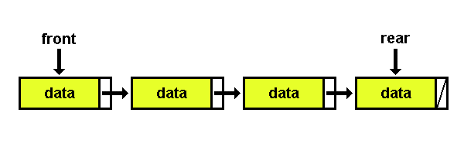
Queue – Linked Representation

Slide 35
Implementing Queue – Linked List
front
rear
front
rear
1
7
5
2
1
7
5
2
dequeue()
front
rear
front
rear
7
5
2
1
7
5
2
enqueue(9)
front
rear
front
rear
7
5
2
9
7
5
2
9

Slide 36
Enqueue Operation - Algorithm
//(linked list) enqueue:
Make newNode point at a new node allocated from heap
Copy new data into node newNode
Set newNode's pointer next field to NULL
Set the next in the rear node to point to newNode
Set rear = newNode;

Slide 37
Implementing Enqueue Operation
void enqueue(int x, Node *rear){
Node* newNode;
newNode = new Node;
newNode->data = x;
newNode->next = NULL;
if (rear == NULL) { // queue is empty
rear = newNode;
front = rear; }
else {
rear->next = newNode;
rear = newNode; }
}

Slide 38
Dequeue Operation - Algorithm
//(linked list) dequeue:
If front is NULL then message “Queue is Empty”
Else
  copy front to a temporary pointer
  Set front to the next of the front
  Delete the temporary pointer

Slide 39
Implementing Dequeue Operation
void dequeue(Node *front) {
Node *p; // temporary pointer
if (front = NULL)
cout<< “Queue is Empty”;
else {
p = front;
front = front->next;
if (front == NULL)
rear = NULL;
delete p;
}
}

Slide 40
Implementing Queue operations
int front(Node *front) {
if (front == NULL)
return 0;
else
return front->data;
}
int isEmpty(Node *front) {
if (front == NULL)
return 1;
else
return 0;
}

Slide 41
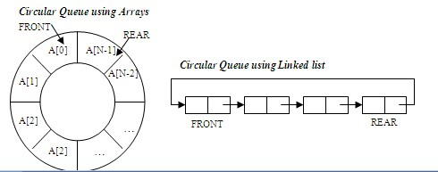
Circular Queue Linked Representation
Keep a counter of number of items in queue
int count = 0

Slide 42
Circular Linked Queue - Enqueue
void enqueue(int x, Node *rear){
Node* newNode;
newNode = new Node;
newNode->data = x;
newNode->next = NULL;
if (count == 0) { // queue is empty
rear = newNode;
front = rear; }
else {
rear->next = newNode;
rear = newNode;
rear->next = front; }
count++;
}

Slide 43
Circular Linked Queue - Dequeue
void dequeue(Node *front) {
Node *p; // temporary pointer
if (count == 0)
cout<< “Queue is Empty”;
else {
count--;
if (front == rear) {
delete front;
front = NULL;
rear = NULL;
} else {
p = front;
front = front->next;
rear->next = front;
delete p;
} // end of inner else
} // end of outer else
} // end of function

Slide 44
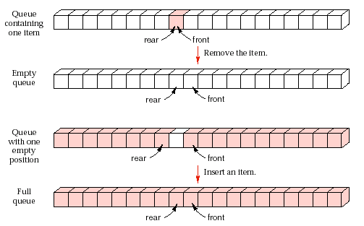
Boundary Conditions

Slide 45
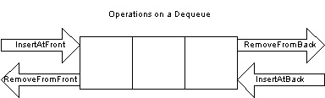
Deque – Double Ended Queue
Elements can only be added or removed from front and back of the queue
Typical operations include
  Insert at front an element
  Insert at back an element
  Remove from back an element
  Remove from front an element
  List the front element and
  List the back element.

Slide 46
Deque - Double Ended Queue
Simple method of implementing a deque is using a doubly linked list
The time complexity of all the deque operations using a doubly linked list can be achieced O(1)
A general purpose deque implementation can be used to mimic specialized behaviors like stacks and queues
For example to use deque as a stack
  Insert at back an element (Push) and Remove at back an element (Pop) can behave as a stack
For example to use deque as a queue.
  Insert at back an element (Enqueue) and Remove at front an element (Dequeue) can behave as a queue.

Slide 47
Deque
struct Node{
int data;
Node* next;
Node* prev;
} *front, *rear;
front = NULL;
rear = NULL;
int count = 0; // to keep the number of items in queue

Slide 48
InsertFront operation
void insertFront(int x){
Node* newNode;
newNode = new Node;
newNode->data = x;
newNode->next = NULL;
newNode->prev = NULL;
if (count == 0) { // queue is empty
rear = newNode;
front = rear ; }
else {
newNode->next = front;
front->prev = newNode;
front = newNode ; }
count++;
}

Slide 49
RemoveFront operation
void removeFront(){
Node *temp;
if (count == 0) { // queue is empty
cout << “Queue is empty”;
temp = front;
// Delete the front node and fix the links
if (front->next != NULL) {
front = front->next;
front->prev = NULL;
} else
front = NULL;
count--;
delete temp;
}

Slide 50
InsertBack operation
void insertBack(int x){
Node* newNode;
newNode = new Node;
newNode->data = x;
newNode->next = NULL;
newNode->prev = NULL;
if (count == 0) { // queue is empty
rear = newNode;
front = rear ; }
else { // append to the list and fix links
rear->next = newNode;
newNode->prev = rear;
rear = newNode ; }
count++;
}

Slide 51
RemoveBack operation
void removeBack(){
Node *temp;
if (count == 0) { // queue is empty
cout << “Queue is empty”;
temp = rear;
// Delete the back node and fix the links
if (rear->prev != NULL) {
rear = rear->prev;
rear->next = NULL;
} else
rear = NULL;
count--;
delete temp;
}

Slide 52
Deque Other Operation
int Front() {
if (count == 0)
return 0
else
return front->data
}
int Back() {
if (count == 0)
return 0
else
return rear->data
}

Slide 53
Deque Other Operation
int Size()
{
return count;
}
int isEmpty() {
if (count == 0)
return 1;
else
return 0;
}

Slide 54
Queue Applications
Operating system
  multi-user/multitasking environments, where several users or task may be requesting the same resource simultaneously.
Communication Software
  queues to hold information received over networks and dial up connections. (Information can be transmitted faster than it can be processed, so is placed in a queue waiting to be processed)
Simulation
Print Queue

Slide 55
Summary
Queues
Concept
Operations on Queues
  Insertion
  Deletion
  Traversing
  Search
Implementation Code
Circular Queue and Deque
  Insertion and Deletion

