Slide 1
CSC 211
Data Structures
Lecture 20
Dr. Iftikhar Azim Niaz
ianiaz@comsats.edu.pk
1

Slide 2
Last Lecture Summary
Quick Sort
Concept
Algorithm
Examples
Implementation
Trace of Quick sort
Complexity of Quick Sort
2

Slide 3
Objectives Overview
Comparison of Merge Sort and Quick Sort
Shell Sort
  Concept, Examples, Algorithm, Complexity
Radix Sort
  Concept, Examples, Algorithm, Complexity
Bucket Sort
  Concept, Examples, Algorithm, Complexity
Comparison of Sorting Techniques

Slide 4
Comparison of Merge and Quick Sort
In the worst case, merge sort does about 39% fewer comparisons than quick sort does in the average case
Merge sort always makes fewer comparisons than quick sort, except in extremely rare cases, when they tie
  where merge sort's worst case is found simultaneously with quick sort's best case
In terms of moves, merge sort's worst case complexity is O(n log n)—the same complexity as quick sort's best case, and
  merge sort's best case takes about half as many iterations as the worst case
4

Slide 5
Comparison of Merge and Quick Sort
Recursive implementations of merge sort make 2n−1 method calls in the worst case, compared to quick sort's n,
  thus merge sort has roughly twice as much recursive overhead as quick sort
However, iterative, non-recursive implementations of merge sort, avoiding method call overhead, are not difficult to code
Merge sort's most common implementation does not sort in place
  therefore, the memory size of the input must be allocated for the sorted output to be stored in
5

Slide 6
Shell Sort
was invented by Donald Shell in 1959, that’s why it is called Shell sorting Algorithm
Also called diminishing increment sort
is an in-place comparison sort
It improves upon bubble sort and insertion sort by moving out of order elements more than one position at a time
It generalizes an exchanging sort, such as insertion or bubble sort, by starting the comparison and exchange of elements with elements that are far apart before finishing with neighboring elements

Slide 7
Shell Sort
Starting with far apart elements can move some out-of-place elements into position faster than a simple nearest neighbor exchange
The algorithm sorts the sub-list of the original list based on increment value or sequence number k Common Sequence numbers are 5,3,1
  There is no proof that these are the best sequence numbers.
Each sub-list contains every kth element of the original list

Slide 8
Shell Sort - Algorithm
Using Marcin Ciura's gap sequence, with an inner insertion sort.
# Sort an array a[0...n-1].
gaps = [701, 301, 132, 57, 23, 10, 4, 1]
for each (gap in gaps)
# Do an insertion sort for each gap size.
for (i = gap; i < n; i += 1)
temp = a[i]
for (j = i; j >= gap and a[j - gap] > temp; j -= gap)
a[j] = a[j - gap]
a[j] = temp

Slide 9
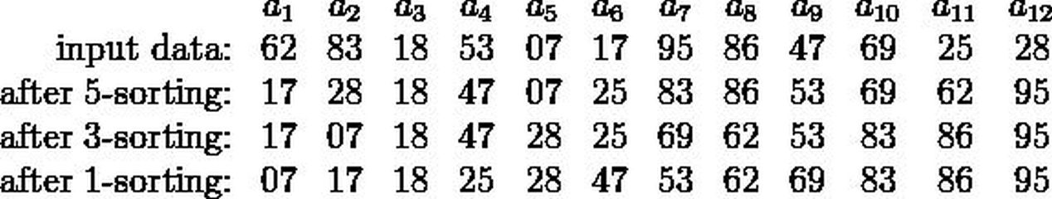
Shell Sort
The first pass, 5-sorting, performs insertion sort on separate subarrays
(a₁, a₆, a₁₁), (a₂, a₇, a₁₂), (a₃, a₈), (a₄, a₉), (a₅, a₁₀)
For instance, it changes the subarray (a₁, a₆, a₁₁) from (62, 17, 25) to (17, 25, 62)
The next pass, 3-sorting, performs insertion sort on the subarrays
(a₁, a₄, a₇, a₁₀), (a₂, a₅, a₈, a₁₁), (a₃, a₆, a₉, a₁₂)
The last pass, 1-sorting, is an ordinary insertion sort of the entire array (a₁,..., a₁₂).

Slide 10
Shell Sort
The sub-arrays that Shell sort operates on are initially short;
later they are longer but almost ordered
In both cases insertion sort works efficiently.
Shellsort is unstable
  it may change the relative order of elements with equal values
It has "natural" behavior, in that it executes faster when the input is partially sorted

Slide 11
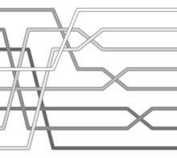
Shell Sort – Exchange Pattern

Slide 12
Shell Sort
Shell sort is a simple extension of insertion sort
It gains speed by allowing exchanges with elements that are far apart.
The idea is that taking every hth element of the file (starting anywhere) will yield a sorted file
  Such a file is h-sorted
  An h-sorted file is h independent sorted files, interleaved together.
By h-sorting for some large values of the increment h, we can move records far apart and thus make it easier for h-sort for smaller values of h
  Using such a procedure for any sequence of values of h which ends in 1 will produce a sorted file

Slide 13
Shell Sort - Algorithm
For example: if k = 5 then sub-lists will be as follows.
s[0] s[5] s[10] ... This means that there are 5 sub-lists and each contain 1/5 of the original list.
Sublist1: s[0] s[5] s[10] ...
Sublist2: s[1] s[6] s[11] ...
Sublist3: s[2] s[7] s[12] ...
Sublist4: s[3] s[8] s[13] ...
Sublist5: s[4] s[9] s[14] ...
If k = 3 then there will be three sub-lists and so on
Create the sub-lists based on increment number sequence number
Sort the lists
Combine the lists
Let’s see this algorithm in action

Slide 14
Shell Sort Pseudocode
Determine a set of h values from ht to h1 that will be used to divide A.
Starting at ht and looping to h1:
  Divide A into h sub-arrays
  Sort each sub-array
Sort side-by-side elements in A

Slide 15
Shell Sort -
How to select h values?
A combination of some empirical and theoretical studies suggests the following algorithm for choosing h values:
h1 = 1
h_{i}+1 = 3h_{i} + 1
Stop at h_{t}, when h_{t+2} >= n
For example for n=10,000 this gives the following values for hi:
1, 4, 13, 40, 121, 364, 1093, 3280

Slide 16
Shell Sort - Algorithm
1. h ← 1
2. while h ≤ n {
3. h ← 3h + 1
4. }
5. repeat
6. h ← h/3
7. for i = h to n do {
8. key ← A[i]
9. j ← i
10. while key < A[j - h] {
11. A[j] ← A[j - h]
12. j ← j - h
13. if j < h then break
14. }
15. A[j] ← key
16. }
17. until h ≤ 1

Slide 17
Shell Sort – C Code
shellsort(itemType a[], int l, int r) {
int i, j, k, h; itemType v;
int incs[16] = { 1391376, 463792, 198768, 86961, 33936,
13776, 4592, 1968, 861, 336,112, 48, 21, 7, 3, 1 };
for ( k = 0; k < 16; k++)
for (h = incs[k], i = l+h; i <= r; i++) {
v = a[i]; j = i;
while (j >= h && a[j-h] > v)
{ a[j] = a[j-h]; j -= h; }
a[j] = v;
}
}

Slide 18
Shell Sort - Example
Let’s sort the following list given the sequence (gaps) numbers are 5, 3, 1
30 62 53 42 17 97 91 38
Step 1: Create the sub list k = 5
S[0] S[5]
S[1] S[6]
30
62
53
42
17
97
91
38
S[2] S[7]
S[3]
S[4]
[0]
[1]
[2]
[3]
[4]
[5]
[6]
[7]
Step 2 - 3: Sort the sub list & combine
S[0] < S[5] This is OK
30
62
38
42
17
97
91
53
S[1] < S[6] This is OK
S[2] > S[7] This is not OK.
Swap them
[0]
[1]
[2]
[3]
[4]
[5]
[6]
[7]

Slide 19
Shell Sort - Example
Pass – 2 with Gap value 3
Step 1: Create the sub list k = 3
S[0] S[3] S[6]
30
62
38
42
17
97
91
53
S[1] S[4] S[7]
S[2] S[5]
[0]
[1]
[2]
[3]
[4]
[5]
[6]
[7]
Step 2 - 3: Sort the sub list & combine
S[0] S[3] S[6] 30, 42, 91 OK
30
17
38
42
53
97
91
62
S[1] S[4] S[7] 62, 17, 53 not OK
SORT them 17, 53, 62
S[2] S[5] 38, 97 OK
[0]
[1]
[2]
[3]
[4]
[5]
[6]
[7]

Slide 20
Shell Sort - Example
Pass – 2 with Gap value 3
Step 1: Create the sub list k =1
S[0] S[1] S[2] S[3] S[4] S[5] S[6] S[7]
30
17
38
42
53
97
91
62
[0]
[1]
[2]
[3]
[4]
[5]
[6]
[7]
Step 2 - 3: Sort the sub list & combine
Sorting will be like insertion sort
17
30
38
42
53
62
91
97
[0]
[1]
[2]
[3]
[4]
[5]
[6]
[7]
DONE

Slide 21
Shell Sort
Named after its creator, Donald Shell, the shell sort is an improved version of the insertion sort.
In the shell sort, a list of N elements is divided into K segments where K is known as the increment.
What this means is that instead of comparing adjacent values, we will compare values that are a distance K apart.
We will shrink K as we run through our algorithm.

Slide 22
Shell Sort - Example
Just as in the straight insertion sort, we compare 2 values and swap them if they are out of order. In the shell sort we compare values that are a distance K apart.
Once we have completed going through the elements in our list with K=5, we decrease K and continue process

Slide 23
Shell Sort - Example
Here we have reduced K to 2. Just as in the insertion sort, if we swap 2 values, we have to go back and compare the previous 2 values to make sure they are still in order.

Slide 24
Shell Sort - Example
All shell sorts will terminate by running an insertion sort (i.e., K=1). However, using the larger values of K first has helped to sort our list so that the straight insertion sort will run faster

Slide 25
Shell Sort - Pseudocode
k = last/2 //compute original k value
loop (k not 0)
current = k
loop (current <= last)
hold = list[current]
walker = current – k
loop (walker >= 0 AND hold < list[walker])
list[walker+k] = list[walker] //move larger element
walker = walker – k //recheck previous comparison
end loop
list[walker+k] = hold //place the smaller element
current = current + 1
end loop
k = k/2 //compute the new k value
end loop

Slide 26
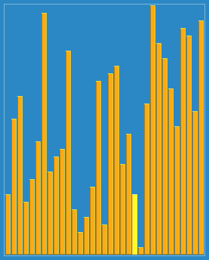
Shell Sort
There are many schools of thought on what the increment should be in the shell sort.
Also note that just because an increment is optimal on one list, it might not be optimal for another list
Shell sort with 23, 10, 4, 1 in action

Slide 27
Complexity of Shell Sort
Best case performance O(n)
Average case performance O(n(log n)²) or
O(n^{3/2})
Worst case performance O(n^{3/2})
Depends on the gap sequence . Best known is
Worst case space complexity O(1) auxiliary
Where n is the number of elements to be sorted

Slide 28
Insertion Sort vs. Shell Sort
Comparing the Big-O notation (for the average case) we find that:
  Insertion: O(n²)
  Shell: O(n^{1.25}) //empirically determined
Although this doesn’t seem like much of a gain, it makes a big difference as n gets large
  Note that in the worst case, the Shell sort has an efficiency of O(n²) .
  However, using a special incrementing technique, this worst case can be reduced to O(n^{1.5})

Slide 29
Insertion Sort vs. Shell Sort

Slide 30
Radix Sort
How did IBM get rich originally?
Answer: punched card readers for census tabulation in early 1900’s.
  In particular, a card sorter that could sort cards into different bins
    Each column can be punched in 12 places
    (Decimal digits use only 10 places!)
  Problem: only one column can be sorted on at a time

Slide 31
Radix Sort
It was used by the card-sorting machines.
Card sorters worked on one column at a time.
It is the algorithm for using the machine that extends the technique to multi-column sorting.
The human operator was part of the algorithm!
Key idea: sort on the “least significant digit” first and on the remaining digits in sequential order. The sorting method used to sort each digit must be “stable”.
  If we start with the “most significant digit”, we’ll need extra storage.

Slide 32
Radix Sort
Based on examining digits in some base-b numeric representation of items (or keys)
Least significant digit radix sort
  Processes digits from right to left
  Used in early punched-card sorting machines
Create groupings of items with same value in specified digit
  Collect in order and create grouping with next significant digit

Slide 33
Radix Sort
Start with least significant digit
Separate keys into groups based on value of current digit
Make sure not to disturb original order of keys
Combine separate groups in ascending order
Repeat, scanning digits in reverse order

Slide 34
Radix Sort
Extra information: every integer can be represented by at most k digits
  d₁d₂…d_{k} where d_{i} are digits in base r
  d₁: most significant digit
  d_{k}: least significant digit

Slide 35
Radix Sort Example
0 0 0
1 0 0
0 1 0
0 1 0
1 0 0
0 1 1
0 0 1
0 0 0
1 0 0
1 0 0
0 0 0
0 1 0
0 1 0
1 0 1
1 1 0
1 1 0
1 0 1
1 0 0
0 1 1
0 0 1
0 0 0
0 0 0
0 0 1
1 0 1
0 1 1
0 1 0
1 1 0
0 1 0
1 0 0
0 1 1
1 0 1
1 1 0
0 0 0
1 1 0
1 0 1
1 0 1
0 0 1
0 1 1
0 0 1
0 1 1
1 1 0
0 0 1
1 1 1
1 1 1
1 1 1
1 1 1
1 1 1
1 1 1

Slide 36
Radix Sort Analysis
Each digit requires n comparisons
The algorithm is Θ(n)
The preceding lower bound analysis does not apply, because Radix Sort does not compare keys.
Radix Sort is sometimes known as bucket sort. (Any distinction between the two is unimportant
Alg. was used by operators of card sorters.

Slide 37
Radix Sort
Intuitively, you might sort on the most significant digit, then the second most significant, etc.
Problem: lots of intermediate piles of cards to keep track of
Key idea: sort the least significant digit first
  RadixSort(A, d)
  for i=1 to d
  StableSort(A) on digit i

Slide 38
Radix Sort
Can we prove it will work?
Inductive argument:
  Assume lower-order digits {j: j<i}are sorted
  Show that sorting next digit i leaves array correctly sorted
    If two digits at position i are different, ordering numbers by that digit is correct (lower-order digits irrelevant)
    If they are the same, numbers are already sorted on the lower-order digits. Since we use a stable sort, the numbers stay in the right order

Slide 39
Radix Sort Example
Problem: sort 1 million 64-bit numbers
  Treat as four-digit radix 2¹⁶ numbers
  Can sort in just four passes with radix sort!
  Running time: 4( 1 million + 2¹⁶ ) ≈ 4 million operations
Compare with typical O(n log n) comparison sort
  Requires approx log n = 20 operations per number being sorted
  Total running time ≈ 20 million operations

Slide 40
Radix Sort
In general, radix sort based on bucket sort is
  Fast
  Asymptotically fast (i.e., O(n))
  Simple to code
  A good choice
Can radix sort be used on floating-point numbers?

Slide 41
Radix Sort - Algorithm
sort by the least significant digit first (counting sort)
  => Numbers with the same digit go to same bin
reorder all the numbers: the numbers in bin 0 precede the numbers in bin 1, which precede the numbers in bin 2, and so on
sort by the next least significant digit
continue this process until the numbers have been sorted on all k digits

Slide 42
Radix Sort
Does it work?
Clearly, if the most significant digit of a and b are different and a < b, then finally a comes before b
If the most significant digit of a and b are the same, and the second most significant digit of b is less than that of a, then b comes before a.

Slide 43
Radix sort
Example 2: sorting cards
  2 digits for each card: d₁d₂
  d₁ = ♠♥♣♦: base 4
    ♦ ≤ ♣ ≤ ♥ ≤ ♠
  d₂ = A, 2, 3, ...J, Q, K: base 13
    A ≤ 2 ≤ 3 ≤ ... ≤ J ≤ Q ≤ K
  ♦2 ≤ ♣2 ≤ ♥5 ≤ ♠K

Slide 44
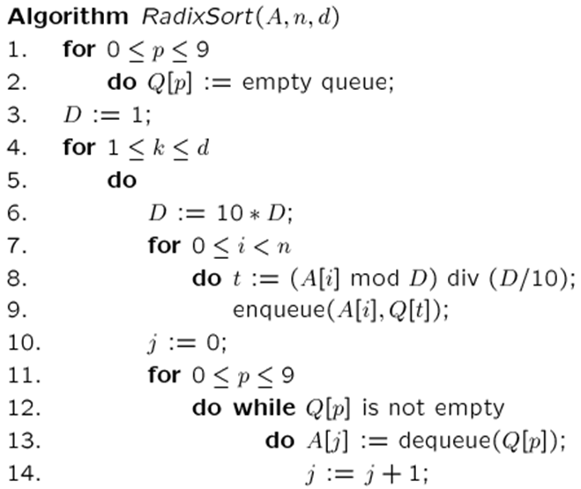
A=input array, n=|numbers to be sorted|,
d=# of digits, k=the digit being sorted, j=array index
// Base 10
// FIFO
// d times counting of sort
// scan A[i], put into correct slot
// reorder back to original array

Slide 45
Radix Sort
Increasing the base r decreases the number of passes
Running time
  k passes over the numbers (i.e. k counting sorts, with range being 0..r)
  each pass takes 2N
  total: O(2Nk)=O(Nk)
  r and k are constants: O(N)
Note:
  radix sort is not based on comparisons; the values are used as array indices
  If all N input values are distinct, then k = Ω(log N) (e.g., in binary digits, to represent 8 different numbers, we need at least 3 digits). Thus the running time of Radix Sort also become Ω(N log N)

Slide 46
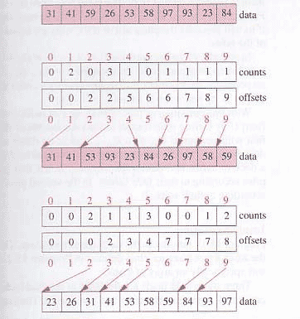
Radix Sort - Example

Slide 47
Radix Sort
What sort will we use to sort on digits?
Bucket sort is a good choice:
  Sort n numbers on digits that range from 1..N
  Time: O(n + N)
Each pass over n numbers with d digits takes time O(n+k), so total time O(dn+dk)
  When d is constant and k=O(n), takes O(n) time

Slide 48
Radix Sort – Analysis
Is radix sort preferable to a comparison based algorithm such as Quick sort?
Radix sort running time is O(n)
Quick sort running time is O(nlogn)
The constant factors hidden in O notations differ.
Radix sort make few passes than quick sort but each pass of radix sort may take significantly longer.

Slide 49
Comments: Radix Sort
Assumption: input has d digits ranging from 0 to k
Basic idea:
  Sort elements by digit starting with least significant
  Use a stable sort (like bucket sort) for each stage
Each pass over n numbers with 1 digit takes time O(n+k), so total time O(dn+dk)
  When d is constant and k=O(n), takes O(n) time
Fast, Stable, Simple
Doesn’t sort in place

Slide 50
Bucket Sort
Works by partitioning an array into a number of buckets
Each bucket is then sorted individually, either using a different sorting algorithm, or by recursively applying the bucket sorting algorithm
It is a distribution sort, and is a cousin of radix sort in the most to least significant digit (LSD) flavour

Slide 51
Bucket Sort
Assumption: the keys are in the range [0, N)
Basic idea:
    1. Create N linked lists (buckets) to divide interval [0,N) into subintervals of size 1
    2. Add each input element to appropriate bucket
    3. Concatenate the buckets
Expected total time is O(n + N), with n = size of original sequence
  if N is O(n) → sorting algorithm in O(n) !

Slide 52
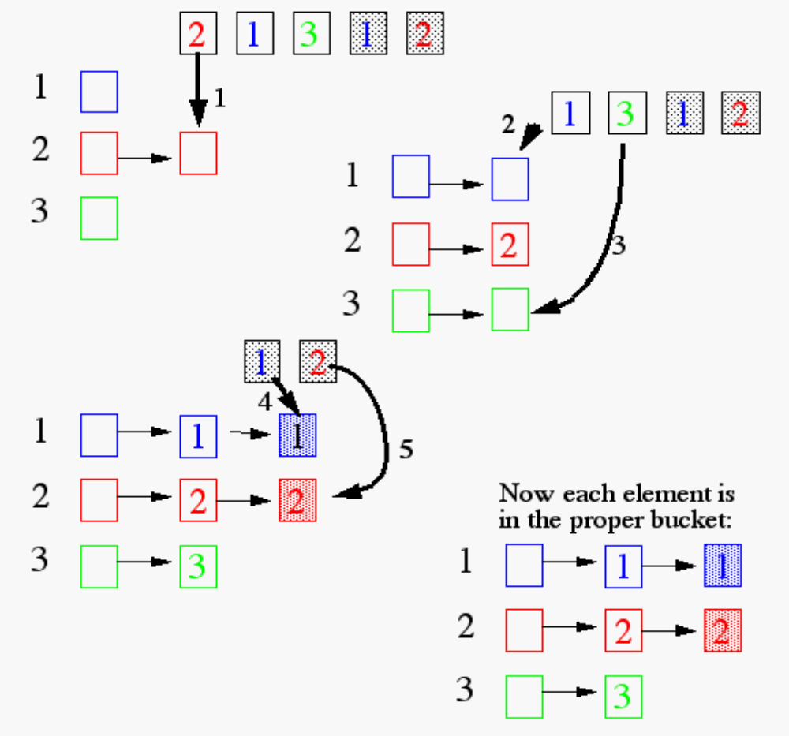
Bucket Sort
Each element of the array is put in one of the N “buckets”

Slide 53
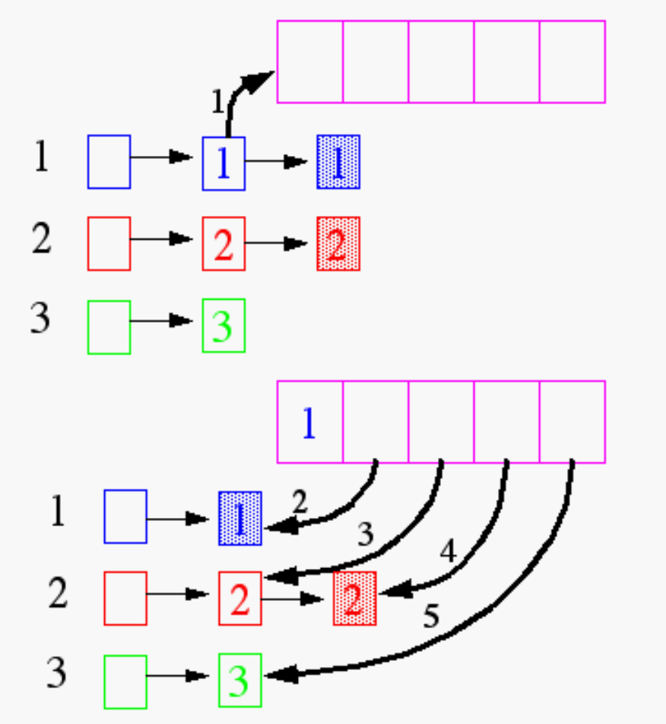
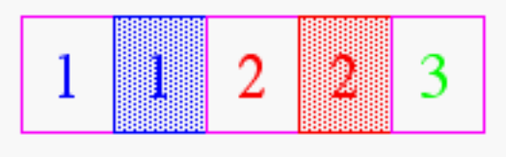
Bucket Sort
Now, pull the elements from the buckets into the array
At last, the sorted array (sorted in a stable way):

Slide 54
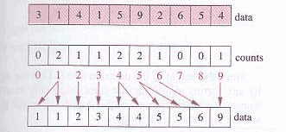
Bucket Sort - Example

Slide 55
Does it Work for Real Numbers?
What if keys are not integers?
  Assumption: input is n reals from [0, 1)
  Basic idea:
    Create N linked lists (buckets) to divide interval [0,1) into subintervals of size 1/N
    Add each input element to appropriate bucket and sort buckets with insertion sort
  Uniform input distribution → O(1) bucket size
    Therefore the expected total time is O(n)
  Distribution of keys in buckets similar with …. ?

Slide 56
Bucket Sort
Bucket sort runs in linear time
Assumption:
  Input is drawn from uniform distribution
Count sort assumes input consists of integers in small range
Bucket sort assumes that input is generated over the interval [0,1).

Slide 57
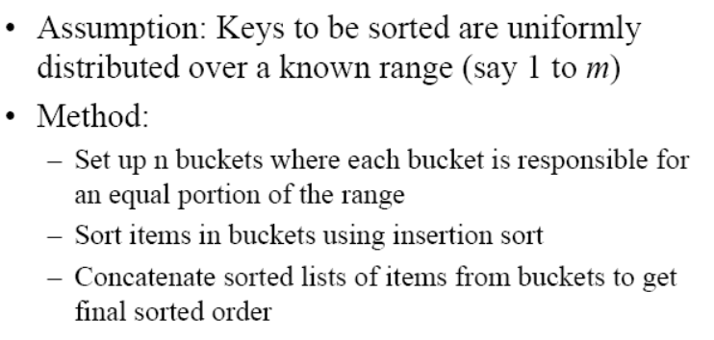
Bucket Sort

Slide 58
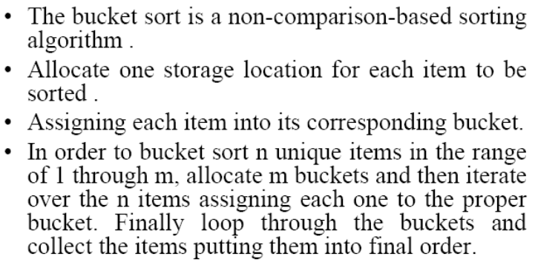
Bucket Sort

Slide 59
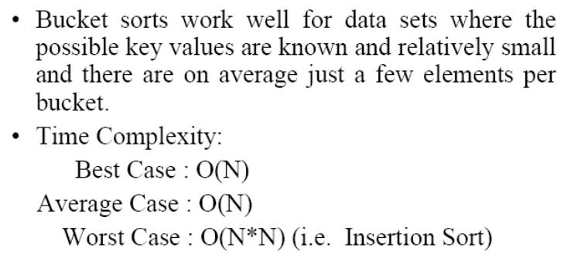
Bucket Sort

Slide 60
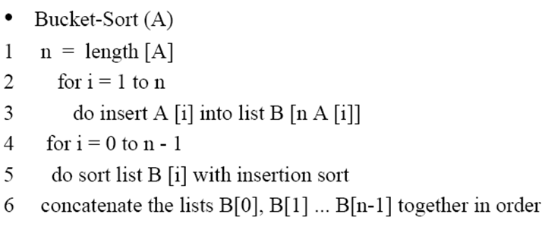
Bucket Sort - Algorithm

Slide 61
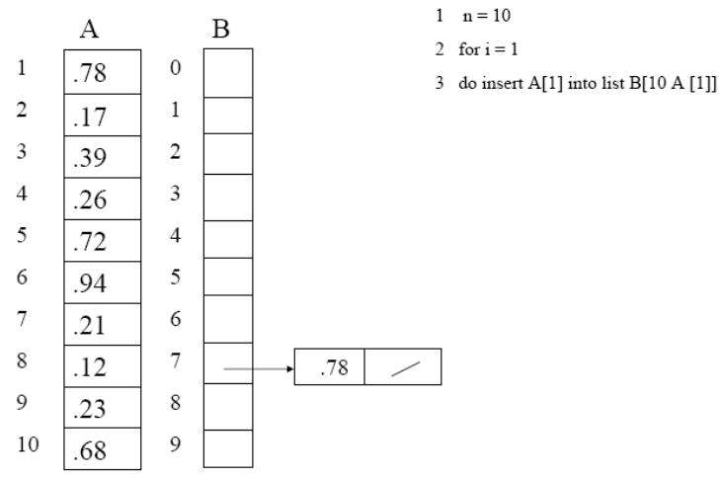
Bucket Sort Trace - 1

Slide 62
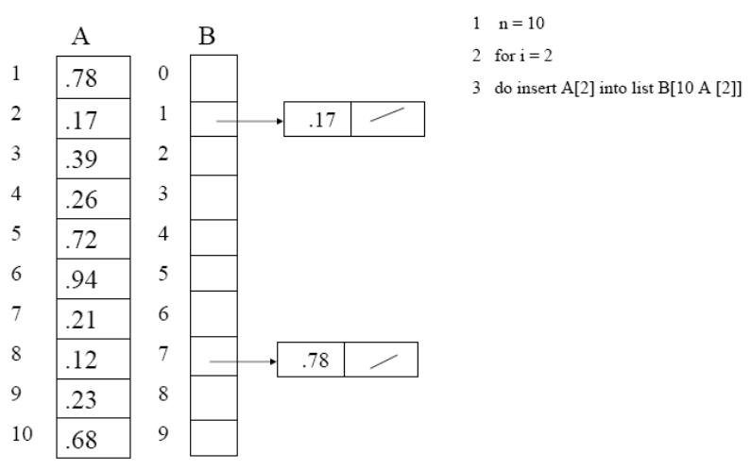
Bucket Sort Trace - 2

Slide 63
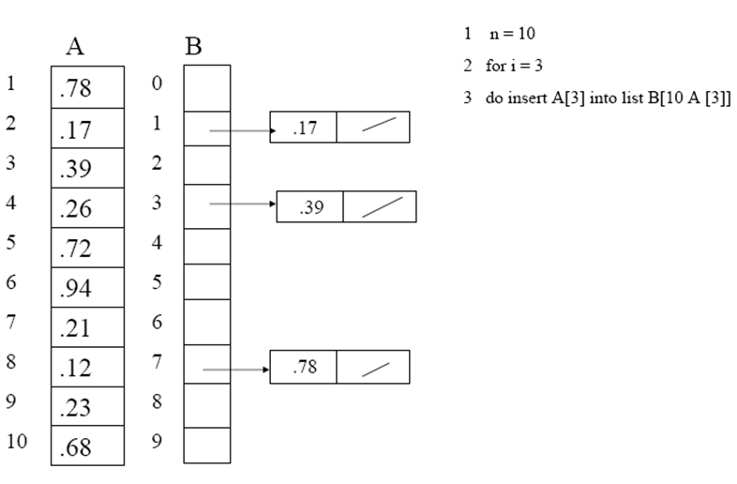
Bucket Sort Trace -3

Slide 64
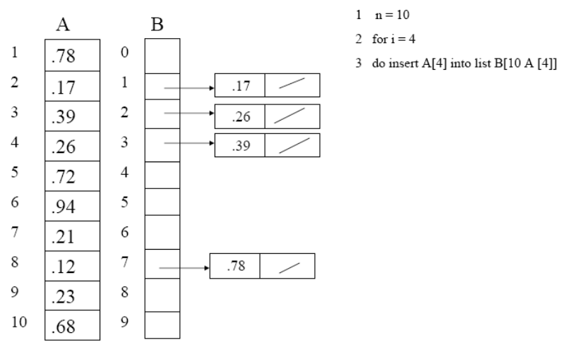
Bucket Sort Trace - 4

Slide 65
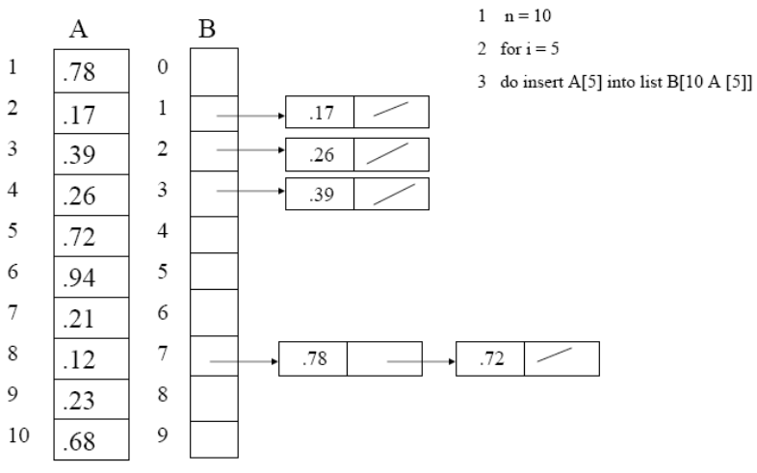
Bucket Sort Trace - 5

Slide 66
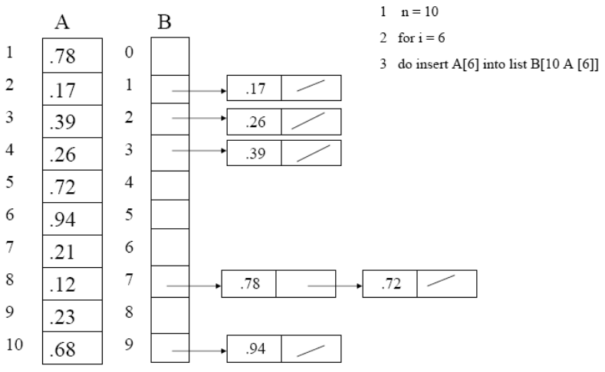
Bucket Sort Trace - 6

Slide 67
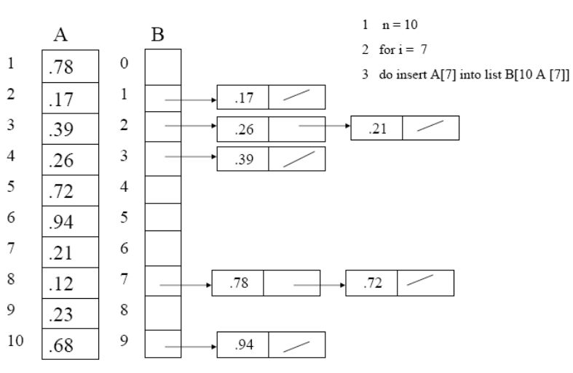
Bucket Sort Trace - 7

Slide 68
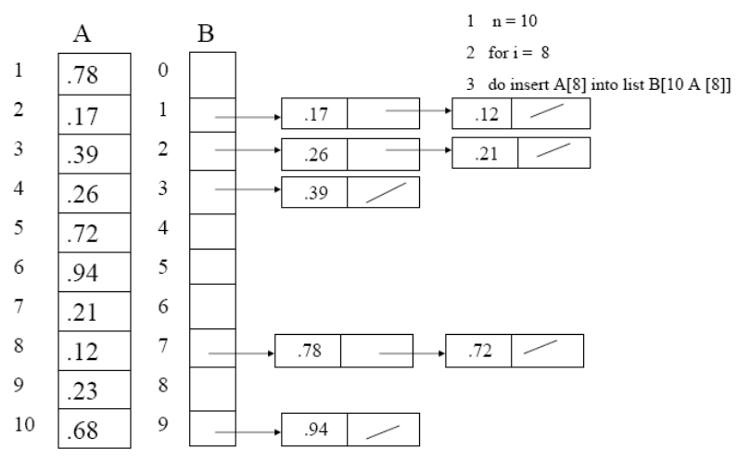
Bucket Sort Trace - 8

Slide 69
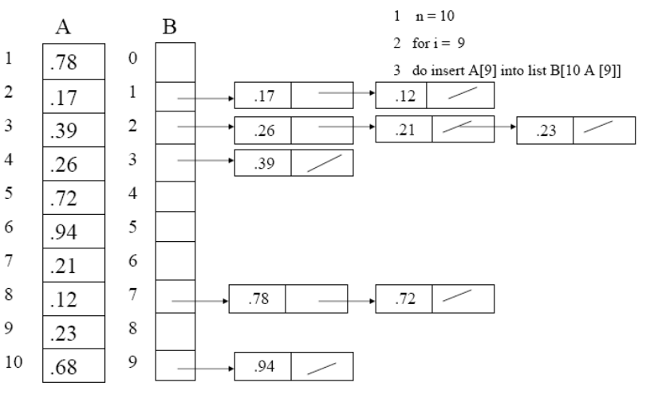
Bucket Sort Trace - 9

Slide 70
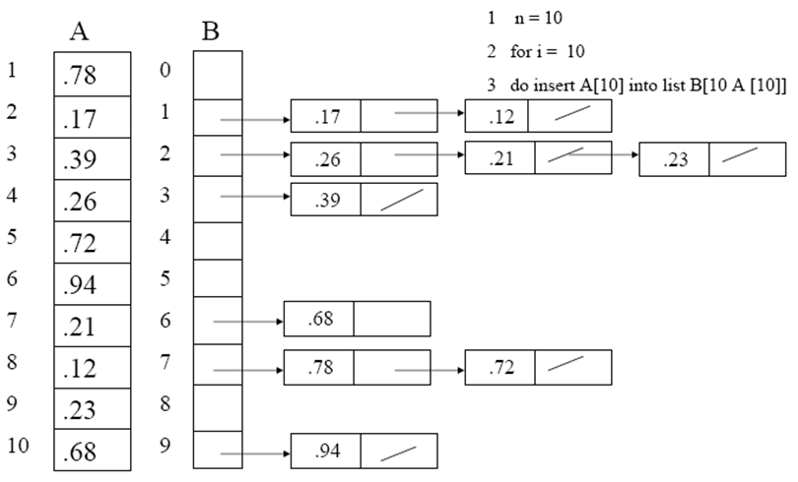
Bucket Sort Trace - 10

Slide 71
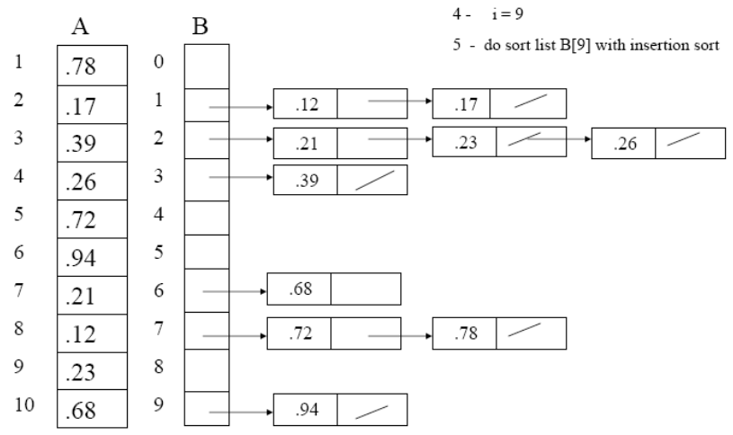
Bucket Sort Trace 11

Slide 72
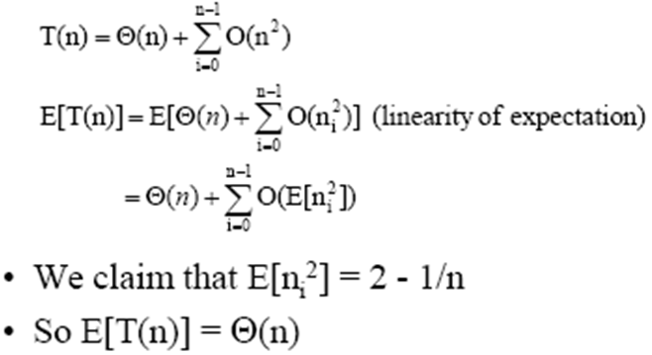
Analysis of Bucket Sort
Worst case running time
  All elements fall into the same bucket
  O(n²) Uniform Keys
  O (n + k) Integer keys
Average case running time
  Θ(n)

Slide 73
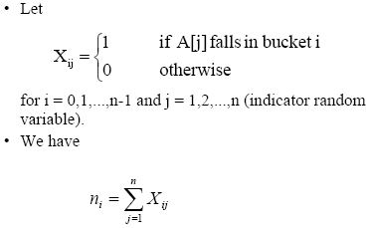
Bucket Sort Analysis

Slide 74
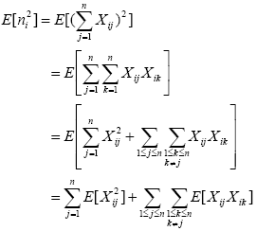
Bucket Sort - Analysis

Slide 75
Bucket Sort - Analysis

Slide 76
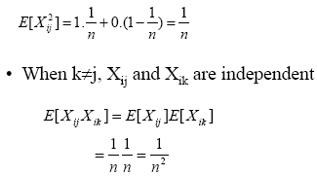
Bucket Sort - Analysis

Slide 77
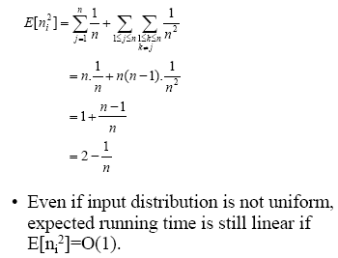
Bucket Sort - Analysis

Slide 78
Sorting Method - Preference
Which sorting algorithm is preferable depends upon
  Characteristics of implementation of underlying machine
  Quick sort uses hardware caches more efficiently
  Radix sort using count sort don’t sort in place.
When primary memory storage is concerned an in-place algorithm is preferable
So Quick sort is preferable.

Slide 79
Efficiency Summary
Sort | Worst Case | Average Case
Insertion | O(n²) | O(n²)
Selection | O(n²) | O(n²)
Bubble | O(n²) | O(n²)
Quick | O(n²) | O(nlog₂n)
Merge | O(nlog₂n) | O(nlog₂n)
Shell | O(n^{1.5}) | O(n^{1.25})
Bucket Sort | O(n²) | O(n + k)

Slide 80
Efficiency of Sorting Algorithms

Slide 81
Efficiency of Sorting Algorithms

Slide 82
Summary
Comparison of Merge Sort and Quick Sort
Shell Sort
  Concept, Examples, Algorithm, Complexity
Radix Sort
  Concept, Examples, Algorithm, Complexity
Bucket Sort
  Concept, Examples, Algorithm, Complexity
Comparison of Sorting Techniques

