Slide 1
CSC 211
Data Structures
Lecture 19
Dr. Iftikhar Azim Niaz
ianiaz@comsats.edu.pk
1

Slide 2
Last Lecture Summary
Merge Sort
Concept
Algorithm
Examples
Implementation
Trace of Merge sort
Complexity of Merge Sort
2

Slide 3
Objectives Overview
Quick Sort
Concept
Algorithm
Examples
Implementation
Trace of Quick sort
Complexity of Quick Sort

Slide 4
Quick Sort
Quick sort is a divide and conquer algorithm which relies on a partition operation:
  to partition an array an element called a pivot is selected
All elements smaller than the pivot are moved before it and all greater elements are moved after it
  This can be done efficiently in linear time and in-place
The lesser and greater sublists are then recursively sorted
4

Slide 5
Quick sort
also known as partition-exchange sort
Efficient implementations (with in-place partitioning) are typically unstable sorts and somewhat complex, but are among the fastest sorting algorithms in practice
One of the most popular sorting algorithms and is available in many standard programming libraries

Slide 6
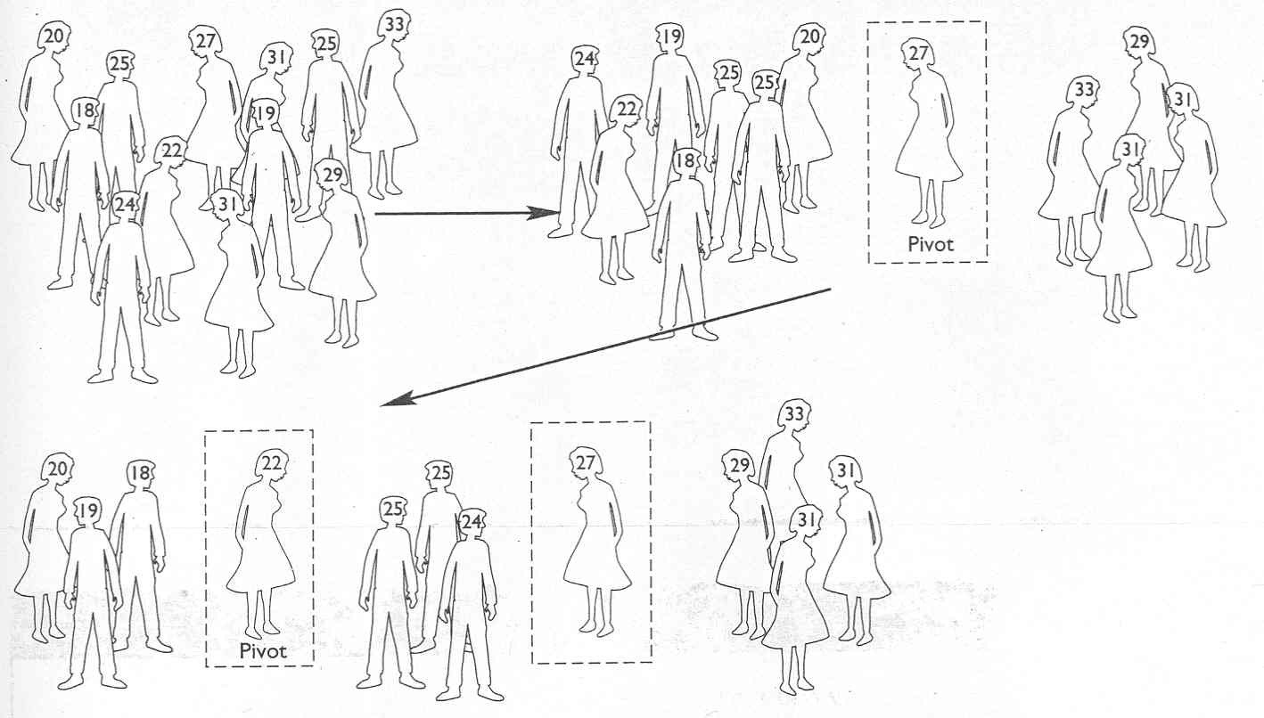
Quick Sort

Slide 7
Idea of Quick-Sort
1) Divide : If the sequence S has 2 or more elements, select an element x from S to be your pivot. Any arbitrary element, like the last, will do. Remove all the elements of S and divide them into 3 sequences:
  L, holds S’s elements less than x
  E, holds S’s elements equal to x
  G, holds S’s elements greater than x
2) Recurse: Recursively sort L and G
3) Conquer: Finally, to put elements back into S in order, first inserts the elements of L, then those of E, and those of G.

Slide 8
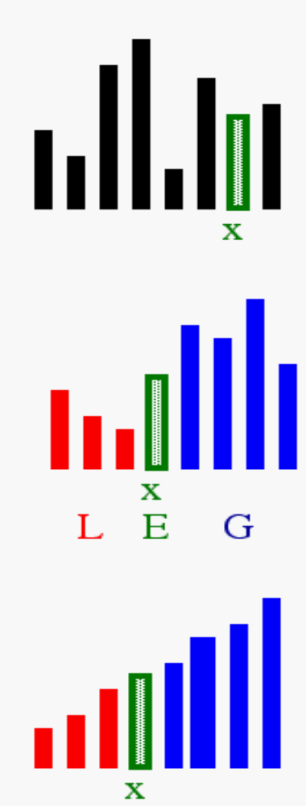
Idea of Quick Sort
1) Select: pick an element
2) Divide: rearrange elements so that x goes to its final position E
3) Recurse and Conquer: recursively sort

Slide 9
Quick Sort
Quick sort, Hoare, 1961
  Quicksort uses “divide-and-conquer” method. If array has only one element – sorted, otherwise partitions the array: all elements on left are smaller than the elements on the right.
  Three stages :
    Choose pivot – first, or middle, or random, or special chosen. Follows partition: all element smaller than pivot on the left, all elements greater than pivot on the right.
    Quicksort recursively the elements before pivot.
    Quicksort recursively the elements after pivot.
  Various techniques applied to improve efficiency.

Slide 10
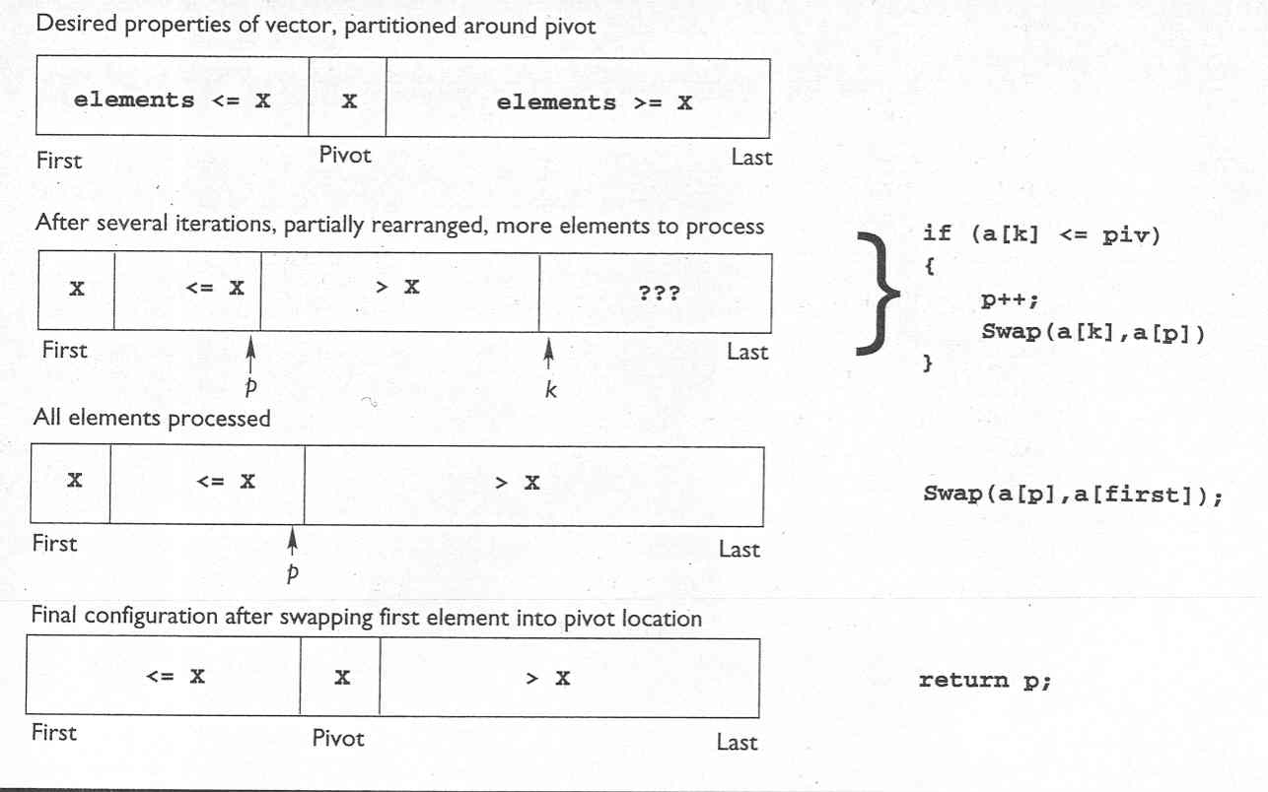
Quick Sort

Slide 11
Quick Sort - Algorithm
Divide and conquer algorithm.
It first divides a large list into two smaller sub-lists
  the low elements and the high elements
It can then recursively sort the sub-lists.
The steps are:
  Pick an element, called a pivot, from the list.
  Reorder the list so that
    all elements with values less than the pivot come before the pivot
    while all elements with values greater than the pivot come after it (equal values can go either way)
    After this partitioning, the pivot is in its final position. This is called the partition operation.
  Recursively sort the sub-list of lesser elements and the sub-list of greater elements.
The base case of the recursion are lists of size zero or one, which never need to be sorted

Slide 12
Quick Sort – Simple Version
function quicksort('array')
if length('array') ≤ 1
return 'array’// an array of zero or one elements is already sorted
select and remove a pivot value 'pivot' from 'array'
create empty lists 'less' and 'greater'
for each 'x' in 'array'
if 'x' ≤ 'pivot' then append 'x' to 'less'
else append 'x' to 'greater'
return concatenate(quicksort('less'), 'pivot', quicksort('greater')) // two recursive calls

Slide 13
Simpler Version - Analysis
We only examine elements by comparing them to other elements. This makes it a comparison sort
This version is also a stable sort
  assuming that the "for each" method retrieves elements in original order, and the pivot selected is the last among those of equal value
The correctness of the partition algorithm is based on the following two arguments:
  At each iteration, all the elements processed so far are in the desired position: before the pivot if less than the pivot's value, after the pivot if greater than the pivot's value (loop invariant).
  Each iteration leaves one fewer element to be processed (loop variant).
Correctness of the overall algorithm can be proven via induction:
  for zero or one element, the algorithm leaves the data unchanged
  for a larger data set it produces the concatenation of two parts
    elements less than the pivot and elements greater than it, themselves sorted by the recursive hypothesis

Slide 14
In-Place Version
The disadvantage of the simple version is that it requires O(n) extra storage space
  which is as bad as merge sort
The additional memory allocations required can also drastically impact speed and cache performance in practical implementations
There is a more complex version which uses an in-place partition algorithm and can achieve the complete sort using O(log n) space
  (not counting the input) on average (for the call stack)

Slide 15
In-Place Partition function
// left is index of the leftmost element of the array. Right is index of the rightmost element of the array (inclusive)
// Number of elements in subarray = right-left+1
function partition(array, 'left', 'right', 'pivotIndex')
'pivotValue' := array['pivotIndex']
swap array['pivotIndex'] and array['right'] // Move pivot to end
'storeIndex' := 'left'
for 'i' from 'left' to 'right' - 1 // left ≤ i < right
if array['i'] < 'pivotValue'
swap array['i'] and array['storeIndex']
'storeIndex' := 'storeIndex' + 1
swap array['storeIndex'] and array['right'] // Move pivot to its final place
return 'storeIndex'

Slide 16
In-Place Partition Function Working
It partitions the portion of the array between indexes left and right, inclusively, by moving
  all elements less than array[pivotIndex] before the pivot, and the equal or greater elements after it.
  In the process it also finds the final position for the pivot element, which it returns.
  It temporarily moves the pivot element to the end of the subarray, so that it doesn't get in the way.
Because it only uses exchanges, the final list has the same elements as the original list
Notice that an element may be exchanged multiple times before reaching its final place
Also, in case of pivot duplicates in the input array, they can be spread across the right subarray, in any order
  This doesn't represent a partitioning failure, as further sorting will reposition and finally "glue" them together.

Slide 17
In-Place Quick Sort Function
function quicksort(array, 'left', 'right')
// If the list has 2 or more items
if 'left' < 'right‘
choose any 'pivotIndex' such that
'left' ≤ 'pivotIndex' ≤ 'right‘
// Get lists of bigger and smaller items and final position of pivot
'pivotNewIndex' := partition(array, 'left', 'right', 'pivotIndex')
// Recursively sort elements smaller than the pivot
quicksort(array, 'left', 'pivotNewIndex' - 1)
// Recursively sort elements at least as big as the pivot
quicksort(array, 'pivotNewIndex' + 1, 'right')

Slide 18
In-Place Analysis
Each recursive call to this quicksort function reduces the size of the array being sorted by at least one element,
  since in each invocation the element at pivotNewIndex is placed in its final position
Therefore, this algorithm is guaranteed to terminate after at most n recursive calls
However, since partition reorders elements within a partition, this version of quicksort is not a stable sort.

Slide 19
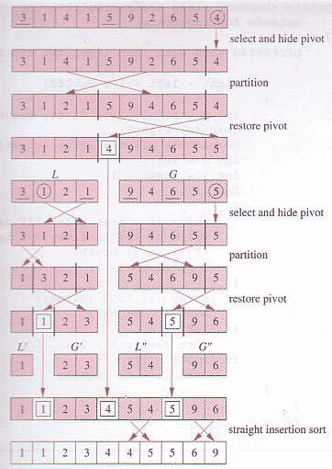
Quick Sort - Example

Slide 20
Quick Sort – C++ Code
void quickSort(int arr[], int left, int right) {
int i = left, j = right; int tmp; int pivot = arr[(left + right) / 2];
/* partition */
while (i <= j) {
while (arr[i] < pivot)
i++;
while (arr[j] > pivot)
j--;
if (i <= j) {
tmp = arr[i]; arr[i] = arr[j]; arr[j] = tmp;
i++;
j--;
} // end if
}; // end while
/* recursion */
if (left < j)
quickSort(arr, left, j);
if (i < right)
quickSort(arr, i, right);
}

Slide 21
Choice Of Pivot
Choosing Pivot is a vital discussion and usually following methods are popular in selecting a Pivot.
Leftmost element in list that is to be sorted
  When sorting a[1:20], use a[1] as the pivot
Randomly select one of the elements to be sorted as the pivot
  When sorting a[1:20], generate a random number r in the range [1, 20]. Use a[r] as the pivot

Slide 22
Choice Of Pivot
Median-of-Three rule - from leftmost, middle, and rightmost elements of the list to be sorted, select the one with median key as the pivot
  When sorting a[1:20], examine a[1], a[10] ((1+20)/2), and a[20]. Select the element with median (i.e., middle) key
  If a[1].key = 30, a[10].key = 2, and a[20].key = 10, a[20] becomes the pivot
  If a[1].key = 3, a[10].key = 2, and a[20].key = 10, a[1] becomes the pivot
  If a[1].key = 30, a[10].key = 25, and a[20].key = 10, a[10] becomes the pivot

Slide 23
Pivot – First Element
The quick sort algorithm works by partitioning the array to be sorted
Each partitions are internally sorted recursively
In partition the first element of an array is chosen as a key value
This key value can be the first element of an array
If A is an array then key = A [0], and rest of the elements are grouped into two portions such that
  One partition contains elements smaller than key value
  Another partition contains elements larger than the key value

Slide 24
Pivot – First Element
Two pointers, up and low, are initialized to the upper and lower bounds of the sub array
During execution, at any point each element in a position above up is greater than or equal to key value
And each element in a position below low pointer is less than or equal to key
up pointer will move in a decrement
And low pointer will move in an increment

Slide 25
Pivot – First Element
Let A be an array A[1],A[2],A[3]…..A[n] of n numbers, then
Step 1: Choose the first element of the array as the key i.e. key=A[1]
Step 2: Place the low pointer in second position of the array and up pointer in the last position of the array i.e. low=2 and up=n
Step 3: Repeatedly increase the low pointer by one position until A[low]>key
Step 4: Repeated decrease the up pointer by one position until A[up]<=key
Step 5: if up>low, interchange A[low] with A[up], swap=A[low], A[low]=A[up], A[up]=swap
Step 6: Repeat steps 3,4 and 5 until the condition in step 5 fails (i.e. up<=low) then interchange A[up] with key

Slide 26
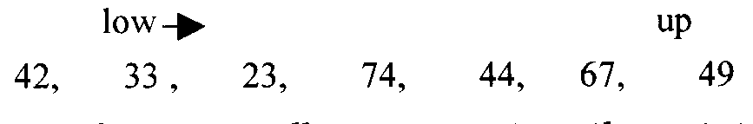
Quick Sort –Trace Pivot = First
We have an array with seven(7) elements 42,33,23,74,44,67,49
Select the first value of the array as the key, so key=42
Pointer low points to 33 and up points to 49
Move the low pointer repeatedly by incrementing one position until A[low]>key

Slide 27
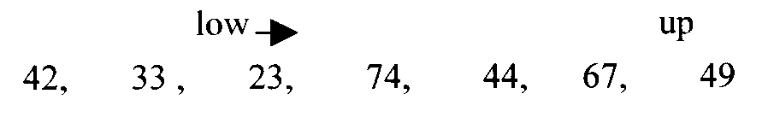
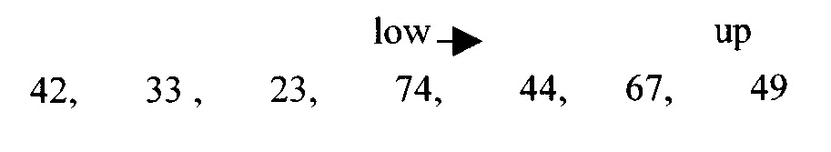
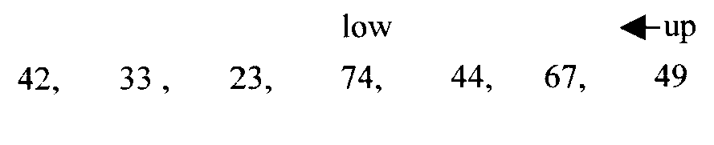
Quick Sort –Trace Pivot = First
Here A[low]>key i.e. 74>42
Now decrease the pointer up by one position until A[up]<=key

Slide 28




Quick Sort –Trace Pivot = First

Slide 29


Quick Sort –Trace Pivot = First
We will recursively call the quicksort function and will pass the sub-arrays along with the low and up pointers

Slide 30
Quick Sort –Trace Pivot - First
We are given array of n integers to sort:
40
20
10
80
60
50
7
30
100

Slide 31
Quick Sort –Trace Pivot - First
There are a number of ways to pick the key element. In this example, we will use the first element in the array:
40
20
10
80
60
50
7
30
100

Slide 32
Quick Sort –Trace Pivot - First
key_index = 0
40
20
10
80
60
50
7
30
100
[0] [1] [2] [3] [4] [5] [6] [7] [8]
low
up

Slide 33
Quick Sort –Trace Pivot - First
While data[low] <= data[key]
++low
key_index = 0
40
20
10
80
60
50
7
30
100
[0] [1] [2] [3] [4] [5] [6] [7] [8]
low
high

Slide 34
Quick Sort –Trace Pivot - First
While data[low] <= data[key]
++low
key_index = 0
40
20
10
80
60
50
7
30
100
[0] [1] [2] [3] [4] [5] [6] [7] [8]
low
high

Slide 35
Quick Sort –Trace Pivot - First
While data[low] <= data[key]
++low
key_index = 0
40
20
10
80
60
50
7
30
100
[0] [1] [2] [3] [4] [5] [6] [7] [8]
low
high

Slide 36
Quick Sort –Trace Pivot - First
While data[low] <= data[key]
  ++low
While data[high] > data[key]
  --high
key_index = 0
40
20
10
80
60
50
7
30
100
[0] [1] [2] [3] [4] [5] [6] [7] [8]
low
high

Slide 37
Quick Sort –Trace Pivot - First
While data[low] <= data[key]
  ++low
While data[high] > data[key]
  --high
key_index = 0
40
20
10
80
60
50
7
30
100
[0] [1] [2] [3] [4] [5] [6] [7] [8]
low
high

Slide 38
Quick Sort –Trace Pivot - First
While data[low] <= data[key]
  ++low
While data[high] > data[key]
  --high
If low < high
  swap data[low] and data[high]
key_index = 0
40
20
10
80
60
50
7
30
100
[0] [1] [2] [3] [4] [5] [6] [7] [8]
low
high

Slide 39
Quick Sort –Trace Pivot - First
While data[low] <= data[key]
  ++low
While data[high] > data[key]
  --high
If low < high
  swap data[low] and data[high]
key_index = 0
40
20
10
30
60
50
7
80
100
[0] [1] [2] [3] [4] [5] [6] [7] [8]
low
high

Slide 40
Quick Sort –Trace Pivot - First
While data[low] <= data[key]
  ++low
While data[high] > data[key]
  --high
If low < high
  swap data[low] and data[high]
While high > low, go to 1.
key_index = 0
40
20
10
30
60
50
7
80
100
[0] [1] [2] [3] [4] [5] [6] [7] [8]
low
high

Slide 41
Quick Sort –Trace Pivot - First
While data[low] <= data[key]
  ++low
While data[high] > data[key]
  --high
If low < high
  swap data[low] and data[high]
While high > low, go to 1.
key_index = 0
40
20
10
30
60
50
7
80
100
[0] [1] [2] [3] [4] [5] [6] [7] [8]
low
high

Slide 42
Quick Sort –Trace Pivot - First
While data[low] <= data[key]
  ++low
While data[high] > data[key]
  --high
If low < high
  swap data[low] and data[high]
While high > low, go to 1.
key_index = 0
40
20
10
30
60
50
7
80
100
[0] [1] [2] [3] [4] [5] [6] [7] [8]
low
high

Slide 43
Quick Sort –Trace Pivot - First
While data[low] <= data[key]
  ++low
While data[high] > data[key]
  --high
If low < high
  swap data[low] and data[high]
While high > low, go to 1.
key_index = 0
40
20
10
30
60
50
7
80
100
[0] [1] [2] [3] [4] [5] [6] [7] [8]
low
high

Slide 44
Quick Sort –Trace Pivot - First
While data[low] <= data[key]
  ++low
While data[high] > data[key]
  --high
If low < high
  swap data[low] and data[high]
While high > low, go to 1.
key_index = 0
40
20
10
30
60
50
7
80
100
[0] [1] [2] [3] [4] [5] [6] [7] [8]
low
high

Slide 45
Quick Sort –Trace Pivot - First
While data[low] <= data[key]
  ++low
While data[high] > data[key]
  --high
If low < high
  swap data[low] and data[high]
While high > low, go to 1.
key_index = 0
40
20
10
30
60
50
7
80
100
[0] [1] [2] [3] [4] [5] [6] [7] [8]
low
high

Slide 46
Quick Sort –Trace Pivot - First
While data[low] <= data[key]
  ++low
While data[high] > data[key]
  --high
If low < high
  swap data[low] and data[high]
While high > low, go to 1.
key_index = 0
40
20
10
30
7
50
60
80
100
[0] [1] [2] [3] [4] [5] [6] [7] [8]
low
high

Slide 47
Quick Sort –Trace Pivot - First
While data[low] <= data[key]
  ++low
While data[high] > data[key]
  --high
If low < high
  swap data[low] and data[high]
While high > low, go to 1.
key_index = 0
40
20
10
30
7
50
60
80
100
[0] [1] [2] [3] [4] [5] [6] [7] [8]
low
high

Slide 48
Quick Sort –Trace Pivot - First
While data[low] <= data[key]
  ++low
While data[high] > data[key]
  --high
If low < high
  swap data[low] and data[high]
While high > low, go to 1.
key_index = 0
40
20
10
30
7
50
60
80
100
[0] [1] [2] [3] [4] [5] [6] [7] [8]
low
high

Slide 49
Quick Sort –Trace Pivot - First
While data[low] <= data[key]
  ++low
While data[high] > data[key]
  --high
If low < high
  swap data[low] and data[high]
While high > low, go to 1.
key_index = 0
40
20
10
30
7
50
60
80
100
[0] [1] [2] [3] [4] [5] [6] [7] [8]
low
high

Slide 50
Quick Sort –Trace Pivot - First
While data[low] <= data[key]
  ++low
While data[high] > data[key]
  --high
If low < high
  swap data[low] and data[high]
While high > low, go to 1.
key_index = 0
40
20
10
30
7
50
60
80
100
[0] [1] [2] [3] [4] [5] [6] [7] [8]
low
high

Slide 51
Quick Sort –Trace Pivot - First
While data[low] <= data[key]
  ++low
While data[high] > data[key]
  --high
If low < high
  swap data[low] and data[high]
While high > low, go to 1.
key_index = 0
40
20
10
30
7
50
60
80
100
[0] [1] [2] [3] [4] [5] [6] [7] [8]
low
high

Slide 52
Quick Sort –Trace Pivot - First
While data[low] <= data[key]
  ++low
While data[high] > data[key]
  --high
If low < high
  swap data[low] and data[high]
While high > low, go to 1.
key_index = 0
40
20
10
30
7
50
60
80
100
[0] [1] [2] [3] [4] [5] [6] [7] [8]
low
high

Slide 53
Quick Sort –Trace Pivot - First
While data[low] <= data[key]
  ++low
While data[high] > data[key]
  --high
If low < high
  swap data[low] and data[high]
While high > low, go to 1.
key_index = 0
40
20
10
30
7
50
60
80
100
[0] [1] [2] [3] [4] [5] [6] [7] [8]
low
high

Slide 54
Quick Sort –Trace Pivot - First
While data[low] <= data[key]
  ++low
While data[high] > data[key]
  --high
If low < high
  swap data[low] and data[high]
While high > low, go to 1.
key_index = 0
40
20
10
30
7
50
60
80
100
[0] [1] [2] [3] [4] [5] [6] [7] [8]
low
high

Slide 55
Quick Sort –Trace Pivot - First
While data[low] <= data[key]
  ++low
While data[high] > data[key]
  --high
If low < high
  swap data[low] and data[high]
While high > low, go to 1.
Swap data[high] and data[key_index]
key_index = 0
40
20
10
30
7
50
60
80
100
[0] [1] [2] [3] [4] [5] [6] [7] [8]
low
high

Slide 56
Quick Sort –Trace Pivot - First
While data[low] <= data[key]
  ++low
While data[high] > data[key]
  --high
If low < high
  swap data[low] and data[high]
While high > low, go to 1.
Swap data[high] and data[key_index]
7
20
10
30
40
50
60
80
100
key_index = 4
[0] [1] [2] [3] [4] [5] [6] [7] [8]
low
high

Slide 57
Partition Result
7
20
10
30
40
50
60
80
100
[0] [1] [2] [3] [4] [5] [6] [7] [8]
<= data[key]
> data[key]

Slide 58
Recursion: Quicksort Sub-arrays
7
20
10
30
40
50
60
80
100
[0] [1] [2] [3] [4] [5] [6] [7] [8]
<= data[key]
> data[key]

Slide 59
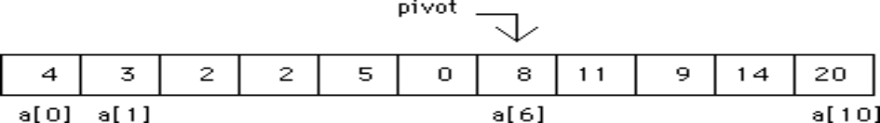
Quick Sort Trace – Median Pivot
If an unsorted list (represented as vector a) originally contains:
we might select the item in the middle position, a[5], as the pivot, which is 8 in our illustration. Our process would then put all values less than 8 on the left side and all values greater than 8 on the right side.
This first subdivision produces
Now, each sublist is subdivided in exactly the same manner. This process continues until all sublists are in order. The list is then sorted. This is a recursive process.

Slide 60
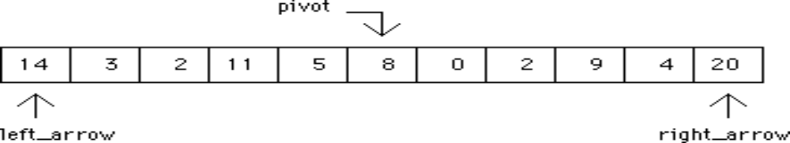
Quick Sort Trace 2
We choose the value in the middle for the pivot.
As in binary search, the index of this value is found by (first + last) / 2,
  where first and last are the indices of the initial and final items in the vector representing the list.
  We then identify a left_arrow and right_arrow on the far left and far right, respectively.
  This can be envisioned as:
  where left_arrow and right_arrow initially represent the lowest and highest indices of the vector items.

Slide 61
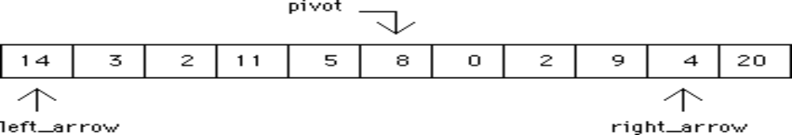
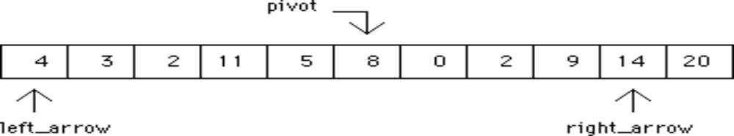
Quick Sort Trace 3
Starting on the right, the right_arrow is moved left until a value less than or equal to the pivot is encountered. This produces
In a similar manner, left_arrow is moved right until a value greater than or equal to the pivot is encountered. This is the situation just encountered. Now the contents of the two vector items are swapped to produce

Slide 62
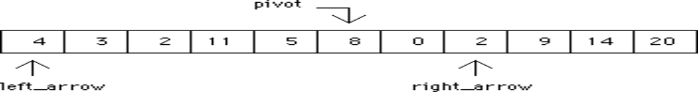
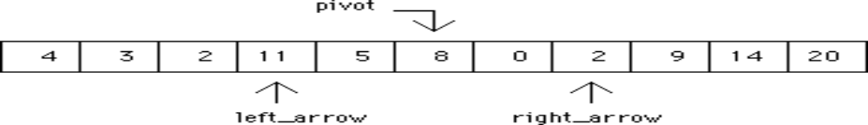

Quick Sort Trace 4
We continue by moving right_arrow left to produce
and moving left_arrow right yields
These values are exchanged to produce

Slide 63
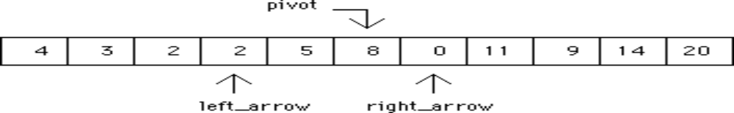
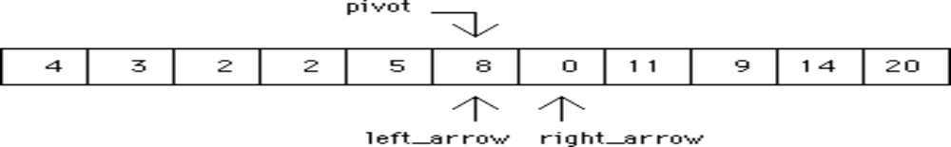
Quick Sort Trace 5
This process stops when left_arrow > right_arrow is TRUE. Since this is still FALSE at this point, the next right_arrow move produces
and the left_arrow move to the right yields

Slide 64
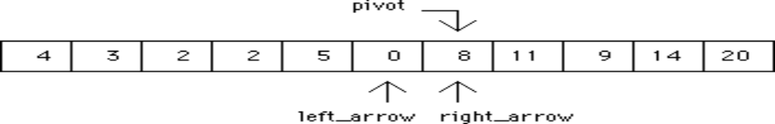
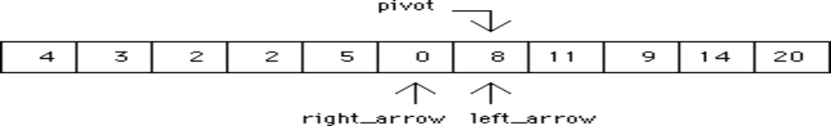
Quick Sort Trace 6
Because we are looking for a value greater than or equal to pivot when moving left, left_arrow stops moving and an exchange is made to produce
Notice that the pivot, 8, has been exchanged to occupy a new position. This is acceptable because pivot is the value of the item, not the index. As before, right_arrow is moved left and left_arrow is moved right to produce

Slide 65
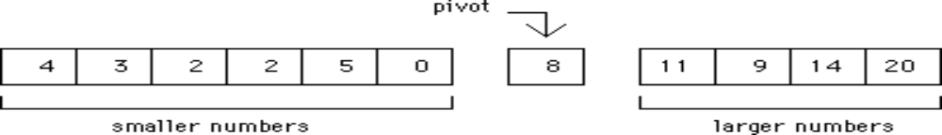
Quick Sort Trace 7
Since right_arrow < left_arrow is TRUE, the first subdivision is complete. At this stage, numbers smaller than pivot are on the left side and numbers larger than pivot are on the right side. This produces two sublists that can be envisioned as
Each sublist can now be sorted by the same function. This would require a recursive call to the sorting function. In each case, the vector is passed as a parameter together with the right and left indices for the appropriate sublist.

Slide 66
Quick Sort Source Code C ++
void QuickSort(int list[], int left, int right) {
int pivot, leftArrow, rightArrow;
leftArrow = left;
rightArrow = right;
pivot = list[(left + right) / 2];
do {
while (list[rightArrow] > pivot)
--rightArrow;
while (list[leftArrow] < pivot)
++leftArrow;
if (leftArrow <= rightArrow) {
Swap_Data(list[leftArrow], list[rightArrow]);
++leftArrow;
--rightArrow;
}
} while (rightArrow >= leftArrow);
if (left < rightArrow)
QuickSort(list, left, rightArrow);
if (leftArrow < right)
QuickSort(list, leftArrow, right);
}

Slide 67
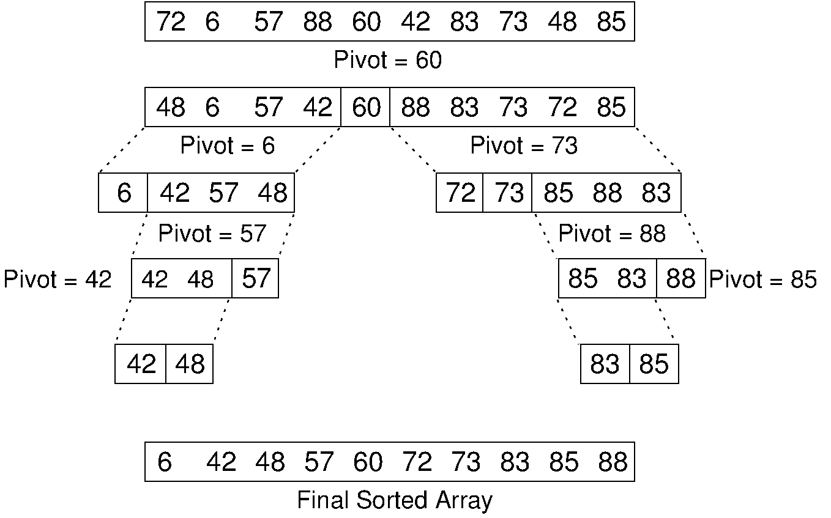
Quick Sort – Median Pivot

Slide 68
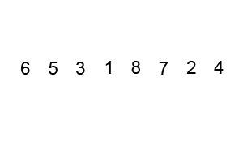
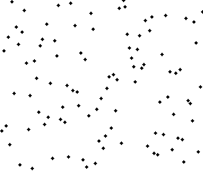
Quick Sort - Animation
Pivot Selection - Random

Slide 69
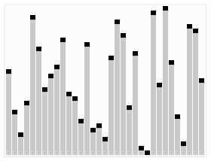
Quick Sort – Pivot Selection - Last

Slide 70
Quick Sort Running Time
Worst case: when the pivot does not divide the sequence in two
At each step, the length of the sequence is only reduced by 1
Total running time
General case:
  Time spent at level i in the tree is O(n)
  Running time: O(n) * O(height)
Average case:
  O(n log n)

Slide 71
Quick Sort
Pivot point may not be the exact median
Finding the precise median is hard
If we “get lucky”, the following recurrence applies (n/2 is approximate)

Slide 72
Analysis of QuickSort
We assume a random choice of pivot
Let the time to carry out a QuickSort on n elements be T(n)
We have T(0) = T(1) = 1
The running time of QuickSort is the running time of the partitioning (linear in n) plus the running time of the two recursive calls of QuickSort
Let i be the number of elements in the left partition, then
T(n) = T(i) + T(n–i–1) + cn (for some constant c)

Slide 73
Worst-case analysis
If the pivot is always the smallest element, then i = 0 always
We ignore the term T(0) = 1, so the recurrence relation is
T(n) = T(n–1) + cn
So, T(n–1) = T(n–2) + c(n–1) and so on until we get
T(2) = T(1) + c(2)
Substituting back up gives T(n) = T(1) + c(n + … + 2) = O(n²)
Notice that this case happens if we always take the pivot to be the first element in the array and the array is already sorted
So, in this extreme case, QuickSort takes O(n²) time to do absolutely nothing!

Slide 74
Worst-case Running Time
The worst case for quick-sort occurs when the pivot is the unique minimum or maximum element
One of L and G has size n − 1 and the other has size 0
The running time is proportional to the sum
n + (n − 1) + … + 2 + 1
Thus, the worst-case running time of quick-sort is O(n²)
depth | time
0 | n
1 | n − 1
… | …
n − 1 | 1
…

Slide 75
Expected Running Time
Consider a recursive call of quick-sort on a sequence of size s
  Good call: the sizes of L and G are each less than 3s/4
  Bad call: one of L and G has size greater than 3s/4
A call is good with probability 1/2
  1/2 of the possible pivots cause good calls:
7 2 9 4 3 7 6 1 9
7 2 9 4 3 7 6 1
2 4 3 1
7 9 7 1 → 1
1
7 2 9 4 3 7 6
Good call
Bad call
1 2 3 4 5 6 7 8 9 10 11 12 13 14 15 16
Bad pivots
Good pivots
Bad pivots

Slide 76
Expected Running Time, Part 2
Probabilistic Fact: The expected number of coin tosses required in order to get k heads is 2k
For a node of depth i, we expect
  i/2 ancestors are good calls
  The size of the input sequence for the current call is at most (3/4)^{i/2}n
Therefore, we have
  For a node of depth 2log_{4/3}n, the expected input size is one
  The expected height of the quick-sort tree is O(log n)
The amount or work done at the nodes of the same depth is O(n)
Thus, the expected running time of quick-sort is O(n log n)

Slide 77
Best-case analysis
In the best case, the pivot is in the middle
To simplify the equations, we assume that the two subarrays are each exactly half the length of the original (a slight overestimate which is acceptable for big-Oh calculations)
So, we get T(n) = 2T(n/2) + cn
This is very similar to the formula for MergeSort, and a similar analysis leads to T(n) = cn log₂n + n = O(n log n)

Slide 78
Average-case analysis
We assume that each of the sizes of the left partition are equally likely, and hence have probability 1/n
With this assumption, the average value of T(i), and hence also of T(n–i–1), is
  (T(0) + T(1) + … + T(n–1))/n
Hence, our recurrence relation becomes
  T(n) = 2(T(0) + T(1) + … + T(n–1))/n + cn
Multiplying by n gives
  nT(n) = 2(T(0) + T(1) + … + T(n–1)) + cn²
Replacing n by n–1 gives
  (n–1)T(n–1) = 2(T(0) + T(1) + … + T(n–2)) + c(n–1)²
Subtracting the last equation from the previous one gives
  nT(n) – (n–1)T(n–1) = 2T(n–1) + 2cn – c

Slide 79
Average-case Analysis (2)
Rearranging, and dropping the insignificant c on the end, gives nT(n) = (n+1)T(n–1) + 2cn
Divide through by n(n+1) to get
T(n)/(n+1) = T(n–1)/n + 2c/(n+1)
Hence, T(n–1)/n = T(n–2)/(n–1) + 2c/n and so on down to
T(2)/3 = T(1)/2 + 2c/3
Substituting back up gives
T(n)/(n+1) = T(1)/2 + 2c(1/3 + 1/4 + … + 1/(n+1))
The sum in brackets is about log_{e}(n+1) + γ – 3/2, where γ is Euler’s constant, which is approximately 0.577
So, T(n)/(n+1) = O(log n) and T(n) = O(n log n)

Slide 80
Complexity of Quick Sort
Best case performance O(n log n)
Average case performance O(n log n)
Worst case performance O(n²)
Worst case space complexity O(log n) auxiliary
Where n is the number of elements to be sorted

Slide 81
Analysis of Quick Sort
Quicksort can be implemented with an in-place partitioning algorithm,
  so the entire sort can be done with only O(log n) additional space
Space usage is O(log n)
On average, makes O(n log n) comparisons to sort n items
In the worst case, it makes O(n²) comparisons, though this behavior is rare

Slide 82
Analysis of Quick Sort
The most complex issue in quick sort is choosing a good pivot element;
  Consistently poor choices of pivots can result in drastically slower O(n²) performance
if at each step the median is chosen as the pivot then the algorithm works in O(n log n)
Finding the median however, is an O(n) operation on unsorted lists and therefore exacts its own penalty with sorting
Its sequential and localized memory references work well with a cache

Slide 83
Some observations about QuickSort
We have seen that a consistently poor choice of pivot can lead to O(n²) time performance
A good strategy is to pick the middle value of the left, centre, and right elements
For small arrays, with n less than (say) 20, QuickSort does not perform as well as simpler sorts such as SelectionSort
Because QuickSort is recursive, these small cases will occur frequently
A common solution is to stop the recursion at n = 10, say, and use a different, non-recursive sort
This also avoids nasty special cases, e.g., trying to take the middle of three elements when n is one or two

Slide 84
Final comments
Until 2002, quicksort was the fastest known general sorting algorithm, on average.
Still the most common sorting algorithm in standard libraries.
For optimum speed, the pivot must be chosen carefully.
“Median of three” is a good technique for choosing the pivot.
There will be some cases where Quicksort runs in O(n²) time.

Slide 85
Summary
Quick Sort
Concept
Algorithm
Examples
Implementation
Trace of Quick sort
Complexity of Quick Sort

