Slide 1
CSC 211
Data Structures
Lecture 18
Dr. Iftikhar Azim Niaz
ianiaz@comsats.edu.pk
1

Slide 2
Last Lecture Summary
Recursion
Examples
Implementation
Recursive Search Algorithms
  Linear or Sequential Search
  Binary Search
Recursion with Linked Lists
Advantages and Disadvantages
Comparison with Iteration
Analysis of Recursion
2

Slide 3
Objectives Overview
Merge Sort
Concept
Algorithm
Examples
Implementation
Trace of Merge sort
Complexity of Merge Sort

Slide 4
Merge Sort
Merge sort (also commonly spelled mergesort) is a comparison-based sorting algorithm
Most implementations produce a stable sort
  which means that the implementation preserves the input order of equal elements in the sorted output
Merge sort is a divide and conquer algorithm that was invented by John von Neumann in 1945
Merge sort takes advantage of the ease of merging already sorted lists into a new sorted list

Slide 5
Merge Sort
Conceptually, a merge sort works as follows
  Divide the unsorted list into n sublists, each containing 1 element
    A list of 1 element is considered sorted
  Repeatedly merge sublists to produce new sublists until there is only 1 sublist remaining
    This will be the sorted list.
It starts by comparing every two elements (i.e., 1 with 2, then 3 with 4...) and swapping them if the first should come after the second.
It then merges each of the resulting lists of two into lists of four,
  then merges those lists of four, and so on;
  until at last two lists are merged into the final sorted list.
5

Slide 6
Divide-and-Conquer
Divide and Conquer is a method of algorithm design that has created such efficient algorithms as Merge Sort.
In terms or algorithms, this method has three distinct steps:
  Divide: If the input size is too large to deal with in a straightforward manner, divide the data into two or more disjoint subsets.
  Recur: Use divide and conquer to solve the subproblems associated with the data subsets.
  Conquer: Take the solutions to the subproblems and “merge” these solutions into a solution for the original problem.

Slide 7
Merge-Sort
Algorithm:
  Divide: If S has at leas two elements (nothing needs to be done if S has zero or one elements), remove all the elements from S and put them into two sequences, S₁ and S₂, each containing about half of the elements of S. (i.e. S₁ contains the first ⎡n/2⎤ elements and S₂ contains the remaining ⎣n/2⎦ elements.
  Recur: Recursive sort sequences S₁ and S₂.
  Conquer: Put back the elements into S by merging the sorted sequences S₁ and S₂ into a unique sorted sequence.

Slide 8
Merge Sort Algorithm
Let A be an array of n number of elements to be sorted A[1], A[2] ...... A[n]
Step 1: Divide the array A into approximately n/2 sorted sub-array,
  i.e., the elements in the (A [1], A [2]), (A [3], A [4]), (A [k], A [k + 1]), (A [n – 1], A [n]) sub-arrays are in sorted order
Step 2: Merge each pair of pairs to obtain the following list of sorted sub-array
  The elements in the sub-array are also in the sorted order
  (A [1], A [2], A [3], A [4)),...... (A [k – 1], A [k], A [k + 1], A [k + 2]), ...... (A [n – 3], A [n – 2], A [n – 1], A [n]).
Step 3: Repeat the step 2 recursively until there is only one sorted array of size n

Slide 9
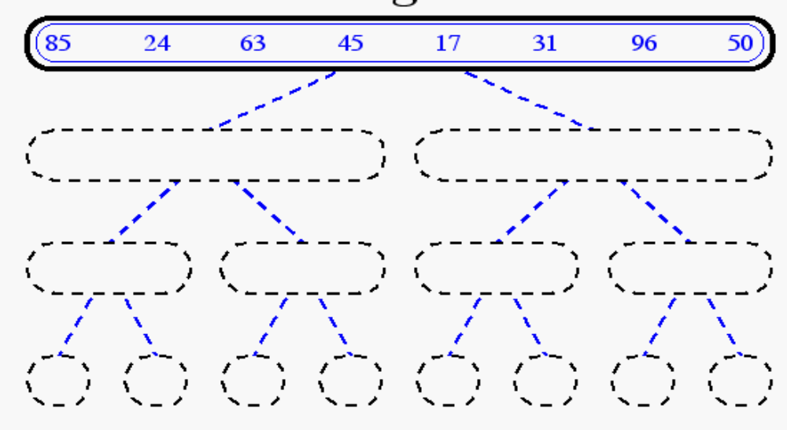
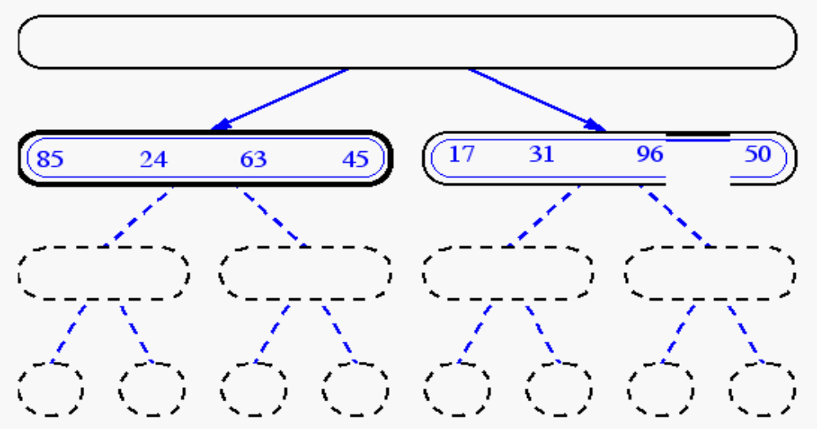
Merge-Sort

Slide 10
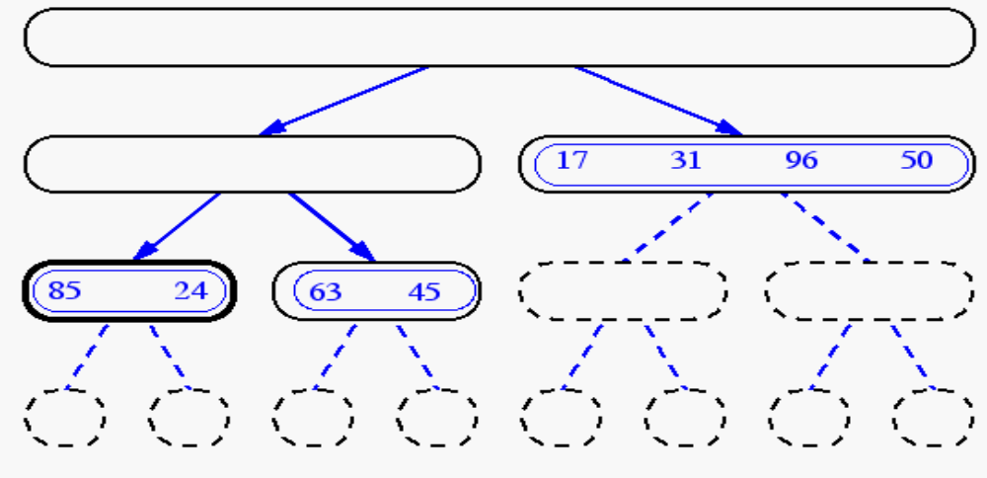
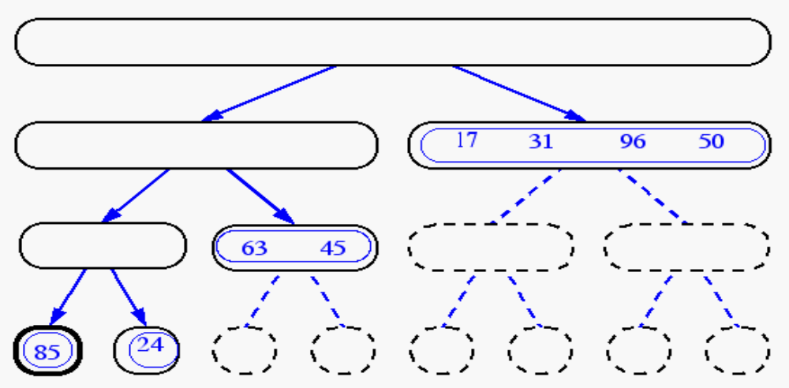
Merge-Sort

Slide 11
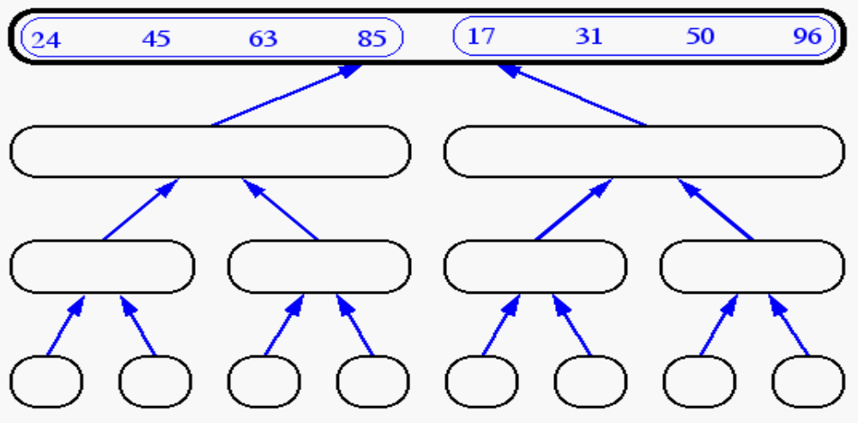
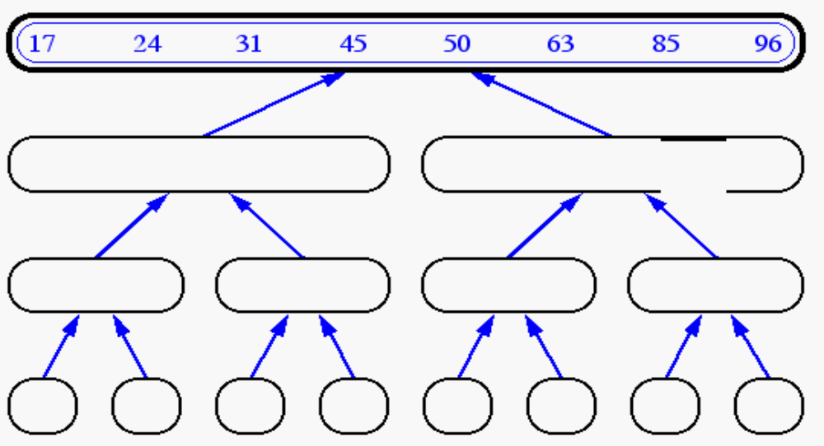
Merge-Sort

Slide 12
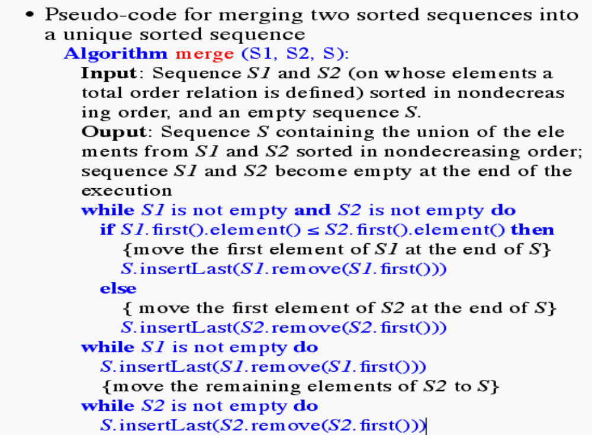
Merge-Two Sequences

Slide 13
Merge Sort
Idea:
  Take the array you would like to sort and divide it in half to create 2 unsorted subarrays.
  Next, sort each of the 2 subarrays.
  Finally, merge the 2 sorted subarrays into 1 sorted array.

Slide 14
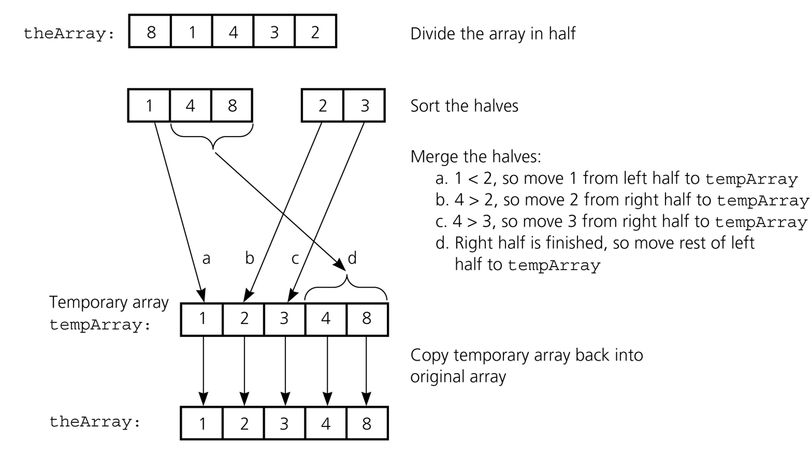
Merge Sort

Slide 15
Merge Sort
Although the merge step produces a sorted array, we have overlooked a very important step.
How did we sort the 2 halves before performing the merge step?
By continually calling the merge sort algorithm, we eventually get a subarray of size 1.
Since an array with only 1 element is clearly sorted, we can back out and merge 2 arrays of size 1.
We used merge sort!

Slide 16
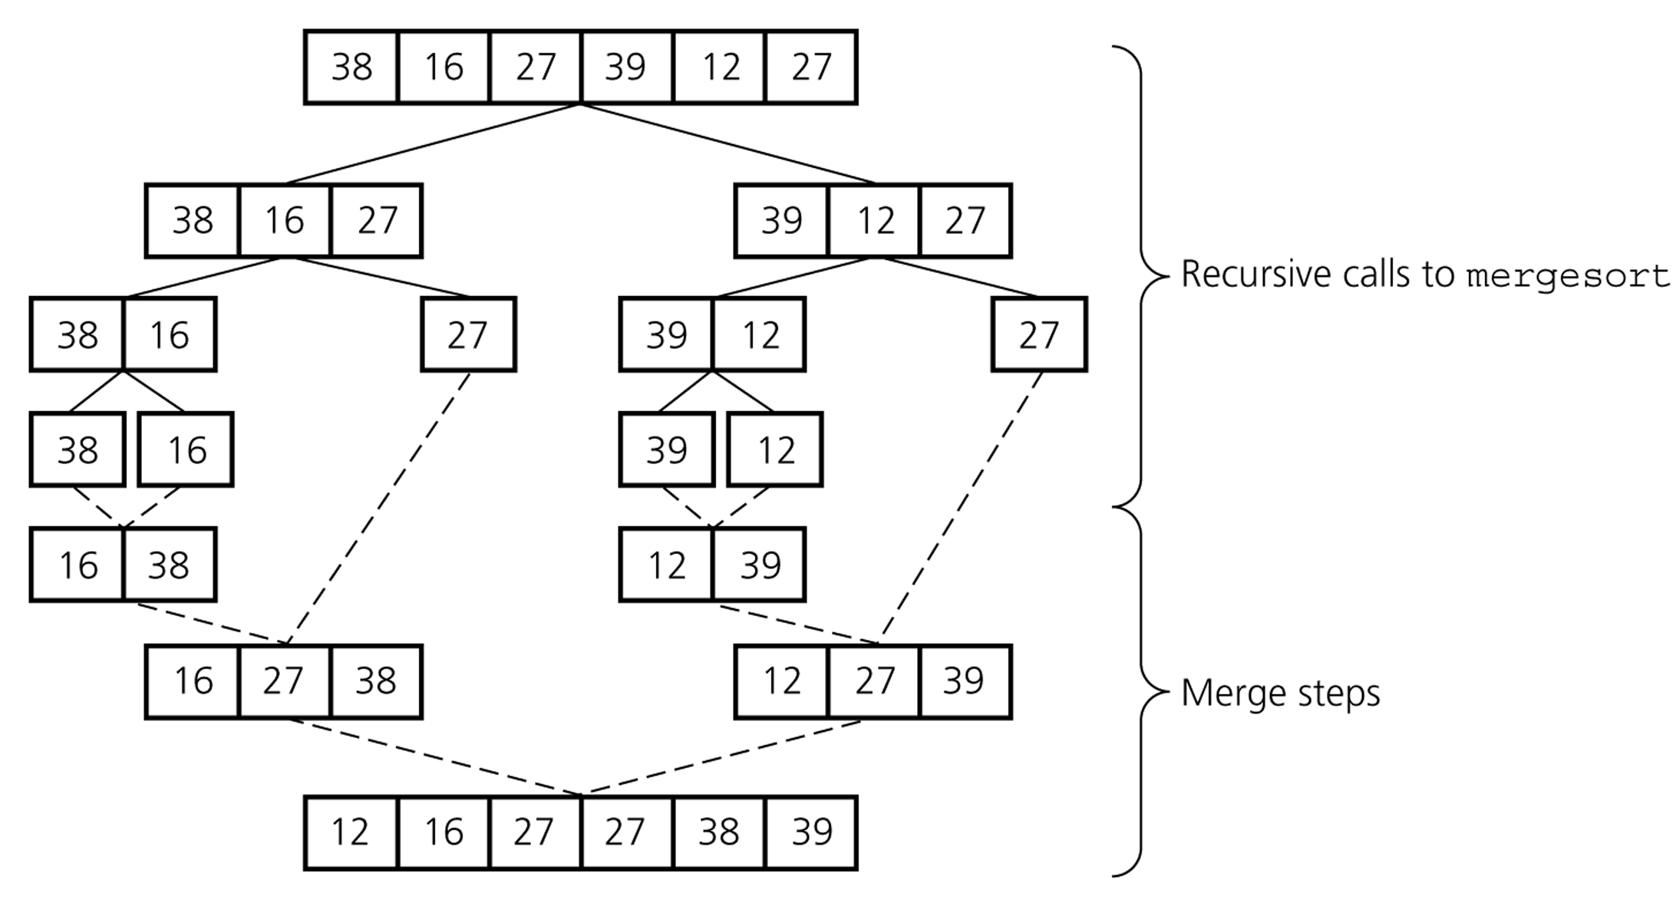
Merge Sort

Slide 17
Merge Sort
1 | 13 | 24 | 26
indexA
We compare arrayA[indexA]
with arrayB[indexB].
Whichever value is smaller is
placed into arrayC[indexC].
1 < 2 so we insert
arrayA[indexA] into
arrayC[indexC]
arrayA
arrayB
2 | 15 | 27 | 38
indexB
indexC
arrayC

Slide 18
Merge Sort
1 | 13 | 24 | 26
 | indexA
arrayA
2 < 13 so we insert
arrayB[indexB] into
arrayC[indexC]
arrayB
2 | 15 | 27 | 38
indexB
1
 | indexC
arrayC

Slide 19
Merge Sort
1 | 13 | 24 | 26
 | indexA
arrayA
13 < 15 so we insert
arrayA[indexA] into
arrayC[indexC]
arrayB
2 | 15 | 27 | 38
 | indexB
1 | 2
 |  | indexC
arrayC

Slide 20
Merge Sort
1 | 13 | 24 | 26
 |  | indexA
arrayA
15 < 24 so we insert
arrayB[indexB] into
arrayC[indexC]
arrayB
2 | 15 | 27 | 38
 | indexB
1 | 2 | 13
 |  |  | indexC
arrayC

Slide 21
Merge Sort
1 | 13 | 24 | 26
 |  | indexA
arrayA
24 < 27 so we insert
arrayA[indexA] into
arrayC[indexC]
arrayB
2 | 15 | 27 | 38
 |  | indexB
1 | 2 | 13 | 15
 |  |  |  | indexC
arrayC

Slide 22
Merge Sort
1 | 13 | 24 | 26
 |  |  | indexA
arrayA
26 < 27 so we insert
arrayA[indexA] into
arrayC[indexC]
arrayB
2 | 15 | 27 | 38
 |  | indexB
1 | 2 | 13 | 15 | 24
 |  |  |  |  | indexC
arrayC

Slide 23
Merge Sort
1 | 13 | 24 | 26
arrayA
Since we have exhausted
one of the arrays, arrayA,
we simply copy the
remaining items from the
other array, arrayB, into
arrayC
arrayB
2 | 15 | 27 | 38
 |  | indexB
1 | 2 | 13 | 15 | 24 | 26
 |  |  |  |  |  | indexC
arrayC

Slide 24
Merge Sort
1 | 13 | 24 | 26
arrayA
arrayB
2 | 15 | 27 | 38
1 | 2 | 13 | 15 | 24 | 26 | 27 | 38
arrayC

Slide 25
Merge Sort Pseudocode
void mergesort(int list[], int first, int last) {
if( first < last )
mid = (first + last)/2;
// Sort the 1st half of the list
mergesort(list, first, mid);
// Sort the 2nd half of the list
mergesort(list, mid+1, last);
// Merge the 2 sorted halves
merge(list, first, mid, last);
end if
}

Slide 26
Merge Sort Pseudocode (cont)
merge(list, first, mid, last) {
// Initialize the first and last indices of our subarrays
firstA = first; lastA = mid; firstB = mid+1; lastB = last
index = firstA // Index into our temp array
// Start the merging
loop( firstA <= lastA AND firstB <= lastB )
if( list[firstA] < list[firstB] )
tempArray[index] = list[firstA]
firstA = firstA + 1
else
tempArray[index] = list[firstB]
firstB = firstB + 1
end if
index = index + 1;
end loop

Slide 27
Merge Sort Pseudocode (cont)
// At this point, one of our subarrays is empty
// Now go through and copy any remaining items
// from the non-empty array into our temp array
loop (firstA <= lastA)
tempArray[index] = list[firstA]
firstA = firstA + 1
index = index + 1
end loop
loop ( firstB <= lastB )
tempArray[index] = list[firstB]
firstB = firstB + 1
index = index + 1
end loop

Slide 28
Merge Sort Pseudocode (cont)
// Finally, we copy our temp array back into
// our original array
index = first
loop (index <= last)
list[index] = tempArray[index]
index = index + 1
end loop
}

Slide 29
Merge Sorting
Sorting takes an unordered collection and makes it an ordered one.
1 2 3 4 5 6
77
42
35
12
101
5
1 2 3 4 5 6
5
12
35
42
77
101

Slide 30
Divide and Conquer
Divide and Conquer cuts the problem in half each time, but uses the result of both halves:
  cut the problem in half until the problem is trivial
  solve for both halves
  combine the solutions

Slide 31
Merge Sort
A divide-and-conquer algorithm:
Divide the unsorted array into 2 halves until the sub-arrays only contain one element
Merge the sub-problem solutions together:
  Compare the sub-array’s first elements
  Remove the smallest element and put it into the result array
  Continue the process until all elements have been put into the result array
37
23
6
89
15
12
2
19

Slide 32
Merge sort – Top Down Implementation
Top down merge sort algorithm which uses recursion to divide the list into sub-lists, then merges sublists during returns back up the call chain
function merge_sort(list m)
// if list size is 1, consider it sorted and return it
if length(m) <= 1
return m
// else list size is > 1, so split the list into two sublists
var list left, right
var integer middle = length(m) / 2
for each x in m before middle
add x to left
for each x in m after or equal middle
add x to right
// recursively call merge_sort() to further split each sublist until sublist size is 1
left = merge_sort(left)
right = merge_sort(right)
// merge the sublists returned from prior calls to merge_sort()
// and return the resulting merged sublist
return merge(left, right)

Slide 33
Merge sort – Top Down Implementation
The merge function merges the left and right sublists.
function merge(left, right)
var list result
while length(left) > 0 or length(right) > 0
if length(left) > 0 and length(right) > 0
if first(left) <= first(right)
append first(left) to result
left = rest(left)
else
append first(right) to result
right = rest(right)
else if length(left) > 0
append first(left) to result
left = rest(left)
else if length(right) > 0
append first(right) to result
right = rest(right)
end while
return result

Slide 34
Merge sort – Bottom Up Implementation
Bottom up merge sort algorithm which treats the list as an array of n sublists (called runs in this example) of size 1, and iteratively merges sub-lists back and forth between two buffers:
/* array A[] has the items to sort; array B[] is a work array */
BottomUpSort(int n, array A[n], array B[n]) {
int width;
/* each 1-element run in A is already "sorted". */
/* Make successively longer sorted runs of length 2, 4, 8, 16... until whole array is sorted*/
for (width = 1; width < n; width = 2 * width) {
int i; /* array A is full of runs of length width */
for (i = 0; i < n; i = i + 2 * width) {
/* merge two runs: A[i:i+width-1] and A[i+width:i+2*width-1] to B[] */
/* or copy A[i:n-1] to B[] ( if(i+width >= n) ) */
BottomUpMerge(A, i, min(i+width, n), min(i+2*width, n), B);
}
/* now work array B is full of runs of length 2*width . Copy array B to array A for next iteration . A more efficient implementation would swap the roles of A and B */
CopyArray(A, B, n); /* now array A is full of runs of length 2*width */
}
}

Slide 35
Merge sort – Bottom Up Implementation
BottomUpMerge(array A[], int iLeft, int iRight, int iEnd, array B[]) {
int i0 = iLeft; int i1 = iRight; int j;
/* while there are elements in the left or right lists */
for (j = iLeft; j < iEnd; j++) {
/* if left list head exists and is <= existing right list head */
if (i0 < iRight && (i1 >= iEnd || A[i0] <= A[i1])) {
B[j] = A[i0];
i0 = i0 + 1;
}
else {
B[j] = A[i1];
i1 = i1 + 1;
} // end of else } // end if } // end for } // end of function

Slide 36
Algorithm
Mergesort(Passed an array)
if array size > 1
Divide array in half
Call Mergesort on first half.
Call Mergesort on second half.
Merge two halves.
Merge(Passed two arrays)
Compare leading element in each array
Select lower and place in new array.
(If one input array is empty then place
remainder of other array in output array)

Slide 37
More TRUTH in CS
We don’t really pass in two arrays!
We pass in one array with indicator variables which tell us where one set of data starts and finishes and where the other set of data starts and finishes.
Honest.
s1
f1
s2
f2

Slide 38
Algorithm
LB
Mergesort(Passed an array)
if array size > 1
Divide array in half
Call Mergesort on first half.
Call Mergesort on second half.
Merge two halves.
Merge(Passed two arrays)
Compare leading element in each array
Select lower and place in new array.
(If one input array is empty then place
remainder of other array in output array)

Slide 39
98
23
45
14
6
67
33
42

Slide 40
98
23
45
14
6
67
33
42
98
23
45
14
6
67
33
42

Slide 41
98
23
45
14
6
67
33
42
98
23
45
14
6
67
33
42
98
23
45
14

Slide 42
98
23
45
14
6
67
33
42
98
23
45
14
6
67
33
42
98
23
45
14
98
23

Slide 43
98
23
45
14
6
67
33
42
98
23
45
14
6
67
33
42
98
23
45
14
98
23
Merge

Slide 44
98
23
45
14
6
67
33
42
98
23
45
14
6
67
33
42
98
23
45
14
98
23
23
Merge

Slide 45
98
23
45
14
6
67
33
42
98
23
45
14
6
67
33
42
98
23
45
14
98
23
23
98
Merge

Slide 46
98
23
45
14
6
67
33
42
98
23
45
14
6
67
33
42
98
23
45
14
98
23
45
14
23
98

Slide 47
98
23
45
14
6
67
33
42
98
23
45
14
6
67
33
42
98
23
45
14
98
23
45
14
23
98
Merge

Slide 48
98
23
45
14
6
67
33
42
98
23
45
14
6
67
33
42
98
23
45
14
98
23
45
14
23
98
14
Merge

Slide 49
98
23
45
14
6
67
33
42
98
23
45
14
6
67
33
42
98
23
45
14
98
23
45
14
23
98
14
45
Merge

Slide 50
98
23
45
14
6
67
33
42
98
23
45
14
6
67
33
42
98
23
45
14
98
23
45
14
23
98
14
45
Merge

Slide 51
98
23
45
14
6
67
33
42
98
23
45
14
6
67
33
42
98
23
45
14
98
23
45
14
23
98
14
45
14
Merge

Slide 52
98
23
45
14
6
67
33
42
98
23
45
14
6
67
33
42
98
23
45
14
98
23
45
14
23
98
14
45
14
23
Merge

Slide 53
98
23
45
14
6
67
33
42
98
23
45
14
6
67
33
42
98
23
45
14
98
23
45
14
23
98
14
45
14
23
45
Merge

Slide 54
98
23
45
14
6
67
33
42
98
23
45
14
6
67
33
42
98
23
45
14
98
23
45
14
23
98
14
45
14
23
45
98
Merge

Slide 55
98
23
45
14
6
67
33
42
98
23
45
14
6
67
33
42
98
23
45
14
6
67
33
42
98
23
45
14
23
98
14
45
14
23
45
98

Slide 56
98
23
45
14
6
67
33
42
98
23
45
14
6
67
33
42
98
23
45
14
6
67
33
42
98
23
45
14
6
67
23
98
14
45
14
23
45
98

Slide 57
98
23
45
14
6
67
33
42
98
23
45
14
6
67
33
42
98
23
45
14
6
67
33
42
98
23
45
14
6
67
23
98
14
45
14
23
45
98
Merge

Slide 58
98
23
45
14
6
67
33
42
98
23
45
14
6
67
33
42
98
23
45
14
6
67
33
42
98
23
45
14
6
67
23
98
14
45
6
14
23
45
98
Merge

Slide 59
98
23
45
14
6
67
33
42
98
23
45
14
6
67
33
42
98
23
45
14
6
67
33
42
98
23
45
14
6
67
23
98
14
45
6
67
14
23
45
98
Merge

Slide 60
98
23
45
14
6
67
33
42
98
23
45
14
6
67
33
42
98
23
45
14
6
67
33
42
98
23
45
14
6
67
33
42
23
98
14
45
6
67
14
23
45
98

Slide 61
98
23
45
14
6
67
33
42
98
23
45
14
6
67
33
42
98
23
45
14
6
67
33
42
98
23
45
14
6
67
33
42
23
98
14
45
6
67
14
23
45
98
Merge

Slide 62
98
23
45
14
6
67
33
42
98
23
45
14
6
67
33
42
98
23
45
14
6
67
33
42
98
23
45
14
6
67
33
42
23
98
14
45
6
67
33
14
23
45
98
Merge

Slide 63
98
23
45
14
6
67
33
42
98
23
45
14
6
67
33
42
98
23
45
14
6
67
33
42
98
23
45
14
6
67
33
42
23
98
14
45
6
67
33
42
14
23
45
98
Merge

Slide 64
98
23
45
14
6
67
33
42
98
23
45
14
6
67
33
42
98
23
45
14
6
67
33
42
98
23
45
14
6
67
33
42
23
98
14
45
6
67
33
42
14
23
45
98
Merge

Slide 65
98
23
45
14
6
67
33
42
98
23
45
14
6
67
33
42
98
23
45
14
6
67
33
42
98
23
45
14
6
67
33
42
23
98
14
45
6
67
33
42
14
23
45
98
6
Merge

Slide 66
98
23
45
14
6
67
33
42
98
23
45
14
6
67
33
42
98
23
45
14
6
67
33
42
98
23
45
14
6
67
33
42
23
98
14
45
6
67
33
42
14
23
45
98
6
33
Merge

Slide 67
98
23
45
14
6
67
33
42
98
23
45
14
6
67
33
42
98
23
45
14
6
67
33
42
98
23
45
14
6
67
33
42
23
98
14
45
6
67
33
42
14
23
45
98
6
33
42
Merge

Slide 68
98
23
45
14
6
67
33
42
98
23
45
14
6
67
33
42
98
23
45
14
6
67
33
42
98
23
45
14
6
67
33
42
23
98
14
45
6
67
33
42
14
23
45
98
6
33
42
67
Merge

Slide 69
98
23
45
14
6
67
33
42
98
23
45
14
6
67
33
42
98
23
45
14
6
67
33
42
98
23
45
14
6
67
33
42
23
98
14
45
6
67
33
42
14
23
45
98
6
33
42
67
Merge

Slide 70
98
23
45
14
6
67
33
42
98
23
45
14
6
67
33
42
98
23
45
14
6
67
33
42
98
23
45
14
6
67
33
42
23
98
14
45
6
67
33
42
14
23
45
98
6
33
42
67
6
Merge

Slide 71
98
23
45
14
6
67
33
42
98
23
45
14
6
67
33
42
98
23
45
14
6
67
33
42
98
23
45
14
6
67
33
42
23
98
14
45
6
67
33
42
14
23
45
98
6
33
42
67
6
14
Merge

Slide 72
98
23
45
14
6
67
33
42
98
23
45
14
6
67
33
42
98
23
45
14
6
67
33
42
98
23
45
14
6
67
33
42
23
98
14
45
6
67
33
42
14
23
45
98
6
33
42
67
6
14
23
Merge

Slide 73
98
23
45
14
6
67
33
42
98
23
45
14
6
67
33
42
98
23
45
14
6
67
33
42
98
23
45
14
6
67
33
42
23
98
14
45
6
67
33
42
14
23
45
98
6
33
42
67
6
14
23
33
Merge

Slide 74
98
23
45
14
6
67
33
42
98
23
45
14
6
67
33
42
98
23
45
14
6
67
33
42
98
23
45
14
6
67
33
42
23
98
14
45
6
67
33
42
14
23
45
98
6
33
42
67
6
14
23
33
42
Merge

Slide 75
98
23
45
14
6
67
33
42
98
23
45
14
6
67
33
42
98
23
45
14
6
67
33
42
98
23
45
14
6
67
33
42
23
98
14
45
6
67
33
42
14
23
45
98
6
33
42
67
6
14
23
33
42
45
Merge

Slide 76
98
23
45
14
6
67
33
42
98
23
45
14
6
67
33
42
98
23
45
14
6
67
33
42
98
23
45
14
6
67
33
42
23
98
14
45
6
67
33
42
14
23
45
98
6
33
42
67
6
14
23
33
42
45
67
Merge

Slide 77
98
23
45
14
6
67
33
42
98
23
45
14
6
67
33
42
98
23
45
14
6
67
33
42
98
23
45
14
6
67
33
42
23
98
14
45
6
67
33
42
14
23
45
98
6
33
42
67
6
14
23
33
42
45
67
98
Merge

Slide 78
98
23
45
14
6
67
33
42
98
23
45
14
6
67
33
42
98
23
45
14
6
67
33
42
98
23
45
14
6
67
33
42
23
98
14
45
6
67
33
42
14
23
45
98
6
33
42
67
6
14
23
33
42
45
67
98

Slide 79
98
23
45
14
6
67
33
42
6
14
23
33
42
45
67
98

Slide 80
Merge Sort - Algorithm
Input: An array A[1..m] of elements and three indices p, q and r, with 1 ≤ p ≤ q <r ≤ m, such that both the subarrays A[p..q] and A[q + 1..r] are sorted individually in nondecreasing order.
Output: A[p..r] contains the result of merging the two subarrays A[p..q] and A[q + 1..r].
1. comment: B[p..r] is an auxiliary array.
2. s ← p; t ← q + 1; k ← p
3. while s ≤ q and t ≤ r
4. if A[s] ≤ A[t] then
5. B[k] ← A[s]
6. s ← s + 1
7. else
8. B[k] ←A[t]
9. t ← t + 1
10. end if
11. k ← k + 1
12. end while
13. if s = q + 1then B[k..r] ← A[t..r]
14. else B[k..r] ← A[s..q]
15. end if
16. A[p..r] ← B[p..r]

Slide 81
Merge Sort - Analysis
# of element Comparisons performed by Algorithm MERGE to merge two nonempty arrays of sizes n1 and n2, respectively into one sorted array of size n = n1 + n2 is between n1 and n - 1. In particular, # of comparisons needed is between n/2 and n - 1.
# of element Assignments: performed by Algorithm MERGE to merge two nonempty arrays into one sorted array of size n is exactly 2n.
➔ time complexty = O(n)
➔Space complexity = O(n)

Slide 82
Merge Sort – Divide and Conquer
Divide: divide the n-element sequence into two subproblems of n/2 elements each.
Conquer: sort the two subsequences recursively using merge sort. If the length of a sequence is 1, do nothing since it is already in order.
Combine: merge the two sorted subsequences to produce the sorted answer.

Slide 83
Recursive Merge Sort Trace
First
Last
6 | 4 | 3 | 9 | 5 | 1
1 2 3 4 5 6
MergerSort(First, Last)
if First < Last do
Set Middle to (First + Last) div 2
MergeSort(First, Middle)
MergeSort(Middle+1, Last)
Merge(First, Middle, Middle+1, Last)
end
return

Slide 84
Recursive Merge Sort Trace
First
Last
6 | 4 | 3 | 9 | 5 | 1
1 2 3 4 5 6
MergerSort(First, Last)
if First < Last do
Set Middle to (First + Last) div 2
MergeSort(First, Middle)
MergeSort(Middle+1, Last)
Merge(First, Middle, Middle+1, Last)
end
return
Middle := 3
MergeSort(1,3)
MergeSort(4,6)
Merge(1,3,4,6)

Slide 85
Recursive Merge Sort Trace
6 | 4 | 3 | 9 | 5 | 1
1 2 3 4 5 6
MergerSort(First, Last)
if First < Last do
Set Middle to (First + Last) div 2
MergeSort(First, Middle)
MergeSort(Middle+1, Last)
Merge(First, Middle, Middle+1, Last)
end
return
Middle := 2
MergeSort(1,2)
MergeSort(3,3)
Merge(1,2,3,3)
Middle := 3
MergeSort(1,3)
MergeSort(4,6)
Merge(1,3,4,6)

Slide 86
Recursive Merge Sort Trace
6 | 4 | 3 | 9 | 5 | 1
1 2 3 4 5 6
Middle := 1
MergeSort(1,1)
MergerSort(First, Last)
if First < Last do
Set Middle to (First + Last) div 2
MergeSort(First, Middle)
MergeSort(Middle+1, Last)
Merge(First, Middle, Middle+1, Last)
end
return
MergeSort(2,2)
Merge(1,1,2,2)
Middle := 2
MergeSort(1,2)
MergeSort(3,3)
Merge(1,2,3,3)
Middle := 3
MergeSort(1,3)
MergeSort(4,6)
Merge(1,3,4,6)

Slide 87
Recursive Merge Sort Trace
6 | 4 | 3 | 9 | 5 | 1
Condition: False
1 2 3 4 5 6
Middle := 1
MergeSort(1,1)
MergerSort(First, Last)
if First < Last do
Set Middle to (First + Last) div 2
MergeSort(First, Middle)
MergeSort(Middle+1, Last)
Merge(First, Middle, Middle+1, Last)
end
return
MergeSort(2,2)
Merge(1,1,2,2)
Middle := 2
MergeSort(1,2)
MergeSort(3,3)
Merge(1,2,3,3)
Middle := 3
MergeSort(1,3)
MergeSort(4,6)
Merge(1,3,4,6)

Slide 88
Recursive Merge Sort Trace
6 | 4 | 3 | 9 | 5 | 1
Condition: False
1 2 3 4 5 6
Middle := 1
MergeSort(1,1)
MergerSort(First, Last)
if First < Last do
Set Middle to (First + Last) div 2
MergeSort(First, Middle)
MergeSort(Middle+1, Last)
Merge(First, Middle, Middle+1, Last)
end
return
MergeSort(2,2)
Merge(1,1,2,2)
Middle := 2
MergeSort(1,2)
MergeSort(3,3)
Merge(1,2,3,3)
Middle := 3
MergeSort(1,3)
MergeSort(4,6)
Merge(1,3,4,6)

Slide 89
Recursive Merge Sort Trace
4 | 6 | 3 | 9 | 5 | 1
1 2 3 4 5 6
Middle := 1
MergeSort(1,1)
MergeSort(2,2)
Merge(1,1,2,2)
Merge(1,2,2,2)
Middle := 2
MergeSort(1,2)
MergeSort(3,3)
Merge(1,2,3,3)
Middle := 3
MergeSort(1,3)
MergeSort(4,6)
Merge(1,3,4,6)

Slide 90
Recursive Merge Sort Trace
4 | 6 | 3 | 9 | 5 | 1
1 2 3 4 5 6
Middle := 1
MergeSort(1,1)
MergerSort(First, Last)
if First < Last do
Set Middle to (First + Last) div 2
MergeSort(First, Middle)
MergeSort(Middle+1, Last)
Merge(First, Middle, Middle+1, Last)
end
return
MergeSort(2,2)
Merge(1,1,2,2)
Middle := 2
MergeSort(1,2)
MergeSort(3,3)
Merge(1,2,3,3)
Middle := 3
MergeSort(1,3)
MergeSort(4,6)
Merge(1,3,4,6)

Slide 91
Recursive Merge Sort Trace
4 | 6 | 3 | 9 | 5 | 1
1 2 3 4 5 6
MergerSort(First, Last)
if First < Last do
Set Middle to (First + Last) div 2
MergeSort(First, Middle)
MergeSort(Middle+1, Last)
Merge(First, Middle, Middle+1, Last)
end
return
Middle := 2
MergeSort(1,2)
MergeSort(3,3)
Merge(1,2,3,3)
Middle := 3
MergeSort(1,3)
MergeSort(4,6)
Merge(1,3,4,6)

Slide 92
Recursive Merge Sort Trace
4 | 6 | 3 | 9 | 5 | 1
1 2 3 4 5 6
MergerSort(First, Last)
if First < Last do
Set Middle to (First + Last) div 2
MergeSort(First, Middle)
MergeSort(Middle+1, Last)
Merge(First, Middle, Middle+1, Last)
end
return
Condition: False
Middle := 2
MergeSort(1,2)
MergeSort(3,3)
Merge(1,2,3,3)
Middle := 3
MergeSort(1,3)
MergeSort(4,6)
Merge(1,3,4,6)

Slide 93
Recursive Merge Sort Trace
3 | 4 | 6 | 9 | 5 | 1
1 2 3 4 5 6
Middle := 2
MergeSort(1,2)
MergeSort(3,3)
Merge(1,2,3,3)
Merge(1,2,2,3)
Middle := 3
MergeSort(1,3)
MergeSort(4,6)
Merge(1,3,4,6)

Slide 94
Recursive Merge Sort Trace
3 | 4 | 6 | 9 | 5 | 1
1 2 3 4 5 6
MergerSort(First, Last)
if First < Last do
Set Middle to (First + Last) div 2
MergeSort(First, Middle)
MergeSort(Middle+1, Last)
Merge(First, Middle, Middle+1, Last)
end
return
Middle := 2
MergeSort(1,2)
MergeSort(3,3)
Merge(1,2,3,3)
Middle := 3
MergeSort(1,3)
MergeSort(4,6)
Merge(1,3,4,6)

Slide 95
Recursive Merge Sort Trace
First
Last
3 | 4 | 6 | 9 | 5 | 1
1 2 3 4 5 6
MergerSort(First, Last)
if First < Last do
Set Middle to (First + Last) div 2
MergeSort(First, Middle)
MergeSort(Middle+1, Last)
Merge(First, Middle, Middle+1, Last)
end
return
Middle := 3
MergeSort(1,3)
MergeSort(4,6)
Merge(1,3,4,6)

Slide 96
Recursive Merge Sort Trace
3 | 4 | 6 | 9 | 5 | 1
1 2 3 4 5 6
MergerSort(First, Last)
if First < Last do
Set Middle to (First + Last) div 2
MergeSort(First, Middle)
MergeSort(Middle+1, Last)
Merge(First, Middle, Middle+1, Last)
end
return
Middle := 5
MergeSort(4,5)
MergeSort(6,6)
Merge(4,5,6,6)
Middle := 3
MergeSort(1,3)
MergeSort(4,6)
Merge(1,3,4,6)

Slide 97
Recursive Merge Sort Trace
3 | 4 | 6 | 9 | 5 | 1
1 2 3 4 5 6
Middle := 4
MergeSort(4,4)
MergerSort(First, Last)
if First < Last do
Set Middle to (First + Last) div 2
MergeSort(First, Middle)
MergeSort(Middle+1, Last)
Merge(First, Middle, Middle+1, Last)
end
return
MergeSort(5,5)
Merge(4,4,5,5)
Middle := 5
MergeSort(4,5)
MergeSort(6,6)
Merge(4,5,6,6)
Middle := 3
MergeSort(1,3)
MergeSort(4,6)
Merge(1,3,4,6)

Slide 98
Recursive Merge Sort Trace
3 | 4 | 6 | 9 | 5 | 1
Condition: False
1 2 3 4 5 6
Middle := 4
MergeSort(4,4)
MergerSort(First, Last)
if First < Last do
Set Middle to (First + Last) div 2
MergeSort(First, Middle)
MergeSort(Middle+1, Last)
Merge(First, Middle, Middle+1, Last)
end
return
MergeSort(5,5)
Merge(4,4,5,5)
Middle := 5
MergeSort(4,5)
MergeSort(6,6)
Merge(4,5,6,6)
Middle := 3
MergeSort(1,3)
MergeSort(4,6)
Merge(1,3,4,6)

Slide 99
Recursive Merge Sort Trace
3 | 4 | 6 | 9 | 5 | 1
Condition: False
1 2 3 4 5 6
Middle := 4
MergeSort(4,4)
MergerSort(First, Last)
if First < Last do
Set Middle to (First + Last) div 2
MergeSort(First, Middle)
MergeSort(Middle+1, Last)
Merge(First, Middle, Middle+1, Last)
end
return
MergeSort(5,5)
Merge(4,4,5,5)
Middle := 5
MergeSort(4,5)
MergeSort(6,6)
Merge(4,5,6,6)
Middle := 3
MergeSort(1,3)
MergeSort(4,6)
Merge(1,3,4,6)

Slide 100
Recursive Merge Sort Trace
3 | 4 | 6 | 5 | 9 | 1
1 2 3 4 5 6
Middle := 4
MergeSort(4,4)
MergeSort(5,5)
Merge(4,4,5,5)
Merge(4,4,5,5)
Middle := 5
MergeSort(4,5)
MergeSort(6,6)
Merge(4,5,6,6)
Middle := 3
MergeSort(1,3)
MergeSort(4,6)
Merge(1,3,4,6)

Slide 101
Recursive Merge Sort Trace
3 | 4 | 6 | 5 | 9 | 1
1 2 3 4 5 6
Middle := 4
MergeSort(4,4)
MergerSort(First, Last)
if First < Last do
Set Middle to (First + Last) div 2
MergeSort(First, Middle)
MergeSort(Middle+1, Last)
Merge(First, Middle, Middle+1, Last)
end
return
MergeSort(5,5)
Merge(4,4,5,5)
Middle := 5
MergeSort(4,5)
MergeSort(6,6)
Merge(4,5,6,6)
Middle := 3
MergeSort(1,3)
MergeSort(4,6)
Merge(1,3,4,6)

Slide 102
Recursive Merge Sort Trace
3 | 4 | 6 | 5 | 9 | 1
1 2 3 4 5 6
MergerSort(First, Last)
if First < Last do
Set Middle to (First + Last) div 2
MergeSort(First, Middle)
MergeSort(Middle+1, Last)
Merge(First, Middle, Middle+1, Last)
end
return
Condition: False
Middle := 5
MergeSort(4,5)
MergeSort(6,6)
Merge(4,5,6,6)
Middle := 3
MergeSort(1,3)
MergeSort(4,6)
Merge(1,3,4,6)

Slide 103
Recursive Merge Sort Trace
3 | 4 | 6 | 1 | 9 | 5
1 2 3 4 5 6
Middle := 5
MergeSort(4,5)
MergeSort(6,6)
Merge(4,5,6,6)
Merge(4,5,6,6)
Middle := 3
MergeSort(1,3)
MergeSort(4,6)
Merge(1,3,4,6)

Slide 104
Recursive Merge Sort Trace
3 | 4 | 6 | 1 | 9 | 5
1 2 3 4 5 6
MergerSort(First, Last)
if First < Last do
Set Middle to (First + Last) div 2
MergeSort(First, Middle)
MergeSort(Middle+1, Last)
Merge(First, Middle, Middle+1, Last)
end
return
Middle := 5
MergeSort(4,5)
MergeSort(6,6)
Merge(4,5,6,6)
Middle := 3
MergeSort(1,3)
MergeSort(4,6)
Merge(1,3,4,6)

Slide 105
Recursive Merge Sort Trace
3 | 4 | 6 | 1 | 9 | 5
1 2 3 4 5 6
MergerSort(First, Last)
if First < Last do
Set Middle to (First + Last) div 2
MergeSort(First, Middle)
MergeSort(Middle+1, Last)
Merge(First, Middle, Middle+1, Last)
end
return
Middle := 3
MergeSort(1,3)
MergeSort(4,6)
Merge(1,3,4,6)

Slide 106
Recursive Merge Sort Trace
First
Last
1 | 3 | 4 | 5 | 6 | 9
1 2 3 4 5 6
MergerSort(First, Last)
if First < Last do
Set Middle to (First + Last) div 2
MergeSort(First, Middle)
MergeSort(Middle+1, Last)
Merge(First, Middle, Middle+1, Last)
end
return
Middle := 3
MergeSort(1,3)
MergeSort(4,6)
Merge(1,3,4,6)
Merge(1,3,4,6)

Slide 107
Merge Sort (A,p,r)
if lo < hi
then mid ← ⎣(lo+hi)/2⎦
MERGE-SORT(A,lo,mid)
MERGE-SORT(A,mid+1,hi)
MERGE(A,lo,mid,hi)
Call MERGE-SORT(A,1,n) (assume n=length of list A)
A = {10, 5, 7, 6, 1, 4, 8, 3, 2, 9}

Slide 108
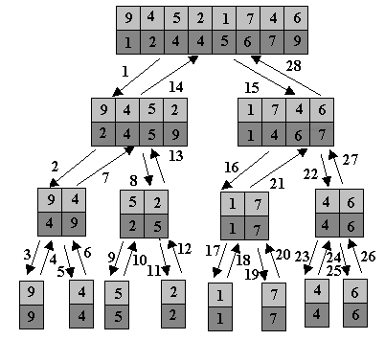
Merge Sort

Slide 109
Analysis of Merge Sort
if lo < hi …………… 1
then mid ← ⎣(lo+hi)/2⎦ ……………. 1
MERGE-SORT(A,lo,mid) ……………. n/2
MERGE-SORT(A,mid+1,hi) …………… n/2
MERGE(A,lo,mid,hi) …………….n
Described by recursive equation
Suppose T(n) is the running time on a problem of size n.
T(n) = c if n=1
2T(n/2)+ cn if n>1

Slide 110
Running Time of Merge-Sort
At each level in the binary tree created for Merge Sort, there are n elements, with O(1) time spent at each element
  → O(n) running time for processing one level
The height of the tree is O(log n)
Therefore, the time complexity is O(nlog n)

Slide 111
Merge Sort - Analysis
Sorting requires no comparisons
Merging requires n-1 comparisons in the worst case, where n is the total size of both lists (n key movements are required in all cases)
Recurrence relation:

Slide 112
Complexity of Merge Sort
Best case performance O(nlogn)
Average case performance O(nlogn)
Worst case performance O(nlogn)
Worst case space complexity auxiliary O(n)
Where n is the number of elements being sorted

Slide 113
Complexity of Merge Sort
In sorting n objects, merge sort has an average and worst-case performance of O(n log n).
If the running time of merge sort for a list of length n is T(n),
then the recurrence T(n) = 2T(n/2) + n follows from the definition of the algorithm
  apply the algorithm to two lists of half the size of the original list, and
  add the n steps taken to merge the resulting two lists
  The closed form follows from the master theorem.

Slide 114
Analysis of MergeSort
Let the time to carry out a MergeSort on n elements be T(n)
Assume that n is a power of 2, so that we always split into equal halves (the analysis can be refined for the general case)
For n=1, the time is constant, so we can take T(1) = 1
Otherwise, the time T(n) is the time to do two MergeSorts on n/2 elements, plus the time to merge, which is linear
So, T(n) = 2 T(n/2) + n
Divide through by n to get T(n)/n = T(n/2)/(n/2) + 1
Replacing n by n/2 gives, T(n/2)/(n/2) = T(n/4)/(n/4) + 1
And again gives, T(n/4)/(n/4) = T(n/8)/(n/8) + 1

Slide 115
Analysis of MergeSort (2)
We continue until we end up with T(2)/2 = T(1)/1 + 1
Since n is divided by 2 at each step, we have log₂n steps
Now, substituting the last equation in the previous one, and working back up to the top gives T(n)/n = T(1)/1 + log₂n
That is, T(n)/n = log₂n + 1
So T(n) = n log₂n + n = O(n log n)
Although this is an O(n log n) algorithm, it is hardly ever used for main memory sorts because it requires linear extra memory

Slide 116

Analysis of Merge Sort (3)
In the worst case, the number of comparisons merge sort makes is equal to or slightly smaller than
(n ⌈log n⌉ - 2^{⌈log n⌉} + 1), which is between (n log n - n + 1) and (n log n + n + O(log n)).
For large n and a randomly ordered input list, merge sort's expected (average) number of comparisons approaches α·n fewer than the worst case where

Slide 117
Analysis of Merge Sort
computing the middle takes O(1)
solving 2 sub-problem takes 2T(n/2)
merging n-element takes O(n)
Total:
    T(n) = O(1) if n = 1
    T(n) = 2T(n/2) + O(n) + O(1) if n > 1
  T(n) = O(n log n)
Solving this recurrence gives T(n) = O(n log n)

Slide 118
Analysis of Merge Sort
Assume n=2^{k} for k>=1
T(n) = 2 T(n/2) + bn + c
T(n/2) = 2T((n/2) /2) + b(n/2) + c
= 2[2T(n/4) + b(n/2) + c] + bn +c
= 4 T(n/4)+ bn +2c +bn +c
= 4 T(n/4) + 2bn+ (1 + 2) c = 2² T(n/2²)+2bn+(2⁰+2¹) c
= 4 [2T((n/4)/2) + b(n/4) + c] +2bn + (1+2)c
=8 T(n/8) + 3bn+ (1+2+4)c
=2³ T(n/2³) + 3bn+ (2⁰+2¹+2²)c
=2^{k} T(n/2^{k}) +kbn+(2⁰+2¹+…+2^{k-1})c
T(1) = a, since n=2^{k ➔} log n = log2^{k} = k
T(n) = 2^{k}. a + k bn + (2⁰+2¹+…+2^{k-1}) c
= b. n log n + (a + c) n – c
= O (n log n) Worst case

Slide 119
Merge Sort Applications
Highly parallelizable (up to O(log(n))) for processing large amounts of data
his is the first that scales well to very large lists, because its worst-case running time is O(n log n).
Merge sort has seen a relatively recent surge in popularity for practical implementations, being used for the standard sort routine in the programming languages Perl , Python, and Java among others.
Merge sort has been used in Java at least since 2000 in JDK1.3

Slide 120
Summary
Merge Sort
Concept
Algorithm
Examples
Implementation
Trace of Merge sort
Complexity of Merge Sort

