Slide 1
CSC 211
Data Structures
Lecture 17
Dr. Iftikhar Azim Niaz
ianiaz@comsats.edu.pk
1

Slide 2
Last Lecture Summary
Comparison of Sorting methods
  Bubble,
  Selection and
  Insertion
Recursion
  Concept
  Example
  Implementation Code
2

Slide 3
Objectives Overview
Recursion
Examples
Implementation
Recursive Search Algorithms
  Linear or Sequential Search
  Binary Search
Recursion with Linked Lists
Advantages and Disadvantages
Comparison with Iteration
Analysis of Recursion

Slide 4
Recursion
Just as one student can call another student to ask for help with a programming problem, functions can also call other functions to do part of the work:
int main(){
show_menu(choice); // main calls
… // show_menu for help
return 0;
}
However, students seldom call themselves…
But functions can call themselves, and on some occasions this even makes sense!

Slide 5
Ex. 1: The Handshake Problem
There are n people in a room. If each person shakes hands once with every other person. What is the total number h(n) of handshakes?

Slide 6
Ex. 1: The Handshake Problem
There are n people in a room. If each person shakes hands once with every other person. What is the total number h(n) of handshakes?
h(2) = 1

Slide 7
Ex. 1: The Handshake Problem
There are n people in a room. If each person shakes hands once with every other person. What is the total number h(n) of handshakes?
h(3) = h(2) + 2
h(2) = 1

Slide 8
Ex. 1: The Handshake Problem
There are n people in a room. If each person shakes hands once with every other person. What is the total number h(n) of handshakes?
h(4) = h(3) + 3
h(3) = h(2) + 2
h(2) = 1

Slide 9
Ex. 1: The Handshake Problem
There are n people in a room. If each person shakes hands once with every other person. What is the total number h(n) of handshakes?
h(n) = h(n-1) + n-1
h(4) = h(3) + 3
h(3) = h(2) + 2
h(2) = 1
Solution: Sum of integer from 1 to n-1 = n(n-1)/2

Slide 10
Recursion
A recursive method is a method that calls itself either directly or indirectly (via another method).
It looks like a regular method except that:
  It contains at least one method call to itself.
  It contains at least one BASE CASE.
A BASE CASE is the Boolean test that when true stops the method from calling itself.
  A base case is the instance when no further calculations can occur.
  Base cases are contained in if-else structures and contain a return statement

Slide 11
Recursion
A recursive solution solves a problem by solving a smaller instance of the same problem.
It solves this new problem by solving an even smaller instance of the same problem.
Eventually, the new problem will be so small that its solution will be either obvious or known.
This solution will lead to the solution of the original problem

Slide 12
Recursion
Recursion is more than just a programming technique. It has two other uses in computer science and software engineering, namely:
  as a way of describing, defining, or specifying things.
  as a way of designing solutions to problems (divide and conquer).
Recursion can be seen as building objects from objects that have set definitions.
Recursion can also be seen in the opposite direction as objects that are defined from smaller and smaller parts.

Slide 13
Ex. 2: Factorial
In some problems, it may be natural to define the problem in terms of the problem itself.
Recursion is useful for problems that can be represented by a simpler version of the same problem.
Consider for example the factorial function:
6! = 6 * 5 * 4 * 3 * 2 * 1
We could also write:
6! = 6 * 5!

Slide 14
Ex. 2: Factorial
In general, we can express the factorial function as follows:
n! = n * (n-1)!
Is this correct? Well… almost. The factorial function is only defined for positive integers. So we should be a little bit more precise:
n! = 1 (if n is equal to 1)
n! = n * (n-1)!(if n is larger than 1)

Slide 15
Ex. 2: Factorial
The C++ equivalent of this definition:
int fac(int numb){
if(numb<=1)
return 1;
else
return numb * fac(numb-1);
}
recursion means that a function calls itself

Slide 16
Ex. 2: Factorial
Assume the number typed is 3, that is, numb=3.
fac(3) :
  3 <= 1 ? No.
  fac(3) = 3 * fac(2)
  fac(2) :
    2 <= 1 ? No.
    fac(2) = 2 * fac(1)
    fac(1) :
      1 <= 1 ? Yes.
      return 1
int fac(int numb){
if(numb<=1)
return 1;
else
return numb * fac(numb-1);
}
    fac(2) = 2 * 1 = 2
    return fac(2)
  fac(3) = 3 * 2 = 6
  return fac(3)
fac(3) has the value 6

Slide 17
Ex. 2: Factorial
For certain problems (such as the factorial function), a recursive solution often leads to short and elegant code. Compare the recursive solution with the iterative solution:
int fac(int numb){
int product=1;
while(numb>1){
product *= numb;
numb--;
}
return product;
}
int fac(int numb){
if(numb<=1)
return 1;
else
return numb*fac(numb-1);
}

Slide 18
Example - Factorial
First, a simple, incredibly common example - factorial
  n! = n * (n - 1) * (n - 2) * ... * (n - (n-1))
  4! = 4 * (4 - 1) * (4 - 2) * (4 - 3) = 4 * 3 * 2 * 1 = 24
Notice that 4! = 4 * 3! = 4 * 3 * 2! = 4 * 3 * 2 * 1!
This is a pattern that suggest recursion as a good solution
Iterative solution (NOT recursive):
int factorial(int n) {
int i;
int fact = 1;
for (i = n; i >= 1; i--)
{
fact *= i;
}
return fact;
}

Slide 19
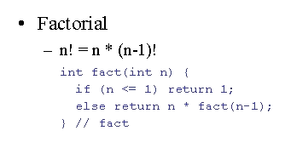
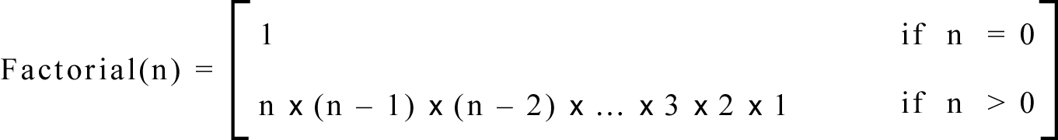
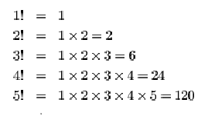
Example : Factorial - Recursive
In general, we can define the factorial function in the following way:

Slide 20
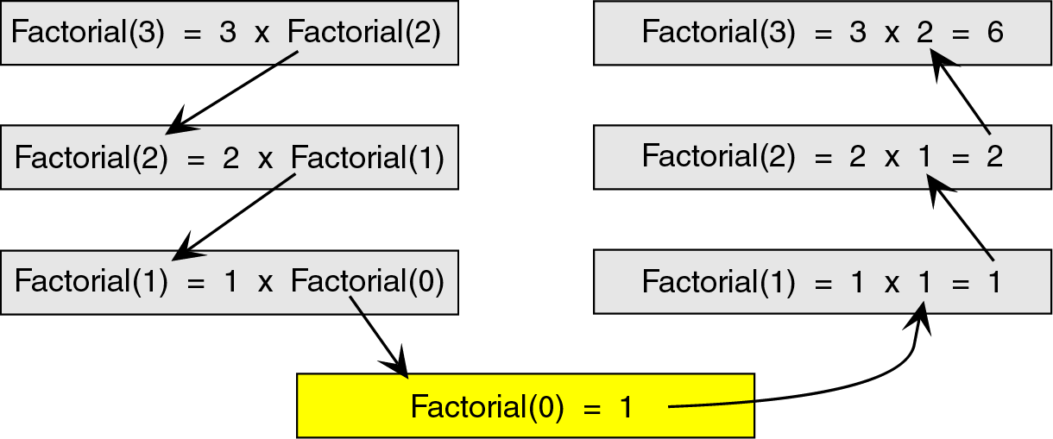
Factorial Trace
To see how the recursion works, let’s break down the factorial function to solve factorial(3)

Slide 21
Factorial - Recursive
Function calls
(trace downwards)
Return values
(trace upwards)
int recFact(int n)
{
if (n <= 1)
{
//this is the base case
//(or terminal case)
return 1;
}
else
{
//Otherwise, return the
//current val times the
//factorial of the next
//lowest integer
return (n * recFact(n – 1));
}
}
24
recFact(4)
4 * recFact(3)
4 * 6
3 * recFact(2)
3 * 2
2 * recFact(1)
2 * 1
1
1

Slide 22
Assume the number typed is 3, that is, numb=3.
fac(3) :
  3 <= 1 ? No.
  fac(3) = 3 * fac(2)
  fac(2) :
    2 <= 1 ? No.
    fac(2) = 2 * fac(1)
    fac(1) :
      1 <= 1 ? Yes.
      return 1
int fac(int numb){
if(numb<=1)
return 1;
else
return numb * fac(numb-1);
}
    fac(2) = 2 * 1 = 2
    return fac(2)
  fac(3) = 3 * 2 = 6
  return fac(3)
fac(3) has the value 6

Slide 23
Recursion
We must always make sure that the recursion bottoms out:
A recursive function must contain at least one non-recursive branch.
The recursive calls must eventually lead to a non-recursive branch.

Slide 24
Care to be taken - Iteration
If we use iteration, we must be careful not to create an infinite loop by accident:
for(int incr=1; incr!=10;incr+=2)
...
int result = 1;
while(result >0){
...
result++;
}
Oops!
Oops!

Slide 25
Care to be taken - Recursion
Similarly, if we use recursion we must be careful not to create an infinite chain of function calls:
int fac(int numb){
return numb * fac(numb-1);
}
Or:
int fac(int numb){
if (numb<=1)
return 1;
else
return numb * fac(numb+1);
}
Oops!
No termination condition
Oops!

Slide 26
Recursive Procedures
A way of defining a concept where the text of the definition refers to the concept that is being defined.
In programming: A recursive procedure is a procedure which calls itself.
  The recursive procedure call must use a different argument that the original one: otherwise the procedure would always get into an infinite loop…
Classic example: Here is the non-recursive definition of the factorial function:
  n! = 1· 2· 3· ··· · (n-1)· n
Here is the recursive definition of a factorial:
(here f(n) = n!)

Slide 27
Content of a Recursive Method
Base case(s).
  Values of the input variables for which we perform no recursive calls are called base cases
  There should be at least one base case
  Every possible chain of recursive calls must eventually reach a base case.
Recursive calls.
  Calls to the current method.
  Each recursive call should be defined so that it makes progress towards a base case.

Slide 28
Visualizing Recursion
Recursion trace
A box for each recursive call
An arrow from each caller to callee
An arrow from each callee to caller showing return value
Example recursion trace:
return
4
*
call
6
=
24
final answer
recursiveFactorial
(
4
)
return
3
*
call
2
=
6
recursiveFactorial
(
3
)
return
2
*
call
1
=
2
recursiveFactorial
(
2
)
return
1
*
call
1
=
1
recursiveFactorial
(
1
)
return
call
1
recursiveFactorial
(
0
)

Slide 29
Linear Recursion
Test for base cases.
  Begin by testing for a set of base cases (there should be at least one).
  Every possible chain of recursive calls must eventually reach a base case, and the handling of each base case should not use recursion.
Recur once.
  Perform a single recursive call. (This recursive step may involve a test that decides which of several possible recursive calls to make, but it should ultimately choose to make just one of these calls each time we perform this step.)
  Define each possible recursive call so that it makes progress towards a base case.

Slide 30
A Simple Example of Linear Recursion
Example recursion trace:
Algorithm LinearSum(A, n):
Input: A integer array A and an integer n = 1, such that A has at least n elements
Output:
The sum of the first n integers in A
if n = 1 then
return A[0]
else
return LinearSum(A, n - 1) + A[n - 1]
call
return
15
+
A
[
4
] =
15
+
5
=
20
LinearSum
(
A
,
5
)
call
return
13
+
A
[
3
] =
13
+
2
=
15
LinearSum
(
A
,
4
)
call
return
7
+
A
[
2
] =
7
+
6
=
13
LinearSum
(
A
,
3
)
call
return
4
+
A
[
1
] =
4
+
3
=
7
LinearSum
(
A
,
2
)
return
A
[
0
] =
call
4
LinearSum
(
A
,
1
)

Slide 31
Reversing an Array
Algorithm ReverseArray(A, i, j):
Input: An array A and nonnegative integer indices i and j
Output: The reversal of the elements in A starting at index i and ending at j
if i < j then
Swap A[i] and A[ j]
ReverseArray(A, i + 1, j - 1)
return

Slide 32
Defining Arguments for Recursion
In creating recursive methods, it is important to define the methods in ways that facilitate recursion.
This sometimes requires we define additional paramaters that are passed to the method.
For example, we defined the array reversal method as ReverseArray(A, i, j), not ReverseArray(A).

Slide 33
Computing Powers
The power function, p(x,n)=x^{n}, can be defined recursively:
This leads to an power function that runs in O(n) time (for we make n recursive calls).
We can do better than this, however.

Slide 34
Recursive Squaring
We can derive a more efficient linearly recursive algorithm by using repeated squaring:
For example,
  2⁴ = 2^{(4/2)2} = (2^{4/2})² = (2²)² = 4² = 16
  2⁵ = 2^{1+(4/2)2} = 2(2^{4/2})² = 2(2²)² = 2(4²) = 32
  2⁶ = 2^{(6/ 2)2} = (2^{6/2})² = (2³)² = 8² = 64
  2⁷ = 2^{1+(6/2)2} = 2(2^{6/2})² = 2(2³)² = 2(8²) = 128.

Slide 35
Analyzing the Recursive Squaring Method
Algorithm Power(x, n):
Input: A number x and integer n = 0
Output: The value x^{n}
if n = 0 then
return 1
if n is odd then
y = Power(x, (n - 1)/ 2)
return x · y · y
else
y = Power(x, n/ 2)
return y · y
Each time we make a recursive call we halve the value of n; hence, we make log n recursive calls. That is, this method runs in O(log n) time.
It is important that we used a variable twice here rather than calling the method twice.

Slide 36
Tail Recursion
Tail recursion occurs when a linearly recursive method makes its recursive call as its last step.
The array reversal method is an example.
Such methods can be easily converted to non-recursive methods (which saves on some resources).
Example:
  Algorithm IterativeReverseArray(A, i, j ):
  Input: An array A and nonnegative integer indices i and j
  Output: The reversal of the elements in A starting at index i and ending at j
  while i < j do
    Swap A[i ] and A[ j ]
    i = i + 1
    j = j - 1
  return

Slide 37
How many pairs of rabbits can be produced from a single pair in a year's time?
Assumptions:
  Each pair of rabbits produces a new pair of offspring every month;
  each new pair becomes fertile at the age of one month;
  none of the rabbits dies in that year.
Example:
  After 1 month there will be 2 pairs of rabbits;
  after 2 months, there will be 3 pairs;
  after 3 months, there will be 5 pairs (since the following month the original pair and the pair born during the first month will both produce a new pair and there will be 5 in all).

Slide 38
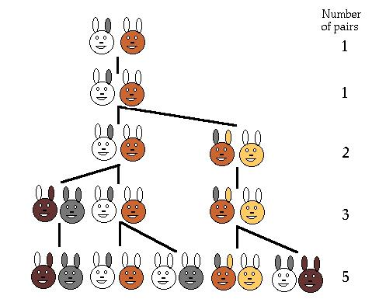
Population Growth in Nature
Leonardo Pisano (Leonardo Fibonacci = Leonardo, son of Bonaccio) proposed the sequence in 1202 in The Book of the Abacus.
Fibonacci numbers are believed to model nature to a certain extent, such as Kepler's observation of leaves and flowers in 1611.

Slide 39
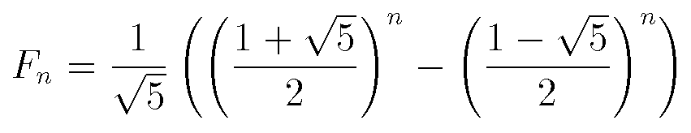
Direct Computation Method
Fibonacci numbers:
  0, 1, 1, 2, 3, 5, 8, 13, 21, 34, ...
where each number is the sum of the preceding two.
Recursive definition:
  F(0) = 0;
  F(1) = 1;
  F(number) = F(number-1)+ F(number-2);

Slide 40
Example : Fibonacci numbers
#include <iostream.h>
int fib(int number){ //Calculate Fibonacci numbers
if (number == 0) return 0; //using recursive function.
if (number == 1) return 1;
return (fib(number-1) + fib(number-2));
}
int main(){ // driver function
int inp_number;
cout << "How many Fibonacci numbers do you want? ";
cin >> inp_number;
cout <<"Fibonacci numbs up to "<< inp_number<< " are ";
for(count = 0); count < inp_number; count++)
cout << fib(count) << " ";
cout << endl;
return 0;
}
Output
all of them

Slide 41
Simplest Example
int factorial(int x) {
if (x <= 1)
return 1;
else
return x * factorial (x-1);
} // factorial
This if statement “breaks” the recursion

Slide 42
Simplest Example (continued)
int factorial(int x) {
if (x <= 1)
return 1;
else
return x * factorial (x-1);
} // factorial
This puts the current execution of factorial “on hold” and starts a new one
With a new argument!

Slide 43
Simplest Example (continued)
int factorial(int x) {
if (x <= 1)
return 1;
else
return x * factorial (x-1);
} // factorial
When factorial(x-1) returns, its result it multiplied by x
Mathematically:– x! = x × (x-1)!

Slide 44
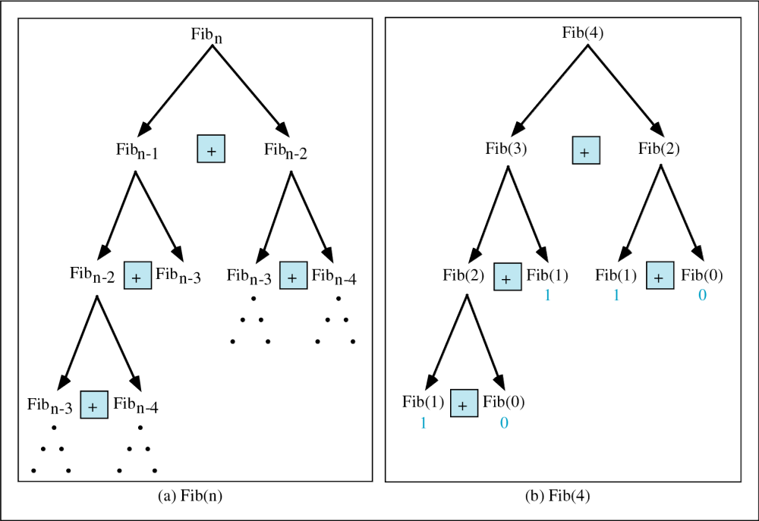

Slide 45
Trace a Fibonacci Number
Assume the input number is 4, that is, num=4:
fib(4):
  4 == 0 ? No; 4 == 1? No.
  fib(4) = fib(3) + fib(2)
  fib(3):
    3 == 0 ? No; 3 == 1? No.
    fib(3) = fib(2) + fib(1)
    fib(2):
      2 == 0? No; 2==1? No.
      fib(2) = fib(1)+fib(0)
    fib(1):
    1== 0 ? No; 1 == 1? Yes.
    fib(1) = 1;
    return fib(1);
int fib(int num)
{
if (num == 0) return 0;
if (num == 1) return 1;
return
(fib(num-1)+fib(num-2));
}

Slide 46
Trace a Fibonacci Number
fib(4):
  4 == 0 ? No; 4 == 1? No.
  fib(4) = fib(3) + fib(2)
  fib(3):
    3 == 0 ? No; 3 == 1? No.
    fib(3) = fib(2) + fib(1)
    fib(2):
    2 == 0 ? No; 2 == 1? No.
    fib(2) = fib(1) + fib(0)
    fib(1):
    1== 0 ? No; 1 == 1? Yes
    fib(1) = 1;
    return fib(1);
fib(0):
    0 == 0 ? Yes.
    fib(0) = 0;
    return fib(0);
    fib(2) = 1 + 0 = 1;
    return fib(2);
  fib(3) = 1 + fib(1)
fib(1):
    1 == 0 ? No; 1 == 1? Yes
    fib(1) = 1;
    return fib(1);
  fib(3) = 1 + 1 = 2;
  return fib(3)

Slide 47
Trace a Fibonacci Number
fib(2):
      2 == 0 ? No; 2 == 1? No.
      fib(2) = fib(1) + fib(0)
      fib(1):
    1== 0 ? No; 1 == 1? Yes.
    fib(1) = 1;
    return fib(1);
    fib(0):
    0 == 0 ? Yes.
    fib(0) = 0;
    return fib(0);
    fib(2) = 1 + 0 = 1;
    return fib(2);
  fib(4) = fib(3) + fib(2) = 2 + 1 = 3;
  return fib(4);

Slide 48
Recursion (continued)
There is an obvious circularity here
  factorial calls factorial calls factorial, etc.
But each one is called with a smaller value for argument!
  Eventually, argument becomes ≤ 1
  Invokes if clause to terminate recursion

Slide 49
Recursive Function
The recursive function is
  a kind of function that calls itself, or
  a function that is part of a cycle in the sequence of function calls.
f1
f1
f2
…
fn

Slide 50
Problem suitable for Recursive
One or more simple cases of the problem have a straightforward solution.
The other cases can be redefined in terms of problems that are closer to the simple cases.
The problem can be reduced entirely to simple cases by calling the recursive function.
  If this is a simple case
  solve it
  else
  redefine the problem using recursion

Slide 51
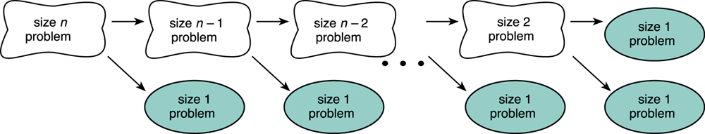
Splitting a Problem into Smaller Problems
Assume that the problem of size 1 can be solved easily (i.e., the simple case).
We can recursively split the problem into a problem of size 1 and another problem of size n-1

Slide 52
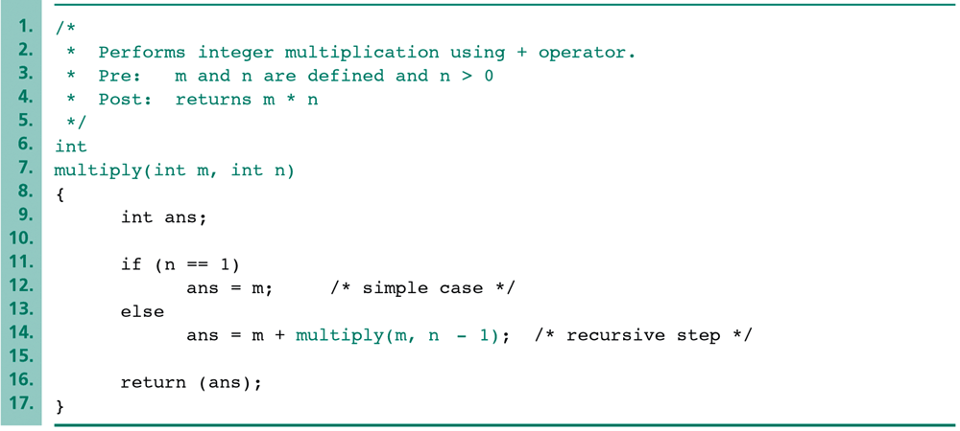
Example of Recursive Function
We can implement multiplication by addition
The simple case is “m*1=m.”
The recursive step uses the following equation: “m*n = m+m*(n-1).”

Slide 53
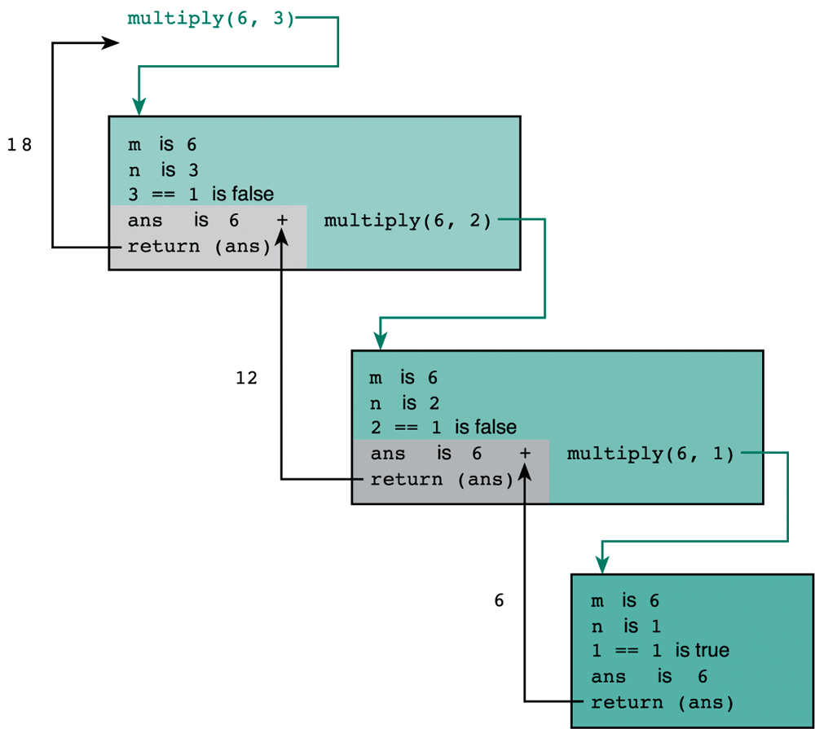
Trace of Function multiply (6, 3)
The recursive step.
The recursive step.
The simple case.

Slide 54
Terminating Condition
The recursive functions always contains one or more terminating conditions.
  A condition when a recursive function is processing a simple case instead of processing recursion.
Without the terminating condition, the recursive function may run forever.
  e.g., in the previous multiply function, the if statement “if (n == 1) …” is the terminating condition.

Slide 55
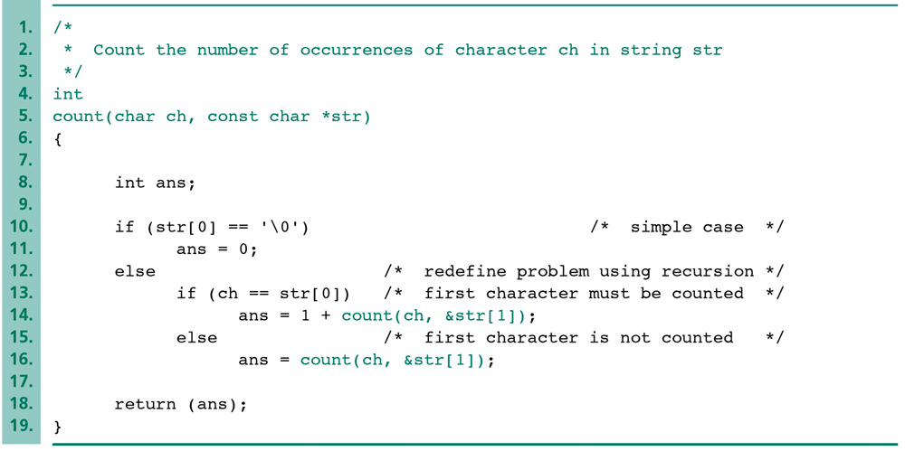
To Count a Character in a String
We can count the number of occurrences of a given character in a string.
  e.g., the number of ‘s’ in “Mississippi” is 4.
The terminating condition.

Slide 56
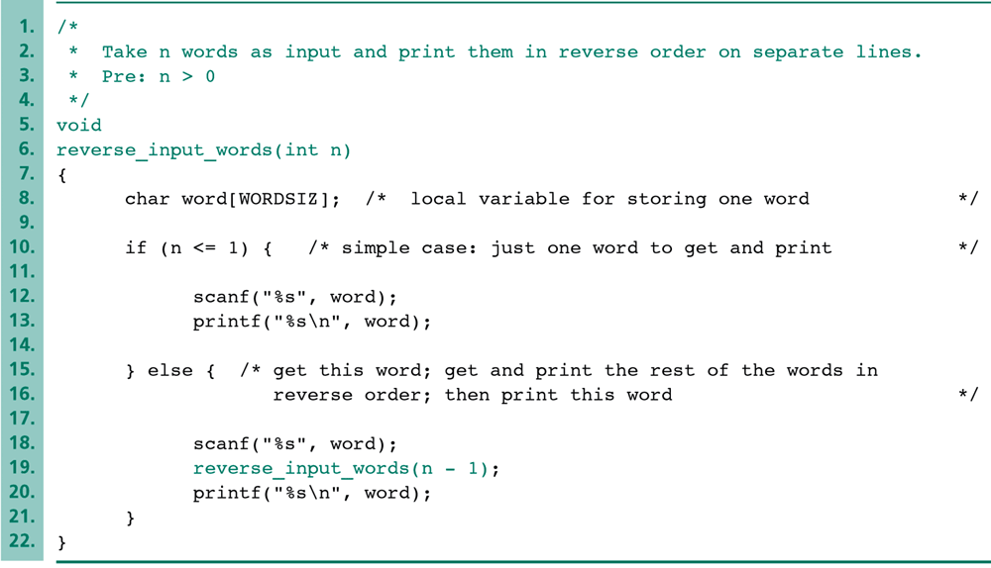
Function that Reverses Input words 1/2
The recursive concept can be used to reverse an input string.
  It can also be done without recursion.
The scanned word will not be printed until the recursion finishes.
The first scanned word is last printed.

Slide 57
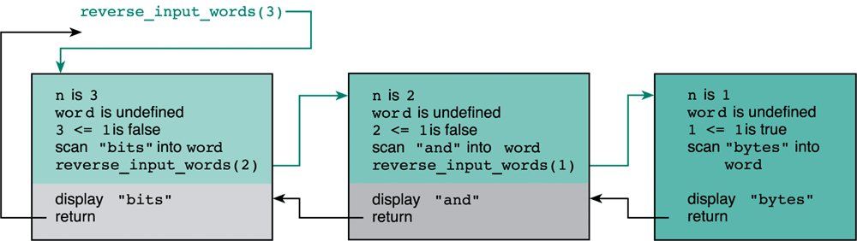
Function that Reverses Input words 2/2
Note that the recursive function is just an alternative solution to a problem.
  You can always solve the problem without recursion.

Slide 58
How C Maintains the Recursive Steps
C keeps track of the values of variables by the stack data structure.
  Recall that stack is a data structure where the last item added is the first item processed.
  There are two operations (push and pop) associated with stack.
a
b
c
pop
b
c
push d
d
b
c

Slide 59
How C Maintains the Recursive Steps
Each time a function is called, the execution state of the caller function (e.g., parameters, local variables, and memory address) are pushed onto the stack.
When the execution of the called function is finished, the execution can be restored by popping up the execution state from the stack.
This is sufficient to maintain the execution of the recursive function.
  The execution state of each recursive step are stored and kept in order in the stack.

Slide 60
What happens when a method is called
When a set of code calls a method, some interesting things happen:
  A method call generates an activation record
  The activation record (AR) is placed on the run-time stack
AR will store the following information about the method:
  Local variables of the method
  Parameters passed to the method
  Value returned to the calling code (if the method is not a void type)
  The location in the calling code of the instruction to execute after returning from the called method

Slide 61
Stack
push
pop
A stack is open at one end (the top) only. You can push entry onto the top, or pop the top entry out of the stack.
Note that you cannot add/extract entry in the middle of the stack.
C
B
A
bottom

Slide 62
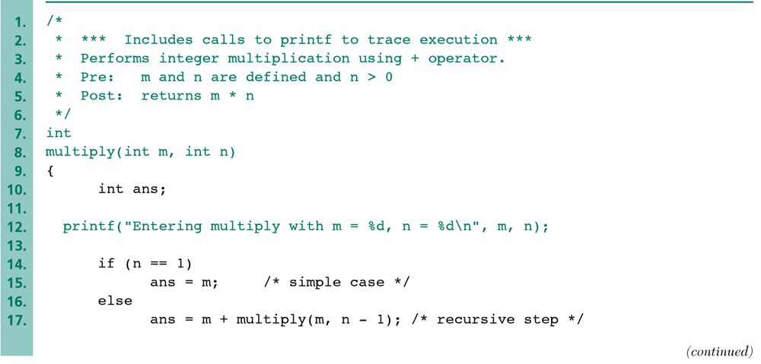
How to Trace Recursive Functions
The recursive function is not easy to trace and to debug.
  If there are hundreds of recursive steps, it is not useful to set the breaking point or to trace step-by-step.
A naïve but useful approach is inserting printing statements and then watching the output to trace the recursive steps.
Watch the input arguments passed into each recursive step.

Slide 63
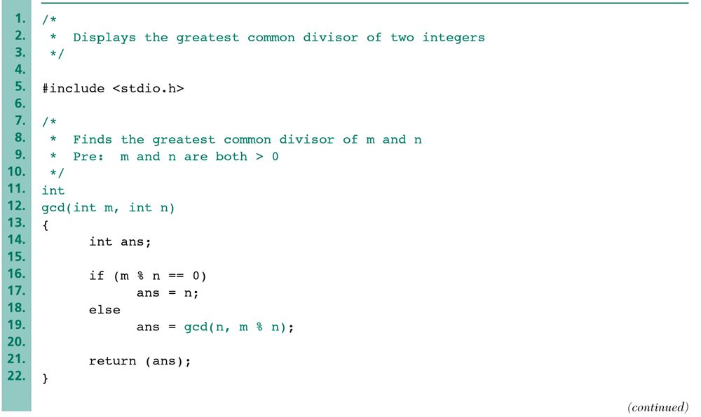
Recursive gcd Function
Generally speaking, if the algorithm to a problem is defined recursively in itself, we would tend to use the recursive function.
e.g., the greatest common divisor (GCD) of two integers m and n can be defined recursively.
  gcd(m,n) is n if n divides m evenly;
  gcd(m,n) is gcd(n, remainder of m divided by n) otherwise.

Slide 64
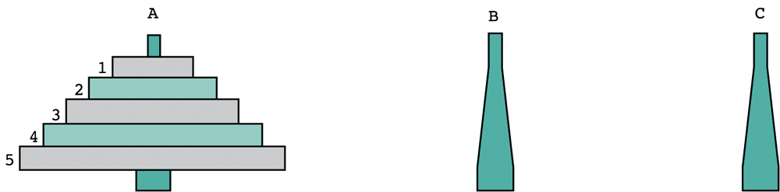
A Classical Case: Towers of Hanoi
The towers of Hanoi problem involves moving a number of disks (in different sizes) from one tower (or called “peg”) to another.
  The constraint is that the larger disk can never be placed on top of a smaller disk.
  Only one disk can be moved at each time
  Assume there are three towers available.

Slide 65
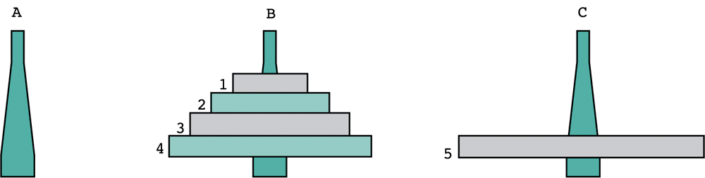
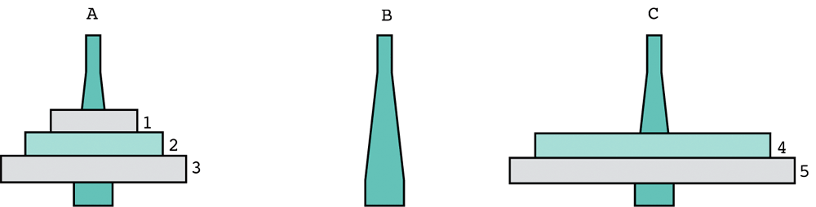
A Classical Case: Towers of Hanoi

Slide 66
A Classical Case: Towers of Hanoi
This problem can be solved easily by recursion.
Algorithm:
if n is 1 then
move disk 1 from the source tower to the destination tower
else
1. move n-1 disks from the source tower to the temp tower.
2. move disk n from the source tower to the destination tower.
3. move n-1 disks from the temp tower to the source tower

Slide 67
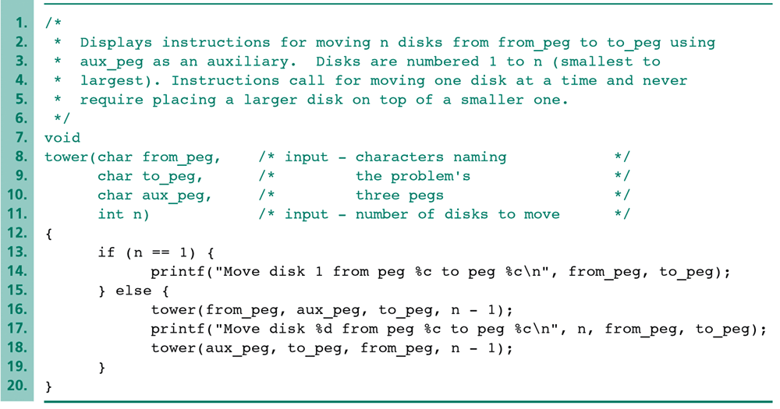
A Classical Case: Towers of Hanoi
The recursive step
The recursive step

Slide 68
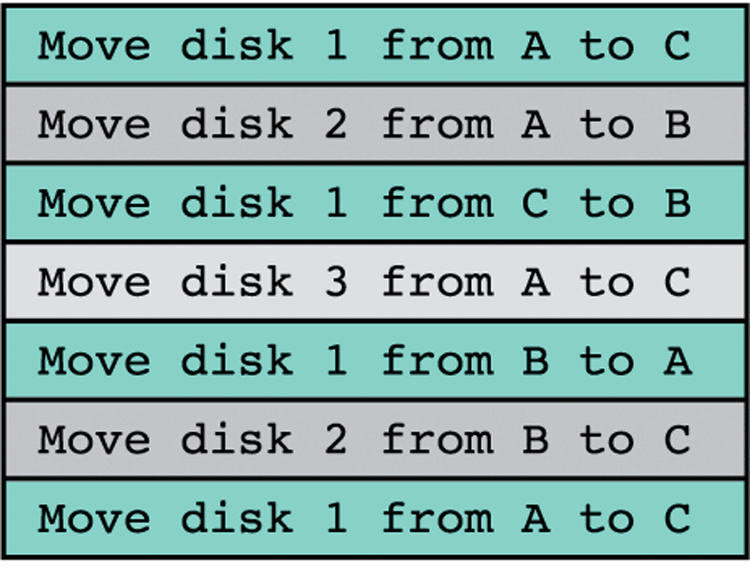
A Classical Case: Towers of Hanoi
The execution result of calling Tower(‘A’, ‘B’, ‘C’,3);

Slide 69
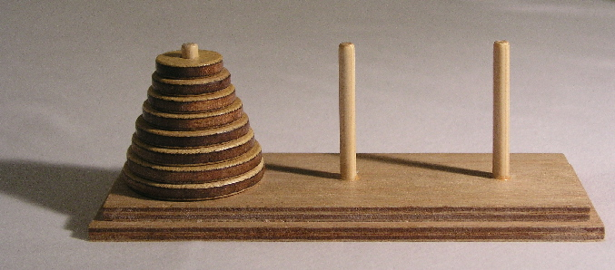
Example :Towers of Hanoi
Move stack of disks from one peg to another
Move one disk at a time
Larger disk may never be on top of smaller disk

Slide 70
Tower of Hanoi Program
#include <stdio.h>
void move (int disks, int a, int c, int b);
int main() {
int n;
printf ("How many disks?");
scanf ("%d", &n);
printf ("\n");
move (n, 1, 3, 2);
return 0;
} // main
/* PRE: n >= 0; a, b, and c represent some order of the distinct integers 1, 2, 3
POST: the function displays the individual moves necessary to move n disks from needle a to needle c, using needle b as a temporary storage needle
*/
void move (int disks, int a, int c, int b) {
if (disks > 0)
{
move (disks-1, a, c, b);
printf ("Move one disk from %d to %d\n", a, c);
move (disks-1, b, a, c);
} // if (disks > 0
return;
} // move

Slide 71
Tower of Hanoi Program
#include <stdio.h>
void move (int disks, int a, int c, int b);
int main() {
int n;
printf ("How many disks?");
scanf ("%d", &n);
printf ("\n");
move (n, 1, 3, 2);
return 0;
} // main
/* PRE: n >= 0; a, b, and c represent some order of the distinct integers 1, 2, 3
POST: the function displays the individual moves necessary to move n disks from needle a to needle c, using needle b as a temporary storage needle
*/
void move (int disks, int a, int c, int b) {
if (disks > 0){
move (disks-1, a, c, b);
printf ("Move one disk from %d to %d\n", a, c);
move (disks-1, b, a, c);
} // if (disks > 0
return;
} // move
The function main – gets number of disks and invokes function move

Slide 72
Tower of Hanoi Program
#include <stdio.h>
void move (int disks, int a, int c, int b);
int main() {
int n;
printf ("How many disks?");
scanf ("%d", &n);
printf ("\n");
move (n, 1, 3, 2);
return 0;
} // main
/* PRE: n >= 0; a, b, and c represent some order of the distinct integers 1, 2, 3
POST: the function displays the individual moves necessary to move n disks from needle a to needle c, using needle b as a temporary storage needle
*/
void move (int disks, int a, int c, int b) {
if (disks > 0){
move (disks-1, a, c, b);
printf ("Move one disk " "from %d to %d\n",a,c);
move (disks-1, b, a, c);
} // if (disks > 0
return;
} // move
The function move – where the action is

Slide 73
Tower of Hanoi Program
#include <stdio.h>
void move (int disks, int a, int c, int b);
int main() {
int n;
printf ("How many disks?");
scanf ("%d", &n);
printf ("\n");
move (n, 1, 3, 2);
return 0;
} // main
/* PRE: n >= 0; a, b, and c represent some order of the distinct integers 1, 2, 3
POST: the function displays the individual moves necessary to move n disks from needle a to needle c, using needle b as a temporary storage needle
*/
void move (int disks, int a, int c, int b) {
if (disks > 0){
move (disks-1, a, c, b);
printf ("Move one disk " "from %d to %d\n",a,c);
move (disks-1, b, a, c);
} // if (disks > 0
return;
} // move
First move all but one of the disks to temporary peg

Slide 74
Tower of Hanoi Program
#include <stdio.h>
void move (int disks, int a, int c, int b);
int main() {
int n;
printf ("How many disks?");
scanf ("%d", &n);
printf ("\n");
move (n, 1, 3, 2);
return 0;
} // main
/* PRE: n >= 0; a, b, and c represent some order of the distinct integers 1, 2, 3
POST: the function displays the individual moves necessary to move n disks from needle a to needle c, using needle b as a temporary storage needle
*/
void move (int disks, int a, int c, int b) {
if (disks > 0){
move (disks-1, a, c, b);
printf ("Move one disk " "from %d to %d\n",a,c);
move (disks-1, b, a, c);
} // if (disks > 0
return;
} // move
Next, move the remaining disk to the destination peg

Slide 75
Tower of Hanoi Program
#include <stdio.h>
void move (int disks, int a, int c, int b);
int main() {
int n;
printf ("How many disks?");
scanf ("%d", &n);
printf ("\n");
move (n, 1, 3, 2);
return 0;
} // main
/* PRE: n >= 0; a, b, and c represent some order of the distinct integers 1, 2, 3
POST: the function displays the individual moves necessary to move n disks from needle a to needle c, using needle b as a temporary storage needle
*/
void move (int disks, int a, int c, int b) {
if (disks > 0){
move (disks-1, a, c, b);
printf ("Move one disk " "from %d to %d\n",a,c);
move (disks-1, b, a, c);
} // if (disks > 0
return;
} // move
Finally, move disks from temporary to destination peg

Slide 76
Tower of Hanoi Program
#include <stdio.h>
void move (int disks, int a, int c, int b);
int main() {
int n;
printf ("How many disks?");
scanf ("%d", &n);
printf ("\n");
move (n, 1, 3, 2);
return 0;
} // main
/* PRE: n >= 0; a, b, and c represent some order of the distinct integers 1, 2, 3
POST: the function displays the individual moves necessary to move n disks from needle a to needle c, using needle b as a temporary storage needle
*/
void move (int disks, int a, int c, int b) {
if (disks > 0){
move (disks-1, a, c, b);
printf ("Move one disk " "from %d to %d\n",a,c);
move (disks-1, b, a, c);
} // if (disks > 0
return;
} // move
Notice that move calls itself twice, but with one fewer disks each time

Slide 77
Ex. 7: The Towers of Hanoi
According to legend, monks in a remote monastery could predict when the world would end. They had a set of 3 diamond needles. Stacked on the first diamond needle were 64 discs of decreasing size.

Slide 78
Ex. 7: The Towers of Hanoi
The monks moved one disk to another needle each hour, subject to the following rules:
  Only one disc could be moved at a time
  A larger disc must never be stacked above a smaller one
  One and only one extra needle could be used for intermediate storage of discs
This task requires 2⁶⁴-1 moves!

Slide 79
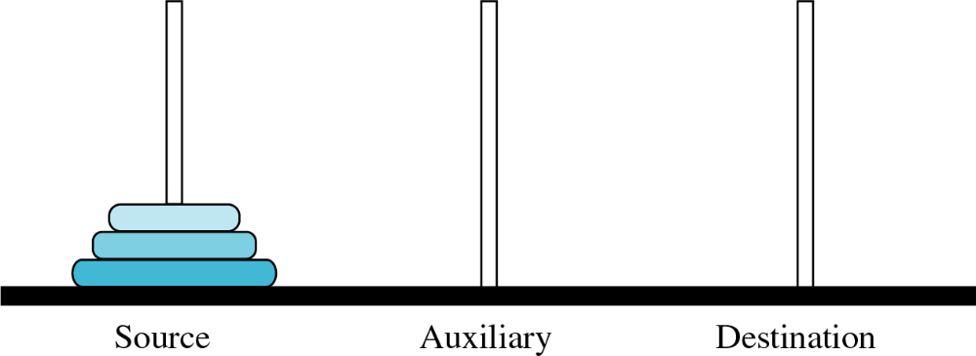
Ex. 7: The Towers of Hanoi
Let's try an example with 3 disks:
Figure 6-29

Slide 80
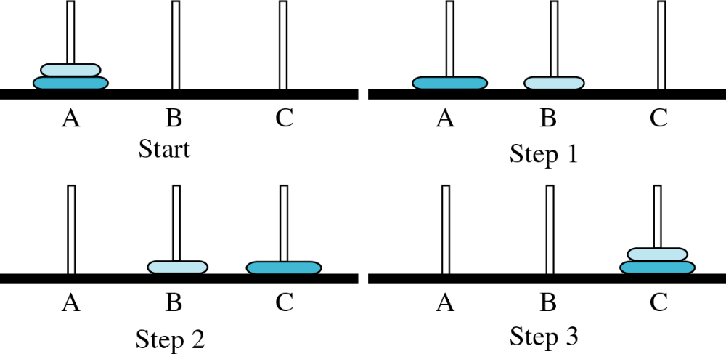
Ex. 7: The Towers of Hanoi
Moving 2 disks to another needle
Figure 6-30

Slide 81
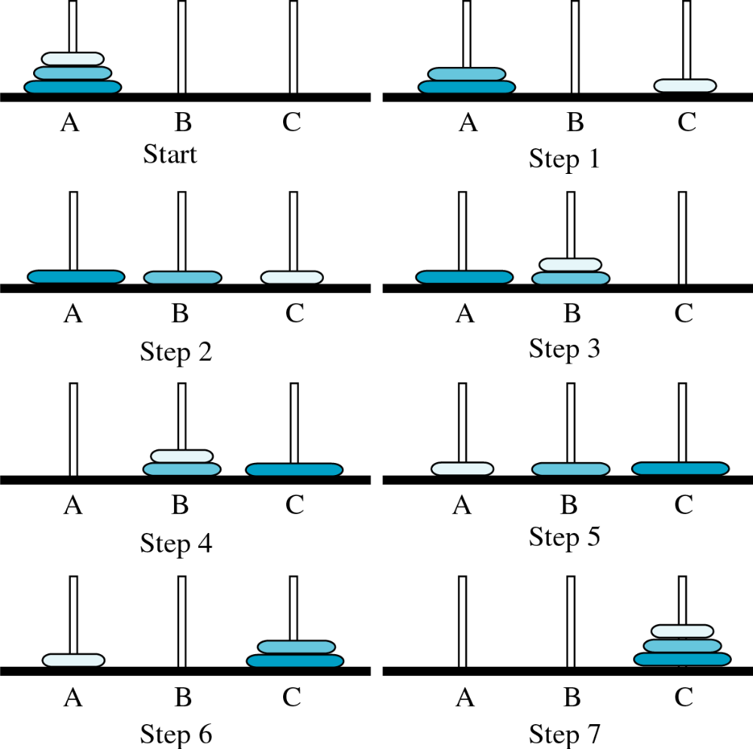

Slide 82
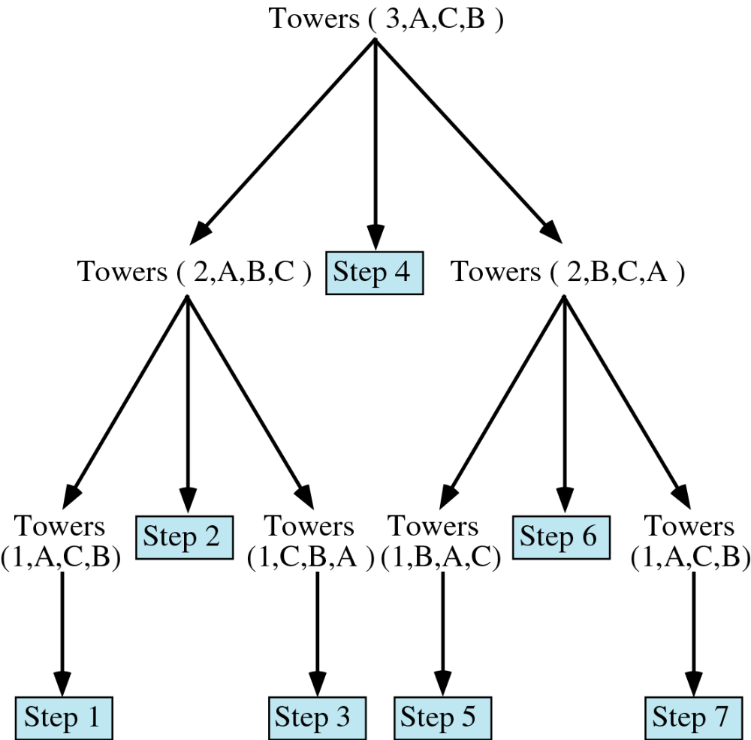

Slide 83
Ex. 7: The Towers of Hanoi
int main() {
int num_disc; //number of discs
cout << "Please enter a positive number (0 to quit)";
cin >> num_disc;
while (num_disc > 0){
hanoi(1, 3, num_disc);
cout << "Please enter a positive number ";
cin >> num_disc;
}
return 0;
}

Slide 84
Ex. 7: The Towers of Hanoi
void hanoi(int from, int to, int num)
{
int temp = 6 - from - to; //find the temporary
//storage column
if (num == 1){
cout << "move disc 1 from " << from
<< " to " << to << endl;
}
else {
hanoi(from, temp, num - 1);
cout << "move disc " << num << " from " << from
<< " to " << to << endl;
hanoi(temp, to, num - 1);
}
}

Slide 85
Linear Search - Iterative
Int LinSearch(int [] list, int item, int size) {
int found = 0;
int position = -1;
int index = 0;
while (index < size) && (found == 0) {
if (list[index] == item ) {
found = 1;
position = index;
} // end if
index++;
} // end of while
return position;
} // end of function LinSearch

Slide 86
Linear Search - Recursive
Linear search can also be described as a recursive algorithm:
LinearSearch(list, size, key)
if the list is empty, return Λ;
else
  if the first item of the list has the desired value, return its location;
  else
  return LinearSearch(value, remainder of the list)

Slide 87
Linear Search – Recursive Code
int linearSearch(const int list[], int first, int last, int key)
{
if (first == last) // base case: target not found
return last;
if (list[first] == target) // base case: target found return first;
// inductive step: search with range [first+1, last)
return RecLinearSearch (arr, first+1, last, target)
} // end RecLinearSearch

Slide 88
Example : Binary Search
int main() {
const int array_size = 8;
int list[array_size]={1, 2, 3, 5, 7, 10, 14, 17};
int search_value;
cout << "Enter search value: ";
cin >> search_value;
cout << bsearchr(list,0,array_size-1,search_value)
<< endl;
return 0;
}

Slide 89
Binary Search - Iterative
// Searches an ordered array of integers
int bsearch(const int data[], // input: array
int size, // input: array size
int value // input: value to find
){ // output: if found,return
// index; otherwise, return -1
int first, last, upper;
first = 0;
last = size - 1;
while (true) {
middle = (first + last) / 2;
if (data[middle] == value)
return middle;
else if (first >= last)
return -1;
else if (value < data[middle])
last = middle - 1;
else
first = middle + 1;
}
}

Slide 90
Binary Search with Recursion
// Searches an ordered array of integers using recursion
int bsearchr(const int data[], // input: array
int first, // input: lower bound
int last, // input: upper bound
int value // input: value to find
)// output: index if found, otherwise return –1
{ int middle = (first + last) / 2;
if (data[middle] == value)
return middle;
else if (first >= last)
return -1;
else if (value < data[middle])
return bsearchr(data, first, middle-1, value);
else
return bsearchr(data, middle+1, last, value);
}

Slide 91
Binary Search W & W/O Recursion
int first, last, upper;
first = 0;
last = size - 1;
while (true) {
middle = (first + last) / 2;
if (data[middle] == value)
return middle;
else if (first >= last)
return -1;
else if (value < data[middle])
last = middle - 1;
else
first = middle + 1;
}
}
{ int middle = (first + last) / 2;
if (data[middle] == value)
return middle;
else if (first >= last)
return -1;
else if (value < data[middle])
return bsearchr(data, first, middle-1, value);
else
return bsearchr(data, middle+1, last, value);
}
w/o recursion
with recursion

Slide 92
Recursive Binary Search
int binarySearch(double b, double X[], int left, int right){
if (left == right)
if (b==X[left]) return left;
else return -1;
int mid = (left+right)/2;
if (b==X[mid]) return mid;
if (b < X[mid]) return binarySearch (b, X, left, mid-1);
if (b > X[mid]) return binarySearch(b, X, mid+1, right);
}

Slide 93
Printing a linked List - Iterative
struct ListNode{
int val;
ListNode *next; };
void main(){
int x;
ListNode *head; //data member
for(int i=0, i<5, i++) {
cout<<“Enter value…”>>x;
insert(x); }
void insert(int inVal ) { …………}
void printFwd() {
ListNode *tmp = head;
cout << "Fwd List!" << endl;
while (tmp != NULL) {
cout << "Val: " << tmp->val << endl;
tmp = tmp->next;
}
}
From main():
insertHead(1);
insertHead(5);
insertHead(2);
insertHead(9);
printFwd();
Output:
Fwd List!
Val: 9
Val: 2
Val: 5
Val: 1

Slide 94
Printing a list backward - Recursive
On the way down
On the way up
9
2
5
1
For node 9:
endOfList=false
recPrintBwd(node 2)
Node NULL:
no print - returns
to node 1
Node 1:
prints 1 - returns
to node 5
Node 5:
prints 5 - returns
to node 2
Node 2:
prints 2 - returns
to node 9
Node 9:
prints 9 - returns
to calling
function
void recPrintBwd(ListNode *n)
{
bool endOfList = false;
if (n != Null)
recPrintBwd(n->next); //recursion
else
endOfList = true; //base case
if (!endOfList)
cout << "Val: " << n->val << endl;
}
void printBwd2()
{
cout << "Bwd list!" << endl;
recPrintBwd(head);
}
For node 2:
endOfList=false
recPrintBwd(node 5)
For node 5:
endOfList=false
recPrintBwd(node 1)
For node 1:
endOfList=false
recPrintBwd(node NULL)
For node NULL:
endOfList=true

Slide 95
Recursion - Comments
Recursion is never "necessary"
  Anything that can be done recursively, can be done iteratively
  Recursive solution may seem more logical
    For example, printing the list - the iterative solution given is very awkward, and does not model the human way of doing the problem, if given a list
The recursive solution did not use any nested loops, while the iterative solution did
However, the recursive solution made many more function calls, which adds a lot of overhead
Recursion is NOT an efficiency tool - use it only when it helps the logical flow of your program

Slide 96
Recursion
PROS
  Clearer logic
  Often more compact code
  Often easier to modify
  Allows for complete analysis of runtime performance
CONS
  Overhead costs

Slide 97
Why Recursion?
Not often used by programmers with ordinary skills in some areas, but …
… some problems are too hard to solve without recursion
  Most notably, the compiler!
  Tower of Hanoi problem
  Most problems involving linked lists and trees
    (Later in the course)

Slide 98
Recursion vs. Iteration
Some simple recursive problems can be “unwound” into loops
  But code becomes less compact, harder to follow!
Hard problems cannot easily be expressed in non-recursive code
  Tower of Hanoi
  Robots or avatars that “learn”
  Advanced games

Slide 99
Recursion is so important …
… that all modern computer architectures specifically support it
  Stack register
  Instructions for manipulating The Stack
… most modern programming languages allow it
  But not Fortran and not Cobol
From my own experience, programming languages and environments that do not support recursion …
… are usually not rich enough to support a diverse portfolio of programs
  i.e., a wide variety of applications in many different disciplines

Slide 100
Limitation of Recursion
while it makes it easier to write simple and elegant programs, it also makes it easier to write inefficient ones.
when we use recursion to solve problems we are interested exclusively with correctness, and not at all with efficiency. Consequently, our simple, elegant recursive algorithms may be inherently inefficient.
By using recursion, you can often write simple, short implementations of your solution.
  However, just because an algorithm can be implemented in a recursive manner doesn’t mean that it should be implemented in a recursive manner

Slide 101
Limitation of Recursion
Recursive solutions may involve extensive overhead because they use calls.
When a call is made, it takes time to build a stack frame and push it onto the system stack.
Conversely, when a return is executed, the stack frame must be popped from the stack and the local variables reset to their previous values – this also takes time.
In general, recursive algorithms run slower than their iterative counterparts.
Also, every time we make a call, we must use some of the memory resources to make room for the stack frame.

Slide 102
Recursion - Overhead
Space: Every invocation of a function call may require space for parameters and local variables, and for an indication of where to return when the function is finished
Typically this space (allocation record) is allocated on the stack and is released automatically when the function returns. Thus, a recursive algorithm may need space proportional to the number of nested calls to the same function.

Slide 103
Recursion - Overhead
Time: The operations involved in calling a function - allocating, and later releasing, local memory, copying values into the local memory for the parameters, branching to/returning from the function - all contribute to the time overhead.
If a function has very large local memory requirements, it would be very costly to program it recursively. But even if there is very little overhead in a single function call, recursive functions often call themselves many many times, which can magnify a small individual overhead into a very large cumulative overhead

Slide 104
Recursion - Overhead
We have to pay a price for recursion:
  calling a function consumes more time and memory than adjusting a loop counter.
  high performance applications (graphic action games, simulations of nuclear explosions) hardly ever use recursion.
In less demanding applications recursion is an attractive alternative for iteration (for the right problems!)

Slide 105
Recursion – Final comments
For every recursive algorithm, there is an equivalent iterative algorithm.
Recursive algorithms are often shorter, more elegant, and easier to understand than their iterative counterparts.
However, iterative algorithms are usually more efficient in their use of space and time.
105

Slide 106
Summary
Recursion
Examples
Implementation
Recursive Search Algorithms
  Linear or Sequential Search
  Binary Search
Recursion with Linked Lists
Advantages and Disadvantages
Comparison with Iteration
Analysis of Recursion

