Slide 1
CSC 211
Data Structures
Lecture 16
Dr. Iftikhar Azim Niaz
ianiaz@comsats.edu.pk
1

Slide 2
Last Lecture Summary
Complexity of Bubble Sort
Selection Sort
  Concept and Algorithm
  Code and Implementation
Complexity of Selection Sort
Insertion Sort
  Concept and Algorithm
  Code and Implementation
Complexity of Insertion Sort
2

Slide 3
Objectives Overview
Comparison of Sorting methods
  Bubble,
  Selection and
  Insertion
Recursion
  Concept
  Example
  Implementation Code

Slide 4
The Sorting Problem
Input:
  A sequence of n numbers a₁, a₂, . . . , a_{n}
Output:
  A permutation (reordering) a₁’, a₂’, . . . , a_{n}’ of the input sequence such that a₁’ ≤ a₂’ ≤ · · · ≤ a_{n}’

Slide 5
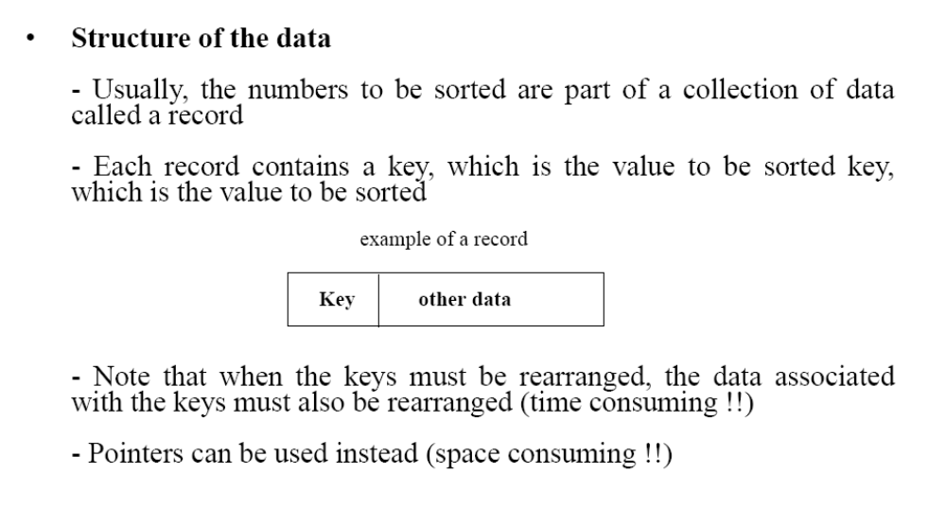
Structure of data

Slide 6
Why Study Sorting Algorithms?
There are a variety of situations that we can encounter
  Do we have randomly ordered keys?
  Are all keys distinct?
  How large is the set of keys to be ordered?
  Need guaranteed performance?
Various algorithms are better suited to some of these situations

Slide 7
Some Definitions
Internal Sort
  The data to be sorted is all stored in the computer’s main memory.
External Sort
  Some of the data to be sorted might be stored in some external, slower, device.
In Place Sort
  The amount of extra space required to sort the data is constant with the input size.

Slide 8
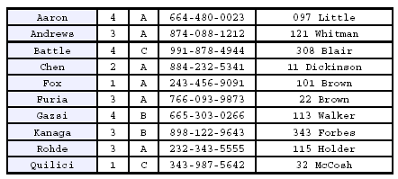
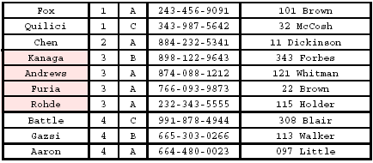
Stability
A STABLE sort preserves relative order of records with equal keys
Sorted on first key:
Sort file on second key:
Records with key value 3 are not in order on first key!!

Slide 9
Selection Sort
Idea:
  Find the smallest element in the array
  Exchange it with the element in the first position
  Find the second smallest element and exchange it with the element in the second position
  Continue until the array is sorted i.e. for n-1 keys.
  Use current position to hold current minimum to avoid large-scale movement of keys.
Disadvantage:
  Running time depends only slightly on the amount of order in the file

Slide 10
Selection Sort Example
8
4
6
9
2
3
1
1
2
3
4
9
6
8
1
4
6
9
2
3
8
1
2
3
4
6
9
8
1
2
6
9
4
3
8
1
2
3
4
6
8
9
1
2
3
9
4
6
8
1
2
3
4
6
8
9

Slide 11
Selection Sort
Alg.: SELECTION-SORT(A)
n ← length[A]
for j ← 1 to n - 1
do smallest ← j
for i ← j + 1 to n
do if A[i] < A[smallest]
then smallest ← i
exchange A[j] ↔ A[smallest]
8
4
6
9
2
3
1

Slide 12
Selection Sort: Analysis
Alg.: SELECTION-SORT(A)
n ← length[A]
for j ← 1 to n - 1
do smallest ← j
for i ← j + 1 to n
do if A[i] < A[smallest]
then smallest ← i
exchange A[j] ↔ A[smallest]
cost times
c₁ 1
c₂ n
c₃ n-1
c₄
c₅
c₆
c₇ n-1
Fixed n-1 iterations
Fixed n-i iterations
n²/2
comparisons
n
exchanges

Slide 13
Selection Sort: Analysis
Doing it the dumb way:
The smart way: I do one comparison when i=n-1,
two when i=n-2, … , n-1 when i=1.

Slide 14
Complexity of Selection Sort
Worst case performance
Best case performance
Average case performance
Worst case space complexity Total
Worst case space complexity auxiliary
Where n is the number of elements being sorted
14

Slide 15
Bubble Sort
Search for adjacent pairs that are out of order.
Switch the out-of-order keys.
Repeat this n-1 times.
After the first iteration, the last key is guaranteed to be the largest.
If no switches are done in an iteration, we can stop.

Slide 16
Bubble Sort
Idea:
  Repeatedly pass through the array
  Swaps adjacent elements that are out of order
Easier to implement, but slower than Insertion sort
i
1
2
3
n
8
4
6
9
2
3
1
j

Slide 17
Example
8
4
6
9
2
3
1
1
8
4
6
9
2
3
i = 1
j
i = 2
j
8
4
6
9
2
1
3
1
2
8
4
6
9
3
i = 1
j
i = 3
j
8
4
6
9
1
2
3
1
2
3
8
4
6
9
i = 1
j
i = 4
j
8
4
6
1
9
2
3
1
2
3
4
8
6
9
i = 1
j
i = 5
j
8
4
1
6
9
2
3
1
2
3
4
6
8
9
i = 1
j
i = 6
j
8
1
4
6
9
2
3
1
2
3
4
6
8
9
i = 1
j
i = 7
1
8
4
6
9
2
3
j
i = 1
j

Slide 18
Bubble Sort
Alg.: BUBBLESORT(A)
for i ← 1 to length[A]
do for j ← length[A] downto i + 1
do if A[j] < A[j -1]
then exchange A[j] ↔ A[j-1]
i
8
4
6
9
2
3
1
i = 1
j

Slide 19
Bubble-Sort Running Time
Alg.: BUBBLESORT(A)
for i ← 1 to length[A]
do for j ← length[A] downto i + 1
do if A[j] < A[j -1]
then exchange A[j] ↔ A[j-1]
Worst case n-1 iterations
c₁
Fixed n-i iterations
c₂
Comparisons: ≈ n²/2
c₃
Exchanges: ≈ n²/2
c₄
T(n) =
c₁(n+1) +
c₂
c₃
c₄
= Θ(n) +
(c₂ + c₂ + c₄)
Thus,T(n) = Θ(n²)

Slide 20
Bubble Sort Analysis
Being smart right from the beginning:

Slide 21
Complexity of Bubble Sort
Worst case performance
Best case performance
Average case performance
Worst case space complexity auxiliary
Where n is the number of elements being sorted
21

Slide 22
Insertion Sort
Idea: like sorting a hand of playing cards
  Start with an empty left hand and the cards facing down on the table.
  Remove one card at a time from the table, and insert it into the correct position in the left hand
    compare it with each of the cards already in the hand, from right to left
  The cards held in the left hand are sorted
    these cards were originally the top cards of the pile on the table

Slide 23
Insertion Sort
To insert 12, we need to make room for it by moving first 36 and then 24.
6
10
24
36
12

Slide 24
Insertion Sort
6
10
24
36
12

Slide 25
Insertion Sort
6
10
24
36
12

Slide 26
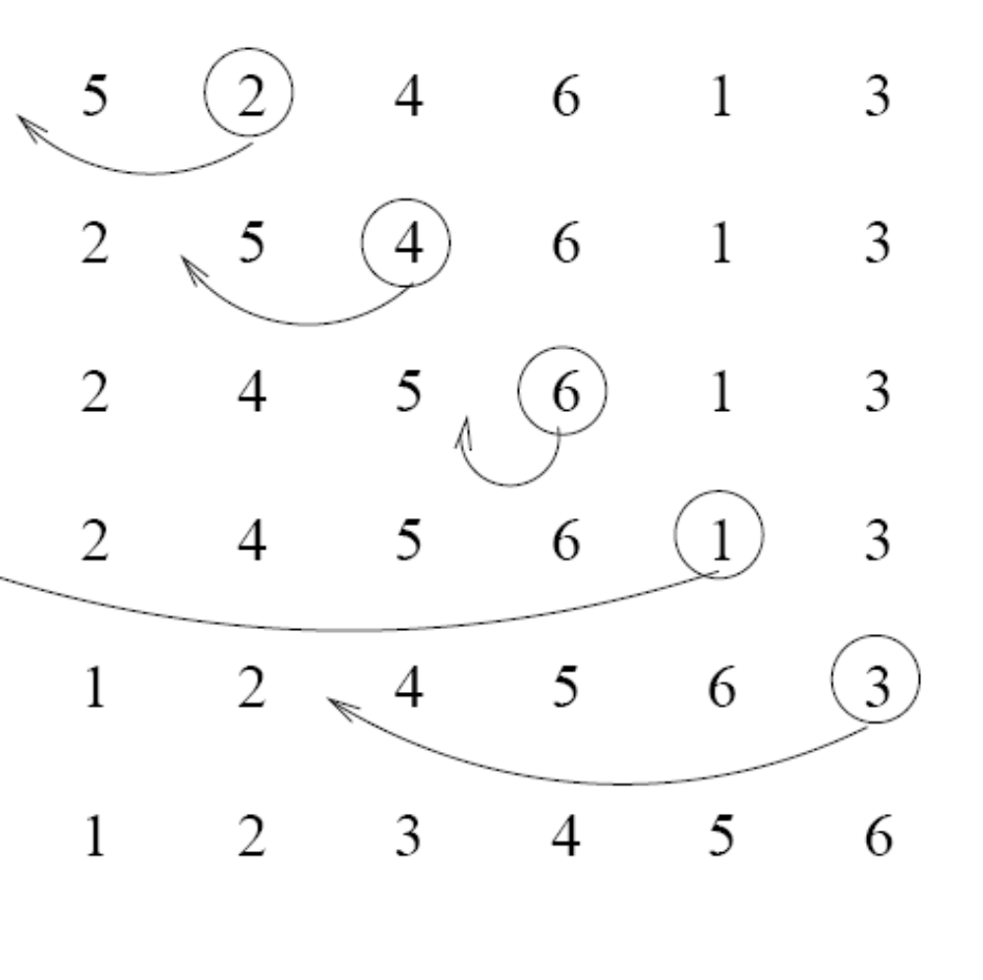
Insertion Sort
input array
5 2 4 6 1 3
at each iteration, the array is divided in two sub-arrays:
left sub-array
right sub-array
sorted
unsorted

Slide 27
Insertion Sort

Slide 28
Insertion Sort I
The list is assumed to be broken into a sorted portion and an unsorted portion
Keys will be inserted from the unsorted portion into the sorted portion.
Sorted
Unsorted

Slide 29
Insertion Sort II
For each new key, search backward through sorted keys
Move keys until proper position is found
Place key in proper position
Moved

Slide 30
INSERTION-SORT
Alg.: INSERTION-SORT(A)
for j ← 2 to n
do key ← A[ j ]
Insert A[ j ] into the sorted sequence A[1 . . j -1]
i ← j - 1
while i > 0 and A[i] > key
do A[i + 1] ← A[i]
i ← i – 1
A[i + 1] ← key
Insertion sort – sorts the elements in place
1
2
3
4
5
6
7
8
a₁
a₂
a₃
a₄
a₅
a₆
a₇
a₈
key

Slide 31
Loop Invariant for Insertion Sort
Alg.: INSERTION-SORT(A)
for j ← 2 to n
do key ← A[ j ]
Insert A[ j ] into the sorted sequence A[1 . . j -1]
i ← j - 1
while i > 0 and A[i] > key
do A[i + 1] ← A[i]
i ← i – 1
A[i + 1] ← key
Invariant: at the start of the for loop the elements in A[1 . . j-1] are in sorted order

Slide 32
Proving Loop Invariants
Proving loop invariants works like induction
Initialization (base case):
  It is true prior to the first iteration of the loop
Maintenance (inductive step):
  If it is true before an iteration of the loop, it remains true before the next iteration
Termination:
  When the loop terminates, the invariant gives us a useful property that helps show that the algorithm is correct
  Stop the induction when the loop terminates

Slide 33
Loop Invariant for Insertion Sort
Initialization:
  Just before the first iteration, j = 2:
  the subarray A[1 . . j-1] = A[1], (the element originally in A[1]) – is sorted

Slide 34
Loop Invariant for Insertion Sort
Maintenance:
  the while inner loop moves A[j -1], A[j -2], A[j -3], and so on, by one position to the right until the proper position for key (which has the value that started out in A[j]) is found
  At that point, the value of key is placed into this position.

Slide 35
Loop Invariant for Insertion Sort
Termination:
  The outer for loop ends when j = n + 1 ⇒ j-1 = n
  Replace n with j-1 in the loop invariant:
    the subarray A[1 . . n] consists of the elements originally in A[1 . . n], but in sorted order
The entire array is sorted!
j - 1
j
Invariant: at the start of the for loop the elements in A[1 . . j-1] are in sorted order

Slide 36
Analysis of Insertion Sort
INSERTION-SORT(A)
for j ← 2 to n
do key ← A[ j ]
Insert A[ j ] into the sorted sequence A[1 . . j -1]
i ← j - 1
while i > 0 and A[i] > key
do A[i + 1] ← A[i]
i ← i – 1
A[i + 1] ← key
cost times
c₁ n
c₂ n-1
0 n-1
c₄ n-1
c₅
c₆
c₇
c₈ n-1
Fixed n-1 iterations
Worst case i-1 comparisons
t_{j}: # of times the while statement is executed at iteration j
Notes:
₇

Slide 37
Best Case Analysis
The array is already sorted
  A[i] ≤ key upon the first time the while loop test is run (when i = j -1)
  t_{j} = 1
T(n) = c₁n + c₂(n -1) + c₄(n -1) + c₅(n -1) + c₈(n-1) = (c₁ + c₂ + c₄ + c₅ + c₈)n + (c₂ + c₄ + c₅ + c₈)
= an + b = Θ(n)
“while i > 0 and A[i] > key”

Slide 38
Insertion Sort: Analysis
Worst Case: Keys are in reverse order
Do i-1 comparisons for each new key, where i runs from 2 to n.
Total Comparisons: 1+2+3+ … + n-1

Slide 39
Worst Case Analysis
The array is in reverse sorted order
  Always A[i] > key in while loop test
  Have to compare key with all elements to the left of the j-th position ⇒ compare with j-1 elements ⇒ t_{j} = j
  a quadratic function of n
T(n) = Θ(n²) order of growth in n²
“while i > 0 and A[i] > key”
using
we have:

Slide 40
Comparisons and Exchanges in Insertion Sort
INSERTION-SORT(A)
for j ← 2 to n
do key ← A[ j ]
Insert A[ j ] into the sorted sequence A[1 . . j -1]
i ← j - 1
while i > 0 and A[i] > key
do A[i + 1] ← A[i]
i ← i – 1
A[i + 1] ← key
cost times
c₁ n
c₂ n-1
0 n-1
c₄ n-1
c₅
c₆
c₇
c₈ n-1
≈ n²/2 comparisons
≈ n²/2 exchanges

Slide 41
Insertion Sort: Average I
Assume: When a key is moved by the While loop, all positions are equally likely.
There are i positions (i is loop variable of for loop) (Probability of each: 1/i.)
One comparison is needed to leave the key in its present position.
Two comparisons are needed to move key over one position.

Slide 42
Insertion Sort Average II
In general: k comparisons are required to move the key over k-1 positions.
Exception: Both first and second positions require i-1 comparisons.
Position
1
2
3
...
i-2
i-1
i
...
i-1
i-1
i-2
...
3
2
1
Comparisons necessary to place key in this position.

Slide 43
Insertion Sort Average III
Average Comparisons to place one key
Solving

Slide 44
Insertion Sort Average IV
For All Keys:

Slide 45
Complexity of Insertion Sort
Best case performance
Average case performance
Worst case performance
Worst case space complexity auxiliary
Where n is the number of elements being sorted
  ≈ n²/2 comparisons and exchanges
45

Slide 46
Comparison of Sorts
 | Bubble | Selection | Insertion
Best Case
Average Case
Worst Case
Space complexity

Slide 47
Comparison Bubble and Insertion Sort
Bubble sort is asymptotically equivalent in running time O(n²) to insertion sort in the worst case
But the two algorithms differ greatly in the number of swaps necessary
Experimental results have also shown that insertion sort performs considerably better even on random lists.
For these reasons many modern algorithm textbooks avoid using the bubble sort algorithm in favor of insertion sort.

Slide 48
Comparison Bubble and Insertion Sort
Bubble sort also interacts poorly with modern CPU hardware. It requires
  at least twice as many writes as insertion sort,
  twice as many cache misses, and
  asymptotically more branch miss predictions.
Experiments of sorting strings in Java show bubble sort to be
  roughly 5 times slower than insertion sort and
  40% slower than selection sort

Slide 49
Comparison of Selection Sort
Among simple average-case Θ(n²) algorithms, selection sort almost always outperforms bubble sort
Simple calculation shows that insertion sort will therefore usually perform about half as many comparisons as selection sort, although it can perform just as many or far fewer depending on the order the array was in prior to sorting
selection sort is preferable to insertion sort in terms of number of writes (Θ(n) swaps versus Ο(n²) swaps)

Slide 50
Optimality Analysis I
To discover an optimal algorithm we need to find an upper and lower asymptotic bound for a problem.
An algorithm gives us an upper bound. The worst case for sorting cannot exceed Θ(n²) because we have Insertion Sort that runs that fast.
Lower bounds require mathematical arguments

Slide 51
Optimality Analysis II
Making mathematical arguments usually involves assumptions about how the problem will be solved.
Invalidating the assumptions invalidates the lower bound.
Sorting an array of numbers requires at least Θ(n) time, because it would take that much time to rearrange a list that was rotated one element out of position.

Slide 52
Rotating One Element
Assumptions:
Keys must be moved
one at a time
All key movements take
the same amount of time
The amount of time
needed to move one key
is not dependent on n.
2nd
1st
3rd
n keys must
be moved
2nd
4th
3rd
Θ(n) time
nth
n-1st
1st
nth

Slide 53
Other Assumptions
The only operation used for sorting the list is swapping two keys.
Only adjacent keys can be swapped.
This is true for Insertion Sort and Bubble Sort.
Is it true for Selection Sort? What about if we search the remainder of the list in reverse order?

Slide 54
Inversions
Suppose we are given a list of elements L, of size n.
Let i, and j be chosen so 1≤i<j≤n.
If L[i]>L[j] then the pair (i,j) is an inversion.
Not an Inversion
1
2
3
5
4
10
6
7
8
9
Inversion
Inversion
Inversion

Slide 55
Maximum Inversions
The total number of pairs is:
This is the maximum number of inversions in any list.
Exchanging adjacent pairs of keys removes at most one inversion.

Slide 56
Swapping Adjacent Pairs
The only inversion
that could be removed
is the (possible) one
between the red and
green keys.
Swap Red and Green
The relative position of the Red
and blue areas has not changed.
No inversions between the red key
and the blue area have been removed.
The same is true for the red key and
the orange area. The same analysis can
be done for the green key.

Slide 57
Lower Bound Argument
A sorted list has no inversions.
A reverse-order list has the maximum number of inversions, Θ(n²) inversions.
A sorting algorithm must exchange Θ(n²) adjacent pairs to sort a list.
A sort algorithm that operates by exchanging adjacent pairs of keys must have a time bound of at least Θ(n²).

Slide 58
Lower Bound For Average I
There are n! ways to rearrange a list of n elements.
Recall that a rearrangement is called a permutation.
If we reverse a rearranged list, every pair that used to be an inversion will no longer be an inversion.
By the same token, all non-inversions become inversions.

Slide 59
Lower Bound For Average II
There are n(n-1)/2 inversions in a permutation and its reverse.
Assuming that all n! permutations are equally likely, there are n(n-1)/4 inversions in a permutation, on the average.
The average performance of a “swap-adjacent-pairs” sorting algorithm will be Θ(n²).

Slide 60
Recursion
is the process of repeating items in a self-similar way.
For instance, when the surfaces of two mirrors are exactly parallel with each other the nested images that occur are a form of infinite recursion.
The term recursion has a variety of meanings specific to a variety of disciplines ranging from linguistics to logic.

Slide 61
Recursion - Concept
In computer science, a class of objects or methods exhibit recursive behavior when they can be defined by two properties:
  A simple base case (or cases), and
  A set of rules which reduce all other cases toward the base case.
For example, the following is a recursive definition of a person's ancestors:
  One's parents are one's ancestors (base case).
  The parents of one's ancestors are also one's ancestors (recursion step).
The Fibonacci sequence is a classic example of recursion:
  Fib(0) is 0 [base case] Fib(1) is 1 [base case]
  For all integers n > 1: Fib(n) is (Fib(n-1) + Fib(n-2))
Many mathematical axioms are based upon recursive rules.
  e.g. the formal definition of the natural numbers in set theory follows: 1 is a natural number, and each natural number has a successor, which is also a natural number.
  By this base case and recursive rule, one can generate the set of all natural numbers

Slide 62
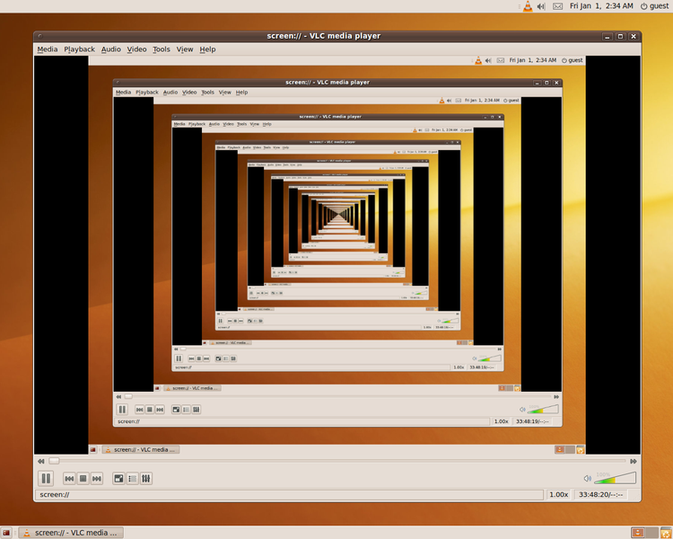
Recursion - Concept
Recursion in a screen recording program, where the smaller window contains a snapshot of the entire screen.

Slide 63
Recursion
It is a method where the solution to a problem depends on solutions to smaller instances of the same problem
The approach can be applied to many types of problems, and is one of the central ideas of computer science
The power of recursion evidently lies in the possibility of defining an infinite set of objects by a finite statement.
In the same manner, an infinite number of computations can be described by a finite recursive program, even if this program contains no explicit repetitions

Slide 64
Recursion
Most computer programming languages support recursion by allowing a function to call itself within the program text
Some functional programming languages do not define any looping constructs but rely solely on recursion to repeatedly call code
Computability theory has proven that these recursive-only languages are mathematically equivalent to the imperative languages
  meaning they can solve the same kinds of problems even without the typical control structures like “while” and “for”

Slide 65
Recursive Algorithms
A common computer programming tactic is
  to divide a problem into sub-problems of the same type as the original,
  solve those problems, and combine the results
  This is often referred to as the divide-and-conquer method
When combined with a lookup table that stores the results of solving sub-problems
  (to avoid solving them repeatedly and incurring extra computation time)
It can be referred to as dynamic programming

Slide 66
Recursive Function
A recursive function definition has one or more base cases
  meaning input(s) for which the function produces a result trivially (without recurring), and
  one or more recursive cases, meaning input(s) for which the program recurs (calls itself).
  For example, the factorial function can be defined recursively by the equations 0! = 1
  and, for all n >0; n! = n(n-1)!
Neither equation by itself constitutes a complete definition;
  First is the base case, and
  Second is the recursive case.

Slide 67
Recursive Function
The job of the recursive cases can be seen as breaking down complex inputs into simpler ones
In a properly designed recursive function, with each recursive call, the input problem must be simplified in such a way that eventually the base case must be reached.
Neglecting to write a base case, or testing for it incorrectly, can cause an infinite loop

Slide 68
Recursion
Recursive functions
  Function that calls itself
  Can only solve a base case
  Divides up problem into
    What it can do
    What it cannot do - resembles original problem
      Launches a new copy of itself (recursion step)
Eventually base case gets solved
  Gets plugged in, works its way up and solves whole problem

Slide 69
Recursion – Example
Example: factorial:
  5! = 5 * 4 * 3 * 2 * 1
  Notice that 5! = 5 * 4! 4! = 4 * 3! ...
  Can compute factorials recursively
  Solve base case (1! = 0! = 1) then plug in
    2! = 2 * 1! = 2 * 1 = 2;
    3! = 3 * 2! = 3 * 2 = 6;
unsigned int factorial(unsigned int n) {
  if (n <= 1)
    return 1;
    else
    return n * factorial(n-1); }

Slide 70
Recursion – Fibonacci Series
Fibonacci series: 0, 1, 1, 2, 3, 5, 8, 13, 21, 34, 55, 89, ...
  Each number sum of the previous two
  fib(n) = fib(n-1) + fib(n-2) - recursive formula
  long fibonacci(long n)
  {
  if (n==0 || n==1) //base case
  return n;
  else return fibonacci(n-1)+fibonacci(n-2);
  }

Slide 71
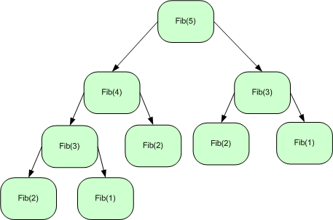
Recursive Fibonacci Series

Slide 72
Recursion : Fibonacci Series
f( 3 )
return
f( 2 )
+
f( 1 )
return
f( 1 )
+
f( 0 )
return 1
return 1
return 0

Slide 73
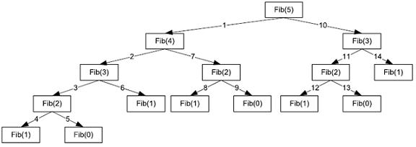
Recursion – Fibonacci Series

Slide 74
1 /* Fig. 5.15: fig05_15.c
2 Recursive fibonacci function */
3 #include <stdio.h>
4
1. Function prototype
1.1 Initialize variables
2. Input an integer
2.1 Call function fibonacci
2.2 Output results.
3. Define fibonacci recursively
Program Output
5 long fibonacci( long );
6
7 int main()
8 {
9 long result, number;
10
11 printf( "Enter an integer: " );
12 scanf( "%ld", &number );
13 result = fibonacci( number );
14 printf( "Fibonacci( %ld ) = %ld\n", number, result );
15 return 0;
16 }
17
18 /* Recursive definition of function fibonacci */
19 long fibonacci( long n )
20 {
21 if ( n == 0 || n == 1 )
22 return n;
23 else
24 return fibonacci( n - 1 ) + fibonacci( n - 2 );
25 }
Enter an integer: 0
Fibonacci(0) = 0
Enter an integer: 1
Fibonacci(1) = 1

Slide 75
Enter an integer: 2
Fibonacci(2) = 1
Enter an integer: 3
Fibonacci(3) = 2
Enter an integer: 4
Fibonacci(4) = 3
Enter an integer: 5
Fibonacci(5) = 5
Enter an integer: 6
Fibonacci(6) = 8
Enter an integer: 10
Fibonacci(10) = 55
Enter an integer: 20
Fibonacci(20) = 6765
Enter an integer: 30
Fibonacci(30) = 832040
Enter an integer: 35
Fibonacci(35) = 9227465
Program Output

Slide 76
Recusrion Vs. Iteration
Repetition
  Iteration: explicit loop
  Recursion: repeated function calls
Termination
  Iteration: loop condition fails
  Recursion: base case recognized
Both can have infinite loops
Balance
  Choice between performance (iteration) and good software engineering (recursion)
Recursion
  Main advantage is usually simplicity
  Main disadvantage is often that the algorithm may require large amounts of memory if the depth of the recursion is very large

Slide 77
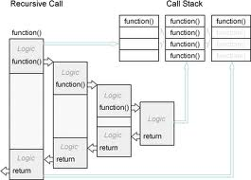
Recursion – Memory Map

Slide 78
Summary
Comparison of Sorting methods
  Bubble,
  Selection and
  Insertion
Recursion
  Concept
  Example
  Implementation Code

