Slide 1
CSC 211
Data Structures
Lecture 15
Dr. Iftikhar Azim Niaz
ianiaz@comsats.edu.pk
1

Slide 2
Last Lecture Summary
Sorting
  Concept
Reasons for Sorting
Basic Terminology
Sorting Classification
Stability of Key
Bubble Sort
  Concept
  Algorithm
  Code and Implementation
2

Slide 3
Objectives Overview
Complexity of Bubble Sort
Selection Sort
  Concept and Algorithm
  Code and Implementation
Complexity of Selection Sort
Insertion Sort
  Concept and Algorithm
  Code and Implementation
Complexity of Insertion Sort

Slide 4
Complexity of Bubble Sort
Worst case performance
Best case performance
Average case performance
Worst case space complexity auxiliary
Where n is the number of elements being sorted
4

Slide 5
Complexity of Bubble Sort
average and worst case performance is O(n²), so it is rarely used to sort large, unordered, data sets.
Can be used to sort a small number of items (where its asymptotic inefficiency is not a high penalty).
Can also be used efficiently on a list of any length that is nearly sorted
  i.e. the elements are not significantly out of place
  E.g. if any number of elements are out of place by only one position (e.g. 0123546789 and 1032547698),
  bubble sort's exchange will get them in order on the first pass, the second pass will find all elements in order, so the sort will take only 2n time.
5

Slide 6
Complexity of Bubble Sort
The only significant advantage that bubble sort has over most other implementations, even quick sort, but not insertion sort, is that the ability to detect that the list is sorted is efficiently built into the algorithm.
Performance of bubble sort over an already-sorted list (best-case) is O(n).
By contrast, most other algorithms, even those with better average-case complexity, perform their entire sorting process on the set and thus are more complex.
However, not only does insertion sort have this mechanism too, but it also performs better on a list that is substantially sorted
  having a small number of inversions
6

Slide 7
Selection Sort
It is specifically an in-place comparison sort
Noted for its simplicity,
It has performance advantages over more complicated algorithms in certain situations, particularly where auxiliary memory is limited
The algorithm
  finds the minimum value,
  swaps it with the value in the first position, and
  repeats these steps for the remainder of the list
It does no more than n swaps, and thus is useful where swapping is very expensive

Slide 8
Sorting an Array of Integers
The picture shows an array of six integers that we want to sort from smallest to largest
[0] [1] [2] [3] [4] [5]
Notes:
The picture shows a graphical representation of an array which we will sort so that the smallest element ends up at the front, and the other elements increase to the largest at the end. The bar graph indicates the values which are in the array before sorting--for example the first element of the array contains the integer 45.

Slide 9
The Selection Sort Algorithm
Start by finding the smallest entry.
[0] [1] [2] [3] [4] [5]
Notes:
The first sorting algorithm that we'll examine is called Selectionsort. It begins by going through the entire array and finding the smallest element. In this example, the smallest element is the number 8 at location [4] of the array.

Slide 10
The Selection Sort Algorithm
Start by finding the smallest entry.
Swap the smallest entry with the first entry.
[0] [1] [2] [3] [4] [5]
Notes:
Once we have found the smallest element, that element is swapped with the first element of the array...

Slide 11
The Selection Sort Algorithm
Start by finding the smallest entry.
Swap the smallest entry with the first entry.
[0] [1] [2] [3] [4] [5]
Notes:
...like this.
The smallest element is now at the front of the array, and we have taken one small step toward producing a sorted array.

Slide 12
The Selection Sort Algorithm
Sorted side
Unsorted side
Part of the array is now sorted.
[0] [1] [2] [3] [4] [5]
Notes:
At this point, we can view the array as being split into two sides: To the left of the dotted line is the "sorted side", and to the right of the dotted line is the "unsorted side". Our goal is to push the dotted line forward, increasing the number of elements in the sorted side, until the entire array is sorted.

Slide 13
The Selection Sort Algorithm
Sorted side
Unsorted side
Find the smallest element in the unsorted side.
[0] [1] [2] [3] [4] [5]
Notes:
Each step of the Selectionsort works by finding the smallest element in the unsorted side. At this point, we would find the number 15 at location [5] in the unsorted side.

Slide 14
The Selection Sort Algorithm
Sorted side
Unsorted side
Find the smallest element in the unsorted side.
Swap with the front of the unsorted side.
[0] [1] [2] [3] [4] [5]
Notes:
This small element is swapped with the number at the front of the unsorted side, as shown here...

Slide 15
The Selection Sort Algorithm
Sorted side
Unsorted side
We have increased the size of the sorted side by one element.
[0] [1] [2] [3] [4] [5]
Notes:
...and the effect is to increase the size of the sorted side by one element.
As you can see, the sorted side always contains the smallest numbers, and those numbers are sorted from small to large. The unsorted side contains the rest of the numbers, and those numbers are in no particular order.

Slide 16
The Selection Sort Algorithm
Sorted side
Unsorted side
Smallest
from
unsorted
The process continues...
[0] [1] [2] [3] [4] [5]
Notes:
Again, we find the smallest entry in the unsorted side...

Slide 17
The Selection Sort Algorithm
Sorted side
Unsorted side
The process continues...
Swap
with
front
[0] [1] [2] [3] [4] [5]
Notes:
...and swap this element with the front of the unsorted side.

Slide 18
The Selection Sort Algorithm
Sorted side
is bigger
Sorted side
Unsorted side
The process continues...
[0] [1] [2] [3] [4] [5]
Notes:
The sorted side now contains the three smallest elements of the array.

Slide 19
The Selection Sort Algorithm
The process keeps adding one more number to the sorted side.
The sorted side has the smallest numbers, arranged from small to large.
Sorted side
Unsorted side
[0] [1] [2] [3] [4] [5]
Notes:
Here is the array after increasing the sorted side to four elements.

Slide 20
The Selection Sort Algorithm
We can stop when the unsorted side has just one number, since that number must be the largest number.
Sorted side
Unsorted side
[0] [1] [2] [3] [4] [5]
Notes:
And now the sorted side has five elements.
In fact, once the unsorted side is down to a single element, the sort is completed. At this point the 5 smallest elements are in the sorted side, and so the the one largest element is left in the unsorted side.
We are done...

Slide 21
The Selection Sort Algorithm
The array is now sorted.
We repeatedly selected the smallest element, and moved this element to the front of the unsorted side.
[0] [1] [2] [3] [4] [5]
Notes:
...The array is sorted.
The basic algorithm is easy to state and also easy to program.

Slide 22
Selection Sort – Pseudocode
Input: An array A[1..n] of n elements.
Output: A[1..n] sorted in descending order
1. for i ← 1 to n - 1
2. min ← i
3. for j ← i + 1 to n {Find the i th smallest element.}
4. if A[j] < A[min] then
5. min ← j
6. end for
7. if min ≠ i then interchange A[i] and A[min]
8. end for

Slide 23
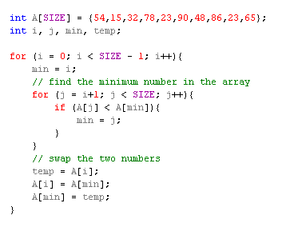
Selection Sort – Implementation

Slide 24
Selection Sort - Implementation Code
void selectionSort (int list[ ] , int size) {
int i, j, temp, minIndex;
for ( i = 0; i < size-1; i++ ) { /* controls passes through the list */
minIndex = i;
for ( j = i+1; j < size; j++ ) /* performs adjacent comparisons */
{
if ( list[ j ] < list[ minIndex] ) /* determines the minimum */
minIndex = j;
} // end of inner for loop
temp = list[i ]; /* swap is performed in outer for loop */
list[ i ] = list[min];
list[min] = temp;
} // end of outer for loop
} // end of function

Slide 25
Selection Sort Using Call-by-reference
Implement Selection sort using pointers
  Swap two elements
  swap function must receive address (using &) of array elements
    Array elements have call-by-value default
  Using pointers and the * operator, swap can switch array elements
Psuedocode
    Initialize array
    print data in original order
    Call function selectionsort
    print sorted array
    Define selectionsort and Swap functions

Slide 26
1
2 This program puts values into an array, sorts the values into
3 ascending order, and prints the resulting array. */
4 #include <stdio.h>
5 #define SIZE 10
1. Initialize array
1.1 Declare variables
2. Print array
2.1 Call selectionSort
2.2 Print array
6 void selectionSort( int *, const int );
7
8 int main()
9 {
10
11 int a[ SIZE ] = { 2, 6, 4, 8, 10, 12, 89, 68, 45, 37 };
selectionsort gets passed the address of array elements (pointers). The name of an array is a pointer.
12 int i;
13
14 printf( "Data items in original order\n" );
15
16 for ( i = 0; i < SIZE; i++ )
17 printf( "%4d", a[ i ] );
18
19 selectionSort( a, SIZE ); /* sort the array */
20 printf( "\nData items in ascending order\n" );
21
22 for ( i = 0; i < SIZE; i++ )
23 printf( "%4d", a[ i ] );
24
25 printf( "\n" );
26
27 return 0;
28 }

Slide 27
30 void selectionSort(int *array, const int size)
31{
32 void swap( int *, int * );
3. Function definitions
Program Output
33 int i, j, minIndex;
34 for ( i = 0; i < size - 1; i++ ) {
35 minIndex = i;
36 for ( j = i+1; j < size - 1; j++ )
37 if ( array[ j ] < array[ minIndex ] )
38 minIndex = j;
39 swap( &array[ i ], &array[ minIndex ] );
40 } // end of outer for loop
41 }
42 void swap( int *element1Ptr, int *element2Ptr )
43 {
44 int hold = *element1Ptr;
45 *element1Ptr = *element2Ptr;
46 *element2Ptr = hold;
47 }
Data items in original order
2 6 4 8 10 12 89 68 45 37
Data items in ascending order
2 4 6 8 10 12 37 45 68 89

Slide 28
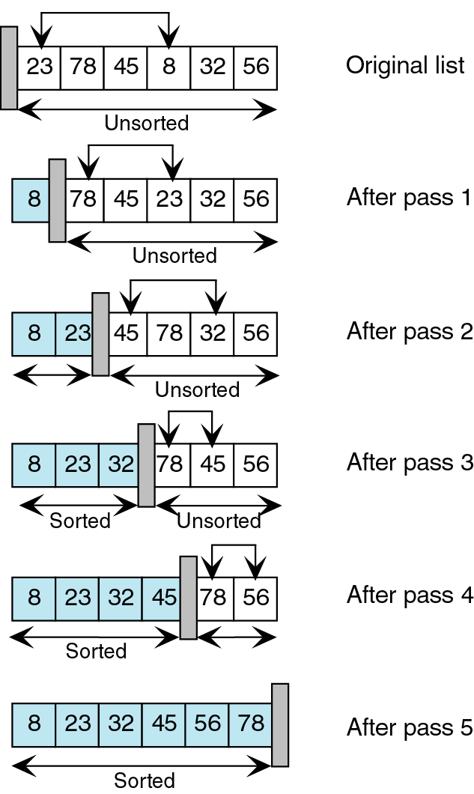
Selection Sort - Step through
Again, we search the unsorted list for the smallest element.
We then exchange the smallest element (23) with the first element
in the unsorted list (78) and move the conceptual wall.
We start with an unsorted list. We search this list for the smallest element.
We then exchange the smallest element (8) with the first element in the
unsorted list (23) and move theconceptual wall.
This process continues until the list is fully sorted.

Slide 29
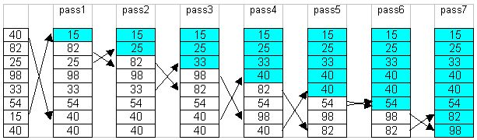
Selection Sort Example
To sort an array with k elements, Selection sort requires k – 1 passes.
Example:

Slide 30
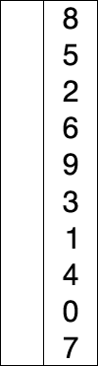
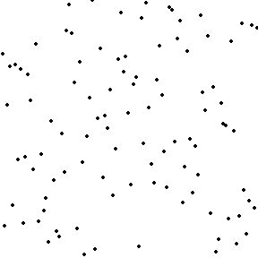
Selection Sort - Animation

Slide 31
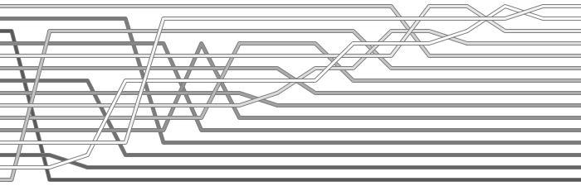
Selection Sort Descending

Slide 32
Complexity of Selection Sort
An in-place comparison sort
O(n²) complexity, making it inefficient on large lists, and generally performs worse than the similar insertion sort.
Selection sort is not difficult to analyze compared to other sorting algorithms since none of the loops depend on the data in the array

Slide 33
Complexity of Selection Sort
Selecting the lowest element requires scanning all n elements (this takes n − 1 comparisons) and then swapping it into the first position
Finding the next lowest element requires scanning the remaining n − 1 elements and so on,
for (n − 1) + (n − 2) + ... + 2 + 1 = n(n − 1) / 2 ∈ O(n²) comparisons
Each of these scans requires one swap for n − 1 elements (the final element is already in place).

Slide 34
Complexity of Selection Sort
Worst case performance
Best case performance
Average case performance
Worst case space complexity Total
Worst case space complexity auxiliary
Where n is the number of elements being sorted
34

Slide 35
Insertion Sort
Insertion sort is not as slow as bubble sort, and it is easy to understand.
Insertion sort keeps making the left side of the array sorted until the whole array is sorted.
Real life example:
  Insertion sort works the same way as arranging your hand when playing cards.
  To sort the cards in your hand you extract a card, shift the remaining cards, and then insert the extracted card in the correct place.

Slide 36
Arranging Your Hand
7
5
7

Slide 37
Arranging Your Hand
5
7
5
6
7
5
6
7
K
5
6
7
8
K

Slide 38
Insertion Sort
Unsorted - shaded
Look at 2nd item - 5.
Compare 5 to 7.
5 is smaller, so move 5 to temp, leaving
an empty slot in
position 2.
Move 7 into the empty
slot, leaving position 1
open.
Move 5 into the open
position.
7
K
1
7
5
v
7
5
7
>
2
5
7
3
<

Slide 39
Insertion Sort (con’t)
5
Look at next item - 6.
Compare to 1st - 5.
6 is larger, so leave 5. Compare to next - 7. 6 is smaller, so move 6 to temp, leaving an empty slot.
Move 7 into the empty
slot, leaving position 2
open.
Move 6 to the open
2nd position.
7
6
K
1
5
7
v
5
7
6
5
7
>
2
5
6
7
3
<

Slide 40
Insertion Sort (con’t)
Look at next item - King.
Compare to 1st - 5.
King is larger, so leave 5 where it is.
Compare to next - 6. King is larger, so leave 6 where it is.
Compare to next - 7. King is larger, so
leave 7 where it is.
5
6
7
K

Slide 41
Insertion Sort (con’t)
5
6
7
K
8
6
1
5
7
K
8
v
5
6
7
K
8
5
6
7
K
>
2
5
6
7
8
K
3
<

Slide 42
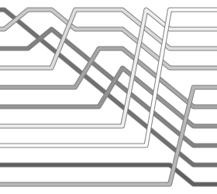
Insertion Sort

Slide 43
The Insertion Sort Algorithm
Views the array as having two sides
a sorted side and
an unsorted side.
[0] [1] [2] [3] [4] [5]
Notes:
Now we'll look at another sorting method called Insertionsort. The end result will be the same: The array will be sorted from smallest to largest. But the sorting method is different.
However, there are some common features. As with the Selectionsort, the Insertionsort algorithm also views the array as having a sorted side and an unsorted side, ...

Slide 44
The Insertion Sort Algorithm
Sorted side
Unsorted side
The sorted side starts with just the first element, which is not necessarily the smallest element.
[0] [1] [2] [3] [4] [5]
Notes:
...like this.
However, in the Selectionsort, the sorted side always contained the smallest elements of the array. In the Insertionsort, the sorted side will be sorted from small to large, but the elements in the sorted side will not necessarily be the smallest entries of the array.
Because the sorted side does not need to have the smallest entries, we can start by placing one element in the sorted side--we don't need to worry about sorting just one element. But we do need to worry about how to increase the number of elements that are in the sorted side.

Slide 45
The Insertion Sort Algorithm
Sorted side
Unsorted side
The sorted side grows by taking the front element from the unsorted side...
[0] [1] [2] [3] [4] [5]
Notes:
The basic approach is to take the front element from the unsorted side...

Slide 46
The Insertion Sort Algorithm
Sorted side
Unsorted side
...and inserting it in the place that keeps the sorted side arranged from small to large.
[0] [1] [2] [3] [4] [5]
Notes:
...and insert this element at the correct spot of the sorted side.
In this example, the front element of the unsorted side is 20. So the 20 must be inserted before the number 45 which is already in the sorted side.

Slide 47
The Insertion Sort Algorithm
In this example, the new element goes in front of the element that was already in the sorted side.
Sorted side
Unsorted side
[0] [1] [2] [3] [4] [5]
Notes:
After the insertion, the sorted side contains two elements. These two elements are in order from small to large, although they are not the smallest elements in the array.

Slide 48
The Insertion Sort Algorithm
Sometimes we are lucky and the new inserted item doesn't need to move at all.
Sorted side
Unsorted side
[0] [1] [2] [3] [4] [5]
Notes:
Sometimes we are lucky and the newly inserted element is already in the right spot. This happens if the new element is larger than anything that's already in the array.

Slide 49
The Insertion Sort Algorithm
Sorted side
Unsorted side
Sometimes we are lucky twice in a row.
[0] [1] [2] [3] [4] [5]
Notes:
Sometimes we are lucky twice in a row.

Slide 50
The Insertion Sort Algorithm
Copy the new element to a separate location.
Sorted side
Unsorted side
[0] [1] [2] [3] [4] [5]
Notes:
The actual insertion process requires a bit of work that is shown here. The first step of the insertion is to make a copy of the new element. Usually this copy is stored in a local variable. It just sits off to the side, ready for us to use whenever we need it.

Slide 51
The Insertion Sort Algorithm
Shift elements in the sorted side, creating an open space for the new element.
[0] [1] [2] [3] [4] [5]
Notes:
After we have safely made a copy of the new element, we start shifting elements from the end of the sorted side. These elements are shifted rightward, to create an "empty spot" for our new element to be placed.
In this example we take the last element of the sorted side and shift it rightward one spot...

Slide 52
The Insertion Sort Algorithm
Shift elements in the sorted side, creating an open space for the new element.
[0] [1] [2] [3] [4] [5]
Notes:
...like this.
Is this the correct spot for the new element? No, because the new element is smaller than the next element in the sorted section. So we continue shifting elements rightward...

Slide 53
The Insertion Sort Algorithm
Continue shifting elements...
[0] [1] [2] [3] [4] [5]
Notes:
This is still not the correct spot for our new element, so we shift again...

Slide 54
The Insertion Sort Algorithm
Continue shifting elements...
[0] [1] [2] [3] [4] [5]
Notes:
...and shift one more time...

Slide 55
The Insertion Sort Algorithm
...until you reach the location for the new element.
[0] [1] [2] [3] [4] [5]
Notes:
Finally, this is the correct location for the new element. In general there are two situations that indicate the "correct location" has been found:
1. We reach the front of the array (as happened here), or
2. We reached an element that is less than or equal to the new element.

Slide 56
The Insertion Sort Algorithm
Copy the new element back into the array, at the correct location.
Sorted side
Unsorted side
[0] [1] [2] [3] [4] [5]
Notes:
Once the correct spot is found, we copy the new element back into the array. The number of elements in the sorted side has increased by one.

Slide 57
The Insertion Sort Algorithm
The last element must also be inserted. Start by copying it...
Sorted side
Unsorted side
[0] [1] [2] [3] [4] [5]
Notes:
The last element of the array also needs to be inserted. Start by copying it to a safe location.

Slide 58
The Insertion Sort Algorithm
How many shifts will occur before we copy this element back into the array?
[0] [1] [2] [3] [4] [5]
Notes:
Now we will shift elements rightward. How many shifts will be done?

Slide 59
The Insertion Sort Algorithm
Four items are shifted.
[0] [1] [2] [3] [4] [5]
Notes:
These four elements are shifted. But the 7 at location [0] is not shifted since it is smaller than the new element.

Slide 60
The Insertion Sort Algorithm
Four items are shifted.
And then the element is copied back into the array.
[0] [1] [2] [3] [4] [5]
Notes:
The new element is inserted into the array.

Slide 61
Insertion Sort - Algorithm
For i = 2 to n do the following
a. set NextElement = x[i] and
x[0] = nextElement
b. set j = i
c. While nextElement < x[j – 1] do following
set x[j] equal to x[j – 1]
decrement j by 1
End wile
d. set x[j] equal to nextElement
End for

Slide 62
Insertion Sort - Pseudocode
Input: An array A[1..n] of n elements.
Output: A[1..n] sorted in nondecreasing order.
1. for i ← 2 to n
2. x ← A[i]
3. j ← i - 1
4. while (j >0) and (A[j] > x)
5. A[j + 1] ← A[j]
6. j ← j - 1
7. end while
8. A[j + 1] ← x
9. end for

Slide 63
Insertion Sort - Pseudocode
A[i] is inserted in its proper position in the ith iteration in the sorted subarray A[1 .. i-1]
In the ith step, the elements from index i-1 down to 1 are scanned, each time comparing A[i] with the element at the correct position.
In each iteration an element is shifted one position up to a higher index.
The process of comparison and shifting continues until:
  Either an element ≤ A[i] is found or
  When all the sorted sequence so far is scanned.
Then A[i] is inserted in its proper position.

Slide 64
Insertion Sort - Algorithm
Array consists of two parts:
  sorted and unsorted.
  Initially only first element belongs to the sorted part.
Consider first of unsorted elements.
  It leaves the unsorted part and moves to a “proper” position of the sorted part, so that the sorted part must remain sorted.
  Many elements have to be shifted to “open room” for the movement.
Repeat step 2 until array is sorted.

Slide 65
Insertion Sort - Implementation
void InsertionSort(int s1[], int size){
int i,j,k,temp;
for(i=1;i < size;i++) {
temp=s1[i];
j=i;
while((j > 0)&&(temp < s1[j-1]) {
s1[j]=s1[j-1];
j=j-1;
} // end of while loop
s1[j]=temp;
} // end of for loop
} // end of function

Slide 66
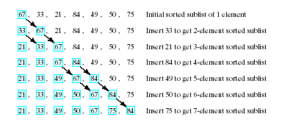
Example of Insertion Sort

Slide 67
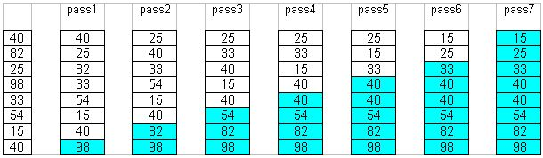
Insertion Sort Example
To sort an array with k elements, Insertion sort requires k – 1 passes.
Example:

Slide 68
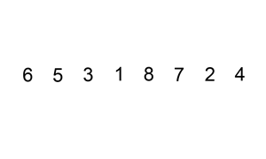
Insertion Sort - Animation

Slide 69
Complexity of Insertion Sort
Let a0, ..., an-1 be the sequence to be sorted. At the beginning and after each iteration of the algorithm the sequence consists of two parts: the first part a0, ..., ai-1 is already sorted, the second part ai, ..., an-1 is still unsorted (i in 0, ..., n).
The worst case occurs when in every step the proper position for the element that is inserted is found at the beginning of the sorted part of the sequence.

Slide 70
Complexity of Insertion Sort
The minimum # of element comparisons (best case) occurs when the array is already sorted in nondecreasing order. In this case, the # of element comparisons is exactly n - 1, as each element A[i], 2 ≤ i ≤ n, is compared with A[i - 1] only.
The maximum # of element comparisons (Worst case) occurs if the array is already sorted in decreasing order and all elements are distinct. In this case, the number is
n n-1
∑ (i – 1) = ∑ (i – 1) = n(n-1)/2
i =2 i =1
This is because each element A[i], 2 ≤ i ≤ n is
compared with each entry in subarray A[1 .. i-1]
➔ Pros: Relatively simple and easy to implement.
Cons: Inefficient for large lists.

Slide 71
Complexity of Insertion Sort
In the insertion sort algorithm (n – 1) times the loop will execute for comparisons and interchanging the numbers
The inner while loop iterates maximum of ((n – 1) × (n – 1))/2 times to compute the sorting
Best Case
  occurs when the array A is in sorted order and the outer for loop will iterate for (n – 1) times
  And the inner while loop will not execute because the given array is a sorted array
i.e. f(n)=O(n)

Slide 72
Complexity of Insertion Sort
Average Case
  On the average case there will be approximately (n – 1)/2 comparisons in the inner while loop
  Hence the average case
f (n) = (n – 1)/2 + ...... + 2/2 +1/2
= n (n – 1)/4
= O(n²)
Worst Case
  The worst case occurs when the array A is in reverse order and the inner while loop must use the maximum number (n – 1) of comparisons
f(n) = (n – 1) + ....... 2 + 1
= (n (n – 1))/2
= O(n²)

Slide 73
Complexity of Insertion Sort
Best case: O(n). It occurs when the data is in sorted order. After making one pass through the data and making no insertions, insertion sort exits.
Average case: θ(n²) since there is a wide variation with the running time.
Worst case: O(n²) if the numbers were sorted in reverse order.

Slide 74
Comparison Bubble and Insertion Sort
Bubble sort is asymptotically equivalent in running time O(n²) to insertion sort in the worst case
But the two algorithms differ greatly in the number of swaps necessary
Experimental results have also shown that insertion sort performs considerably better even on random lists.
For these reasons many modern algorithm textbooks avoid using the bubble sort algorithm in favor of insertion sort.

Slide 75
Comparison Bubble and Insertion Sort
Bubble sort also interacts poorly with modern CPU hardware. It requires
  at least twice as many writes as insertion sort,
  twice as many cache misses, and
  asymptotically more branch mispredictions.
Experiments of sorting strings in Java show bubble sort to be
  roughly 5 times slower than insertion sort and
  40% slower than selection sort

Slide 76
Summary
Complexity of Bubble Sort
Selection Sort
  Concept and Algorithm
  Code and Implementation
Complexity of Selection Sort
Insertion Sort
  Concept and Algorithm
  Code and Implementation
Complexity of Insertion Sort

