Slide 1
CSC 211
Data Structures
Lecture 13
Dr. Iftikhar Azim Niaz
ianiaz@comsats.edu.pk
1

Slide 2
Last Lecture Summary
Cursor-based Implementation of List
Search operation
Concepts and Definitions
Linear (Sequential) Search
Implementation of Linear search
Complexity of Linear Search
2

Slide 3
Objectives Overview
Binary Search
  Concept
  Algorithm
Implementation of Binary Search
Complexity of Binary Search
Comparison of Linear and Binary Search
Searching Unordered Linked List
Searching Ordered Linked List

Slide 4
Binary Search
A linear search is not efficient because on the average it needs to search half a list to find an item
If we have an ordered list and we know how many things are in the list (i.e., number of records in a file), we can use a different strategy
A binary search is much faster than a linear search, but only works on an ordered list!

Slide 5
Binary Search
Gets its name because the algorithm continually divides the list into two parts.
Uses a "divide and conquer" technique to search the list.
It starts with the middle element in a list.
  if that is it, the search is done.
  If the middle item is greater than the wanted item, throw out the last half of the list and search the first half.
  Otherwise, throw out the first half of the list and search the last half of the list.

Slide 6
Binary Search - Concept
Take a sorted array A to find an element x
First x is compared with middle element
  if they are equal search is successful,
  Otherwise if the two are not equal narrows the either to the lower sub array or upper sub array.
The search continues by repeating same process over and over on successively smaller sub arrays.
Process terminates
  either when a match occurs or
  when search is narrowed down to a sub array which contains no elements.

Slide 7
How a Binary Search Works
Always look at the center value. Each time you get to discard half of the remaining list.
Is this fast ?

Slide 8

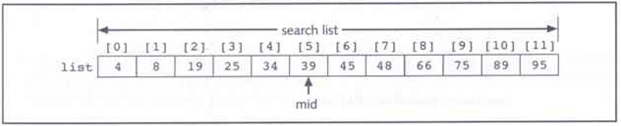
Binary Search - Example
Suppose we have the following list of length 12.
We want to find the item with the value of 75.
We start with the whole list and find the middle item
The middle item, in list[5] is equal to 39. Since 39 < 75,
we restrict our search to last part of the list, which is items list[6] - list[11]

Slide 9
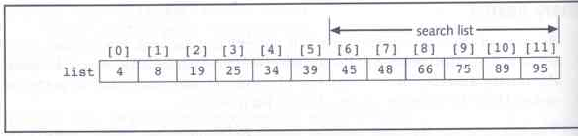
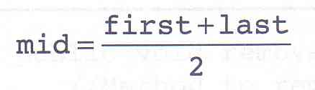
Binary Search - Example
This process is repeated on this new list of length 6.
The formula for finding the middle item is:
Where initially, first = 0, and last = length - 1.

Slide 10
Binary Search Tracing
Search for target = 4.
Step 1: Indices first= 0, last= 8, mid = (0+8)/2 = 4.
0
1
2
3
4
5
6
7
8
arr
-7
3
5
8
12
16
23
33
55
mid

Slide 11
Binary Search Tracing
Search for target = 4.
Step 2: Indices first= 0, last= 3, mid = (0+3)/2 = 1
0
1
2
3
4
5
6
7
8
arr
-7
3
5
8
12
16
23
33
55
mid
Since target = 4 > mid value = 3,
Step 3 will search the higher sublist with
First = 2 and Last =3.

Slide 12
Binary Search Tracing
Search for target = 4.
Step 3: Indices first= 2, last= 3, mid = (2+3)/2 = 2
0
1
2
3
4
5
6
7
8
arr
-7
3
5
8
12
16
23
33
55
mid
Since target = 4 < mid value = 5,
Step 4 should search the lower sublist with first = 2 and last=1.
However, since first >= last , the target is not in the list and we will return index -1.

Slide 13
Binary Search
Requires array elements to be in order
Divides the array into three sections:
  middle element
  elements on one side of the middle element
  elements on the other side of the middle element
If the middle element is the correct value, done. Otherwise, go to step 1. using only the half of the array that may contain the correct value.
Continue steps 1. and 2. until either the value is found or there are no more elements to examine

Slide 14
Binary Search Example
Array numlist2 contains:
Searching for the the value 11, binary search examines 11 and stops
Searching for the the value 7, linear search examines 11, 3, 5, and stops
2 | 3 | 5 | 11 | 17 | 23 | 29

Slide 15
Binary Search Algorithm
int binary_search(int A[], int size, int key) {
first = 0, last = size-1
// continue searching while [first, last] is not empty
while (last >= first) {
/* calculate the midpoint for roughly equal partition */
int mid = midpoint(first, last);
// determine which subarray to search
if (A[mid] < key) // change min index to search upper subarray
first = mid + 1;
else if (A[mid] > key ) // change max index to search lower subarray
last = mid - 1;
else // key found at index mid
return mid;
}
return KEY_NOT_FOUND; // key not found }

Slide 16
Binary Search Program
int binarySearch (int list[], int size, int key) {
int first = 0, last , mid, position = -1;
last = size - 1
int found = 0;
while (!found && first <= last) {
middle = (first + last) / 2; /* Calculate mid point */
if (list[mid] == key) { /* If value is found at mid */
found = 1;
position = mid;
}
else if (list[mid] > key) /* If value is in lower half */
last = mid - 1;
else
first = mid + 1; /* If value is in upper half */
} // end while loop
return position;
} // end of function

Slide 17
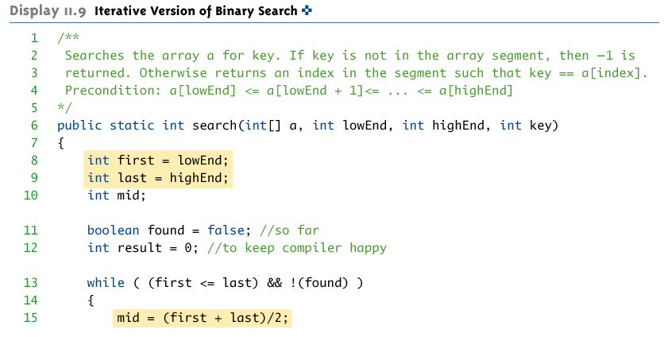
Binary Search - Program

Slide 18
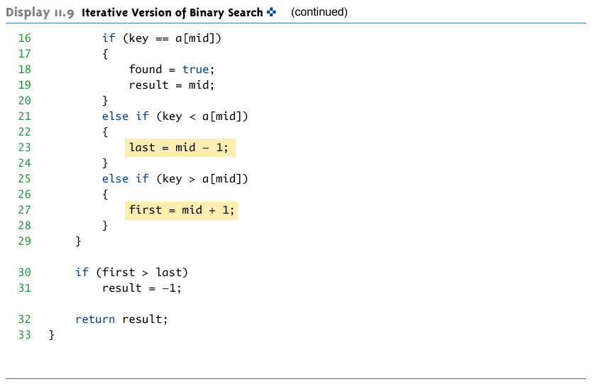
Binary Search - Program

Slide 19
Binary Search Demo
Maintain array of Items
Store in sorted order
Use binary search to find Item with key = 33
index
0
1
2
3
4
5
6
7
8
9
10
11
12
13
14
value
6
13
14
25
33
43
51
53
64
72
84
93
95
96
97

Slide 20
Binary Search Demo
Maintain array of Items
Store in sorted order
Use binary search to find Item with key = 33
left
right
index
0
1
2
3
4
5
6
7
8
9
10
11
12
13
14
value
6
13
14
25
33
43
51
53
64
72
84
93
95
96
97
if Key v is in array, it is has index between left and right.

Slide 21
Binary Search Demo
Maintain array of Items
Store in sorted order
Use binary search to find Item with key = 33
left
mid
right
index
0
1
2
3
4
5
6
7
8
9
10
11
12
13
14
value
6
13
14
25
33
43
51
53
64
72
84
93
95
96
97
Compute midpoint and check if matching Key is in that position.

Slide 22
Binary Search Demo
Maintain array of Items
Store in sorted order
Use binary search to find Item with key = 33
first
mid
last
index
0
1
2
3
4
5
6
7
8
9
10
11
12
13
14
value
6
13
14
25
33
43
51
53
64
72
84
93
95
96
97
Since 33 < 53, can reduce search interval.

Slide 23
Binary Search Demo
Maintain array of Items
Store in sorted order
Use binary search to find Item with key = 33
first
last
index
0
1
2
3
4
5
6
7
8
9
10
11
12
13
14
value
6
13
14
25
33
43
51
53
64
72
84
93
95
96
97
Since 33 < 53, can reduce search interval.

Slide 24
Binary Search Demo
Maintain array of Items
Store in sorted order
Use binary search to find Item with key = 33
first
mid
last
index
0
1
2
3
4
5
6
7
8
9
10
11
12
13
14
value
6
13
14
25
33
43
51
53
64
72
84
93
95
96
97
Compute midpoint and check if matching Key is in that position.

Slide 25
Binary Search Demo
Maintain array of Items
Store in sorted order
Use binary search to find Item with key = 33
first
mid
last
index
0
1
2
3
4
5
6
7
8
9
10
11
12
13
14
value
6
13
14
25
33
43
51
53
64
72
84
93
95
96
97
Since 33 > 25, can reduce search interval.

Slide 26
Binary Search Demo
Maintain array of Items
Store in sorted order
Use binary search to find Item with key = 33
first
last
index
0
1
2
3
4
5
6
7
8
9
10
11
12
13
14
value
6
13
14
25
33
43
51
53
64
72
84
93
95
96
97
Since 33 > 25, can reduce search interval.

Slide 27
Binary Search Demo
Maintain array of Items
Store in sorted order
Use binary search to find Item with key = 33
first
last
index
0
1
2
3
4
5
6
7
8
9
10
11
12
13
14
value
6
13
14
25
33
43
51
53
64
72
84
93
95
96
97
mid

Slide 28
Binary Search Demo
Maintain array of Items
Store in sorted order
Use binary search to find Item with key = 33
first
index
0
1
2
3
4
5
6
7
8
9
10
11
12
13
14
value
6
13
14
25
33
43
51
53
64
72
84
93
95
96
97
last
Compute midpoint and check if matching Key is in that position.

Slide 29
Binary Search Demo
Maintain array of Items
Store in sorted order
Use binary search to find Item with key = 33
first
index
0
1
2
3
4
5
6
7
8
9
10
11
12
13
14
value
6
13
14
25
33
43
51
53
64
72
84
93
95
96
97
last
Matching Key found. Return index 4.

Slide 30

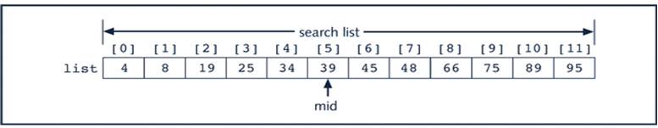
Binary Search Example
Suppose we have the following list of length 12.
We want to find the item with the value of 75.
We start with the whole list and find the middle item
The middle item, in list[5] is equal to 39. Since 39 is less than 75, we restrict our search to last part of the list, which is items list[6] - list[11].

Slide 31
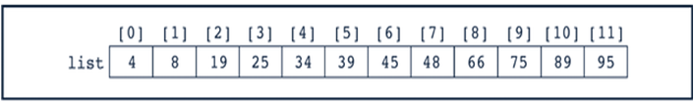
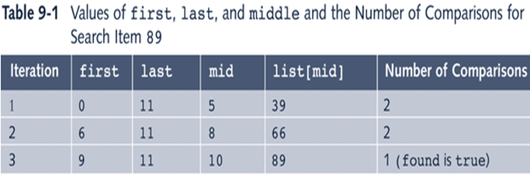
Binary Search Example 2
Once more, given the following sorted list of length 12,
Suppose that we are searching for item 89.
Here is a trace of the binary search for the item 89.
The item was found at location 10, and it took 3 look ups to find it.

Slide 32
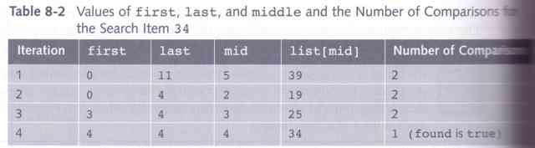
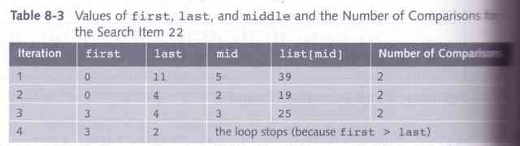
Binary Search – Example 3
Here is a trace for finding the item 34.
Here is a trace for finding the item 22.
It failed. The unsuccessful search took only 4 comparisons.

Slide 33
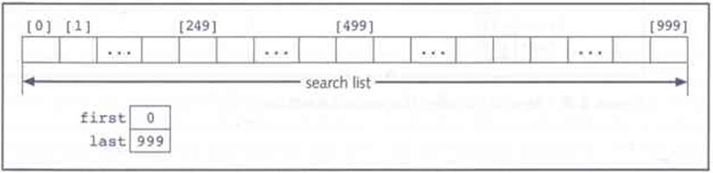
Binary Search – Performance
Suppose that L is a sorted list of 1000 elements, and you want to determine whether x is in L.
The first iteration of the while loop searches for x in L[0] - L[999]. It compares x with L[499].
If x is less than L[499], the next iteration searches for x in L[0] - L[498].

Slide 34
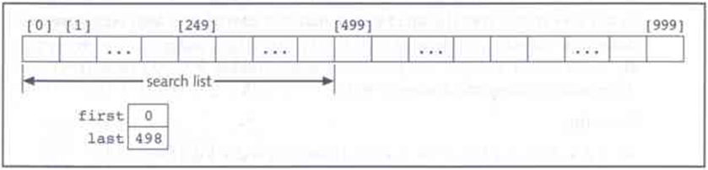
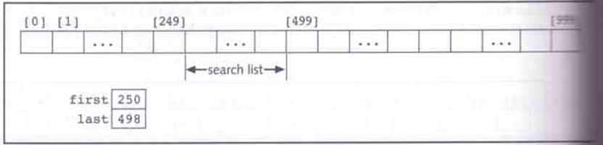
Binary Search – Performance
x is compared to L[249]. If it is greater than L[249], the new list to search is L[250] to L[498].
Each search cuts the list length in half.
Because 1000 is approximately 1024, which is 2 to the 10th power, the while loop has at most 10 iterations to determine if x is in L.

Slide 35
Binary Search
We also have looked at the binary search algorithm
How much more efficient (if at all) is a binary search when compared to a sequential search?
We can use “order” to help find the answer

Slide 36
(Time) Efficiency of an algorithm
Worst case efficiency is the maximum number of steps that an algorithm can take for any input data values.
Best case efficiency is the minimum number of steps that an algorithm can take for any input data values.
Average case efficiency
- the efficiency averaged on all possible inputs
- must assume a distribution of the input
- we normally assume uniform distribution (all keys are equally probable)
If input has size n, efficiency will be a function of n

Slide 37
Binary Search Analysis
Considering the worst-case for binary search:
  We don’t find the item until we have divided the array as far as it will divide
We first look at the middle of n items, then we look at the middle of n/2 items, then n/2² items, and so on…
We will divide until n/2^{k} = 1, k is the number of times we have divided the set (when we have divided all we can, the above equation will be true)
n/2^{k} = 1 when n = 2^{k}, so to find out how many times we divided the set, we solve for k
  k = log₂ n
Thus, the algorithm takes O(log n), the worst-case
For Average case is log n – 1 i.e. one less

Slide 38
How Fast is a Binary Search?
Worst case: 11 items in the list took 4 tries
How about the worst case for a list with 32 items ?
  1st try - list has 16 items
  2nd try - list has 8 items
  3rd try - list has 4 items
  4th try - list has 2 items
  5th try - list has 1 item

Slide 39
How Fast is a Binary Search? (con’t)
List has 250 items
1st try - 125 items
2nd try - 63 items
3rd try - 32 items
4th try - 16 items
5th try - 8 items
6th try - 4 items
7th try - 2 items
8th try - 1 item
List has 512 items
1st try - 256 items
2nd try - 128 items
3rd try - 64 items
4th try - 32 items
5th try - 16 items
6th try - 8 items
7th try - 4 items
8th try - 2 items
9th try - 1 item

Slide 40
What’s the Pattern?
List of 11 took 4 tries
List of 32 took 5 tries
List of 250 took 8 tries
List of 512 took 9 tries
32 = 2⁵ and 512 = 2⁹
8 < 11 < 16 2³ < 11 < 2⁴
128 < 250 < 256 2⁷ < 250 < 2⁸

Slide 41
A Very Fast Algorithm!
How long (worst case) will it take to find an item in a list 30,000 items long?
  2¹⁰ = 1024 2¹³ = 8192
  2¹¹ = 2048 2¹⁴ = 16384
  2¹² = 4096 2¹⁵ = 32768
So, it will take only 15 tries!

Slide 42
Log₂ n Efficiency
We say that the binary search algorithm runs in log₂n time. (Also written as lg n)
Log₂n means the log to the base 2 of some value of n.
8 = 2³ log₂8 = 3 16 = 2⁴ log₂16 = 4
There are no algorithms that run faster than log₂ n time

Slide 43
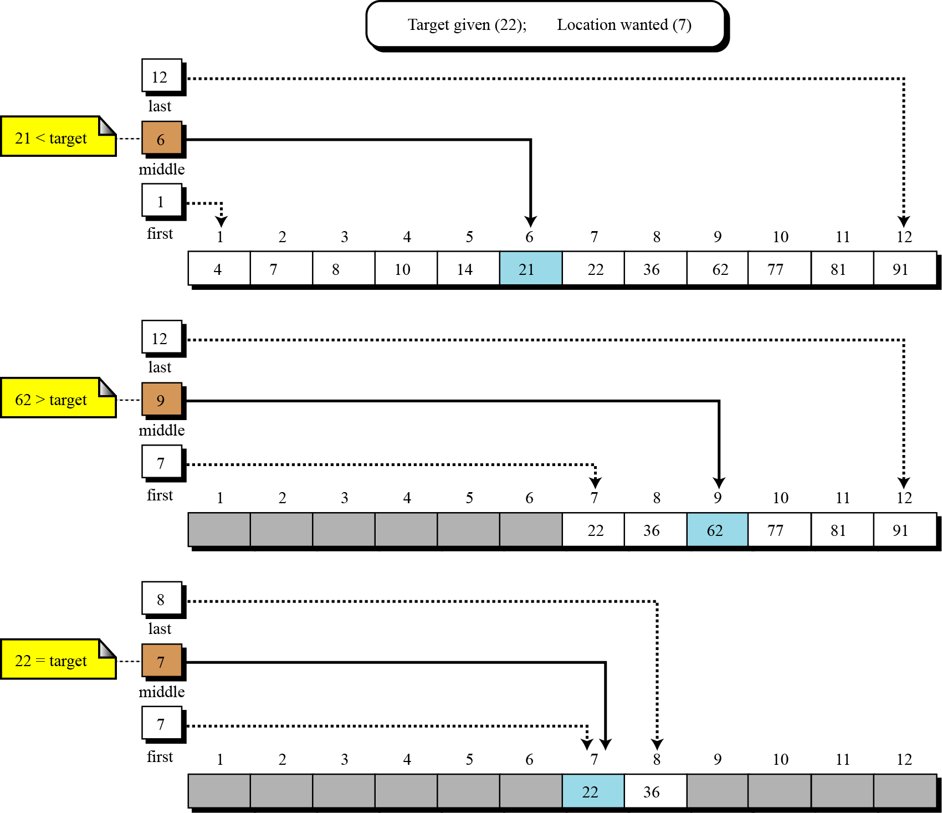
Binary Search

Slide 44
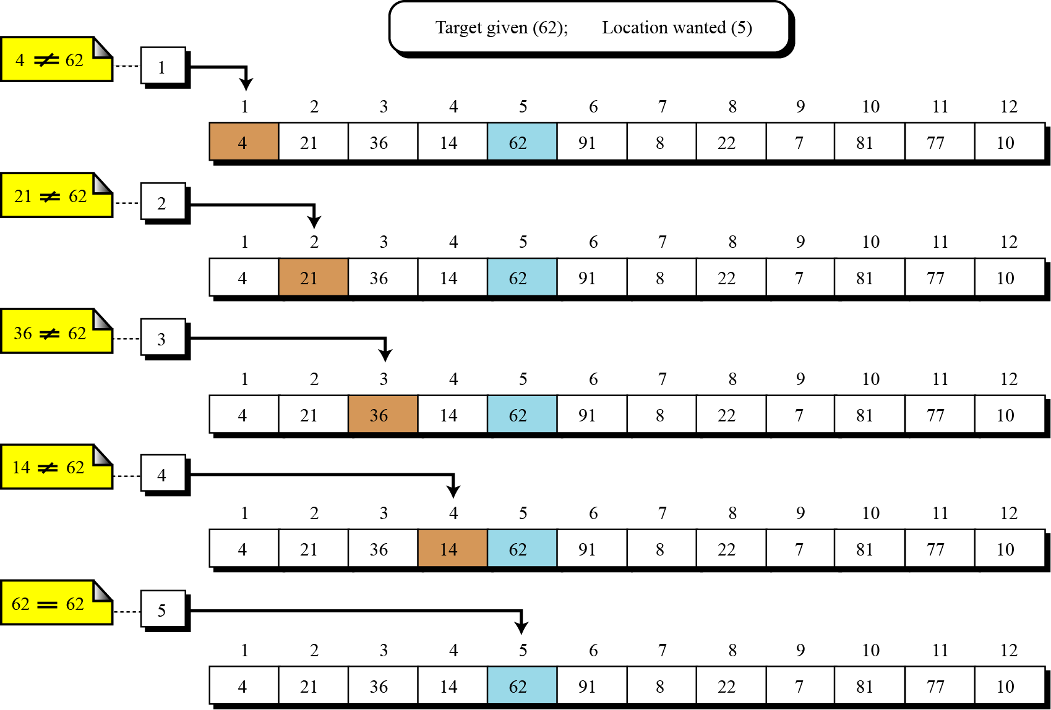
Linear (Sequential) Search

Slide 45
Worst Case Efficiency for Linear Search
Get the value of target, n, and the list of n values 1
Set index to 1 1
Set found to false 1
Repeat steps 5-8 until found = true or index > n n
  5 if the value of list_{index} = target then n
      Output the index 0
      Set found to true 0
  8 else Increment the index by 1 n
9 if not found then 1
  10 Print a message that target was not found 0
Stop 1
        Total 3n+5

Slide 46
Analysis of Sequential Search
Time efficiency
  Best-case : 1 comparison
    target is found immediately
  Worst-case: 3n + 5 comparisons
    Target is not found
  Average-case: 3n/2+4 comparisons
    Target is found in the middle
Space efficiency
  How much space is used in addition to the input?

Slide 47
Order of Magnitude
Worst-case of Linear search:
  3n+5 comparisons
  Are these constants accurate? Can we ignore them?
Simplification:
  ignore the constants, look only at the order of magnitude
  n, 0.5n, 2n, 4n, 3n+5, 2n+100, 0.1n+3 are all linear
  we say that their order of magnitude is n
    3n+5 is order of magnitude n: 3n+5 = Θ(n)
    2n +100 is order of magnitude n: 2n+100=Θ(n)
    0.1n+3 is order of magnitude n: 0.1n+3=Θ(n)
    ….

Slide 48
Comparing Search Algorithms
We know
  sequential search is O(n) worst-case
  binary search is O(log₂ n) worst-case
Which is better?
Given n = 1,000,000 items
  O(n) = O(1,000,000) /* sequential */
  O(log₂ n) = O(19) /* binary */
Clearly binary search is better in worst-case for large values of n, but there is always trade-offs that must be considered
  Binary search requires the array to be sorted
  If the item to be found is near the extremes of the array, sequential may be faster

Slide 49
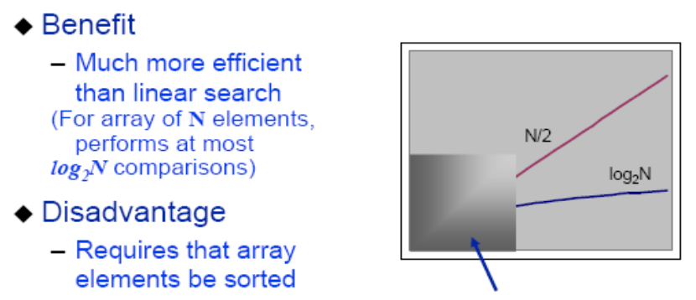
Binary Search Tradeoffs

Slide 50
Comparison Sequential and Binary
The sequential search starts at the first element in the list and continues down the list until either the item is found or the entire list has been searched. If the wanted item is found, its index is returned. So it is slow.
Sequential search is not efficient because on the average it needs to search half a list to find an item.
A Binary search is much faster than a sequential search.
Binary search works only on an ordered list.
Binary search is efficient as it disregards lower half after a comparison.

Slide 51
Searching Unordered Link List
Let LIST be a linked list in memory pointed to by a pointer HEAD
Suppose a specific ITEM of information is given. ITEM is the key value to be searched
Two cases
  LIST is Unordered i.e. not sorted
  LIST is Ordered i.e. sorted
We will search ITEM in LIST by traversing through the list using a pointer variable PTR
Comparing ITEM with the contents of each node of the LIST one by one until the ITEM is found or the LIST is completely traversed

Slide 52
Searching Unordered Link List
ListNode* Search_List (int item) {
// This algorithm finds the location Loc of the node in an Unordered linked
// list where It first appears in the list or sets loc = NULL
ListNode *ptr, *loc;
int found = 0;
ptr = head;
while (ptr != NULL) && (found == 0) {
if (ptr->value == item) {
loc = ptr;
found = 1;
} // end if
else
ptr = ptr->next;
} // end of while
if (found == 0);
loc = NULL
return loc; } // end of function Search_List

Slide 53
Complexity Analysis
Complexity of this algorithm is same as that of linear (sequential) algorithm
Worst-case running time is approximately proportional to the number n of elements in LIST i.e. O(n)
Average-case running time is approximately proportional to n/2 (with the condition that Item appears once in LIST but with equal probability in any node of LIST i.e. O(n)

Slide 54
Searching Ordered Link List
ListNode* Search_List (int item) {
// This algorithm finds the location Loc of the node in an Ordered linked list where It first appears in the list or sets loc = NULL
ListNode *ptr, *loc;
ptr = head;
loc = NULL;
while (ptr != NULL) {
if (ptr->value < item) {
ptr = ptr -> next;
else if (ptr->value == item)
loc = ptr;
} // end while
return loc; } // end of function Search_List

Slide 55
Complexity Analysis
Complexity of this algorithm is same as that of linear (sequential) algorithm
Worst-case running time is approximately proportional to the number n of elements in LIST i.e. O(n)
Average-case running time is approximately proportional to n/2 (with the condition that Item appears once in LIST but with equal probability in any node of LIST i.e. O(n)

Slide 56
Ordered Linked List and Binary Search
With a sorted linear array, we can apply a binary search whose running time is proportional to log₂ n
A binary search algorithm cannot be applied to a Ordered (Sorted) Linked List
  Since there is no way of indexing the middle element in the list
This property is one of the main drawback in using a linked list as a data structure
56

Slide 57
Summary
Binary Search
  Concept
  Algorithm
Implementation of Binary search
Complexity of Binary Search
Comparison of Linear and Binary Search
Searching Unordered Linked List
Searching Ordered Linked List

