Slide 1
CSC 211
Data Structures
Lecture 11
Dr. Iftikhar Azim Niaz
ianiaz@comsats.edu.pk
1

Slide 2
Last Lecture Summary
Data structure Operations
  Traverse, Search, Insert, Delete, Sort, Merge
Options for Implementing ADT List
Array-based and Pointer based
Linked List
Linked List Operations
  Append
  Traverse
2

Slide 3
Objectives Overview
Dynamic Representation
Allocation from Dynamic Storage
Returning unused storage back to dynamic storage
Linked List Operations
  Insert
  Delete

Slide 4
Dynamic Representation
Efficient way of representing a linked list is using the free pool of storage (heap)
In this method
  Memory bank – nothing but a collection of free memory spaces
  Memory manager – a program in fact
During creation of linked list
  whenever a node is required, the request is placed to the memory manager
  Memory manager will then search the memory bank for the block of memory requested and if found, grants the desired block to the program
Garbage collector - a program which plays whenever a node is no more in use, it returns the unused node to the memory bank
Memory bank is basically a list of memory spaces which is available to a programmer
Such a memory management is known as dynamic memory management
The dynamic representation of linked list uses the dynamic memory management policy

Slide 5
Dynamic Representation (Cont..)
Let Avail be the pointer which stores the starting address of the list of available memory spaces
For a request of memory location for a new node, the list Avail is searched for the block of right size
If Avail = Null or if the block of desired size is not found, the memory manager will return a message accordingly
If the memory is available the memory manager will return the pointer of the desired block to the caller in a temporary buffer say newNode
The newly availed node pointed by newNode then can be inserted at any position in the linked list by changing the pointers of the concerned nodes
Such allocations and deallocations are carried out by changing the pointers only

Slide 6
Dynamic Storage
Allocation from dynamic storage
  Function Getnode (Node)
  Concept
  Algorithm
Returning unused storage back to dynamic storage
  Function ReturnNode(Ptr)
  Concept
  Algorithm

Slide 7
Function GetNode (Node) - Algorithm
Purpose – To get a pointer of a memory block which suits the type Node
Input – Node is the type of data for which a memory has to be allocated
Output – Return a message if the allocation fails else the pointer to the memory block allocated
Note – the GetNode(Node) function is just to understand how a node can be allocated from the available storage space
  malloc(size) and calloc(elements, size) in C
  new in C++ and Java

Slide 8
Function GetNode (Node) - Algorithm
If (Avail = NULL) // Avail is a pointer to pool of free storage
Return (NULL)
Print “Insufficient Memory: Unable to allocate memory”
Else
ptr = Avail // start from the location where Avail points
While (SizeOf(ptr) != SizeOf(Node) AND (ptr->Link !=NULL) do
// till the desired block is found or the search reaches the end of pool
ptr1 = ptr
ptr = ptr->Link
EndWhile
If (SizeOf(Ptr) = SizeOf(Node))
ptr1->Link = ptr->Link
Return(ptr)
Else
Print “The memory block is too large to fit”
Return (NULL)
EndIf
EndIf
Stop

Slide 9
Function ReturnNode (Ptr) - Algorithm
Purpose – To return a node having pointer Ptr to the free pool of storage.
Input – Ptr is the pointer of a node to be returned to a list pointed by the pointer Avail.
Output – The node in inserted at the end of the list Avail
Note – We can insert the free node at the front or at any position of the Avail list which is left as an exercise for the students.
  free(ptr) in C
  delete in C++
  Automatic garbage collection in Java

Slide 10
Function ReturnNode (Ptr) - Algorithm
1 ptr1 = Avail
2 While (ptr1->Link != NULL) do
3 ptr1 = ptr1-> link
4 EndWhile
5 ptr1->Link = Ptr
6 Ptr->Link = NULL
7 Stop

Slide 11
Inserting a Node in a Linked List
Inserting a node in the middle of a list is more complicated than appending a node.
Assume all values in the list are sorted, and you want all new values to be inserted in their proper position (preserving the order of the list).
We will use the same ListNode structure again, with pseudo code
11

Slide 12
Inserting a Node - Pseudocode
Precondition Linked List is in sorted order
Create a new node.
Store data in the new node.
If there are no nodes in the list
Make the new node the first node.
Else
Find the first node whose value is greater than or equal the new value, or the end of the list (whichever is first).
Insert the new node before the found node, or at the end of the list if no node was found.
End If.

Slide 13
Insert – Implementation Explanation
num holds the float value to be inserted in list
newNode is used to allocate a new node and store num in it
The algorithm finds first node whose value is greater that or equal to the new node. The new node is then inserted before the found node
nodePtr will be used to traverse the list and will point to the node being inspected
previousNode points to the node previous to nodePtr
previousNode is initialized to null in the start

Slide 14
Insert – Implementation Code - I
void insertNode(float num) {
ListNode *newNode, *nodePtr, *previousNode;
// Allocate a new node & store Num in the new node
newNode = new ListNode;
newNode->value = num;
// Initialize previous node to NULL
previousNode = NULL;
// If there are no nodes in the list make newNode the first node
if (head == NULL) {
head = newNode;
newNode->next = NULL;
}
else { // Otherwise, insert newNode.
// Initialize nodePtr to head of list
nodePtr = head;
// Skip all nodes whose value member is less than num.
while (nodePtr != NULL && nodePtr->value < num) {
previousNode = nodePtr;
nodePtr = nodePtr->next;
} // end While loop

Slide 15
Insert – Implementation Code - II
// If the new mode is to be the 1st in the list,
// insert it before all other nodes.
if (previousNode == NULL)
{
head = newNode;
newNode->next = nodePtr;
}
else
// the new node is inserted either in the middle or in the last
{
previousNode->next = newNode;
newNode->next = nodePtr;
}
} // end of outer else
} // End of insertnode function

Slide 16
Main Program using insertNode
// This program calls the displayList member function.
// The function traverses the linked list displaying
// the value stored in each node.
#include <iostream.h>
#include "FloatList.h”
void main(void) {
ListNode *head;
head = NULL;
// Build the list
appendNode(2.5);
appendNode(7.9);
appendNode(12.6);
// Insert a node in the middle of the list
insertNode(10.5);
// Dispay the list
displayList();
}
Program Output
2.5
7.9
10.5
12.6

Slide 17
Program Step Through - 1
As in previous program, this program calls the appendNode function 3 times to build the list with the values 2.5, 7.9, 12.6
The insertNode function is called with argument 10.5
In insertNode, the new node is created, and the function argument num is copied to its value member
Since the list already has nodes stored in it, so the condition (head == NULL) becomes false and
the else part of the if statement will execute.
It begins by assigning nodePtr to Head, i.e.

Slide 18
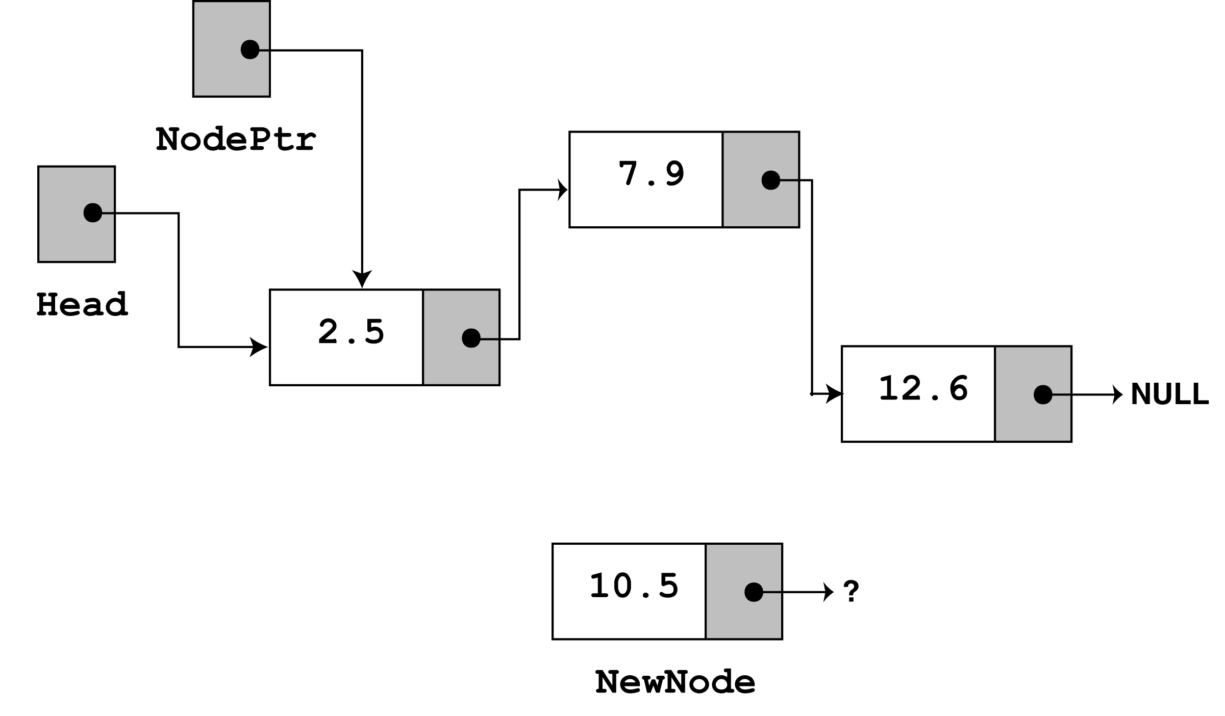
Program Step Through - 2
If the list is empty then
if (head == NULL) {
head = newNode;
newNode->next = NULL;
}

Slide 19
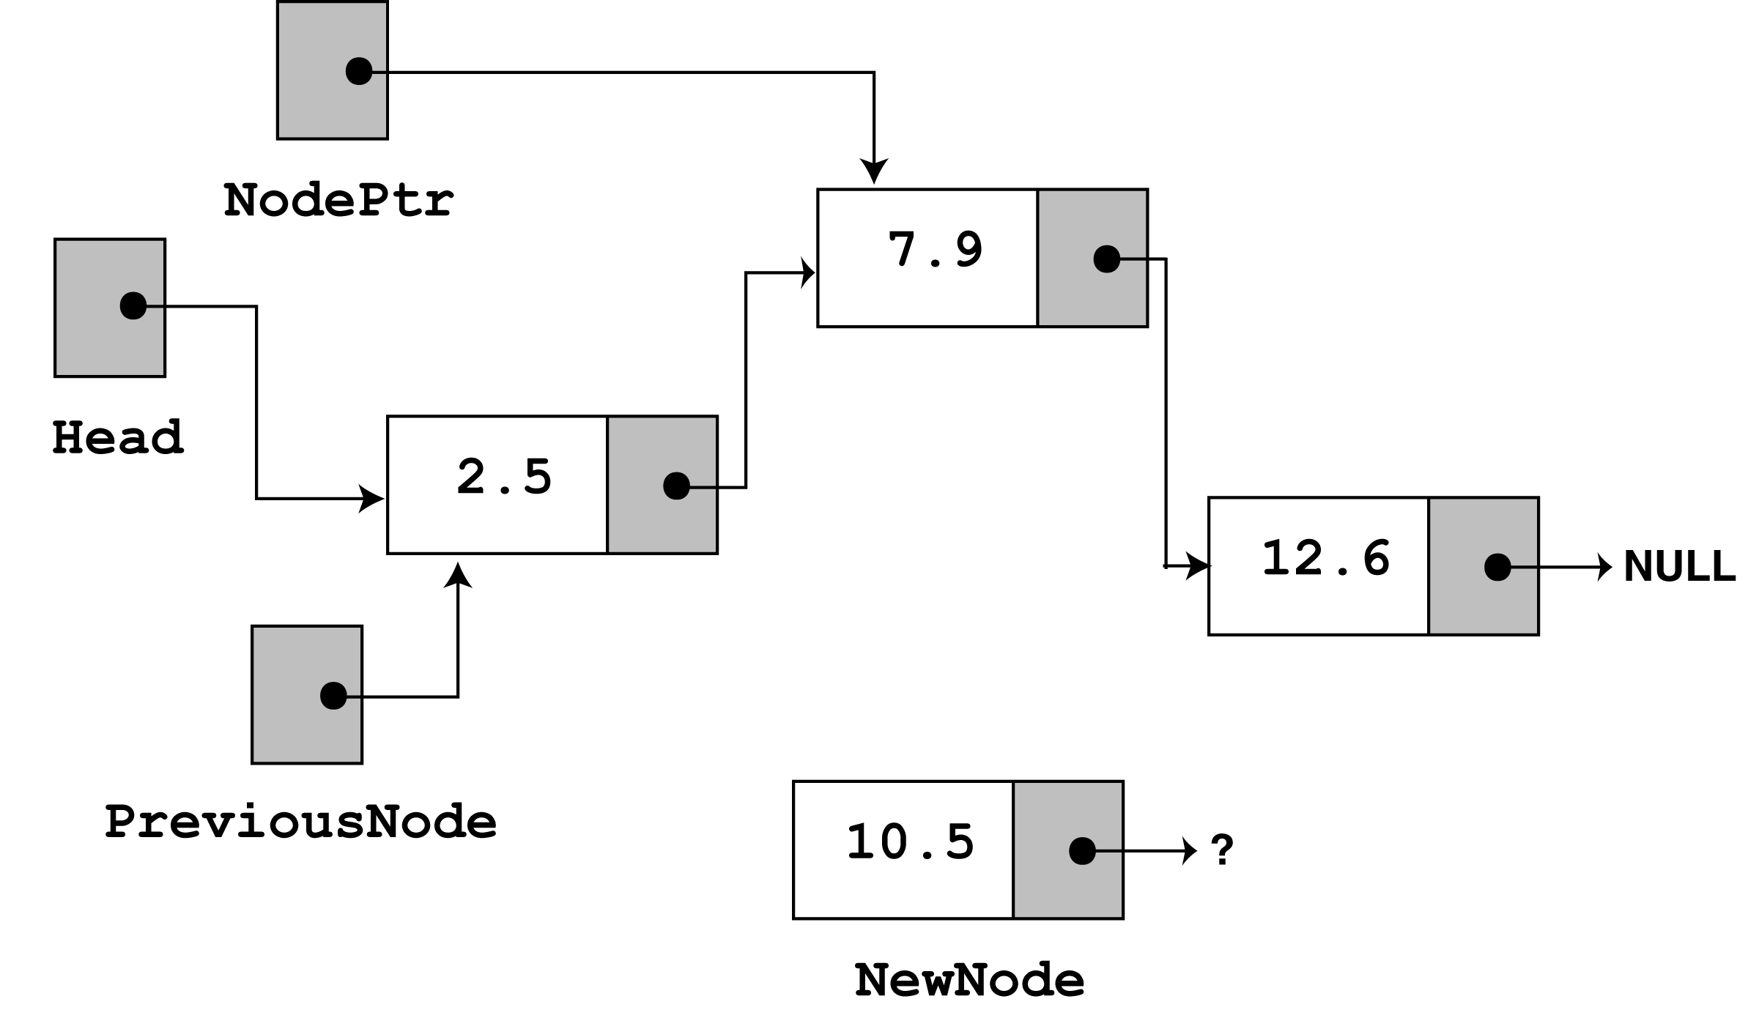
Program Step Through - 3
Since nodePtr is not NULL, and nodePtr->value is less than num, the while loop will iterate and the body is executed.
During the iteration,
1. previousNode is made to point to the node that nodePtr is pointing to.
2. nodePtr is then advanced to point to the next node. i.e.
while (nodePtr != NULL && nodePtr->value < num) {
previousNode = nodePtr;
nodePtr = nodePtr->next
} // end While loop

Slide 20
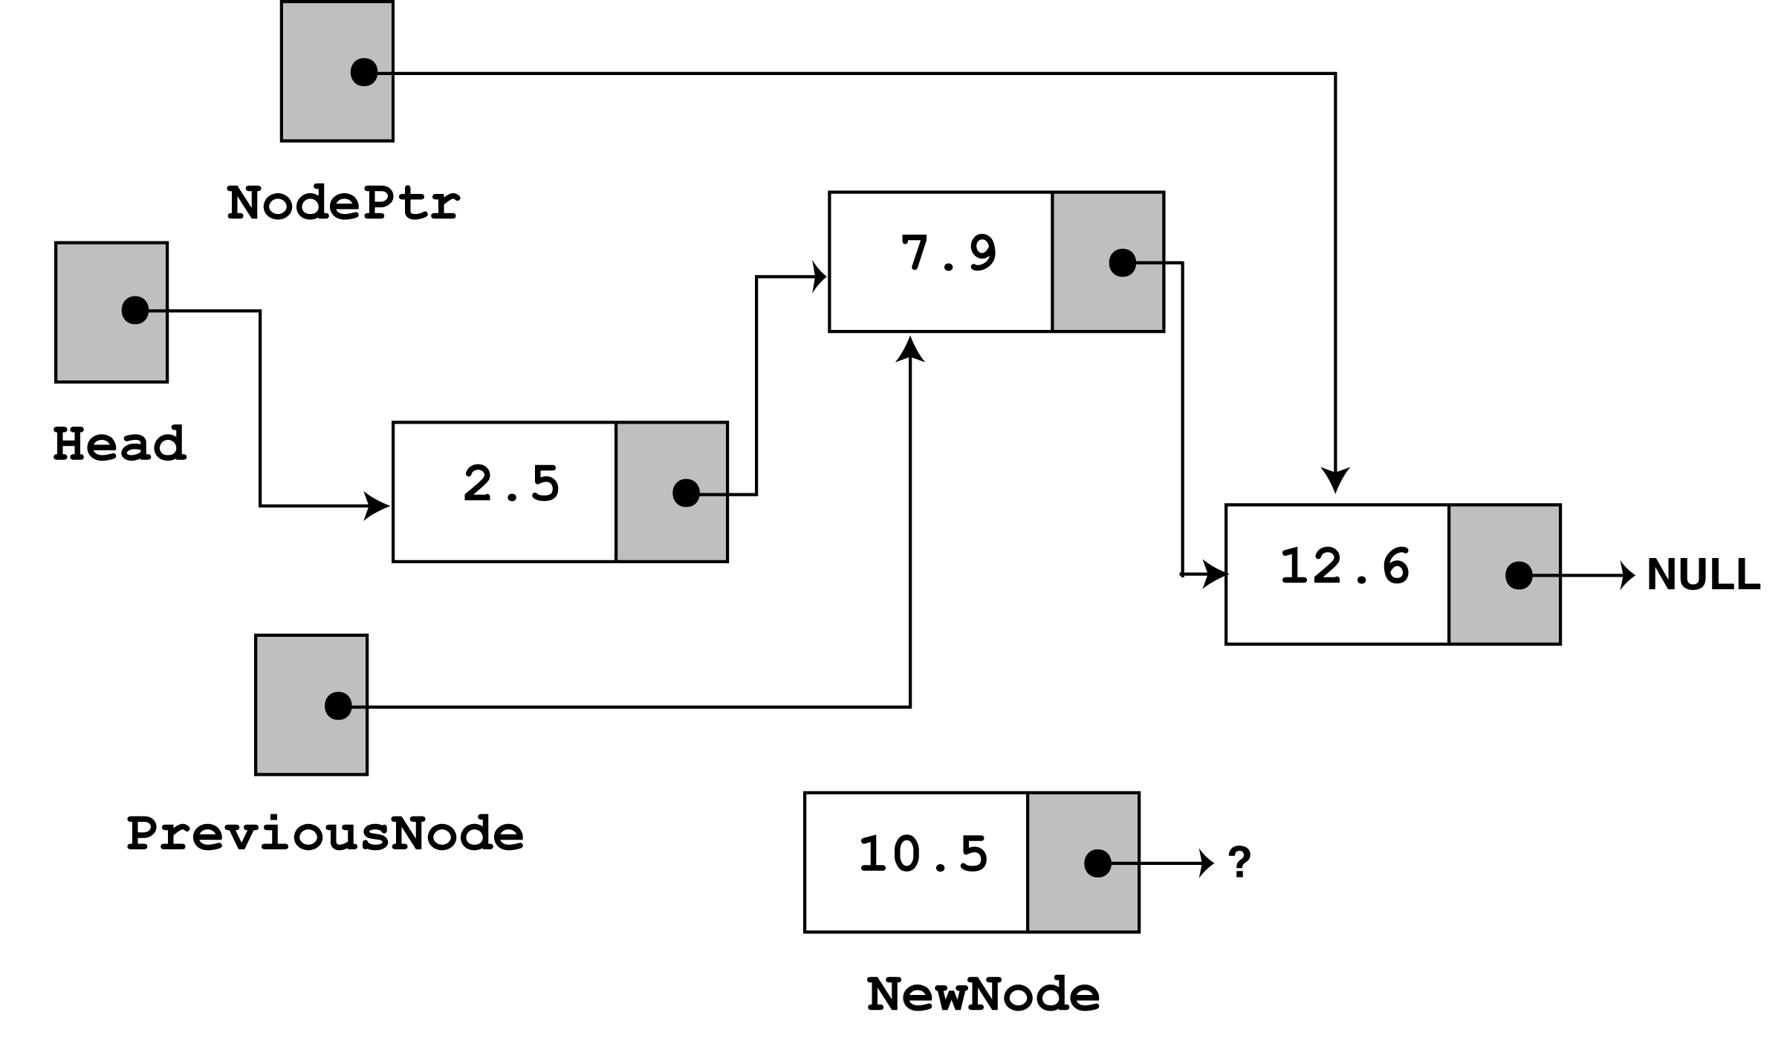
Program Step Through - 4
The loop does its test once more.
Since nodePtr is not NULL, and nodePtr->value is less than num, the loop iterates a second time.
During the second iteration, both previousNode and nodePtr are advanced by one node in the list, i.e.
while (nodePtr != NULL && nodePtr->value < num) {
previousNode = nodePtr;
nodePtr = nodePtr->next
} // end While loop

Slide 21
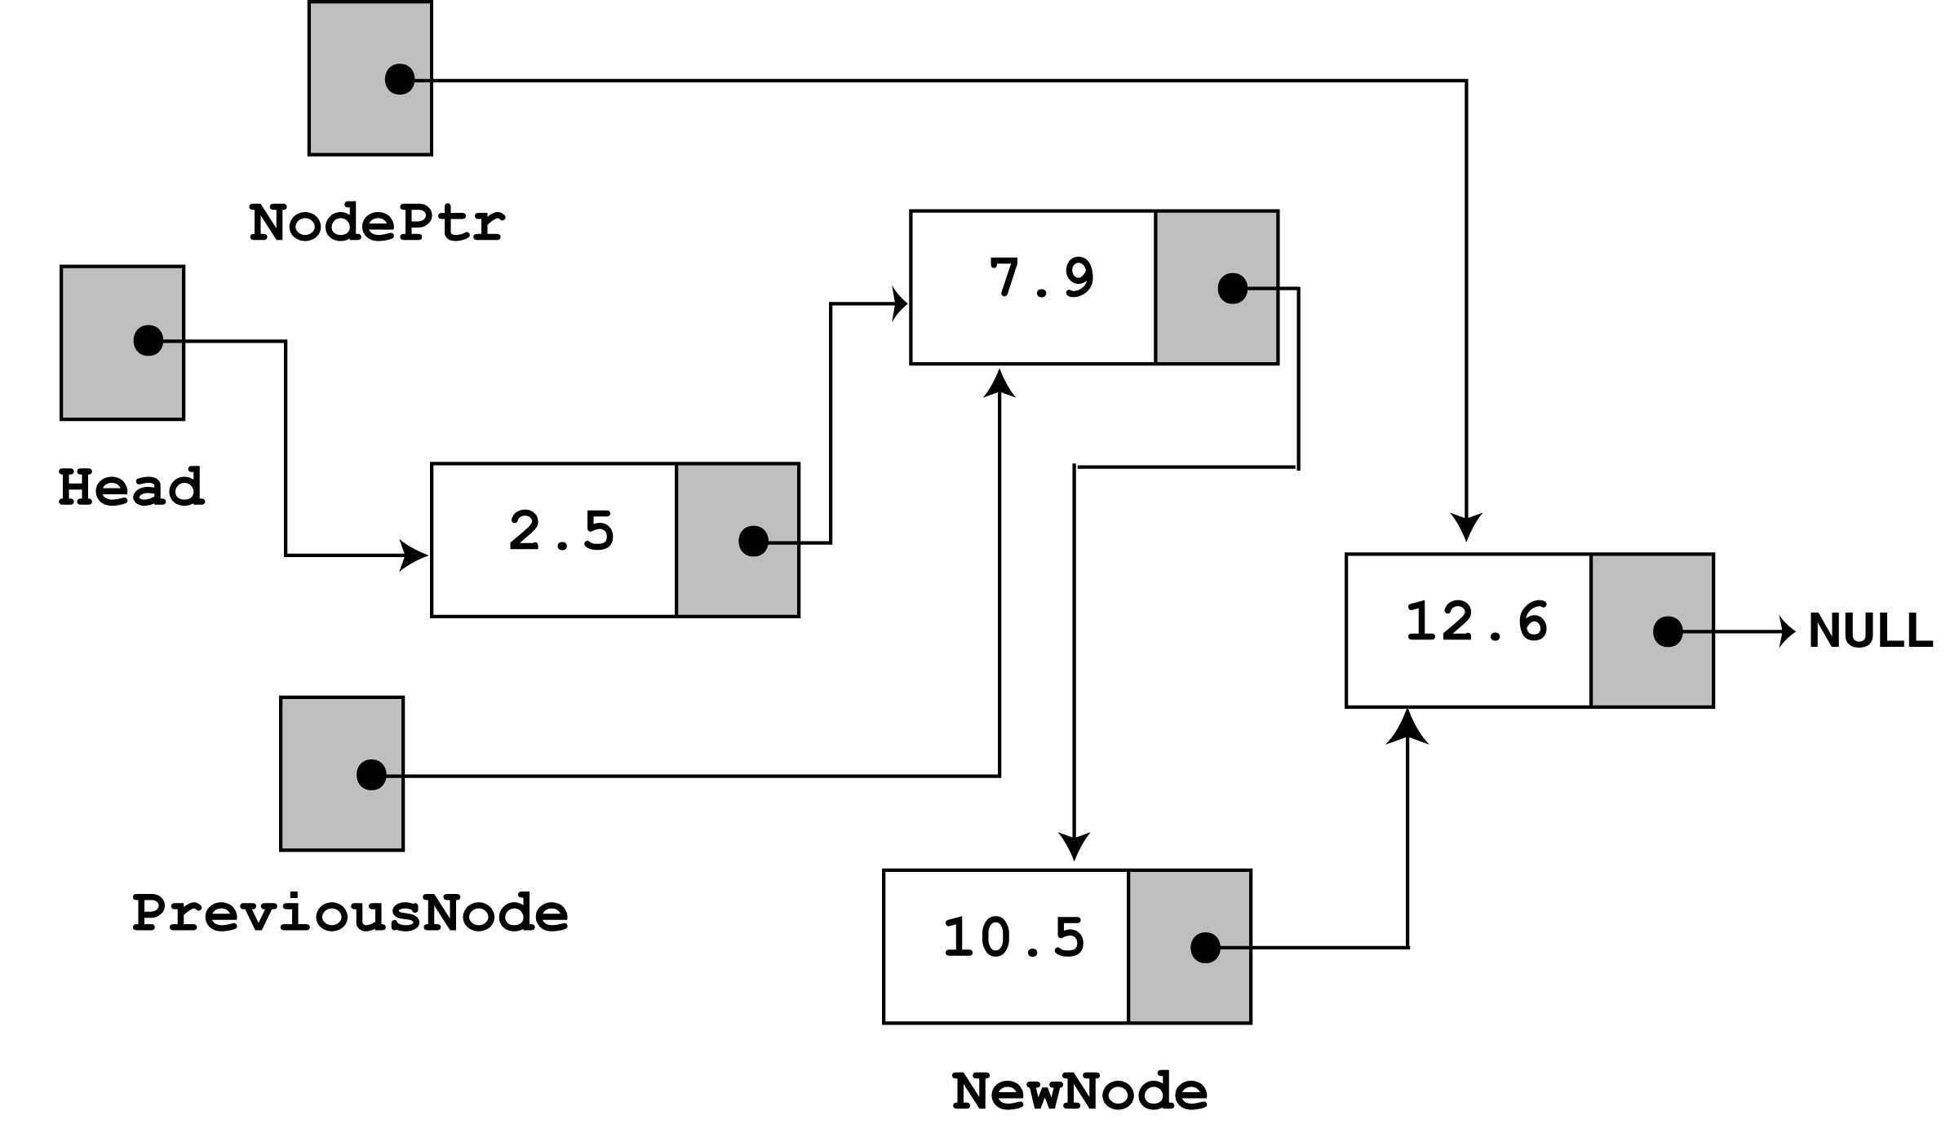
Program Step Through - 5
This time, the loop’s test will fail, because nodePtr is not less than num.
The statements after the loop will execute, which cause
previousNode->next to point to newNode, and
newNode->next to point to nodePtr, i.e.
previousNode->next = newNode;
newNode->next = nodePtr;

Slide 22
Program Step Through - 6
This leaves the list in its final state.
The nodes (you will see if you follow the links from the head pointer to NULL) are stored in the order of their value members.
The main program then calls the displayList() function to traverse the list and display all the nodes stored in it.

Slide 23
Deleting a Node in a Linked List
This requires 2 steps –
  Remove the node from the list without breaking the links created by the next pointers.
  Delete the node from memory
We will consider the following cases
  List is empty i.e it does not contain any node
  Deleting the first node
  Deleting the node in the middle of the list
  Deleting the last node in the list

Slide 24
Deleting a Node - Algorithm
The deleteNode member function searches for a node with a particular value and deletes it from the list.
It uses an algorithm similar to the insertNode function.
The two node pointers nodePtr and previousPtr are used to traverse the list (as before).
When nodePtr points to the node to be deleted, adjust the pointers previousNode->next is made to point to nodePtr->next.
This marks the node pointed to by nodePtr to be deleted safely from the list .
The final step is to free the memory used by the node pointed to by nodePtr using the delete operator.

Slide 25
Deleting a Node – Implementation Code
void deleteNode(float num) {
ListNode *nodePtr, *previousNode;
// If the list is empty, do nothing and return to calling program.
if (head == NULL)
return;
// Determine if the first node is the one
if (head->value == num) {
nodePtr = head;
head = head->next;
delete nodePtr;
}
else { // Initialize nodePtr to head of list
nodePtr = head;
// Skip all nodes whose value member is not equal to num
while (nodePtr != NULL && nodePtr->value != num) {
previousNode = nodePtr;
nodePtr = nodePtr->next;
} // end of while loop
//Link previous node to the node after nodePtr, and delete nodePtr
previousNode->next = nodePtr->next;
delete nodePtr;
} // end of else part
} // end of deleteNode function

Slide 26
Main Program using deleteNode
// This program demonstrate the deletenode function.
#include <iostream.h>
#include "FloatList.h”
void main(void) {
ListNode *head;
head = NULL;
// Build the list
appendNode(2.5); appendNode(7.9); appendNode(12.6);
cout << "Here are the initial values:\n";
displayList(); cout << endl;
cout << "Now deleting the node in the middle.\n";
cout << "Here are the nodes left.\n";
deleteNode(7.9); displayList(); cout << endl;
cout << "Now deleting the last node.\n";
cout << "Here are the nodes left.\n";
deleteNode(12.6); displayList(); cout << endl;
cout << "Now deleting the only remaining node.\n";
cout << "Here are the nodes left.\n";
deleteNode(2.5); displayList();
} // end of main function

Slide 27
Program Output
Here are the initial values:
2.5
7.9
12.6
Now deleting the node in the middle.
Here are the nodes left.
2.5
12.6
Now deleting the last node.
Here are the nodes left.
2.5
Now deleting the only remaining node.
Here are the nodes left.

Slide 28
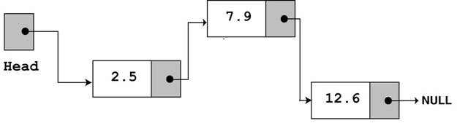
Program Step Through - 1
After the following three calls to the function appendNode
appendNode(2.5);
appendNode(7.9);
appendNode(12.6);
The list will be in the following position :

Slide 29
Program Step Through - 2
After the execution of following
cout << "Here are the initial values:\n";
displayList(); cout << endl;
The Program Output will be the following:
Here are the initial values:
2.5
7.9
12.6

Slide 30
Program Step Through - 3
To show how deleteNode works, we do a step through of the call to deleteNode with value 7.9
Look at the else part of the 2nd if statement. It is here the function does its thing, since the list is not empty, and the first node does not contain 7.9
else {// Initialize nodePtr to head of list
nodePtr = head;
// Skip all nodes whose value member is not equal to num
while (nodePtr != NULL && nodePtr->value != num) {
previousNode = nodePtr;
nodePtr = nodePtr->next;
} // end of while loop
The node pointers nodePtr and previousPtr are used to traverse the list (as with the insertNode function).
The while loop terminates when the value 7.9 is found. When this happens the list and other pointers are in the following state -

Slide 31
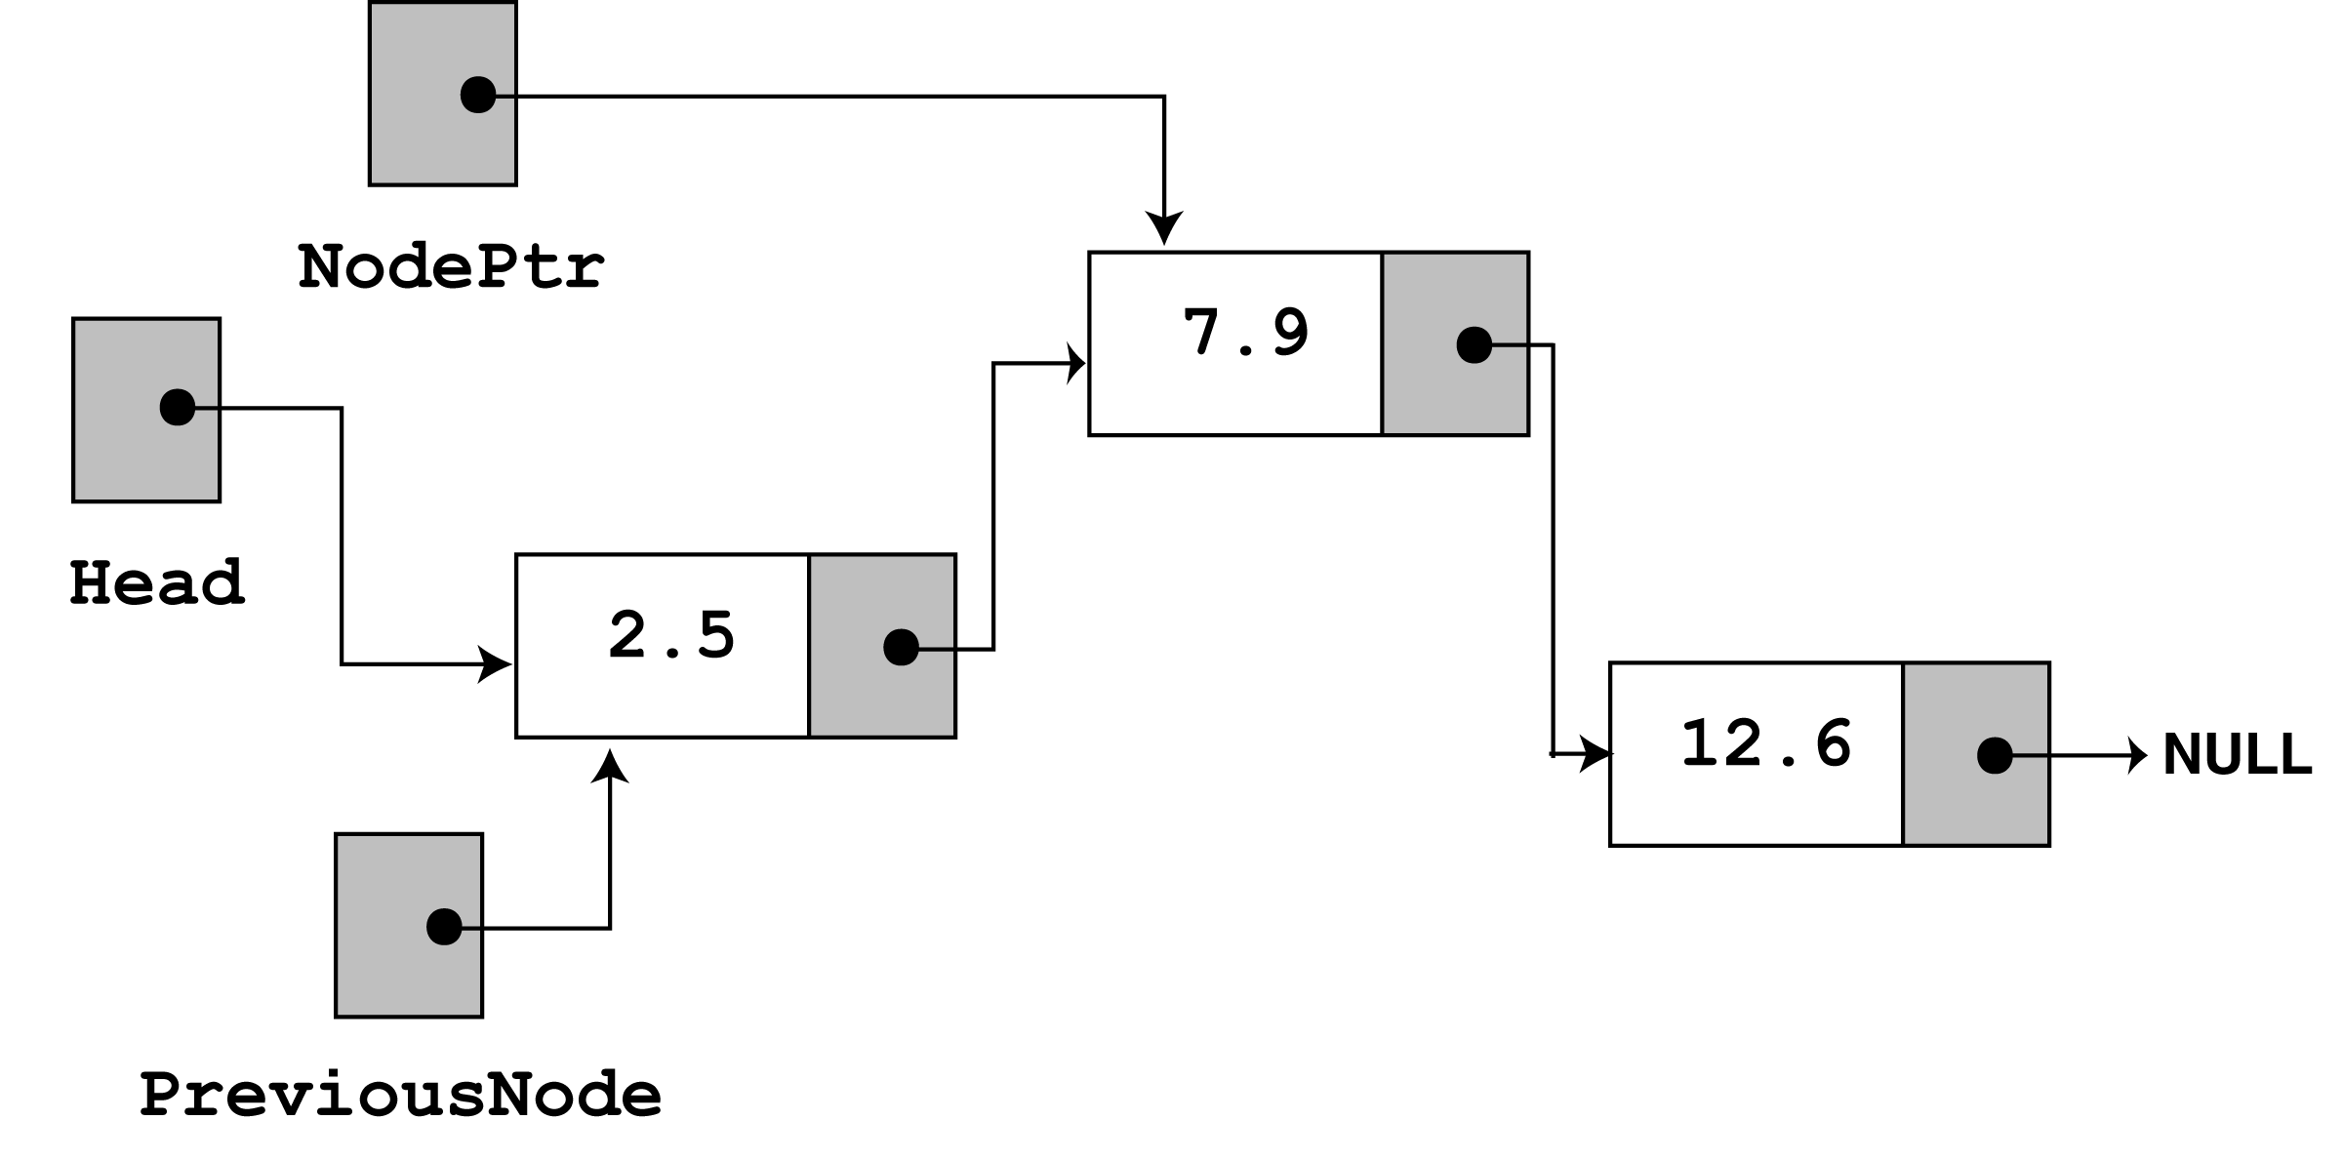
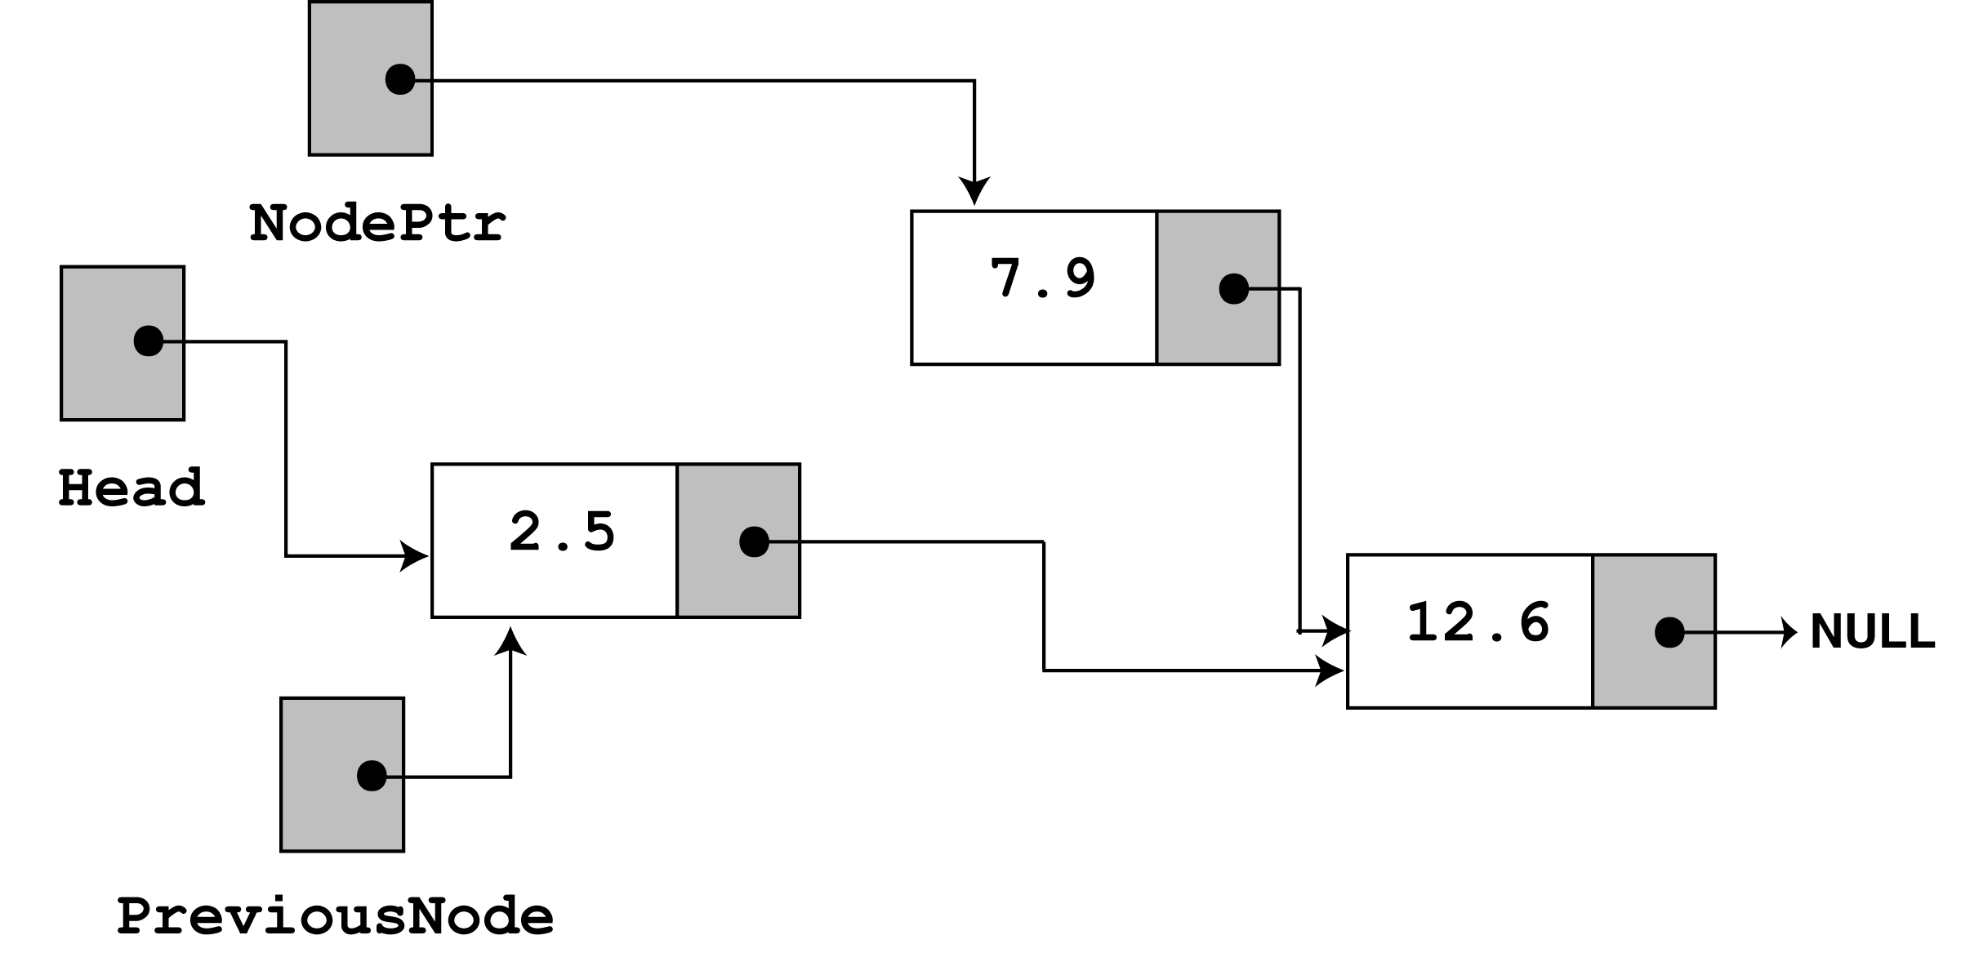
Program Step Through - 4
Then the following statement executes –
previousNode->next = nodePtr->next;
This causes the links in the list to bypass the node that nodePtr points to

Slide 32
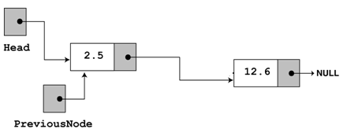
Program Step Through - 5
The node still exists in memory, but it is bypassed from the list.
The bypass node pointed by nodePtr is then destroyed with the statement :
delete nodePtr;
The linked List will be in the following state :

Slide 33
Program Step Through - 6
After the execution of following
cout << "Now deleting the node in the middle.\n";
cout << "Here are the nodes left.\n";
deleteNode(7.9); displayList(); cout << endl;
The Program Output will be the following:
Now deleting the node in the middle.
Here are the nodes left.
2.5
12.6

Slide 34
Program Step Through - 7
We will now do a step through of the call to deleteNode with value 12.6
Look at the else part of the 2nd if statement. It is here the function does its thing, since the list is not empty, and the first node does not contain 12.6
else {// Initialize nodePtr to head of list
nodePtr = head;
// Skip all nodes whose value member is not equal to num
while (nodePtr != NULL && nodePtr->value != num) {
previousNode = nodePtr;
nodePtr = nodePtr->next;
} // end of while loop
The node pointers nodePtr and previousPtr are used to traverse the list (as with the insertNode function).
The while loop terminates when the value 12.6 is found. When this happens the list and other pointers are in the following state -

Slide 35
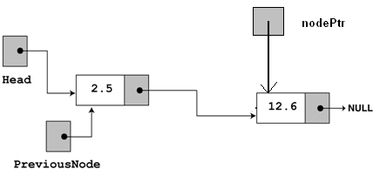
Program Step Through - 8
Then the following statement executes –
previousNode->next = nodePtr->next;
This causes the links in the list to bypass the node that nodePtr points to. The node still exists in memory.
The bypass node pointed by nodePtr is then destroyed with the statement :
delete nodePtr;

Slide 36
Program Step Through - 9
After the execution of following
cout << "Now deleting the last node.\n";
cout << "Here are the nodes left.\n";
deleteNode(12.6); displayList(); cout << endl;
The Program Output will be the following:
Now deleting the last node.
Here are the nodes left.
2.5

Slide 37
Program Step Through - 10
We will now do a step through of the call to deleteNode with value 2.5
Look at the 2nd if statement.
It is here the function does its thing,
since the list is not empty, and the first node contains 2.5
// Determine if the first node is the one
if (head->value == num) {
nodePtr = head;
head = head->next;
delete nodePtr;
}

Slide 38
Program Step Through - 11
After the execution of following
cout << "Now deleting the only remaining node.\n";
cout << "Here are the nodes left.\n";
deleteNode(2.5); displayList(); cout << endl;
The Program Output will be the following:
Now deleting the only remaining node.
Here are the nodes left.

Slide 39
Summary
Dynamic Representation
Allocation from Dynamic Storage
Returning unused storage back to dynamic storage
Linked List Operations
  Insert
  Delete

