Slide 1
CSC141- Introduction to Computer Programming
Teacher:
AHMED MUMTAZ MUSTEHSAN
Lecture – 9
Thanks
to Detal and Detal official website for some lecture slides
http://highered.mcgrawhill.com/sites/0072978902/student_view0/

Slide 2
Switch Statement continued from the last Lecture

Slide 3
Decisions Using switch
The control statement that allows us to make a decision from the number of choices is called a switch,
or
Switch is also called a switch-case-default, since these three keywords go together to make up the control statement

Slide 4
Switch --- Features
The integer expression following the keyword switch could be:
an integer constant like 1, 2 or 3, or
a character constant like ‘a’ or
an expression that evaluates to an integer like 2*4
The constant in each case must be different from all the others.
The “do this” lines in the body of switch construct represent any valid C statements

Slide 5
Switch --- General Format
switch ( integer expression )
{
case constant 1 :
do this ;
case constant 2 :
do this ;
case constant 3 :
do this ;
default :
do this ;
}

Slide 6
Switch statement ---- incorrect
void main( )
{
int i = 2 ;
switch ( i )
{
case 1 :
printf ( "I am in case 1 \n" ) ;
case 2 :
printf ( "I am in case 2 \n" ) ;
case 3 :
printf ( "I am in case 3 \n" ) ;
default :
printf ( "I am in default \n" ) ;
} /* What is the out put? */
}

Slide 7
Switch statement ---- incorrect output
I am in case 2
I am in case 3
I am in default
Why ?
Correct program would be

Slide 8
Switch statement ---- correct
void main( )
{
int i = 2 ;
switch ( i )
{
case 1 :
printf ( "I am in case 1 \n" ) ;
break ;
case 2 :
printf ( "I am in case 2 \n" ) ;
break ;
case 3 :
printf ( "I am in case 3 \n" ) ;
break ;
default :
printf ( "I am in default \n" ) ;
}
}
Output:
I am in case 2

Slide 9
In switch statement : Cases can be put in any order
void main( )
{
int i = 22 ;
switch ( i )
{
case 121 :
printf ( "I am in case 121 \n" ) ;
break ;
case 7 :
printf ( "I am in case 7 \n" ) ;
break ;
case 22 :
printf ( "I am in case 22 \n" ) ;
break ;
default :
printf ( "I am in default \n" ) ;
}
}
Output:
I am in case 22

Slide 10
switch statement: using character as constants
void main()
{
char c = 'x' ;
switch ( c )
{
case 'v' :
printf ( "I am in case v \n" ) ;
break ;
case 'a' :
printf ( "I am in case a \n" ) ;
break ;
case 'x' :
printf ( "I am in case x \n" ) ;
break ;
default :
printf ( "I am in default \n" ) ;
}
}
Output: I am in x
Here ‘v’, ‘a’, ‘x’ are replaced by the ASCII values
(118, 97, 120) of these character constants.

Slide 11
void main( ) switch statement: combining multiple constants
{
char ch ;
printf ( "Enter any of the alphabet a, b, or c " ) ;
scanf ( "%c", &ch ) ;
switch ( ch )
{
case 'a' :
case 'A' :
printf ( "a as in ashar" ) ;
break ;
case 'b' :
case 'B' :
printf ( "b as in brain" ) ;
break ;
case 'c' :
case 'C' :
printf ( "c as in cookie" ) ;
break ;
default :
printf ( “do you knew what are alphabets?" ) ;
}
}

Slide 12
switch statement: Combining multiple constants
Explanation
Here, if an alphabet a is entered the case ‘a’ is satisfied and since there are no statements to be executed in this case the control automatically reaches the next case i.e. case ‘A’ and executes all the statements in this case
Even if there are multiple statements to be executed in each case there is no need to enclose them within a pair of braces (unlike if, and else).

Slide 13
switch statement: -- Compiler does not report an error
void main( )
{
int i, j ;
printf ( "Enter value of i" ) ;
scanf ( "%d”, &i ) ;
switch ( i )
{
printf ( "Hello" ) ;
case 1 :
j = 10 ;
break ;
case 2 :
j = 20 ;
break ;
}
}
Every statement in a switch must belong to some case or the other. If a statement doesn’t belong to any case the compiler won’t report an error. However, the statement would never get executed. For example, in the following program the printf( ) will never be executed.

Slide 14
switch statement: -- Features
If we have no default case, then the program simply falls through the entire switch and continues with the next instruction (if any,) that follows the closing brace of switch.
Is switch a replacement for if?
  Yes and No.
  Yes,
  because it offers a better way of writing programs as compared to if, and

Slide 15
switch statement: -- Features contd…
No
  because in certain situations we are left with no choice but to use if. For example we do not have a case in a switch which looks like:
  case i <= 20 :
All that we can have after the case is an int constant or a char constant or an expression that evaluates to one of these constants. Even a float is not allowed.
The advantage of switch over if is that it leads to a more structured program and the level of indentation is manageable, more so if there are multiple statements within each case of a switch.

Slide 16
switch statement: -- Features contd…
The break statement when used in a switch takes the control outside the switch. However, use of continue will not take the control to the beginning of switch as one is likely to believe.
In principle, a switch may occur within another, but in practice it is rarely done. Such statements would be called nested switch statements.

Slide 17
switch statement: -- using Expressions
We can check the value of any expression in a switch. Thus the following switch statements are legal:
switch ( i + j * k )
switch ( 23 + 45 % 4 * k )
switch ( a < 4 && b > 7 )
Expressions can also be used in cases provided they are constant expressions. Thus :
The case 3 + 7 is correct,
The case a + b is incorrect.

Slide 18
switch Versus if-else Ladder
There are some things that you simply cannot do with a switch. These are:
A float expression cannot be tested using a switch
Cases can never have variable expressions (for example it is wrong to say case a +3 : )
Multiple cases cannot use same expressions. Thus the following switch is illegal:
    switch ( a )
    {
    case 3 :
    ...
    case 1 + 2 :
    ...
    }

Slide 19
Why use switch?
When switch has so many limitations, why use it?
Because, switch works faster than an equivalent if-else ladder. How come?
The compiler generates a jump table for a switch during compilation. As a result, during execution it simply refers the jump table to decide which case should be executed.
if-elses are slower because they are evaluated at execution time.
A switch with 10 cases would work faster than an equivalent if-else ladder.
If the if-else conditions are simple and few in number, then if-else would work out faster than the lookup mechanism of a switch.

Slide 20
Switch --- Summary
When we need to choose one among number of alternatives, a switch statement is used.
The switch keyword is followed by an integer or an expression that evaluates to an integer.
The case keyword is followed by an integer or a character constant.
The control falls through all the cases unless the break statement is given.
The usage of the goto keyword should be avoided as it usually violates the normal flow of execution.

Slide 21
/* Four Function Calculator */
void main(void)
{
float num1 = 1,0, num2 =1.0;
char op;
while ( ! ( num1 == 0.0 & num2 == 0.0))
{
printf ( “Type number, operator, number \n”);
scanf ( “%f %c %f, &num1, &op, &num2);
switch ( op )
{
case ‘+’:
printf ( “ = %f”, num1 + num2);
break;
case ‘-’:
printf ( “ = %f”, num1 - num2);
break;
case ‘*’ :
case ‘x’:
printf ( “ = %f”, num1 * num2);
break;
case ‘/’:
case ’ \\’ :
printf ( “ = %f”, num1 / num2);
break;
case ‘-’:
printf ( “ = %f”, num1 - num2);
break;
default:
printf ( “ unknown operator”);
}
}

Slide 22
The goto Keyword
goto keyword!
Is used to transfer the control or flow of execution of the program

Slide 23
The goto Keyword
avoid goto keyword!
reasons that programs become unreliable, and hard to debug.
In a difficult programming situation it seems so easy to use a goto to take the control where you want. However, almost always, there is a more elegant way of writing the same program using if, for, while and switch. These constructs are far more logical and easy to understand.

Slide 24
The goto Keyword
Conclusion:
You can always get the job done without goto.
With good programming skills and practices goto should always be avoided.
So donot use it if you can avoid it !!

Slide 25
The use of goto statement not recommended
int main () {
unsigned Count;
Count = rand () % 7;
printf ("The count is %i. \nThis is ", Count);
switch (Count) {
case 0:
printf ("none.\n");
goto done;
default:
printf ("many.\n");
goto done;
}
done:
return 0;
}

Slide 26
The use of goto statement Recommended
The only programming situation in favor of using goto is when we want to take the control out of the loop that is contained in several other loops. The following program illustrates this:
void main( ) {
int i, j, k ;
for ( i = 1 ; i <= 3 ; i++ )
{
for ( j = 1 ; j <= 3 ; j++ )
{
for ( k = 1 ; k <= 3 ; k++ )
{
if ( i == 3 && j == 3 && k == 3 )
goto out ;
else
printf ( "%d %d %d\n", i, j, k ) ;
}
}
}
out :
printf ( "Out of the loop at last!" ) ;
}

Slide 27
Revision
control structure
operators
Structure programming

Slide 28
switch Multiple-Selection Structure
switch
  Test variable for multiple values
  Series of case labels and optional default case
switch ( variable ) {
case value1: // taken if variable == value1
statements
break; // necessary to exit switch
case value2:
case value3: // taken if variable == value2 or == value3
statements
break;
default: // taken if variable matches no other cases
statements
break;
}

Slide 29
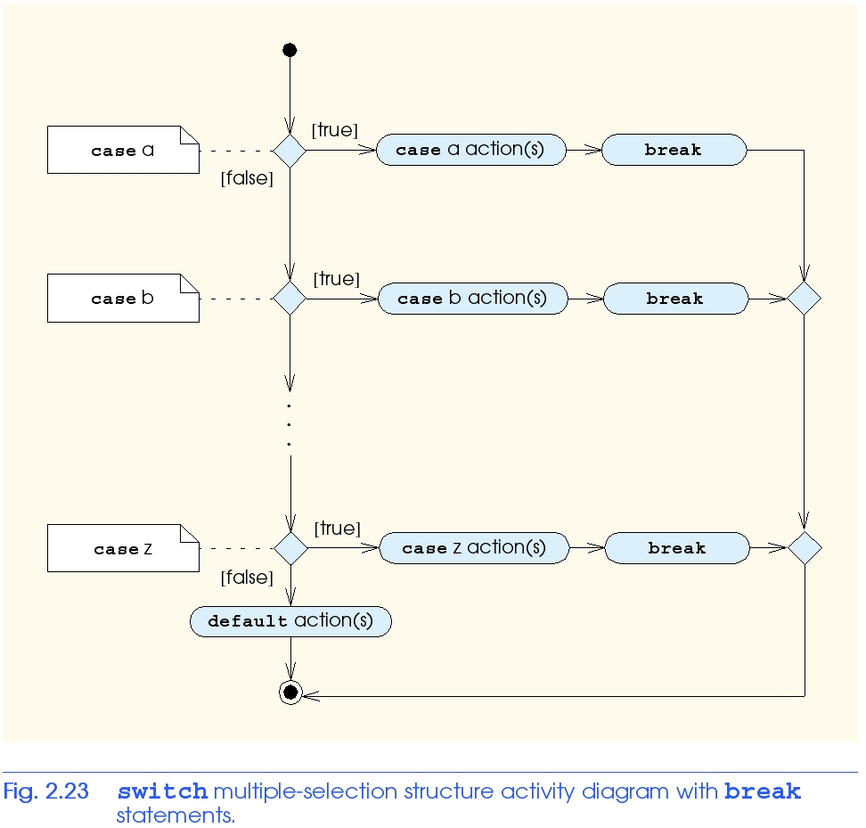
switch Multiple-Selection Structure

Slide 30
do/while Repetition Structure
Similar to while structure
  Makes loop continuation test at end, not in the beginning
  Loop body executes at least once
Format
    do {
    statement
    } while ( condition );

Slide 31
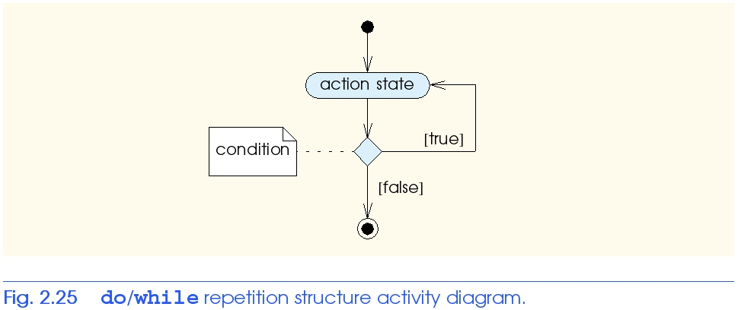
do/while Repetition Structure

Slide 32
break and continue Statements
break statement
  Immediate exit from while, for, do/while, switch
  Program continues with first statement after structure
Common uses
  Escape early from a loop
  Skip the remainder of switch

Slide 33
Example of Break
1 // Fig. 2.26: fig02_26.cpp
2 // Using the break statement in a for structure.
3 #include <iostream>
4
5 using std::cout;
6 using std::endl;
7
8 // function main begins program execution
9 int main()
10 {
11
12 int x; // x declared here so it can be used after the loop
13
14 // loop 10 times
15 for ( x = 1; x <= 10; x++ ) {
16
17 // if x is 5, terminate loop
18 if ( x == 5 )
19 break; // break loop only if x is 5
20
21 cout << x << " "; // display value of x
22
23 } // end for
24
25 cout << "\nBroke out of loop when x became " << x << endl;
Exits for structure when break executed.
Output
1 2 3 4
Broke out of loop when x became 5
26
27 return 0; // indicate successful termination
28
29 } // end function main

Slide 34
break and continue Statements
continue statement
  Used in while, for, do/while
  Skips remainder of loop body
  Proceeds with next iteration of loop
while and do/while structure
  Loop-continuation test evaluated immediately after the continue statement
for structure
  Increment expression executed
  Next, loop-continuation test evaluated

Slide 35
Example of continue
1 // Fig. 2.27: fig02_27.cpp
2 // Using the continue statement in a for structure.
3 #include <iostream>
4
5 using std::cout;
6 using std::endl;
7
8 // function main begins program execution
9 int main()
10 {
11 // loop 10 times
12 for ( int x = 1; x <= 10; x++ ) {
13
14 // if x is 5, continue with next iteration of loop
15 if ( x == 5 )
16 continue; // skip remaining code in loop body
17
18 cout << x << " "; // display value of x
19
20 } // end for structure
21
22 cout << "\nUsed continue to skip printing the value 5"
23 << endl;
24
25 return 0; // indicate successful termination
Skips to next iteration of the loop.
1 2 3 4 6 7 8 9 10
Used continue to skip printing the value 5

Slide 36
Logical Operators
Used as conditions in loops, if statements
&& (logical AND)
  true if both conditions are true
  if ( gender == 1 && age >= 65 )
  ++seniorFemales;
|| (logical OR)
  true if either of condition is true
  if ( semesterAverage >= 90 || finalExam >= 90 )
  cout << "Student grade is A" << endl;

Slide 37
Logical Operators
! (logical NOT, logical negation)
  Returns true when its condition is false, & vice versa
  if ( !( grade == sentinelValue ) )
  cout << "The next grade is " << grade << endl;
  Alternative:
  if ( grade != sentinelValue )
  cout << "The next grade is " << grade << endl;

Slide 38
Confusing Equality (==) and
Assignment (=) Operators
Common error
  Does not typically cause syntax errors
Aspects of problem
  Expressions that have a value can be used for decision
    Zero = false, nonzero = true
  Assignment statements produce a value (the value to be assigned)

Slide 39
Confusing Equality (==) and
Assignment (=) Operators
Example
    if ( payCode == 4 )
    cout << "You get a bonus!" << endl;
  If paycode is 4, bonus given
If == was replaced with =
    if ( payCode = 4 )
    cout << "You get a bonus!" << endl;
  Paycode set to 4 (no matter what it was before)
  Statement is true (since 4 is non-zero)
  Bonus given in every case

Slide 40
Confusing Equality (==) and
Assignment (=) Operators
Lvalues
  Expressions that can appear on left side of equation
  Can be changed (I.e., variables)
    x = 4;
Rvalues
  Only appear on right side of equation
  Constants, such as numbers (i.e. cannot write 4 = x;)
Lvalues can be used as rvalues, but not vice versa

Slide 41
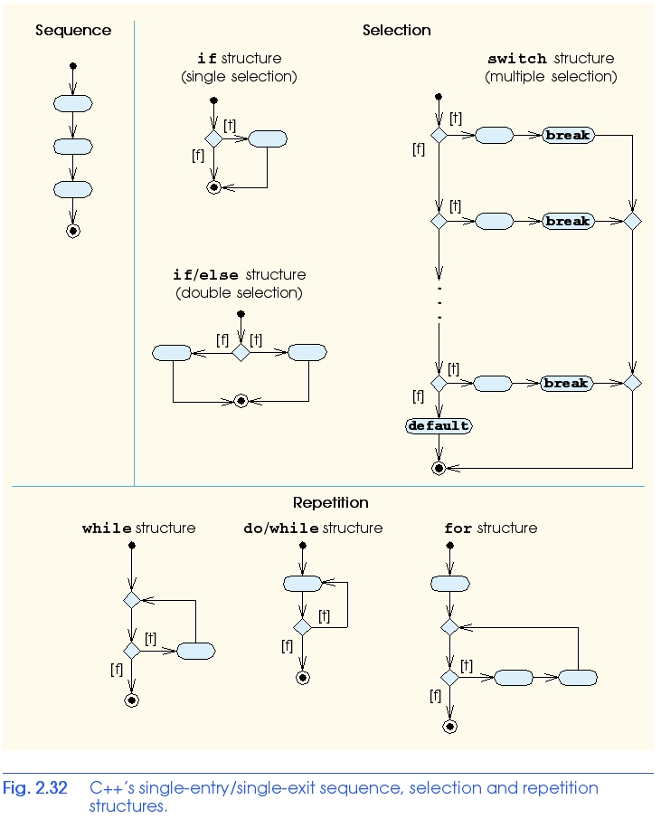
Structured-Programming Summary

Slide 42
Structured-Programming Summary
Structured programming
  Programs easier to understand, test, debug and modify
Rules for structured programming
  Only use single-entry/single-exit control structures
  Rules
    1) Begin with the “simplest flowchart”
    2) Any rectangle (action) can be replaced by two rectangles (actions) in sequence
    3) Any rectangle (action) can be replaced by any control structure (sequence, if, if/else, switch, while, do/while or for)
    4) Rules 2 and 3 can be applied in any order and multiple times

Slide 43
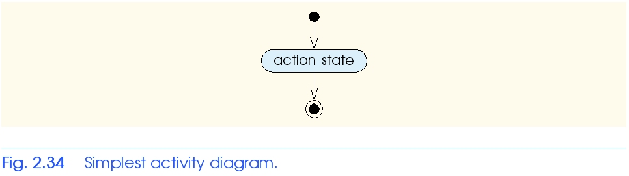
Structured-Programming Summary

Slide 44
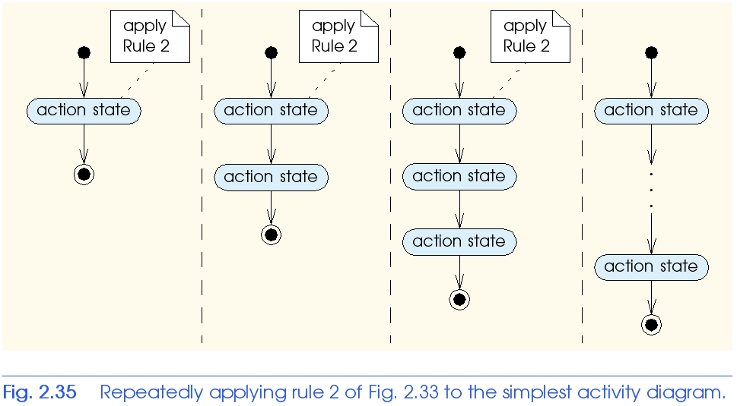
Structured-Programming Summary

Slide 45
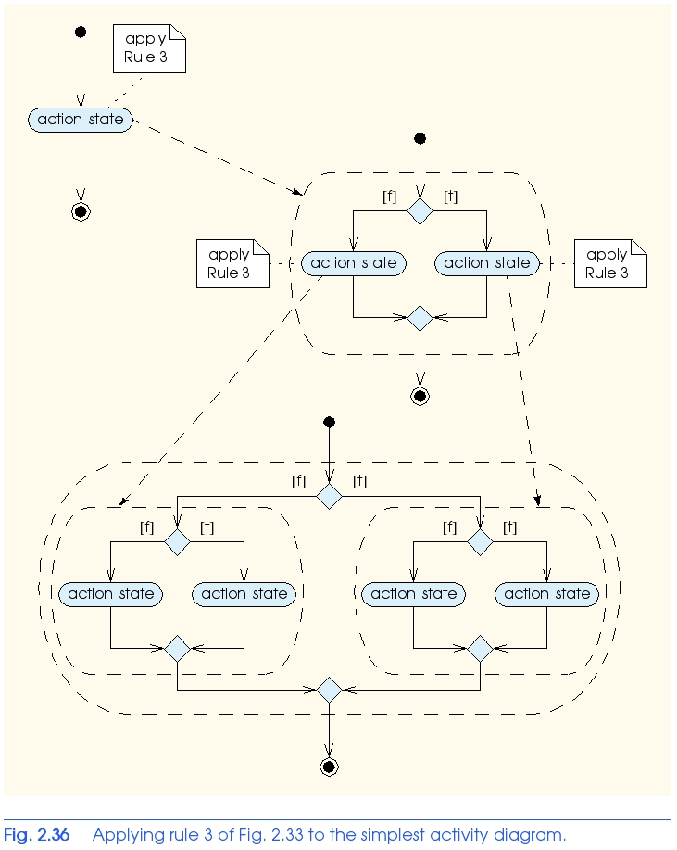
Structured-Programming Summary

Slide 46
Structured-Programming Summary
All programs broken down into
  Sequence
  Selection
    if, if/else, or switch
    Any selection can be rewritten as an if statement
  Repetition
    while, do/while or for
    Any repetition structure can be rewritten as a while statement

