Slide 1
CSC141- Introduction to Computer programming
Teacher:
AHMED MUMTAZ MUSTEHSAN
Lecture – 18
Thanks to Reference Book & its website for lecture material
Computer Science:
A Structured Programming Approach Using C; Chapter 10

Slide 2
Pointers
Notes:
Narrator:
Lecture 14: Introduction to Pointers

Slide 3
POINTERS
Pointers are variables that contain memory addresses as their values.
A variable name directly references a value.
A pointer indirectly references a value. Referencing a value through a pointer is called indirection.
A pointer variable must be declared before it can be used.
Notes:
Instructor:
Students have already used pointer without knowing it when they declare FILE variables, which basically point to the address where a file stream is located.
Narrator:
Pointers are variables that contain instead of data, the memory address where the data exists as their values. It can be said that a regular variable name directly references the value in that variable. A pointer, on the other hand, indirectly references a value. Referencing through a pointer is called indirection. Like any other variable, a pointer must be declared before it can be used.

Slide 4
Concept of Address and Pointers
Memory can be conceptualized as a linear set of data locations.
Variables reference the contents of a locations
The contents (value) of a pointers are the address of a given location
ADDR1
Contents1
ADDR2
ADDR3
ADDR4
ADDR5
ADDR6
*
*
*
ADDR11
Contents11
*
*
ADDR16
Contents16
Notes:
Instructor:
A computer has two basic types of busses to the memory: an address and data bus. Thus far we have been concerned mainly with the data we store but not its storage location. Pointers allow us to also use the address in which our data is stored in various ways. This conceptualization of memory can be likened to a street with various address where mail is delivered. The mailman delivers the correct data (letters) to the correct address written on each piece of mail.

Slide 5
POINTERS
Examples of pointer declarations:
int *aptr;
float *bptr;
char *cptr;
The asterisk ( * ), when used in the declaration, tells the compiler that the variable is to be a pointer, and the type of data that the pointer points to;
NOT the name of the variable;
Notes:
Instructor:
Pointers can be declared with regular variables in the same line, the asterisk (or lack of one) determines if the variable will contain an address or data. It is important to declare the correct type of pointer depending on the type of data it will point to. It is NOT possible to give a variable and pointer the same name. All variables (pointer or data) must still have a unique name.
Narrator:
Pointers are declared much like variables, except an asterisk must be before each variable name. Pointers can be declared with regular variables in the same line, the asterisk (or lack of one) determines if the variable will contain an address or data. It is important to declare the correct type of pointer depending on the type of data it will point to. It is NOT possible to give a variable and pointer the same name. All variables (pointer or data) must still have a unique name.

Slide 6
POINTERS
Consider the statements:
#include <stdio.h>
int main ( )
{
int *aptr ; /* Declare a pointer to an int */
float *bptr ; /* Declare a pointer to a float */
int a ; /* Declare an int variable */
float b ; /* Declare a float variable */
aptr = &a ; /* loads the address of int a into pointer aptr */
bptr = &b ; /* loads the address of float b into pointer bptr */
Notes:
Instructor:
In this case the pointer and variable declarations are separated. They could have also been handled as such:
FILE *fptr1, *fptr2;
int *aptr, a;
int *bptr, b;
Narrator:
In these statements we are declaring pointers of multiple types, along with the familiar FILE pointer type. We also declare normal variables. In this case the pointer and variable declarations are separated. Pointers and variables of the same type could have been declared on the same line, separated by commas.

Slide 7
Use of & and *
When & is used?
& "address operator" which gives or produces the memory address of a data variable
When * is used?
* "dereferencing operator" which provides the contents in the memory location specified by a pointer
Notes:
Instructor:
Use the & when you wish to know the address of a variable.
Use the * when you wish to return the value stored in the variable as an address, then look in that address and return its data
Narrator:
With the introduction of pointers, we now have the & and the * being used for various operations. The & is used when you wish to know the address of a variable. This is known as the address operator. The *, or dereferencing operator, provides the contents of the memory location specified by a pointer. This operation takes the value stored in the pointer as an address, looks in that address and returns the data stored there.

Slide 8
Memory Addresses
Storage cells are typically viewed as being byte-sized
Usually the smallest addressable unit of memory
Few machines can directly address bits individually
Such addresses are sometimes called byte addresses
Memory is often accessed as words
Usually a word is the largest unit of memory access by a single machine instruction
A word size may be 4 or 8 bytes (to check use sizeof(long))
A word-address is simply the byte-address of the word’s first byte

Slide 9
Pointers
Special case of bounded-size natural numbers
  Maximum memory limited by processor word-size
  2³² bytes = 4GB
  2⁶⁴ bytes = 16 Exabytes
A pointer is just another kind of value
  A basic type in C
int *ptr;
The variable “ptr” is a pointer to an “int”.

Slide 10
Using of Special feature/function of C
Sizeof
This keyword can be used to determine the number of bytes in a data type, a variable, or an array
Example:
double array [10];
sizeof (double); /* Returns the value 8 */
sizeof (array); /* Returns the value 80 */
sizeof(int); /* Returns 2 or 4 */
Notes:
Instructor:
The sizeof() function does some of the memory math for the programmer, so depending on the system the program is compiled on, one doesn’t need to be concerned with the memory usage of each type of variable. In this case an array size is also calculated. This shows the total size of the array in bytes (each double is 8 bytes, an array of 10 doubles is 80 bytes). The last line shows math that can indirectly determine the size of an array.
Narrator:
The sizeof() function can be used to determine the number of bytes in a data type, a variable, or an array. This function does some of the memory math for the programmer, so depending on the system the program is compiled on, one doesn’t need to be concerned with the memory usage of each type of variable. In this case an array size is also calculated. This shows the total size of the array in bytes (each double is 8 bytes, an array of 10 doubles is 80 bytes). The last line shows math that can indirectly determine the size of an array.

Slide 11
Pointer Operations in C
How to pick address of variable?
  & variable Returns variable’s memory address
How to pick content of address loaded into a pointer ?
  * pointer Returns contents stored at address
Indirect assignment
  * pointer = val Stores value at address
Also allowed:
Copying address of one pointer to other pointer
  pointer = ptr Stores pointer in another pointer variable

Slide 12
Using Pointers
int i1;
int i2;
int *ptr1;
int *ptr2;
i1 = 1;
i2 = 2;
ptr1 = &i1;
ptr2 = ptr1;
*ptr1 = 3;
i2 = *ptr2;
0x1014
…
0x1000
0x1010
ptr2:
0x100C
…
0x1000
0x1008
ptr1:
i2:
2
0x1004
3
i1:
3
0x1000
1

Slide 13
Using Pointers (cont.)
int int1 = 1036; /* some data to point to */
int int2 = 8;
int *int_ptr1 = &int1; /* get addresses of data */
int *int_ptr2 = &int2;
*int_ptr1 = int_ptr2;
*int_ptr1 = int2;
What happens?
Type check warning: int_ptr2 is not an int
int1 becomes 8

Slide 14
Using Pointers (cont.)
int int1 = 1036; /* some data to point to */
int int2 = 8;
int *int_ptr1 = &int1; /* get addresses of data */
int *int_ptr2 = &int2;
int_ptr1 = *int_ptr2;
int_ptr1 = int_ptr2;
What happens?
Type check warning: *int_ptr2 is not an int *
Changes int_ptr1 – doesn’t change int1

Slide 15
The Simplest Pointer in C
Special constant pointer NULL
  Points to no data
  Dereferencing illegal – causes segmentation fault

Slide 16
Arithmetic and Logical Operations on Pointers
A pointer may be incremented or decremented
An integer may be added to or subtracted from a pointer.
Pointer variables may be subtracted from one another.
Pointer variables can be used in comparisons, but usually only in a comparison to NULL.
Notes:
Instructor:
Most logical operations can be used on pointers as with regular variables, but the programmer must be careful of the results since each program doesn’t have free reign of the entire computer’s memory space. Errors which attempt to use memory not assigned to a certain program will cause what will be seen as a segmentation fault or bus error in UNIX, or Windows’ extreme, more deadly blue screen of death.
Pointers can be incremented and decremented. Integers can be added or subtracted from a pointer, and pointers variable may be subtracted from one another. Pointers can also be used in comparisons, but usually only in a comparison to NULL as been shown when testing file pointers for a successful file open.

Slide 17
Arithmetic Operations on Pointers
When an integer is added to or subtracted from a pointer, the new pointer value is changed by the integer times the number of bytes in the data variable the pointer is pointing to.
For example, if the pointer valptr contains the address of a double precision variable and that address is 234567870, then the statement:
valptr = valptr + 2;
would change valptr to 234567886
Why added 16 in the address?
Notes:
Instructor:
Memory arithmetic is slightly more complicated than standard algebra. Each byte of memory has its own unique address. Remember that different data types use multiple bytes of memory thus span multiple addresses. The UNIX data sizes are reviewed:
int: 32 bit – 4 bytes
float: 32 bit – 4 bytes
double: 64 bit – 8 bytes
char: 8 bit – 1 byte
So addition of y to a pointer will actually be a multiple of y*x where x is the size of the data type in bytes.
In the example shown here, the pointer valptr contains the address of a double precision variable and the address is shown. Each double precision number is 8 bytes. The addition of 2 to the pointer is then 2*8, or 16. Thus we can see the addition of 2 to the pointer adds 16 to the address.

Slide 18
Pointer Arithmetic
  pointer + number pointer – number
  E.g., pointer + 1 adds 1 something to a pointer
char *p;
char a;
char b;
p = &a;
p += 1;
int *p;
int a;
int b;
p = &a;
p += 1;
In each, p now points to b
(Assuming compiler doesn’t reorder variables in memory)
Adds 1*sizeof(char) to the memory address
Adds 1*sizeof(int) to the memory address
Pointer arithmetic should be used cautiously

Slide 19
Example: Pointers and Functions
#include <stdio.h>
void swap ( int *a, int *b ) ;
int main ( )
{
int a = 5, b = 6;
printf("a=%d b=%d\n",a,b) ;
swap (&a, &b) ;
printf("a=%d b=%d\n",a,b) ;
return 0 ;
}
void swap( int *a, int *b )
{
int temp;
temp= *a; *a= *b; *b = temp ;
printf ("a=%d b=%d\n", *a, *b);
}
Results:
a=5 b=6
a=6 b=5
a=6 b=5
Notes:
Instructor/Narrator:
Here is a modified swap program. Notice the swap function now requires pointer variables as input (both in the function and function prototype), and that all operations are done by dereferencing the pointers within the swap function to get the values and move them around with the aid of the local “temp” variable. In the main() function the addresses of the a and b variable are passed to the swap() function (given by &a and &b). The results are now what would be expected of a swap function.

Slide 20
Pointers and Functions
Pointers can be used to pass addresses of variables to called functions, thus allowing the called function to alter the values stored there.
We looked earlier at a swap function that did not change the values stored in the main program because only the values were passed to the function swap.
That is known as "call by value".
Notes:
Instructor:
Looking back as the swap function problem, the variable scope problem can now be solved by passing pointers, or the original location of variables, instead of just the values. The next slide explains more.
Narrator:
So now we can see how pointers can be used to pass addresses of variables around. They can also be used to pass addresses of variables to functions, thus allowing the function to alter the values of the original variables. Looking back at the swap function, you may remember it received copies of the variables, since they were called by value.

Slide 21
Pointers and Functions
If instead of passing the values of the variables to the called function, we pass their addresses, so that the called function can change the values stored in the calling routine. This is known as "call by reference" since we are referencing the variables.
The following shows the swap function modified from a "call by value" to a "call by reference". Note that the values are now actually swapped when the control is returned to main function.
Notes:
Instructor:
Call by reference is now explained. It simply involves passing the location in memory of the original variables to any supporting function.
Narrator:
If instead of passing the value of variables to the function, we now pass the addresses so that the function can change the values stored in the calling routine. The is known as “called by reference” since we are referencing the variables. The swap function is shown again modified to call by reference instead of call by value. This will now actually swap the values in the function, and will return to the main with actual swapped values.

Slide 22
Example: Pointers and Functions
#include <stdio.h>
void swap ( int *a, int *b ) ;
int main ( )
{
int a = 5, b = 6;
printf("a=%d b=%d\n",a,b) ;
swap (&a, &b) ;
printf("a=%d b=%d\n",a,b) ;
return 0 ;
}
void swap( int *a, int *b )
{
int temp;
temp= *a; *a= *b; *b = temp ;
printf ("a=%d b=%d\n", *a, *b);
}
Results:
a=5 b=6
a=6 b=5
a=6 b=5
Notes:
Instructor/Narrator:
Here is a modified swap program. Notice the swap function now requires pointer variables as input (both in the function and function prototype), and that all operations are done by dereferencing the pointers within the swap function to get the values and move them around with the aid of the local “temp” variable. In the main() function the addresses of the a and b variable are passed to the swap() function (given by &a and &b). The results are now what would be expected of a swap function.

Slide 23
Pointers and Arrays
Notes:
Narrator:
Lecture 14: Introduction to Pointers

Slide 24
Arrays in C
All elements of same type – homogenous
int array[10];
int b;
array[0] = 3;
array[9] = 4;
array[10] = 5;
array[-1] = 6;
int array[10];
First element (index 0)
Last element (index size - 1)
No bounds checking!
Allowed – usually causes no error
array[10] may overwrite b

Slide 25
Array Representation
Homogeneous → Each element same size – s bytes
  An array of m data values is a sequence of m×s bytes
  Indexing: 0th value at byte s×0, 1st value at byte s×1, …
m (number of elements) and s (size) both are not part of representation
  Unlike in some other languages
  s known by compiler – usually irrelevant to programmer
  m often known by compiler – if not, must be saved by programmer
0x1008
a[2]
0x1004
a[1]
int a[3];
0x1000
a[0]

Slide 26
Array Representation
char c1;
int a[3];
char c2;
int i;
0x1014
i
0x1010
c2
0x100C
a[2]
Could be optimized by making these adjacent, and reducing padding (by default, not)
0x1008
a[1]
0x1004
a[0]
0x1000
c1
Array aligned by
size of elements

Slide 27
Array Sizes
What is
sizeof(array[3])?
sizeof(array)?
int array[10];
4
returns the size of
an object in bytes
40

Slide 28
Arrays and Pointers
Passing arrays:
The name of the array is the address of the array.
Address of array is the address of first element of array.
Array ≈ pointer to the initial (0th) array element
a[0] ≡ *(a+0)
  a[i] ≡ *(a+i)
  a[i] ≡ *(a+i)
An array is passed to a function as a pointer, The array size is lost!
Must explicitly
pass the size
Really int *array
int
foo(int array[],
unsigned int size)
{
… array[size - 1] …
}
int
main(void)
{
int a[10], b[5];
… foo(a, 10)… foo(b, 5) …
}

Slide 29
Arrays and Pointers
int
foo(int array[],
unsigned int size)
{
…
printf(“%d\n”, sizeof(array));
}
int
main(void)
{
int a[10], b[5];
… foo(a, 10)… foo(b, 5) …
printf(“%d\n”, sizeof(a));
}
What does this print?
8
... because array is really
a pointer
What does this print?
40

Slide 30
Arrays and Pointers
int i;
int array[10];
for (i = 0; i < 10; i++)
{
array[i] = …;
}
int *p;
int array[10];
for (p = array; p < &array[10]; p++)
{
*p = …;
}
These two blocks of code are functionally equivalent

Slide 31
Reinforcement of Concepts from Reference
Computer Science: A Structured Programming Approach Using C; Chapter 10 : Arrays and Pointers
The name of an array is a pointer constant to the first element. Because the array’s name is a pointer constant, its value cannot be changed. Since the array name is a pointer constant to the first element, the address of the first element and the name of the array both represent the same location in memory.

Slide 32
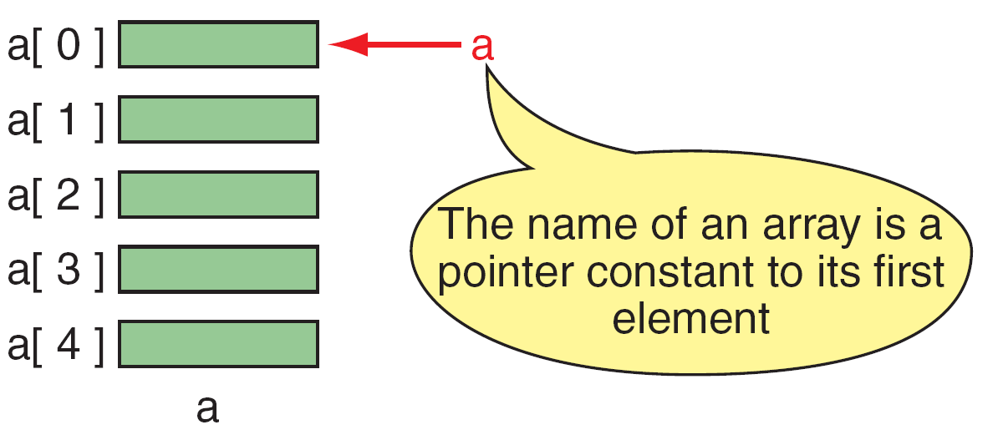
FIGURE 10-1 Pointers to Arrays

Slide 33
Note
same
a &a[0]
a is a pointer only to the first element—not the whole array.

Slide 34
Note
The name of an array is a pointer constant;
it cannot be used as an lvalue.

Slide 35
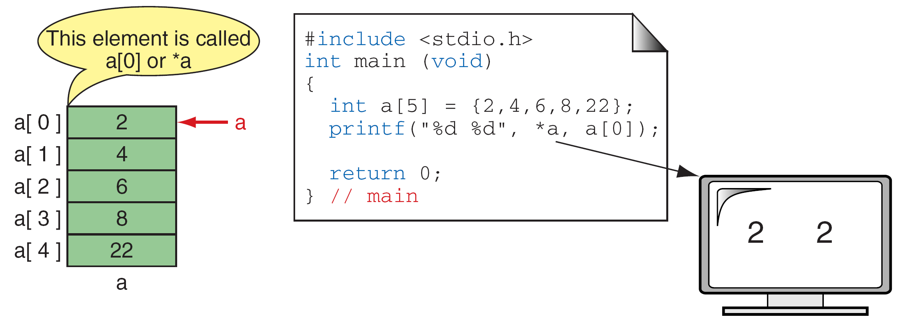
FIGURE 10-2 Dereference of Array Name

Slide 36
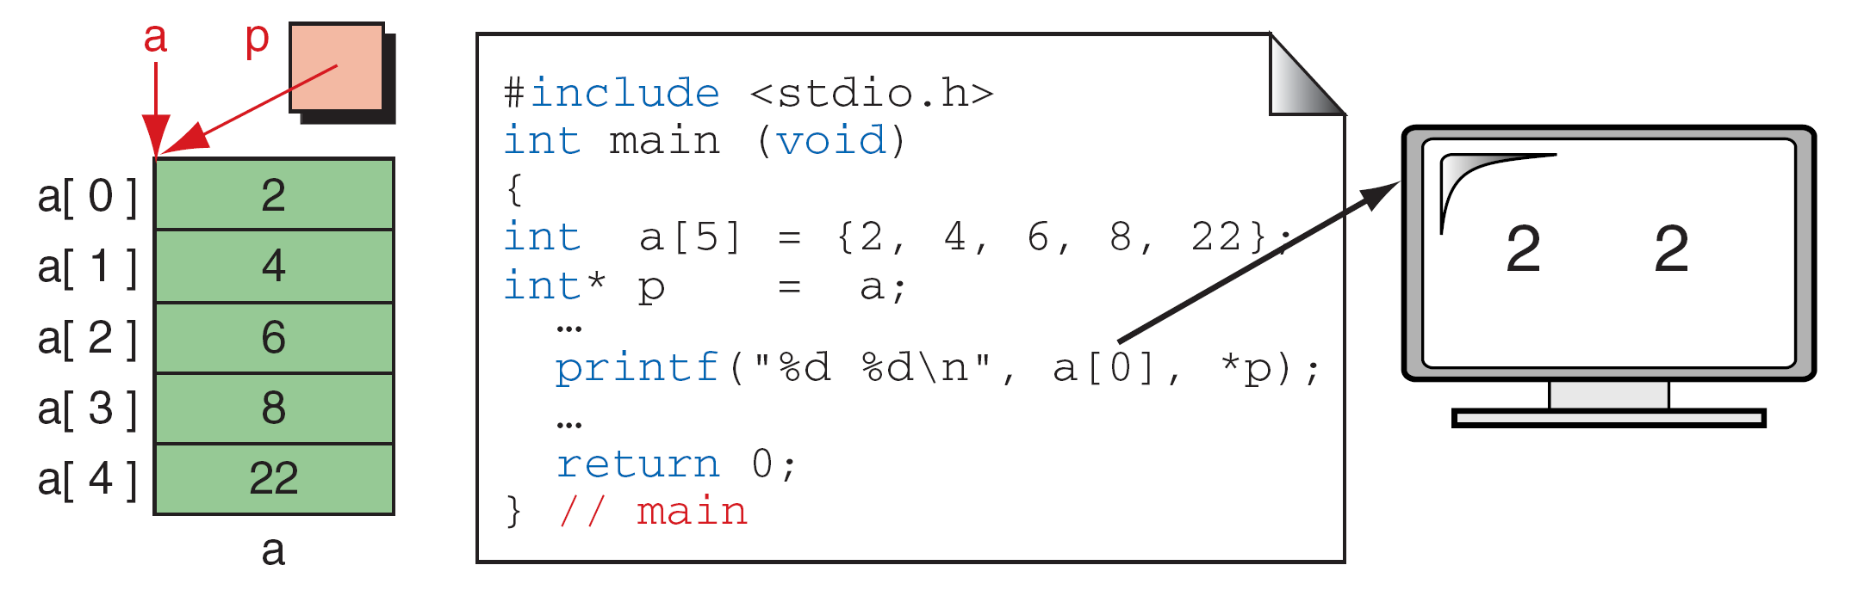
FIGURE 10-3 Array Names as Pointers

Slide 37
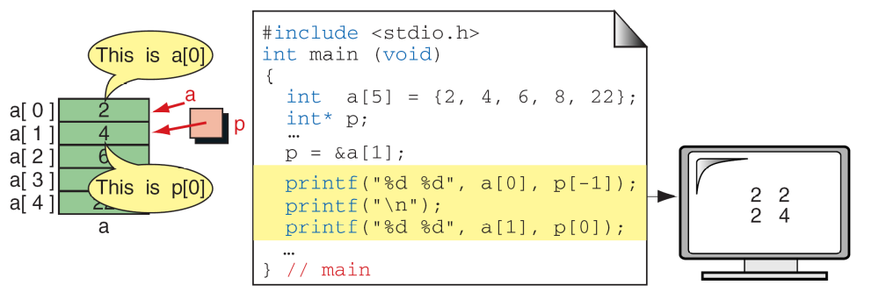
FIGURE 10-4 Multiple Array Pointers

Slide 38
Note
To access an array, any pointer to the first element can be used instead of the name of the array.

Slide 39
Pointer Arithmetic and Arrays
Besides indexing, programmers use another powerful method of moving through an array: pointer arithmetic. Pointer arithmetic offers a restricted set of arithmetic operators for manipulating the addresses in pointers.
Topics discussed in this section:
Pointers and One-Dimensional Arrays
Arithmetic Operations on Pointers
Using Pointer Arithmetic
Pointers and Two-Dimensional Arrays

Slide 40
Note
Given pointer, p, p ± n is a pointer to the
value n elements away.

Slide 41
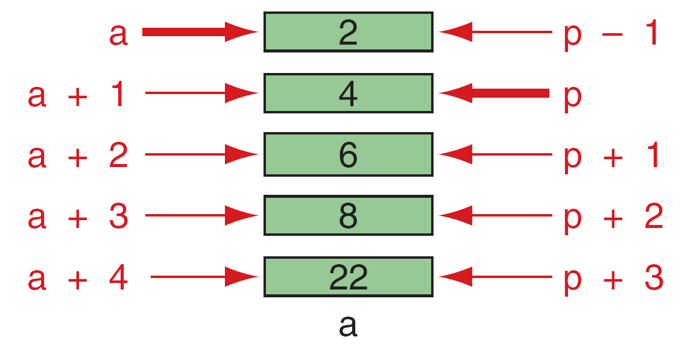
FIGURE 10-5 Pointer Arithmetic

Slide 42
Note
a + n
↓
a + n * (sizeof (one element))

Slide 43
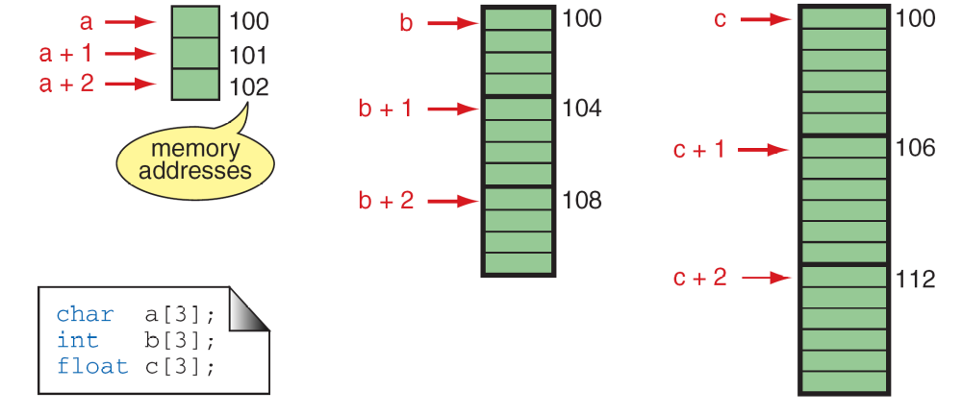
FIGURE 10-6 Pointer Arithmetic and Different Types

Slide 44
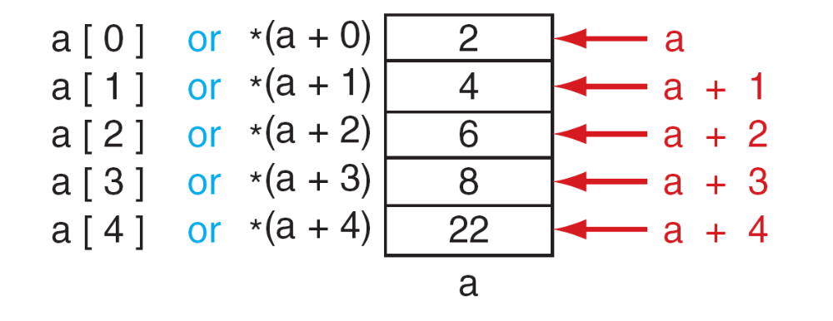
FIGURE 10-7 Dereferencing Array Pointers

Slide 45
Note
The following expressions are identical.
*(a + n) and a[n]

Slide 46
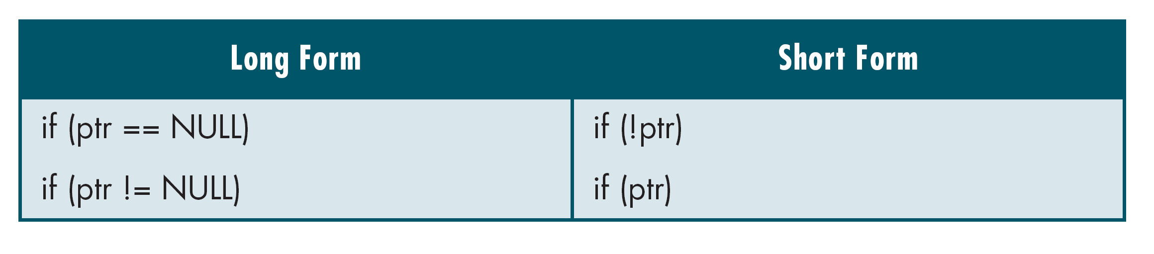
Table 10-1
Pointers and Relational Operators

Slide 47
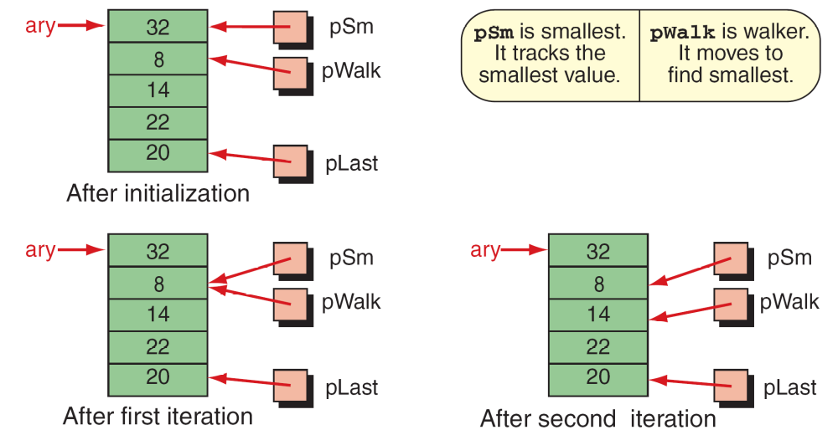
FIGURE 10-8 (Part I) Find Smallest

Slide 48
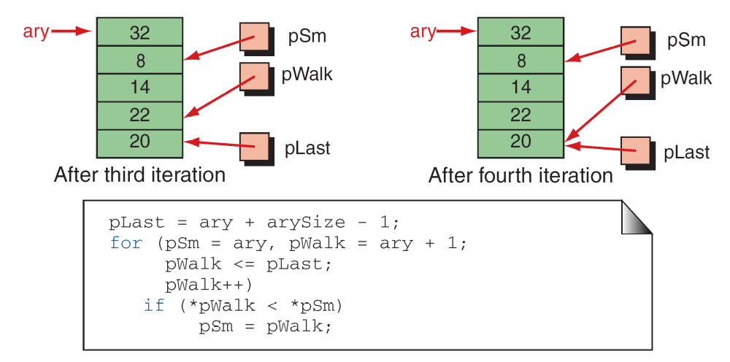
FIGURE 10-8 (Part II) Find Smallest

Slide 49
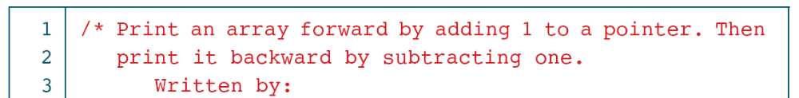
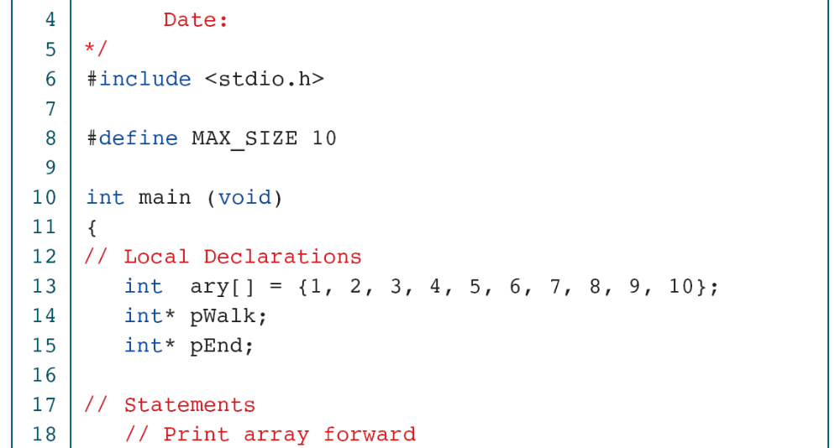
PROGRAM 10-1
Print Array with Pointers

Slide 50
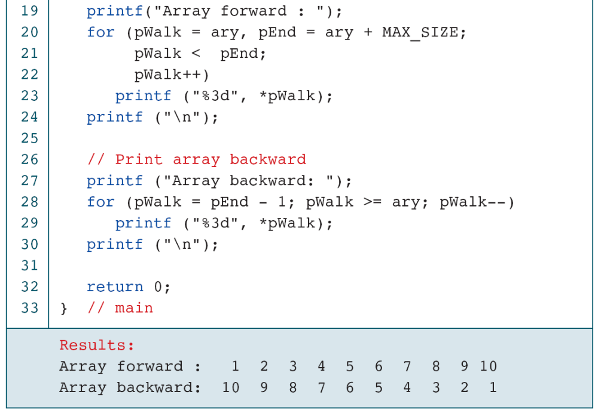
PROGRAM 10-1
Print Array with Pointers

