Slide 1
CSC141- Introduction to Computer Programming
Teacher:
AHMED MUMTAZ MUSTEHSAN
Lecture 1

Slide 2
Personal profile
Master Of Computer Sciences (1979-81) from Quaid-e-Azam university Islamabad. Area of expertise; Satellite Image Processing and GIS.
More than 30 years of experience in the field of IT industry, including Education and R & D
Served on different reputable posts at middle and top management at national and International organizations.
Hands on experience of programming in ;
  Assembly , FORTRAN, COBAL, Java and C languages.
Contributed in the Development of Projects of National interest.

Slide 3
CSC141- Introduction to Computer Programming
Course Objective
“Introduction to Computer Programming” aims to familiarize the students with the fundamental concepts of computer and computer programming. The students will learn basic concept of IT, fundamental concepts of programming by developing and executing programs in C and C++. The course will be focused mostly on structured programming and will be completed with the introduction to Object oriented programming.”

Slide 4
Course Outline
The need of this course is to develop fundamental skill and techniques of problem analysis and solution synthesis using computer;
Introduction (computer & language)
  Computer components (software, hardware and utility)
  Types of hardware and software
  Languages History
  Language types and levels
Visual C++ IDE
(Integrated Development Environment)

Slide 5
Course Outline
Algorithms and flowcharting
  Program Development steps. Algorithms and pseudo code. Flowcharting
Intro to C Programming
  Syntax and Semantics, Key words; Basic data types in C; Operators, arithmetic operators, assignment operators, increment and decrement operators, expressions, equality operators, precedence of operators;
Program control
  If and else structures, nested if structure,
  for, while and do while loops; nested loops,
  Switch statements; Compound statements;

Slide 6
Course Outline
Functions and Parameters
  Passing by value and by reference
Recursion
  Recursive procedure and recursive functions
Arrays
  Declaration. Array passing to functions, multidimensional arrays, parallel arrays
Strings
  Character strings, string manipulation, library functions
Pointers
  pointers and arrays, pointers and functions
Structures, Unions and Enumerated data types
  Declaration and initialization structures, unions and numerated data types.Accessing members, passing structures to functions, pointers and structures.

Slide 7
Course Outline
Bitwise Operators
  Displaying an Unsigned Integer in Bits
  Making Function displayBits; Using the Bitwise AND, Inclusive OR, Exclusive OR and Complement Operators
  Bit fields
File Processing
  Creating Reading and Writing to sequential access files; Creating Reading and Writing to random access files. case study using files.
I/O Streams of C++,
Difference between C and C++
Introduction to OOP

Slide 8
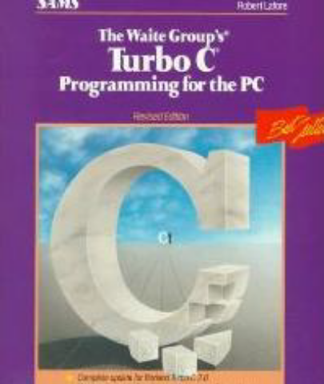
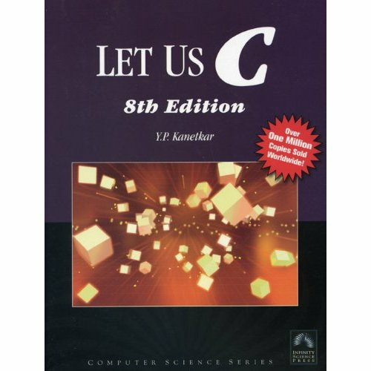
Recommended books:
The Waite Group’s Turbo C Programming for the PC by Robert Lafore, Revised Ed.
Let Us C, by Yashavant P. Kanetkar

Slide 9
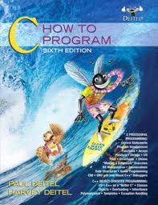
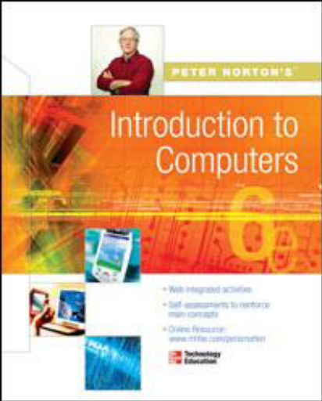
Recommended Books:
C How to Program, by Dietel and Dietel, 4/e 5/e or 6/e
Introduction to Computers, by Peter Norton, 6th or 7th Ed.
  Online Learning Center of Intro to Computers:
  http://highered.mcgraw-hill.com/sites/0072978902/student_view0/

Slide 10
Other References :
An Introduction to Programming with C++
By Diane Zak, Publisher Course Technology
A Laboratory Course in C++
  By Nell Dale, University of Texas,
  Austin Jones and Bartlett Publisher

Slide 11
Demo Sessions
Each registered student should have Access to the computer having Visual C++ installed on it.
Students will be demonstrated to setup Visual C++ environment at their home or resource centers.
At the end of the class lessons, almost all the concepts discussed in the lectures will be demonstrated in the Visual C++ environment.
A student must practice each lesson by him/her self and apply theoretical knowledge gained in the lessons hands on in the Visual C++ environment.

Slide 12
Delivery:
32 lectures including hands on demonstrations
4 Quizzes
4 Assignment
Midterm Examination
Terminal Examination
Practice:
Exercises, Quizzes, Assignments

Slide 13
Fundamentals of Computer Concepts

Slide 14
Computer
A computer is a programmable, multiuse machine that accepts data, ( raw facts and figures) and process ,or manipulates, it into information.
“processed data on a computer is called information”
Information:

Slide 15
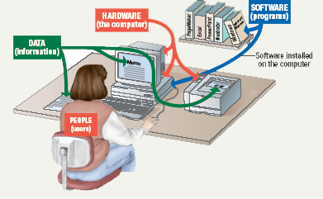
Parts of the Computer System
Building Blocks of computer system
  Data (information)
  User
  Hardware
  Software

Slide 16
Parts of the Computer System
Data
  Pieces of facts
  Computer organize and present information
Users
  People operating the computer
  Computer working for the people
  Users are most important part of the computers
  Tell the computer what to do
Notes:
Teaching tip
A good exercise to relate the importance of making data meaningful is to list some random numbers on the board. Then ask what they mean. Without a title, the numbers have no meaning. Once a title is presented, the numbers make sense.

Slide 17
HARDWARE
  Physical Components of the Computer.
  TANGIBLE (can be touched)
SOFTWARE
  Step-by-step instructions to perform the task.
  Also called a program
  INTANGIBLE (cannot be touched)
  Programs and software interchangeable terms

Slide 18
HARDWARE :
Major components of a Computer
INPUT DEVICES
OUTPUT DEVICES
CPU
MEMORY
STORAGE DEVICES

Slide 19
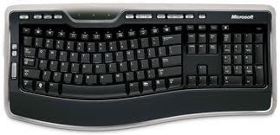
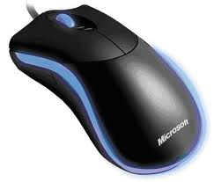
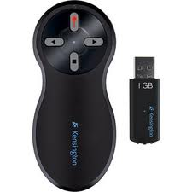
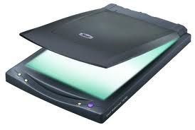
HARDWARE:
INPUT DEVICES
These devices allow the user to enter the data into the computer.
These devices are;
Keyboard
Mouse
Scanner
Pointer

Slide 20
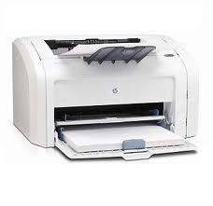
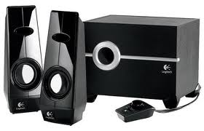
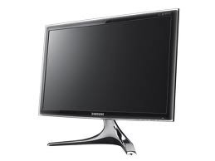
HARDWARE:
OUTPUT DEVICES
Consist of devices that translate information processed by the computer into human understandable format.
These devices are:
Printer
Monitor
Speaker

Slide 21
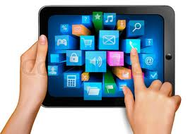
HARDWARE:
I/O DEVICES
Some devices are both input as well as output devices.
Can perform I/O simultaneously.
Touchpad Screens

Slide 22
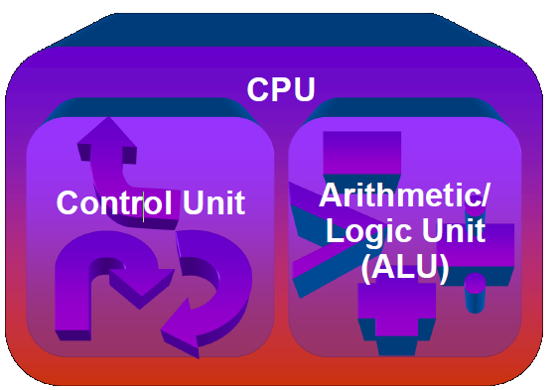
HARDWARE :
CPU; Central Processing Unit
Brain of the computer.
Two parts are:
  ALU
  CU

Slide 23

HARDWARE :
CPU; CONTROL UNIT
Directs and coordinates flow of data through the CPU and to and from other devices
Traffic cop
CPU’s Instruction set is built into the Control unit called Commands that a CPU can execute

Slide 24
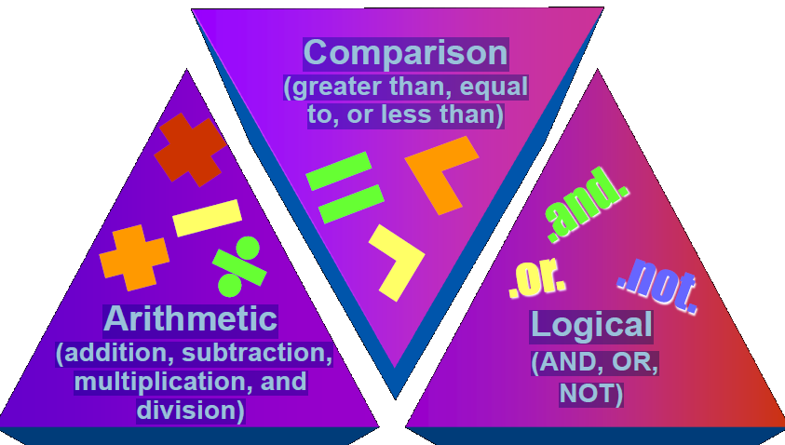
HARDWARE :
CPU; ALU
Arithmetic Logic Unit

Slide 25
HARDWARE:
MEMORY
Two categories of Memory
Volatile Memory
  Loses its contents when the computer's power is turned off
Non-volatile Memory
  Does not lose its contents when the computer’s power is turned off

Slide 26
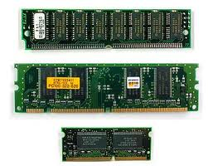
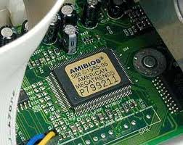
HARDWARE:
MEMORY
Stores Data or programs
(workspace or archiving/storage space)
RAM: Random Access Memory (Volatile)
Stores current Data and programs
More RAM results in a faster system
ROM: Read Only Memory (non-volatile)
Permanent storage of programs/instructions
Holds the computer boot directions

Slide 27
HARDWARE:
Memory; CPU Registers (Part of ALU)
High speed memory locations built directly into the CPU
Temporary storage location used by the CPU (Scratchpad)
Used to hold data currently being processed
Results of the calculations
Very expensive that’s why very limited.

Slide 28
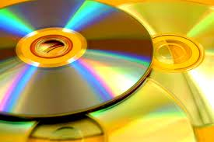
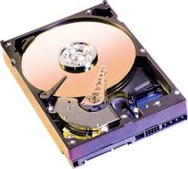
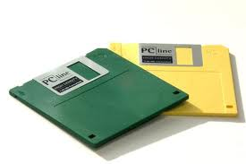
HARDWARE:
STORAGE DEVICES
Hold data and programs permanently
Different from RAM
Magnetic storage; Uses a magnet to access data
(Floppy and hard drive, USB drives)
Optical storage; Uses a laser to access data
(CD and DVD drives )

Slide 29
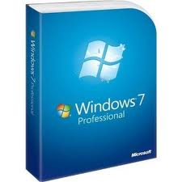

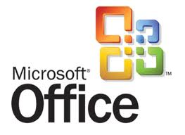

TYPES OF SOFTWARE
SYSTEM SOFTWARE
Enables the application to interact with the computer and manages the computer internal resources.
Examples:
  Operating System
  Device Drivers
APPLICATION SOFTWARE
It performs useful work on General-purpose task.
Examples:
  MS-Word
  PowerPoint
  Google(search engine)

Slide 30

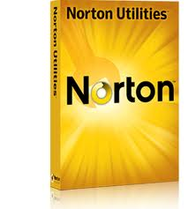
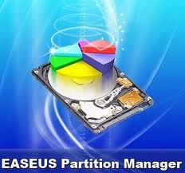
Utility Programs
Utility Programs provide services not provided by the system software.
Usually used to recover the system, data or resources.
Examples:
  Screen savers
  Data recovery
  Backup
  Virus protection
  Norton utilities

Slide 31
How CPU works?
Four basic operations:
Fetch: obtain a program instruction or data item from memory.
Decode: translate the instruction into commands.
Execute: carry out the command.
Store: write the result into the memory

Slide 32
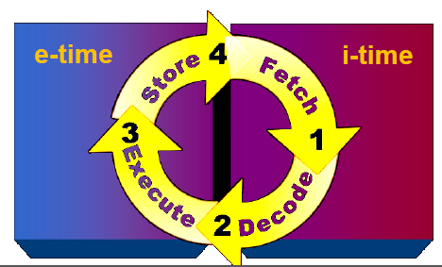
Machine Cycle
A Machine Cycle comprises i-time and e-time:
Instruction time or i–time
  to fetch and decode
Execution time or e–time
  to execute and store the
  result

Slide 33
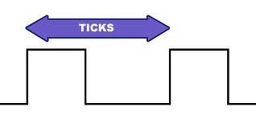
How CPU Synchronizes?
Through System Clock
System Clock Synchronizes all computer operations
Train of binary pulses
Faster clock speed means the CPU can
execute more instructions each second
Units: MHz and GHz
Hz = cycles per second

Slide 34
Types of Computers
1. Supercomputers
2. Mainframes
3. Minicomputers
4. Microcontrollers

Slide 35
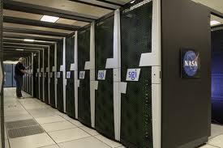
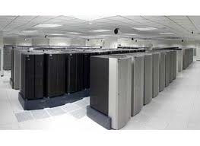
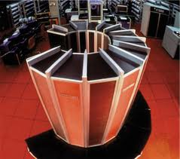
Supercomputer
Most powerful computers
Physically largest in size
Hundreds of thousands of processors that can process huge amounts of data
Perform over 1 quadrillion calculations per second. e.g. IBM ASCI White, Cray
Ideal for handling large and highly complex problems that require extreme calculating power

Slide 36
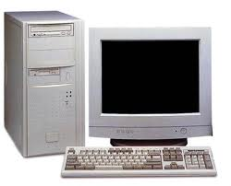
Mainframe
Mainly used by large organizations for critical applications, typically bulk data processing
  Banks, Airlines, Insurance Companies
Measured in millions of integer operations per second (MIPS)
Vary in size from small, to medium, to large, depending on their use.
Normally Dumb Terminals are connected to these main frames. Processing is done by Main Frames.
Dumb terminals only have keyboard, monitors.

Slide 37
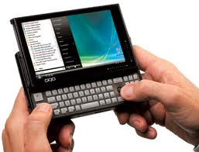
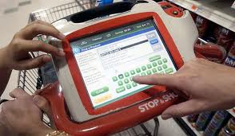
Minicomputers
• Class of multi-user computers that lies in between mainframe computers (multi user) and microcomputers or personal computers (single user)
• Midrange computer, such as the higher-end SPARC, POWER and Itanium-based systems from Sun Microsystems, IBM and Hewlett-Packard.

Slide 38
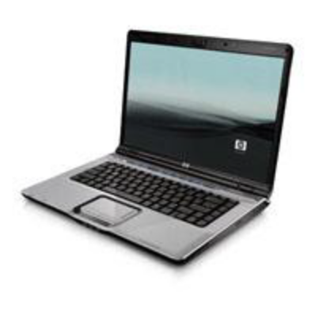
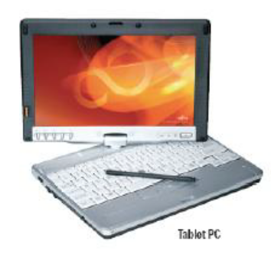
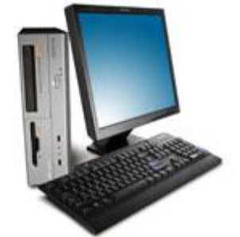
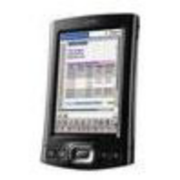
Computers for individuals -PCs
Microcomputers
  – Workstation
  – Desktop computers
  – Notebook computers
  – Tablet computers
  – Handheld computers
  – Smart phones

Slide 39
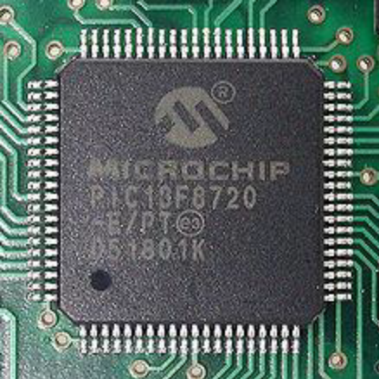
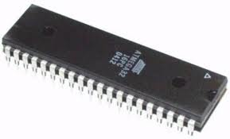
Microcontroller
Embedded computers are small in size, specialized microprocessors
Designed for small or dedicated applications
Installed in "smart" appliances from automobiles to washing machines

Slide 40
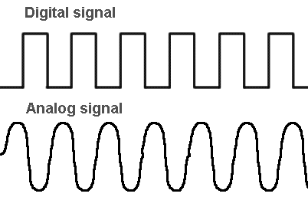
What is IT?
Base of the Computer was/is:
digital signal;
Base of Communication devices
was analog signal transferred to digital signal
The day Communication changed its base from analog to digital; There was natural merger of the two technologies
Computer and Communication
The following industries also joined : Mass storage, Consumer Electronics, Entertainment, Multimedia
The Name given to the family
Information Technology : IT

Slide 41
Practice Quiz
What is the difference between data and Information?
What is the difference between volatile and non-volatile memory?
Memory is used for?
What does computer do in i-time and e-time?
How CPU synchronizes with its other components?
Name a device which is both input and output?
Give few examples of utility software.
Name at least two operating systems (OS).
What is the use of embedded systems?
What is Information Technology?

