Slide 1
Algorithms and Data Structures
(CSC112)

Slide 2
Review
List Using Array
Representation of Linear Array In Memory
Operations on linear Arrays
  Traverse
  Insert
  Delete
Example

Slide 3
Introduction
Suppose we wish to arrange the percentage marks obtained by 100 students in ascending order
In such a case we have two options to store these marks in memory:
  (a) Construct 100 variables to store percentage marks obtained by 100 different students, i.e. each variable containing one student’s marks
  (b) Construct one variable (called array or subscripted variable) capable of storing or holding all the hundred values

Slide 4
Obviously, the second alternative is better. A simple reason for this is, it would be much easier to handle one variable than handling 100 different variables
Moreover, there are certain logics that cannot be dealt with, without the use of an array
Based on the above facts, we can define array as:
  “A collective name given to a group of ‘similar quantities’”

Slide 5
These similar quantities could be percentage marks of 100 students, or salaries of 300 employees, or ages of 50 employees
What is important is that the quantities must be ‘similar’
These similar elements could be all int, or all float, or all char
Each member in the group is referred to by its position in the group

Slide 6
For Example
Assume the following group of numbers, which represent percentage marks obtained by five students
per = { 48, 88, 34, 23, 96 }
In C, the fourth number is referred as per[3]
Because in C the counting of elements begins with 0 and not with 1
Thus, in this example per[3] refers to 23 and per[4] refers to 96
In general, the notation would be per[i], where, i can take a value 0, 1, 2, 3, or 4, depending on the position of the element being referred

Slide 7
Operations on linear Arrays
A linear array is a list of a finite number n of homogenous data elements (data elements of the same type)
  Traversal: Processing each element in the list
  Search: Finding the location of the element with a given value or the record with a given key
  Insertion: Adding a new element from the list
  Sorting: Arranging the elements in some type of order
  Merging: Combining two lists into a single list

Slide 8
Stack
Introduction
Stack in our life
Stack Operations
Stack Implementation
  Stack Using Array
  Stack Using Linked List
Use of Stack

Slide 9
Introduction
A Stack is an ordered collection of items into which new data items may be added/inserted and from which items may be deleted at only one end
A Stack is a container that implements the Last-In-First-Out (LIFO) protocol

Slide 10
Stack in Our Life
Stacks in real life: stack of books, stack of plates
Add new items at the top
Remove an item from the top
Stack data structure similar to real life: collection of elements arranged in a linear order.
Can only access element at the top

Slide 11
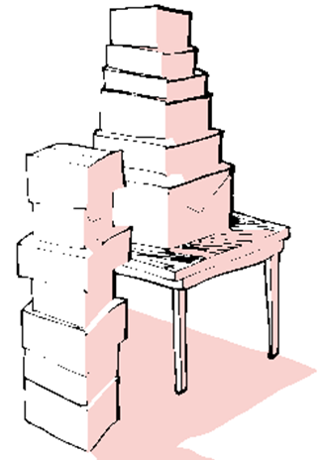

Slide 12
Stack Operations
Push(X) – insert X as the top element of the stack
Pop() – remove the top element of the stack and return it.
Top() – return the top element without removing it from the stack.
Notes:
A primary concern for this course is efficiency.
You might believe that faster computers make it unnecessary to be concerned with efficiency. However…
So we need special training.

Slide 13
Polish Notation
  Prefix
  Infix
  Postfix
Precedence of Operators
Converting Infix to Postfix
Evaluating Postfix

Slide 14
Prefix, Infix, Postfix
Two other ways of writing the expression are
+ A B prefix (Polish Notation)
A B + postfix (Reverse Polish Notation)
The prefixes “pre” and “post” refer to the position of the operator with respect to the two operands.
Notes:
A primary concern for this course is efficiency.
You might believe that faster computers make it unnecessary to be concerned with efficiency. However…
So we need special training.

Slide 15
Prefix, Infix, Postfix
Consider the infix expression
A + B * C
We “know” that multiplication is done before addition.
The expression is interpreted as
A + ( B * C )
Multiplication has precedence over addition.
Notes:
A primary concern for this course is efficiency.
You might believe that faster computers make it unnecessary to be concerned with efficiency. However…
So we need special training.

Slide 16
Precedence of Operators
The five binary operators are: addition, subtraction, multiplication, division and exponentiation.
The order of precedence is (highest to lowest)
Exponentiation ↑
Multiplication/division *, /
Addition/subtraction +, -
Notes:
A primary concern for this course is efficiency.
You might believe that faster computers make it unnecessary to be concerned with efficiency. However…
So we need special training.

Slide 17
Precedence of Operators
For operators of same precedence, the left-to-right rule applies:
A+B+C means (A+B)+C.
For exponentiation, the right-to-left rule applies
A ↑ B ↑ C means A ↑ ( B ↑ C )
Notes:
A primary concern for this course is efficiency.
You might believe that faster computers make it unnecessary to be concerned with efficiency. However…
So we need special training.

Slide 18
Polish Notation
Converting Infix to Postfix
Converting Postfix to Infix
Converting Infix to Prefix
Examples

Slide 19
Linked Lists
Introduction
Insertion Description
Deletion Description
Basic Node Implementation
Conclusion

Slide 20
Introduction
Definitions
  Lists and arrays
  Nodes and pointers
  Single Linked Lists
  Double Linked Lists
  Circular Lists
Advantages

Slide 21
Linked List Traversal
Inserting into a linked list involves two steps:
  Find the correct location
  Do the work to insert the new value
We can insert into any position
  Front
  End
  Somewhere in the middle
  (to preserve order)

Slide 22
Linked List Traversal
Traversal means “visiting” or examining each node.
Simple linked list
  Start at the beginning
  Go one node at a time until the end
Recursive procedure (or function)
  Given a head pointer
  Looks at just one node
  What procedure will look at the rest?

Slide 23
Inserting to the Front
head
93
48
17
142
head
There is no work to find the correct location
Empty or not, head will point to the right location

Slide 24
Inserting to the End
head
48
17
142
//
93
//
Find the end of the list
(when at NIL)
  Recursion or iteration

Slide 25
Inserting to the Middle
head
17
48
142
//
//
93
142
Used when order is important
Go to the node that should follow the one to add
  Recursion or iteration

Slide 26
Deleting an Element from a Linked List
Deletion involves:
  Getting to the correct position
  Moving a pointer so nothing points to the element to be deleted
Can delete from any location
  Front
  First occurrence
  All occurrences

Slide 27
Singly link list
All the nodes in a singly linked list are arranged sequentially by linking with a pointer.
A singly linked list can grow or shrink, because it is a dynamic data structure.

Slide 28
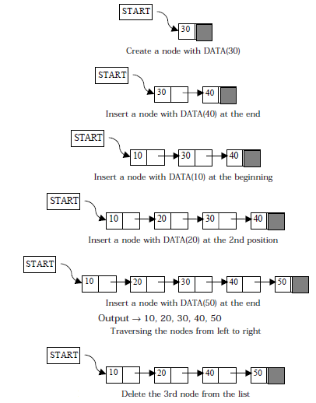

figure explains the different
operations on a singly linked list.

Slide 29

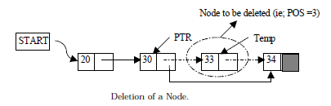
Insertion and Deletion

Slide 30
Singly Link list
Learn about linked lists
Become aware of the basic properties of linked lists
Explore the insertion and deletion operations on linked lists
Discover how to build and manipulate a linked list

Slide 31
Linked List as an ADT
The basic operations on linked lists are:
  Initialize the list
  Determine whether the list is empty
  Print the list
  Find the length of the list
  Destroy the list

Slide 32
Linked List as an ADT (cont'd.)
  Retrieve the info contained in the first node
  Retrieve the info contained in the last node
  Search the list for a given item
  Insert an item in the list
  Delete an item from the list
  Make a copy of the linked list

Slide 33
Doubly linked lists
Doubly linked lists
Become aware of the basic properties of doubly linked lists
Explore the insertion and deletion operations on doubly linked lists
Discover how to build and manipulate a doubly linked list
Learn about circular linked list

Slide 34
WHY DOUBLY LINKED LIST
The only way to find the specific node that precedes p is to start at the beginning of the list.
The same problem arias when one wishes to delete an arbitrary node from a singly linked list.
If we have a problem in which moving in either direction is often necessary, then it is useful to have doubly linked lists.
Each node now has two link data members,
  One linking in the forward direction
  One in the backward direction

Slide 35

Introduction
A doubly linked list is one in which all nodes are linked together by multiple links
which help in accessing both the successor (next) and predecessor (previous) node for any arbitrary node within the list.
Every nodes in the doubly linked list has three fields:
  LeftPointer
  RightPointer
  DATA.

Slide 36
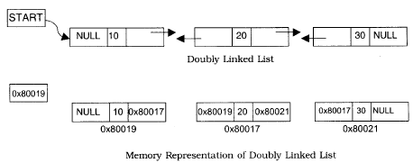
Cont…..
LPoint will point to the node in the left side (or previous node) that is LPoint will hold the address of the previous node.
RPoint will point to the node in the right side (or next node) that is RPoint will hold the address of the next node.
Data will hold the information of the node.

Slide 37
REPRESENTATION OF DOUBLY LINKED LIST
A node in the doubly linked list can be represented in memory with the following declaration.
Struct Node
{
int Data;
struct Node *next;
struct Node *prev;
};

Slide 38
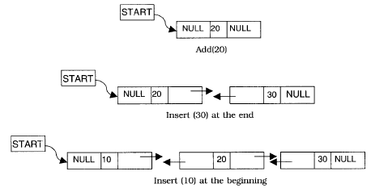

INSERTION AND DELETION OF NODES

Slide 39
Doubly-Linked Lists
It is a way of going both directions in a linked list, forward and reverse.
Many applications require a quick access to the predecessor node of some node in list.

Slide 40
Advantages over Singly-linked Lists
Quick update operations:
such as: insertions, deletions at both ends (head and tail), and also at the middle of the list.
A node in a doubly-linked list store two references:
  A next link; that points to the next node in the list, and
  A prev link; that points to the previous node in the list.

Slide 41
Queue
Queue
Operations on Queues
A Dequeue Operation
An Enqueue Operation
Array Implementation
Link list Implementation
Examples

Slide 42
INTRODUCTION
A queue is logically a first in first out (FIFO or first come first serve) linear data structure.
It is a homogeneous collection of elements in which new elements are added at one end called rear, and the existing elements are deleted from other end called front.
The basic operations that can be performed on queue are
  1. Insert (or add) an element to the queue (push)
  2. Delete (or remove) an element from a queue (pop)
Push operation will insert (or add) an element to queue, at the rear end, by incrementing the array index.
Pop operation will delete (or remove) from the front end by
decrementing the array index and will assign the deleted value to a variable.

Slide 43
A Graphic Model of a Queue
Head:
All items are
deleted from
this end
Tail:
All new items
are added on
this end

Slide 44
Operations on Queues
Insert(item): (also called enqueue)
  It adds a new item to the tail of the queue
Remove( ): (also called delete or dequeue)
  It deletes the head item of the queue, and returns to the caller. If the queue is already empty, this operation returns NULL
getHead( ):
  Returns the value in the head element of the queue
getTail( ):
  Returns the value in the tail element of the queue
isEmpty( )
  Returns true if the queue has no items
size( )
  Returns the number of items in the queue

Slide 45
Examples of Queues
An electronic mailbox is a queue
  The ordering is chronological (by arrival time)
A waiting line in a store, at a service counter, on a one-lane road
Equal-priority processes waiting to run on a processor in a computer system

Slide 46
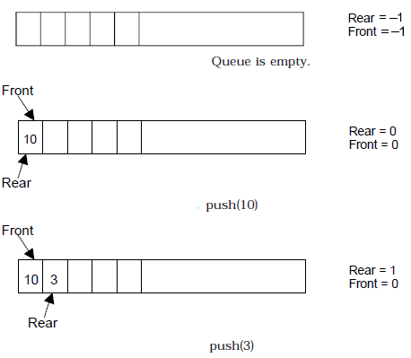
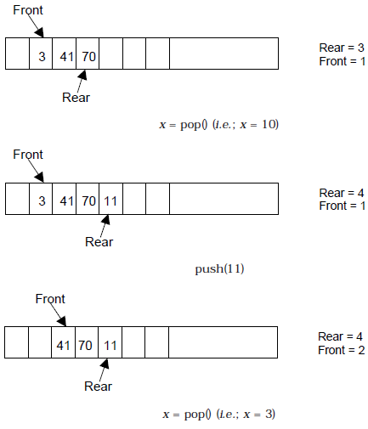
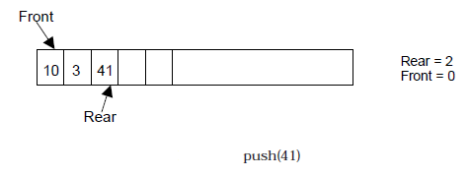
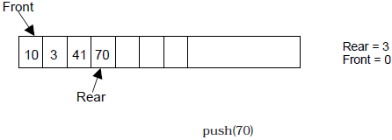
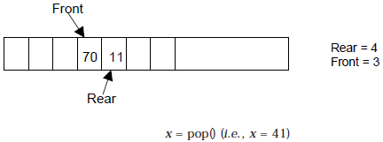
BASIC OPERATIONS ON QUEUE

Slide 47
Different type of queue
Circular queue
Double Ended Queue
Priority queue

Slide 48
Circular queue
Let we have an array named Q, that contains n element in which Q[1] comes after Q[n] in the array.
When this technique is used to construct a queue is called circular queue.
In other word we can say that a queue is called circular when the last room comes just before the first room.

Slide 49
Circular queue….
Q[n]
Q[1]
Q[n-1]
Q[2]
.
Q[3]
.
.

Slide 50
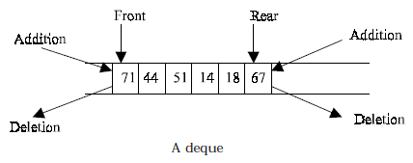
DEQUES
A deque is a homogeneous list in which elements can be added or inserted and deleted or removed from both the ends.
  We can add a new element at the rear or front end and also we can remove an element from both front and rear end.
Hence it is called Double Ended Queue.

Slide 51
Cont….
There are two types of deque depending upon the restriction to perform insertion or deletion operations at the two ends.
  1. Input restricted deque
  2. Output restricted deque
An input restricted deque
  is a deque, which allows insertion at only 1 end, rear end,
  but allows deletion at both ends, rear and front end of the lists.
An output-restricted deque
  is a deque, which allows deletion at only one end, front end,
  but allows insertion at both ends, rear and front ends, of the lists.

Slide 52
The possible operation performed on deque
  1. Add an element at the rear end
  2. Add an element at the front end
  3. Delete an element from the front end
  4. Delete an element from the rear end
Only 1st, 3rd and 4th operations are performed by input-restricted deque
1st, 2nd and 3rd operations are performed by output-restricted deque.

Slide 53
PRIORITY QUEUES
The priority queue is a data structure in which intrinsic ordering of the elements determines the results of its basic operations.
An ascending priority queue is a collection of items into which items can be inserted arbitrarily and from which only the smallest item can be removed. On the other hand a descending priority queue allows only the largest item to be removed.

Slide 54
Priority QUEUE Operations
Insertion
  The insertion in Priority queues is the same as in non-priority queues.
Deletion
  Deletion requires a search for the element of highest priority and deletes the element with highest priority. The following methods can be used for deletion/removal from a given Priority Queue:
    An empty indicator replaces deleted elements.
    After each deletion elements can be moved up in the array decrementing the rear.
    The array in the queue can be maintained as an ordered circular array

Slide 55
Priority Queue Declaration
Queue data type of Priority Queue is the same as the Non-priority Queue.
#define MAXQUEUE 10 /* size of the queue items*/
typedef struct {
int front, rear;
int items[MAXQUEUE];
}QUEUE;

Slide 56
Trees
Binary Tree
Binary Tree Representation
  Array Representation
  Link List Representation
Operations on Binary Trees
Traversing Binary Trees
  Pre-Order Traversal Recursively
  In-Order Traversal Recursively
  Post-Order Traversal Recursively

Slide 57
Trees
Trees are very flexible, versatile and powerful non-liner data structure
It can be used to represent data items possessing hierarchical relationship
A tree can be theoretically defined as a finite set of one or more data items (or nodes) such that
  There is a special node called the root of the tree
  Remaining nodes (or data item) are partitioned into number of subsets each of which is itself a tree, are called sub tree
A tree is a set of related interconnected nodes in a hierarchical structure

Slide 58
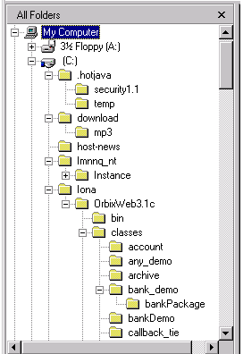
Trees
Where have you seen a tree structure before?
Examples of trees:
- Directory tree
- Family tree
- Company organization chart
- Table of contents
- etc.

Slide 59
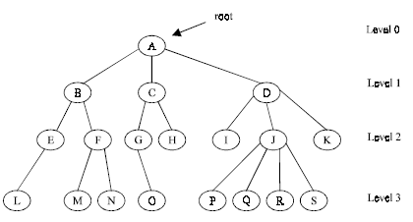
Basic Terminologies
Root is a specially designed node (or data items) in a tree
It is the first node in the hierarchical arrangement of the data items
For example,
Figure 1. A Tree

Slide 60
In this example ‘A’ is the root node
Each data item in a tree is known as node
It specifies the data information and links to other data items
Degree of a node
Degree of a node is the number of subtrees of a node in a given tree
In the above example
  the degree of node A is 3
  the degree of node B is 2
  the degree of node C is 2
  the degree of node D is 3

Slide 61
The Degree of a Tree
The degree of a tree is the maximum degree of node in a given tree
The degree of node J is 4
All other nodes have less or equal degree
So the degree of the above tree is 4
A node with degree zero (0) is called terminal node or a leaf
In the above example, nodes M,N,I,O etc are leaf nodes
Any node whose degree is not zero is called a non-terminal node

Slide 62
Levels of a Tree
The tree is structured in different levels
The entire tree is leveled in such a way that the root node is always of level 0
Its immediate children are at level 1 and their immediate children are at level 2 and so on up to the terminal nodes
If a node is at level n then its children will be at level n+1

Slide 63
Depth of a Tree
Depth of a tree is the maximum level of any node in a given tree
The number of levels from root to the leaves is called depth of a tree
The term height is also used to denote the depth of a tree

Slide 64
A vertex (or node) is a simple object that can have a name and can carry other associated information
An edge is a connection between two vertices
A path in a tree is a list of distinct vertices in which successive vertices are connected by edges in the tree
  example: {a, b, d, i } is path
The defining property of a tree is that there is precisely one path connecting any two nodes

Slide 65
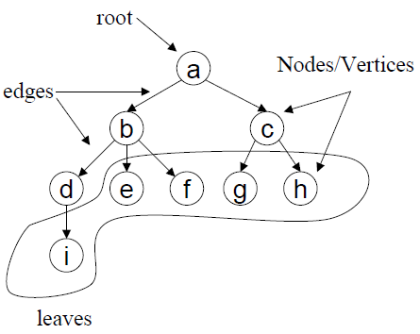
Example of a Tree

Slide 66
Binary Trees
A binary tree is a tree in which no node can have more than 2 children
These children are described as “left child” and “right child” of the parent node
A binary tree T is defined as a finite set of elements called nodes such that
  T is empty if T has no nodes called the null or empty tree
  T contains a special node R, called root node of T and the remaining nodes of T form an ordered pair of disjoined binary trees T1 and T2. They are called left and right sub tree of R

Slide 67
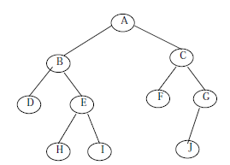
Consider the following binary tree T
Here ‘A’ is the root node of the tree
‘B’ is the left child of ‘A’ and ‘C’ is the right child of ‘A’
i.e. ‘A’ is the father of ‘B’ and ‘C’
The nodes ‘B’ and ‘C’ are called brothers

Slide 68
Strictly Binary Tree
The tree is said to be strictly binary tree, if every non-leaf node in a binary tree has non-empty left and right sub trees
A strictly binary tree with n level always contains 2^{n}–1 nodes
Every node in the strictly binary tree can have either no children or two children
They are also called 2-tree or extended binary tree

Slide 69
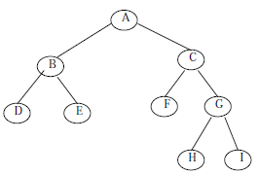
Example of a strictly binary tree

Slide 70
Operations on Binary Trees
The basic operations that are commonly performed on binary trees are listed below:
  Create an empty binary tree
  Traversing a binary tree
  Inserting a new node
  Deleting a Node
  Searching for a Node
  Determine the total no. of Nodes
  Determine the total no. of leaf Nodes
  Determine the total no. of non-leaf Nodes
  Find the smallest element in the tree
  Finding the largest element
  Find the Height of the tree
  Finding the Father/Left Child/Right Child/Brother of an arbitrary node

Slide 71
Graphs
Graph
Directed Graph
Undirected Graph
Sub-Graph
Spanning Sub-Graph
Degree of a Vertex
Weighted Graph
Elementary and Simple Path
Link List Representation

Slide 72
Introduction
A graph G consist of
1. Set of vertices V (called nodes), V = {v1, v2, v3, v4......} and
2. Set of edges E={e1, e2, e3......}
A graph can be represented as G = (V, E), where V is a finite and non empty set of vertices and E is a set of pairs of vertices called edges
Each edge ‘e’ in E is identified with a unique pair (a, b) of nodes in V, denoted by e = {a, b}

Slide 73
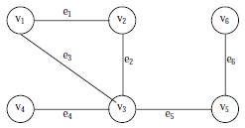
Consider the following graph, G
Then the vertex V and edge E can be represented as:
V = {v1, v2, v3, v4, v5, v6} and E = {e1, e2, e3, e4, e5, e6}
E = {(v1, v2) (v2, v3) (v1, v3) (v3, v4),(v3, v5) (v5, v6)}
There are six edges and vertex in the graph

Slide 74
Directed Graph
A graph can be a
  Directed Graph
  Undirected/Simple Graph
A directed graph G is defined as an ordered pair (V, E) where, V is a set of vertices and the ordered pairs in E are called edges on V
A directed graph can be represented geometrically as a set of marked points (called vertices) V with a set of arrows (called edges) E between pairs of points (or vertex or nodes) so that there is at most one arrow from one vertex to another vertex

Slide 75
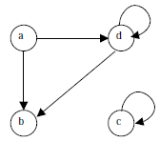
For example, following figure shows a directed graph, where G ={a, b, c, d }, E={(a, b), (a, d), (d, b), (d, d), (c, c)}
An edge (a, b), is said to be the incident with the vertices it joints, i.e., a, b
We can also say that the edge (a, b) is incident from a to b
The vertex a is called the initial vertex and the vertex b is called the terminal vertex of the edge (a, b)

Slide 76
If an edge that is incident from and into the same vertex, say (d, d) or (c, c) in figure, is called a loop
Two vertices are said to be adjacent if they are joined by an edge
Consider edge (a, b), the vertex a is said to be adjacent to the vertex b, and the vertex b is said to be adjacent to vertex a
A vertex is said to be an isolated vertex if there is no edge incident with it
In this figure vertex C is an isolated vertex

Slide 77
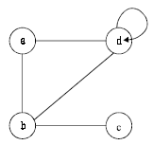
Undirected Graph
An undirected graph G is defined abstractly as an ordered pair (V, E), where V is a set of vertices and the E is a set at edges
An undirected graph can be represented geometrically as a set of marked points (called vertices) V with a set of lines (called edges) E between the points
An undirected graph G is shown in the following figure

Slide 78


Sub-Graph
Let G = (V, E) be a graph
A graph G1 = (V1, E1) is said to be a sub-graph of G if E1 is a subset of E and V1 is a subset of V such that the edges in E1 are incident only with the vertices in V1
For example, Fig.(b) is a sub-graph of Fig. (a)
Fig (a)
Fig (a)

Slide 79

Spanning Sub-Graph
A sub-graph of G is said to be a spanning sub-graph if it contains all the vertices of G
For example Fig.(c) shows a spanning sub-graph of Fig.(a).
Fig (a)
Fig (a)

Slide 80
Degree of a Vertex
The number of edges incident on a vertex is its degree
The degree of vertex a, is written as degree (a)
If the degree of vertex a is zero, then vertex a is called isolated vertex
For example the degree of the vertex a in following figure is 3

Slide 81
Weighted Graph
A graph G is said to be weighted graph if every edge and/or vertices in the graph is assigned with some weight or value
A weighted graph can be defined as G = (V, E, We, Wv) where V is the set of vertices, E is the set of edges and We is a weight of the edges whose domain is E and Wv is a weight of the vertices whose domain is V

Slide 82
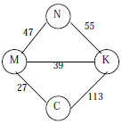
Consider the following figure
Here V = {N, K, M, C,} E = {(N, K), (N,M,), (M,K), (M,C), (K,C)} We = {55,47, 39, 27, 113} and Wv = {N, K, M, C}
The weight of the vertices is not necessary as the set Wv and V are same

Slide 83
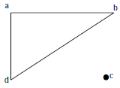
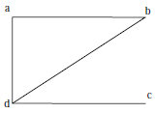
Connected and Disconnected Graphs
An undirected graph is said to be connected if there exist a path from any vertex to any other vertex
Otherwise it is said to be disconnected
Fig. A shows the disconnected graph, where the vertex c is not connected to the graph
Fig. B shows the connected graph, where all the vertexes are connected

Slide 84
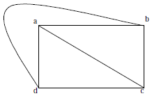
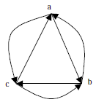
Complete Graph
A graph G is said to complete (or fully connected or strongly connected) if there is a path from every vertex to every other vertex
Let a and b are two vertices in the directed graph, then it is a complete graph if there is a path from a to b as well as a path from b to a
Fig X illustrates the complete undirected graph
Fig Y shows the complete directed graph
Fig X
Fig Y

Slide 85
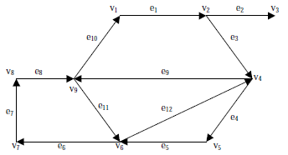
Elementary and Simple Path
In a directed graph, a path is a sequence of edges (e1, e2, e3, ...... en) such that the edges are connected with each other
A path is said to be elementary if it does not meet the same vertex twice
A path is said to be simple if it does not meet the same edges twice
Consider a graph in Fig.

Slide 86
Representation of Graphs
Graph is a mathematical structure
The problems related to graph G must be represented in computer memory using any suitable data structure to solve it
There are two standard ways of maintaining a graph G in the memory of a computer
1. Sequential representation of a graph using adjacent
2. Linked representation of a graph using linked list

Slide 87
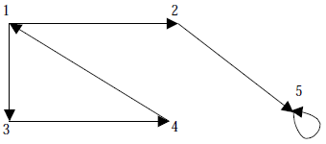
Adjacency Matrix Representation
The adjacency of a graph G = (V, E) with n vertices, is an n × n matrix
To represent it, considered a directed graph in following figure where all the vertices are numbered, (1, 2, 3, 4, 5)

Slide 88
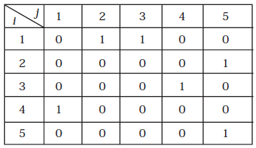
The adjacency matrix A of a directed graph G = (V, E) can be represented with the following conditions:
  Aij = 1 {if there is an edge from Vi to Vj or if the edge (i, j) is member of E.}
  Aij = 0 {if there is no edge from Vi to Vj}

Slide 89
Linked List Representation
It is also called Adjacency List Representation
In this representation we store a graph as a linked structure
First we store all the vertices of the graph in a list and then each adjacent vertices will be represented using linked list node

Slide 90
Traversing a Graph
Breadth First Search (BFS)
Depth First Search (DFS)

Slide 91
Traversing a Graph
Many application of graph requires a structured system to examine the vertices and edges of a graph G
That is a graph traversal, which means visiting all the nodes of the graph
There are two graph traversal methods
(a) Breadth First Search (BFS)
  Think Queue
(b) Depth First Search (DFS)
  Think Stack

Slide 92
Overview
Goal
  To systematically visit the nodes of a graph
A tree is a directed, acyclic, graph (DAG)
If the graph is a tree,
  DFS is exhibited by preorder, postorder, and (for binary trees) inorder traversals
  BFS is exhibited by level-order traversal

Slide 93
Hashing
  Hash Function
  Properties of Hash Function
  Division Method
  Mid-Square Method
  Folding Method
  Hash Collision
    Open addressing
    Chaining
    Bucket addressing

Slide 94
Introduction
The searching time of each searching technique depends on the comparison. i.e., n comparisons required for an array A with n elements
To increase the efficiency, i.e., to reduce the searching time, we need to avoid unnecessary comparisons
Hashing is a technique where we can compute the location of the desired record in order to retrieve it in a single access (or comparison)
Let there is a table of n employee records and each employee record is defined by a unique employee code, which is a key to the record and employee name
If the key (or employee code) is used as the array index, then the record can be accessed by the key directly

Slide 95
If L is the memory location where each record is related with the key
If we can locate the memory address of a record from the key then the desired record can be retrieved in a single access
For notational and coding convenience, we assume that the keys in k and the address in L are (decimal) integers
So the location is selected by applying a function which is called hash function or hashing function from the key k
Unfortunately such a function H may not yield different values (or index); it is possible that two different keys k1 and k2 will yield the same hash address
This situation is called Hash Collision, which is discussed later

Slide 96
Hash Function
The basic idea of hash function is the transformation of the key into the corresponding location in the hash table
A Hash function H can be defined as a function that takes key as input and transforms it into a hash table index

Slide 97
Properties of Hash Function
A good hash function should:
Minimize collisions
Be easy and quick to compute
Distribute key values evenly in the hash table
Use all the information provided in the key

Slide 98
Following are the most popular hash functions :
1. Division method
2. Mid Square method
3. Folding method

Slide 99
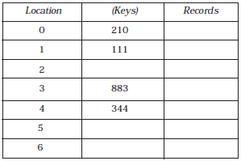

Hash Collision
It is possible that two non-identical keys K1, K2 are hashed into the same hash address
This situation is called Hash Collision
Let us consider a hash table having 10 locations as shown in Figure

Slide 100
Division method is used to hash the key
H(k) = k (mod m)
Here m is chosen as 10
The Hash function produces any integer between 0 and 9, depending on the value of the key
If we want to insert a new record with key 500 then
H(500) = 500(mod 10) = 0
The location 0 in the table is already filled (i.e., not empty)
Thus collision occurred

Slide 101
Collisions are almost impossible to avoid but it can be minimized considerably by introducing any one of the following three techniques:
1. Open addressing
2. Chaining
3. Bucket addressing

