Slide 1
Algorithms and Data Structures
(CSC112)

Slide 2
Review
Introduction to Algorithms and Data Structures
Static Data Structures
  Searching Algorithms
  Sorting Algorithms
  List implementation through Array
  ADT: Stack
  ADT: Queue
Dynamic Data Structures (Linear)
  Linked List (Linear Data Structure)
Dynamic Data Structures (Non-Linear)
  Trees, Heap, Hashing, Graphs

Slide 3
Algorithm Analysis
Problem Solving
Space Complexity
Time Complexity
Classifying Functions by Their Asymptotic Growth

Slide 4
Problem Solving: Main Steps
Problem definition
Algorithm design / Algorithm specification
Algorithm analysis
Implementation
Testing
Maintenance

Slide 5
1. Problem Definition
What is the task to be accomplished?
  Calculate the average of the grades for a given student
  Find the largest number in a list
What are the time /space performance requirements ?

Slide 6
2. Algorithm Design/Specifications
Algorithm: Finite set of instructions that, if followed, accomplishes a particular task.
Describe: in natural language / pseudo-code / diagrams / etc.
Criteria to follow:
  Input: Zero or more quantities (externally produced)
  Output: One or more quantities
  Definiteness: Clarity, precision of each instruction
  Effectiveness: Each instruction has to be basic enough and feasible
  Finiteness: The algorithm has to stop after a finite (may be very large) number of steps

Slide 7
4,5,6: Implementation, Testing and Maintenance
Implementation
  Decide on the programming language to use
    C, C++, Python, Java, Perl, etc.
  Write clean, well documented code
Test, test, test
Integrate feedback from users, fix bugs, ensure compatibility across different versions → Maintenance

Slide 8
3. Algorithm Analysis
Space complexity
  How much space is required
Time complexity
  How much time does it take to run the algorithm

Slide 9
Space Complexity
Space complexity = The amount of memory required by an algorithm to run to completion
  the most often encountered cause is “memory leaks” – the amount of memory required larger than the memory available on a given system
Some algorithms may be more efficient if data completely loaded into memory
  Need to look also at system limitations
  e.g. Classify 2GB of text in various categories – can I afford to load the entire collection?

Slide 10
Space Complexity (cont…)
Fixed part: The size required to store certain data/variables, that is independent of the size of the problem:
  - e.g. name of the data collection
Variable part: Space needed by variables, whose size is dependent on the size of the problem:
  - e.g. actual text
  - load 2GB of text VS. load 1MB of text

Slide 11
Time Complexity
Often more important than space complexity
  space available tends to be larger and larger
  time is still a problem for all of us
3-4GHz processors on the market
  still …
  researchers estimate that the computation of various transformations for 1 single DNA chain for one single protein on 1 TerraHZ computer would take about 1 year to run to completion
Algorithms running time is an important issue

Slide 12
Pseudo Code and Flow Charts
Pseudo Code
Basic elements of Pseudo code
Basic operations of Pseudo code
Flow Chart
Symbols used in flow charts
Examples

Slide 13
Pseudo Code and Flow Charts
There are two commonly used tools to help to document program logic (the algorithm).
These are
  Flowcharts
  Pseudocode.
Generally, flowcharts work well for small problems but Pseudocode is used for larger problems.

Slide 14
Pseudo-Code
Pseudo-Code is simply a numbered list of instructions to perform some task.

Slide 15
Writing Pseudo Code
Number each instruction
    This is to enforce the notion of an ordered sequence of operations
    Furthermore we introduce a dot notation (e.g. 3.1 come after 3 but before 4) to number subordinate operations for conditional and iterative operations
Each instruction should be unambiguous and effective.
Completeness. Nothing is left out.

Slide 16
Pseudo-code
Statements are written in simple English without regard to the final programming language.
Each instruction is written on a separate line.
The pseudo-code is the program-like statements written for human readers, not for computers. Thus, the pseudo-code should be readable by anyone who has done a little programming.
Implementation is to translate the pseudo-code into programs/software, such as “C++” language programs.

Slide 17
Basic Elements of Pseudo-code
A Variable
  Having name and value
  There are two operations performed on a variable
    Assignment Operation is the one in which we associate a value to a variable.
    The other operation is the one in which at any given time we intend to retrieve the value previously assigned to that variable (Read Operation)

Slide 18
Basic Elements of Pseudo-code
Assignment Operation
  This operation associates a value to a variable.
  While writing Pseudo-code you may follow your own syntax.
  Some of the possible syntaxes are:
    Assign 3 to x
    Set x equal to 3
    x=3

Slide 19
Basic Operations of Pseudo-code
Read Operation
  In this operation we intend to retrieve the value previously assigned to that variable. For example Set Value of x equal to y
Read the input from user
  This operation causes the algorithm to get the value of a variable from the user.
    Get x Get a, b, c

Slide 20
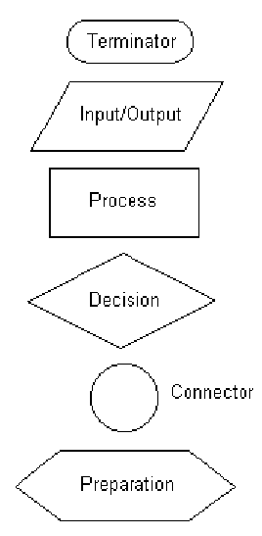
Flow Chart
Some of the common symbols used in flowcharts are shown.
…

Slide 21
…
With flowcharting, essential steps of an algorithm are shown using the shapes above.
The flow of data between steps is indicated by arrows, or flowlines. For example, a flowchart (and equivalent Pseudocode) to compute the interest on a loan is shown below:

Slide 22
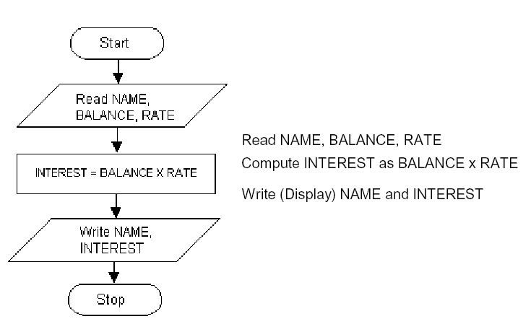

Slide 23
List
List Data Structure
List operations
List Implementation
Array
Linked List

Slide 24
The LIST Data Structure
The List is among the most generic of data structures.
Real life:
    shopping list,
    groceries list,
    list of people to invite to dinner
    List of presents to get

Slide 25
Lists
A list is collection of items that are all of the same type (grocery items, integers, names)
The items, or elements of the list, are stored in some particular order
It is possible to insert new elements into various positions in the list and remove any element of the list

Slide 26
Lists
List is a set of elements in a linear order.
For example, data values a₁, a₂, a₃, a₄ can be arranged in a list:
(a₃, a₁, a₂, a₄)
In this list, a₃, is the first element, a₁ is the second element, and so on
The order is important here; this is not just a random collection of elements, it is an ordered collection

Slide 27
Lists
List is a set of elements in a linear order.
For example, data values a₁, a₂, a₃, a₄ can be arranged in a list:
(a₃, a₁, a₂, a₄)
In this list, a₃, is the first element, a₁ is the second element, and so on
The order is important here; this is not just a random collection of elements, it is an ordered collection

Slide 28
List Operations
Useful operations
createList(): create a new list (presumably empty)
copy(): set one list to be a copy of another
clear(); clear a list (remove all elments)
insert(X, ?): Insert element X at a particular position
in the list
remove(?): Remove element at some position in
the list
get(?): Get element at a given position
update(X, ?): replace the element at a given position with X
find(X): determine if the element X is in the list
length(): return the length of the list.

Slide 29
Pointer
Pointer
Pointer Variables
Dynamic Memory Allocation
Functions

Slide 30
What is a Pointer?
A Pointer provides a way of accessing a variable without referring to the variable directly.
The mechanism used for this purpose is the address of the variable.
A variable that stores the address of another variable is called a pointer variable.

Slide 31
Pointer Variables
Pointer variable: A variable that holds an address
Can perform some tasks more easily with an address than by accessing memory via a symbolic name:
Accessing unnamed memory locations
Array manipulation
etc.

Slide 32
Why Use Pointers?
To operate on data stored in an array
To enable convenient access within a function to large blocks data, such as arrays, that are defined outside the function.
To allocate space for new variables dynamically–that is during program execution

Slide 33
Pointer Data Types and Pointer Variables
Pointer variable: variable whose content is a memory address
Syntax to declare pointer variable:
dataType *identifier;
Address of operator: Ampersand, &
Dereferencing operator/Indirection operator: Asterisk, *

Slide 34
The Address-Of Operator (&)
The address-of operator, &, is a unary operator that obtains the address in memory where a variable is stored.
int number = 1234;
int*pnumber= &number; //stores address of //number in pnumber
char a = „a‟;
char *pa = &a;//stores address of a in pa.

Slide 35
The Indirection Operator
How pointer variable is used to access the contents of memory location?
The indirection operator, *is used for this purpose.
cout<< *pnumber;

Slide 36
Arrays & Strings
Array
Array Elements
Accessing array elements
Declaring an array
Initializing an array
Two-dimensional Array
Array of Structure
String
Array of Strings
Examples

Slide 37
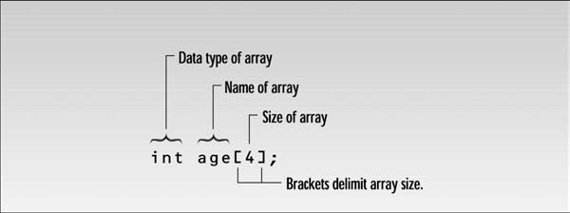
Introduction
Arrays
  Contain fixed number of elements of same data type
  Static entity- same size throughout the program
  An array must be defined before it is used
  An array definition specifies a variable type, a name and size
  Size specifies how many data items the array will contain
  An example

Slide 38
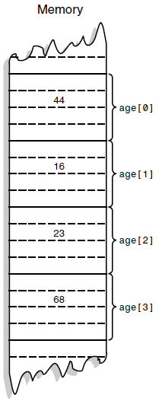
Array Elements
The items in an array are called elements
All the elements are of the same type
The first array element is numbered 0
Four elements (0-3) are stored consecutively in
the memory

Slide 39
Accessing array elements
To access an element specify array name and array index number
Syntax:
  arrayname[ arrayindex]
to access 3rd element of array age we use
  age[2] age is the name of the array and 2 is the index number

Slide 40
Declaring an array
when declaring an array, specify
  type of array
  array name
  number of elements
    arrayType arrayName [ numberofElements ]
  examples
    int results [10 ];
    float myArray [50];
declaring multiple arrays of same type
  format similar to regular variables
  example: int b[5], x[10];

Slide 41
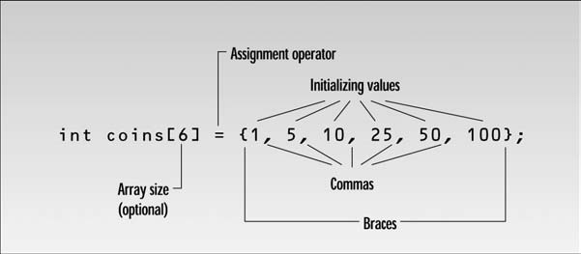
Initializing an array
when an array is defined then you can give values to each array elements
example:
  int n[5]={1,2,3,4,5};

Slide 42
Strings
two types of strings are used in C++
C-Strings and strings that are object of the String class
we will study C-Strings only
C-Strings or C-Style String

Slide 43
an example
#include <iostream>
int main()
{
const int MAX = 80; //max characters in string
char str[MAX];
cout << “Enter a string: “;
cin >> str; //put string in str
//display string from str
cout << “You entered: “ << str << endl;
return 0;
}

Slide 44
the definition of the string variable looks like the definition of an array of type char
char str[MAX];
we read a string from the keyboard and place it in the string variable str
the extraction operator >> knows how to deal with strings
if the user enters a string “Amanuensis”, it will look like

Slide 45
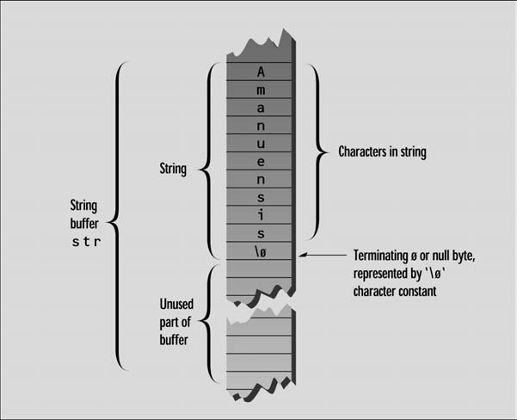

Slide 46
each character occupies 1 byte of memory
C-Strings must terminate with a byte containing 0
it is often represented by a character constant “\0” which is character with an ASCII value of 0
this terminating zero is called “Null character”
when the operator << displays a string, it displays characters until it encounters the null character

Slide 47
Searching
Introduction to Searching
External and Internal Searching
Types of Searching
  Linear or sequential search
  Binary Search
Algorithms for Linear Search
Algorithms for Binary Search

Slide 48
Introduction
Information retrieval is one of the most important applications of computers
We are given a name and are asked for an associated telephone listing
We are given an account number and are asked for the transactions occurring in that account
We are given an employee name or number and are asked for the employee records

Slide 49
Searching is a process of checking and finding an element from a list of elements
If we want to find the presence of an element “data” in A, then we have to search for it
The search is successful if data does appear in A and unsuccessful otherwise
A question you should always ask when selecting a search algorithm is “How fast does the search have to be?” The reason is that, in general, the faster the algorithm is, the more complex it is.
Bottom line: you don’t always need to use or should use the fastest algorithm

Slide 50
Key
In these examples, we are given one piece of information, which we shall call a key
We are asked to find a record that contains other information associated with the key
We shall allow both the possibility that there is more than one record with the same key and that there is no record with the given key

Slide 51
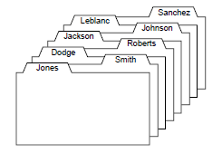
Records and their keys

Slide 52
Types of Searching
There are two types of searching techniques:
  Linear or Sequential Searching
  Binary Searching
Linear or Sequential Searching
In linear search, each element of an array is read one by one sequentially
It is compared with the desired element
A search will be unsuccessful if all the elements are read and the desired element is not found

Slide 53
Binary Search
Sequential search is easy to write and efficient for short lists, but a disaster for long ones
Imagine trying to find the name “Ahmad Tahir” in a large telephone book by reading one name at a time starting at the front of the book
To find any entry in a long list, there are far more efficient methods, provided that the keys in the list are already sorted into order
If we have an ordered list, we can use a different strategy
The binary search gets its name because the algorithm continually divides the list into two parts

Slide 54
Binary Search
Binary search is an extremely efficient algorithm when it is compared to linear search
Binary search technique searches “data” in minimum possible comparisons
First compare the target key with one in the center of the list and then restrict our attention to only the first or second half of the list, depending on whether the target key comes before or after the central one
With one comparison of keys we thus reduce the list to half its original size
Continuing in this way, at each step, we reduce the length of the list to be searched by half

Slide 55
Recursion
Introduction to Recursion
Recursive Definition
Recursive Algorithms
Finding a Recursive Solution
Example Recursive Function
Recursive Programming
Rules for Recursive Function
Example Tower of Hanoi
Other examples

Slide 56
Introduction
Any function can call another function
A function can even call itself
When a function call itself, it is making a recursive call
Recursive Call
  A function call in which the function being called is the same as the one making the call
Recursion is a powerful technique that can be used in place of iteration(looping)
Recursion
  Recursion is a programming technique in which functions call themselves.

Slide 57
Recursive Definition
A definition in which something is defined in terms of smaller versions of itself.
To do recursion we should know the followings
  Base Case:
    The case for which the solution can be stated non-recursively
    The case for which the answer is explicitly known.
  General Case:
    The case for which the solution is expressed in smaller version of itself. Also known as recursive case

Slide 58
Recursive Algorithm
Definition
  An algorithm that calls itself
Approach
  Solve small problem directly
  Simplify large problem into 1 or more smaller sub problem(s) & solve recursively
  Calculate solution from solution(s) for sub problem

Slide 59
Rules For Recursive Function
In recursion, it is essential for a function to call itself, otherwise recursion will not take place.
To stop the recursive function it is necessary to base the recursion on test condition and proper terminating statement such as exit() or return must be written using if() statement.
When a recursive function is executed, the recursive calls are not implemented instantly. All the recursive calls are pushed onto the stack until the terminating condition is not detected, the recursive calls stored in the stack are popped and executed.
During recursion, at each recursive call new memory is allocated to all the local variables of the recursive functions with the same name.

Slide 60
Sorting Algorithms
There are many sorting algorithms, such as:
  Selection Sort
  Insertion Sort
  Bubble Sort
  Merge Sort
  Quick Sort
The first three are the foundations for faster and more efficient algorithms.

Slide 61
Sorting
Sorting is a process that organizes a collection of data into either ascending or descending order.
An internal sort requires that the collection of data fit entirely in the computer’s main memory.
We can use an external sort when the collection of data cannot fit in the computer’s main memory all at once but must reside in secondary storage such as on a disk.
We will analyze only internal sorting algorithms.
Any significant amount of computer output is generally arranged in some sorted order so that it can be interpreted.
Sorting also has indirect uses. An initial sort of the data can significantly enhance the performance of an algorithm.
Majority of programming projects use a sort somewhere, and in many cases, the sorting cost determines the running time.
A comparison-based sorting algorithm makes ordering decisions only on the basis of comparisons.

Slide 62
Selection Sort
The list is divided into two sublists, sorted and unsorted, which are divided by an imaginary wall.
We find the smallest element from the unsorted sublist and swap it with the element at the beginning of the unsorted data.
After each selection and swapping, the imaginary wall between the two sublists move one element ahead, increasing the number of sorted elements and decreasing the number of unsorted ones.
Each time we move one element from the unsorted sublist to the sorted sublist, we say that we have completed a sort pass.
A list of n elements requires n-1 passes to completely rearrange the data.

Slide 63
Sorted
Unsorted
23 | 78 | 45 | 8 | 32 | 56
8 | 78 | 45 | 23 | 32 | 56
8 | 23 | 45 | 78 | 32 | 56
8 | 23 | 32 | 78 | 45 | 56
8 | 23 | 32 | 45 | 78 | 56
8 | 23 | 32 | 45 | 56 | 78
Original List
After pass 1
After pass 2
After pass 3
After pass 4
After pass 5

Slide 64
Insertion Sort
Insertion sort is a simple sorting algorithm that is appropriate for small inputs.
  Most common sorting technique used by card players.
The list is divided into two parts: sorted and unsorted.
In each pass, the first element of the unsorted part is picked up, transferred to the sorted sublist, and inserted at the appropriate place.
A list of n elements will take at most n-1 passes to sort the data.

Slide 65
Sorted
Unsorted
23 | 78 | 45 | 8 | 32 | 56
23 | 78 | 45 | 8 | 32 | 56
23 | 45 | 78 | 8 | 32 | 56
8 | 23 | 45 | 78 | 32 | 56
8 | 23 | 32 | 45 | 78 | 56
8 | 23 | 32 | 45 | 56 | 78
Original List
After pass 1
After pass 2
After pass 3
After pass 4
After pass 5

Slide 66
Bubble Sort
The list is divided into two sublists: sorted and unsorted.
The smallest element is bubbled from the unsorted list and moved to the sorted sublist.
After that, the wall moves one element ahead, increasing the number of sorted elements and decreasing the number of unsorted ones.
Each time an element moves from the unsorted part to the sorted part one sort pass is completed.
Given a list of n elements, bubble sort requires up to n-1 passes to sort the data.

Slide 67
Bubble Sort
23 | 78 | 45 | 8 | 32 | 56
8 | 23 | 78 | 45 | 32 | 56
8 | 23 | 32 | 78 | 45 | 56
8 | 23 | 32 | 45 | 78 | 56
8 | 23 | 32 | 45 | 56 | 78
Original List
After pass 1
After pass 2
After pass 3
After pass 4

Slide 68
Mergesort
Mergesort algorithm is one of two important divide-and-conquer sorting algorithms (the other one is quicksort).
It is a recursive algorithm.
  Divides the list into halves,
  Sort each halve separately, and
  Then merge the sorted halves into one sorted array.

Slide 69
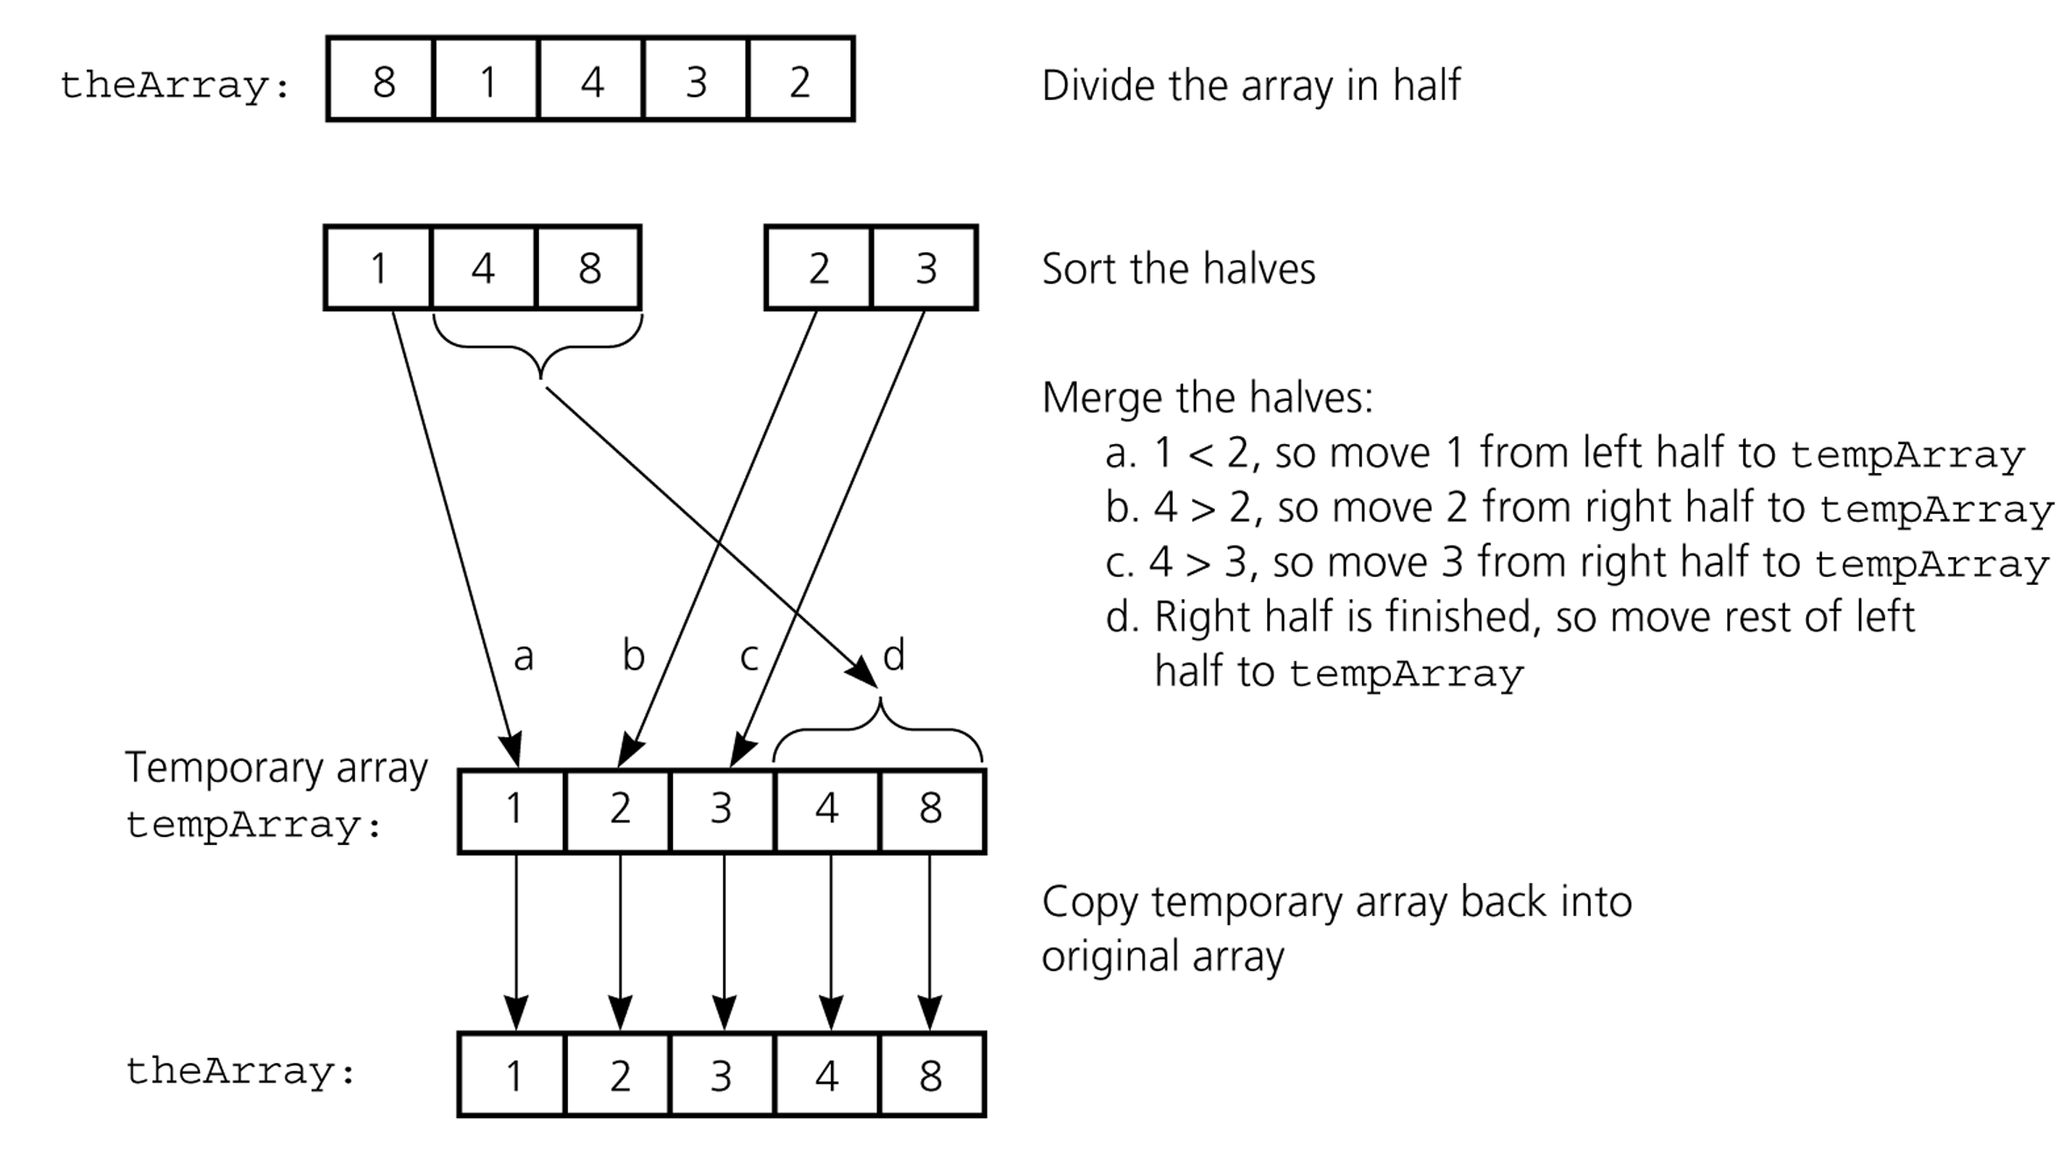
Mergesort - Example

Slide 70
Mergesort - Example
6 | 3 | 9 | 1 | 5 | 4 | 7 | 2
divide
6 | 3 | 9 | 1
5 | 4 | 7 | 2
divide
divide
6 | 3
9 | 1
5 | 4
7 | 2
divide
divide
divide
divide
6
3
9
1
5
4
7
2
merge
merge
merge
merge
3 | 6
1 | 9
4 | 5
2 | 7
merge
merge
1 | 3 | 6 | 9
2 | 4 | 5 | 7
merge
1 | 2 | 3 | 4 | 5 | 7 | 8 | 9

Slide 71
Quicksort
Like mergesort, Quicksort is also based on
the divide-and-conquer paradigm.
But it uses this technique in a somewhat opposite manner,
as all the hard work is done before the recursive calls.
It works as follows:
  First, it partitions an array into two parts,
  Then, it sorts the parts independently,
  Finally, it combines the sorted subsequences by
  a simple concatenation.

Slide 72
Quicksort (cont.)
The quick-sort algorithm consists of the following three steps:
1. Divide: Partition the list.
  To partition the list, we first choose some element from the list for which we hope about half the elements will come before and half after. Call this element the pivot.
  Then we partition the elements so that all those with values less than the pivot come in one sublist and all those with greater values come in another.
2. Recursion: Recursively sort the sublists separately.
3. Conquer: Put the sorted sublists together.

Slide 73
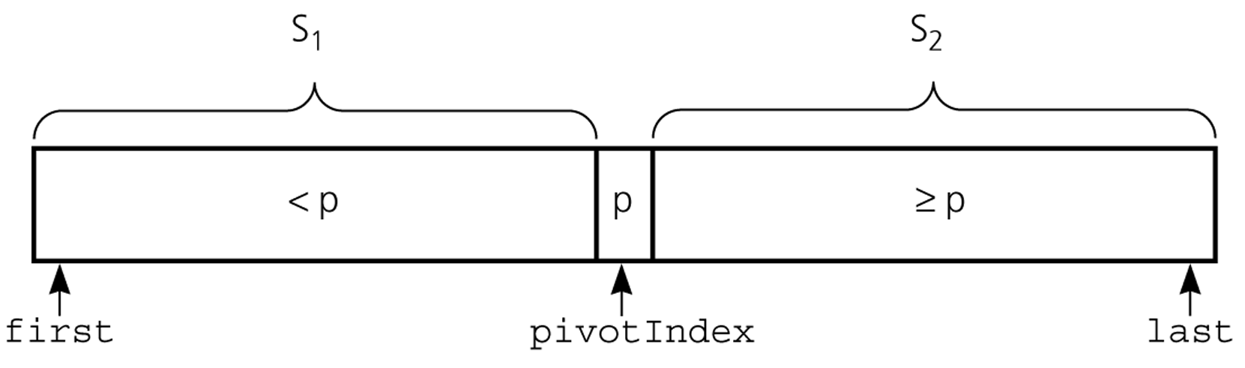
Partition
Partitioning places the pivot in its correct place position within the array.
Arranging the array elements around the pivot p generates two smaller sorting problems.
  sort the left section of the array, and sort the right section of the array.
  when these two smaller sorting problems are solved recursively, our bigger sorting problem is solved.

Slide 74
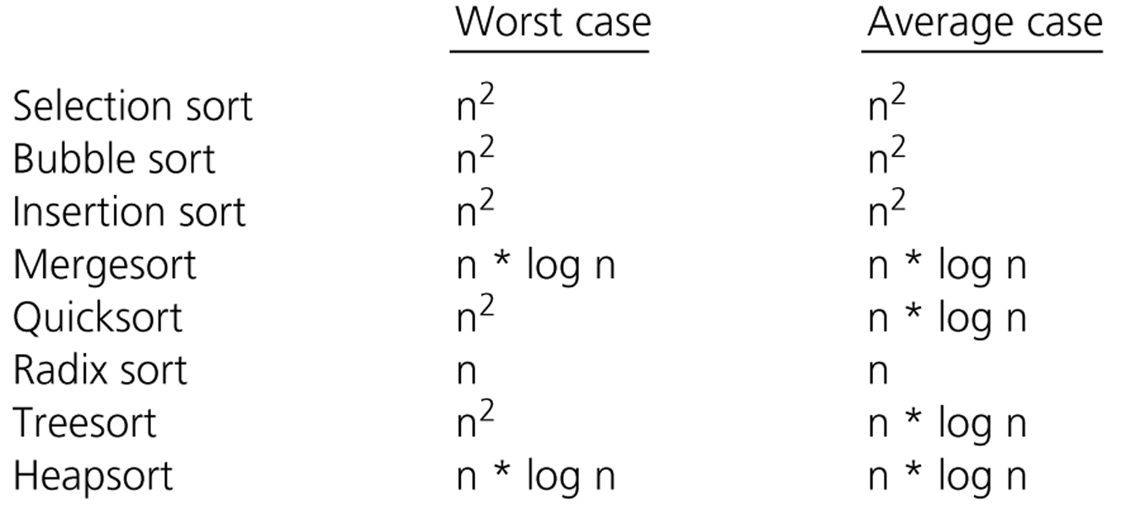
Comparison of Sorting Algorithms

