Slide 1
Review
Graph
Directed Graph
Undirected Graph
Sub-Graph
Spanning Sub-Graph
Degree of a Vertex
Weighted Graph
Elementary and Simple Path
Link List Representation

Slide 2
Traversing a Graph
Breadth First Search (BFS)
Depth First Search (DFS)

Slide 3
Hashing
  Hash Function
  Properties of Hash Function
  Division Method
  Mid-Square Method
  Folding Method
  Hash Collision
    Open addressing
    Chaining
    Bucket addressing

Slide 4
Introduction
The searching time of each searching technique depends on the comparison. i.e., n comparisons required for an array A with n elements
To increase the efficiency, i.e., to reduce the searching time, we need to avoid unnecessary comparisons
Hashing is a technique where we can compute the location of the desired record in order to retrieve it in a single access (or comparison)
Let there is a table of n employee records and each employee record is defined by a unique employee code, which is a key to the record and employee name
If the key (or employee code) is used as the array index, then the record can be accessed by the key directly

Slide 5
If L is the memory location where each record is related with the key
If we can locate the memory address of a record from the key then the desired record can be retrieved in a single access
For notational and coding convenience, we assume that the keys in k and the address in L are (decimal) integers
So the location is selected by applying a function which is called hash function or hashing function from the key k
Unfortunately such a function H may not yield different values (or index); it is possible that two different keys k1 and k2 will yield the same hash address
This situation is called Hash Collision, which is discussed later

Slide 6
Hash Function
The basic idea of hash function is the transformation of the key into the corresponding location in the hash table
A Hash function H can be defined as a function that takes key as input and transforms it into a hash table index

Slide 7
Properties of Hash Function
A good hash function should:
Minimize collisions
Be easy and quick to compute
Distribute key values evenly in the hash table
Use all the information provided in the key

Slide 8
Following are the most popular hash functions :
1. Division method
2. Mid Square method
3. Folding method

Slide 9
Division Method
TABLE is an array of database file where the employee details are stored
Choose a number m, which is larger than the number of keys k. i.e., m is greater than the total number of records in the TABLE
The number m is usually chosen to be prime number to minimize the collision
The hash function H is defined by
H(k) = k mod m
Where H(k) is the hash address and k mod m means the remainder when k is divided by m

Slide 10
For Example
Let a company has 90 employees and 00, 01, 02, ...... 99 be the two digit 100 memory address (or index or hash address) to store the records
We have employee code as the key
Choose m in such a way that it is greater than 90
Suppose m = 91. Then for the following employee code (or key k) :
H(k) = H(2103) = 2103 mod 91 = 10
H(k) = H(6147) = 6147 mod 91 = 50
H(k) = H(3750) = 3750 mod 91 = 19

Slide 11
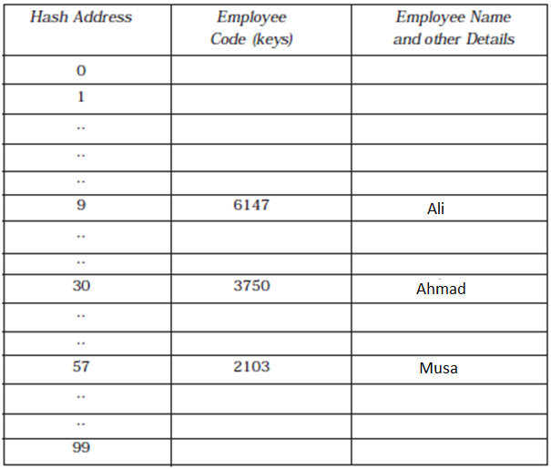
Then a typical employee hash table will look like as in Figure

Slide 12
So if you enter the employee code to the hash function, we can directly retrieve TABLE[H(k)] details directly

Slide 13
Mid-Square Method
In this method, the key is squared and the address selected from the middle of the squared number
The hash function H is defined by:
H(k) = k² = l
Where l is obtained by digits from both the end of k² starting from left
The most obvious limitation of this method is the size of the key
Given a key of 6 digits, the product will be 12 digits, which may be beyond the maximum integer size of many computers
Same number of digits must be used for all of the keys

Slide 14


For Example
Consider following keys in the table and its hash index :

Slide 15
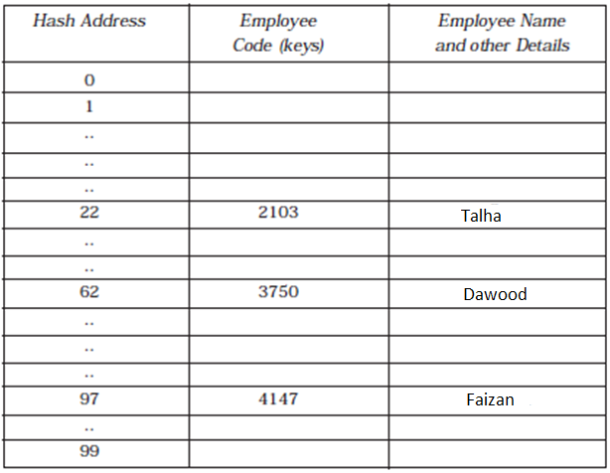
Hash Table with Mid-Square Division

Slide 16

Folding Method
In this method, the key K is partitioned into number of parts, k1, k2,...... kr
The parts have same number of digits as the required hash address, except possibly for the last part
Then the parts are added together, ignoring the last carry
H(k) = k1 + k2 + ...... + kr
Here we are dealing with a hash table with index from 00 to 99, i.e., two-digit hash table
So we divide the K numbers of two digits
8

Slide 17
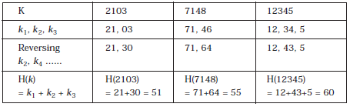
Extra milling can also be applied to even numbered parts, k2, k4, ...... are each reversed before the addition
H(7148) = 71 + 84 = 155, here we will eliminate the leading carry (i.e., 1). So H(7148) = 71 + 64 = 55
8

Slide 18
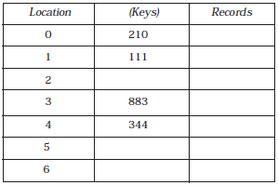

Hash Collision
It is possible that two non-identical keys K1, K2 are hashed into the same hash address
This situation is called Hash Collision
Let us consider a hash table having 10 locations as shown in Figure

Slide 19
Division method is used to hash the key
H(k) = k (mod m)
Here m is chosen as 10
The Hash function produces any integer between 0 and 9, depending on the value of the key
If we want to insert a new record with key 500 then
H(500) = 500(mod 10) = 0
The location 0 in the table is already filled (i.e., not empty)
Thus collision occurred

Slide 20
Collisions are almost impossible to avoid but it can be minimized considerably by introducing any one of the following three techniques:
1. Open addressing
2. Chaining
3. Bucket addressing

Slide 21
Open Addressing
In open addressing method, when a key is colliding with another key, the collision is resolved by finding a nearest empty space by probing the cells
Suppose a record R with key K has a hash address H(k) = h
then we will linearly search h + i (where i = 0, 1, 2, ...... m) locations for free space (i.e., h, h + 1, h + 2, h + 3 ...... hash address)
To understand the concept, let us consider a hash collision which is in the hash table shown in last Figure
If we try to insert a new record with a key 500 then
H(500) = 500(mod 10) = 0

Slide 22
The array index 0 is already occupied by H(210)
With open addressing we resolve the hash collision by inserting the record in the next available free or empty location in the table
Here next location, i.e., array hash index 1, is also occupied by the key 111
Next available free location in the table is array index 2 and we place the record in this free location

Slide 23
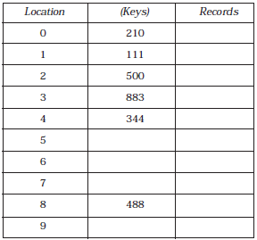

Slide 24
The position in which a key can be stored is found by sequentially searching all positions starting from the position calculated by the hash function until an empty cell is found
This type of probing is called Linear Probing
The main disadvantage of Linear Probing is that substantial amount of time will take to find the free cell by sequential or linear searching the table
Other two techniques, which are discussed next, will minimize this searching time considerably

Slide 25
Quadratic Probing
Suppose a record with R with key k has the hash address H(k) = h
Then instead of searching the location with address h, h + 1, h + 2,...... h + i ......, we search for free hash address h, h + 1, h + 4, h + 9, h + 16, ...... h + i²,...... .
Double Hashing
Second hash function H1 is used to resolve the collision
Suppose a record R with key k has the hash address H(k) = h and H1(k) = h1
Then we linearly search for the location with addresses
h, h + h¹, h + 2h¹, h + 3h¹, ...... h + i h¹
(where i = 0, 1, 2, ......).

Slide 26
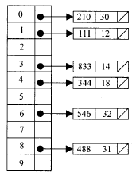
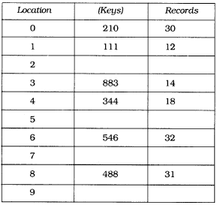
Chaining
In chaining technique the entries in the hash table are dynamically allocated and entered into a linked list associated with each hash key
The hash table in Fig. A can be represented using linked list as in Fig. B
Figure A
Figure B

Slide 27
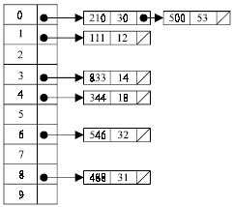
If we try to insert a new record with a key 500 then H(500)= 500 (mod 10)=0
Then the collision occurs because there exist a record in the 0th position
But in chaining corresponding linked list can be extended to accommodate the new record with the key as shown below

Slide 28
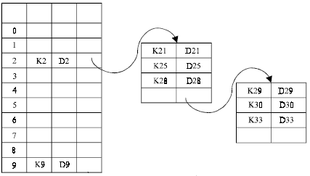
Bucket Addressing
Another solution to the hash collision problem is to store colliding elements in the same position in table by introducing a bucket with each hash address
A bucket is a block of memory space, which is large enough to store multiple items

Slide 29
Summary
  Hash Function
  Properties of Hash Function
  Division Method
  Mid-Square Method
  Folding Method
  Hash Collision
    Open addressing
    Chaining
    Bucket addressing

