Slide 1
Review
Algorithm Analysis
Problem Solving
Space Complexity
Time Complexity
Classifying Functions by Their Asymptotic Growth

Slide 2
Pseudo Code and Flow Charts
Pseudo Code
Basic elements of Pseudo code
Basic operations of Pseudo code
Flow Chart
Symbols used in flow charts
Examples

Slide 3
Pseudo Code and Flow Charts
There are two commonly used tools to help to document program logic (the algorithm).
These are
  Flowcharts
  Pseudocode.
Generally, flowcharts work well for small problems but Pseudocode is used for larger problems.

Slide 4
Pseudo-Code
Pseudo-Code is simply a numbered list of instructions to perform some task.

Slide 5
Writing Pseudo Code
Number each instruction
    This is to enforce the notion of an ordered sequence of operations
    Furthermore we introduce a dot notation (e.g. 3.1 come after 3 but before 4) to number subordinate operations for conditional and iterative operations
Each instruction should be unambiguous and effective.
Completeness. Nothing is left out.

Slide 6
Pseudo-code
Statements are written in simple English without regard to the final programming language.
Each instruction is written on a separate line.
The pseudo-code is the program-like statements written for human readers, not for computers. Thus, the pseudo-code should be readable by anyone who has done a little programming.
Implementation is to translate the pseudo-code into programs/software, such as “C++” language programs.

Slide 7
Basic Elements of Pseudo-code
A Variable
  Having name and value
  There are two operations performed on a variable
    Assignment Operation is the one in which we associate a value to a variable.
    The other operation is the one in which at any given time we intend to retrieve the value previously assigned to that variable (Read Operation)

Slide 8
Basic Elements of Pseudo-code
Assignment Operation
  This operation associates a value to a variable.
  While writing Pseudo-code you may follow your own syntax.
  Some of the possible syntaxes are:
    Assign 3 to x
    Set x equal to 3
    x=3

Slide 9
Basic Operations of Pseudo-code
Read Operation
  In this operation we intend to retrieve the value previously assigned to that variable. For example Set Value of x equal to y
Read the input from user
  This operation causes the algorithm to get the value of a variable from the user.
    Get x Get a, b, c

Slide 10
Basic Operations of Pseudo-code
Print the output to the user
  Print x (This will print value of variable x)
  Print “Your mileage is” x
Cary out basic arithmetical computations
  Set x to 10
  Set y to x*x/3

Slide 11
Example: Pseudo-code of calculating area of circle
1. Begin
2. Input value for radius
3. Calculate area (pi x radius²)
4. Output radius and area
5. Quit
THEN PROGRAM

Slide 12
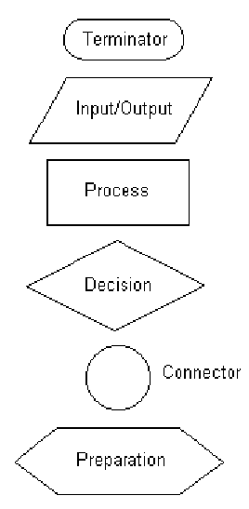
Flow Chart
Some of the common symbols used in flowcharts are shown.
…

Slide 13
…
With flowcharting, essential steps of an algorithm are shown using the shapes above.
The flow of data between steps is indicated by arrows, or flowlines. For example, a flowchart (and equivalent Pseudocode) to compute the interest on a loan is shown below:

Slide 14
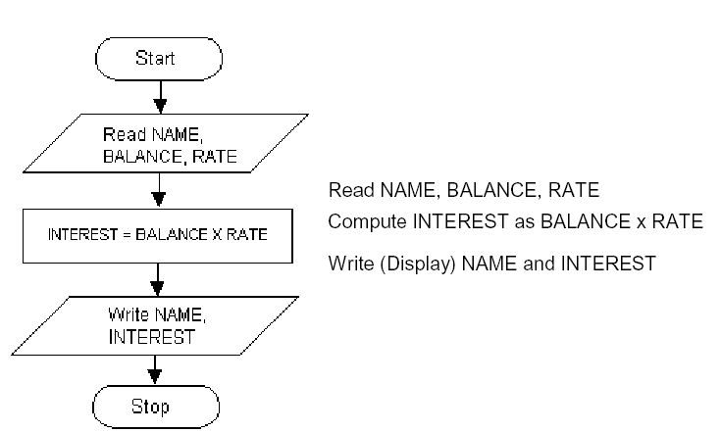

Slide 15
Note that the Pseudocode also describes the essential steps to be taken, but without the graphical enhancements.
Another example of a flowchart and the equivalent Pseudocode is shown next.

Slide 16
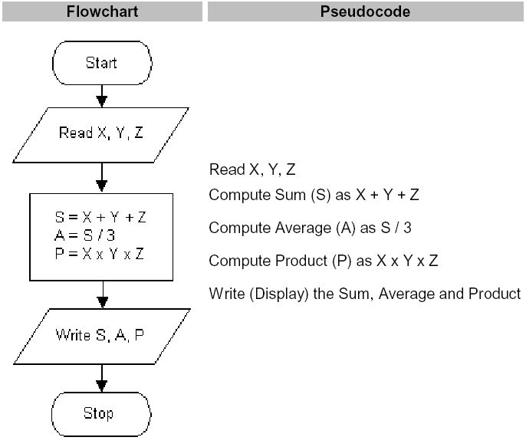

Slide 17
Some Examples
Write pseudo-code of a program that asks the user to enter two numbers and prints the sum, product, difference, and division of the two numbers.
Write pseudo-code of a program that solves a quadratic equation ax²+bx+c by taking a, b and c as input from user.

Slide 18
Decision Making and Pseudo Code

Slide 19
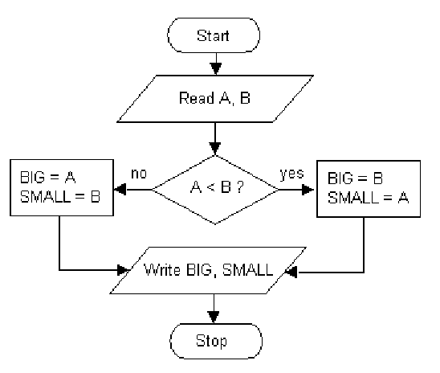
Another Example

Slide 20
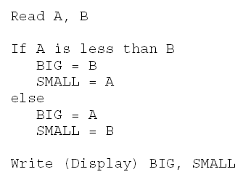
Pseudo Code

Slide 21
Loops and Pseudo Code

Slide 22
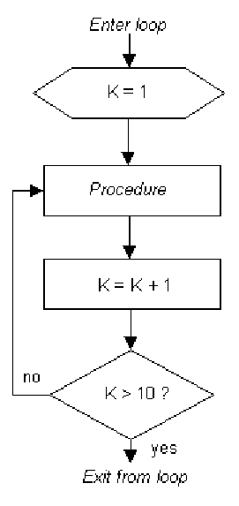

Slide 23


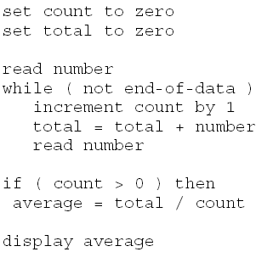
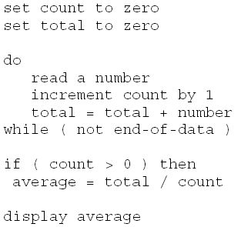

Slide 24
Draw the Flowchart
1. get hours worked
2. get pay rate
3. if hours worked ≤ 40 then
3.1 gross pay = pay rate times hours worked
4. else
4.1 gross pay = pay rate times 40 plus 1.5 times pay rate times (hours worked minus 40)
5. display gross pay
6. halt

Slide 25
Draw the Flowchart
1. get number of quizzes
2. sum = 0
3. count = 0
4. while count < number of quizzes
4.1 get quiz grade
4.2 sum = sum + quiz grade
4.3 count = count + 1
5. average = sum / number of quizzes
6. display average
7. halt

Slide 26
Summary
Pseudo Code
Basic elements of Pseudo code
Basic operations of Pseudo code
Flow Chart
Symbols used in flow charts
Examples

