Slide 1
Review
Graph
Directed Graph
Undirected Graph
Sub-Graph
Spanning Sub-Graph
Degree of a Vertex
Weighted Graph
Elementary and Simple Path
Link List Representation

Slide 2
Traversing a Graph
Breadth First Search (BFS)
Depth First Search (DFS)

Slide 3
Traversing a Graph
Many application of graph requires a structured system to examine the vertices and edges of a graph G
That is a graph traversal, which means visiting all the nodes of the graph
There are two graph traversal methods
(a) Breadth First Search (BFS)
  Think Queue
(b) Depth First Search (DFS)
  Think Stack

Slide 4
Overview
Goal
  To systematically visit the nodes of a graph
A tree is a directed, acyclic, graph (DAG)
If the graph is a tree,
  DFS is exhibited by preorder, postorder, and (for binary trees) inorder traversals
  BFS is exhibited by level-order traversal

Slide 5
Example
5
2
0
1
3
7
4
6
Policy: Visit adjacent nodes in increasing index order

Slide 6
Preorder DFS: Start with Node 5
5
2
0
1
3
7
4
6
5 1 0 3 2 7 6 4

Slide 7
Preorder DFS: Start with Node 5
5
5
2
0
1
3
7
4
6
Push 5

Slide 8
Preorder DFS: Start with Node 5
5
2
0
1
3
7
4
6
Pop/Visit/Mark 5
5

Slide 9
Preorder DFS: Start with Node 5
1
2
5
2
0
1
3
7
4
6
Push 2, Push 1
5

Slide 10
Preorder DFS: Start with Node 5
2
5
2
0
1
3
7
4
6
Pop/Visit/Mark 1
5 1

Slide 11
Preorder DFS: Start with Node 5
0
2
4
2
5
2
0
1
3
7
4
6
Push 4, Push 2, Push 0
5 1

Slide 12
Preorder DFS: Start with Node 5
2
4
2
5
2
0
1
3
7
4
6
Pop/Visit/Mark 0
5 1 0

Slide 13
Preorder DFS: Start with Node 5
3
7
2
4
2
5
2
0
1
3
7
4
6
Push 7, Push 3
5 1 0

Slide 14
Preorder DFS: Start with Node 5
7
2
4
2
5
2
0
1
3
7
4
6
Pop/Visit/Mark 3
5 1 0 3

Slide 15
Preorder DFS: Start with Node 5
2
7
2
4
2
5
2
0
1
3
7
4
6
Push 2
5 1 0 3

Slide 16
Preorder DFS: Start with Node 5
7
2
4
2
5
2
0
1
3
7
4
6
Pop/Mark/Visit 2
5 1 0 3 2

Slide 17
Preorder DFS: Start with Node 5
2
4
2
5
2
0
1
3
7
4
6
Pop/Mark/Visit 7
5 1 0 3 2 7

Slide 18
Preorder DFS: Start with Node 5
6
2
4
2
5
2
0
1
3
7
4
6
Push 6
5 1 0 3 2 7

Slide 19
Preorder DFS: Start with Node 5
2
4
2
5
2
0
1
3
7
4
6
Pop/Mark/Visit 6
5 1 0 3 2 7 6

Slide 20
Preorder DFS: Start with Node 5
4
2
5
2
0
1
3
7
4
6
Pop (don’t visit) 2
5 1 0 3 2 7 6

Slide 21
Preorder DFS: Start with Node 5
2
5
2
0
1
3
7
4
6
Pop/Mark/Visit 4
5 1 0 3 2 7 6 4

Slide 22
Preorder DFS: Start with Node 5
5
2
0
1
3
7
4
6
Pop (don’t visit) 2
5 1 0 3 2 7 6 4

Slide 23
Preorder DFS: Start with Node 5
5
2
0
1
3
7
4
6
Done
5 1 0 3 2 7 6 4

Slide 24
Breadth-first Search
Ripples in a pond
Visit designated node
Then visited unvisited nodes a distance i away, where i = 1, 2, 3, etc.
For nodes the same distance away, visit nodes in systematic manner (eg. increasing index order)

Slide 25
BFS: Start with Node 5
5
2
0
1
3
7
4
6
5 1 2 0 4 3 7 6

Slide 26
BFS: Start with Node 5
5
2
0
1
3
7
4
6
5

Slide 27
BFS: Node one-away
5
2
0
1
3
7
4
6
5

Slide 28
BFS: Visit 1 and 2
5
2
0
1
3
7
4
6
5 1 2

Slide 29
BFS: Nodes two-away
5
2
0
1
3
7
4
6
5 1 2

Slide 30
BFS: Visit 0 and 4
5
2
0
1
3
7
4
6
5 1 2 0 4

Slide 31
BFS: Nodes three-away
5
2
0
1
3
7
4
6
5 1 2 0 4

Slide 32
BFS: Visit nodes 3 and 7
5
2
0
1
3
7
4
6
5 1 2 0 4 3 7

Slide 33
BFS: Node four-away
5
2
0
1
3
7
4
6
5 1 2 0 4 3 7

Slide 34
BFS: Visit 6
5
2
0
1
3
7
4
6
5 1 2 0 4 3 7 6

Slide 35
Tree searches
A tree search starts at the root and explores nodes from there, looking for a goal node (a node that satisfies certain conditions, depending on the problem)
For some problems, any goal node is acceptable (N or J); for other problems, you want a minimum-depth goal node, that is, a goal node nearest the root (only J)
A
B
C
D
E
F
G
H
I
J
K
L
M
N
O
P
Q
Goal nodes

Slide 36
Depth-first searching
A depth-first search (DFS) explores a path all the way to a leaf before backtracking and exploring another path
For example, after searching A, then B, then D, the search backtracks and tries another path from B
Node are explored in the order A B D E H L M N I O P C F G J K Q
N will be found before J
A
B
C
D
E
F
G
H
I
J
K
L
M
N
O
P
Q

Slide 37
Breadth-first searching
A breadth-first search (BFS) explores nodes nearest the root before exploring nodes further away
For example, after searching A, then B, then C, the search proceeds with D, E, F, G
Node are explored in the order A B C D E F G H I J K L M N O P Q
J will be found before N
A
B
C
D
E
F
G
H
I
J
K
L
M
N
O
P
Q

Slide 38
Graph Traversal
Problem: Search for a certain node or traverse all nodes in the graph
Depth First Search
  Once a possible path is found, continue the search until the end of the path
Breadth First Search
  Start several paths at a time, and advance in each one step at a time

Slide 39
Exploring a Labyrinth Without Getting Lost
A Depth-First Search (DFS) in an undirected graph G is like wandering in a labyrinth with a string and a can of red paint without getting lost.
We start at vertex s, tying the end of our string to the point and painting s “visited”. Next we label s as our current vertex called u.
Now we travel along an arbitrary edge (u, v).
If edge (u, v) leads us to an already visited vertex v we return to u.
If vertex v is unvisited, we unroll our string and move to v, paint v “visited”, set v as our current vertex, and repeat the previous steps.

Slide 40
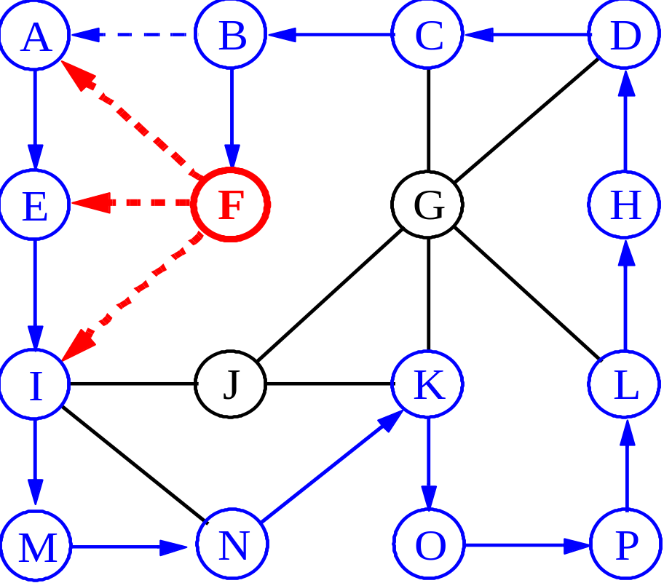
Depth-First Search

Slide 41
Breadth-First Search
Like DFS, a Breadth-First Search (BFS) traverses a connected component of a graph, and in doing so defines a spanning tree with several useful properties.
The starting vertex s has level 0, and, as in DFS, defines that point as an “anchor.”
In the first round, the string is unrolled the length of one edge, and all of the edges that are only one edge away from the anchor are visited.
These edges are placed into level 1

Slide 42
Breadth-First Search
In the second round, all the new edges that can be reached by unrolling the string 2 edges are visited and placed in level 2.
This continues until every vertex has been assigned a level.
The label of any vertex v corresponds to the length of the shortest path from s to v.

Slide 43
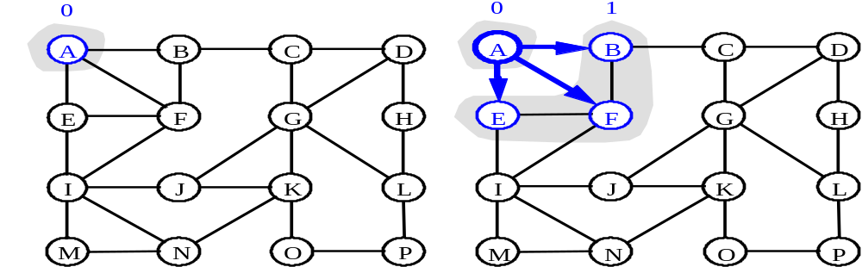
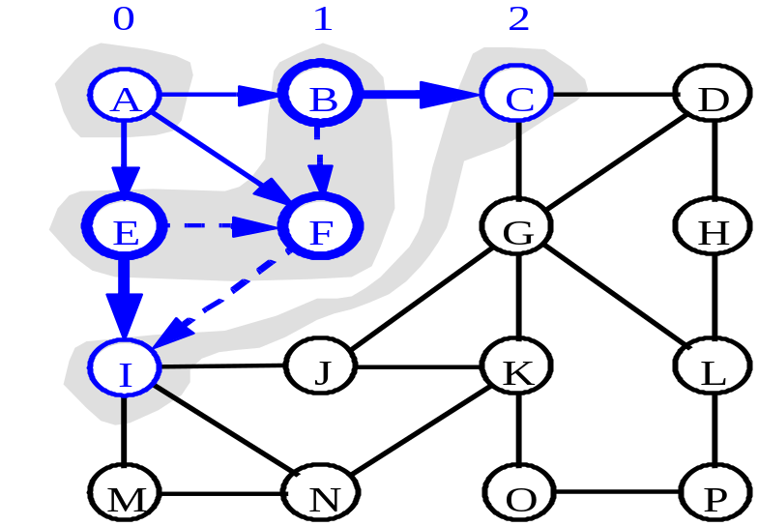
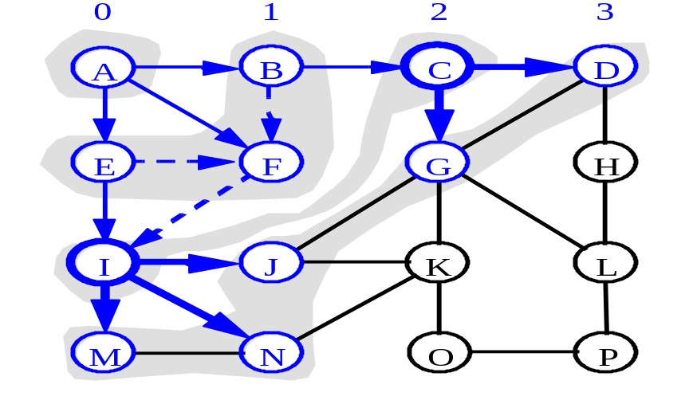
BFS - A Graphical Representation
a)
b)
c)
d)

Slide 44
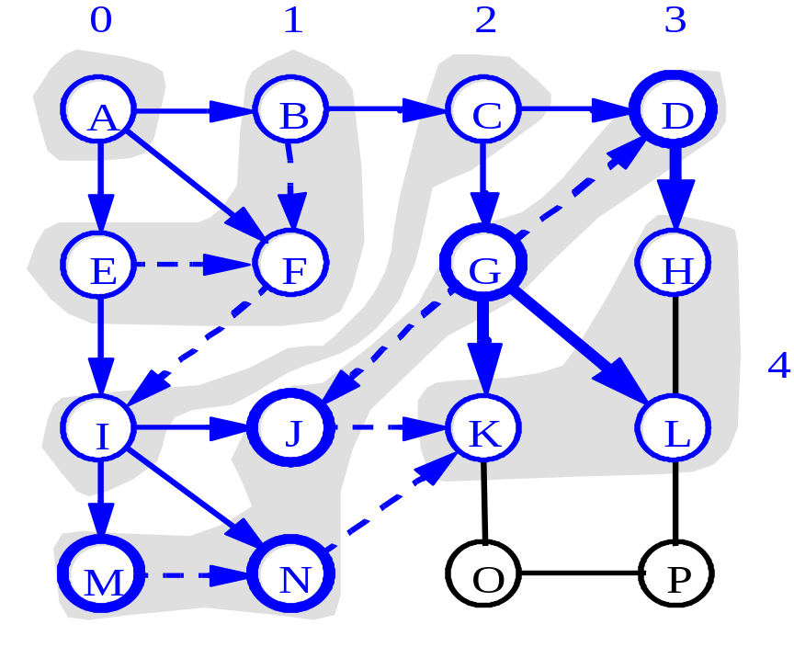
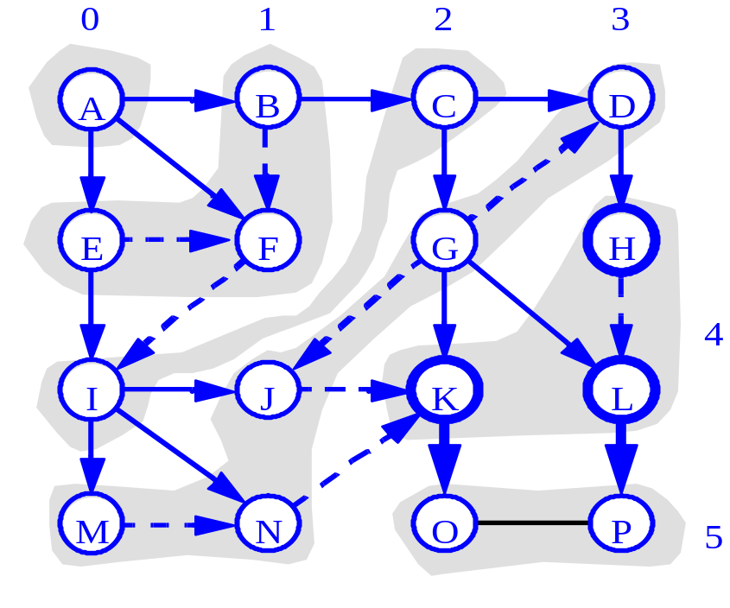
More BFS

Slide 45
Applications: Finding a Path
Find path from source vertex s to destination vertex d
Use graph search starting at s and terminating as soon as we reach d
  Need to remember edges traversed
Use depth – first search ?
Use breath – first search?

Slide 46
DFS vs. BFS
DFS Process
F
B
A
start
E
G
D
C
destination
C
DFS on C
D
Call DFS on D
B
DFS on B
B
B
Return to call on B
A
DFS on A
A
A
A
G
Call DFS on G
found destination - done!
Path is implicitly stored in DFS recursion
Path is: A, B, D, G
D
B
A

Slide 47
DFS vs. BFS
F
B
A
start
E
BFS Process
G
D
C
destination
rear
front
rear
front
rear
front
rear
front
A
B
D
C
D
Initial call to BFS on A
Add A to queue
Dequeue A
Add B
Dequeue B
Add C, D
Dequeue C
Nothing to add
rear
front
G
found destination - done!
Path must be stored separately
Dequeue D
Add G

Slide 48



Example
In DFS, each vertex has three possible colors representing its state:
white: vertex is unvisited;
gray: vertex is in progress
black: DFS has finished processing the vertex.

Slide 49
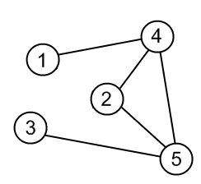
Example
Source graph

Slide 50
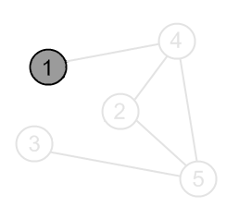
Mark a vertex 1 as visited.
Print the vertex.

Slide 51
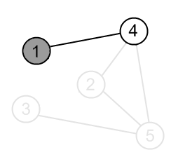
There is an edge (1, 4) and a vertex 4 is unvisited. Go there.

Slide 52
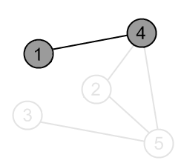
Mark the vertex 4 as visited.
Print the vertex

Slide 53
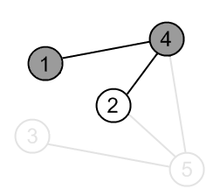
There is an edge (4, 2) and vertex a 2 is unvisited. Go there.

Slide 54
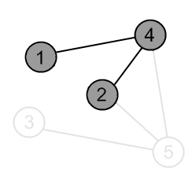
Mark the vertex 2 as visited.
Print the vertex.

Slide 55
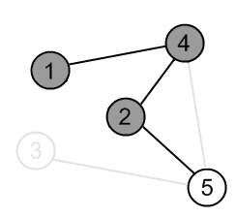
There is an edge (2, 5) and a vertex 5 is unvisited. Go there.

Slide 56
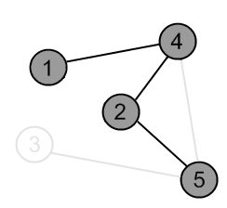
Mark the vertex 5 as visited.
Print the vertex.

Slide 57
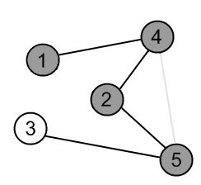
There is an edge (5, 3) and a vertex 3 is unvisited. Go there.

Slide 58

Mark the vertex 3 as visited.
Print the vertex.

Slide 59
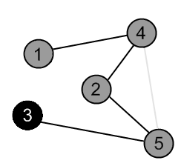
There are no ways to go from the vertex 3.
So, backtrack to the vertex 5 to check other adjacent vertices of the vertex 5.

Slide 60
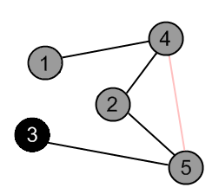
There is an edge (5, 4), but the vertex 4 is already visited.
So do not go to the vertex 4. Continue with other adjacent vertices of vertex 5.

Slide 61
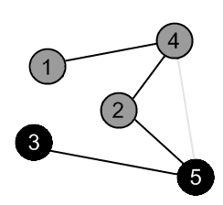
There are no ways to go from the vertex 5.
So, backtrack to the vertex 2 to check other adjacent vertices of the vertex 2.

Slide 62
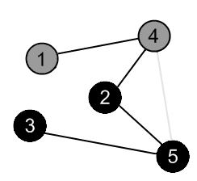
There are no more edges, adjacent to vertex 2. So, backtrack to the vertex 4 to check other adjacent vertices of the vertex 4.

Slide 63
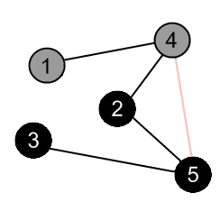
There is an edge (4, 5), but the vertex 5 is already visited. So do not go to the vertex 5. Continue with other adjacent vertices of vertex 4.

Slide 64
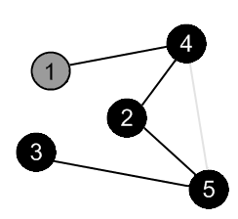
There are no more edges, adjacent to the vertex 4. So, backtrack to the vertex 1 to check other adjacent vertices of the vertex 1.

Slide 65
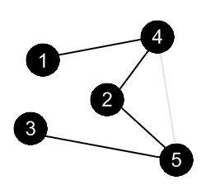
There are no more edges, adjacent to the vertex 1.
DFS is over.

Slide 66
A depth first traversal method tends to traverse very long, narrow trees; whereas breadth first traversal method tends to traverse very wide, short trees.

Slide 67
Summary
Breadth First Search (BFS)
Depth First Search (DFS)

