Slide 1
Review
Binary Search Trees
Operations on Binary Search Tree
  Inserting a Node
  Searching a Node
  Deleting a Node
Expression Tree
Decision Tree

Slide 2
Graphs
Graph
Directed Graph
Undirected Graph
Sub-Graph
Spanning Sub-Graph
Degree of a Vertex
Weighted Graph
Elementary and Simple Path
Link List Representation

Slide 3
Introduction
A graph G consist of
1. Set of vertices V (called nodes), V = {v1, v2, v3, v4......} and
2. Set of edges E={e1, e2, e3......}
A graph can be represented as G = (V, E), where V is a finite and non empty set of vertices and E is a set of pairs of vertices called edges
Each edge ‘e’ in E is identified with a unique pair (a, b) of nodes in V, denoted by e = {a, b}

Slide 4
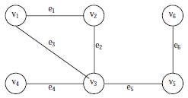
Consider the following graph, G
Then the vertex V and edge E can be represented as:
V = {v1, v2, v3, v4, v5, v6} and E = {e1, e2, e3, e4, e5, e6}
E = {(v1, v2) (v2, v3) (v1, v3) (v3, v4),(v3, v5) (v5, v6)}
There are six edges and vertex in the graph

Slide 5
Directed Graph
A graph can be a
  Directed Graph
  Undirected/Simple Graph
A directed graph G is defined as an ordered pair (V, E) where, V is a set of vertices and the ordered pairs in E are called edges on V
A directed graph can be represented geometrically as a set of marked points (called vertices) V with a set of arrows (called edges) E between pairs of points (or vertex or nodes) so that there is at most one arrow from one vertex to another vertex

Slide 6
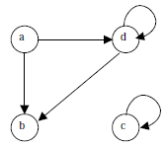
For example, following figure shows a directed graph, where G ={a, b, c, d }, E={(a, b), (a, d), (d, b), (d, d), (c, c)}
An edge (a, b), is said to be the incident with the vertices it joints, i.e., a, b
We can also say that the edge (a, b) is incident from a to b
The vertex a is called the initial vertex and the vertex b is called the terminal vertex of the edge (a, b)

Slide 7
If an edge that is incident from and into the same vertex, say (d, d) or (c, c) in figure, is called a loop
Two vertices are said to be adjacent if they are joined by an edge
Consider edge (a, b), the vertex a is said to be adjacent to the vertex b, and the vertex b is said to be adjacent to vertex a
A vertex is said to be an isolated vertex if there is no edge incident with it
In this figure vertex C is an isolated vertex

Slide 8
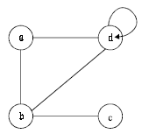
Undirected Graph
An undirected graph G is defined abstractly as an ordered pair (V, E), where V is a set of vertices and the E is a set at edges
An undirected graph can be represented geometrically as a set of marked points (called vertices) V with a set of lines (called edges) E between the points
An undirected graph G is shown in the following figure

Slide 9


Sub-Graph
Let G = (V, E) be a graph
A graph G1 = (V1, E1) is said to be a sub-graph of G if E1 is a subset of E and V1 is a subset of V such that the edges in E1 are incident only with the vertices in V1
For example, Fig.(b) is a sub-graph of Fig. (a)
Fig (a)
Fig (a)

Slide 10

Spanning Sub-Graph
A sub-graph of G is said to be a spanning sub-graph if it contains all the vertices of G
For example Fig.(c) shows a spanning sub-graph of Fig.(a).
Fig (a)
Fig (a)

Slide 11
Degree of a Vertex
The number of edges incident on a vertex is its degree
The degree of vertex a, is written as degree (a)
If the degree of vertex a is zero, then vertex a is called isolated vertex
For example the degree of the vertex a in following figure is 3

Slide 12
Weighted Graph
A graph G is said to be weighted graph if every edge and/or vertices in the graph is assigned with some weight or value
A weighted graph can be defined as G = (V, E, We, Wv) where V is the set of vertices, E is the set of edges and We is a weight of the edges whose domain is E and Wv is a weight of the vertices whose domain is V

Slide 13
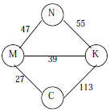
Consider the following figure
Here V = {N, K, M, C,} E = {(N, K), (N,M,), (M,K), (M,C), (K,C)} We = {55,47, 39, 27, 113} and Wv = {N, K, M, C}
The weight of the vertices is not necessary as the set Wv and V are same

Slide 14
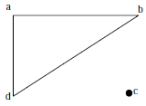
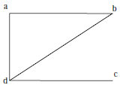
Connected and Disconnected Graphs
An undirected graph is said to be connected if there exist a path from any vertex to any other vertex
Otherwise it is said to be disconnected
Fig. A shows the disconnected graph, where the vertex c is not connected to the graph
Fig. B shows the connected graph, where all the vertexes are connected

Slide 15
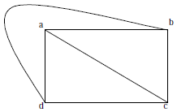
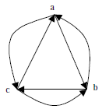
Complete Graph
A graph G is said to complete (or fully connected or strongly connected) if there is a path from every vertex to every other vertex
Let a and b are two vertices in the directed graph, then it is a complete graph if there is a path from a to b as well as a path from b to a
Fig X illustrates the complete undirected graph
Fig Y shows the complete directed graph
Fig X
Fig Y

Slide 16
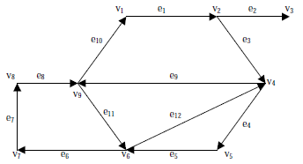
Elementary and Simple Path
In a directed graph, a path is a sequence of edges (e1, e2, e3, ...... en) such that the edges are connected with each other
A path is said to be elementary if it does not meet the same vertex twice
A path is said to be simple if it does not meet the same edges twice
Consider a graph in Fig.

Slide 17
Where (e1, e3, e4, e5) is a path; (e1, e3, e4, e5, e12, e9, e11, e6, e7, e8, e11) is a path but not a simple one; (e1, e3, e4, e5, e6, e7, e8, e11, e12) is a simple path but not elementary one; (e1, e3, e4, e5, e6, e7, e8) is an elementary path
A circuit is a path (e1, e2, .... en) in which terminal vertex of en coincides with initial vertex of e1
A circuit is said to be simple if it does not include (or visit) the same edge twice
A circuit is said to be elementary if it does not visit the same vertex twice
In above figure (e1, e3, e4, e5, e12, e9, e10) is a simple circuit but not a elementary one
(e1, e3, e4, e5, e6, e7, e8, e10) is an elementary circuit

Slide 18
Representation of Graphs
Graph is a mathematical structure
The problems related to graph G must be represented in computer memory using any suitable data structure to solve it
There are two standard ways of maintaining a graph G in the memory of a computer
1. Sequential representation of a graph using adjacent
2. Linked representation of a graph using linked list

Slide 19
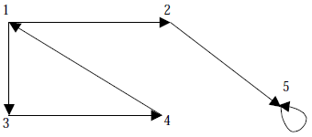
Adjacency Matrix Representation
The adjacency of a graph G = (V, E) with n vertices, is an n × n matrix
To represent it, considered a directed graph in following figure where all the vertices are numbered, (1, 2, 3, 4, 5)

Slide 20
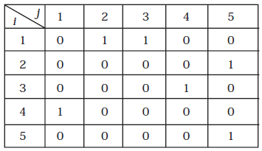
The adjacency matrix A of a directed graph G = (V, E) can be represented with the following conditions:
  Aij = 1 {if there is an edge from Vi to Vj or if the edge (i, j) is member of E.}
  Aij = 0 {if there is no edge from Vi to Vj}

Slide 21
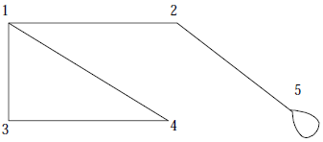
Now let us discuss how an undirected graph can be represented using adjacency matrix
Consider an undirected graph in following figure:

Slide 22
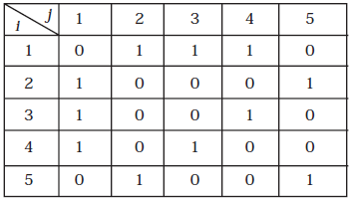
The adjacency matrix A of an undirected graph G = (V, E) can be represented with the following conditions:
Aij = 1 {if there is an edge from Vi to Vj or if the edge (i, j) is member of E}
Aij = 0 {if there is no edge from Vi to Vj or the edge i, j, is not a member of E}

Slide 23
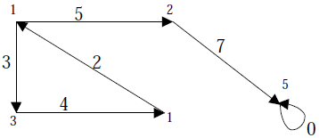
To represent a weighted graph using adjacency matrix, weight of the edge (i, j) is simply stored as the entry in i th row and j th column of the adjacency matrix
There are some cases where zero can also be the possible weight of the edge, then we have to store some sentinel value for non-existent edge, which can be a negative value; since the weight of the edge is always a positive number
Consider a weighted graph in the following figure:

Slide 24
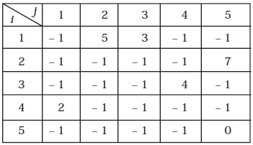
The adjacency matrix A for a directed weighted graph G = (V, E, We ) can be represented as:
Aij = Wij { if there is an edge from Vi to Vj then represent its weight Wij}
Aij = – 1 { if there is no edge from Vi to Vj}

Slide 25
In this representation, n² memory location is required to represent a graph with n vertices
The adjacency matrix is a simple way to represent a graph, but it has two disadvantages
1. It takes n² space to represent a graph with n vertices, even for a small graph and
2. It takes O(n² ) time to solve the graph problem

Slide 26
Linked List Representation
It is also called Adjacency List Representation
In this representation we store a graph as a linked structure
First we store all the vertices of the graph in a list and then each adjacent vertices will be represented using linked list node

Slide 27
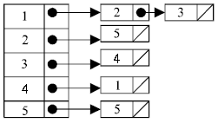
Consider a directed graph
It can be represented using linked list as:

Slide 28
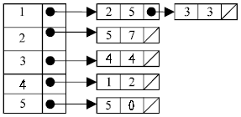
Weighted graph can be represented using linked list by storing the corresponding weight along with the terminal vertex of the edge
Consider a weighted graph
It can be represented using linked list as

Slide 29
Although the linked list representation requires very less memory as compared to the adjacency matrix
The simplicity of adjacency matrix makes it preferable when graphs are reasonably small

Slide 30
Traversing a Graph
Many application of graph requires a structured system to examine the vertices and edges of a graph G
That is a graph traversal, which means visiting all the nodes of the graph
There are two graph traversal methods
Breadth First Search (BFS)
  Think Queue
(b) Depth First Search (DFS)
  Think Stack

Slide 31
Summary
Graph
Directed Graph
Undirected Graph
Sub-Graph
Spanning Sub-Graph
Degree of a Vertex
Weighted Graph
Elementary and Simple Path
Link List Representation

