Slide 1
Review
Binary Tree
Binary Tree Representation
  Array Representation
  Link List Representation
Operations on Binary Trees
Traversing Binary Trees
  Pre-Order Traversal Recursively
  In-Order Traversal Recursively
  Post-Order Traversal Recursively

Slide 2
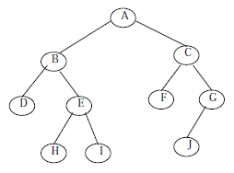
For Example
The preorder traversal of this binary tree is
A, B, D, E, H, I, C, F, G, J.

Slide 3
For Example
The in order traversal of this binary tree is
D, B, H, E, I, A, F, C, J, G.

Slide 4
For Example
The post order traversal of this binary tree is
D, H, I, E, B, F, J, G, C, A

Slide 5
Binary Search Trees
Binary Search Trees
Operations on Binary Search Tree
  Inserting a Node
  Searching a Node
  Deleting a Node
Expression Tree
Decision Tree

Slide 6
Binary Search Trees
A Binary Search Tree is a binary tree, which is either empty or satisfies the following properties:
1. Every node has a value and no two nodes have the same value (i.e., all the values are unique)
2. If there exists a left child or left sub tree then its value is less than the value of the root
3. The value(s) in the right child or right sub tree is larger than the value of the root node
All the nodes or sub trees of the left and right children follows above rules

Slide 7
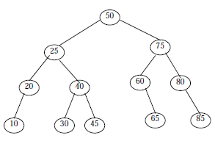
For Example
This figure shows an example of binary search tree
Here the root node information is 50
The right sub tree node’s value is greater than 50, and the left sub tree nodes value is less than 50
Again right child node of 25 has large values than 25 and left child node has small values than 25
Similarly right child node of 75 has large values than 75 and left child node has small values that 75 and so on

Slide 8
Operations on Binary Search Tree
The operations performed on binary tree can also be applied to Binary Search Tree (BST)
Most commonly performed operation on BST is, traversal. The tree traversal algorithm (pre-order, post-order and in-order) are the standard way of traversing a binary search tree
In this section we discuss few other operations performed on BST:
1. Inserting/Adding a node
2. Searching a node
3. Deleting a node

Slide 9
Inserting a New Node
A BST is constructed by the repeated insertion of new nodes to the tree structure
Inserting a node in to a tree is achieved by performing two separate operations
1. The tree must be searched to determine where the node is to be inserted
2. Then the node is inserted into the tree

Slide 10
Steps to Insert a New Node
Suppose a “DATA” is the information to be inserted in a BST
Step 1: Compare DATA with root node information of the tree
(i) If (DATA < ROOT → Info)
Proceed to the left child of ROOT
(ii) If (DATA > ROOT → Info)
Proceed to the right child of ROOT
Step 2: Repeat the Step 1 until we meet an empty sub tree, where we can insert the DATA in place of the empty sub tree by creating a new node.
Step 3: Exit

Slide 11
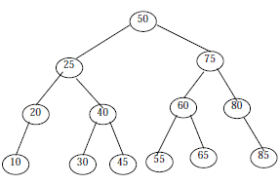
For Example
Consider the following BST
Suppose we want to insert a DATA=55 in to the tree, then following steps are performed:

Slide 12
1. Compare 55 with root node info (i.e., 50) since 55 > 50 proceed to the right sub tree of 50
2. The root node of the right sub tree contains 75. Compare 55 with 75. Since 55 < 75 proceed to the left sub tree of 75
3. The root node of the left sub tree contains 60. Compare 55 with 60. Since 55 < 60 proceed to the left sub tree of 60
4. Since left sub tree is NULL, place 55 as the left child of 60 as shown in the figure

Slide 13
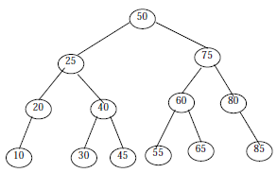

Slide 14
Algorithm
NEWNODE is a pointer variable to hold the address of the newly created node. DATA is the information to be pushed
1. Input the DATA to be pushed and ROOT node of the tree
2. NEWNODE = Create a New Node
3. If (ROOT == NULL)
(a) ROOT=NEW NODE
4. Else If (DATA < ROOT → Info) and ROOT → Lchild != NULL
(a) ROOT = ROOT → Lchild
(b) GoTo Step 4
5. Else If (DATA > ROOT → Info) and ROOT → Rchild != NULL
(a) ROOT = ROOT → Rchild
(b) GoTo Step 4

Slide 15
cont…
6. If (DATA < ROOT → Info)
(a) ROOT → LChild = NEWNODE
7. Else If (DATA > ROOT → Info)
(a) ROOT → RChild = NEWNODE
8. Else
(a) Display (“DUPLICATE NODE”)
(b) EXIT
9. NEW NODE → Info = DATA
10. NEW NODE → LChild = NULL
11. NEW NODE → RChild = NULL
12. EXIT

Slide 16
Searching a Node
Searching a node was part of the operation performed during insertion
Algorithm to search an element from a binary search tree is given below:
Algorithm
1. Input the DATA to be searched and assign the address of the root node to ROOT.
2. If (DATA == ROOT → Info)
(a) Display “The DATA exist in the tree”
(b) GoTo Step 6
3. If (ROOT == NULL)
(a) Display “The DATA does not exist”
(b) GoTo Step 6

Slide 17
cont…
4. If(DATA > ROOT→Info)
(a) ROOT = ROOT→RChild
(b) GoTo Step 2
5. If(DATA < ROOT→Info)
(a) ROOT = ROOT→Lchild
(b) GoTo Step 2
6. Exit

Slide 18
Deleting a Node
First search and locate the node to be deleted
Then any one of the following conditions arises:
1. The node to be deleted has no children
2. The node has exactly one child (or sub tress, left or right sub tree)
3. The node has two children (or two sub tress, left and right sub tree)
Suppose the node to be deleted is N
If N has no children then simply delete the node and place its parent node by the NULL pointer

Slide 19
If N has one child, check whether it is a right or left child. If it is a right child, then find the smallest element from the corresponding right sub tree
Then replace the smallest node information with the deleted node
If N has a left child, find the largest element from the corresponding left sub tree
Then replace the largest node information with the deleted node
The same process is repeated if N has two children, i.e., left and right child

Slide 20
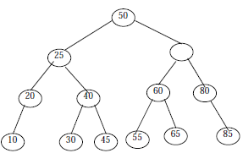
Randomly select a child and find the small/large node and replace it with deleted node
NOTE that the tree that we get after deleting a node should also be a binary search tree
For example:
Consider a binary search tree as given below:

Slide 21
If we want to delete 75 from the tree, following steps are performed:
Step 1: Assign the data to be deleted in DATA and NODE = ROOT
Step 2: Compare the DATA with ROOT node, i.e., NODE, information of the tree
Since (50 < 75)
NODE = NODE → RChild
Step 3: Compare DATA with NODE Since (75 = 75) searching successful
Now we have located the data to be deleted, and delete the DATA

Slide 22
Step 4: Since NODE (i.e., node where value was 75) has both left and right child choose one, lets choose right child
If right sub tree is opted then we have to find the smallest node but if left sub tree is opted then we have to find the largest node
Step 5: Find the smallest element from the right sub tree (i.e., 80) and replace the node with deleted node

Slide 23
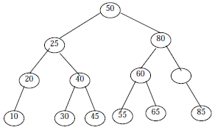
Step 6: Again the (NODE → Rchild is not equal to NULL) find the smallest element from the right sub tree (Which is 85) and replace it with empty node

Slide 24
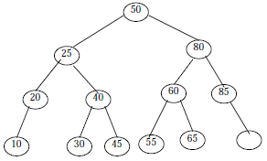
Step 7: Since (NODE→Rchild = NODE→Lchild = NULL) delete the NODE and place NULL in the parent node

Slide 25
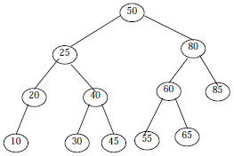
Step 8: Exit

Slide 26
Algorithm
Write an Algorithm to delete a node

Slide 27

Expression Tree
An ordered tree may be used to represent a general expressions, is called expression tree
Nodes in one expression tree contain operators and operands
A binary tree is used to represent a binary expression called binary expression tree
Root node of the binary expressions trees contains operator and two children node contain its operand
For example, a+b can be represented as

Slide 28
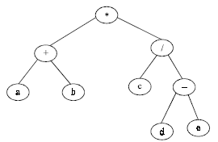
The expression E = (a + b) * (c/ (d – e)) ) can be represented in binary expression tree as follows:
Expression tree can be evaluated, if its operands are numerical constants

Slide 29
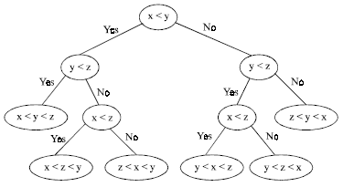
Decision Tree
A decision tree is a binary tree, where sorting of elements is done by only comparisons
A decision tree can be applied to any sorting algorithms that sorts by using comparisons
For example

Slide 30
Summary
Binary Search Trees
Operations on Binary Search Tree
  Inserting a Node
  Searching a Node
  Deleting a Node
Expression Tree
Decision Tree

