Slide 1
Review
Queue
Operations on Queues
  A Dequeue Operation
  An Enqueue Operation
Array Implementation
Link list Implementation
Examples

Slide 2
Review
Circular queue
Double Ended Queue
Priority queue

Slide 3
Trees
Binary Tree
Binary Tree Representation
  Array Representation
  Link List Representation
Operations on Binary Trees
Traversing Binary Trees
  Pre-Order Traversal Recursively
  In-Order Traversal Recursively
  Post-Order Traversal Recursively

Slide 4
Trees
Trees are very flexible, versatile and powerful non-liner data structure
It can be used to represent data items possessing hierarchical relationship
A tree can be theoretically defined as a finite set of one or more data items (or nodes) such that
  There is a special node called the root of the tree
  Remaining nodes (or data item) are partitioned into number of subsets each of which is itself a tree, are called sub tree
A tree is a set of related interconnected nodes in a hierarchical structure

Slide 5
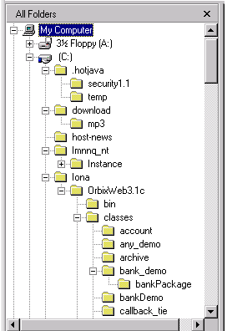
Trees
Where have you seen a tree structure before?
Examples of trees:
- Directory tree
- Family tree
- Company organization chart
- Table of contents
- etc.

Slide 6
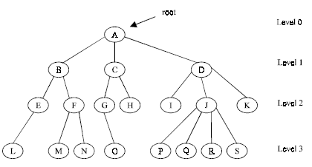
Basic Terminologies
Root is a specially designed node (or data items) in a tree
It is the first node in the hierarchical arrangement of the data items
For example,
Figure 1. A Tree

Slide 7
In this example ‘A’ is the root node
Each data item in a tree is known as node
It specifies the data information and links to other data items
Degree of a node
Degree of a node is the number of subtrees of a node in a given tree
In the above example
  the degree of node A is 3
  the degree of node B is 2
  the degree of node C is 2
  the degree of node D is 3

Slide 8
The Degree of a Tree
The degree of a tree is the maximum degree of node in a given tree
The degree of node J is 4
All other nodes have less or equal degree
So the degree of the above tree is 4
A node with degree zero (0) is called terminal node or a leaf
In the above example, nodes M,N,I,O etc are leaf nodes
Any node whose degree is not zero is called a non-terminal node

Slide 9
Levels of a Tree
The tree is structured in different levels
The entire tree is leveled in such a way that the root node is always of level 0
Its immediate children are at level 1 and their immediate children are at level 2 and so on up to the terminal nodes
If a node is at level n then its children will be at level n+1

Slide 10
Depth of a Tree
Depth of a tree is the maximum level of any node in a given tree
The number of levels from root to the leaves is called depth of a tree
The term height is also used to denote the depth of a tree

Slide 11
A vertex (or node) is a simple object that can have a name and can carry other associated information
An edge is a connection between two vertices
A path in a tree is a list of distinct vertices in which successive vertices are connected by edges in the tree
  example: {a, b, d, i } is path
The defining property of a tree is that there is precisely one path connecting any two nodes

Slide 12
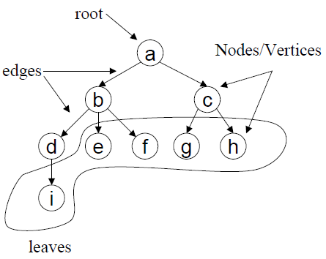
Example of a Tree

Slide 13
Binary Trees
A binary tree is a tree in which no node can have more than 2 children
These children are described as “left child” and “right child” of the parent node
A binary tree T is defined as a finite set of elements called nodes such that
  T is empty if T has no nodes called the null or empty tree
  T contains a special node R, called root node of T and the remaining nodes of T form an ordered pair of disjoined binary trees T1 and T2. They are called left and right sub tree of R

Slide 14
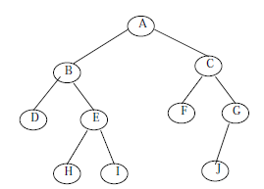
Consider the following binary tree T
Here ‘A’ is the root node of the tree
‘B’ is the left child of ‘A’ and ‘C’ is the right child of ‘A’
i.e. ‘A’ is the father of ‘B’ and ‘C’
The nodes ‘B’ and ‘C’ are called brothers

Slide 15
Strictly Binary Tree
The tree is said to be strictly binary tree, if every non-leaf node in a binary tree has non-empty left and right sub trees
A strictly binary tree with n level always contains 2^{n}–1 nodes
Every node in the strictly binary tree can have either no children or two children
They are also called 2-tree or extended binary tree

Slide 16
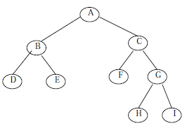
Example of a strictly binary tree

Slide 17
Application of an extended binary tree
The main application of a 2-tree is to represent and compute any algebraic expression using binary operation
For example, consider an algebraic expression E
E = (a + b)/((c – d )*e)
E can be represented by means of the extended binary tree T as shown in figure
Each variable or constant in E appears as an internal node in T whose left and right sub tree corresponds to the operands of the operation

Slide 18
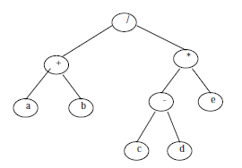
E = (a + b)/((c – d )*e)

Slide 19
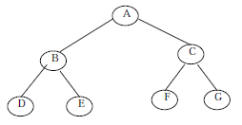
A complete binary tree at depth ‘d’ is the strictly binary tree where all the leaves are at level d
Following figure illustration the complete binary tree of depth 3

Slide 20
A binary tree with n nodes, n > 0, has exactly n – 1 edges
A binary tree of depth d, d > 0, has at least d and at most 2^{d} – 1 nodes in it
If a binary tree contains n nodes at level l, then it contains at most 2n nodes at level l + 1
The main difference between a binary tree and ordinary tree is
1. A binary tree can be empty where as a tree cannot
2. Each element in binary tree has exactly two sub trees. Each element in a tree can have any number of sub trees
3. The sub tree of each element in a binary tree are ordered, left and right sub trees. The sub trees in a tree are unordered

Slide 21
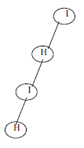
If a binary tree has only left sub trees, then it is called left skewed binary tree
Following is an example of left skewed binary tree

Slide 22
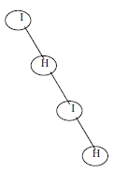
If a binary tree has only right sub trees, then it is called right skewed binary tree
Following is an example

Slide 23
Binary Tree Representation
There are two ways of representing binary tree T in memory :
1. Sequential representation using arrays
2. Linked list representation
Array Representation
An array can be used to store the nodes of a binary tree
The nodes stored in an array of memory can be accessed sequentially
Suppose a binary tree T of depth d, Then at most 2^{d} – 1 nodes can be there in T.(i.e. SIZE = 2^{d}–1)
So the array of size “SIZE” to represent the binary tree

Slide 24
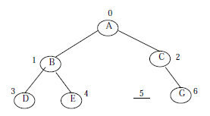
Consider a binary tree in the figure of depth 3
Then SIZE = 2³ – 1 = 7
Then the array A[7] is declared to hold the nodes

Slide 25

The array representation of the binary tree is shown below:
To perform any operation often we have to identify the father, the left child and right child of an arbitrary node
1. The father of a node having index n can be obtained by (n – 1)/2. For example to find the father of D, where array index n = 3. Then the father nodes index can be obtained
= (n – 1)/2
= 3 – 1/2
= 2/2
= 1
i.e., A[1] is the father of D, which is B

Slide 26
2. The left child of a node having index n can be obtained by (2n+1)
For example to find the left child of C, where array index n = 2. Then it can be obtained by
= (2n +1)
= 2*2 + 1
= 4 + 1
= 5
i.e., A[5] is the left child of C, which is NULL. So no left child for C.

Slide 27
3. The right child of a node having array index n can be obtained by the formula (2n+ 2).
For example to find the right child of B, where the array index n = 1. Then
= (2n + 2)
= 2*1 + 2
= 4
i.e., A[4] is the right child of B, which is E.

Slide 28
4. If the left child is at array index n, then its right brother is at (n + 1).Similarly, if the right child is at index n, then its left brother is at (n – 1)
The array representation is more ideal for the complete binary tree
The Fig. given in this example is not a complete binary tree Since there is no left child for node C, i.e., A[5] is vacant. Even though memory is allocated for A[5] it is not used, so wasted unnecessarily

Slide 29
Linked List Representation
The most popular and practical way of representing a binary tree is using linked list
In linked list, every element is represented as nodes
A node consists of three fields such as :
(a) Left Child (LChild)
(b) Information of the Node (Info)
(c) Right Child (RChild)

Slide 30
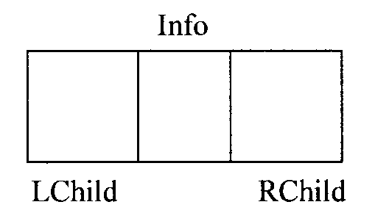
The LChild links to the left child node of the parent node
Info holds the information of the node
And RChild holds the address of the right child node of the parent node
The following figure shows the structure of a binary tree node:

Slide 31
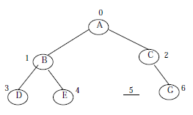
For example we have the following binary tree
We want to present this binary tree in linked list form

Slide 32
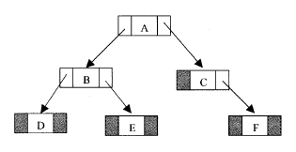
The linked list representation of this binary tree is:
If a node has no left or/and right node, corresponding LChild or RChild is assigned to NULL

Slide 33
Operations on Binary Trees
The basic operations that are commonly performed on binary trees are listed below:
  Create an empty binary tree
  Traversing a binary tree
  Inserting a new node
  Deleting a Node
  Searching for a Node
  Determine the total no. of Nodes
  Determine the total no. of leaf Nodes
  Determine the total no. of non-leaf Nodes
  Find the smallest element in the tree
  Finding the largest element
  Find the Height of the tree
  Finding the Father/Left Child/Right Child/Brother of an arbitrary node

Slide 34
Traversing Binary Trees
Tree traversal is one of the most common operations performed on trees
In traversing right sub-tree is always traversed after left sub-tree
It is a way in which each node in the tree is visited exactly once in a systematic manner
There are three standard ways of traversing a binary tree
  1. Pre Order Traversal (Root-left-right)
  2. In order Traversal (Left-root-right)
  3. Post Order Traversal (Left-right-root)

Slide 35
Pre-Order Traversal Recursively
To traverse a non-empty binary tree in pre-order following steps are to be processed
1. Visit the root node
2. Traverse the left sub tree in preorder
3. Traverse the right sub tree in preorder
That is, in pre-order traversal, the root node is visited (or processed) first, before traversing through left and right sub trees recursively

Slide 36
void preorder (Node * Root)
{
If (Root != NULL)
{
cout <<Root → Info;
preorder(Root → L child);
preorder(Root → R child);
}
}

Slide 37
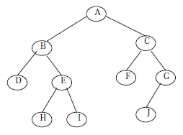
For Example
The preorder traversal of this binary tree is
A, B, D, E, H, I, C, F, G, J.

Slide 38
In-Order Traversal Recursively
The in order traversal of a non-empty binary tree is defined as follows :
1. Traverse the left sub tree in order
2. Visit the root node
3. Traverse the right sub tree in order
In order traversal, the left sub tree is traversed recursively, before visiting the root
After visiting the root the right sub tree is traversed recursively

Slide 39
The procedure for an in order traversal is given below :
void inorder (NODE *Root)
{
If (Root != NULL)
{
inorder(Root → L child);
cout<<Root → info;
inorder(Root → R child);
}
}

Slide 40
For Example
The in order traversal of this binary tree is
D, B, H, E, I, A, F, C, J, G.

Slide 41
Post-Order Traversal Recursively
The post order traversal of a non-empty binary tree can be defined as :
1. Traverse the left sub tree in post order
2. Traverse the right sub tree in post order
3. Visit the root node
In Post Order traversal, the left and right sub tree(s) are recursively processed before visiting the root

Slide 42
The procedure for post order traversal is given below:
void postorder (NODE *Root)
{
If (Root != NULL)
{
postorder(Root → Lchild);
postorder(Root → Rchild);
cout<<Root → info;
}
}

Slide 43
For Example
The post order traversal of this binary tree is
D, H, I, E, B, F, J, G, C, A

Slide 44
Summary
Binary Tree
Binary Tree Representation
  Array Representation
  Link List Representation
Operations on Binary Trees
Traversing Binary Trees
  Pre-Order Traversal Recursively
  In-Order Traversal Recursively
  Post-Order Traversal Recursively

