Slide 1
Queue
Queue
Operations on Queues
A Dequeue Operation
An Enqueue Operation
Array Implementation
Link list Implementation
Examples

Slide 2
Queue
It is a linear data structure used to represent a linear list and permits deletion to be performed at one end and of the list and the insertions at the other end.
The information in such a list is processed in the same order as it was received.
i.e-FIRST-COME-FIRST-SERVE basis(FCFS).
Or FIRST IN FIRST OUT(FIFO).

Slide 3
Queue
items[MAXQUEUE-1]
. | .
. | .
. | .
items[2] | C
items[1] | B
items[0] | A
Rear=2
Front=0

Slide 4
Declaration of a Queue
# define MAXQUEUE 50 /* size of the queue items*/
typedef struct {
int front;
int rear;
int items[MAXQUEUE];
}QUEUE;

Slide 5
Implementation of queue.
Two common ways in which queues may be implemented are as follows:
ARRAYS
POINTERS(one way linear linked list)

Slide 6
Operations of queue
Insertion in queue.
Deletion in queue.
List(display) of the queue.

Slide 7
Different type of queue
Circular queue
Double Ended Queue
Priority queue

Slide 8
Circular queue
Let we have an array named Q, that contains n element in which Q[1] comes after Q[n] in the array.
When this technique is used to construct a queue is called circular queue.
In other word we can say that a queue is called circular when the last room comes just before the first room.

Slide 9
Circular queue….
Q[n]
Q[1]
Q[n-1]
Q[2]
.
Q[3]
.
.

Slide 10
Queue cont….
In a circular queue when rear=n, if we insert an element then this element is assigned to q[1] instead of increasing rear to n+1.
Suppose queue contains only one element that is front=rear!=0 and suppose that the element is removed then the front and rear pointers are now assigned ‘0’ to indicate that the queue is EMPTY.

Slide 11
Application of queue
An e.g. of queue is time sharing computer system where many users share the system simultaneously.
The procedure, which is used to design such type of system, is Round Robin Technique.
The railway reservation counter is also an example of queue where the people collect their tickets on FIFO or FCFS based.

Slide 12
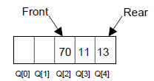
TYPES OF QUEUES
Suppose a queue Q has maximum size 5, say 5 elements pushed and 2 elements popped.
There are three major variations in a simple queue.
  1. Circular queue
  2. Double ended queue (de-queue)
  3. Priority queue
Priority queue is generally implemented using linked list so we discussed it later.

Slide 13
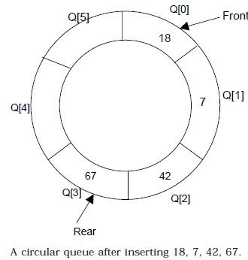
CIRCULAR QUEUE
In circular queues the elements Q[0],Q[1],Q[2] .... Q[n – 1] is represented in a circular fashion with Q[1] following Q[n].
A circular queue is one in which the insertion of a new element is done at the very first location of the queue if the last location at the queue is full.
Suppose Q is a queue array of 6 elements.
Push and pop operation can be performed on circular.

Slide 14
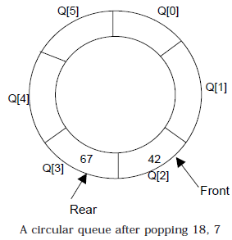
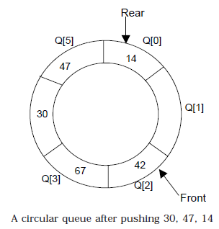
Cont…..
After inserting an element at last location Q[5], the next element will be inserted at the very first location (i.e., Q[0]).
Circular queue is one in which the first element comes just after the last element.

Slide 15
Cont……
At any time the position of the element to be inserted will be calculated by the relation
Rear = (Rear + 1) % SIZE
After deleting an element from circular queue the position of the front end is calculated by the relation
Front= (Front + 1) % SIZE
After locating the position of the new element to be inserted, rear, compare it with front.
  If (rear = front), the queue is full and cannot be inserted anymore.

Slide 16
ALGORITHMS
Inserting an element to circular Queue
  1. Initialize FRONT = – 1; REAR = -1
  2. REAR = (REAR + 1) % SIZE
  3. If (FRONT is equal to REAR)
    (a) Display “Queue is full”
    (b) Exit
  4. Else
    (a) Input the value to be inserted and assign to variable “DATA”
  5. If (FRONT is equal to – 1)
    (a) FRONT = 0
    (b) REAR = 0
  6. Q[REAR] = DATA
  7. Repeat steps 2 to 5 if we want to insert more elements
  8. Exit

Slide 17
Cont…
Deleting an element from a circular queue
  1. If (FRONT is equal to – 1)
    (a) Display “Queue is empty”
    (b) Exit
  2. Else
    (a) DATA = Q[FRONT]
  3. If (REAR is equal to FRONT)
    (a) FRONT = –1
    (b) REAR = –1
  4. Else
    (a) FRONT = (FRONT +1) % SIZE
  5. Repeat the steps 1, 2 and 3 if we want to delete more elements
  6. Exit

Slide 18
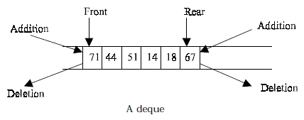
DEQUES
A deque is a homogeneous list in which elements can be added or inserted and deleted or removed from both the ends.
  We can add a new element at the rear or front end and also we can remove an element from both front and rear end.
Hence it is called Double Ended Queue.

Slide 19
Cont….
There are two types of deque depending upon the restriction to perform insertion or deletion operations at the two ends.
  1. Input restricted deque
  2. Output restricted deque
An input restricted deque
  is a deque, which allows insertion at only 1 end, rear end,
  but allows deletion at both ends, rear and front end of the lists.
An output-restricted deque
  is a deque, which allows deletion at only one end, front end,
  but allows insertion at both ends, rear and front ends, of the lists.

Slide 20
The possible operation performed on deque
  1. Add an element at the rear end
  2. Add an element at the front end
  3. Delete an element from the front end
  4. Delete an element from the rear end
Only 1st, 3rd and 4th operations are performed by input-restricted deque
1st, 2nd and 3rd operations are performed by output-restricted deque.

Slide 21
ALGORITHUM
Let Q be the array of MAX elements. front (or left) and rear (or right) are two array index (pointers), where the addition and deletion of elements occurred. Let DATA be the element to be inserted. Before inserting any element to the queue left and right pointer will point to the – 1.
INSERT AN ELEMENT AT THE RIGHT SIDE OF THE DE-QUEUE
  1. Input the DATA to be inserted
  2. If ((left == 0 && right == MAX–1) || (left == right + 1))
  (a) Display “Queue Overflow”
  (b) Exit
  3. If (left == –1) // if queue is initially empty
  (a) left = 0
  (b) right = 0
  4. Else
  (a) if (right == MAX –1)// right is at last position of queue
  (i) right = 0
  (b) else
  (i) right = right+1
  5. Q[right] = DATA
  6. Exit

Slide 22
Cont….
INSERT AN ELEMENT AT THE LEFT SIDE OF THE DE-QUEUE
  1. Input the DATA to be inserted
  2. If ((left == 0 && right == MAX–1) || (left == right+1))
  (a) Display “Queue Overflow”
  (b) Exit
  3. If (left == – 1)
  (a) Left = 0
  (b) Right = 0
  4. Else
  (a) if (left == 0)
  (i) left = MAX – 1
  (b) else
  (i) left = left – 1
  5. Q[left] = DATA
  6. Exit

Slide 23
ALGORITHMS FOR DELETING AN ELEMENT
Let Q be the array of MAX elements.
  front (or left) and rear (or right) are two array index (pointers), where the addition and deletion of elements occurred.
  DATA will contain the element just deleted.

Slide 24
Cont….
DELETE AN ELEMENT FROM THE RIGHT SIDE OF THE DE-QUEUE
  1. If (left == – 1)
    (a) Display “Queue Underflow”
    (b) Exit
  2. DATA = Q [right]
  3. If (left == right) //queue has only one element
    (a) left = – 1
    (b) right = – 1
  4. Else
    (a) if(right == 0)
      (i) right = MAX-1
    (b) else
      (i) right = right-1
  5. Exit

Slide 25
Cont…..
DELETE AN ELEMENT FROM THE LEFT SIDE OF THE DE-QUEUE
1. If (left == – 1)
  (a) Display “Queue Underflow”
  (b) Exit
2. DATA = Q [left]
3. If(left == right)
  (a) left = – 1
  (b) right = – 1
4. Else
  (a) if (left == MAX-1)
    (i) left = 0
  (b) Else
    (i) left = left +1
5. Exit

Slide 26
Queue (Linear Queue)
It is a linear data structure consisting of list of items.
In queue, data elements are added at one end, called the rear and removed from another end, called the front of the list.
Two basic operations are associated with queue:
1. “Insert” operation is used to insert an element into a queue.
2. “Delete” operation is used to delete an element from a queue.
FIFO list
Example:
Queue: AAA, BBB, CCC, DDD, EEE
7
6
EEE
5
1
2
3
4
5
6
7
DDD
4
AAA
BBB
CCC
DDD
EEE
CCC
3
BBB
2
Front
Rear
AAA
1
Rear
Front

Slide 27
Example: Consider the following queue (linear queue).
Rear = 4 and Front = 1 and N = 7
10
50
30
40
1
2
3
4
5
6
7
(1) Insert 20. Now Rear = 5 and Front = 1
10
50
30
40
20
1
2
3
4
5
6
7
(2) Delete Front Element. Now Rear = 5 and Front = 2
50
30
40
20
1
2
3
4
5
6
7
(3) Delete Front Element. Now Rear = 5 and Front = 3
30
40
20
1
2
3
4
5
6
7
(4) Insert 60. Now Rear = 6 and Front = 3
30
40
20
60
1
2
3
4
5
6
7
09/10/08

Slide 28
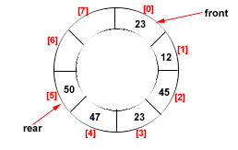
Drawback of Linear Queue
Once the queue is full, even though few elements from the front are deleted and
some occupied space is relieved, it is not possible to add anymore new elements,
as the rear has already reached the Queue’s rear most position.
Circular Queue
This queue is not linear but circular.
Its structure can be like the following figure:
In circular queue, once the Queue is full the
"First" element of the Queue becomes the
"Rear" most element, if and only if the "Front"
has moved forward. otherwise it will again be
a "Queue overflow" state.
Figure: Circular Queue having
Rear = 5 and Front = 0

Slide 29
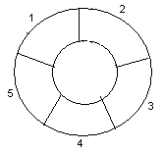
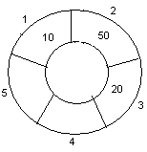
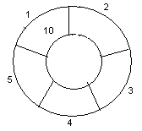
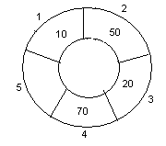
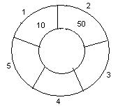
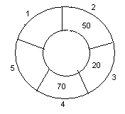
Example: Consider the following circular queue with N = 5.
1. Initially, Rear = 0, Front = 0.
4. Insert 20, Rear = 3, Front = 0.
Front
Rear
2. Insert 10, Rear = 1, Front = 1.
5. Insert 70, Rear = 4, Front = 1.
Rear
Front
Front
Rear
3. Insert 50, Rear = 2, Front = 1.
6. Delete front, Rear = 4, Front = 2.
Front
Rear
Front
Rear

Slide 30
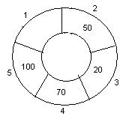
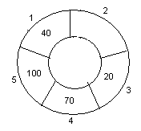
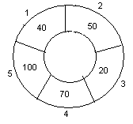
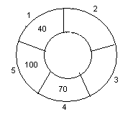
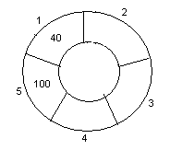
7. Insert 100, Rear = 5, Front = 2.
10. Delete front, Rear = 1, Front = 3.
Front
Rear
Front
Rear
8. Insert 40, Rear = 1, Front = 2.
11. Delete front, Rear = 1, Front = 4.
Rear
Rear
Front
Front
9. Insert 140, Rear = 1, Front = 2.
As Front = Rear + 1, so Queue overflow.
12. Delete front, Rear = 1, Front = 5.
Rear
Rear
Front
Front

Slide 31
QUEUE OPERATIONS
Initialize the queue
Insert to the rear of the queue
Remove (Delete) from the front of the queue
Is the Queue Empty
Is the Queue Full
What is the size of the Queue

Slide 32
INITIALIZE THE QUEUE
The queue is initialized by having the rear set to -1, and front set to 0. Let us assume that maximum number of the element we have in a queue is MAXQUEUE elements as shown below.
items[MAXQUEUE-1]
. | .
. | .
.
items[1]
items[0] |  | front=0
 |  | rear=-1

Slide 33
insert(&Queue, ‘A’)
an item (A) is inserted at the Rear of the queue
items[MAXQUEUE-1]
. | .
. | .
items[3]
items[2]
items[1]
items[0] | A | Front=0, Rear=0

Slide 34
insert(&Queue, ‘B’)
A new item (B) is inserted at the Rear of the queue
items[MAXQUEUE-1]
. | .
. | .
items[3]
items[2]
items[1] | B | Rear=1
items[0] | A | Front=0

Slide 35
insert(&Queue, ‘C’)
A new item (C) is inserted at the Rear of the queue
items[MAXQUEUE-1]
. | .
. | .
items[3]
items[2] | C | Rear=2
items[1] | B
items[0] | A | Front=0

Slide 36
insert(&Queue, ‘D’)
A new item (D) is inserted at the Rear of the queue
items[MAXQUEUE-1]
. | .
. | .
items[3] | D | Rear=3
items[2] | C
items[1] | B
items[0] | A | Front=0

Slide 37
char remove(&Queue)
an item (A) is removed (deleted) from the Front of the queue
items[MAXQUEUE-1]
. | .
. | .
items[3] | D | Rear=3
items[2] | C
items[1] | B | Front=1
items[0] | A

Slide 38
char remove(&Queue)
Remove two items from the front of the queue.
items[MAXQUEUE-1]
. | .
. | .
items[3] | D | Rear=3
items[2] | C | Front=2
items[1] | B
items[0] | A

Slide 39
char remove(&Queue)
Remove two items from the front of the queue.
items[MAXQUEUE-1]
. | .
. | .
items[3] | D | Front=Rear=3
items[2] | C
items[1] | B
items[0] | A

Slide 40
char remove(&Queue)
Remove one more item from the front of the queue.
items[MAXQUEUE-1]
. | .
items[4] |  | Front=4
items[3] | D | Rear=3
items[2] | C
items[1] | B
items[0] | A

Slide 41
INSERT / REMOVE ITEMS
Assume that the rear= MAXQUEUE-1
items[MAXQUEUE-1] | X | rear=MAXQUEUE-1
. | .
. | .
items[3] | D | front=3
items[2] | C
items[1] | B
items[0] | A
What happens if we want to insert a new item into the queue?

Slide 42
INSERT / REMOVE ITEMS
What happens if we want to insert a new item F into the queue?
Although there is some empty space, the queue is full.
One of the methods to overcome this problem is to shift all the items to occupy the location of deleted item.

Slide 43
REMOVE ITEM
items[MAXQUEUE-1]
. | .
. | .
items[3] | D | Rear=3
items[2] | C
items[1] | B | Front=1
items[0] | A

Slide 44
REMOVE ITEM
items[MAXQUEUE-1]
. | .
. | .
items[3] | D | Rear=3
items[2] | C
items[1] | B | Front=1
items[0] | B

Slide 45
REMOVE ITEM
items[MAXQUEUE-1]
. | .
. | .
items[3] | D | Rear=3
items[2] | C
items[1] | C
items[0] | B

Slide 46
REMOVE ITEM
items[MAXQUEUE-1]
. | .
. | .
items[3] | D | Rear=3
items[2] | D
items[1] | C
items[0] | B

Slide 47
REMOVE ITEM
items[MAXQUEUE-1]
. | .
. | .
items[3] | D
items[2] | D | Rear=2
items[1] | C
items[0] | B

Slide 48
INSERT / REMOVE ITEMS
Since all the items in the queue are required to shift when an item is deleted, this method is not preferred.
The other method is circular queue.
When rear = MAXQUEUE-1, the next element is entered at items[0] in case that spot is free.

Slide 49
Initialize the queue.
items[6] |  | front=rear=6
items[5]
items[4]
items[3]
items[2]
items[1]
items[0]

Slide 50
Insert items into circular queue
Insert A,B,C to the rear of the queue.
items[6] |  | front=6
items[5]
items[4]
items[3]
items[2]
items[1]
items[0] | A | rear=0

Slide 51
Insert items into circular queue
Insert A,B,C to the rear of the queue.
items[6] |  | front=6
items[5]
items[4]
items[3]
items[2]
items[1] | B | rear=1
items[0] | A

Slide 52
Insert items into circular queue
Insert A,B,C to the rear of the queue.
items[6] |  | front=6
items[5]
items[4]
items[3]
items[2] | C | rear=2
items[1] | B
items[0] | A

Slide 53
Remove items from circular queue
Remove two items from the queue.
items[6]
items[5]
items[4]
items[3]
items[2] | C | rear=2
items[1] | B
items[0] | A | front=0

Slide 54
Remove items from circular queue
Remove two items from the queue.
items[6]
items[5]
items[4]
items[3]
items[2] | C | rear=2
items[1] | B | front=1
items[0] | A

Slide 55
Remove items from circular queue
Remove one more item from the queue.
items[6]
items[5]
items[4]
items[3]
items[2] | C | rear=front=2
items[1] | B
items[0] | A

Slide 56
Insert D,E,F,G to the queue.
items[6] | G | rear=6
items[5] | F
items[4] | E
items[3] | D
items[2] | C | front=2
items[1] | B
items[0] | A

Slide 57
Insert H and I to the queue.
items[6] | G
items[5] | F
items[4] | E
items[3] | D
items[2] | C | front=2
items[1] | B
items[0] | H | rear=0

Slide 58
Insert H and I to the queue.
items[6] | G
items[5] | F
items[4] | E
items[3] | D
items[2] | C | front=2
items[1] | I
items[0] | H | rear=0

Slide 59
Insert J to the queue.
items[6] | G
items[5] | F
items[4] | E
items[3] | D
items[2] | ?? | front=rear=2
items[1] | I
items[0] | H

Slide 60
PRIORITY QUEUES
The priority queue is a data structure in which intrinsic ordering of the elements determines the results of its basic operations.
An ascending priority queue is a collection of items into which items can be inserted arbitrarily and from which only the smallest item can be removed. On the other hand a descending priority queue allows only the largest item to be removed.

Slide 61
Priority QUEUE Operations
Insertion
  The insertion in Priority queues is the same as in non-priority queues.
Deletion
  Deletion requires a search for the element of highest priority and deletes the element with highest priority. The following methods can be used for deletion/removal from a given Priority Queue:
    An empty indicator replaces deleted elements.
    After each deletion elements can be moved up in the array decrementing the rear.
    The array in the queue can be maintained as an ordered circular array

Slide 62
Priority Queue Declaration
Queue data type of Priority Queue is the same as the Non-priority Queue.
#define MAXQUEUE 10 /* size of the queue items*/
typedef struct {
int front, rear;
int items[MAXQUEUE];
}QUEUE;

Slide 63
Summary
Circular queue
Double Ended Queue
Priority queue

