Slide 1
Review
Array
Array Elements
Accessing array elements
Declaring an array
Initializing an array
Two-dimensional Array
Array of Structure
String
Array of Strings
Examples

Slide 2
Queue
Queue
Operations on Queues
A Dequeue Operation
An Enqueue Operation
Array Implementation
Link list Implementation
Examples

Slide 3
INTRODUCTION
A queue is logically a first in first out (FIFO or first come first serve) linear data structure.
It is a homogeneous collection of elements in which new elements are added at one end called rear, and the existing elements are deleted from other end called front.
The basic operations that can be performed on queue are
  1. Insert (or add) an element to the queue (push)
  2. Delete (or remove) an element from a queue (pop)
Push operation will insert (or add) an element to queue, at the rear end, by incrementing the array index.
Pop operation will delete (or remove) from the front end by
decrementing the array index and will assign the deleted value to a variable.

Slide 4
A Graphic Model of a Queue
Head:
All items are
deleted from
this end
Tail:
All new items
are added on
this end

Slide 5
Operations on Queues
Insert(item): (also called enqueue)
  It adds a new item to the tail of the queue
Remove( ): (also called delete or dequeue)
  It deletes the head item of the queue, and returns to the caller. If the queue is already empty, this operation returns NULL
getHead( ):
  Returns the value in the head element of the queue
getTail( ):
  Returns the value in the tail element of the queue
isEmpty( )
  Returns true if the queue has no items
size( )
  Returns the number of items in the queue

Slide 6
Examples of Queues
An electronic mailbox is a queue
  The ordering is chronological (by arrival time)
A waiting line in a store, at a service counter, on a one-lane road
Equal-priority processes waiting to run on a processor in a computer system

Slide 7
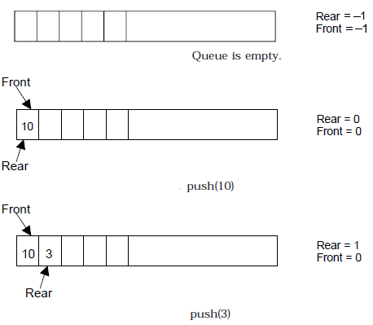
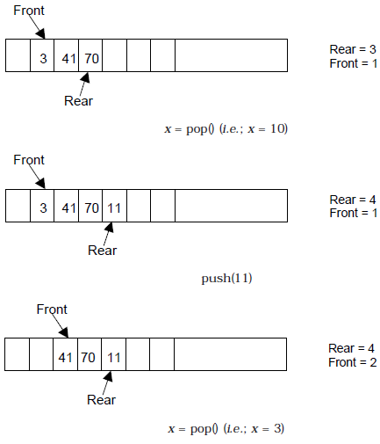
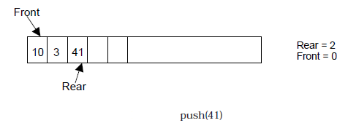
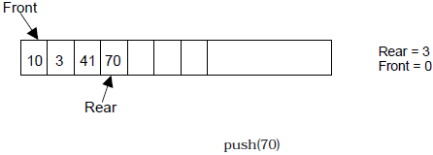
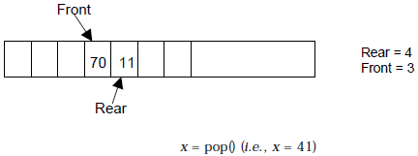
BASIC OPERATIONS ON QUEUE

Slide 8
The Queue Operations
A queue is like a line of people waiting for a bank teller. The queue has a front and a rear.
$ $
Front
Rear
Notes:
When you think of a computer science queue, you can imagine a line of people waiting for a teller in a bank. The line has a front (the next person to be served) and a rear (the last person to arrive.

Slide 9
The Queue Operations
New people must enter the queue at the rear. The C++ queue class calls this a push, although it is usually called an enqueue operation.
$ $
Front
Rear
Notes:
Don’t ask me why the C++ STL used the name push. It only confuses matters with a stack. In any case, when a new item enters a queue, it does so at the rear.

Slide 10
The Queue Operations
When an item is taken from the queue, it always comes from the front. The C++ queue calls this a pop, although it is usually called a dequeue operation.
$ $
Front
Rear
Notes:
When an item is removed from a queue, the removal occurs at the front.

Slide 11
Array Implementation
A queue can be implemented with an array, as shown here. For example, this queue contains the integers 4 (at the front), 8 and 6 (at the rear).
[ 0 ]
[1]
[ 2 ]
[ 3 ]
[ 4 ]
[ 5 ]
. . .
4
8
6
An array of integers to implement a queue of integers
We don't care what's in
this part of the array.
Notes:
Just like our stack implementation in the previous chapter, one way to implement a queue is to store the elements in an array.

Slide 12
Array Implementation
The easiest implementation also keeps track of the number of items in the queue and the index of the first element (at the front of the queue), the last element (at the rear).
3
size
0
first
2
last
[ 0 ]
[1]
[ 2 ]
[ 3 ]
[ 4 ]
[ 5 ]
. . .
4
8
6
Notes:
The easiest implementation also keeps track of three numbers. The size could be as small as zero or as large as the number of items in the array. The index of the front element is stored in the first member variable. The front item in the queue is at that index of the array. The next item is after the first one and so on until the rear of the queue that occurs at the index stored in a member variable called last.

Slide 13
A Dequeue Operation
When an element leaves the queue, size is decremented, and first changes, too.
2
size
1
first
2
last
[ 0 ]
[1]
[ 2 ]
[ 3 ]
[ 4 ]
[ 5 ]
. . .
4
8
6
Notes:
This shows how the member variables change when an item leaves the queue.

Slide 14
An Enqueue Operation
When an element enters the queue, size is incremented, and last changes, too.
3
size
1
first
3
last
[ 0 ]
[1]
[ 2 ]
[ 3 ]
[ 4 ]
[ 5 ]
. . .
8
6
2
Notes:
And this shows how the member variables change when a new item enters the queue. For a fixed size array, a new item may enter only if the current size of the queue is less than the size of the array. For a dynamic array, we could increase the size of the array when the queue grows beyond the current array size.

Slide 15
At the End of the Array
There is special behavior at the end of the array. For example, suppose we want to add a new element to this queue, where the last index is [5]:
3
size
3
first
5
last
[ 0 ]
[1]
[ 2 ]
[ 3 ]
[ 4 ]
[ 5 ]
2
6
1
Notes:
An array implementation of a queue must have special behavior when the rear of the queue reaches the end of the array. In this example, suppose we want to add the number 4 to the queue. We can do so…

Slide 16
At the End of the Array
The new element goes at the front of the array (if that spot isn’t already used):
4
size
3
first
0
last
[ 0 ]
[1]
[ 2 ]
[ 3 ]
[ 4 ]
[ 5 ]
4
2
6
1
Notes:
…by putting it at location 0 (if that location is not already used).

Slide 17
Array Implementation
Easy to implement
But it has a limited capacity with a fixed array
Or you must use a dynamic array for an unbounded capacity
Special behavior is needed when the rear reaches the end of the array.
3
size
0
first
2
last
[ 0 ]
[1]
[ 2 ]
[ 3 ]
[ 4 ]
[ 5 ]
. . .
4
8
6
Notes:
Here are some of the key aspects of an array implementation of a queue.

Slide 18
Linked List Implementation
A queue can also be implemented with a linked list with both a head and a tail pointer.
13
15
10
7
null
head_ptr
tail_ptr
Notes:
A linked list can also be used to implement a queue, but we must maintain both a head and a tail pointer because we need access to both the front and the rear of the queue.

Slide 19
Linked List Implementation
Which end do you think is the front of the queue? Why?
13
15
10
7
null
head_ptr
tail_ptr
Notes:
Does it matter which end of a singly-linked list we use for the front of the queue?

Slide 20
Linked List Implementation
The head_ptr points to the front of the list.
Because it is harder to remove items from the tail of the list.
Front
13
15
10
7
null
head_ptr
Rear
tail_ptr
Notes:
Of course, we could put the front of the queue at the end of the linked list, but it would be hard to remove an item. Do you see why?

Slide 21
Like stacks, queues have many applications.
Items enter a queue at the rear and leave a queue at the front.
Queues can be implemented using an array or using a linked list.
Notes:
A quick summary . . .

Slide 22
Queue can be implemented in two ways:
  1. Using arrays (static)
  2. Using pointers (dynamic)
If we try to pop (or delete or remove) an element from queue when it is empty, underflow occurs.
If we try to push (or insert or add) an element to queue When queue is full, overflow occurs.
Total number of elements present in the queue is rear-front+1, when implemented using arrays.

Slide 23
ALGORITHM FOR QUEUE OPERATIONS
Let Q be the array of some specified size say SIZE
Inserting an element into the queue
  1. Initialize front=0 rear = –1
  2. Input the value to be inserted and assign to variable “data”
  3. If (rear >= SIZE)
  (a) Display “Queue overflow”
  (b) Exit
  4. Else
  (a) Rear = rear +1
  5. Q[rear] = data
  6. Exit

Slide 24
ALGORITHM FOR QUEUE OPERATIONS
Deleting an element from queue
  1. If (front==-1 II rear< front)
  (a) Display “The queue is empty”
  (b) Exit
  2. Else
  (a) Data = Q[front]
  3. front = front +1
  4. Exit

Slide 25
Queue as a Class
Much like stacks and linked lists were designed and implemented as classes, a queue can be conveniently packaged as a class
It seems natural to think of a queue as similar to a linked list, but with more basic operations, to enforce the FIFO order of insertion and deletion

Slide 26
A Linked List Implementation of the Queue Class
The container for items is a linked list, that is, an object of type List
Let’s call it: List q;

Slide 27
A Dynamic-Array Implementation of the Queue Class
The container for items is a dynamic array
It is accomplished as:
datatype *p=new datatype[50];

Slide 28
How head and tail Change
head increases by 1 after each dequeue( )
tail increases by 1 after each enqueue( )
tail
head
Now:
49
48
47
4
3
2
1
0
tail
head
After enqueue:
49
48
47
4
3
2
1
0
tail
head
After dequeue:
49
48
47
4
3
2
1
0

Slide 29
False-Overflow Issue First
Suppose 50 calls to enqueue have been made, so now the queue array is full
Assume 4 calls to dequeue( ) are made
Assume a call to enqueue( ) is made now. The tail part seems to have no space, but the front has 4 unused spaces; if never used, they are wasted.
49
48
47
4
3
2
1
0
49
48
47
4
3
2
1
0

Slide 30
Solution: A Circular Queue
Allow the head (and the tail) to be moving targets
When the tail end fills up and front part of the array has empty slots, new insertions should go into the front end
Next insertion goes into slot 0, and tail tracks it. The insertion after that goes into a lot 1, etc.
tail
head
49
48
47
4
3
2
1
0

Slide 31
Illustration of Circular Queues
Current state:
After One Call to enqueue()
After One Call to enqueue()
head
49
48
47
4
3
2
1
0
tail
head
tail
49
48
47
4
3
2
1
0
head
tail
49
48
47
4
3
2
1
0

Slide 32
Numerics for Circular Queues
head increases by (1 modulo capacity) after each dequeue( ):
head = (head +1) % capacity;
tail increases by (1 modulo capacity) after each enqueue( ):
tail = (tail +1) % capacity;

Slide 33
Queue Applications
Real life examples
  Waiting in line
  Waiting on hold for tech support
Applications related to Computer Science
  Threads
  Job scheduling (e.g. Round-Robin algorithm for CPU allocation)

Slide 34
First In First Out
A
B
A
C
B
A
D
C
B
A
rear
front
D
C
B
rear
front
rear
front
rear
front
rear
front

Slide 35
Applications: Job Scheduling

Slide 36
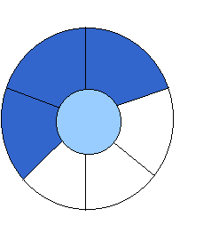
Implementation 2:
Wrapped Configuration
EMPTY QUEUE
[2]
[3] [2] [3]
J2
J3
[1] [4] [1] [4]
J1
[0] [5] [0] [5]
front = 0 front = 0
rear = 0 rear = 3
Can be seen as a circular queue

Slide 37
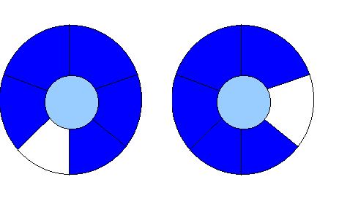
Leave one empty space when queue is full
Why?
FULL QUEUE FULL QUEUE
[2] [3] [2] [3]
J2 J3
J8 J9
J7
[1] [4][1] [4]
J1 J4
J5
J6 J5
[0] [5] [0] [5]
front =0
rear = 5
front =4
rear =3
How to test when queue is empty?
How to test when queue is full?

Slide 38
Queue
Queue
Operations on Queues
A Dequeue Operation
An Enqueue Operation
Array Implementation
Link list Implementation
Examples

