Slide 1
Algorithm Analysis
Problem Solving
Space Complexity
Time Complexity
Classifying Functions by Their Asymptotic Growth

Slide 2
Problem Solving: Main Steps
Problem definition
Algorithm design / Algorithm specification
Algorithm analysis
Implementation
Testing
Maintenance

Slide 3
1. Problem Definition
What is the task to be accomplished?
  Calculate the average of the grades for a given student
  Find the largest number in a list
What are the time /space performance requirements ?

Slide 4
2. Algorithm Design/Specifications
Algorithm: Finite set of instructions that, if followed, accomplishes a particular task.
Describe: in natural language / pseudo-code / diagrams / etc.
Criteria to follow:
  Input: Zero or more quantities (externally produced)
  Output: One or more quantities
  Definiteness: Clarity, precision of each instruction
  Effectiveness: Each instruction has to be basic enough and feasible
  Finiteness: The algorithm has to stop after a finite (may be very large) number of steps

Slide 5
4,5,6: Implementation, Testing and Maintenance
Implementation
  Decide on the programming language to use
    C, C++, Python, Java, Perl, etc.
  Write clean, well documented code
Test, test, test
Integrate feedback from users, fix bugs, ensure compatibility across different versions → Maintenance

Slide 6
3. Algorithm Analysis
Space complexity
  How much space is required
Time complexity
  How much time does it take to run the algorithm

Slide 7
Space Complexity
Space complexity = The amount of memory required by an algorithm to run to completion
  the most often encountered cause is “memory leaks” – the amount of memory required larger than the memory available on a given system
Some algorithms may be more efficient if data completely loaded into memory
  Need to look also at system limitations
  e.g. Classify 2GB of text in various categories – can I afford to load the entire collection?

Slide 8
Space Complexity (cont…)
Fixed part: The size required to store certain data/variables, that is independent of the size of the problem:
  - e.g. name of the data collection
Variable part: Space needed by variables, whose size is dependent on the size of the problem:
  - e.g. actual text
  - load 2GB of text VS. load 1MB of text

Slide 9
Time Complexity
Often more important than space complexity
  space available tends to be larger and larger
  time is still a problem for all of us
3-4GHz processors on the market
  still …
  researchers estimate that the computation of various transformations for 1 single DNA chain for one single protein on 1 TerraHZ computer would take about 1 year to run to completion
Algorithms running time is an important issue

Slide 10
Running Time
Problem: average of elements
  Given an array X
  Compute the array A such that A[i] is the average of elements X[0] … X[i], for i=0..n-1
Sol 1
  At each step i, compute the element X[i] by traversing the array A and determining the sum of its elements, respectively the average
Sol 2
  At each step i update a sum of the elements in the array A
  Compute the element X[i] as sum/I
Which solution to choose?

Slide 11
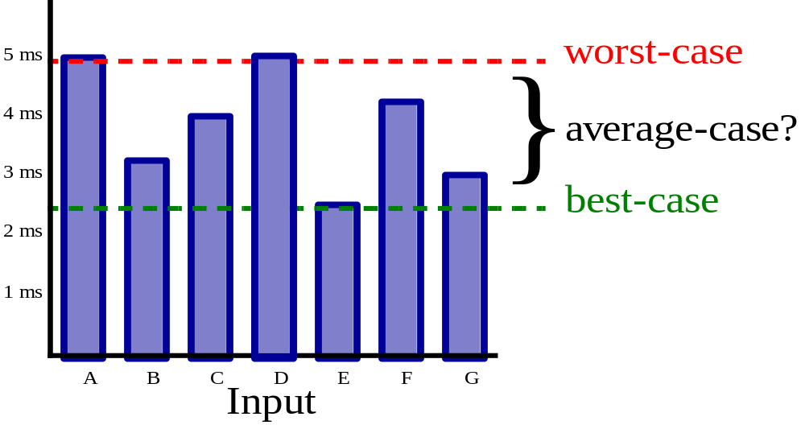
Running Time (cont…)
Suppose the program includes an if-then statement that may execute or not: → variable running time
Typically algorithms are measured by their worst case

Slide 12
Classifying Functions by Their Asymptotic Growth
Asymptotic growth : The rate of growth of a function
Given a particular differentiable function f(n), all other differentiable functions fall into three classes:
    growing with the same rate
    growing faster
    growing slower

Slide 13
Theta
    f(n) and g(n) have
    same rate of growth, if
    lim( f(n) / g(n) ) = c,
    0 < c < ∞, n -> ∞
Notation: f(n) = Θ( g(n) )
pronounced "theta"

Slide 14
Little o
    f(n) grows slower than g(n)
(or g(n) grows faster than f(n))
if
    lim( f(n) / g(n) ) = 0, n → ∞
Notation: f(n) = o( g(n) )
pronounced "little o"

Slide 15
Little omega
    f(n) grows faster than g(n)
(or g(n) grows slower than f(n))
if
    lim( f(n) / g(n) ) = ∞, n -> ∞
Notation: f(n) = ω (g(n))
pronounced "little omega"

Slide 16
Little omega and Little o
if g(n) = o( f(n) )
then f(n) = ω( g(n) )
Examples: Compare n and n²
lim( n/n² ) = 0, n → ∞, n = o(n²)
lim( n²/n ) = ∞, n → ∞, n² = ω(n)

Slide 17
Algorithms with Same Complexity
Two algorithms have same complexity,
if the functions representing the number of operations have
same rate of growth.
Among all functions with same rate of growth we choose the simplest one to represent the complexity.

Slide 18
Example
Compare n and (n+1)/2
lim( n / ((n+1)/2 )) = c,
same rate of growth
(n+1)/2 = Θ(n)
rate of growth of a linear function

Slide 19
Example
Compare n² and n²+ 6n
lim( n² / (n²+ 6n ) )= c
same rate of growth.
n²+6n = Θ(n²)
rate of growth of a quadratic function

Slide 20
The Big O Notation
f(n) = O(g(n))
if f(n) grows with
same rate or slower than g(n).

Slide 21
The Big-Omega Notation
The inverse of Big-O is Ω
If g(n) = O(f(n)),
then f(n) = Ω (g(n))
f(n) grows faster or with the same rate as g(n): f(n) = Ω (g(n))

Slide 22
The Big O Notation
Big O notation is used in Computer Science to describe the performance or complexity of an algorithm.
Big O specifically describes the worst-case scenario, and can be used to describe the execution time required or the space used (e.g. in memory or on disk) by an algorithm
Big O notation characterizes functions according to their growth rates: different functions with the same growth rate may be represented using the same O notation

Slide 23
It is used to describe an algorithm's usage of computational resources: the worst case or average case or running time or memory usage of an algorithm is often expressed as a function of the length of its input using big O notation
Simply, it describes how the algorithm scales (performs) in the worst case scenario as it is run with more input

Slide 24
For example
If we have a sub routine that searches an array item by item looking for a given element, the scenario that the Big-O describes is when the target element is last (or not present at all). This particular algorithm is O(N) so the same algorithm working on an array with 25 elements should take approximately 5 times longer than an array with 5 elements

Slide 25
This allows algorithm designers to predict the behavior of their algorithms and to determine which of multiple algorithms to use, in a way that is independent of computer architecture or clock rate
A description of a function in terms of big O notation usually only provides an upper bound on the growth rate of the function

Slide 26
In typical usage, the formal definition of O notation is not used directly; rather, the O notation for a function f(x) is derived by the following simplification rules:
  If f(x) is a sum of several terms, the one with the largest growth rate is kept, and all others are omitted
  If f(x) is a product of several factors, any constants (terms in the product that do not depend on x) are omitted

Slide 27
For example
Let f(x) = 6x⁴ − 2x³ + 5, and suppose we wish to simplify this function, using O notation, to describe its growth rate as x approaches infinity.
This function is the sum of three terms:
  6x⁴
  −2x³
  5

Slide 28
…
Of these three terms, the one with the highest growth rate is the one with the largest exponent as a function of x, namely 6x⁴.
Now one may apply the second rule: 6x⁴ is a product of 6 and x⁴ in which the first factor does not depend on x.
Omitting this factor results in the simplified form x⁴.
Thus, we say that f(x) is a big-o of (x⁴) or mathematically we can write f(x) = O(x⁴).

Slide 29
O(1)
It describes an algorithm that will always execute in the same time (or space) regardless of the size of the input data set.
e.g.
  Determining if a number is even or odd
  Push and Pop operations for a stack
  Insert and Remove operations for a queue

Slide 30
O(N)
O(N) describes an algorithm whose performance will grow linearly and in direct proportion to the size of the input data set.
Example
  Finding the maximum or minimum element in a list, or sequential search in an unsorted list of n elements
  Traversal of a list (a linked list or an array) with n elements
  Example follows as well

Slide 31
bool ContainsValue(String[] strings, String value)
{
for(int i = 0; i < strings.Length; i++)
{
if(strings[i] == value)
{
return true;
}
}
return false;
}
Explanation follows

Slide 32
The example above also demonstrates how Big O favours the worst-case performance scenario; a matching string could be found during any iteration of the for loop and the function would return early, but Big O notation will always assume the upper limit where the algorithm will perform the maximum number of iterations.

Slide 33
O(N²)
O(N²) represents an algorithm whose performance is directly proportional to the square of the size of the input data set.
Example
  Bubble sort
  Comparing two 2-dimensional arrays of size n by n
  Finding duplicates in an unsorted list of n elements (implemented with two nested loops)
This is common with algorithms that involve nested iterations over the data set.
Deeper nested iterations will result in O(N³), O(N⁴) etc.

Slide 34
bool ContainsDuplicates(String[] strings)
{
for(int i = 0; i < strings.Length; i++)
{
for(int j = 0; j < strings.Length; j++)
{
if(i == j) // Don't compare with self
{ continue; }
if(strings[i] == strings[j])
{
return true;
}
}
}
return false;
}

Slide 35
O(2^{N})
O(2^{N}) denotes an algorithm whose growth will double with each additional element in the input data set. The execution time of an O(2^{N}) function will quickly become very large.
Big O gives the upper bound for time complexity of an algorithm. It is usually used in conjunction with processing data sets (lists) but can be used elsewhere.

Slide 36
A few examples of how it's used
Say we have an array of n elements
int array[n];
If we wanted to access the first element of the array this would be O(1) since it doesn't matter how big the array is, it always takes the same constant time to get the first item.
x = array[0];

Slide 37
If we want to find a number in the list:
for(int i = 0; i < n; i++)
{
if(array[i] == numToFind)
{
return i;
}
}

Slide 38
This would be O(n) since at most we would have to look through the entire list to find our number.
The Big-O is still O(n) even though we might find our number the first try and run through the loop once because Big-O describes the upper bound for an algorithm
Omega is for lower bound

Slide 39
When we get to nested loops:
for(int i = 0; i < n; i++)
{
for(int j = i; j < n; j++)
{
array[j] += 2;
}
}
This is O(n^2) since for each pass of the outer loop ( O(n) ) we have to go through the entire list again so the n's multiply leaving us with n squared.

Slide 40
So if someone says his algorithm has a O(n^2) complexity, does it mean he will be using nested loops?
Not really, any aspect that lead to n squared times will be considered as n^2

Slide 41
define (fac n)
if ( n == 0) return 1
n * (fac (n-1))
which recursively calculates the factorial of the given number

Slide 42
the first step is to try and determine the performance characteristic for the body of the function only in this case, nothing special is done in the body, just check the number and return if the value is 1
So the performance for the base case is: O(1) (constant)
Next try and determine this for the number of recursive calls. In this case we have n-1 recursive calls,
So the performance for the recursive calls is: O(n-1)
then put those two together and you then have the performance for the whole recursive function:
1 * (n-1) = O(n)

Slide 43
Big O
O(1) - Determining if a number is even or odd; using a constant-size lookup table or hash table
O(log n) - Finding an item in a sorted array with a binary search
O(n) - Finding an item in an unsorted list; adding two n-digit numbers
O(n^2) - Multiplying two n-digit numbers by a simple algorithm; adding two n×n matrices; bubble sort or insertion sort
O(n^3) - Multiplying two n×n matrices by simple algorithm

Slide 44
Summary
Problem Solving
Space Complexity
Time Complexity
Classifying Functions by Their Asymptotic Growth

