Slide 1
Review
Insertion Sort
Insertion Sort Algorithm
Time Complexity
  Best case
  Average case
  Worst case
Examples

Slide 2
Quick Sort
Quick Sort
Quick Sort Algorithm
Time Complexity
  Best case
  Average case
  Worst case
Examples

Slide 3
Introduction
It is one of the widely used sorting techniques
Quick sort is an efficient algorithm
It is also called the partition exchange sort
It has a very good time complexity in average case
It is an algorithm of the divide-and conquer type

Slide 4
How it works?
The quick sort algorithm works by partitioning the array to be sorted
Each partitions are internally sorted recursively
In partition the first element of an array is chosen as a key value
This key value can be the first element of an array
If A is an array then key = A [0], and rest of the elements are grouped into two portions such that
  One partition contains elements smaller than key value
  Another partition contains elements larger than the key value

Slide 5
cont…..
Two pointers, up and low, are initialized to the upper and lower bounds of the sub array
During execution, at any point each element in a position above up is greater than or equal to key value
And each element in a position below low pointer is less than or equal to key
up pointer will move in a decrement
And low pointer will move in an increment

Slide 6
Let A be an array A[1],A[2],A[3]…..A[n] of n numbers, then
Step 1: Choose the first element of the array as the key i.e. key=A[1]
Step 2: Place the low pointer in second position of the array and up pointer in the last position of the array i.e. low=2 and up=n
Step 3: Repeatedly increase the low pointer by one position until A[low]<key
Step 4: Repeated decrease the up pointer by one position until A[up]>=key
Step 5: if up>low, interchange A[low] with A[up], swap=A[low], A[low]=A[up], A[up]=swap
Step 6: Repeat steps 3,4 and 5 until the condition in step 5 fails (i.e. up<=low) then interchange A[up] with key

Slide 7
The given array is partitioned into two sub-arrays, the sub-array A[1],A[2],……A[k-1] is less than A[k] i.e. key
The second sub-array A[k+1],A[k+2],……A[n] is greater than the key value A[k]
We can repeatedly apply this procedure on each of these sub-arrays until the entire array is sorted

Slide 8
Algorithm
Let A be a linear array of n elements A (1), A (2), A (3)......A (n)
low represents the lower bound pointer and up represents the upper bound pointer
Key represents the first element of the array
Which is going to become the middle element of the sub-arrays
Or key can be the middle value of the array

Slide 9
cont…
1. Input n number of elements in an array A
2. Initialize low = 2, up = n , key = A[1]
3. Repeat through step 8 while (low < = up)
4. Repeat step 5 while(A [low] > key)
5. low = low + 1
6. Repeat step 7 while(A [up] < key)
7. up = up–1
8. If (low < = up)
  (a) Swap = A [low]
  (b) A [low] = A [up]
  (c) A [up] = swap
  (d) low=low+1
  (e) up=up–1

Slide 10
cont…
9. If (1 < up) Quick sort (A, 1, up)
10. If (low < n) Quick sort (A, low, n)
11. Exit

Slide 11
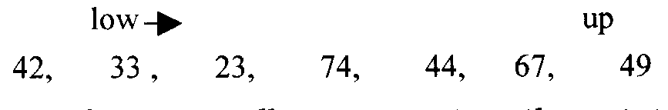
Example
We have an array with seven(7) elements 42,33,23,74,44,67,49
Select the first value of the array as the key, so key=42
Pointer low points to 33 and up points to 49
Move the low pointer repeatedly by incrementing one position until A[low]>key

Slide 12
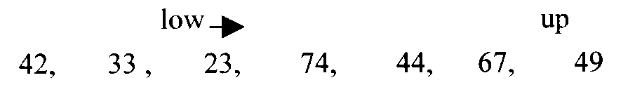
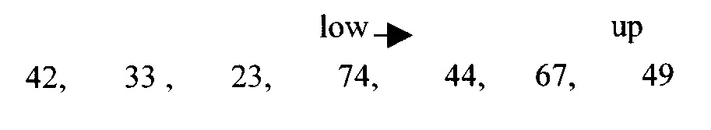
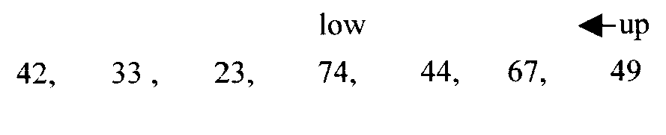
Here A[low]>key i.e. 74>42
Now decrease the pointer up by one position until A[up]<=key

Slide 13





Slide 14


We will recursively call the quicksort function and will pass the sub-arrays along with the low and up pointers

Slide 15
Example
We are given array of n integers to sort:
40
20
10
80
60
50
7
30
100

Slide 16
Pick Key Element
There are a number of ways to pick the key element. In this example, we will use the first element in the array:
40
20
10
80
60
50
7
30
100

Slide 17
key_index = 0
40
20
10
80
60
50
7
30
100
[0] [1] [2] [3] [4] [5] [6] [7] [8]
low
up

Slide 18
While data[low] <= data[key]
++low
key_index = 0
40
20
10
80
60
50
7
30
100
[0] [1] [2] [3] [4] [5] [6] [7] [8]
low
high

Slide 19
While data[low] <= data[key]
++low
key_index = 0
40
20
10
80
60
50
7
30
100
[0] [1] [2] [3] [4] [5] [6] [7] [8]
low
high

Slide 20
While data[low] <= data[key]
++low
key_index = 0
40
20
10
80
60
50
7
30
100
[0] [1] [2] [3] [4] [5] [6] [7] [8]
low
high

Slide 21
While data[low] <= data[key]
  ++low
While data[high] > data[key]
  --high
key_index = 0
40
20
10
80
60
50
7
30
100
[0] [1] [2] [3] [4] [5] [6] [7] [8]
low
high

Slide 22
While data[low] <= data[key]
  ++low
While data[high] > data[key]
  --high
key_index = 0
40
20
10
80
60
50
7
30
100
[0] [1] [2] [3] [4] [5] [6] [7] [8]
low
high

Slide 23
While data[low] <= data[key]
  ++low
While data[high] > data[key]
  --high
If low < high
  swap data[low] and data[high]
key_index = 0
40
20
10
80
60
50
7
30
100
[0] [1] [2] [3] [4] [5] [6] [7] [8]
low
high

Slide 24
While data[low] <= data[key]
  ++low
While data[high] > data[key]
  --high
If low < high
  swap data[low] and data[high]
key_index = 0
40
20
10
30
60
50
7
80
100
[0] [1] [2] [3] [4] [5] [6] [7] [8]
low
high

Slide 25
While data[low] <= data[key]
  ++low
While data[high] > data[key]
  --high
If low < high
  swap data[low] and data[high]
While high > low, go to 1.
key_index = 0
40
20
10
30
60
50
7
80
100
[0] [1] [2] [3] [4] [5] [6] [7] [8]
low
high

Slide 26
While data[low] <= data[key]
  ++low
While data[high] > data[key]
  --high
If low < high
  swap data[low] and data[high]
While high > low, go to 1.
key_index = 0
40
20
10
30
60
50
7
80
100
[0] [1] [2] [3] [4] [5] [6] [7] [8]
low
high

Slide 27
While data[low] <= data[key]
  ++low
While data[high] > data[key]
  --high
If low < high
  swap data[low] and data[high]
While high > low, go to 1.
key_index = 0
40
20
10
30
60
50
7
80
100
[0] [1] [2] [3] [4] [5] [6] [7] [8]
low
high

Slide 28
While data[low] <= data[key]
  ++low
While data[high] > data[key]
  --high
If low < high
  swap data[low] and data[high]
While high > low, go to 1.
key_index = 0
40
20
10
30
60
50
7
80
100
[0] [1] [2] [3] [4] [5] [6] [7] [8]
low
high

Slide 29
While data[low] <= data[key]
  ++low
While data[high] > data[key]
  --high
If low < high
  swap data[low] and data[high]
While high > low, go to 1.
key_index = 0
40
20
10
30
60
50
7
80
100
[0] [1] [2] [3] [4] [5] [6] [7] [8]
low
high

Slide 30
While data[low] <= data[key]
  ++low
While data[high] > data[key]
  --high
If low < high
  swap data[low] and data[high]
While high > low, go to 1.
key_index = 0
40
20
10
30
60
50
7
80
100
[0] [1] [2] [3] [4] [5] [6] [7] [8]
low
high

Slide 31
While data[low] <= data[key]
  ++low
While data[high] > data[key]
  --high
If low < high
  swap data[low] and data[high]
While high > low, go to 1.
key_index = 0
40
20
10
30
7
50
60
80
100
[0] [1] [2] [3] [4] [5] [6] [7] [8]
low
high

Slide 32
While data[low] <= data[key]
  ++low
While data[high] > data[key]
  --high
If low < high
  swap data[low] and data[high]
While high > low, go to 1.
key_index = 0
40
20
10
30
7
50
60
80
100
[0] [1] [2] [3] [4] [5] [6] [7] [8]
low
high

Slide 33
While data[low] <= data[key]
  ++low
While data[high] > data[key]
  --high
If low < high
  swap data[low] and data[high]
While high > low, go to 1.
key_index = 0
40
20
10
30
7
50
60
80
100
[0] [1] [2] [3] [4] [5] [6] [7] [8]
low
high

Slide 34
While data[low] <= data[key]
  ++low
While data[high] > data[key]
  --high
If low < high
  swap data[low] and data[high]
While high > low, go to 1.
key_index = 0
40
20
10
30
7
50
60
80
100
[0] [1] [2] [3] [4] [5] [6] [7] [8]
low
high

Slide 35
While data[low] <= data[key]
  ++low
While data[high] > data[key]
  --high
If low < high
  swap data[low] and data[high]
While high > low, go to 1.
key_index = 0
40
20
10
30
7
50
60
80
100
[0] [1] [2] [3] [4] [5] [6] [7] [8]
low
high

Slide 36
While data[low] <= data[key]
  ++low
While data[high] > data[key]
  --high
If low < high
  swap data[low] and data[high]
While high > low, go to 1.
key_index = 0
40
20
10
30
7
50
60
80
100
[0] [1] [2] [3] [4] [5] [6] [7] [8]
low
high

Slide 37
While data[low] <= data[key]
  ++low
While data[high] > data[key]
  --high
If low < high
  swap data[low] and data[high]
While high > low, go to 1.
key_index = 0
40
20
10
30
7
50
60
80
100
[0] [1] [2] [3] [4] [5] [6] [7] [8]
low
high

Slide 38
While data[low] <= data[key]
  ++low
While data[high] > data[key]
  --high
If low < high
  swap data[low] and data[high]
While high > low, go to 1.
key_index = 0
40
20
10
30
7
50
60
80
100
[0] [1] [2] [3] [4] [5] [6] [7] [8]
low
high

Slide 39
While data[low] <= data[key]
  ++low
While data[high] > data[key]
  --high
If low < high
  swap data[low] and data[high]
While high > low, go to 1.
key_index = 0
40
20
10
30
7
50
60
80
100
[0] [1] [2] [3] [4] [5] [6] [7] [8]
low
high

Slide 40
While data[low] <= data[key]
  ++low
While data[high] > data[key]
  --high
If low < high
  swap data[low] and data[high]
While high > low, go to 1.
Swap data[high] and data[key_index]
key_index = 0
40
20
10
30
7
50
60
80
100
[0] [1] [2] [3] [4] [5] [6] [7] [8]
low
high

Slide 41
While data[low] <= data[key]
  ++low
While data[high] > data[key]
  --high
If low < high
  swap data[low] and data[high]
While high > low, go to 1.
Swap data[high] and data[key_index]
7
20
10
30
40
50
60
80
100
key_index = 4
[0] [1] [2] [3] [4] [5] [6] [7] [8]
low
high

Slide 42
Partition Result
7
20
10
30
40
50
60
80
100
[0] [1] [2] [3] [4] [5] [6] [7] [8]
<= data[key]
> data[key]

Slide 43
Recursion: Quicksort Sub-arrays
7
20
10
30
40
50
60
80
100
[0] [1] [2] [3] [4] [5] [6] [7] [8]
<= data[key]
> data[key]

Slide 44
Quicksort Analysis
Assume that keys are random, uniformly distributed.
What is best case running time?

Slide 45
Quicksort Analysis
Assume that keys are random, uniformly distributed.
What is best case running time?
  Recursion:
    Partition splits array in two sub-arrays of size n/2
    Quick sort each sub-array

Slide 46
Quick sort Analysis
Assume that keys are random, uniformly distributed.
What is best case running time?
  Recursion:
    Partition splits array in two sub-arrays of size n/2
    Quick sort each sub-array
  Depth of recursion tree?

Slide 47
Quicksort Analysis
What is best case running time?
  Recursion:
    Partition splits array in two sub-arrays of size n/2
    Quick sort each sub-array
  Depth of recursion tree? O(log₂n)

Slide 48
Quicksort Analysis
What is best case running time?
  Recursion:
    Partition splits array in two sub-arrays of size n/2
    Quick sort each sub-array
  Depth of recursion tree? O(log₂n)
  Number of accesses in partition?

Slide 49
Quicksort Analysis
What is best case running time?
  Recursion:
    Partition splits array in two sub-arrays of size n/2
    Quicksort each sub-array
  Depth of recursion tree? O(log₂n)
  Number of accesses in partition? O(n)

Slide 50
Quick sort Analysis
Best case running time: O(n log₂n)
Worst case: (n(n-1))/2
f(n)= O(n²)
Average case: O(n log₂n)

Slide 51
Example

Slide 52
Quick Sort
Quick Sort
Quick Sort Algorithm
Time Complexity
  Best case
  Average case
  Worst case
Examples

