Slide 1
Algorithms and Data Structures
(CSC112)

Slide 2
Introduction
Algorithms and Data Structures
Static Data Structures
    Searching Algorithms
    Sorting Algorithms
    List implementation through Array
    ADT: Stack
    ADT: Queue
Dynamic Data Structures (Linear)
    Linked List (Linear Data Structure)
Dynamic Data Structures (Non-Linear)
    Trees, Graphs, Hashing

Slide 3
What is a Computer Program?
To exactly know, what is data structure? We must know:
  What is a computer program?
Some mysterious
processing
Input
Output

Slide 4
Definition
  An organization of information, usually in memory, for better algorithm efficiency
  such as queue, stack, linked list and tree.

Slide 5
3 steps in the study of data structures
Logical or mathematical description of the structure
Implementation of the structure on the computer
Quantitative analysis of the structure, which includes determining the amount of memory needed to store the structure and the time required to process the structure

Slide 6
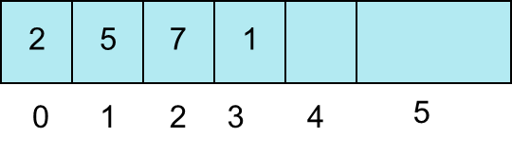
Lists (Array /Linked List)
Items have a position in this Collection
  Random access or not?
Array Lists
  internal storage container is native array
Linked Lists
public class Node
{ private Object data;
private Node next;
}
last
first

Slide 7
Stacks
Collection with access only to the last element inserted
Last in first out
insert/push
remove/pop
top
make empty
Data4
Top
Data3
Data2
Data1

Slide 8
Queues
Collection with access only to the item that has been present the longest
Last in last out or first in first out
enqueue, dequeue, front, rear
priority queues and deques
Front
Rear
Deletion
Insertion
Data1
Data2
Data3
Data4

Slide 9
Trees
Similar to a linked list
public class TreeNode
{ private Object data;
private TreeNode left;
private TreeNode right;
}
Root

Slide 10
Hash Tables
Take a key, apply function
f(key) = hash value
store data or object based on hash value
Sorting O(N), access O(1) if a perfect hash function and enough memory for table
how deal with collisions?

Slide 11
Other ADTs
Graphs
  Nodes with unlimited connections between other nodes

Slide 12
cont…
Data may be organized in many ways
  E.g., arrays, linked lists, trees etc.
The choice of particular data model depends on two considerations:
  It must be rich enough in structure to mirror the actual relationships of data in the real world
  The structure should be simple enough that one can effectively process the data when necessary

Slide 13
Example
Data structure for storing data of students:-
  Arrays
  Linked Lists
Issues
  Space needed
  Operations efficiency (Time required to complete operations)
    Retrieval
    Insertion
    Deletion

Slide 14
What data structure to use?
Data structures let the input and output be represented in a way that can be handled efficiently and effectively.
array
Linked list
queue
tree
stack

Slide 15
Data Structures
Data structure is a representation of data and the operations allowed on that data.

Slide 16
Abstract Data Types
In Object Oriented Programming data and the operations that manipulate that data are grouped together in classes
Abstract Data Types (ADTs) or data structures are collections store data and allow various operations on the data to access and change it

Slide 17
Why Abstract?
Specify the operations of the data structure and leave implementation details to later
  in Java use an interface to specify operations
many, many different ADTs
  picking the right one for the job is an important step in design
  "Get your data structures correct first, and the rest of the program will write itself."
  -Davids Johnson
High level languages often provide built in ADTs,
  the C++ Standard Template Library, the Java Standard Library

Slide 18
The Core Operations
Every Collection ADT should provide a way to:
  add an item
  remove an item
  find, retrieve, or access an item
Many, many more possibilities
  is the collection empty
  make the collection empty
  give me a sub set of the collection
  and on and on and on…
Many different ways to implement these items each with associated costs and benefits

Slide 19
Implementing ADTs
when implementing an ADT the operations and behaviors are already specified
Implementer’s first choice is what to use as the internal storage container for the concrete data type
  the internal storage container is used to hold the items in the collection
  often an implementation of an ADT

Slide 20
Algorithm Analysis
Problem Solving
Space Complexity
Time Complexity
Classifying Functions by Their Asymptotic Growth

Slide 21
1. Problem Definition
What is the task to be accomplished?
  Calculate the average of the grades for a given student
  Find the largest number in a list
What are the time /space performance requirements ?

Slide 22
2. Algorithm Design/Specifications
Algorithm: Finite set of instructions that, if followed, accomplishes a particular task.
Describe: in natural language / pseudo-code / diagrams / etc.
Criteria to follow:
  Input: Zero or more quantities (externally produced)
  Output: One or more quantities
  Definiteness: Clarity, precision of each instruction
  Effectiveness: Each instruction has to be basic enough and feasible
  Finiteness: The algorithm has to stop after a finite (may be very large) number of steps

Slide 23
4,5,6: Implementation, Testing and Maintenance
Implementation
  Decide on the programming language to use
    C, C++, Python, Java, Perl, etc.
  Write clean, well documented code
Test, test, test
Integrate feedback from users, fix bugs, ensure compatibility across different versions → Maintenance

Slide 24
3. Algorithm Analysis
Space complexity
  How much space is required
Time complexity
  How much time does it take to run the algorithm

Slide 25
Space Complexity
Space complexity = The amount of memory required by an algorithm to run to completion
  the most often encountered cause is “memory leaks” – the amount of memory required larger than the memory available on a given system
Some algorithms may be more efficient if data completely loaded into memory
  Need to look also at system limitations
  e.g. Classify 2GB of text in various categories – can I afford to load the entire collection?

Slide 26
Space Complexity (cont…)
Fixed part: The size required to store certain data/variables, that is independent of the size of the problem:
  - e.g. name of the data collection
Variable part: Space needed by variables, whose size is dependent on the size of the problem:
  - e.g. actual text
  - load 2GB of text VS. load 1MB of text

Slide 27
Time Complexity
Often more important than space complexity
  space available tends to be larger and larger
  time is still a problem for all of us
3-4GHz processors on the market
  still …
  researchers estimate that the computation of various transformations for 1 single DNA chain for one single protein on 1 TerraHZ computer would take about 1 year to run to completion
Algorithms running time is an important issue

Slide 28
Pseudo Code and Flow Charts
Pseudo Code
Basic elements of Pseudo code
Basic operations of Pseudo code
Flow Chart
Symbols used in flow charts
Examples

Slide 29
Pseudo Code and Flow Charts
There are two commonly used tools to help to document program logic (the algorithm).
These are
  Flowcharts
  Pseudocode.
Generally, flowcharts work well for small problems but Pseudocode is used for larger problems.

Slide 30
Pseudo-Code
Pseudo-Code is simply a numbered list of instructions to perform some task.

Slide 31
Writing Pseudo Code
Number each instruction
    This is to enforce the notion of an ordered sequence of operations
    Furthermore we introduce a dot notation (e.g. 3.1 come after 3 but before 4) to number subordinate operations for conditional and iterative operations
Each instruction should be unambiguous and effective.
Completeness. Nothing is left out.

Slide 32
Pseudo-code
Statements are written in simple English without regard to the final programming language.
Each instruction is written on a separate line.
The pseudo-code is the program-like statements written for human readers, not for computers. Thus, the pseudo-code should be readable by anyone who has done a little programming.
Implementation is to translate the pseudo-code into programs/software, such as “C++” language programs.

Slide 33
Basic Elements of Pseudo-code
A Variable
  Having name and value
  There are two operations performed on a variable
    Assignment Operation is the one in which we associate a value to a variable.
    The other operation is the one in which at any given time we intend to retrieve the value previously assigned to that variable (Read Operation)

Slide 34
Basic Elements of Pseudo-code
Assignment Operation
  This operation associates a value to a variable.
  While writing Pseudo-code you may follow your own syntax.
  Some of the possible syntaxes are:
    Assign 3 to x
    Set x equal to 3
    x=3

Slide 35
Basic Operations of Pseudo-code
Read Operation
  In this operation we intend to retrieve the value previously assigned to that variable. For example Set Value of x equal to y
Read the input from user
  This operation causes the algorithm to get the value of a variable from the user.
    Get x Get a, b, c

Slide 36
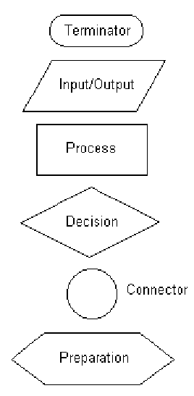
Flow Chart
Some of the common symbols used in flowcharts are shown.
…

Slide 37
…
With flowcharting, essential steps of an algorithm are shown using the shapes above.
The flow of data between steps is indicated by arrows, or flowlines. For example, a flowchart (and equivalent Pseudocode) to compute the interest on a loan is shown below:

Slide 38
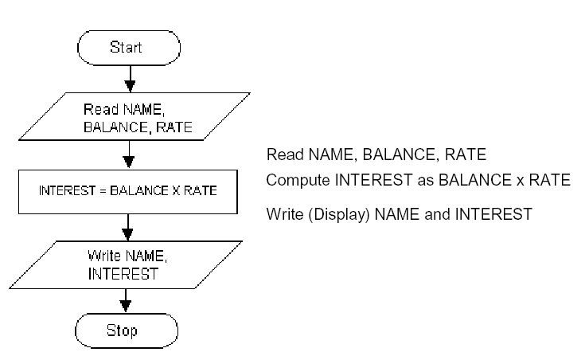

Slide 39
List
List Data Structure
List operations
List Implementation
Array
Linked List

Slide 40
The LIST Data Structure
The List is among the most generic of data structures.
Real life:
    shopping list,
    groceries list,
    list of people to invite to dinner
    List of presents to get

Slide 41
Lists
A list is collection of items that are all of the same type (grocery items, integers, names)
The items, or elements of the list, are stored in some particular order
It is possible to insert new elements into various positions in the list and remove any element of the list

Slide 42
List Operations
Useful operations
createList(): create a new list (presumably empty)
copy(): set one list to be a copy of another
clear(); clear a list (remove all elments)
insert(X, ?): Insert element X at a particular position
in the list
remove(?): Remove element at some position in
the list
get(?): Get element at a given position
update(X, ?): replace the element at a given position with X
find(X): determine if the element X is in the list
length(): return the length of the list.

Slide 43
Pointer
Pointer
Pointer Variables
Dynamic Memory Allocation
Functions

Slide 44
What is a Pointer?
A Pointer provides a way of accessing a variable without referring to the variable directly.
The mechanism used for this purpose is the address of the variable.
A variable that stores the address of another variable is called a pointer variable.

Slide 45
Pointer Variables
Pointer variable: A variable that holds an address
Can perform some tasks more easily with an address than by accessing memory via a symbolic name:
Accessing unnamed memory locations
Array manipulation
etc.

Slide 46
Why Use Pointers?
To operate on data stored in an array
To enable convenient access within a function to large blocks data, such as arrays, that are defined outside the function.
To allocate space for new variables dynamically–that is during program execution

Slide 47
Arrays & Strings
Array
Array Elements
Accessing array elements
Declaring an array
Initializing an array
Two-dimensional Array
Array of Structure
String
Array of Strings
Examples

Slide 48
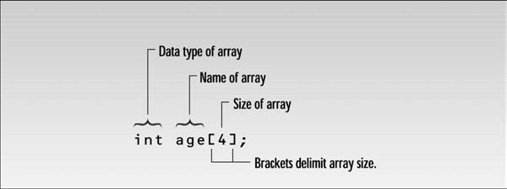
Introduction
Arrays
  Contain fixed number of elements of same data type
  Static entity- same size throughout the program
  An array must be defined before it is used
  An array definition specifies a variable type, a name and size
  Size specifies how many data items the array will contain
  An example

Slide 49
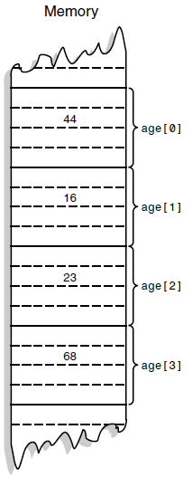
Array Elements
The items in an array are called elements
All the elements are of the same type
The first array element is numbered 0
Four elements (0-3) are stored consecutively in
the memory

Slide 50
Strings
two types of strings are used in C++
C-Strings and strings that are object of the String class
we will study C-Strings only
C-Strings or C-Style String

Slide 51
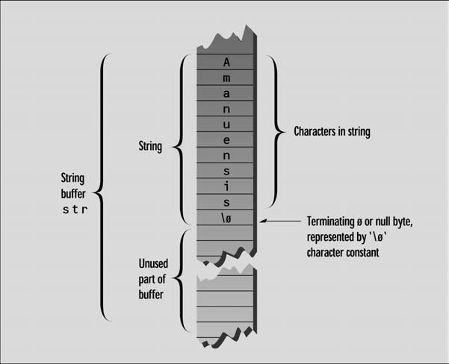

Slide 52
Recursion
Introduction to Recursion
Recursive Definition
Recursive Algorithms
Finding a Recursive Solution
Example Recursive Function
Recursive Programming
Rules for Recursive Function
Example Tower of Hanoi
Other examples

Slide 53
Introduction
Any function can call another function
A function can even call itself
When a function call itself, it is making a recursive call
Recursive Call
  A function call in which the function being called is the same as the one making the call
Recursion is a powerful technique that can be used in place of iteration(looping)
Recursion
  Recursion is a programming technique in which functions call themselves.

Slide 54
Recursive Definition
A definition in which something is defined in terms of smaller versions of itself.
To do recursion we should know the followings
  Base Case:
    The case for which the solution can be stated non-recursively
    The case for which the answer is explicitly known.
  General Case:
    The case for which the solution is expressed in smaller version of itself. Also known as recursive case

Slide 55
Recursive Algorithm
Definition
  An algorithm that calls itself
Approach
  Solve small problem directly
  Simplify large problem into 1 or more smaller sub problem(s) & solve recursively
  Calculate solution from solution(s) for sub problem

Slide 56
Sorting Algorithms
There are many sorting algorithms, such as:
  Selection Sort
  Insertion Sort
  Bubble Sort
  Merge Sort
  Quick Sort

Slide 57
Sorting
Sorting is a process that organizes a collection of data into either ascending or descending order.
An internal sort requires that the collection of data fit entirely in the computer’s main memory.
We can use an external sort when the collection of data cannot fit in the computer’s main memory all at once but must reside in secondary storage such as on a disk.
We will analyze only internal sorting algorithms.
Any significant amount of computer output is generally arranged in some sorted order so that it can be interpreted.
Sorting also has indirect uses. An initial sort of the data can significantly enhance the performance of an algorithm.
Majority of programming projects use a sort somewhere, and in many cases, the sorting cost determines the running time.
A comparison-based sorting algorithm makes ordering decisions only on the basis of comparisons.

Slide 58
List Using Array
Introduction
Representation of Linear Array In Memory
Operations on linear Arrays
  Traverse
  Insert
  Delete
Example

Slide 59
Introduction
Suppose we wish to arrange the percentage marks obtained by 100 students in ascending order
In such a case we have two options to store these marks in memory:
  (a) Construct 100 variables to store percentage marks obtained by 100 different students, i.e. each variable containing one student’s marks
  (b) Construct one variable (called array or subscripted variable) capable of storing or holding all the hundred values

Slide 60
Obviously, the second alternative is better. A simple reason for this is, it would be much easier to handle one variable than handling 100 different variables
Moreover, there are certain logics that cannot be dealt with, without the use of an array
Based on the above facts, we can define array as:
  “A collective name given to a group of ‘similar quantities’”

Slide 61
These similar quantities could be percentage marks of 100 students, or salaries of 300 employees, or ages of 50 employees
What is important is that the quantities must be ‘similar’
These similar elements could be all int, or all float, or all char
Each member in the group is referred to by its position in the group

Slide 62
For Example
Assume the following group of numbers, which represent percentage marks obtained by five students
per = { 48, 88, 34, 23, 96 }
In C, the fourth number is referred as per[3]
Because in C the counting of elements begins with 0 and not with 1
Thus, in this example per[3] refers to 23 and per[4] refers to 96
In general, the notation would be per[i], where, i can take a value 0, 1, 2, 3, or 4, depending on the position of the element being referred

Slide 63
Stack
Introduction
Stack in our life
Stack Operations
Stack Implementation
  Stack Using Array
  Stack Using Linked List
Use of Stack

Slide 64
Introduction
A Stack is an ordered collection of items into which new data items may be added/inserted and from which items may be deleted at only one end
A Stack is a container that implements the Last-In-First-Out (LIFO) protocol

Slide 65
Stack in Our Life
Stacks in real life: stack of books, stack of plates
Add new items at the top
Remove an item from the top
Stack data structure similar to real life: collection of elements arranged in a linear order.
Can only access element at the top

Slide 66
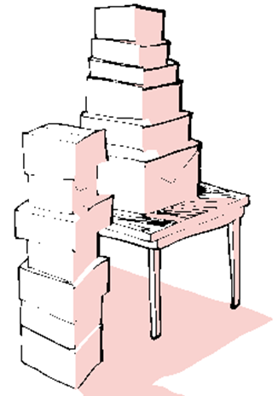

Slide 67
Stack Operations
Push(X) – insert X as the top element of the stack
Pop() – remove the top element of the stack and return it.
Top() – return the top element without removing it from the stack.
Notes:
A primary concern for this course is efficiency.
You might believe that faster computers make it unnecessary to be concerned with efficiency. However…
So we need special training.

Slide 68
Polish Notation
  Prefix
  Infix
  Postfix
Precedence of Operators
Converting Infix to Postfix
Evaluating Postfix

Slide 69
Prefix, Infix, Postfix
Two other ways of writing the expression are
+ A B prefix (Polish Notation)
A B + postfix (Reverse Polish Notation)
The prefixes “pre” and “post” refer to the position of the operator with respect to the two operands.
Notes:
A primary concern for this course is efficiency.
You might believe that faster computers make it unnecessary to be concerned with efficiency. However…
So we need special training.

Slide 70
Polish Notation
Converting Infix to Postfix
Converting Postfix to Infix
Converting Infix to Prefix
Examples

Slide 71
Singly link list
All the nodes in a singly linked list are arranged sequentially by linking with a pointer.
A singly linked list can grow or shrink, because it is a dynamic data structure.

Slide 72
Linked List Traversal
Inserting into a linked list involves two steps:
  Find the correct location
  Do the work to insert the new value
We can insert into any position
  Front
  End
  Somewhere in the middle
  (to preserve order)

Slide 73
Deleting an Element from a Linked List
Deletion involves:
  Getting to the correct position
  Moving a pointer so nothing points to the element to be deleted
Can delete from any location
  Front
  First occurrence
  All occurrences

Slide 74
Linked List
The basic operations on linked lists are:
  Initialize the list
  Determine whether the list is empty
  Print the list
  Find the length of the list
  Destroy the list

Slide 75
Linked List
Learn about linked lists
Become aware of the basic properties of linked lists
Explore the insertion and deletion operations on linked lists
Discover how to build and manipulate a linked list
Learn how to construct a doubly linked list

Slide 76
Doubly linked lists
Doubly linked lists
Become aware of the basic properties of doubly linked lists
Explore the insertion and deletion operations on doubly linked lists
Discover how to build and manipulate a doubly linked list
Learn about circular linked list

Slide 77
WHY DOUBLY LINKED LIST
The only way to find the specific node that precedes p is to start at the beginning of the list.
The same problem arias when one wishes to delete an arbitrary node from a singly linked list.
If we have a problem in which moving in either direction is often necessary, then it is useful to have doubly linked lists.
Each node now has two link data members,
  One linking in the forward direction
  One in the backward direction

Slide 78

Introduction
A doubly linked list is one in which all nodes are linked together by multiple links
which help in accessing both the successor (next) and predecessor (previous) node for any arbitrary node within the list.
Every nodes in the doubly linked list has three fields:
  LeftPointer
  RightPointer
  DATA.

Slide 79
Queue
Queue
Operations on Queues
  A Dequeue Operation
  An Enqueue Operation
Array Implementation
Link list Implementation
Examples

Slide 80
INTRODUCTION
A queue is logically a first in first out (FIFO or first come first serve) linear data structure.
It is a homogeneous collection of elements in which new elements are added at one end called rear, and the existing elements are deleted from other end called front.
The basic operations that can be performed on queue are
  1. Insert (or add) an element to the queue (push)
  2. Delete (or remove) an element from a queue (pop)
Push operation will insert (or add) an element to queue, at the rear end, by incrementing the array index.
Pop operation will delete (or remove) from the front end by
decrementing the array index and will assign the deleted value to a variable.

Slide 81
A Graphic Model of a Queue
Head:
All items are
deleted from
this end
Tail:
All new items
are added on
this end

Slide 82
Operations on Queues
Insert(item): (also called enqueue)
  It adds a new item to the tail of the queue
Remove( ): (also called delete or dequeue)
  It deletes the head item of the queue, and returns to the caller. If the queue is already empty, this operation returns NULL
getHead( ):
  Returns the value in the head element of the queue
getTail( ):
  Returns the value in the tail element of the queue
isEmpty( )
  Returns true if the queue has no items
size( )
  Returns the number of items in the queue

Slide 83
Examples of Queues
An electronic mailbox is a queue
  The ordering is chronological (by arrival time)
A waiting line in a store, at a service counter, on a one-lane road
Equal-priority processes waiting to run on a processor in a computer system

Slide 84
Different types of queue
Circular queue
Double Ended Queue
Priority queue

Slide 85
Trees
Binary Tree
Binary Tree Representation
  Array Representation
  Link List Representation
Operations on Binary Trees
Traversing Binary Trees
  Pre-Order Traversal Recursively
  In-Order Traversal Recursively
  Post-Order Traversal Recursively

Slide 86
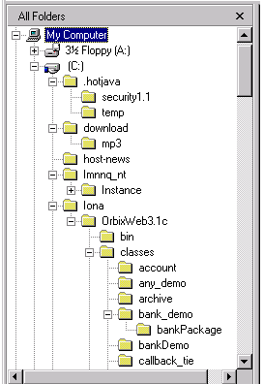
Trees
Where have you seen a tree structure before?
Examples of trees:
- Directory tree
- Family tree
- Company organization chart
- Table of contents
- etc.

Slide 87
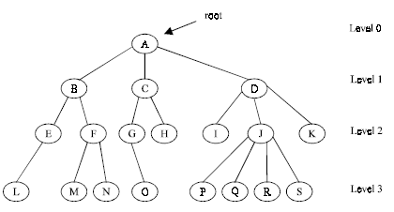
Basic Terminologies
Root is a specially designed node (or data items) in a tree
It is the first node in the hierarchical arrangement of the data items
For example,
Figure 1. A Tree

Slide 88
Graphs
Graph
Directed Graph
Undirected Graph
Sub-Graph
Spanning Sub-Graph
Degree of a Vertex
Weighted Graph
Elementary and Simple Path
Link List Representation

Slide 89
Introduction
A graph G consist of
1. Set of vertices V (called nodes), V = {v1, v2, v3, v4......} and
2. Set of edges E={e1, e2, e3......}
A graph can be represented as G = (V, E), where V is a finite and non empty set of vertices and E is a set of pairs of vertices called edges
Each edge ‘e’ in E is identified with a unique pair (a, b) of nodes in V, denoted by e = {a, b}

Slide 90
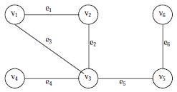
Consider the following graph, G
Then the vertex V and edge E can be represented as:
V = {v1, v2, v3, v4, v5, v6} and E = {e1, e2, e3, e4, e5, e6}
E = {(v1, v2) (v2, v3) (v1, v3) (v3, v4),(v3, v5) (v5, v6)}
There are six edges and vertex in the graph

Slide 91
Traversing a Graph
Breadth First Search (BFS)
Depth First Search (DFS)

Slide 92
Hashing
  Hash Function
  Properties of Hash Function
  Division Method
  Mid-Square Method
  Folding Method
  Hash Collision
    Open addressing
    Chaining
    Bucket addressing

Slide 93
Introduction
The searching time of each searching technique depends on the comparison. i.e., n comparisons required for an array A with n elements
To increase the efficiency, i.e., to reduce the searching time, we need to avoid unnecessary comparisons
Hashing is a technique where we can compute the location of the desired record in order to retrieve it in a single access (or comparison)
Let there is a table of n employee records and each employee record is defined by a unique employee code, which is a key to the record and employee name
If the key (or employee code) is used as the array index, then the record can be accessed by the key directly

Slide 94
If L is the memory location where each record is related with the key
If we can locate the memory address of a record from the key then the desired record can be retrieved in a single access
For notational and coding convenience, we assume that the keys in k and the address in L are (decimal) integers
So the location is selected by applying a function which is called hash function or hashing function from the key k
Unfortunately such a function H may not yield different values (or index); it is possible that two different keys k1 and k2 will yield the same hash address
This situation is called Hash Collision, which is discussed later

Slide 95
Hash Function
The basic idea of hash function is the transformation of the key into the corresponding location in the hash table
A Hash function H can be defined as a function that takes key as input and transforms it into a hash table index

Slide 96
Recommended Book
Schaum's Outline Series, Theory and problems of Data Structures by Seymour Lipschutz
Data Structures using C and C++,2nd edition by A.Tenenbaum, Augenstein, and Langsam
Principles Of Data Structures Using C And C++ by Vinu V Das
Sams Teach Yourself Data Structures and Algorithms in 24 Hours, Lafore Robert
Data structures and algorithms, Alfred V. Aho, John E. Hopcroft.
Standish, Thomas A., Data Structures, Algorithms and Software Principles in C, Addison-Wesley 1995, ISBN: 0-201-59118-9
Data Structures & Algorithm Analysis in C++, Weiss Mark Allen

