Slide 1
CSC103: Introduction to Computer and Programming
Lecture No 9

Slide 2
Previous Lecture
Nested if else statement
Logical operator in C
How logical operator can be used to make compound conditions
Conditional operator

Slide 3
Today’s lecture outline
Nested conditional operator
Example programs –
  nested if-else
  nested conditional operator
Loops
  while loop

Slide 4
Nested conditional operator
(expression 1 ? expression 2 : expression 3);
Single condition or compound condition
(expression 1 ? expression 2 : expression 3);
(expression 1 ? expression 2 : expression 3);

Slide 5
Example program
main( )
{
float sal ;
printf ("Enter the salary" ) ;
scanf ( "%f", &sal ) ;
if ( sal < 40000 && sal > 25000 )
printf ( "Manager" ) ;
else
if ( sal < 25000 && sal > 15000 )
printf ( "Accountant" ) ;
else
printf ( "Clerk" ) ;
}

Slide 6
Cont.
main( )
{
float sal ;
printf ("Enter the salary" ) ;
scanf ( "%f", &sal ) ;
( (sal < 40000 && sal > 25000) ? printf ( "Manager" ) :
(( sal < 25000 && sal > 15000 ) ? printf ( "Accountant") :
printf ( "Clerk" ) ));
}

Slide 7
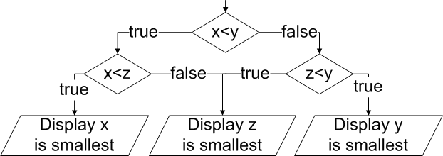
Example program 1
Three numbers x, y, z are input through the keyboard, write a program to determine the smallest of the three.
Write a program

Slide 8
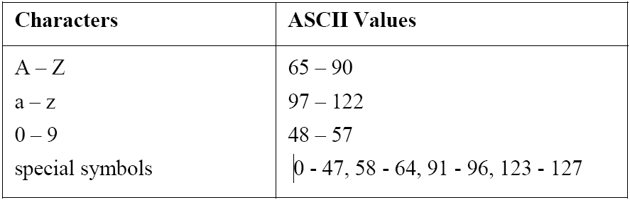
Example program 2
Any character is entered through the keyboard, write a program to determine whether the character entered is a capital letter, a small case letter, a digit or a special symbol.
Write a program

Slide 9
Loops in C
Three major loops structures in C
  while loop
  for loop
  do while

Slide 10
Loop in general
Loop has a termination point → finite loop
  Loop execution stops when the loop condition becomes false
Loop has a counter that counts number of iterations of that loop
Loop has a statement or a set of statements that are executed until the loop condition become false

Slide 11


Repetition - Example
Formula 1 car race
There is a path/track
Each car has to complete a certain no of rounds say 10
In each round, when a car cross the finish line
  the condition is check whether the car has completed total no of round or not.

Slide 12
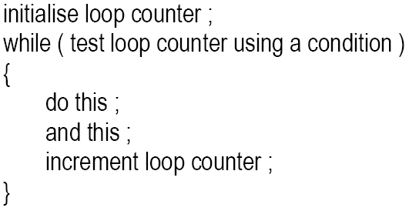
General form while loop

Slide 13
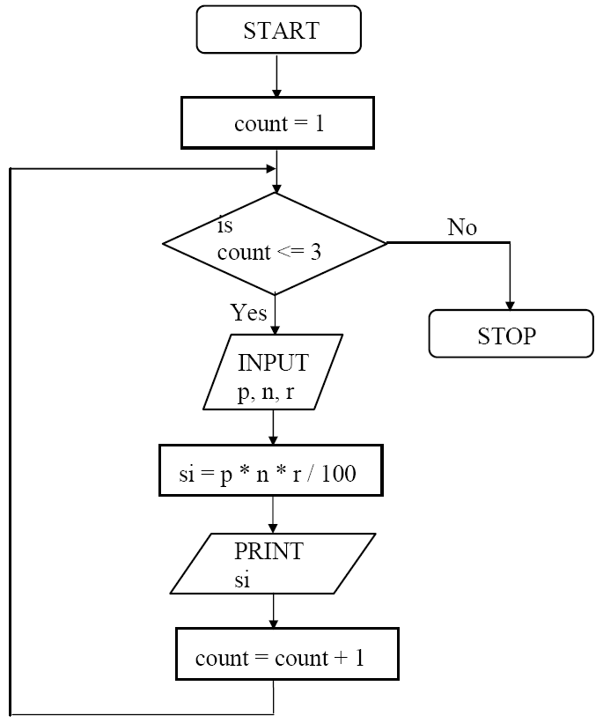
The while loop
Condition
Set of statements
Loop counter

Slide 14
A while loop program
main( )
{
int count = 0;
int total = 0;
while(count < 5)
{
total = total + count;
printf(“count =%d, total = %d”, count, total);
count = count +1;
}
}
Memory
2
count
4
0
1
3
5
total
0
0
1
3
6
10
Program Output
count = 0, total = 0
count = 1, total = 1
count = 2, total = 3
count = 3, total = 6
count = 4, total = 10

Slide 15
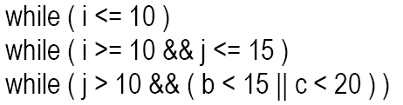
Points to remember
Loop body will keep on executing until the loop condition become false
When loop condition become false, the first statement after the while block will be executed
Condition can be a single or compound

Slide 16


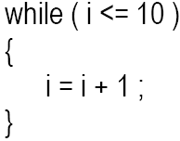
Cont.
Statement within loop body can be single line or block of statement.
In case of single line parentheses are optional
In case of block, parentheses are must

Slide 17
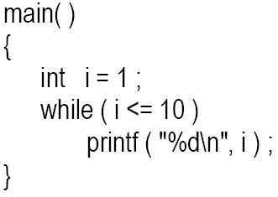
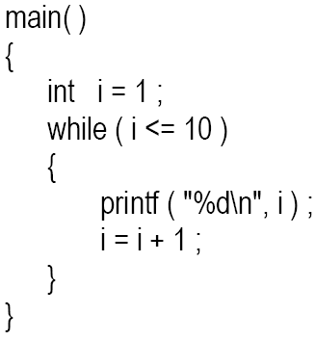
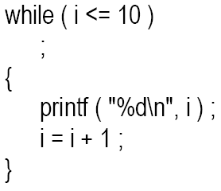
Cont..
A loop can be infinite loop

Slide 18
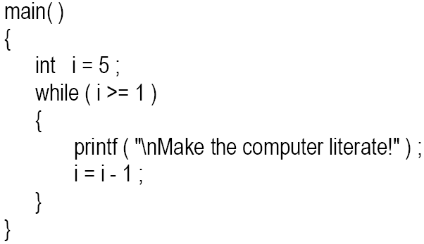
Cont.
Loop counter can be decremented

Slide 19
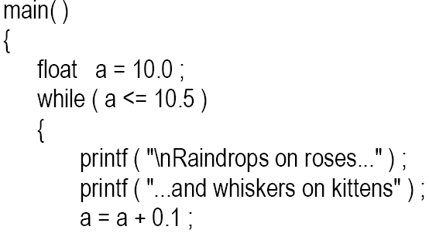

Cont.
It is not necessary that a loop counter must only be int. it can be float or char

Slide 20
Pre and post increment operator
Pre increment/ decrement
  ++x; is same as x = x + 1;
  or – –x is same as x = x – 1;
Post increment/ decrement
  x++; is same as x = x + 1;
  or x-- is same as x = x – 1;

Slide 21
Difference between pre and post operators
x = 1;
y = x ++;
printf(“x = %d, y = %d ”, x, y);
y = x;
x = x + 1;
output
x = 2, y = 1
x = 1;
y = ++ x;
printf(x = %d, y = %d ”, x, y);
x = x + 1;
y = x;
output
x = 2, y = 2
Write a program

Slide 22
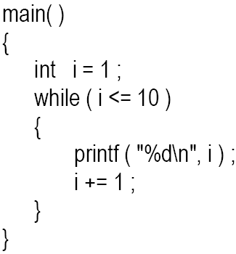
Other operator
i = i + 1;
+= is a compound assignment operator
j = j + 10 can also be written as j += 10
Other compound assignment operators are -=, *=, / =, %=.

Slide 23
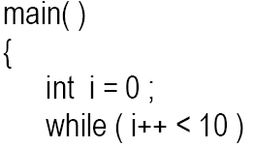

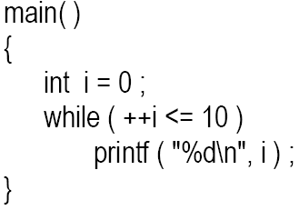
Example program
First comparison i < 10 is performed then value of i is incremented
First the value of i is incremented then comparison i < 10 is performed

