Slide 1
CSC103: Introduction to Computer and Programming
Lecture No 8

Slide 2
Previous Lecture
Example programs – printf, scanf
Decision control structure
Relational operator in C
if statement
if-else statement

Slide 3
Today’s lecture outline
Nested if else statement
Logical operator in C
Conditional operator

Slide 4
Nested if else
It is possible to write an entire if-else with either the if statement block or else statement block

Slide 5
Nested if else flowchart
Start
Display “Enter either 1 or 2”
Go to program
Read x
No
x == 1
Yes
No
x == 2
Yes
Display “you entered 1”
Display “you entered other than 1 or 2”
Display “you entered 2”
End

Slide 6

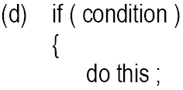
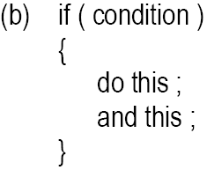
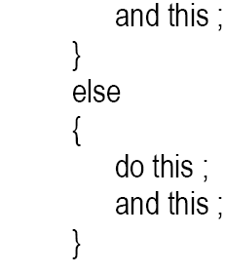
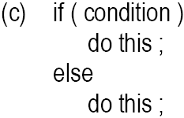
Forms of if statement

Slide 7
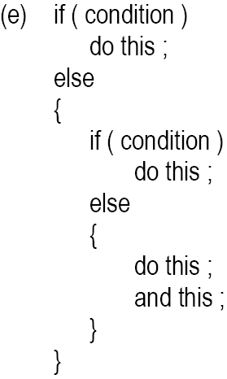
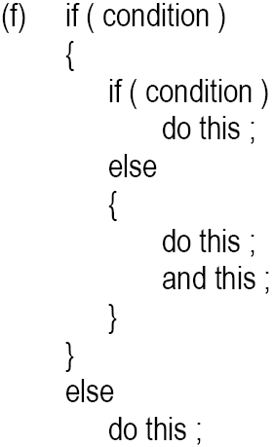
Cont.

Slide 8
Logical Operators
&& (logical AND)
  true if both conditions are true
  if ( gender == 1 && age >= 65 )
  senior++;
|| (logical OR)
  true if either of condition is true
  if (semesterAvg >= 90 || finalExam >=90 )
  printf("Student grade is A“);

Slide 9
Cont.
! (logical NOT, logical negation)
  Returns true when its condition is false, & vice versa
  if ( !( grade == 20 ) )
  printf(“hello world“);
  Alternative:
  if ( grade != 20 )
  printf(“hello world“);
!
False
→ if (True)
True
→ if (False)
!

Slide 10
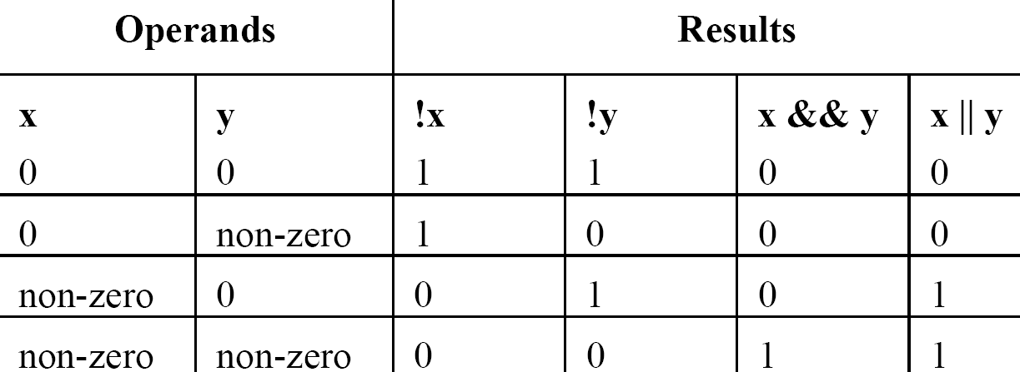
Logical Operators..

Slide 11
Sample Program -1
To calculate the division
Input: marks of 5 different subjects
Rules
  Percentage above or equal to 60 - First division
  Percentage between 50 and 59 - Second division
  Percentage between 40 and 49 - Third division
  Percentage less than 40 – Fail
Solution
  Nested if-else
  Logical operators
Go to Program
Go to Program

Slide 12
Sample Program -2
A company insures its drivers in the following cases:
  If the driver is married
  If the driver is unmarried, male & above 30 years of age
  If the driver is unmarried, female & above 25 years of age
If the marital status, gender and age of the driver are the inputs, write a program to determine whether the driver is to be insured or not.

Slide 13
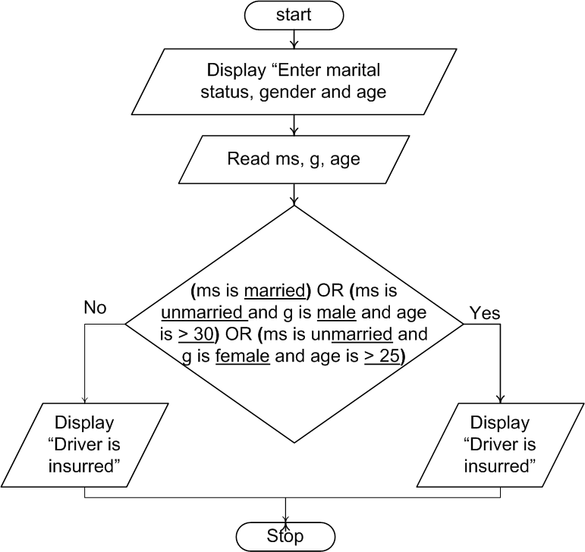
Flowchart
Go to Program with logical operator
Go to Program without logical operator
(ms is married)
OR
(ms is unmarried and g is male and age is > 30)
OR
(ms is unmarried and g is female and age is > 25)

Slide 14
&& and ||
&& and || are useful in the following programming situations
  When after testing several conditions the outcome is only one of the two answers
  When it is to be tested whether a value falls within a particular range or not
Write a Program

Slide 15
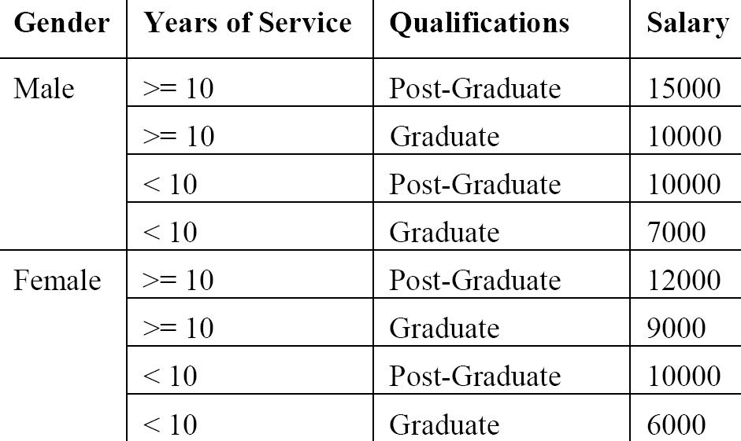
Example program 3
Write a program to calculate the salary as per the following table:

Slide 16
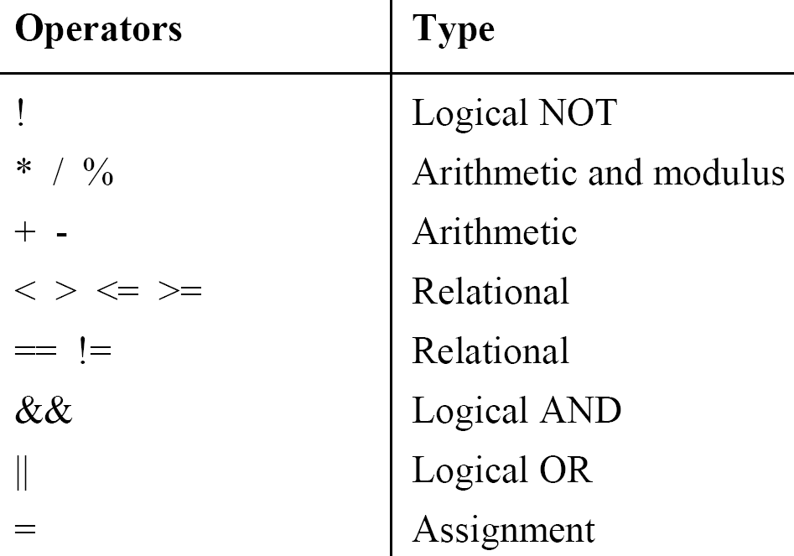
Revised Hierarchy

Slide 17
Caution
Between assignment /equality operator
if ( i = 5 )
printf ( "You entered 5" ) ;
else
printf ( "You entered something other than 5" );
Null statement
if ( i == 5 ) ;
  printf ( "You entered 5" )

Slide 18
Conditional Operators
General form is,
  (expression 1 ? expression 2 : expression 3);
Conditional operators ? and : are sometimes called ternary operators
if expression 1 is true, then the value returned will be expression 2, otherwise the value returned will be expression 3

Slide 19
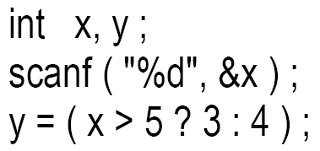
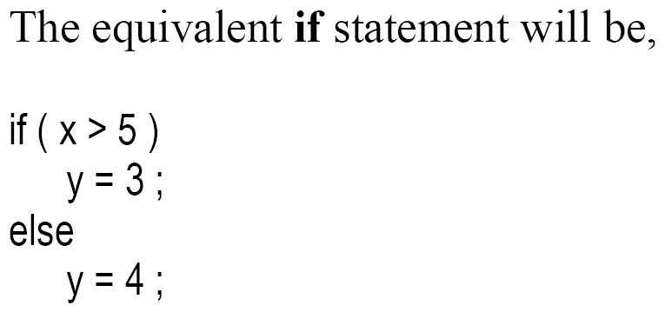
Examples
A

Slide 20
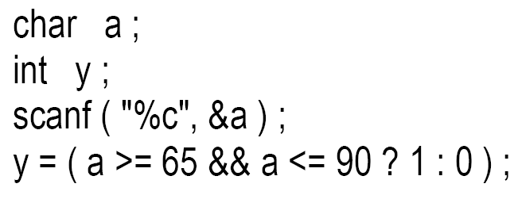
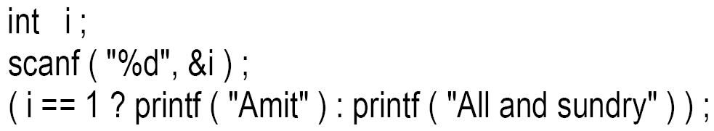
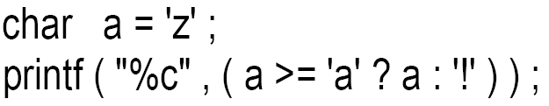
Cont.
B
C
D

Slide 21
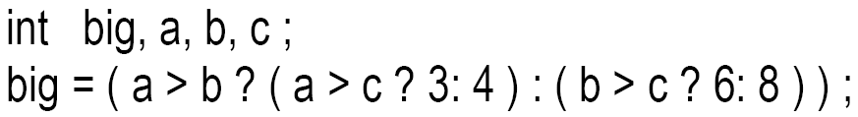
Cont..
E
The limitation of the conditional operators is that after the ? or after the : only one C statement can occur.

Slide 22
Example
main( )
{
int x, y;
printf ("Enter the salary" ) ;
scanf ( "%d", &x ) ;
if ( x > 10 )
{
printf ( “%d“, x ) ;
y = x+10;
}
else
y = x;
}
(expression 1 ? expression 2 : expression 3);
condition
Single statement
Single statement

Slide 23
Example Program
Using conditional operators determine:
Whether the character entered through the keyboard is a Upper case alphabet or not.
Write a Program

Slide 24
Nested conditional operator
(expression 1 ? expression 2 : expression 3);
Single condition or compound condition
(expression 1 ? expression 2 : expression 3);
(expression 1 ? expression 2 : expression 3);

Slide 25
Example program
main( )
{
float sal ;
printf ("Enter the salary" ) ;
scanf ( "%f", &sal ) ;
if ( sal < 40000 && sal > 25000 )
printf ( "Manager" ) ;
else
if ( sal < 25000 && sal > 15000 )
printf ( "Accountant" ) ;
else
printf ( "Clerk" ) ;
}

Slide 26
Cont.
main( )
{
float sal ;
printf ("Enter the salary" ) ;
scanf ( "%f", &sal ) ;
( (sal < 40000 && sal > 25000) ? printf ( "Manager" ) :
(( sal < 25000 && sal > 15000 ) ? printf ( "Accountant") :
printf ( "Clerk" ) ));
}

