Slide 1
CSC103: Introduction to Computer and Programming
Lecture No 6

Slide 2
Previous lecture
Escape sequences
C compiler
Directives
Common errors

Slide 3
Today’s lecture outline
C character set
Basic constants and variables
Output function – printf
Input function – scanf
C instructions
Integer to float conversion
Hierarchy of operator
Control instructions

Slide 4
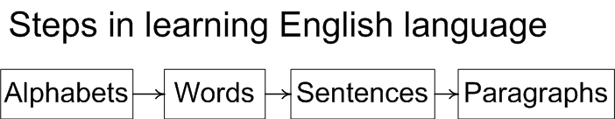
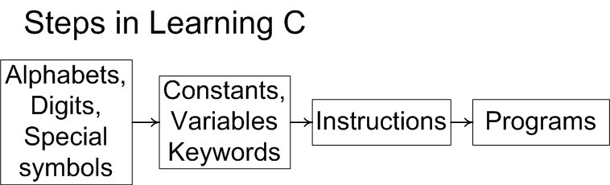
Learning C/C++

Slide 5
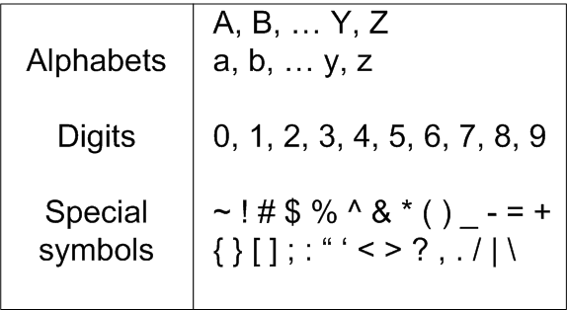
C Character Set

Slide 6
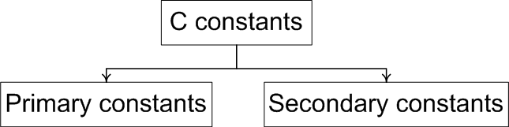
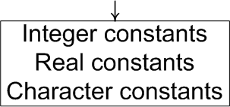
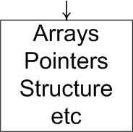
Constants
An entity that doesn’t change

Slide 7
Integer Constants
Must have at least one digit
It must not have a decimal point
It can be either positive or negative
If there is no sign an integer constant is assumed to be positive
No commas or blanks are allowed within an integer constant
Examples: 135, -67, 3401, -5670

Slide 8
Real Constants
Also called Floating Point constants
A real constant must have at least one digit
It must have a decimal point
It could be either positive or negative
Default sign is positive
No commas or blanks are allowed within a real constant
Examples: +325.34, 426.0, -32.76, -48.5792

Slide 9
Character Constants
A character constant is a
  single alphabet
  a single digit
  or a single special symbol
Enclosed within single inverted commas
Both the inverted commas should point to the left
The maximum length can be 1 character
Examples: ’A’, ‘I’, ‘5’, ‘=‘

Slide 10
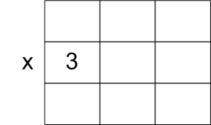
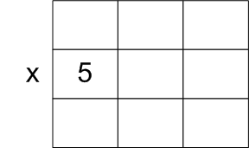
Variables
An entity that may vary during program execution
Names given to locations in memory

Slide 11
Variables..
Series of characters (letters, digits, underscores)
Must begin with a letter or underscore
Case sensitive
Meaningful naming scheme

Slide 12
Variables..
No commas or blanks are allowed within a variable name.
No Special symbol are used in name.
Examples: Interger1, Sum, _FirstNum
Invalid variable names
  #sum, 12x, first name

Slide 13
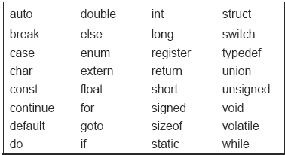
Keywords
Meaning already explained to compiler
Cannot be used as variable name

Slide 14
Writing C/C++ Programs
Instructions as statements
Order of statements
Each statement must end with a ;
Blanks for readability or clarity
Case-Sensitive

Slide 15
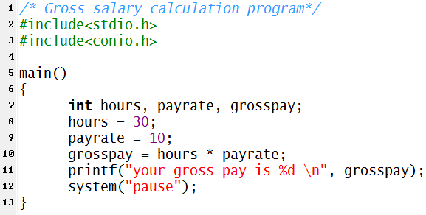
Gross salary C Program
Go to program

Slide 16
Variable declaration
Any variable used in the program must be declared first before using it.

Slide 17
Output function
printf ( "<format string>", <list of variables> ) ;
<format string> can contain,
  %f for printing real values
  %d for printing integer values
  %c for printing character values
printf ( "%d %d %d %d", 3, 3 + 2, c, a + b * c – d ) ;

Slide 18
Input
To make gross salary calculation program general, the program ask the user to input value of hours and payrate during execution
scanf function is used to input value from user during program execution

Slide 19
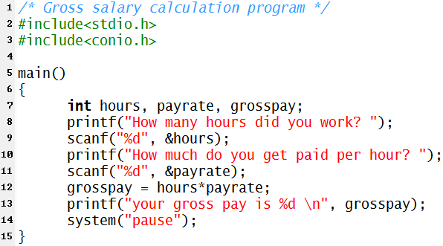
Gross salary C Program
Go to program

Slide 20
Input function syntax
Ampersand (&) before the variables in the scanf( ) function is a must.
& is an ‘Address of’ operator
It gives the location number used by the variable in memory

Slide 21
C Instructions
Type Declaration Instruction
  To declare the type of variables used in a C program.
Arithmetic Instruction
  To perform arithmetic operations between constants and variables
Control Instruction
  To control the sequence of execution of various statements in a C program.

Slide 22
Type Declaration Instruction
This instruction is used to declare the type of variables being used in the program.
The type declaration statement is written at the beginning of main( ) function.
    int hours, payrate, grosspay;
    float salary;
    char name;

Slide 23
Variations of type declaration instruction
Initializing at declare time
  int x =10, y = 20;
  float a = 1.25, b = 1.99*2.4+1.5;
Order of variable decleration
  int i = 10, j = 25 ;
is same as
  int j = 25, j = 10 ;
However,
  float a = 1.5, b = a + 3.1 ;
is alright, but
  float b = a + 3.1, a = 1.5 ;

Slide 24
Cont.
The following statements would work
  int a, b, c, d ;
  a = b = c = 10 ;
However, the following statement would not work
  int a = b = c = d = 10 ;

Slide 25
Arithmetic Instruction
C arithmetic instruction consists of
  variable name on the left hand side of =
  and variable names & constants on the right hand side of =.
The variables and constants appearing on the right hand side of = are connected by arithmetic operators like +, -, *, and /.

Slide 26
Example
int ad ;
float kot, deta, alpha, beta, gamma ;
ad = 3200 ;
kot = 0.0056 ;
deta = alpha * beta / gamma + 3.2 * 2 / 5 ;
The variables and constants together are called ‘operands’ that are operated upon by the ‘arithmetic operators’

Slide 27
Types of arithmetic statement
Integer mode arithmetic statement
  This is an arithmetic statement in which all operands are either integer variables or integer constants.
  Example:
    int i, king, issac, noteit ;
    i = i + 1 ;
    king = issac * 234 + noteit - 7689 ;

Slide 28
Cont.
Real mode arithmetic statement
  This is an arithmetic statement in which all operands are either real constants or real variables.
  Example.
  float x, y, si, prin, anoy, roi ;
x = y + 23.123 / 4.5 * 0.3442 ;
si = prin * anoy * roi / 100.0 ;

Slide 29
Cont..
Mixed mode arithmetic statement
  This is an arithmetic statement in which some of the operands are integers and some of the operands are real.
Example.
float si, prin, anoy, roi, avg ;
int a, b, c, num ;
si = prin * anoy * roi / 100.0 ;
avg = ( a + b + c + num ) / 4 ;

Slide 30
Arithmetic instructions
C allows only one variable on left-hand side
Modular operator
  This operator returns the remainder on dividing one integer with another
  Expression 10 / 2 yields 5 whereas, 10 % 2 yields 0
  Expression 10 / 3 yields 3 whereas 10 % 3 yields 1
An arithmetic instruction is often used for storing character constants in character variables.
  char a, b, ;
  a = 'F' ;
  b = 'G' ;

Slide 31
Cont.
Arithmetic operations can be performed on ints, floats and chars.
  char x, y ;
  int z ;
  x = 'a' ;
  y = 'b' ;
  z = x + y ;

Slide 32
Cont..
No operator is assumed to be present. It must be written explicitly.
a = c.d.b(xy)
b = c * d * b * ( x * y )

Slide 33
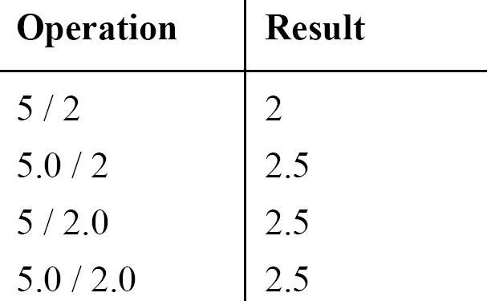
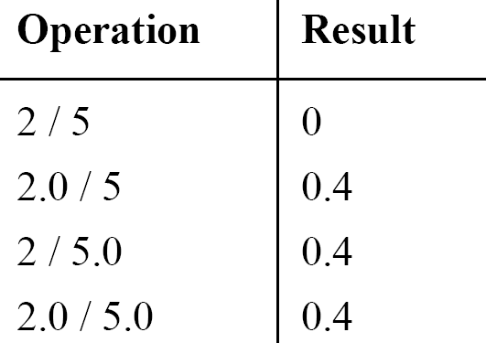
Integer and float conversions
An arithmetic operation between an integer and integer always yields an integer result
An operation between a real and real always yields a real result
An operation between an integer and real always yields a real result

Slide 34
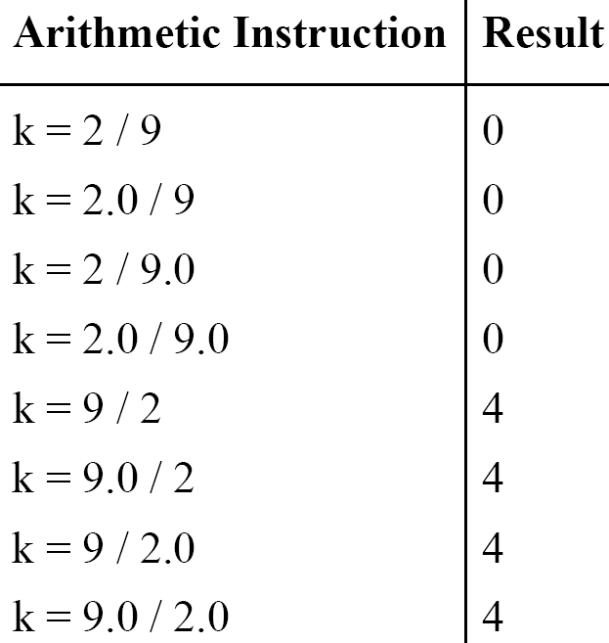
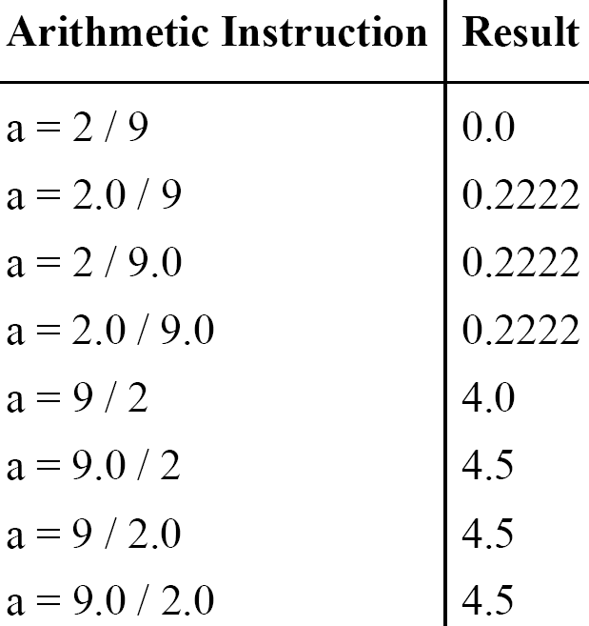
Type Conversion in Assignments
k is int and a is float

Slide 35
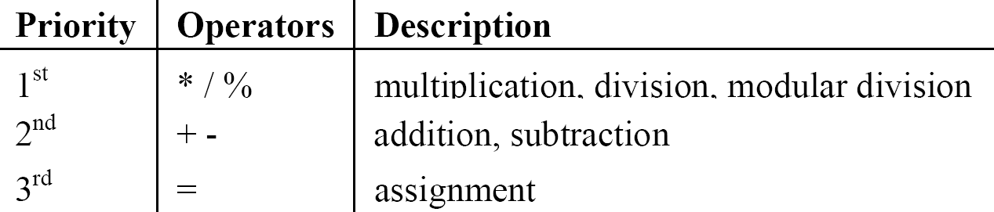
Hierarchy of Operations

Slide 36
Example
i = 2 * 3 / 4 + 4 / 4 + 8 - 2 + 5 / 8
i = 6 / 4 + 4 / 4 + 8 - 2 + 5 / 8 operation: *
i = 1 + 4 / 4 + 8 - 2 + 5 / 8 operation: /
i = 1 + 1+ 8 - 2 + 5 / 8 operation: /
i = 1 + 1 + 8 - 2 + 0 operation: /
i = 2 + 8 - 2 + 0 operation: +
i = 10 - 2 + 0 operation: +
i = 8 + 0 operation : -
i = 8 operation: +

Slide 37
Association of Operators
When an expression contains two operators of equal priority the tie between them is settled using the associativity of the operators
It can be of two types
  Left to right
  Right to left

Slide 38
Example
Consider the expression
a = 3 / 2 * 5 ;
Left to right:
    a = 3 / 2 * 5
    a = 1 * 5
    a = 5
Right to left :
    a = 3 / 2 * 5
    a = 3 / 10
    a = 0

Slide 39
Control Instructions in C
Enable us to specify the order in which the various instructions in a program are to be executed by the computer.
Sequence Control Instruction
Selection or Decision Control Instruction
Repetition or Loop Control Instruction
Case Control Instruction

Slide 40
Cont.
Sequence Control Instruction
  The Sequence control instruction ensures that the instructions are executed in the same order in which they appear in the program.

Slide 41
Cont..
Selection or Decision Control Instruction
  Decision instructions allow the computer to take a decision as to which instruction is to be executed next.
Repetition or Loop Control Instruction
  The Loop control instruction helps computer to execute a group of statements repeatedly.

Slide 42
Cont…
Case Control Instruction
  same as decision control instruction.

Slide 43
Which are invalid variables
BASICSALARY
_basic
basic-hra
#MEAN
group.
422
population in 2006
over time

Slide 44
Point out the errors
int = 314.562 * 150 ;
name = ‘Ajay’ ;
varchar = ‘3’ ;
3.14 * r * r * h = vol_of_cyl ;
k = ( a * b ) ( c + ( 2.5a + b ) ( d + e ) ;
m_inst = rate of interest * amount in rs ;
count = count + 1 ;

Slide 45
Summary
The three primary constants and variable types in C are integer, float and character
A variable name can be of maximum 31 characters
Do not use a keyword as a variable name
An expression may contain any sequence of constants, variables and operators
Operators having equal precedence are evaluated using associativity
Input/output in C can be achieved using scanf( ) and printf( ) functions.

