Slide 1
CSC103: Introduction to Computer and Programming
Lecture No 32

Slide 2
Previous lecture
Console I/O formatting
sprintf ( ) and sscanf( )
Library
  Static library
  How to make C static library using Dev Cpp

Slide 3
Today’s lecture outline
Apply I/O formatting in database management program
Make our database management library
Bit wise operator

Slide 4
Bitwise operator
So far we have dealt with characters, integers, floats and their variations
the smallest unit of memory that we have operated until now is byte
A single byte consists of 8 bits
Bitwise operator allow us to perform manipulation on individual bit
This is very important when your program interact with hardware

Slide 5
Cont.
Bitwise Operators available in C are
These operators can operate upon int and char but not on float and double
Operator | Meaning
~ | One’s complement
>> | Right shift
<< | Left shift
& | Bitwise AND
| | Bitwise OR
^ | Bitwise XOR(Exclusive OR)

Slide 6
Bit numbering scheme
Bit numbering scheme of character
Bit numbering of integer
Showbit(int i) function
7
6
5
4
3
2
1
0
31
. . .
7
6
5
4
3
2
1
0
Go to program

Slide 7
One’s Complement Operator
All 1’s present in the number are changed to 0’s and all 0’s are changed to 1’s
For example one’s complement of 1010 is 0101
One’s complement of 1111 is 0000
Go to program

Slide 8
Cont.
In real-world situations one’s complement operator is useful in encrypting files. Since it changes the original value completely

Slide 9
Right Shift Operator
Right shift operator is represented by >>
It needs two operands
It shifts each bit in its left operand to the right
Number of places the bits are shifted depends on the number following the operator
  ch >> 3 would shift all bits in ch three places to the right
  ch >> 5 would shift all bits 5 places to the right
if the variable ch contains the bit pattern 11010111
  ch >> 1 would give 01101011
  ch >> 2 would give 00110101

Slide 10
Cont.
7
6
5
4
3
2
1
0
1
1
0
1
0
1
1
1
One bit right shift
Two bit right shift
7
6
5
4
3
2
1
0
7
6
5
4
3
2
1
0
0
1
1
0
1
0
1
1
0
0
1
1
0
1
0
1
As the bits are shifted to the right, blanks are created on the left
These blanks are always filled with zeros.
Go to program

Slide 11
Cont.
If the operand is a multiple of 2 then shifting the operand one bit to right is same as dividing it by 2
  64 >> 1 gives 32
  64 >> 2 gives 16
  128 >> 2 gives 32
but,
  27 >> 1 is 13
  49 >> 1 is 24

Slide 12
Caution
a >> b
  if b is negative the result is unpredictable
  If a is negative than its left most bit (sign bit) would be 1
  right shifting a would result in extending the sign bit
  For example, if a contains -1, its binary representation would be
  0111111111111111111111111111111
Go to program

Slide 13
Left Shift Operator
This is similar to the right shift operator,
Only difference being that the bits are shifted to the left, and for each bit shifted, a 0 is added to the right of the number
7
6
5
4
3
2
1
0
1
1
0
1
0
1
1
1
One bit left shift
Two bit left shift
7
6
5
4
3
2
1
0
7
6
5
4
3
2
1
0
1
0
1
0
1
1
1
0
0
1
0
1
1
1
0
0

Slide 14
Storing date
DOS/Windows converts the actual date into a single value using the following formula:
    date = 512 * ( year - 1980 ) + 32 * month + day
Suppose 09/03/1990 is the date
    date = 512 * ( 1990 - 1980 ) + 32 * 3 + 9 = 5225
The binary equivalent of 5225 is 0001 0100 0110 1001
0
0
0
0
0
0
0
0
0
0
0
0
0
0
0
0
0
0
0
1
0
1
0
0
0
1
1
0
1
0
0
1
year
month
day

Slide 15
Cont.
Maximum value of day is 31
  How many bit are required to store value 31
  5 bits because maximum value that can be stored in 5 bits is 2⁵ = 32
Maximum value of month is 12
  How many bits are required to store value 12
  4 bits because maximum value that can be stored in 4 bits is 2⁴ = 16
Rest of bits are used for year

Slide 16
Extracting year from date
0
0
0
0
0
0
0
0
0
0
0
0
0
0
0
0
0
0
0
1
0
1
0
0
0
1
1
0
1
0
0
1
year
month
day
After performing 9 bits right shift
When you read the above integer value it is 10 in decimal, adding 1980 the year will 1990
0
0
0
0
0
0
0
0
0
0
0
0
0
0
0
0
0
0
0
0
0
0
0
0
0
0
0
0
1
0
1
0
year

Slide 17
Extracting value of month
0
0
0
0
0
0
0
0
0
0
0
0
0
0
0
0
0
0
0
1
0
1
0
0
0
1
1
0
1
0
0
1
year
month
day
After performing 23 bits left shift
After performing 28 bits right shift
The above integer value is 3 in decimal
0
0
1
1
0
1
0
0
1
0
0
0
0
0
0
0
0
0
0
0
0
0
0
0
0
0
0
0
0
0
0
0
month
day
0
0
0
0
0
0
0
0
0
0
0
0
0
0
0
0
0
0
0
0
0
0
0
0
0
0
0
0
0
0
1
1
month

Slide 18
Extracting value of day
0
0
0
0
0
0
0
0
0
0
0
0
0
0
0
0
0
0
0
1
0
1
0
0
0
1
1
0
1
0
0
1
year
month
day
After performing 27 bits left shift
After performing 27 bits left shift
The above integer value is 9 in decimal
0
1
0
0
1
0
0
0
0
0
0
0
0
0
0
0
0
0
0
0
0
0
0
0
0
0
0
0
0
0
0
0
day
0
0
0
0
0
0
0
0
0
0
0
0
0
0
0
0
0
0
0
0
0
0
0
0
0
0
0
0
1
0
0
1
day
Go to program

Slide 19
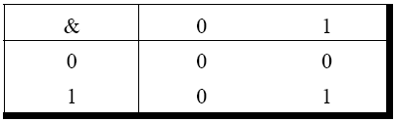
Bitwise AND Operator
& operator operates on two operands
While operating upon these two operands they are compared on a bit-by-bit basis
Both the operands must be of the same type (either char or int)

Slide 20
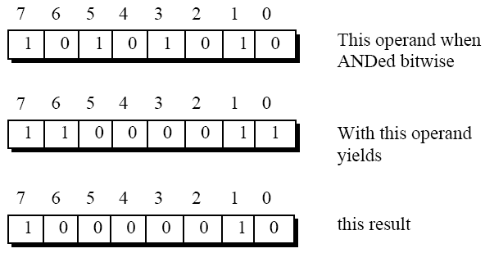
Cont.

Slide 21

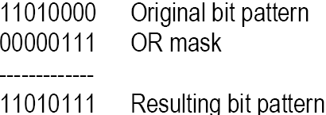
Bitwise OR Operator
| operator operates on two operands
Either the operands could be integer or character

Slide 22
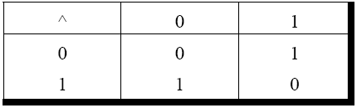
Bitwise XOR Operator
XOR operator is represented as ^ and is also called an Exclusive OR Operator
The XOR operator returns 1, when any one of the two bits is 1
If two bits are zero or both are one it will return 0
Go to program

