Slide 1
CSC103: Introduction to Computer and Programming
Lecture No 30

Slide 2
Previous lecture
Database Management system
  Adding a record
  Displaying all records
  Modify a record
  Delete a record
Seeking in file through fseek ( ) function

Slide 3
Today’s lecture outline
Database management program
Console I/O formatting
sprintf ( ) and sscanf( )

Slide 4
Database management program
It is capable to
  Add record :
    make sure that file pointer points to end of file
  Display record :
    make sure that file pointer point to the beginning of file
  Modify record :
    make sure that file pointer point to the beginning of file
  Delete record :
    make sure that file pointer point to the beginning of file
Go to program

Slide 5
Console formatting
The screen and keyboard together are called a console
Console I/O functions can be further classified into two categories—formatted and unformatted console I/O functions.
Unformatted output
Formatted output
Name Roll No CGPA
Ali 102 3.85
Ahmad 3.5 3.35
Name Roll No CGPA
Ali 102 3.85
Ahmad 3.5 3.35

Slide 6
Console I/O function
Formatted function
Unformatted function
Type | Input | Output
char | scanf( ) | printf( )
int | scanf( ) | printf( )
float | scanf( ) | printf( )
string | scanf( ) | printf( )
Type | Input | Output
char | getch( ) getche( ) getchar( ) | putch( ) putchar( )
int | -
float | -
string | gets( ) | puts( )

Slide 7
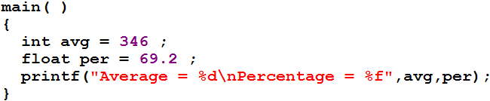
Formatted Console I/O Functions
General form of printf ( ) function
  printf( “formatted string”, list of variables);
Formatted string contains
  Characters that are simply printed as they are
  Conversion specifications that begin with a % sign
  Escape sequences that begin with a \ sign
Character printed as they are
% sign for variable values
Escape sequence

Slide 8
Format Specifications
%d %c and %f used in the printf( ) are called format specifiers
They tell printf( ) function the type of value of a variable
C language provide following optional specifiers in the format specifications
  dd.dd
Specifier | Description
dd | digits specifying field width
. | separating field width from precision
dd | Digit specifying precision
- | Sign for left justification

Slide 9
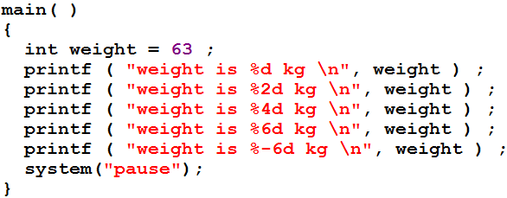
Example program 1
Program output
weight is 63 kg
weight is 63 kg
Go to program
weight is 63 kg
weight is 63 kg
weight is 63 kg

Slide 10
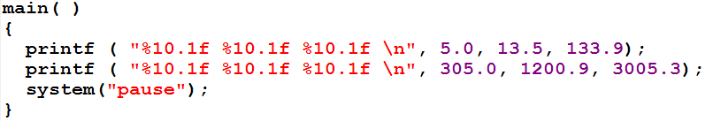
Example program 2
Length of each field
Precision
Go to program
Program output
012345678901234567890123456789
5.0 13.5 133.9
305.0 1200.9 3005.3

Slide 11
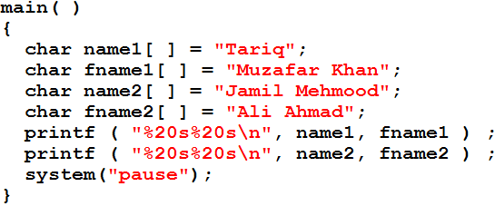
Example program 3
Program output
0123456789012345678901234567890123456789
Tariq Muzafar Khan
Jamil Mehmood Ali Ahmad
Go to program

Slide 12
sprintf( ) and sscanf( )
sprintf ( ) write the output to array of characters
fscanf( ) reads the value from string and store it in variable
Array of character
Output string
Go to program
Go to program

Slide 13
Exercise program
Write a definition of function
int getint(char *s)
  which would convert a numeric string pointed by pointer s in to integers.
  numeric string → “1786”
Write a program

