Slide 1
CSC103: Introduction to Computer and Programming
Lecture 3

Slide 2
What is a Flowchart?
START
Display message “How many hours did you work?”
A flowchart is a diagram that depicts the “flow” of a program.
The figure shown here is a flowchart for the pay-calculating program
Input Hours
Display message “How much do you get paid per hour?”
Input Pay Rate
Multiply Hours by Pay Rate. Store result in Gross Pay.
Display Gross Pay
END

Slide 3
Basic Flowchart Symbols
Rounded Rectangle
START
Display message “How many hours did you work?”
Notice there are three types of symbols in this flowchart:
  rounded rectangles
  parallelograms
  a rectangle
Each symbol represents a different type of operation.
Input Hours
Display message “How much do you get paid per hour?”
Parallelogram
Input Pay Rate
Rectangle
Multiply Hours by Pay Rate. Store result in Gross Pay.
Display Gross Pay
Rounded Rectangle
END

Slide 4
Basic Flowchart Symbols
START
Terminal
Display message “How many hours did you work?”
Terminals
  represented by rounded rectangles
  indicate a starting or ending point
Input Hours
Display message “How much do you get paid per hour?”
Input Pay Rate
Multiply Hours by Pay Rate. Store result in Gross Pay.
START
END
Display Gross Pay
Terminal
END

Slide 5
Basic Flowchart Symbols
START
Display message “How many hours did you work?”
Input Hours
Input/Output Operations
  represented by parallelograms
  indicate an input or output operation
Display message “How much do you get paid per hour?”
Input/output operations
Input Pay Rate
Multiply Hours by Pay Rate. Store result in Gross Pay.
Display message “How many hours did you work?”
Read Hours
Display Gross Pay
END

Slide 6
Basic Flowchart Symbols
START
Display message “How many hours did you work?”
Input Hours
Processes
  represented by rectangles
  indicates a process such as a mathematical computation or variable assignment
Display message “How much do you get paid per hour?”
Input Pay Rate
Process
Multiply Hours by Pay Rate. Store result in Gross Pay.
Multiply Hours by Pay Rate. Store result in Gross Pay.
Display Gross Pay
END

Slide 7
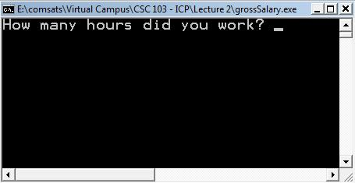
Stepping Through the Flowchart
START
Display message “How many hours did you work?”
Output operation
Input Hours
Display message “How much do you get paid per hour?”
Input Pay Rate
Multiply Hours by Pay Rate. Store result in Gross Pay.
Variable Contents:
Hours
Display Gross Pay
Pay Rate
Gross Pay
END

Slide 8

Stepping Through the Flowchart
START
Display message “How many hours did you work?”
Input
Operation
Input Hours
Display message “How much do you get paid per hour?”
Input Pay Rate
Multiply Hours by Pay Rate. Store result in Gross Pay.
Variable Contents:
Hours
40
Display Gross Pay
Pay Rate
Gross Pay
END

Slide 9
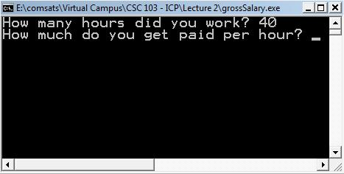
Stepping Through the Flowchart
START
Display message “How many hours did you work?”
Input Hours
Display message “How much do you get paid per hour?”
Output operation
Input Pay Rate
Multiply Hours by Pay Rate. Store result in Gross Pay.
Variable Contents:
Hours
40
Display Gross Pay
Pay Rate
Gross Pay
END

Slide 10
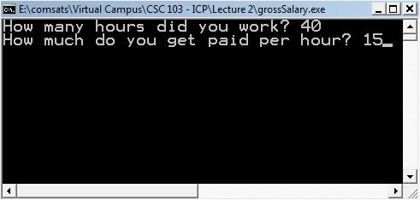
Stepping Through the Flowchart
START
Display message “How many hours did you work?”
Input Hours
Display message “How much do you get paid per hour?”
Input Pay Rate
Input
Operation
Multiply Hours by Pay Rate. Store result in Gross Pay.
Variable Contents:
Hours
40
Display Gross Pay
Pay Rate
15
Gross Pay
END

Slide 11
Stepping Through the Flowchart
START
Display message “How many hours did you work?”
Input Hours
Display message “How much do you get paid per hour?”
Input Pay Rate
Multiply Hours by Pay Rate. Store result in Gross Pay.
Process
Variable Contents:
Hours
40
Display Gross Pay
Pay Rate
15
Gross Pay
600
END

Slide 12
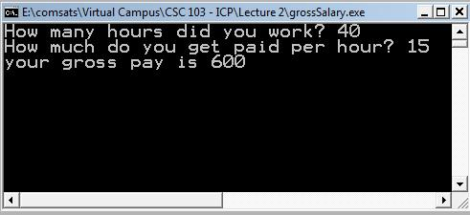
Stepping Through the Flowchart
START
Display message “How many hours did you work?”
Input Hours
Display message “How much do you get paid per hour?”
Input Pay Rate
Multiply Hours by Pay Rate. Store result in Gross Pay.
Variable Contents:
Hours
40
Display Gross Pay
Output operation
Pay Rate
15
Gross Pay
600
END

Slide 13
Four Flowchart Structures
Sequence
Decision
Repetition
Case

Slide 14
Sequence Structure
A series of actions are performed in sequence
The pay-calculating example was a sequence flowchart.

Slide 15
Decision Structure
if ... then
if ... then ... else
One of two possible actions is taken, depending on a condition.
False
True
False
True

Slide 16
Decision Structure
A new symbol, the diamond, indicates a yes/no question.
If the answer to the question is yes, the flow follows one path.
If the answer is no, the flow follows another path
False
True

Slide 17
Decision Structure
In the flowchart segment below, the question “is x < y?” is asked.
If the answer is no, then process A is performed.
If the answer is yes, then process B is performed.
False
x<y?
True
Process A
Process B

Slide 18
Decision Structure
The flowchart segment below shows a decision structure with only one action to perform. It is expressed as an if statement in C code.
Flowchart
C Code
if (x < y)
a = x * 2;
False
True
x < y?
Calculate a as x times 2

Slide 19
Decision Structure
The flowchart segment below shows how a decision structure is expressed in C as an if/else statement.
Flowchart
C Code
False
True
if (x < y)
a = x * 2;
else
a = x + y;
x < y?
Calculate a as x plus y
Calculate a as x times 2

Slide 20

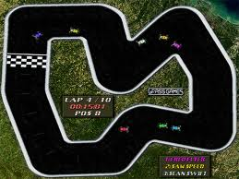
Repetition - Example
Formula 1 car race
There is a path/track
Each car has to complete a certain no of rounds say 10
In each round, when a car cross the finish line
  the condition is check whether the car has completed total no of round or not.

Slide 21
Repetition Structure
A repetition structure represents part of the program that repeats. This type of structure is commonly known as a loop.

Slide 22
Repetition Structure
Notice the use of the diamond symbol.
A loop tests a condition, and if the condition exists, it performs an action.
Then it tests the condition again.
If the condition still exists, the action is repeated.
This continues until the condition no longer exists.

Slide 23
Repetition Structure
In the flowchart segment, the question “is x < y?” is asked
If the answer is yes, then Process A is performed
The question “is x < y?” is asked again
Process A is repeated as long as x is less than y
When x is no longer less than y, the repetition stops and the structure is exited.
x < y ?
true
Process A
false

Slide 24
Repetition Structure
The flowchart segment below shows a repetition structure expressed in C as a while loop.
Flowchart
C Code
while (x < y)
x = x+1;
x < y ?
true
Add 1 in x
false

Slide 25
Controlling a Repetition Structure
The action performed by a repetition structure must eventually cause the loop to terminate. Otherwise, an infinite loop is created
In this flowchart segment, x is never changed. Once the loop starts, it will never end
QUESTION: How can this
flowchart be modified so
it is no longer an infinite
loop?
x < y ?
true
Display x
false

Slide 26
Controlling a Repetition Structure
ANSWER: By adding an action within the repetition that changes the value of x.
x < y ?
true
Display x
Add 1 in x
false

Slide 27
A Pre-Test Repetition Structure
This type of structure is known as a pre-test repetition structure.
The condition is tested BEFORE any actions are performed.
x < y ?
true
Display x
Add 1 in x
false

Slide 28
A Pre-Test Repetition Structure
In a pre-test repetition structure, if the condition is false, the loop will never begin.
x < y ?
true
Display x
Add 1 in x
false

Slide 29
A Post-Test Repetition Structure
This flowchart segment shows a post-test
repetition structure.
The condition is tested AFTER the actions
are performed.
A post-test repetition structure always
performs its actions at least once.
Display x
Add 1 to x
YES
x < y?

Slide 30
A Post-Test Repetition Structure
The flowchart segment below shows a post-test repetition structure expressed in C as a do-while loop.
Flowchart
Display x
C Code
do
{
printf(“%d”, x);
x = x +1;
} while (x < y);
Add 1 to x
YES
x < y?

Slide 31
Case structure
One of several possible actions is taken, depending on the contents of a variable.

Slide 32
Case structure
The structure below indicates actions to perform depending on the value in years_employed.
CASE:
years_employed
1
2
3
Other
bonus = 100
bonus = 200
bonus = 400
bonus = 800

Slide 33
Case structure
If years_employed = 2, bonus is set to 200
If years_employed = 3, bonus is set to 400
If years_employed = 1, bonus is set to 100
If years_employed is any other value, bonus is set to 800
CASE:
years_employed
1
2
3
Other
bonus = 100
bonus = 200
bonus = 400
bonus = 800

Slide 34
Connectors
Sometimes a flowchart will not fit on one page.
A connector (represented by a small circle) allows you to connect two flowchart segments.
A

Slide 35
Connectors
The “A” connector indicates that the second flowchart segment begins where the first segment ends.
A
Start
End
A

Slide 36
Combining Structures
Structures are commonly combined to create more complex algorithms
The flowchart segment below combines a decision structure with a sequence structure
YES
x < y?
Display x
Add 1 to x

Slide 37
Combining Structures
This flowchart segment
shows two decision
structures combined
False
x > min?
True
Display “x is outside the limits.”
False
x < max?
True
Display “x is outside the limits.”
Display “x is within limits.”

Slide 38
Review
What do each of the following symbols represent?
(Answer on next slide)

Slide 39
Answer
What do each of the following symbols represent?
Decision
Terminal
Input/Output Operation
Connector
Process

Slide 40
Review
Name the four flowchart structures.
(Answer on next slide)

Slide 41
Answer
Sequence
Decision
Repetition
Case

Slide 42
Review
What type of structure is this?
(Answer on next slide)

Slide 43
Answer
Repetition

Slide 44
Review
What type of structure is this?
(Answer on next slide)

Slide 45
Answer
Sequence

Slide 46
Review
What type of structure is this?
(Answer on next slide)

Slide 47
Answer
Case

Slide 48
Review
What type of structure is this?
(Answer on next slide)

Slide 49
Answer
Decision

Slide 50
Flow chart examples

Slide 51
Make a flow chart for the process of crossing the street.
Start
Look on your left and right side
If a vehicle near
Yes
Wait for few seconds
No
Cross the street
End

Slide 52
Make a flowchart to fill the bath tub with water
Start
Turn on hot and cold water
Turn on the hot and cold taps.
Is it too hot or cold? If it is, go to step 3, otherwise go to step 4.
Adjust the hot and cold taps and go back to step 2.
Wait for 2 minutes.
Is the bath tub full? If it is, go to step 7, otherwise go to step 4.
Turn off the hot and cold taps.
Too hot or cold
Y
Adjust hot and cold taps
N
Wait for 2 minutes
A
Is the bath full
Adjust hot and cold taps
N
Y
End
A

