Slide 1
CSC103: Introduction to Computer and Programming
Lecture No 29

Slide 2
Previous lecture
File opening mode
String (line) I/O in Files
  Reading a string
  Writing a string
Reading and writing numbers in file
Text vs binary file
Reading and writing in binary file

Slide 3
Today’s lecture outline
Database Management system
  Adding a record
  Displaying all records
  Modify a record
  Delete a record
Seeking in file through fseek ( ) function

Slide 4
Database management system
Database Management system is a large program composed of various modules that control the
  creation,
  modification,
  deletion and
  presentation
of records

Slide 5
Addition of record
Add record: Addition of records must always take place at the end of existing records in the file, much in the same way you would add new records in a register manually
Fatima Tariq | 102 | 3.45 | Physics
Ali Ahmad | 105 | 3.85 | Computer science
Fahad Hamid | 109 | 3.75 | Computer science
Tahir Khan | 110 | 3.35 | Bioinformatics

Slide 6
Display record
Listing records means displaying the existing records on the screen. Records should be listed from first record to last record.
Name | Roll No | CGPA | Department
Fatima Tariq | 102 | 3.45 | Physics
Ali Ahmad | 105 | 3.85 | Computer science
Fahad Hamid | 109 | 3.75 | Computer science
Tahir Khan | 110 | 3.35 | Bioinformatics

Slide 7
Modify record
First ask the user which record he intends to modify. E.g. ask to input name of the employee whose record is to be modified
On modifying the record, the existing record gets overwritten by the new record.
  We want to modify cgpa of Ali Ahmad from 3.85 to 4.00
Fatima Tariq | 102 | 3.45 | Physics
Ali Ahmad | 105 | 3.85 | Computer science
Fahad Hamid | 109 | 3.75 | Computer science
Tahir Khan | 110 | 3.35 | Bioinformatics
Ali Ahmad | 105 | 4.00 | Computer science

Slide 8
Deletion of record
  First ask the name for record to be deleted
  Then write all record except the one to be deleted in a temporary file
  Delete the original file
  Renamed temporary file back to original

Slide 9
Cont.
student.dat
Fatima Tariq | 102 | 3.45 | Physics
Ali Ahmad | 105 | 4.00 | Computer science
Fahad Hamid | 109 | 3.75 | Computer science
Tahir Khan | 110 | 3.35 | Bioinformatics
Enter name for record to be deleted : Fahad Hamid
student.dat
temp.dat
Ali Ahmad | 105 | 4.00 | Computer science
Fatima Tariq | 102 | 3.45 | Physics
Tahir Khan | 110 | 3.35 | Bioinformatics

Slide 10
Opening file strategy
First open the file in “rb+” mode that is read and writing mode. If the file exist it will open that file otherwise return NULL
If first attempt return NULL, this means that file does not exist. Now open the file in “wb+” mode so that it will create a new file

Slide 11
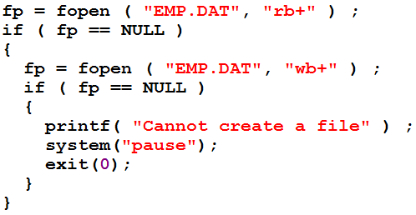
Cont.
Note that the file is being opened only once and closed only once, which is quite logical

Slide 12
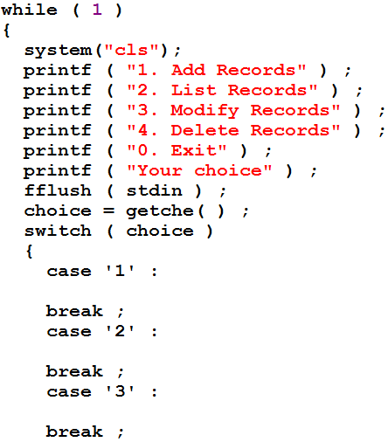
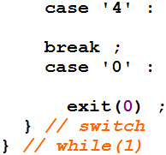
Program skeleton
Code for addition of record
Code for display of all record
Code for modification of a record
Code for deletion of a record

Slide 13
Seeking in file
C provide seeking in file through fseek( ) function
fseek ( fp, 0, SEEK_END ) ;
Offset (2nd parameter) tells how many bytes should the pointer (1st parameter) moved from particular position (3rd parameter)
3rd parameter could be
  SEEK_SET : beginning of file
  SEEK_CUR : Current position of file pointer
  SEEK_END : end of file
File pointer in which you want to seek
offset
Particular position in file

Slide 14
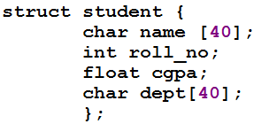
Cont.
Fatima Tariq | 102 | 3.45 | Physics
Ali Ahmad | 105 | 4.00 | Computer science
Fahad Hamid | 109 | 3.75 | Computer science
Tahir Khan | 110 | 3.35 | Bioinformatics
fp
fseek(fp , 0, SEEK_END);
fseek(fp , - sizeof(struct student), SEEK_CUR);

Slide 15
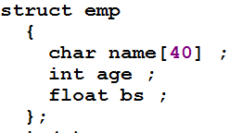
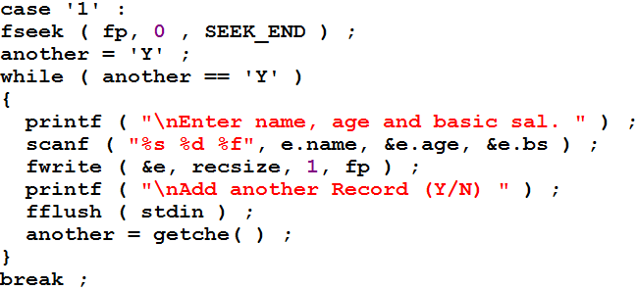
Addition of record
Place the fp at the end of file
Addition is always performed at the end of file

Slide 16
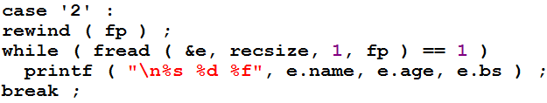
Displaying all records
Before displaying make sure that fp is at the beginning of file
rewind () function place the pointer to the beginning of file

Slide 17
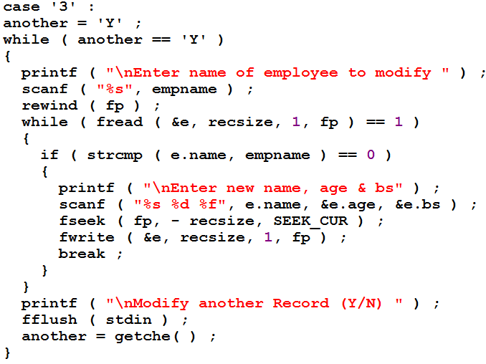
Modify a record
e

Slide 18
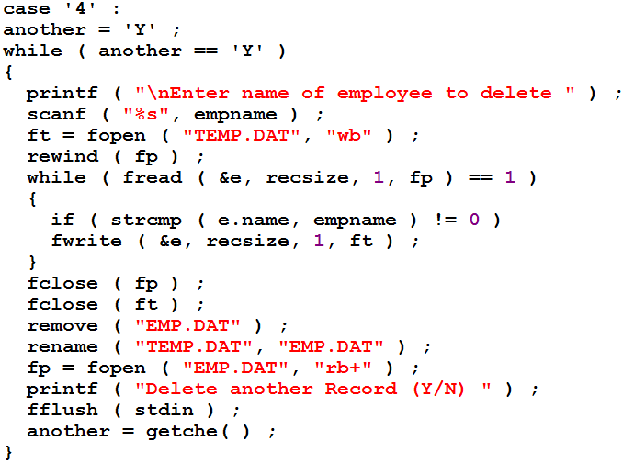
Delete a record
Emp.dat
e
temp.dat
Emp.dat
Go to program

