Slide 1
CSC103: Introduction to Computer and Programming
Lecture No 27

Slide 2
Previous lecture
Example program – structure
C preprocessor directives
    Macro expansion
    File inclusion
    Conditional Compilation

Slide 3
Today’s lecture outline
Introduction to File
File operations
  Reading from file (character by character)
  Writing in file (character by character)

Slide 4
File
Until now we have been saving record in volatile memory i.e. RAM
  E.g. entering books record, display and search facility (struct book)
File can be used to store data permanently i.e. on hard disk
Data in files can be retrieve even the computer is powered off
C programmer is able to read, write, modify and delete the content of file

Slide 5
Cont.
A common data file hierarchy is typically broken down into five categories
  Bit Binary : digit, 0 or 1
  Byte : Eight bits
  Field : Grouping of bytes
  Record : Grouping of fields
  File : Grouping of records

Slide 6
Fields, Records
Fields could be a name, cgpa, department, street address, phone number, and so on
Records are logical groupings of fields that comprise a single row of information
A student record might be comprised of name, age, ID, and GPA fields. Each field is unique in description but together describes a single record.
Field
Record
Name | ID | CGPA | Department
Ali Ahmad | 105 | 3.85 | Computer science
Fahad Hamid | 109 | 3.75 | Computer science

Slide 7
Data file
Data files are comprised of one or more records
Files can be used to store all types of information, such as student or employee data
C programmers use pointers to manage file for reading and writing data
Fatima Tariq | 102 | 3.45 | Physics
Ali Ahmad | 105 | 3.85 | Computer science
Fahad Hamid | 109 | 3.75 | Computer science

Slide 8
File Operations
Creation of a new file
Opening an existing file
Reading from a file
Writing to a file
Moving to a specific location in a file (seeking)
Closing a file

Slide 9
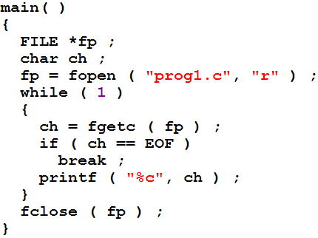
Example program
Go to program

Slide 10
Opening a File
Before reading and writing operation on file, file must be opened
fopen() function can be used to open a file
Example program opens ”prog1.c” file in read mode
Read mode means content of file cannot be modified or added, they can just be read
string
string

Slide 11
Tasks of fopen( ) function
Firstly it searches on the disk the file to be opened
Then it loads the file from the disk into a place in memory called buffer
It sets up a character pointer that points to the first character of the buffer
  It is much faster to read / write content in memory as compare to hard disk

Slide 12
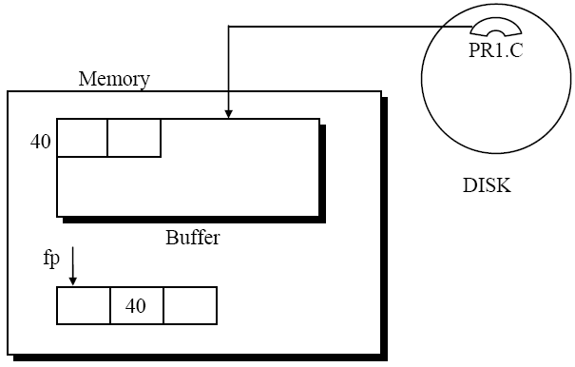
Cont.

Slide 13
structure FILE
For successful reading from a file information like mode of opening, size of file, place in the file from where the next read operation would be performed, etc. has to be maintained
fopen( ) store such information in a FILE structure and returns it address
We store that address in a pointer of type FILE

Slide 14
Reading from a File
Once file is opened using fopen ( ), its content are brought into buffer
A pointer is set that points to the first character in this buffer
This pointer is one of the elements of the structure to which fp is pointing
To read the file’s contents from memory we use a function called fgetc( )

Slide 15
Cont.
ch = fgetc ( fp ) ;
fgetc( ) reads the character from the current pointer position
advances the pointer position so that it now points to the next character, and
returns the character that is read
*fp
855
405
406
855
h
e
l
l
o
w
o
r
l
d
405
406
407
ch = fgetc ( fp ) ;
ch
h

Slide 16

Cont.
Once the file is opened, we can refer file not by its name but through FILE pointer
The function fgetc( ) within an indefinite while loop
Loop will be executed until if finds End Of File (EOF)
EOF is a special character whose ASCII value is 26
EOF is inserted after the last character in the file
EOF is macro has been defined in the file stdio.h.
h
e
l
l
o
w
o
r
l
d
EOF
405

Slide 17
Trouble in Opening a File
There is a possibility that when we try to open a file using the function fopen( ), the file may not be opened
For example, the file may not exist on the disk
Other reasons may be
  disk space may be insufficient to open a new file, or the disk may be write protected or the disk is damaged and so on
If the file opening fails the fopen( ) function returns a value NULL

Slide 18
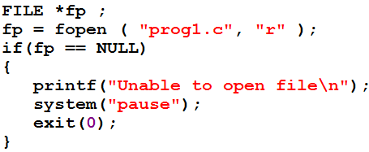
Example code
This check must be performed for every program that involve File I/O

Slide 19
Closing the File
After reading/writing from the file, file should be closed
Once file is closed, it is not possible to perform read/write operation
Three operations would be performed by fclose( )
  The characters in the buffer would be written to the file on the disk
  At the end of file a character with ASCII value 26 would get written (EOF character)
  The buffer would be eliminated from memory

Slide 20
Example program
Write a program that will read a file and count how many characters, spaces, tabs and newlines are present in it
write a program

Slide 21
Writing character in file
fputc( ) is used to writes character in a file
  fputc ( ch, fp ) ;
  fputc write the character constant store in character variable in the buffer that is pointer by a pointer fp
Character variable
File pointer

Slide 22
A File-copy Program
Write a program that create a copy of a file. The user input two file names
  the name of file to be copied
  Copy file name
write a program

Slide 23
File Opening Modes
"r" :
  reading from file, if file does not exist it returns null
"w" :
  writing to the file, if file does not exits a new file is created
"a" :
  adding new contents at the end of file, if file does not exits a new file is created

