Slide 1
CSC103: Introduction to Computer and Programming
Lecture No 26

Slide 2
Previous lecture
Pointer to a structure
Dynamic memory allocation for structure
Passing a structure to a function

Slide 3
Today’s lecture outline
Example program – structure
C preprocessor directives
    Macro expansion
    File inclusion
    Conditional Compilation

Slide 4
Example Program
Create a structure to specify data on students given below:
    Roll number, Name, Department, Course, Year of joining
Create a variable of that structure, input value from user and then display those values.
Write a program

Slide 5
Preprocessor directive
Preprocessor directives are the special instruction to C compiler
Preprocessor directive are resolved before compilation of program
Each preprocessor directive begins with # and can be placed anywhere in the program
Following preprocessor directives are used mostly
    Macro expansion
    File inclusion
    Conditional Compilation

Slide 6
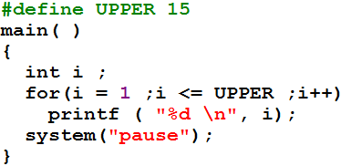
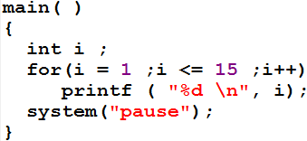
    Macro expansion
Macro definition
Preprocessor

Slide 7
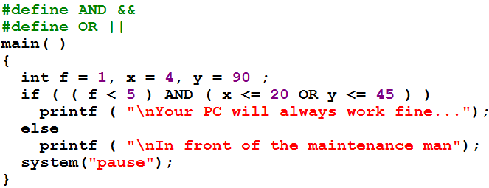
Cont.
&&
||

Slide 8
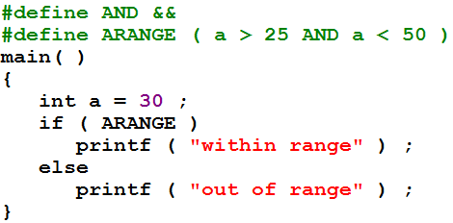
Cont.
A #define directive could be used to replace a condition

Slide 9
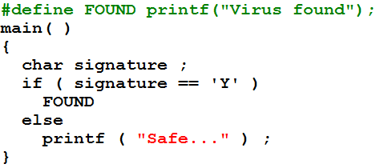
Cont.
A #define directive could be used to replace an entire C statement.

Slide 10
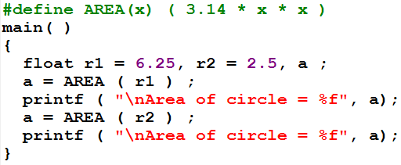
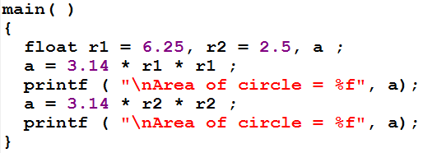
Macros with Arguments
Preprocessor

Slide 11
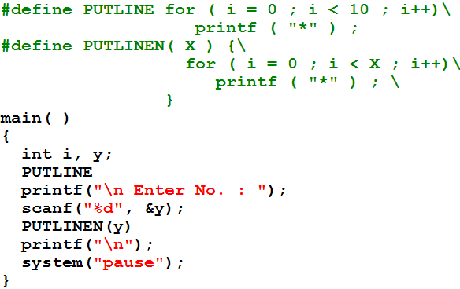
Multi line marcos
Go to program

Slide 12
Macros versus Functions
It seams that macro calls are ‘like’ function calls, they are not really the same things
In a macro call the preprocessor replaces the macro template with its macro expansion
In function call control is transferred to a function, function do processing and then control is returned back
Macro call and expansion

Slide 13
Cont.
when is it best to use macros with arguments and when is it better to use a function
Usually macros make the program run faster but increase the program size
whereas functions make the program smaller and compact
E.g. if we used macro 100 times, then macro expansion goes in source code 100 time before compilation process
If a function is called 100 times, it will make same amount of space in the program

Slide 14
Cont..
Conclusion:
  If macro is simple and small than it can be used to avoid function calls overhead
  But if macro size is larger than it is better to used function

Slide 15
File Inclusion
This directive causes one file to be included in another
    #include <filename>
Why we need it
  It is a good programming practice to keep different sections of a large program separate in form of files. These files are #included at the beginning of main program file.
  There are some functions and some macro definitions that we need almost in all programs that we write #include<stdio.h>

Slide 16
Ways to write #include statement
#include "filename"
  This would look for the file filename in the current folder and than in the include folder. C:\Dev-Cpp\include
#include <filename>
  This command would look for the file filename in the include folder only.
Go to program

Slide 17
Conditional Compilation
This allows to skip some part of the source code for compilation process
General form
  #ifdef macroname
    statement 1 ;
    statement 2 ;
    statement 3 ;
  #endif

Slide 18
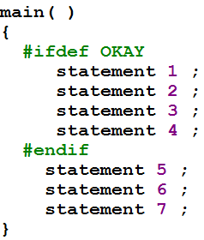
Where would #ifdef be useful
To “comment out” some lines of code
Go to program

Slide 19
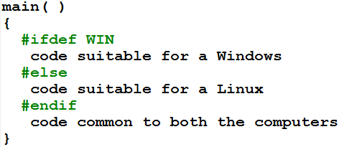
Cont.
A sophisticated use of #ifdef has to do with making the programs portable, i.e. to make them work on two totally different computers

