Slide 1
CSC103: Introduction to Computer and Programming
Lecture No 25

Slide 2
Previous lecture
malloc function for integer array
Structures
Declaring a structure
Accessing structure elements
How structure elements are stored
Array of structure

Slide 3
Today’s lecture outline
Pointer to a structure
Dynamic memory allocation for structure
Passing a structure to a function
Example program

Slide 4
Pointer to a structure
int x;
int *p;
p = &x;
Pointer to an int is a pointer that contain/hold the address of memory where an int value is stored
A pointer to a structure is a pointer that contain/hold the address of memory where a structure value (of pointer’s type) is stored
struct book b1;
struct book *q;
q = &b;
*p
6550
x
6550
*q
8765
b1
8765

Slide 5
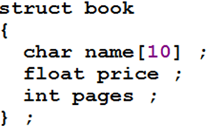
Accessing structure element using pointer
int x=10;
int *p;
p = &x;
*p = 10;
struct book b1;
struct book *q;
q = &b;
q –> price = 95.75;
q –> pages = 105;
strcpy(q –> name, “let us c”);
p is 6550
*p is 10
*p
6550
x
10
6550
*q
8765
b1
Let us c
95.75
105
8765

Slide 6



Cont.
You can also assign values to structure elements input by a user using a pointer
*q
8765
Go to program
b1
Let us c
95.75
105
8765

Slide 7
Dynamic memory allocation for structure
sizeof(int)
*p
6550
For n = 3, malloc function allocates memory for 3 integer values
6550
6554
6558
*q
n = 3
8765
n = 1
8765

Slide 8
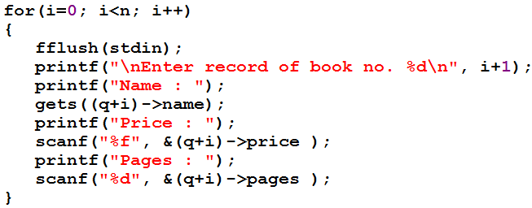
Cont.
Go to program
Enter record of book no. 1
Name :
Let us c
Price :
150.75
Pages :
465
Enter record of book no. 2
Name :
Databases
(8765+1)->name
Price :
375.85
Pages :
650
*q
8765
Let us c
150.75
465
Databases
375.85
650
8765

Slide 9
Passing structure to a function
Two ways
  Passing address of a structure
  Passing value of structure

Slide 10
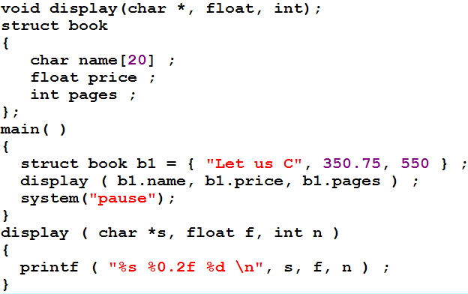
Passing elements of structure to function
Like ordinary variables, individual elements of a structure can be passed to a function

Slide 11
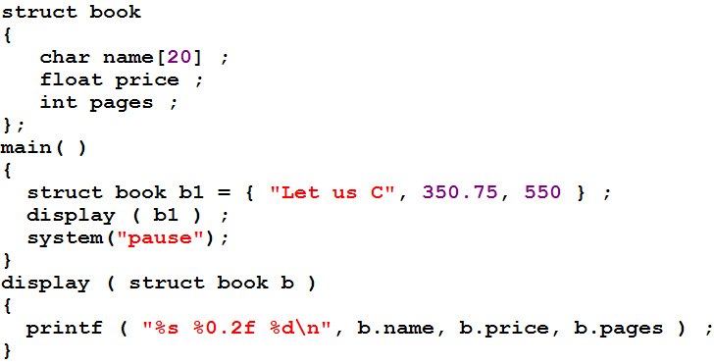
Passing entire structure to function by value
b1
Let us C
350.75
550
8765
Go to program
b
Let us C
350.75
550
9560

Slide 12
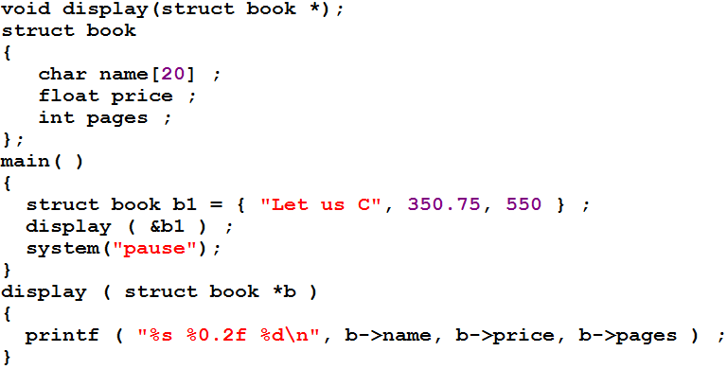
Passing entire structure to function by address
b1
Let us C
350.75
550
8765
*b
8765
Go to program

Slide 13
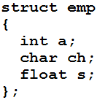
Memory map of structure
Go to program
e
600
604
608
Microsoft visual C , Dev Cpp are example of 32-bit compiler
32-bit microprocessor is able to fetch the data that is present at an address, which is a multiple of four much faster
Hence the 32 bit compiler aligns every element of a structure at an address that is multiple of four.

Slide 14
Structure – summary
A structure is usually used when we wish to store dissimilar data together
Structure elements can be accessed through a structure variable using a dot (.) operator.
Structure elements can be accessed through a pointer to a structure using the arrow (->) operator.
All elements of one structure variable can be assigned to another structure variable using the assignment (=) operator.
It is possible to pass a structure variable to a function either by value or by address.
It is possible to create an array of structures.

Slide 15
Example Program
Create a structure to specify data on students given below:
    Roll number, Name, Department, Course, Year of joining
Create a variable of that structure, input value from user and then display those values.
Write a program

Slide 18
Preprocessor directive
Preprocessor directives are the special instruction to C compiler
Preprocessor directive are resolved before compilation of program
Following preprocessor directives are used mostly
    Macro expansion
    File inclusion
    Conditional Compilation

Slide 19
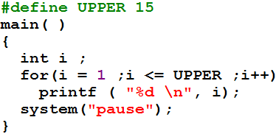
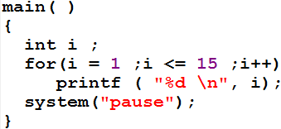
    Macro expansion
Preprocessor

Slide 20
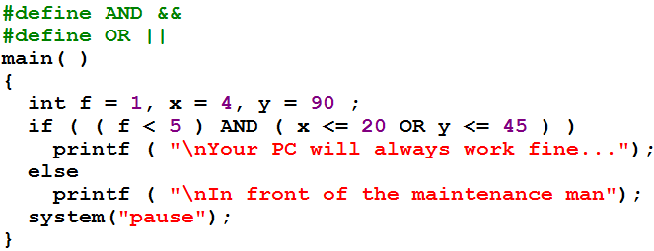
Cont.

Slide 21
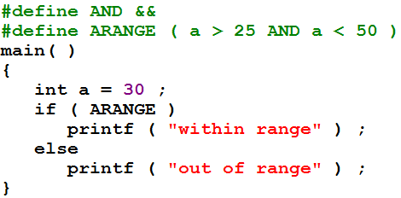
Cont.
A #define directive could be used even to replace a condition

Slide 22
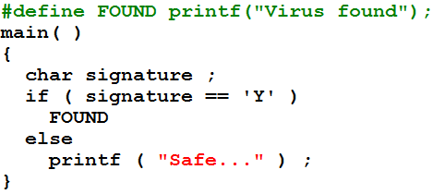
Cont.
A #define directive could be used to replace even an entire C statement.

Slide 23
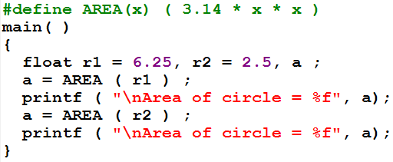
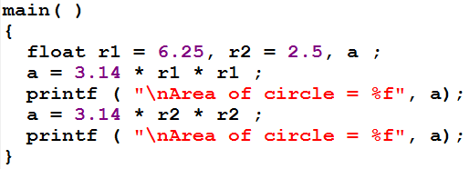
Macros with Arguments

Slide 24
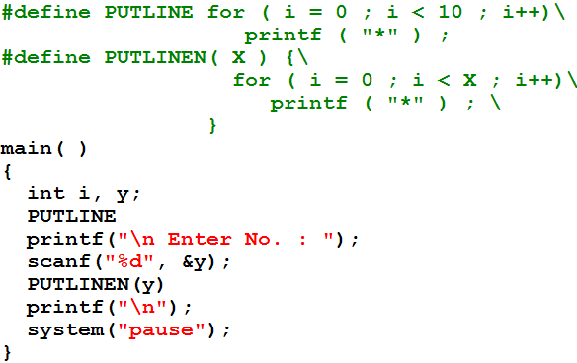
Multi line marcos
Go to program

