Slide 1
CSC103: Introduction to Computer and Programming
Lecture No 24

Slide 2
Previous lecture
Exercise program
Two dimensional array of characters
Array of pointer to string
Garbage value
Dynamic memory allocation
Free function

Slide 3
Today’s lecture outline
malloc function for integer array
Structures
Declaring a structure
Accessing structure elements
How structure elements are stored
Array of structure

Slide 4
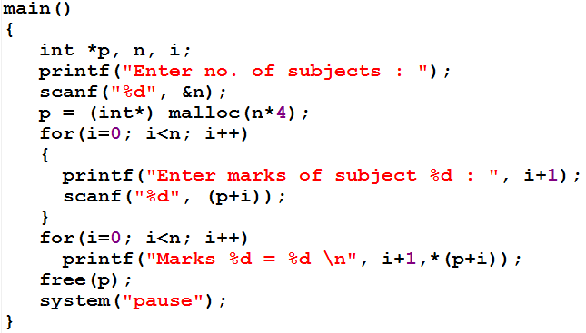
malloc function for integer array
malloc(3*4) = malloc(12)
n
3
2
3
1
2
3
1
0
i
0
*p
6550
Program output
73
85
78
Enter no. of subjects :
3
6550
6554
6558
Enter marks of subject 1 :
73
Marks 1 = 73
Enter marks of subject 2 :
85
Marks 2 = 85
Enter marks of subject 3 :
78
Marks 3 = 78

Slide 5
Structure
Variable can store single value of one type
Array can store multiple values of similar type
Structure can store multiple values of similar or dissimilar type
Structures are a collection of variables related in nature, but not necessarily in data type
Book Name | Price | Pages
Let us C | 550.50 | 728
Kite runner | 500.75 | 336

Slide 6
Why use structures
Suppose we want to store data about a book
You might want to store book’s
    name (a string),
    price (a float)
    number of pages (an int).
If data about say 3 such books is to be stored, then we can follow two approaches:
  Construct three arrays, one for storing names, second for storing prices and third for number of pages
  Use of structure variables

Slide 7
Cont.
Three separate array approaches
Structure variable
1
2
3
1
2
3
1
2
3
0
1
2
0
1
2
0
1
2
name[]
price[]
pages[]
s1
s2
s3
name
price
pages

Slide 8
fflush function
fflush(stdin);
Standard input stream (stdin) is the default source of data for applications
It is usually directed to the input device of the standard console (like a keyboard)
Go to program

Slide 9
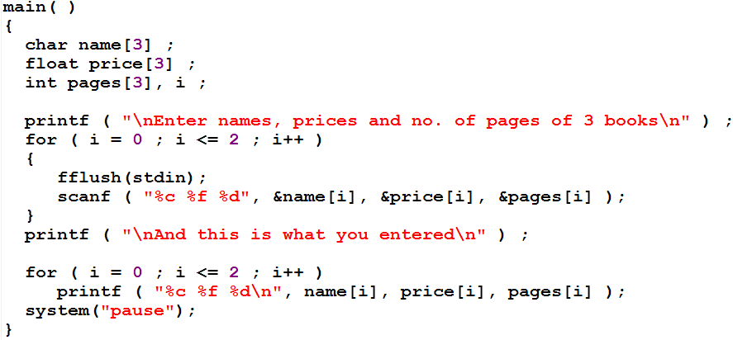
Three separate array approach
Go to program

Slide 10
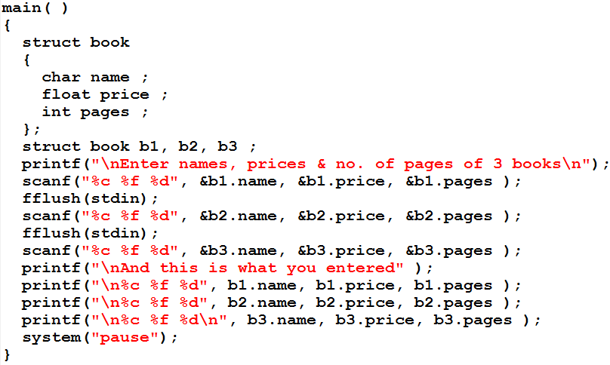
Structure approach
Go to program
b1
b2
b3
name
price
pages

Slide 11
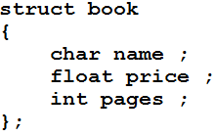
Structure definition
Memory will not be allocated when you write function definition
This is just to tell the C compiler that what are the elements of a variable of this structure
This statement defines a new data type called struct book

Slide 12
Declaring structure variable
This statement declare three variables b1, b2 and b3 of struct book type.
Now the memory will be allocated for these three variables
These bytes are always in adjacent memory locations
b1
b2
b3
name
price
pages

Slide 13
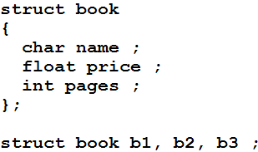
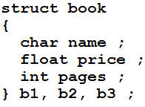
Cont.
Structure definition and declaration of structure variables can be combined
Variable declaration
Structure definition Variable declaration
Definition

Slide 14
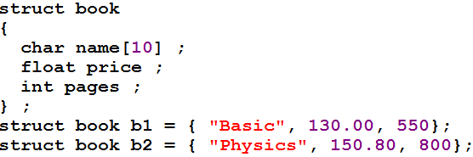
Variable initialization
Structure variable can be initialize at declare time as well from the input by user

Slide 15
Scope of structure
Local scope
  If the structure is define inside any function, it will only be accessible within that function
Global scope
  If structure is define outside function, it will be accessible to all the function in that program
Go to program

Slide 16
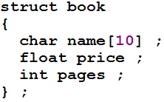
Accessing Structure Elements
In arrays individual elements are accessed using a subscript
A dot (.) operator is used with structure variable name to access individual element of structure
For example
b1.price = 100.75;
b1.pages = 450;
strcpy(b1.name, “let us c”);

Slide 17
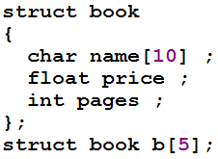
Array of Structures
Go to program
0
1
2
3
4
b[5]
price
pages
name[10]

Slide 18
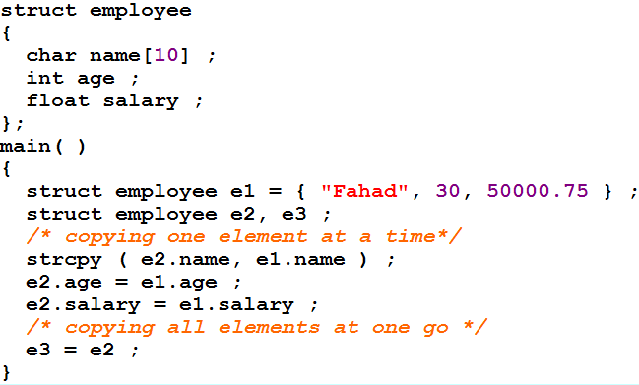
Additional feature
The values of a structure variable can be assigned to another structure variable of the same type using the assignment operator

Slide 19
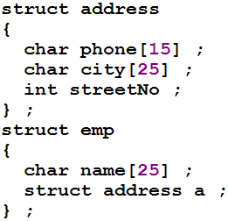

Cont.
One structure can be nested within another structure
Go to program

