Slide 1
CSC103: Introduction to Computer and Programming
Lecture No 23

Slide 2
Previous lecture
Standard library string functions
  strlen()
  strcpy()
  strcat()
  strcmp()

Slide 3
Today’s lecture outline
Exercise program
Two dimensional array of characters
Array of pointer to string
Garbage value
Dynamic memory allocation
Free function

Slide 4
Exercise program
Write the definition of following function then call it from main to check it works or not
  int countchar(char *str, char ch);
write to program

Slide 5
Two-Dimensional Array of Characters
It is same as 2-D array of integer except that each 1-D array in 2-D array terminates at NULL character
int a[3][6]
2
6
8
9
2
-9
5
4
7
8
8
0
4
2
2
0
1
0
char b[3][6]
h
e
l
l
o
\0
w
o
r
l
d
\0
h
a
r
r
y
\0

Slide 6
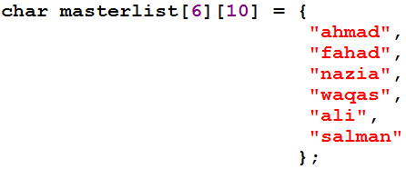
Initializing 2 D array of character
row
column
0
1
2
3
4
5
6
7
8
9
0
a
h
m
a
d
\0
1
f
a
h
a
d
\0
2
n
a
z
i
a
\0
3
w
a
q
a
s
\0
4
a
l
i
\0
5
s
a
l
m
a
n
\0

Slide 7
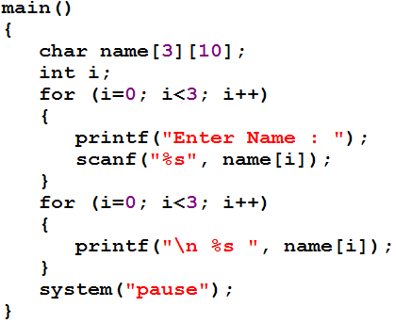
Cont.
&name[i][0]
0
1
2
3
4
5
6
7
8
9
0
a
h
m
a
d
\0
1
a
l
i
\0
2
n
a
z
i
a
\0
a
h
m
a
d
\0
a
l
i
\0
n
a
z
i
a
\0
Wastage of memory

Slide 8
Example program
Example program asks you to type your name. When you do so, it checks your name against a master list to see if the name is present in the list or not
Go to program

Slide 9
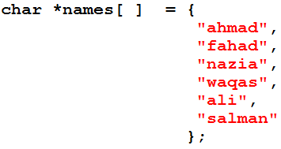
Array of pointers to string
A pointer variable always contains an address
An array of pointers would contain a number of addresses
Array contains base addresses of respective names
Base address of “ahmad” is store in names[0]

Slide 10
Memory map
0
1
2
3
4
5
600
668
712
745
789
800
a
h
m
a
d
\0
s
a
l
m
a
n
\0
600
800
f
a
h
a
d
\0
a
l
i
\0
668
789
n
a
z
i
a
\0
w
a
q
a
s
\0
712
745

Slide 11
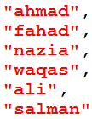
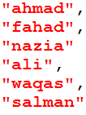
Cont.
Another reason to use an array of pointers to store strings is to obtain greater ease in manipulation of the strings
Let see two programs
  first uses a 2-D array of characters to store the names,
  whereas the second uses an array of pointers to strings.
The purpose of both the programs is very simple. We want to exchange the position of the names “waqas” and “ali”.

Slide 12
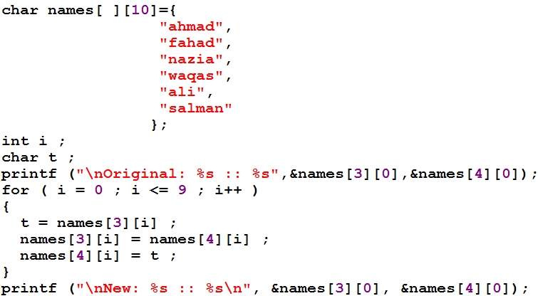
Program using array of character
Go to program
Logic for exchanging 4th and 5th name

Slide 13
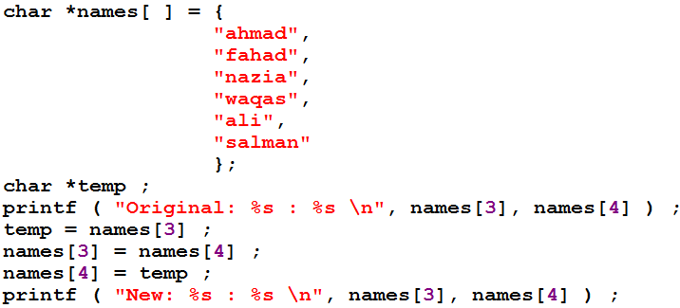
Program using array of pointers
Go to program
Logic for exchanging 4th and 5th name

Slide 14
Garbage value
When a variable is declared it is associated with some memory location
    int x;
Garbage value is the value present in this memory location, before you will initialize x with some other value
  int x = 10;
Garbage value
x
x
10

Slide 15
Limitation of Array of Pointers to Strings
A two-dimensional array of characters can be initialized with strings at declaration time, or from the strings input using scanf( ) or gets() functions
An array of pointers to strings can be initialized with strings at declare time, but we cannot receive the strings from keyboard using scanf( ) or gets() function

Slide 16
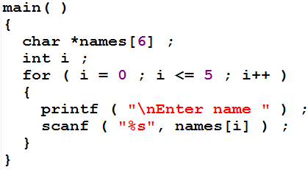
Cont.
The above program will give error at run time
0
1
2
3
4
5
*names[]

Slide 17
Solution
If we want to input string from user and its memory address to be store in the array of pointer then we have to use dynamic memory allocation
Dynamic memory allocation is the process of allocating memory during the execution of program
In C, malloc function used for dynamic memory allocation
Function void* maalloc( int n);
malloc function allocates n bytes of memory and returns that memory space base address

Slide 18
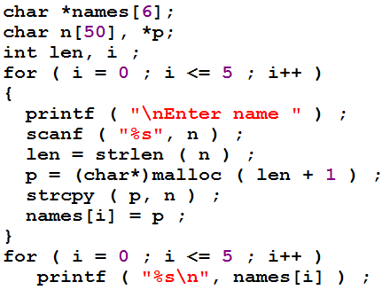
Example program
Copy string
Copy address
Go to program
0
1
2
3
4
5
*names[6]

Slide 19
free function
It is recommended to free the memory that is allocated at run time
In C, free function releases the specified block of memory back to the system
Prototype void free(void *);
for(i=0; i<=5; i++)
  free(name[i]);

Slide 20
malloc function for integer array
Write a program that ask the user to input number of subjects and user start entering the marks for those subjects. After that, the program displays all the marks
Write a program

