Slide 1
CSC103: Introduction to Computer and Programming
Lecture No 22

Slide 2
Previous lecture
Strings
Null character
Memory map of string
String initialization
Display string content
Input string from user
Passing a string to a function

Slide 3
Today’s lecture outline
Standard library string functions
  strlen()
  strcpy()
  strcat()
  strcmp()

Slide 4
Standard Library String Functions
With every C compiler a large set of useful string handling library functions are provided
  strlen( ), to find length of string
  strcpy( ), to copy content of one string in another
  strcat( ) to append content of one string after the content of other string
  strcmp( ) to compare on string with another

Slide 5
strlen( )
Short for string length
This function counts the number of characters present in a string
    Prototype → int strlen(char *);
The base address of the string must be pass when calling strlen function
    char str1[ ] = “hello”;
    strlen(str1) call will return 5 not 6
\0 is not the part of string it is just character that tells where this string terminates
str1[6]
h
e
l
l
o
\0
65508
65509
65510
65511
65512
65513

Slide 6
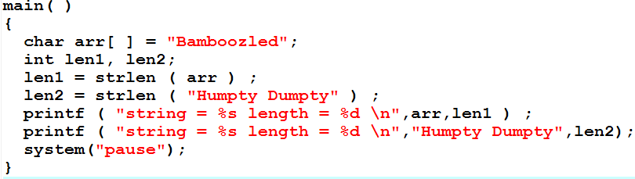
strlen() – program
Go to program

Slide 7
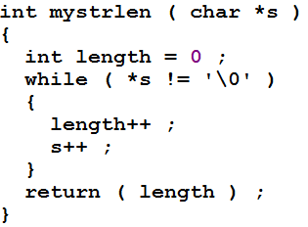
mystrlen( )
. . .
. . .
len
5
a[6]
h
e
l
l
o
\0
500
501
502
503
504
505
504
502
4
*s
length
5
0
505
3
500
2
501
1
503
*s != ‘\0’
*(500) != ‘\0’
‘h’ != ‘\0’
true
*s != ‘\0’
*(501) != ‘\0’
‘e’ != ‘\0’
true
*s != ‘\0’
*(502) != ‘\0’
‘l’ != ‘\0’
true
*s != ‘\0’
*(503) != ‘\0’
‘l’ != ‘\0’
true
*s != ‘\0’
*(504) != ‘\0’
‘o’ != ‘\0’
true
Go to program
*s != ‘\0’
*(505) != ‘\0’
‘\0’ != ‘\0’
false

Slide 8
strcpy( )
This function copies the contents of one string into another
The base addresses of the source and target strings should be supplied to this function
Prototype
void strcpy (char *t, char *s);

Slide 9
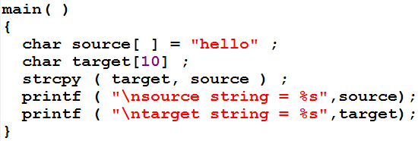
strcpy() - program
Go to program

Slide 10
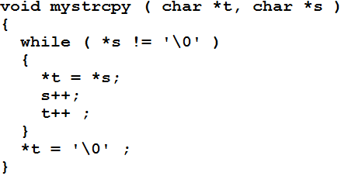
mystrcpy( )
. . .
. . .
a[6]
h
e
l
l
o
\0
500
501
502
503
504
505
504
*s
503
500
501
502
505
b[6]
h
e
l
l
o
\0
600
601
602
603
604
605
*s != ‘\0’
*(500) != ‘\0’
‘h’ != ‘\0’
true
605
602
600
604
*t
601
603
*s != ‘\0’
*(501) != ‘\0’
‘e’ != ‘\0’
true
*s != ‘\0’
*(502) != ‘\0’
‘l’ != ‘\0’
true
*s != ‘\0’
*(503) != ‘\0’
‘l’ != ‘\0’
true
Go to program
*s != ‘\0’
*(504) != ‘\0’
‘o’ != ‘\0’
true
*s != ‘\0’
*(505) != ‘\0’
‘\0’ != ‘\0’
false

Slide 11
Constants
The second parameter to strcpy should char const *
The following code fragment would help you to fix your ideas about const further
*p
M
500
H
e
l
o
\0
600
l
500
501
502
503
504
505
B
y
e
\0
600
601
602
603

Slide 12
Cont.
Cannot change the value of constant
variable
constant
*q
500
H
e
l
l
o
\0
600
500
501
502
503
504
505
B
y
e
\0
600
601
602
603

Slide 13
Cont.
constant
variable
H
e
l
l
o
\0
*t
500
M
500
501
502
503
504
505
constant
constant
*t
500
H
e
l
l
o
\0
500
501
502
503
504
505

Slide 14
strcat( )
This function concatenates the source string at the end of the target string
For example, “hello” and “world” on concatenation would result into a string “helloworld”
Function prototype
void strcat(char *t, char *s);

Slide 15
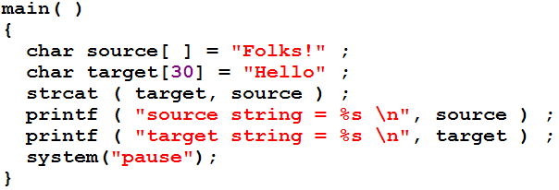
strcat( ) – program
Go to program

Slide 16
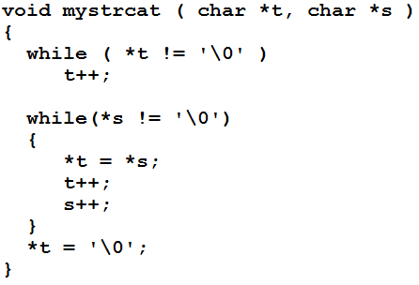
mystrcat( )
. . .
. . .
Go to program
Move *t pointer until it points to Null character in target string
source[6]
w
o
r
l
d
\0
600
601
602
603
604
605
*s
600
603
604
601
602
605
h
e
l
o
w
o
r
l
d
\0
target[6]
l
\0
500
501
502
503
504
505
506
507
508
509
510
511
512
*t
507
506
509
508
500
501
502
505
504
503
510

Slide 17
strcmp ( )
It compares two strings to find out whether they are same or different
The two strings are compared character by character until
  there is a mismatch or
  end of one of the strings is reached
If the two strings are identical, strcmp( ) returns a value zero
If they are not, it returns the numeric value

Slide 18
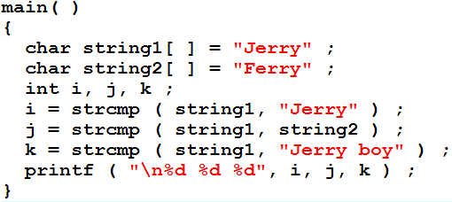
strcmp( ) – program
Go to program

Slide 19
Exercise program
Write the definition of following function then call it from main to check it works or not
  int countchar(char *str, char ch);
write to program

