Slide 1
CSC103: Introduction to Computer and Programming
Lecture No 21

Slide 2
Previous lecture
2 Dimensional array
Initializing 2 Dimensional array
Memory map of 2-D array
Pointer and 2-D array
Array of pointer
Passing 2-D Array to a Function

Slide 3
Today’s lecture outline
Strings
Null character
Memory map of string
String initialization
Display string content
Input string from user
Passing a string to a function

Slide 4
String
A group of integers can be stored in an integer array
Similarly a group of characters can be stored in a character array
Character arrays are many a time also called strings
Character arrays or strings are used by programming languages to manipulate text such as words and sentences

Slide 5
Cont.
A string is a one-dimensional array of characters terminated by a null ( ‘\0’ )
Each character in the array occupies one byte of memory
The last character is always ‘\0’

Slide 6
Null character
Represented by a back slash and a zero
\0
It looks like two characters, but it is actually only one character
Note that ‘\0’ and ‘0’ are not same. ASCII value of ‘\0’ is 0, whereas ASCII value of ‘0’ is 48

Slide 7
Memory allocation for string
The elements of the character array are stored in contiguous memory locations
The terminating null (‘\0’) is important, because it is the only way to know where the string ends
A string not terminated by a ‘\0’ is not really a string, but just a collection of characters
H
A
E
S
L
E
R
\0
65508
65509
65510
65511
65512
65513
65514
65515

Slide 8
String initialization
C will automatically insert \0 character at the end of the string.
Memory allocated for name string is 8 bytes
7bytes for actual string and 1 byte for \0 character

Slide 9
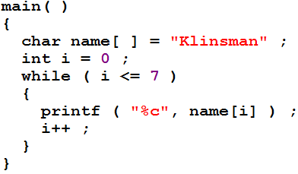
How string element are displayed
Go to program

Slide 10
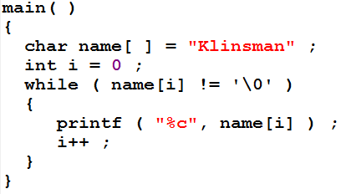
Cont.
Go to program
K
l
i
n
s
m
a
n
\0
65508
65509
65510
65511
65512
65513
65514
65515
65515

Slide 11
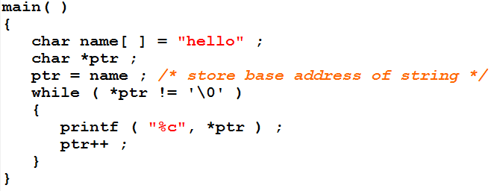
Pointer to string
65508
65510
65509
65512
65513
*ptr
65511
*ptr = *(65508) = h
h ! = \0
true
name[6]
h
e
l
l
o
\0
e ! = \0
true
65508
65509
65510
65511
65512
65513
l ! = \0
true
l ! = \0
true
Program output
h
e
l
l
o ! = \0
true
o
Go to program
\0 ! = \0
false

Slide 12
Cont.
Elements of character array can be accessed exactly in the same way as the elements of an integer array
Thus, all the following notations refer to the same element
  name[i]
  *( name + i )
  *( i + name )
name[6]
h
e
l
l
o
\0
65508
65509
65510
65511
65512
65513

Slide 13
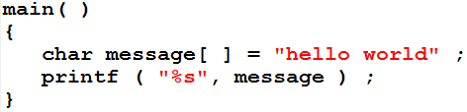
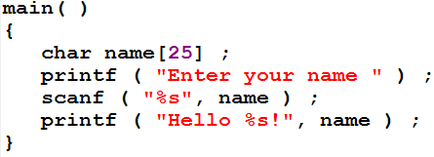
Simple way to display and input string
The %s used in printf( ) is a format specification for printing out a string
Go to program

Slide 14
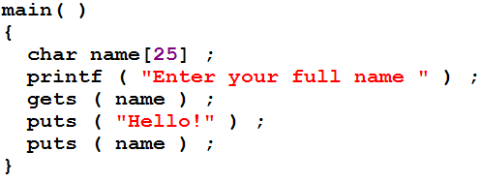
Caution with scanf
The length of the string should not exceed the dimension of the character array
scanf( ) is not capable of receiving multi-word strings. E.g. hello world
gets( ) function can be used to input multi-word strings
Go to program

Slide 15

Pointers and Strings
Suppose we want to store “Hello”.
There are two ways
  We may either store it in a string
  we may ask the C compiler to store it at some location in memory and assign the address of the string in a char pointer
str[6]
H
e
l
l
o
\0
65508
65509
65510
65511
65512
65513
*p
500
H
e
l
l
o
\0
500
501
502
503
504
505

Slide 16
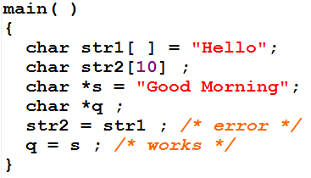
Cont.
Difference
  We cannot assign one string in another string
  But we can assign one char pointer to another char pointer
Go to program

Slide 17
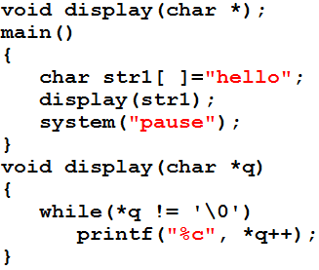
Passing string to a function
Go to program
65508
65510
65509
65512
65513
*q
65511
str1[6]
h
e
l
l
o
\0
65508
65509
65510
65511
65512
65513
Program output
h
e
l
l
o

Slide 18
Standard Library String Functions
With every C compiler a large set of useful string handling library functions are provided
strlen( ), to find length of string
strcpy( ), to copy content of one string in another
strcat( ) to append content of one string after the content of other string
strcmp( ) to compare on string with another

Slide 19
strlen( )
Short for string length
This function counts the number of characters present in a string
The base address of the string must be pass when calling strlen function
char str1[ ] = “hello”;
strlen(str1) → 5 not 6
\0 is not the part of string it is just character that tells where this string terminates
str1[6]
h
e
l
l
o
\0
65508
65509
65510
65511
65512
65513

Slide 20
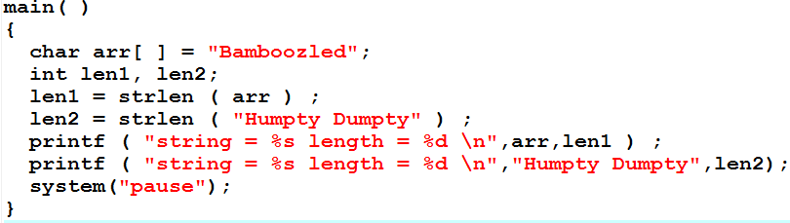
strlen – program
Go to program

Slide 22
strcpy( )
This function copies the contents of one string into another
The base addresses of the source and target strings should be supplied to this function

