Slide 1
CSC103: Introduction to Computer and Programming
Lecture No 20

Slide 2
Previous lecture
Pointer arithmetic – a program
Sorting techniques – a program
Passing an Entire Array to a Function
Array and pointer

Slide 3
Today’s lecture outline
2 Dimensional array
Initializing 2 Dimensional array
Memory map of 2-D array
Pointer and 2-D array
Array of pointer
Passing 2-D Array to a Function

Slide 4
Two Dimensional Arrays
It is also possible for arrays to have two or more dimensions
For example you want to input roll no and mark of 4 students.
Since we know 1-D array, so for this problem we can have two 1-D array
  One for roll number
  Second for marks
One 2-D array can be used to store these values

Slide 5
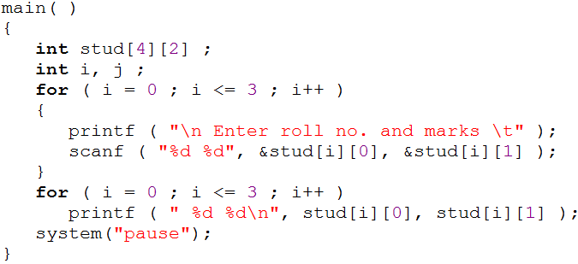
Example program
row
column
0
1
0
10
85
1
12
65
stud[3][1]
stud[2][1]
stud[0][1]
stud[2][0]
stud[1][1]
stud[3][0]
stud[0][0]
stud[1][0]
2
13
89
3
14
92
Go to program
Roll Number
Marks

Slide 6
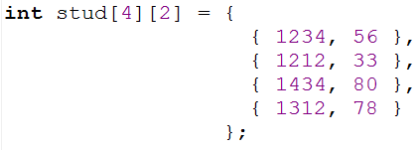
Initializing a 2-Dimensional Array

Slide 7
Example program
Write a program that adds two 4 x 4 matrices.
3 | 5 | 6 | 1
5 | 3 | 2 | 9
1 | 0 | -3 | 4
7 | 2 | 3 | -9
4 | 2 | -7 | 0
5 | 7 | 3 | 1
6 | 3 | -1 | 0
8 | 9 | -2 | 3
7 | 7 | -1 | 1
10 | 10 | 5 | 10
7 | 3 | -4 | 4
15 | 11 | 1 | -6
+
=
Go to program

Slide 8
Memory map of 2D array
Remember student array int s[4][2];
But actually memory allocated is continuous
0
1
0
10
85
1
12
65
2
13
89
3
14
92
s[0][0]
s[0][1]
s[1][0]
s[1][1]
s[2][0]
s[2][1]
s[3][0]
s[3][1]
10
85
12
65
13
89
14
92

Slide 9
Pointers and 2-Dimensional Arrays
Each row of a two-dimensional array can be thought of as a one-dimensional
a[4][2]
This is important to know if you want to access 2-D array elements using pointer
0
1
0
10
85
Array 1
1
12
65
Array 2
2
13
89
Array 3
3
14
92
Array 4

Slide 10
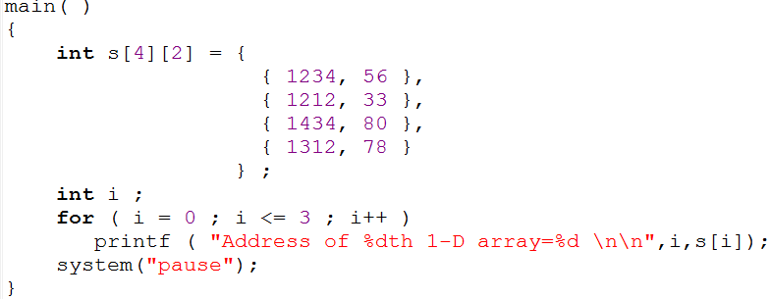
Cont.
s[0][0]
s[0][1]
s[1][0]
s[1][1]
s[2][0]
s[2][1]
s[3][0]
s[3][1]
1234
56
1212
33
1434
80
1312
78
65508
65512
65516
65520
65524
65528
65532
65536
s[0] →
65508
s[2] →
65524
s[1] →
65516
s[3] →
65532

Slide 11
Cont..
Now we know each 1-D array
Next thing is to access elements of a 1-D array
Suppose we want to refer to the element s[2][1] using pointers
s[2] → 65524 that is that address of third 1-D array
65524 + 1 → 65528
*(s[2]+1) → *(65524 + 1) → *(65528) → 80
s[0][0]
s[0][1]
s[1][0]
s[1][1]
s[2][0]
s[2][1]
s[3][0]
s[3][1]
1234
56
1212
33
1434
80
1312
78
65508
65512
65516
65520
65524
65528
65532
65536
s[2]+1 → 65524 +1 → 65528

Slide 12
Cont…
We already know how to access 1-D array using pointer
Similarly, *(s[2]+1) → *( *(s + 2) + 1)
Following expression refer to the same element
  s[2][1]
  * ( s[2] + 1 )
  * ( * ( s + 2 ) + 1 )
that is num[i] → *(num+i)
Go to program

Slide 13
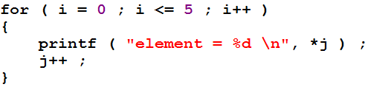
Pointer to an Array
We have pointer to integer, pointer to float
We can have a pointer that points to an array
int s[5] = {12, 17, 57, 33, 21};
int *j;
j = &s[0];
*j
65508
12
17
57
33
21
65508
65512
65516
65520
65524

Slide 14
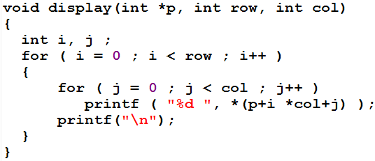
Passing 2-D Array to a Function
Go to program
int a[3][4] = {
1, 2, 3, 4,
5, 6, 7, 8,
9, 0, 1, 6
};
display ( a, 3, 4 ) ;
1
2
3
4
5
6
7
8
9
0
1
6
500
504
508
512
516
520
524
528
532
536
540
544
i = 0
*p
500
row
3
col
4
j = 0
*(p+i *col+j)
=*(500+0*4+0)
= *(500+0+0)
= *(500)
= 1
j = 1
*(p+i *col+j)
=*(500+0*4+1)
= *(500+0+1)
= *(504)
= 2

Slide 15
Cont.
* ( base address + row no. * no. of columns + column no. )
j = 2
*(p+i *col+j)
=*(500+0*4+2)
= *(500+0+2)
= *(508)
= 3
j = 3
*(p+i *col+j)
=*(500+0*4+3)
= *(500+0+3)
= *(512)
= 4
i = 1
j = 0
*(p+i *col+j)
=*(500+1*4+0)
= *(500+4+0)
= *(516)
= 5
j = 1
*(p+i *col+j)
=*(500+1*4+1)
= *(500+4+1)
= *(520)
= 6
j = 2
*(p+i *col+j)
=*(500+1*4+2)
= *(500+4+2)
= *(524)
= 7
j = 3
*(p+i *col+j)
=*(500+1*4+3)
= *(500+4+3)
= *(528)
= 8
i = 2
j = 0
*(p+i *col+j)
=*(500+2*4+0)
= *(500+8+0)
= *(532)
= 9
1
2
3
4
5
6
7
8
9
0
1
6
500
504
508
512
516
520
524
528
532
536
540
544

Slide 16
Array of Pointers
The way there can be an array of ints or an array of floats, similarly there can be an array of pointers
A pointer variable contains an address, an array of pointers is a collection of addresses
The addresses present in the array of pointers can be addresses of
    variables or
    array elements or
    any other addresses
All rules that apply to an ordinary array apply to the array of pointers

Slide 17
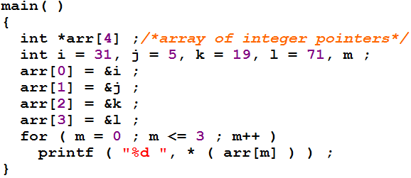
Example program 1
Go to program
i
j
k
l
*(arr[0])
=*(35500)
= 31
31
5
19
71
*(arr[1])
=*(75690)
= 5
35500
75690
85430
95340
*(arr[2])
=*(85430)
= 19
*arr[4]
35500
75690
85430
95340
*(arr[3])
=*(95340)
= 71
65518
65524
65528
65532

Slide 18
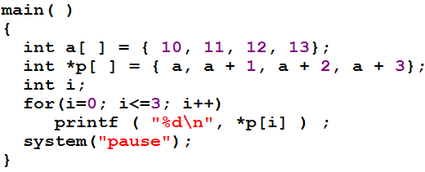
Example program 2
Go to program
p[i] = *(p + i)
*(*(p + i) )
*p[0 ]
=*(35500)
= 10
a[ ]
10
11
12
13
*(*(p + 0) )
=*(*(p))
35500
35554
35558
35562
=*(*(65518))
=*(35500)
*p[ ]
35500
35554
35558
35562
= 10
65518
65524
65528
65532

Slide 19
Summary
An array is similar to an ordinary variable except that it can store multiple elements of similar type
Compiler doesn’t perform bounds checking on an array
The array variable acts as a pointer to the zeroth element of the array. In a 1-D array, zeroth element is a single value, whereas, in a 2-D array this element is a 1-D array
On incrementing a pointer it points to the next location of its type
Array elements are stored in contiguous memory locations and so they can be accessed using pointers.
Only limited arithmetic can be done on pointers.

